Slide 1






Mondrian
K-anonimity
Authors:
Andrea Mercuri, S4714295
Andrea Mazza, S4087085
Github repo: https://github.com/Andrew0133/data-protection-privacy-exam
Introduction
Key concepts
Algorithm
Example
Experimental data

Slide 2
Introduction
Several organizations publish microdata for purposes such as demographic and public health research. In order to protect individual privacy, known identifiers (e.g., Name and Social Security Number) must be removed. In addition, this process must account for the possibility of combining certain other attributes with external data to uniquely identify individuals
K-anonymity has been proposed as a mechanism for protecting privacy in microdata publishing, and numerous recoding “models” have been considered for achieving k-anonymity.
Mondrian is a multidimensional k-anonymity model that anonymizes data through recursively splitting the attributes' dimensions with a median-partition strategy.

Slide 3
Key concepts – Quasi-Identifier (QI)
A QI set is a subset of attributes X₁, ..., X_{d} in table T that could potentially be used to re-identify individual records.
Examples of quasi-identifiers shown in our domain are sex, age and zip code.

Slide 4
Key concepts – Equivalence class
With respect to attributes X₁, ..., X_{d} in table T, an equivalence class is the set of all records in T containing identical values (x₁, ..., x_{d}) for X₁, ..., X_{d}.

Slide 5
Key concepts – Generalization
The method of generalization transforms QI values into less specific, but semantically useful values so that records with the same transformed QI values are indistinguishable.

Slide 6
Key concepts – Local Recoding
With local recoding, individual records are mapped to generalized forms. In this method, the data space is partitioned into different regions and then all records in the same region are mapped to the same generalized record.
For example, a value of "60" for age in two records could possibly be mapped to two different intervals of "[55–60]" and "[60–65]" respectively if the two records are partitioned to different regions.

Slide 7
Key concepts – Strict model
In the strict mode, the algorithm splits a partition in two parts, lhs and rhs, by using a split value (median of partition projected on a quasi-identifier). These parts can't contain common split value, so there is no intersection between the two parts.

Slide 8
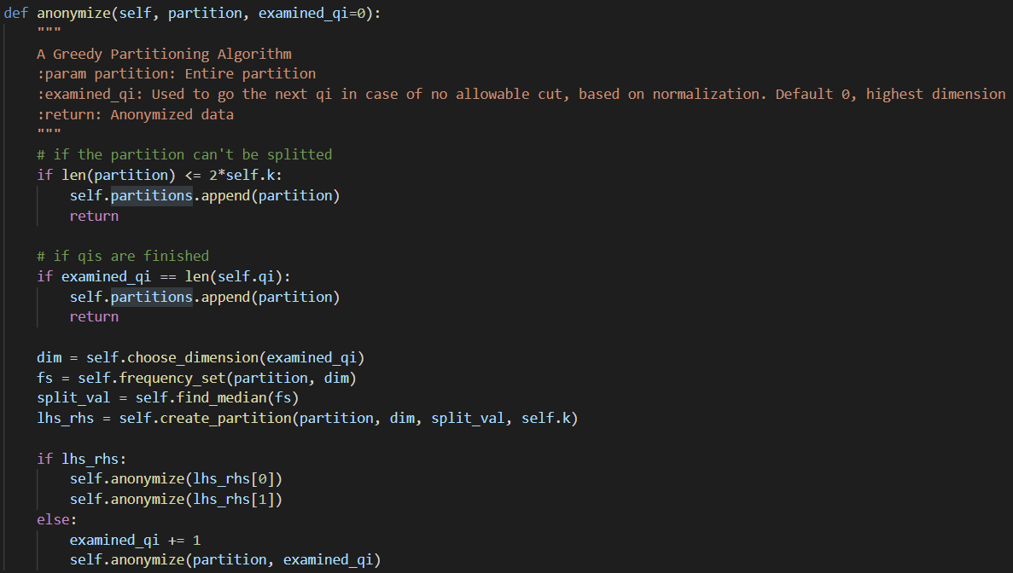
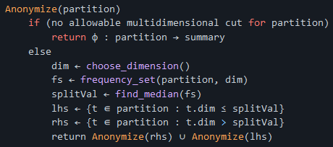
Algorithm - Implementation vs Pseudo code

Slide 9
Algorithm - Algorithm explanation
The algorithm starts with choosing the dim, one heuristic, used in our implementation, chooses the dimension (quasi-identifier) with the widest (normalized) range of values. If there is no allowable cut for choosed dim and the partition is greater than 2*k the algorithm changes dimension (QI) with the next widest (normalized) range of values, until there is no allowable cut for partition considering all QI’s. After the value has been chosen it is calculated the frequency set of the dim. Then the split value is calculated using the standard median-finding algorithm. The split value is the median of the partition projected on dim. Then the current partition is splitted in two sub partitions based on a split_val parameter. In the end, the Anonymize algorithm is called recursively in both sub partitions.

Slide 10
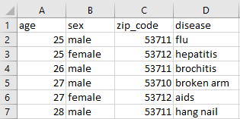
Example – Input data
Original data in CSV/file format

Slide 11
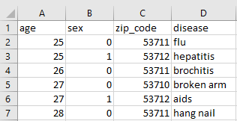
Example – Data normalization
Transformation categorical → non categorical
Dictionaries:
Encoding
Decoding

Slide 12
Example – Partition I
k = 2
QIs: age, sex, zip_code

Slide 13
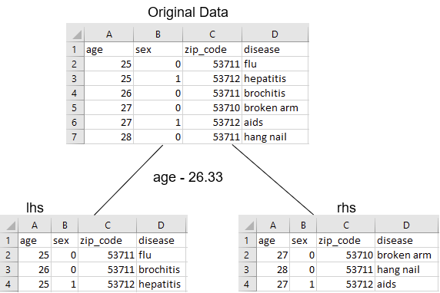
Example – Partition II
dim: age
splitVal: 26.33
no allowable multidimensional cut for partition (lhs, rhs)

Slide 14
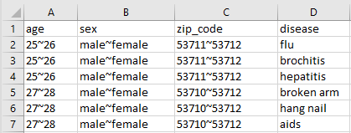
Example – Resulting Anonymization
Anonymized data

Slide 15
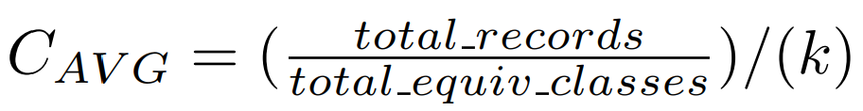
Experimental data – Metric
Normalized average equivalence class size metric (C_{AVG}).
measures how well partitioning approaches the best case (information loss).

Slide 16
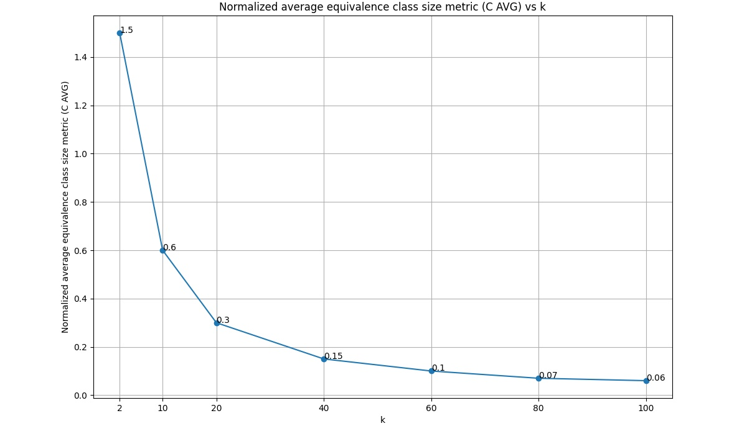

Experimental data – Metric vs k

Slide 17
THANK YOU FOR YOUR ATTENTION

