Slide 1
C程式設計實驗(二)
Chapter12. Separate Compilation and Namespaces

Slide 2
Learning Objectives
Class, Pointers
The this pointer
Destructors, copy constructors
Separate Compilation
Encapsulation reviewed
Header and implementation files
Namespaces
Using directives
Creating a Namespace

Slide 3
Separate Compilation
Program Parts
Kept in separate files
Compiled separately
Linked together before program runs
Class definitions
Separate from “using” programs
Build library of classes
Re-used by many different programs
Just like predefined libraries
Notes:
Separate compilation 顧名思義就是分開編譯程式，將複雜的程式分為多個部位，放置在不同的檔案中，方便管理與修改，甚至可以隨著使用狀況開啟或關閉部分程式功能，當需要使用到時，只需要將程式link起來就好了。
像是class的定義可以放在不同的檔案中，與執行的主要程式分離，可以避免主程式的程式碼太過繁雜，另外，也可以被其他程式呼叫使用，就像是呼叫函式庫一樣，就不用在每個程式都重寫一遍class

Slide 4
Class Separation
Class independence
Separate class definition / specification ( interface )
Separate class implementation
Place in two files
If implementation changes → only that file need be changed
Class specification need not change
“User” programs need not change
Class definition;
Class implementation;
Main function;
Class definition;
Link
Class implementation;
Link
Main function;
Notes:
Class是一個物件，裡面會有函式與變數，其定義的內容可以到上百行，因此可以選擇將class的定義與應用內容分開至兩個不同的檔案內，對於存放class定義的檔案，其他使用者可以清楚看到class的結構、函式、變數，加上註解可以讓其他人更好閱讀class的用法。但不會有函式的內容，這些函式的內容會被寫在另一個檔案，如果需要更改這些函式的內容，就只需要更改這個檔案就好，其他使用到class的程式就不用再做修改。

Slide 5
Encapsulation Reviewed
Encapsulation principle
Separate how class is used by programmer from details of class’s implementation
“Complete” separation
Change to implementation → NO impact on any other programs
Basic OOP Principle
Notes:
Encapsulation封裝，是OOP的基本概念之一，封裝可以將數據與數據的使用方法綁在一起，作為一個物件，並且可以設定從物件外部的存取權，也就是說可以隱藏部分敏感的內容，或是限制使用的方法，像是之前教過的mutator跟accessor。

Slide 6
Encapsulation Rules
Rules to ensure separation
All member variables should be private
Basic class operations should be
Group class definitions and prototypes together
Make class implementation unavailable to users of class
Public member functions
Friend or ordinary functions
Overloaded operators
Called “interface” for class
Notes:
封裝這個概念有以下幾個要點
所有的變數都要是private
Operator的函式需要是public, friend或是overloading，這樣使用者才可以使用
Class的所有定義需要整合在一起，包括函式的header
而函式的內容則不該被其他使用者看到，資料可以放在其他檔案然後另作加密

Slide 7
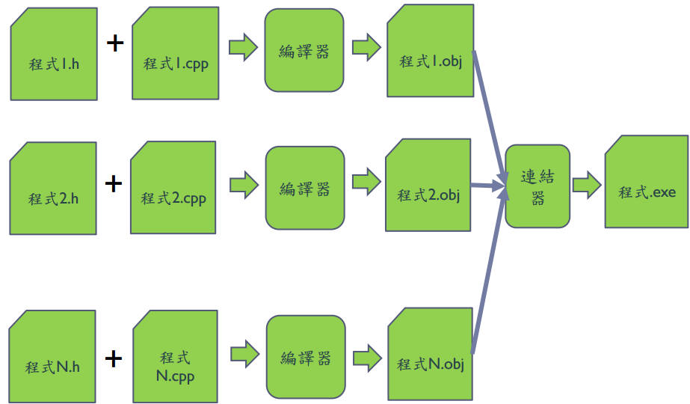
Separate Compilation

Slide 8
Separate Compilation
Example
Compile:
newuser.h
newuser.cpp
username.cpp
password.cpp
makefile:
CC = g++
TARGET1 = Q1
TARGET1-1 = newuser
TARGET1-2 = username
TARGET1-3 = password
FLAG = -std=c++11
all: $(TARGET1-1).cpp $(TARGET1-2).cpp $(TARGET1-3).cpp
$(CC) $(FLAG) -c $(TARGET1-1).cpp $(TARGET1-2).cpp $(TARGET1-3).cpp
$(CC) $(FLAG) -o $(TARGET1) $(TARGET1-1).o $(TARGET1-2).o $(TARGET1-3).o
clean:
rm -f $(TARGET1)
rm -f *.o
Notes:
Makefile的寫法

Slide 9
Learning Objectives
Class, Pointers
The this pointer
Destructors, copy constructors
Separate Compilation
Encapsulation reviewed
Header and implementation files
Namespaces
Using directives
Creating a Namespace

Slide 10
Namespaces
Namespace defined :
A collection of name definitions
Class definitions
Variable declarations
Programs use many classes, functions
Commonly have same names
Namespaces deal with this
Can be “on” or ”off”
If names might conflict →turn off
Notes:
Namespace命名空間，可能不太好懂，大概就是一堆定義的集合，包括class的定義，或是函式、變數的定義，當使用(using)一個Namespace後，表示這裡面的定義都會被套用進來。
有命名空間的原因除了是比較好管理多個定義要求，也可以針對不同程式中相同名字的物件名稱去做管理。

Slide 11
Using Directive
Using namespace std;
Makes all definitions in std namespace available
Why might you NOT want this?
Can make cout, cin have non-standard meaning
Perhaps a need to redefine cout, cin
Can redefine any others
Notes:
像是每次程式開頭都會寫的using namespace std，這個namespace裡面包含輸入輸出常用的cout, cin和其他東西的定義，如前面所說，如果需要定義一個新的東西叫做cout, cin那就必須要先註解掉using namespace std，不然就會重複定義了

Slide 12
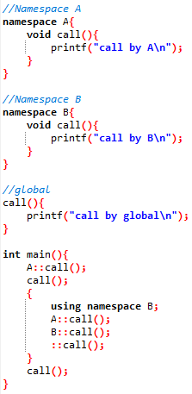

Creating a Namespace
Example.
Notes:
範例

Slide 13
C程式設計實驗(二)
Chapter13. Streams & File I/O

Slide 14
Learning Objectives
I/O Streams
File I/O
Character I/O
Tools for Stream I/O
File names as input
Formatting output, flag settings
Notes:
Stream串流，有河流水流的意思，控制程式的輸入與輸出，因為input/output會需要與其他硬體溝通，所以需要更多OS的程式去驅動這些硬體，而C++有stream可以去暫存或緩衝這些input/output的內容。

Slide 15
Streams
Input stream
Flow into program
Can come from keyboard
Can come from file
Output stream
Flow out of program
Can go to screen
Can go to file
Notes:
Stream有流的意思，input就是流入程式，output則是從程式流出，簡單分為標準流(standard stream)與檔案流(file stream)

Slide 16
Stream Usage
We’ve used streams already
cin
input stream object connected to keyboard
cout
Output stream object connected to screen
Can define other steams
To / from files
Used similarly as cin , cout
Notes:
常用的cin與cout就是standard stream，另外還有cerr，所以這次要交的還有file I/O

Slide 17
File Connection
Must first connect file to stream object !
For input :
file → ifstream object
For output :
File → ofstream object
Classes ifstream and ofstream
Defined in library <fstream>
Named in std namespace
Notes:
首先要先建立程式與檔案之間的連接，用的是ifstream與ofstream，這兩個class需要導入fstream函式庫跟std namespace

Slide 18
File I/O Libraries
To allow both file input and output in your program :
#include <fstream>
using namespace std;
or
#include <fstream>
using std :: ifstream;
using std :: ofstream;

Slide 19
Declaring Streams
Stream must be declared like any other class variable :
ifstream inStream;
ofstream outStream;
Must then “connect” to file :
inStream.open(“infile.txt”);
Called “opening the file”
Used member function open
Can specify complete pathname
Can pass as argument to constructor :
ifstream inStream(“infile.txt”);
Notes:
如果是file input的話，宣告的方法是先建立一個ifstream class，用open函式去打開檔案，這樣就做到與檔案的連接了，或是兩個步驟可以合併在一起。
如果是file output則將class type改成ofstream就好

Slide 20
Closing Files & File Flush
Files should be closed
Disconnects stream from file
In action :
inStream.close();
outStream.close();
Output often “buffered”
Written in “groups”
Occasionally might need to force writing :
outStream.flush(); //all buffered output is physically written
Notes:
在檔案輸入輸出做完之後，要把檔案關閉，用的是close函式。
輸入輸出流是將程式的輸入輸出放入緩存區中，flush則是清空這些緩存區。

Slide 21
Appending to a file
Standard open operation begins with empty file
Open for append :
ofStream outStream;
outstream.open(“important.txt” , ios :: app);
If file doesn’t exist → creates it
If file exists → appends to end
2nd argument is class ios defined constant
In <iostream> library , std namespace
Notes:
在使用open打開檔案時，第二個參數可以決定這個stream的功用，像是ios::app就是接續檔案的寫入，另外ios::in是檔案讀取，ios::out是檔案寫入，要注意的是Ios:out會覆蓋掉原本的檔案內容，app則是接續寫入，

Slide 22
Checking End Of File (EOF)
Member function eof()
inStream.get(next);
while(!inStream.eof()) { // eof() returns bool
cout << next;
instream.get(next); // Reads each character until file ends
}
Notes:
Eof函式可以檢查檔案是否結束，也就是在檔案的讀取時，是否已經讀到最末端

Slide 23
Formatting Output with Stream Functions
Consider :
outStream.setf(ios :: fixed);
outStream.setf(ios :: showpoint);
outStream.precision(2);
Member function setf()
Allows multitude of output flags to be set
Member function precision(x)
Decimals written with “x” digitals after decimal
All output streams have setf() member
Flags are constants in class ios
In library <iostream> , std namespace
Notes:
再來一個跟stream相關的是輸出格式，可以控制一些輸出的形式，像是用科學記號法、小數點要幾位、對其左邊右邊、輸出佔幾格之類的
setf是stream的函式，可以設定stream的格式
precision是四捨五入到固定的位數

Slide 24
Flags : Examples
Common flag constants :
outStream :: setf(ios :: fixed);
Set fixed – point notation (decimal)
outStream :: setf(ios :: showpoint);
Always include decimal point
outStream:: setf(ios :: right);
Sets right – justification
Set multiple flags with one call :
outStream :: setf(ios :: fixed | ios :: showpoint | ios ::right);
Notes:
Fixed是用正常計數法顯示，也就是正常的小數，不會出現科學記號法
showpoint則是輸出固定精度的小數點，不會因為後面是0就省略
right是靠右對齊

Slide 25
Manipulators
Manipulators defined :
“A function called in nontraditional way”
Can have arguments
Placed after insertion operator
setw() and setprecision() are in library <iomanip>
std namespace

Slide 26
Manipulators : Examples
setw() manipulators : (Note. affects only NEXT outputted value)
cout << “Start” << setw(4) << 10 << setw(4) << 20 << setw(6) << 30;
Results in :
Start 10 20 30
setprecision() manipulators :
cout.setf(ios::fixed);
cout << “$ ” << setprecision(2) << 10.3 << “ ” << “$ ” << 20.5 ;
Results in :
$ 10.30 $ 20.50
Notes:
setw跟其他的output寫在一起，功能是讓下次的輸入佔據4格，因為輸出預設是靠右對齊，所以輸出是左邊兩個空格右邊1跟0共佔據4格。
setprecision則是讓後面的輸出的小數都顯示固定位數，動作跟前面教的precision函式是一樣的

