Slide 1
C程式設計實驗(二)
Chapter10. Strings

Slide 2
C - String
Array with base type “char”
One character per indexed variable.
End of string marked with null, “\0” → null character
Example.

Slide 3
C - String Variable
Typically “partially - filled” array
Declare large enough to hold max-size string.
Indicate end with null.
Only difference from standard array :
Must contain null character.
Example. (char s[10])
Declares a c-string variable to hold up to 9 characters.
The last : null character “\0”.

Slide 4
C - String initialization
Two way to initialize c-string
char Message[20]
Need not fill the entire array.
Initialization places “\0” at end.
char shortString[] = “abc”;
Can omit array-size.
Automatically makes size one more than length of quoted string.
NOT same as :
char shortString[] = {‘a’, ’b’, ’c’};

Slide 5
C - String Storage
char s[10];
If s contains string : “Hi Mom!”, store as :

Slide 6
C - String Output / Input
Output
Can output with insertion operator , <<
Possible because << operator is overloaded for c-strings.
Input
Can input with extraction operator, >>
Watch size of c-string.
Whitespace is “delimiter”
Tab , space , line breaks are “skipped”.
Input reading “stops” at delimiter.

Slide 7
Library <cstring> : strlen( )
“String length”
Useful to know string length.
The null character is not counted in the length.

Slide 8
Library <cstring> : strcat( )
“String concatenate”
Be careful!
Incorporate spaces as needed.

Slide 9


Library <cstring> : strcat( )
Core Dumped!

Slide 10
Library <cstring> : strcpy( )
“String copy”
strcpy(Target_string , Src_string)
strncpy(Target_string , Src_string , limit)

Slide 11
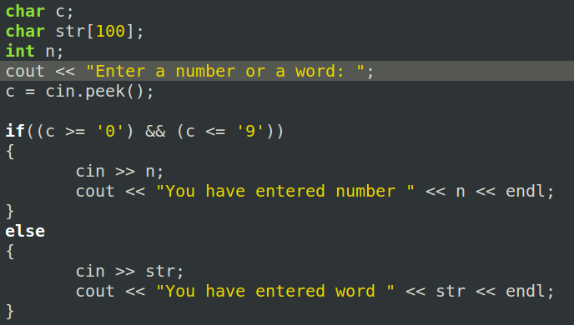


Member Function peek( )
Return next char, but leaves it there.
peekchar = cin.peek();

Slide 12
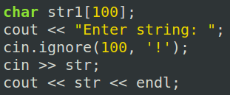

Member Function ignore( )
Skip input, up to designated character.
cin.ignore(100, ‘!’);
Skips at most 100 characters until ‘!’ .

