Slide 1
C程式設計實驗(二)
Chapter11. Pointer

Slide 2
Pointers Variables
Pointer definition :
Memory address of a variable.
Pointers are “typed”
Can store pointer in variable.
Not int,double,etc.
Example. (double *p;)
P is declared a “pointer to double” variable.
Can hold pointer to variables of type double
Not other types!

Slide 3
Declaring Pointers Variables
Pointers declared like other types
Example. (int *p1, *p2, v1, v2;)
p1, p2 hold pointers to int variables.
v1, v2 are ordinary int variables.
Add “ * ” before variable name.
p1 = &v1; // p1 = address of v1.

Slide 4
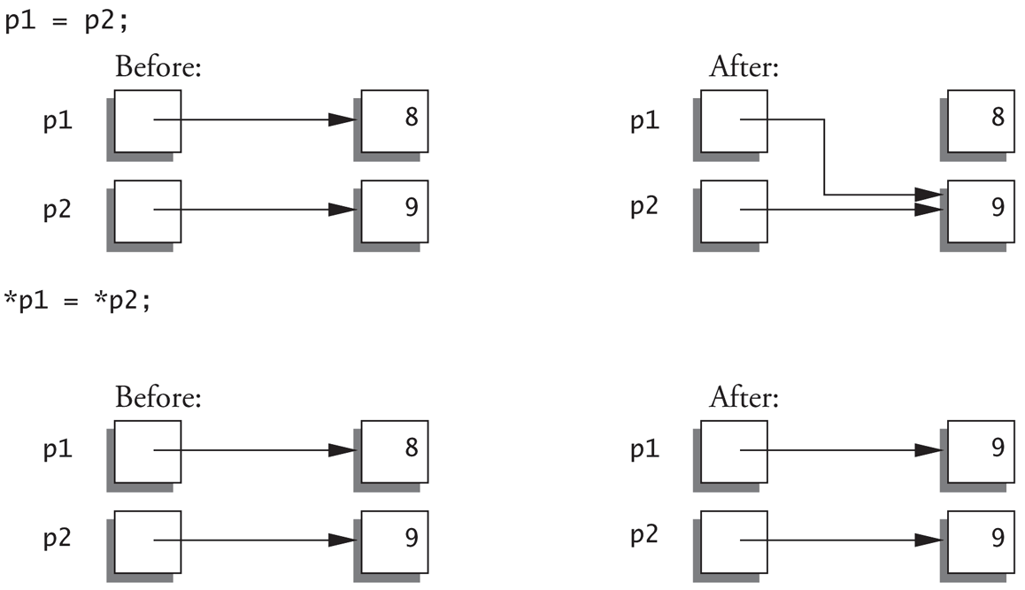
Pointer Assignments
int *p1, *p2;
p1 = p2; //Assigns one pointer to another.
*p1 = *p2; //Assigns “value pointed to” by p1. to “value pointed to” by p2.

Slide 5
Dynamic Arrays
Create
Use new operator
Dynamically allocate with pointer variable.
Treat like standard arrays.
Example.
Typedef double *DoublePtr;
DoublePtr d;
d = new double[10]; //Size in brackets .
Delete
Example.
delete[] d; //de-allocates all memory for dynamic array;

