Slide 1
C程式設計實驗(二)
Chapter12. Separate Compilation and Namespaces

Slide 2
Learning Objectives
Class, Pointers
The this pointer
Destructors, copy constructors
Separate Compilation
Encapsulation reviewed
Header and implementation files
Namespaces
Using directives
Creating a Namespace

Slide 3
The this Pointer
Member function definitions might need to refer to calling object
Using predefined this pointer
Automatically points to calling object:
class Simple
{ public :
void showStuff() const;
private :
int stuff; };
Two ways for member functions to access:
cout << stuff;
cout << this -> stuff;

Slide 4
Destructor Need
Dynamically-allocated variables
Do not go away until “deleted”
If pointers are only private member data
They dynamically allocate “real” data
In constructor
Must have means to “deallocate” when object is destroyed
Answer: Destructor!

Slide 5
Destructors
Opposite of constructor
Automatically called when object is out-of-scope
Default version only removes ordinary variables, not dynamic variables
Defined like constructor, just add ~
MyClass :: ~MyClass()
{ // perform delete clean-up duties }

Slide 6
Shallow and Deep Copies
Shallow copy
Assignment copies only member variable contents over
Default assignment and copy constructors
Deep copy
Pointers, dynamic memory involved
Must dereference pointer variables to “get to” data for copying
Write your own assignment overload and copy constructor in this case

Slide 7
Copy Constructors
Automatically called when :
Class object declared and initialized to other object
When function returns class type object
When argument of class type is “plugged in” as actual argument to call-by-value parameter
Requires “temporary copy” of object
Copy constructor creates it
Default copy constructor
Like default “ = ”, performs member-wise copy
Pointers → write own copy constructors !

Slide 8
Separate Compilation
Program Parts
Kept in separate files
Compiled separately
Linked together before program runs
Class definitions
Separate from “using” programs
Build library of classes
Re-used by many different programs
Just like predefined libraries

Slide 9
Class Separation
Class independence
Separate class definition / specification ( interface )
Separate class implementation
Place in two files
If implementation changes → only that file need be changed
Class specification need not change
“User” programs need not change

Slide 10
Encapsulation Reviewed
Encapsulation principle :
Separate how class is used by programmer from details of class’s implementation
“Complete” separation
Change to implementation → NO impact on any other programs
Basic OOP Principle

Slide 11
Encapsulation Rules
Rules to ensure separation :
All member variables should be private
Basic class operations should be :
Public member functions
Friend or ordinary functions
Overloaded operators
Group class definitions and prototypes together
Called “interface” for class
Make class implementation unavailable to users of class

Slide 12
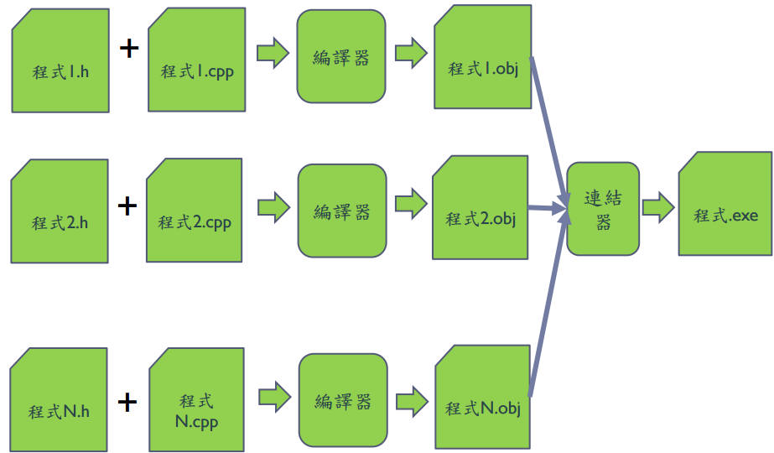
Separate Compilation

Slide 13
Namespaces
Namespace defined :
A collection of name definitions
Class definitions
Variable declarations
Programs use many classes, functions
Commonly have same names
Namespaces deal with this
Can be “on” or ”off”
If names might conflict →turn off

Slide 14
Using Directive
Using namespace std;
Makes all definitions in std namespace available
Why might you NOT want this ?
Can make cout, cin have non-standard meaning
Perhaps a need to redefine cout, cin
Can redefine any others

Slide 15
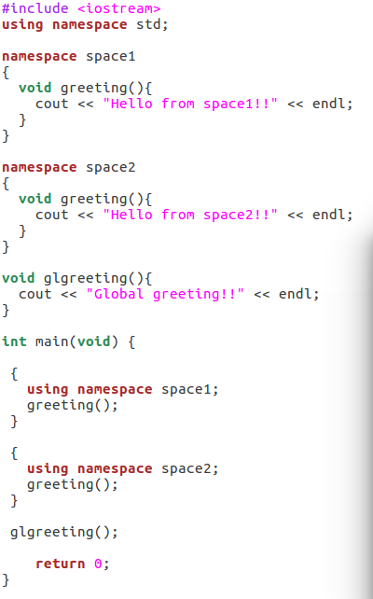

Creating a Namespace
Example.

