Slide 1
C程式設計實驗(二) Chapter 4 Parameters and Overloading

Slide 2
Outline
Call – by – value and Call – by – reference
Overloading

Slide 3
Parameters
Two methods of passing arguments
Call – by – value
“copy” of value is passed
Call – by – reference
“address of” actual argument is passed
Notes:
Call by value 跟 call by ref 是兩種傳遞參數的方法

Slide 4
Call – by – value
顧名思義就是把實際的「值」複製一份給對方
所謂複製便是對方拿了其值後，做任何修改皆不會影響原本的值
Notes:
Copy your house to other

Slide 5
Call – by – reference
「參考」: 把自身的位址(address)給對方
因此，當對方改變數值，原來的也會改變
Notes:
Give your house to other

Slide 6
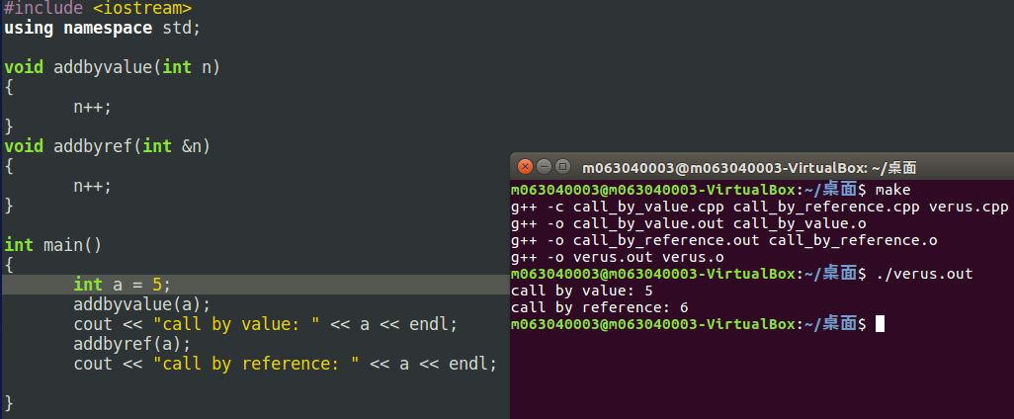
Call – by – value v.s. Call – by – reference

Slide 7
Overloading(多載)
當對於相同「函式名稱」有多種「函式定義」時，此稱為Overloading
Eg.
Given following functions:
1. void f(int n, double m); 2. void f(double n, int m); 3. void f(int n, int m);
These calls: f(98, 99); → Calls #3 f(5.3, 4); → Calls #2 f(4.3, 5.2); → Calls ???

Slide 8
Automatic Type Conversion and Overloading
double mpg(double miles, double gallons) { return (miles/gallons); }
Example function calls:
mpgComputed = mpg(5, 20);
Converts 5 & 20 to doubles, then passes
mpgComputed = mpg(5.8, 20.2);
No conversion necessary
mpgComputed = mpg(5, 2.4);
Converts 5 to 5.0, then passes values to function
Notes:
2

Slide 9
Default Arguments
Allows omitting some arguments
Specified in function declaration/prototype
void showVolume(int length,int width = 1,int height = 1);
Last 2 arguments are defaulted
Possible calls:
showVolume(2, 4, 6); //All arguments supplied
showVolume(3, 5); //height defaulted to 1
showVolume(7); //width & height defaulted to 1
Notes:
允許省略一些參數
在宣告的時候設定參數

Slide 10
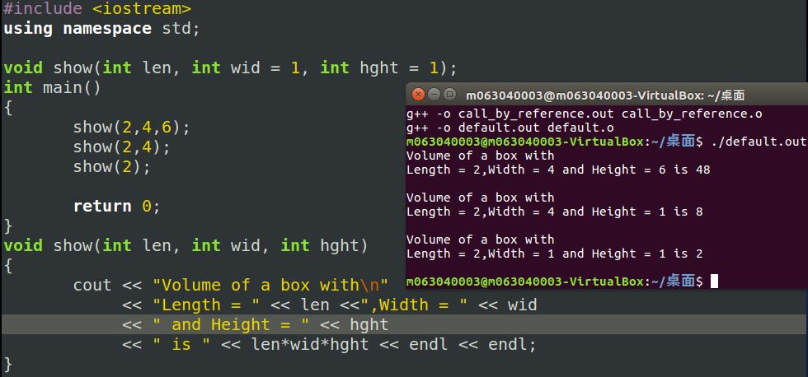
Example

