Slide 1
C程式設計實驗(二)
Chapter9. Operator Overloading

Slide 2
Overloading basics
Overloading operators
VERY similar to overloading functions
Operator overload definitions generally very simple
Just perform “addition” particular to “your” type
Notes:
像之前學的 function overloading一樣
簡單來講就是 運算符號會變成你自己定義的樣子

Slide 3
Overloaded "+"
Given previous example:
Definition is “more involved” than simple “add” !
Must handle negative/positive values
Declarations:
const Complex operator + (const Complex& complex1, const Complex& complex2);
Overloads + for operands of type Complex
Returned value is type Complex
Notes:
用這個例子來說就是 我重新定義Complex這個型態 加號的定義
回傳型態 在這邊就是complex型態
現在的 加號 有兩種不同的算法 第一種是平常的加法 另外一種就是你定義的物件的算法

Slide 4
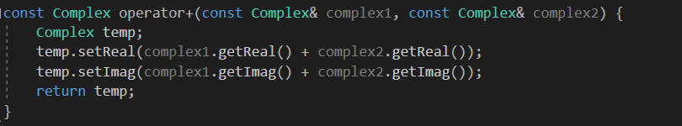
Overloaded "+" (example)
Accessor functions used
Returned value is type Complex
Notes:
在這邊定義為 複數的相加是 實部相加 虛部相加
記得回傳型態是complex

Slide 5
Overloaded "=="
Equality operator, ==
Enables comparison of Complex objects
Declaration:
bool operator ==(const Complex& complex1, const Complex& complex2)
Returns bool type for true/false
Notes:
比較兩個複數是否相等
把==重新定義為兩個complex物件的比較

Slide 6
Overloaded "==" (example)
Accessor functions used
Notes:
判斷實部跟虛部是不是都相等

Slide 7
Returning by const Value
Consider “+” operator overload again……
const Complex operator + (const Complex& complex1, const Complex& complex2);
Return a “constant object”
Why ？
Consider impact of returning “non-const” object to see …
Notes:
為什麼都要在前面加一個const

Slide 8
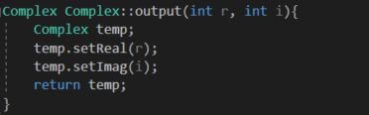
Returning by non-const Value
Can call member functions:
Could invoke member functions on object returned by expression m1+m2:
(m1+m2).output() // legal
Can be modified! ？
Even when they are not associated with any variable
So we define the return object as const
Notes:
比如現在complex class裡面 有一個function叫做output
沒有在前面寫const 就可以把他們加起來再呼叫output 這樣就會把本來正確的值修改掉
所以我們必須用const，讓回傳的物件是只能被讀取的

Slide 9
Overloading Unary Operators
C++ has unary operators:
1 operand
Example.
- (negation) : x = -y //Sets x equal to negative
++,--
Unary operations can also be overload!
Notes:
Unary operator 像是 –(負號)
++ -- 這些都是

Slide 10
Overloading as member function
Previous examples : global functions
Defined outside a class
Can overload as “member operator”
Like “member function”
When operator is member function:
Only 1 parameter, not 2 !
Calling object serves as 1st parameter
Notes:
前面舉的例子 都是global function
Operator overloading 也可以是member function
如果是member function的話 他傳入的參數只會是一個 不是兩個

Slide 11
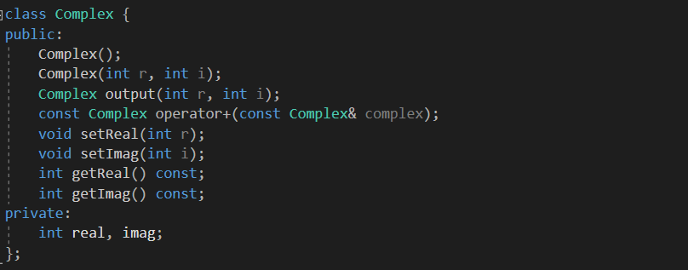
Overloading as member function
One parameter

