Slide 1
C程式設計實驗(二)
Chapter11. Pointer

Slide 2
Pointers Variables
Pointer definition :
A pointer is a variable that stores the memory address of an object
A pointer is a type of variable
Can store pointer in variable.
Notes:
。

Slide 3
Declaring Pointers Variables
Declare : type *ptr
int *p, float *n, double *s, char *c
Initialize
int *p = NULL; // it can be assigned a value of null or 0
int i = 5;
p = &i; // assign pointer to address of object
int j = *p;
illegal instruction
int *p=10;
int i = 5;
int *p = &i;
Notes:
!

Slide 4
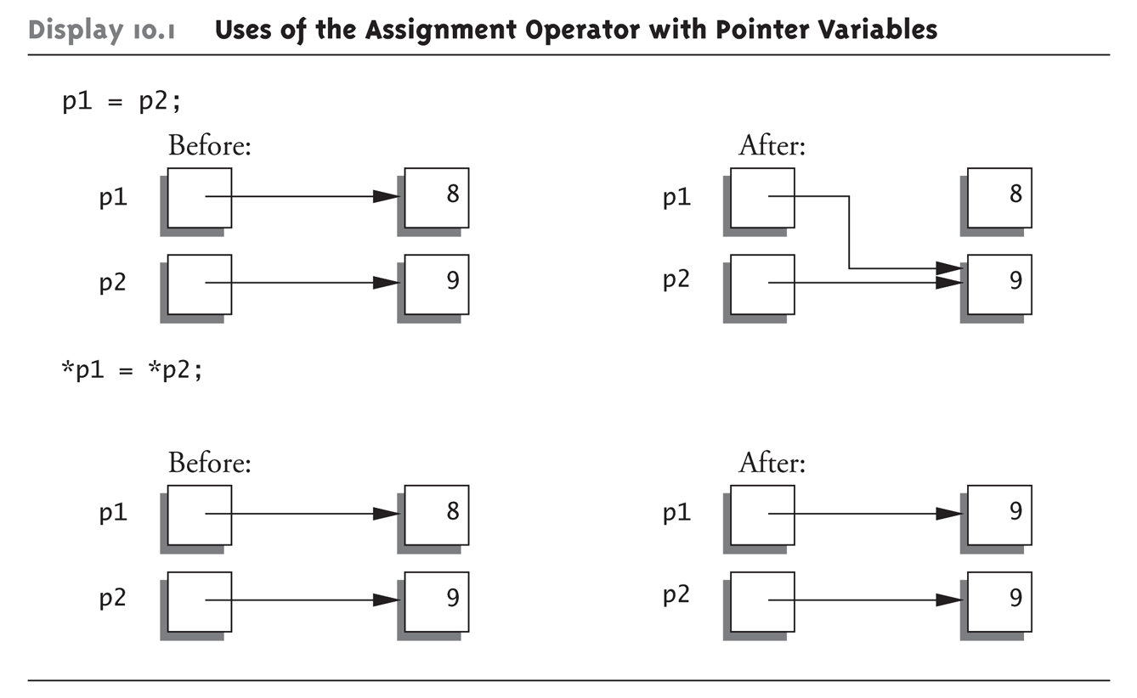
Pointer Assignments
int *p1, *p2;
p1 = p2; //Assigns one pointer to another.
*p1 = *p2; //Assigns “value pointed to” by p1. to “value pointed to” by p2.
Notes:
的數值

Slide 5
Dynamic Array
We can allocate and then deallocate memory dynamically using the new and delete operators respectively
Allocate ---- dataType *ptr = new dataType(initial_value)
Use new operator
Dynamically allocate with pointer variable
Dynamic array : pointer = new type [number_of_elements]
int *ptr;
ptr = new int;
*ptr = 45;
Ex1: int *ptr = new int(45);
Ex2: typedef double *dptr = new double[10];
De-allocate ---- delete ptr
de-allocates all memory for dynamic array
Ex1: delete ptr
Ex2: delete[ ] ptr
ptr = NULL

