Slide 1
C程式設計實驗(二)
Chapter12. Separate Compilation and Namespaces

Slide 2
Learning Objectives
Class, Pointers
The this pointer
Destructors, copy constructors
Separate Compilation
Encapsulation reviewed
Header and implementation files
Namespaces
Using directives
Creating a Namespace

Slide 3
The this Pointer
Member function definitions might need to refer to calling object
Using predefined this pointer
Automatically points to calling object:
class Simple{
public :
void showStuff() const;
private :
int stuff;
};
Two ways for member functions to access:
cout << stuff;
cout << this -> stuff;

Slide 4
Shallow and Deep Copies
Shallow copy
Assignment copies only member variable contents over
Default assignment and copy constructors
Deep copy
Pointers, dynamic memory involved
Must dereference pointer variables to “get to” data for copying
Write your own assignment overload and copy constructor in this case

Slide 5
Copy Constructors
Automatically called when :
Class object declared and initialized to other object
When function returns class type object
When argument of class type is “plugged in” as actual argument to call-by-value parameter
Requires “temporary copy” of object
Copy constructor creates it
Default copy constructor
Like default “ = ”, performs member-wise copy
Pointers → write own copy constructors !

Slide 6
Destructor Need
Dynamically-allocated variables
Do not go away until “deleted”
If pointers are only private member data
They dynamically allocate “real” data
In constructor
Must have means to “deallocate” when object is destroyed
Answer : destructor!

Slide 7
Destructors
Opposite of constructor
Automatically called when object is out-of-scope
Default version only removes ordinary variables, not dynamic variables
Defined like constructor, just add ~
MyClass :: ~MyClass(){
// perform delete clean-up duties
}

Slide 8
Separate Compilation
Program Parts
Kept in separate files
Compiled separately
Linked together before program runs
Class definitions
Separate from “using” programs
Build library of classes
Re-used by many different programs
Just like predefined libraries

Slide 9
Class Separation
Class independence
Separate class definition / specification ( interface )
Separate class implementation
Place in two files
If implementation changes → only that file need be changed
Class specification need not change
“User” programs need not change

Slide 10
Encapsulation Reviewed
Encapsulation principle
Separate how class is used by programmer from details of class’s implementation
“Complete” separation
Change to implementation → NO impact on any other programs
Basic OOP Principle

Slide 11
Encapsulation Rules
Rules to ensure separation
All member variables should be private
Basic class operations should be
Group class definitions and prototypes together
Make class implementation unavailable to users of class
Public member functions
Friend or ordinary functions
Overloaded operators
Called “interface” for class

Slide 12
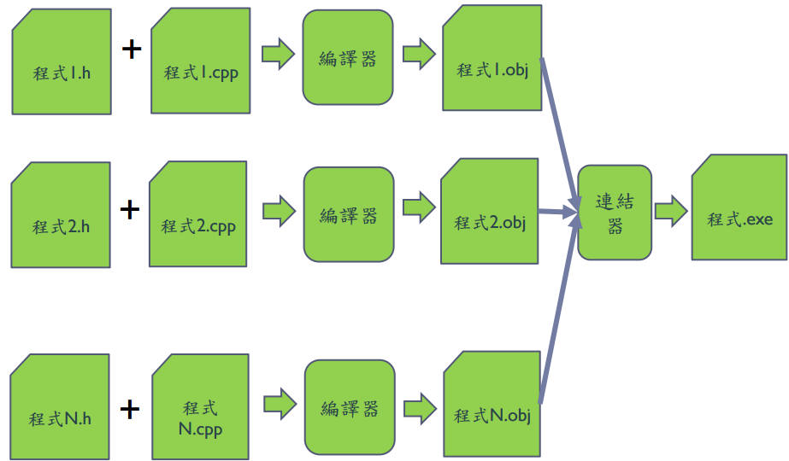
Separate Compilation

Slide 13
Separate Compilation
Example
Compile:
newuser.h
newuser.cpp
username.cpp
password.cpp
makefile:
CC = g++
TARGET1 = Q1
TARGET1-1 = newuser
TARGET1-2 = username
TARGET1-3 = password
FLAG = -std=c++11
all: $(TARGET1-1).cpp $(TARGET1-2).cpp $(TARGET1-3).cpp
$(CC) $(FLAG) -c $(TARGET1-1).cpp $(TARGET1-2).cpp $(TARGET1-3).cpp
$(CC) $(FLAG) -o $(TARGET1) $(TARGET1-1).o $(TARGET1-2).o $(TARGET1-3).o
clean:
rm -f $(TARGET1)
rm -f *.o

Slide 14
Namespaces
Namespace defined :
A collection of name definitions
Class definitions
Variable declarations
Programs use many classes, functions
Commonly have same names
Namespaces deal with this
Can be “on” or ”off”
If names might conflict →turn off

Slide 15
Using Directive
Using namespace std;
Makes all definitions in std namespace available
Why might you NOT want this?
Can make cout, cin have non-standard meaning
Perhaps a need to redefine cout, cin
Can redefine any others

Slide 16
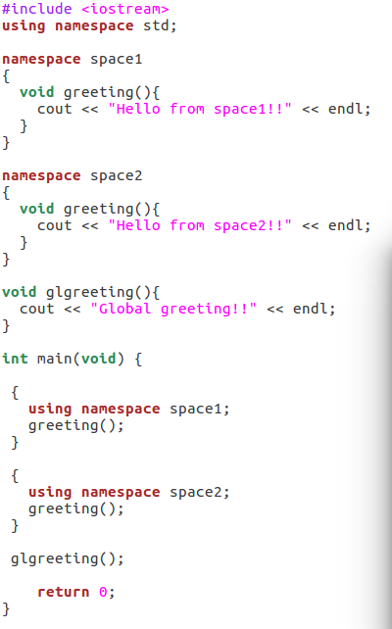

Creating a Namespace
Example.

Slide 17
C程式設計實驗(二)
Chapter13. Streams & File I/O

Slide 18
Learning Objectives
I/O Streams
File I/O
Character I/O
Tools for Stream I/O
File names as input
Formatting output, flag settings

Slide 19
Streams
Input stream
Flow into program
Can come from keyboard
Can come from file
Output stream
Flow out of program
Can go to screen
Can go to file

Slide 20
Stream Usage
We’ve used streams already
cin
input stream object connected to keyboard
cout
Output stream object connected to screen
Can define other steams
To / from files
Used similarly as cin , cout

Slide 21
File Connection
Must first connect file to stream object !
For input :
file → ifstream object
For output :
File → ofstream object
Classes ifstream and ofstream
Defined in library <fstream>
Named in std namespace

Slide 22
File I/O Libraries
To allow both file input and output in your program :
#include <fstream>
using namespace std;
or
#include <fstream>
using std :: ifstream;
using std :: ofstream;

Slide 23
Declaring Streams
Stream must be declared like any other class variable :
ifstream inStream;
ofstream outStream;
Must then “connect” to file :
inStream.open(“infile.txt”);
Called “opening the file”
Used member function open
Can specify complete pathname
Can pass as argument to constructor :
ifstream inStream(“infile.txt”);

Slide 24
Closing Files & File Flush
Files should be closed
Disconnects stream from file
In action :
inStream.close();
outStream.close();
Output often “buffered”
Written in “groups”
Occasionally might need to force writing :
outStream.flush(); //all buffered output is physically written

Slide 25
Appending to a file
Standard open operation begins with empty file
Open for append :
ofStream outStream;
outstream.open(“important.txt” , ios :: app);
If file doesn’t exist → creates it
If file exists → appends to end
2nd argument is class ios defined constant
In <iostream> library , std namespace

Slide 26
Checking End Of File (EOF)
Member function eof()
inStream.get(next);
while(!inStream.eof()) { // eof() returns bool
cout << next;
instream.get(next); // Reads each character until file ends
}

Slide 27
Formatting Output with Stream Functions
Consider :
outStream :: setf(ios :: fixed);
outStream :: setf(ios :: showpoint);
outStream.precision(2);
Member function setf()
Allows multitude of output flags to be set
Member function precision(x)
Decimals written with “x” digitals after decimal

Slide 28
Flags
All output streams have setf() member
Flags are constants in class ios
In library <iostream> , std namespace

Slide 29
Flags : Examples
Common flag constants :
outStream :: setf(ios :: fixed);
Set fixed – point notation (decimal)
outStream :: setf(ios :: showpoint);
Always include decimal point
outStream:: setf(ios :: right);
Sets right – justification
Set multiple flags with one call :
outStream :: setf(ios :: fixed | ios :: showpoint | ios ::right);

Slide 30
Manipulators
Manipulators defined :
“A function called in nontraditional way”
Can have arguments
Placed after insertion operator
setw() and setprecision() are in library <iomanip>
std namespace

Slide 31
Manipulators : Examples
setw() manipulators : (Note. affects only NEXT outputted value)
cout << “Start ” << setw(4) << 10 << setw(4) << 20 << setw(6) << 30;
Results in :
Start 10 20 30
setprecision() manipulators :
cout.setf(ios::fixed);
cout << “$ ” << setprecision(2) << 10.3 << “ ” << “$ ” << 20.5 ;
Results in :
$ 10.30 $ 20.50

