Slide 1
C程式設計實驗(二)
Chapter14. Inheritance & Polymorphism

Slide 2
Pitfall: Base Class Private Data
Derived class “inherits” private member variables
But still cannot directly access them
Not even through derived class member functions!
Private member variables can ONLY be accessed "by name" in member functions of the class they’re defined in

Slide 3
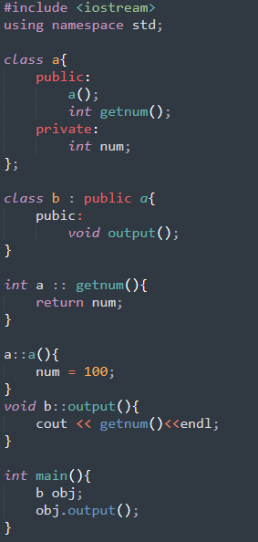

Example

Slide 4
The protected:
New classification of class members
Allows access "by name" in derived class
But nowhere else
Still no access "by name" in other classes
In class it’s defined → acts like private
Considered "protected" in derived class
To allow future derivations

Slide 5
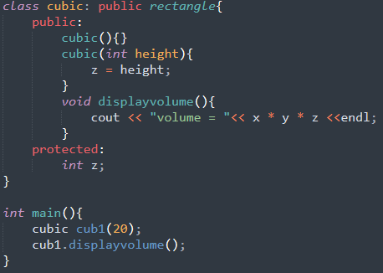
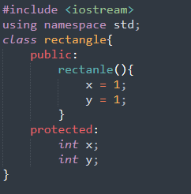

Example

Slide 6
Redefinition of Member Functions
Recall interface of derived class:
Contains declarations for new member functions
Also contains declarations for inherited member functions to be changed
Inherited member functions NOT declared:
Automatically inherited unchanged
Implementation of derived class will:
Define new member functions
Redefine inherited functions as declared

Slide 7
Redefining vs. Overloading
Very different!
Redefining in derived class:
SAME parameter list
Essentially "re-writes" same function
Overloading:
Different parameter list
Defined "new" function that takes different parameters
Overloaded functions must have different signatures

Slide 8
Accessing Redefined Base Function
When redefined in derived class, base class’s definition not "lost"
Can specify it’s use: Employee JaneE; HourlyEmployee SallyH; JaneE.printCheck(); → calls Employee’s printCheck function SallyH.printCheck(); → calls HourlyEmployee printCheck function SallyH.Employee::printCheck(); → Calls Employee’s printCheck function!
Not typical here, but useful sometimes

Slide 9
Inheritance
Access specifier In base class | Type of inheritance
 | public | protected | private
public | public | protected | private
protected | protected | protected | private
private | private (inaccessible) | private (inaccessible) | private (inaccessible)

Slide 10
Polymorphism
A single identity stands for different things
C++ implements polymorphism in 3 ways:
Overloading – static polymorphism
One name stands for several functions
Templates – parameterized polymorphism
One name stands for several types or functions
Virtual functions – dynamic polymorphism
One pointer refers to any base or derived class objects

Slide 11
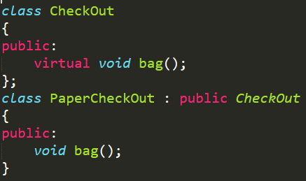
Virtual Function
Use keyword virtual on a superclass (base) function makes the
function virtual for the superclass, as well as ALL its subclasses
Late binding for variables
CheckOut * co = new PaperCheckOut;
Late binding for functions

Slide 12
Virtual Function
Virtual function in base classes
Automatically virtual in derived class
Derived class declaration (in interface)
Not required to have “virtual” keyword
But typically included for readability

Slide 13
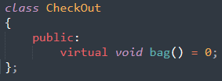
Virtual Function
Pure virtual function
A pure virtual function is a virtual function in C++ for which we need not to write any function definition and only we have to declare it. It is declared by assigning 0 in the declaration.

Slide 14
Overriding
Virtual function definition changed in a derived class
Overridden
Similar to redefined
Virtual functions changed: overridden
Non-virtual functions changed: redefined

Slide 15
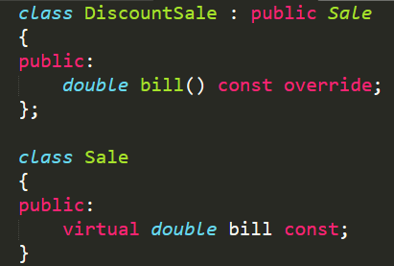
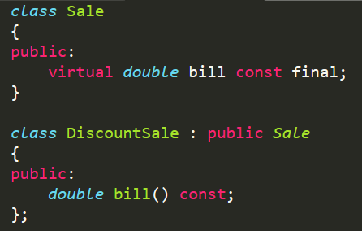
Overriding
Use final when a function is overridden but don’t want a derived class to override it again.
→ Compile error

Slide 16
Virtual Function
Disadvantage: overhead
Uses more storage
Programs run slower
If not needed, don’t use
Constructor can’t be virtual
Since it is not inherited
Subclass defines its own constructor
Destructor should be declared virtual
Friends can’t be virtual
If you override function in the subclass, the overridden function shall have the same parameter list as the superclass’ version

