Slide 1
TensorFlow: A System for Large-Scale Machine Learning

Slide 2
Background: Training deep neural networks
Limited by GPU memory using Nvidia GTX 580 (3GB RAM)
60M Parameters ~ 240 MB
Need to cache activation maps for backpropagation
Batch size = 128
128 * (227*227*3 + 55*55*96*2 + 96*27*27 + 256*27*27*2 + 256*13*13 + 13*13*384 + 384*13*13 + 256*13*13 + 4096 + 4096 + 1000) Parameters ~ 718MB
That assuming no overhead and single precision values
Tuned splitting across GPUS to balance communication and computation

Slide 3
Background: Training deep neural networks
T
Limited by GPU memory using Nvidia GTX 580 (3GB RAM)
60M Parameters ~ 240 MB
Need to cache activation maps for backpropagation
Batch size = 128
128 * (227*227*3 + 55*55*96*2 + 96*27*27 + 256*27*27*2 + 256*13*13 + 13*13*384 + 384*13*13 + 256*13*13 + 4096 + 4096 + 1000) Parameters ~ 718MB
That assuming no overhead and single precision values
Tuned splitting across GPUS to balance communication and computation
Too much manual effort!

Slide 4
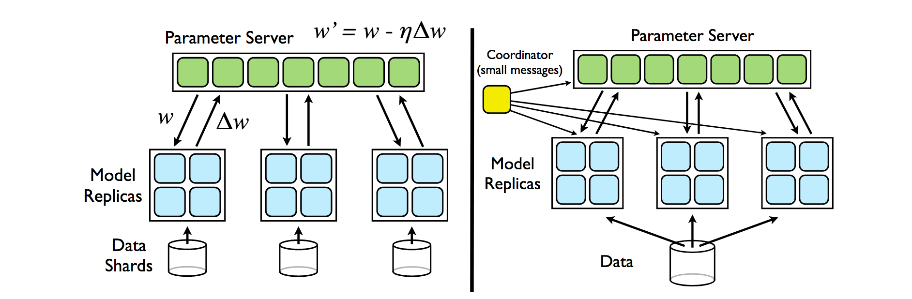
Background: Training deep neural networks
Trend towards distributed training for large-scale models
Parameter server: A shared key-value storage abstraction for distributed training
E.g., DistBelief, Project Adam

Slide 5
Background: Training deep neural networks
T
Hides details of distribution
But still difficult to reason about end-to-end structure
Inflexible update mechanisms and state management
Trend towards distributed training for large-scale models
Parameter server: A shared key-value storage abstraction for distributed training
E.g., DistBelief, Project Adam

Slide 6
TensorFlow
Flexible dataflow-based programming model for machine learning
Dataflow captures natural structure of computation
in both training and inference

Slide 7
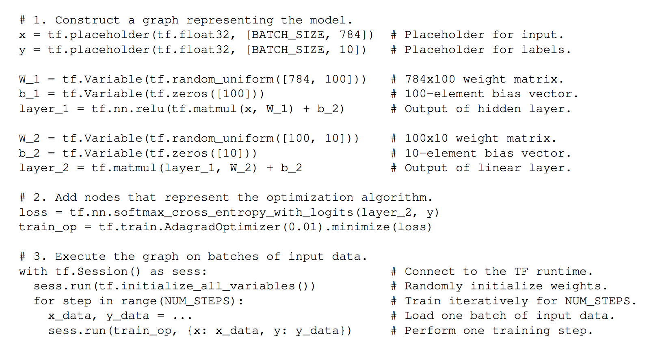
TensorFlow

Slide 8
TensorFlow

Slide 9
TensorFlow

Slide 10
TensorFlow

Slide 11
What is the problem being solved?
Lack of a flexible programming model to build machine learning models
Prior approaches restricted innovation due to their inflexibility
E.g., parameter updates in parameter server-based approaches

Slide 12
Dataflow-based programming model
Computation structured as a dataflow graph
Nodes can be stateful
Captures accumulated state as part of the training process
E.g., parameter values
Graph elements
Tensors flow across edges between nodes
Operations are expressions over tensors (e.g., constants, matrix multiplication, add)
Variables can accumulate state
Queues provide explicit advanced coordination

Slide 13
TensorFlow

Slide 14
TensorFlow

Slide 15
What are the metrics of success?
Variety of specialized extensions built over the framework
“User level” code
Acceptable performance with respect to state-of-the-art

Slide 16
Extensibility
Optimization algorithms
Momentum, AdaGrad, AdaDelta, Adam
E.g., parameter updates in momentum are based on accumulated state over multiple iterations
Difficult to implement extensible optimization algorithms in parameter servers

Slide 17
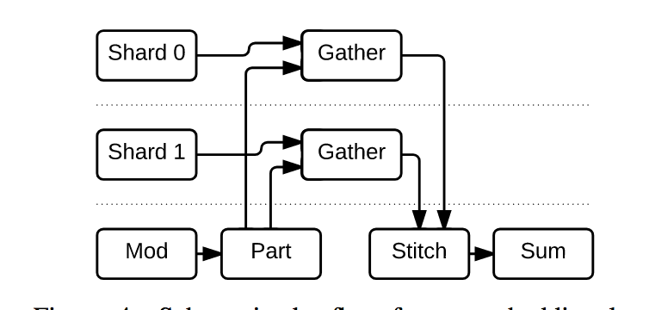
Extensibility
Sharding very large models
E.g., Sparse embedding layers
Shard embedding layer across parameter server tasks
Encode incoming indices as tensors, and ship to the appropriate shard

Slide 18
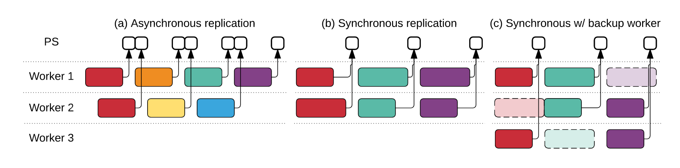
Extensibility
Use queues to coordinate the execution of workers
Synchronous replication
Straggler mitigation with backup workers

Slide 19
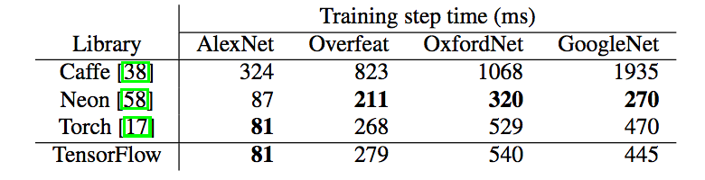
Competitive training times on single node

Slide 20
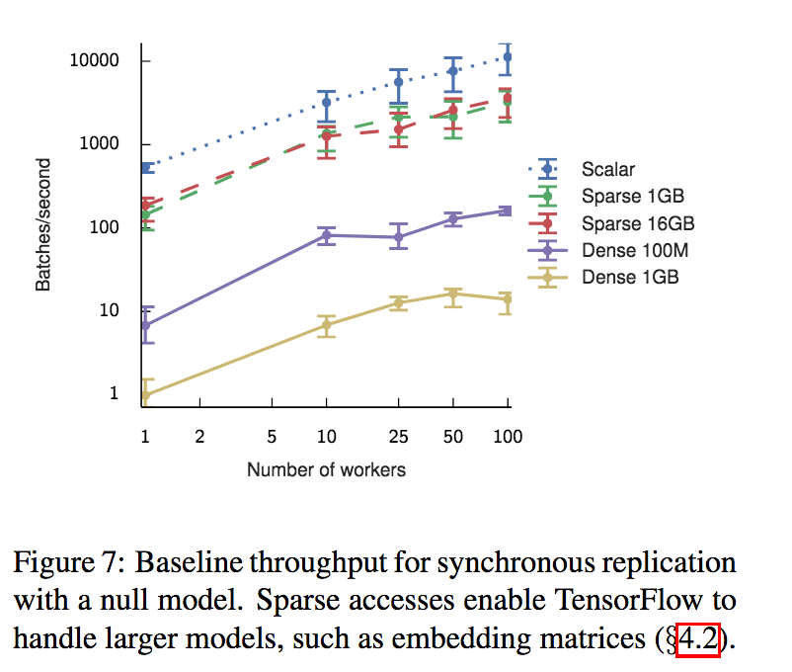
Key results
Extensibility matters!

Slide 21
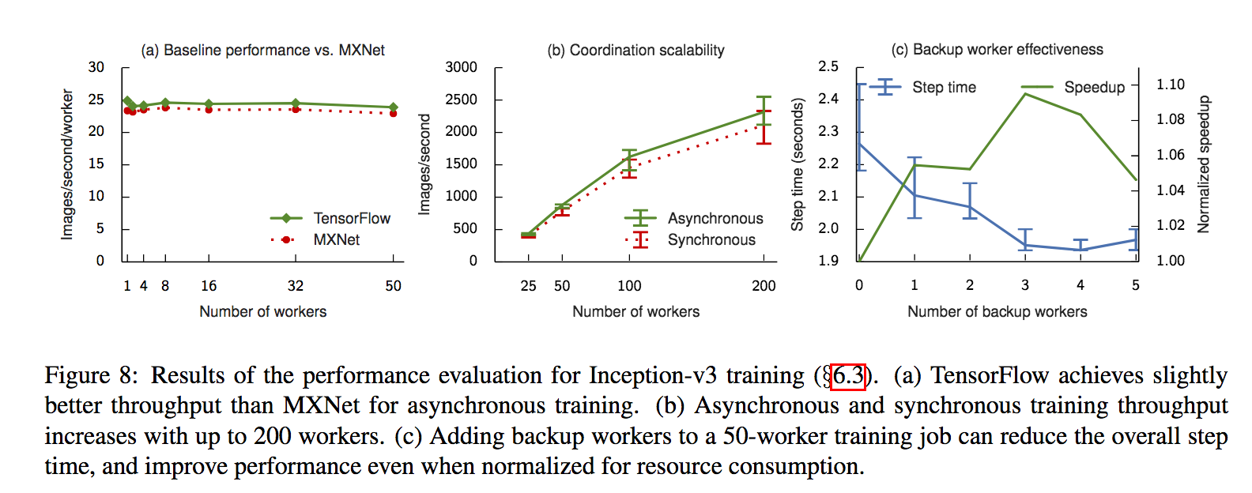
Key results
Extensibility matters!

Slide 22
Limitations and scope for improvement
TF’s high-level programming model is tightly coupled with its execution model
Translate TF programs to more efficient executables using compilation to hide translation
TF dataflow graphs are static
Key runtime decisions, such as number of PS shards, seem to require manual specification
Can these be automatically deduced based on workload characteristics?

