Slide 1
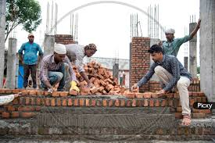
Analysis of National Rural Employment Guarantee Act (NREGA) Data
Evaluating the Impact and Implementation of NREGA

Slide 2
PROJECT OVERVIEW
This project delves into the analysis of data related to the National Rural Employment Guarantee Act (NREGA), a transformative government scheme aimed at providing rural households with guaranteed wage employment opportunities.
The dataset used for this analysis encompasses a wide range of parameters, including the number of job cards issued, the workforce engaged, budget allocation, work completion statistics, and much more.
Through the application of data analytics techniques, we aim to gain valuable insights into the implementation and impact of NREGA across different states and districts in India.

Slide 3
PROBLEM STATEMENT
Some the question this analysis will solve are;
How effective is NREGA in providing employment opportunities to rural households?
Are there regional disparities in the implementation and outcomes of the scheme?
What is the utilization of the allocated budget, and how does it correlate with employment generation?
What are the key factors contributing to the completion of NREGA works, and are there any roadblocks to its success?
Can data-driven insights guide policymakers and administrators in optimizing the scheme's impact?

Slide 4
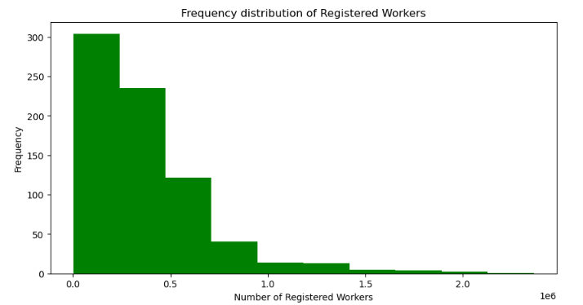
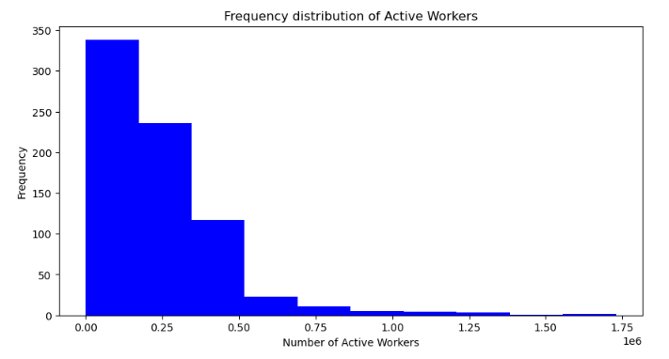
EMPLOYMENT OPPOTUNITIES
A total of 269,233,343 person registered for the NREGA program
175,479,159 which represent 65.2% of the total number of registered persons were active workers

Slide 5
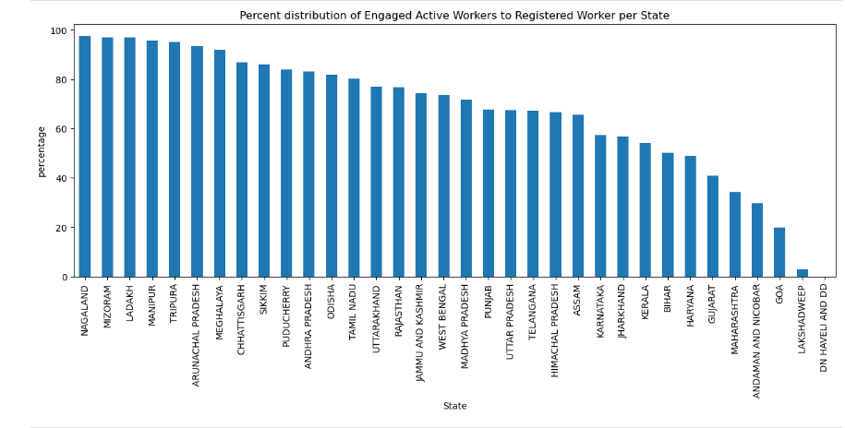
REGIONAL DISPARITIES
NAGALAND has a percentage ratio of number of active workers to number of registered workers at 97.3%. However states like GOA, LAKSHADWEEP and DN HAVELI AND DD has as low as below 20% for same metric. This shows a strong regional disparity

Slide 6
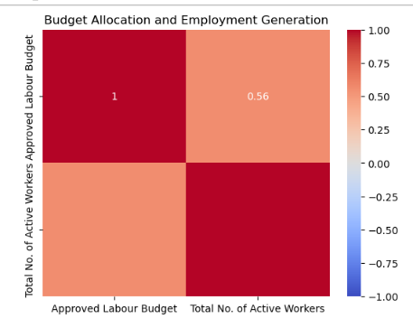
BUDGET UTILIZATION
At a corrolation value of 0.56, we can deduce that the size of the approved budget mildly determines the number of persons employed.

Slide 7
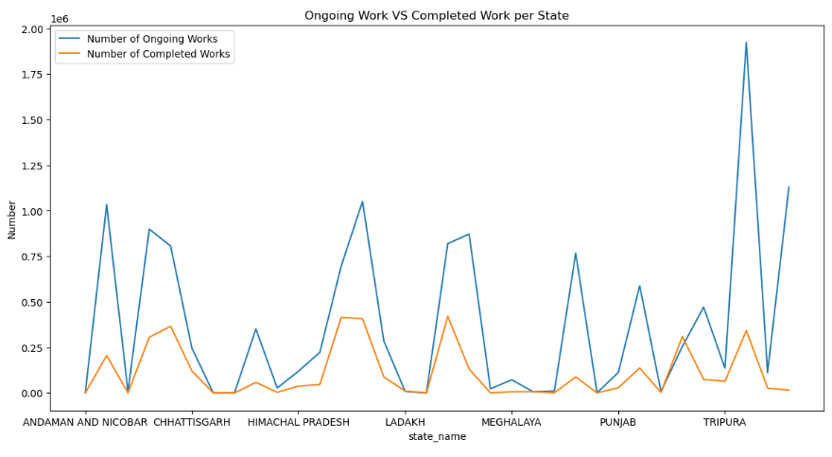
WORK COMPLETION FACTORS
UTTAR PRADESH has the highest number of on-going and completed work while DN HAVELI AND DD recorded the lowest number of ongoing and completed work.
Approved budget and the Total No. of Works Takenup (New+Spill Over) greatly influence the level of work completion.

Slide 8
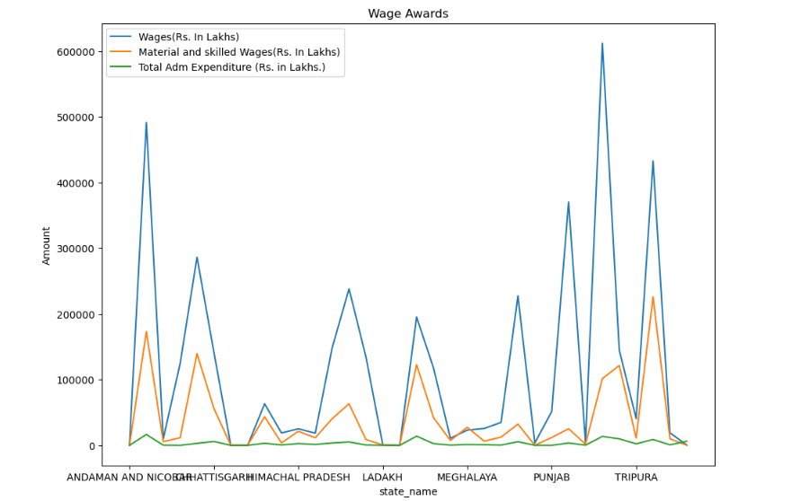
CHALLENGES AND ROADBLOCKS
As expected, Wages of employees took 70% of Approved budget

Slide 9
DATA-DRIVEN INSIGHT
Based on the dataset, 65.2% of the registered workers are actively engaged. Policymakers and administrators should aim to increase this value to at least 80%.
There is a significant uneven distribution of job opportunities across different states. Policymakers should adopt a percentage ratio distribution for future job engagements to ensure an even distribution of these opportunities.
Better policies should be implemented to ensure that the approved budget leads to significant improvements in employment generation.
More projects should be initiated, and ongoing projects should be completed to greatly enhance the overall success of the NREGA program.
Optimizing resource utilization is essential to ensure the success of the program.

Slide 10
