Slide 1
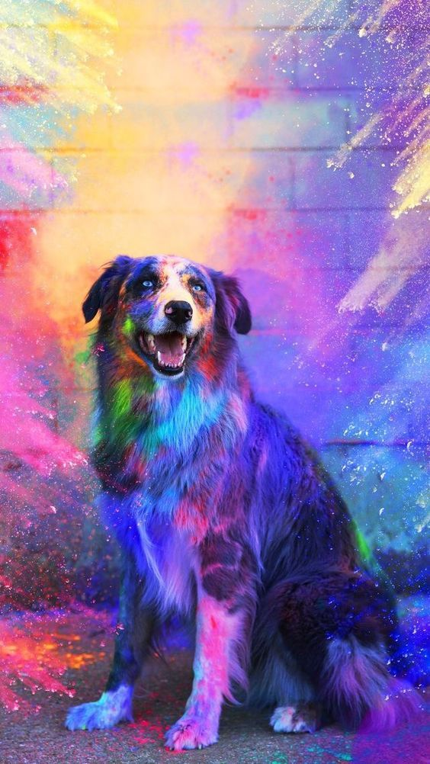

DOGGO
A Dog Search App
By Andrew, Angus, Cynthia & Terry

Slide 2
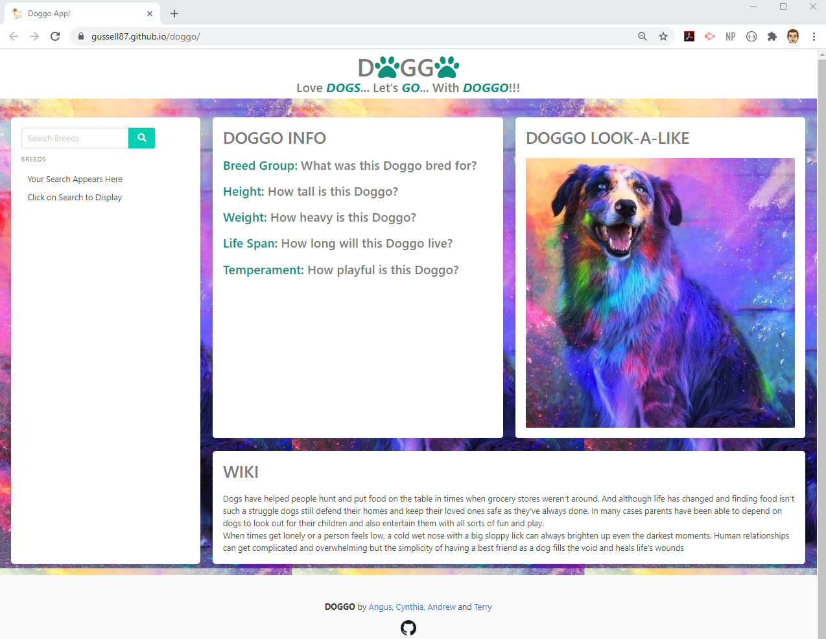
Elevator Pitch
Notes:
Where would you go for a picture and unbiased information about every breed, in an attractive & easy to use interface?
The Doggo app is designed to help the user find information on dog breeds they are interested in. They can enter part of the name of a breed, and the search will return the five closest matches.
The user can then click on the breed they would like to learn more about.
The page will then display a photo of the breed, along with key information: breed group, typical height & weight, life span & temperament. It will also include a Wikipedia description down the bottom.

Slide 3
Concept - Description
User types a dog breed into the search box.
Up to five matches will appear.
Users can then click a different option from the list. Key information appears along with a photo of that breed.
At the bottom of the page, a breed description will appear in the Wiki box.
For some breeds, the user can click again in the list on the left, and a new photo will appear.
Notes:
Doggo app presents users with a striking interface, fun title and easy to navigate page.
Users type a dog breed into the search box at the top of the left content box. They then click the search button, and up to five matches will appear below, with the closest match initially selected.
Users can then click a different option from the list. To the immediate right, key information appears with clear headers. A photo of that breed will appear to the right of that. At the bottom of the page, a breed description will appear in the Wiki box.
For some breeds, the user can click again in the list on the left, and a new photo will appear.
There is also a footer with links to the GitHub repository, and the user profiles of each of the App’s authors.

Slide 4
Concept
Motivation for development:
A dedicated central resource for dog breed information in one place.
Not lost among other information.
Can easily search with incomplete dog name.
Striking user interface.
Delivers concise facts, a photo and a description.
User story:
As a dog lover: I want to search dog breed information. This includes height, weight, life-span, breed group, a description and a picture. This is so I can get a better understanding of different species of dog, to know which it is the right breed for me and my lifestyle.
Notes:
Motivation for Development
We wanted users to have a dedicated central resource to just search dog breed key information in one place.
It is not cluttered and lost amongst other subjects – if you don’t know the exact name of the breed, you can find suggestions only for dog breeds.
A universal online encyclopedia can be updated by anyone, contains an overwhelming amount of information and cannot offer a calming yet captivating user interface. Users need a combination of consistent stats from a dog site, and descriptive prose from Wikipedia with a photo for reference.
User story:
As a dog lover: I want to search dog breed information. This includes height, weight, life-span, breed group, a description and a picture. This is so I can get a better understanding of different species of dog, to know which it is the right breed for me and my lifestyle.

Slide 5
Process
Technologies used
HTML
CSS: Bulma, FontAwesome
JavaScript: JQuery, Popper & Tippy
Other API's: Wikipedia, The Dog API

Slide 6
Process – Breakdown of tasks & roles
Andrew
Build API calls from Wikipedia, TheDogAPI, & Tippy
Review & integrate JavaScript with API’s
Incorporate local storage for prev. searches
Set JS functions (OnClick, dynamic listing)
Angus
Build first JavaScript on Search to incorporate TheDogAPI
Review & update ReadMe throughout
Build presentation
Write elevator pitch
Cynthia
Primary research into topic (esp. in medical fields) & API’s
Complete app concept & draft user story
Build first ReadMe draft
Presentation build: technology + challenges
Terry
HTML skeleton
Styling using CSS, Bulma & FontAwesome
Integrate JavaScript into page

Slide 7
Process
Challenges
Unable to include adoption as PetRescue needs membership.
Overseas adoption API’s require Node & other similar technologies.
Some breeds needed images from Wikipedia.
Successes
Visually appealing interface
Effective search functionality to achieve goals
Strong mobile display & usability.
Active collaboration.
Notes:
Challenges
We had hoped to include whether there are dogs available to adopt in the user’s area. However the PetRescue required paid membership.
Similar overseas adoption API’s use technologies like Node in order to implement.
Not all breeds had images available, so those needed to be pulled from Wikipedia. They then don’t show a different picture when clicked again.
Successes
Visually appealing interface & effective search functionality to achieve initial goals.
App retains functionality & appearance in mobile display.
Collaboration was strong & app was built as a team, with high morale throughout. Teamwork made the dream work.

Slide 8
Demo

Slide 9
Directions for Future Development
PetRescue API for Australian adoption.
Potential to include breeders if API developed.
Scope for higher level of information through additional API’s.
Type of people Doggos are recommended for.
Notes:
The app can be extended to include a search for Doggos available for adoption in Australia. This can be done using PetRescue API.
The app might also have capacity to search for breeders, though a suitable API does not yet exist to our knowledge.
Another API could incorporate more information on the breed including exercise requirements, common ailments, feeding guides and more.
The app could potentially incorporate expert opinions on each breed & the sort of owners they best suit. Families, farmers, couch potatoes etc.

Slide 10
Links
Deployed: https://gussell87.github.io/doggo/
GitHub Repo: https://github.com/gussell87/doggo

