Slide 1
Psychological Testing: Introduction
UCLA
Ψ188B
Andrew Ainsworth PhD

Slide 2
Questions You’ll Encounter
What is a psychological test?
Are there different kinds of psych tests?
For what purposes are they used?
Have psych tests ever been used on me?
How do we know if a test is reliable? Valid?
Statistics AGAIN?

Slide 3
Questions You’ll Encounter
What are qualities of “good” test items?
How can testing situations affect responses?
What is an “IQ” anyway?
Does IQ really measure intelligence?
Should schools really care about my SAT? GRE? LSAT? MCAT?

Slide 4
Questions You’ll Encounter
Can my reaction to some weird inkblot really say something about my personality?
Can my response to a bunch of weird T/F questions really indicate that I have a psychopathology?
All I want to do is help people, why do I need to submit them to all these torturous tests?

Slide 5
Psychological Testing AKA
Psychometrics – field of study concerned with the theory and technique of educational and psychological measurement (Wikipedia)
measurement of knowledge, abilities, attitudes, and personality traits.
It involves two major research tasks
the construction of instruments and procedures for measurement
the development and refinement of theoretical approaches to measurement

Slide 6
Measurement
In psychology we are interested in either describing the distributions of and/or relationships among abstract concepts: e.g.,
Political conservatism
Intelligence
Neuroticism
Aggression

Slide 7
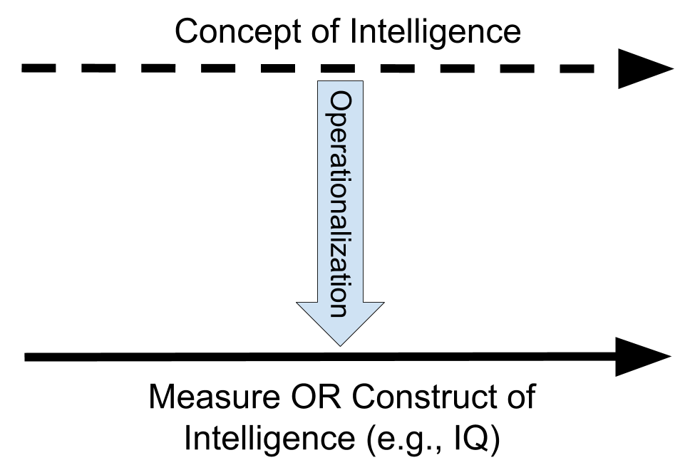
Measurement: Operationalization
However, in most cases these constructs are abstractions that can often not be directly observed.

Slide 8
Measurement: Operationalization
The value of scientific research is completely dependent upon the degree to which the operationalizations are successful or valid.
Note: operationalization → concept = valid measure
More on this later…

Slide 9
Concepts and Constructs
Concept:
“An abstraction formed by generalization from particulars”
Abstracts are hard to define
E.g. intelligence
Construct:
A concept with scientific purpose (i.e. operationalized)
Can be measured and studied.
E.g. IQ

Slide 10
Terms Review: Variables and Constants
Variable: any condition, event, characteristic or attribute that can take on different values at different times or with different people.
Age of people
Temperature
Intelligence
Xenophobia
Constant:
One value in a given context.
Does not change or vary.

Slide 11
Terms Review: Independent and Dependent Variables
Independent variable
we are referring to a variable that the experimenter has some direct control over and can manipulate
In Experiments IVs are the “cause”
In non-experiments IVs are the “influence
i.e., X → Y
Dependent Variables
The variable being influenced/predicted
The outcome variable

Slide 12
Terms Review: Discrete & Continuous Variables
Discrete variables: can only take on a finite or restricted set of values.
Can only take on whole values (think digital)
E.g., number of children per family, Number of students taking 100A
Continuous variables: can take an infinite number of values
E.g., Temperature (10.3 C, 10.24 C, 15.212 C), Weight (102.2lbs., 116.56 lbs.)
The difference often limited only by precision

Slide 13
Psych Testing Basics
Test
A measurement device or technique used to quantify behavior or aid in the understanding and prediction of behavior.
Psychological Test
a set of items designed to measure characteristics of human beings that pertain to behavior.
Behavior
Overt: observable activity of the individual
Covert: takes place within the individual

Slide 14
Psych Testing Basics
Scale
Relate raw scores on a test to some defined theoretical or empirical distribution.
A method of operationalizing a psychological construct using a multiple item test (e.g. questionnaire)

Slide 15
Types of Tests
Individual Tests vs. Group Tests
Individual tests: test administrator gives a test to a single person
e.g. WAIS-III, MMPI-2
Group tests: single examiner gives a test to a group of people
e.g. SAT, GRE

Slide 16
Types of Tests
(Human) Ability Tests
Achievement Tests
evaluates what an individual has learned
measures prior activity
Aptitude Tests
evaluates what an individual is capable of learning
measures capacity or future potential
Intelligence Tests
Measures a person’s general potential to solve problems, adapt to novel situations and profit from experience

Slide 17
Types of Tests
Personality Tests: Objective & Projective
Objective Personality Tests
present specific stimuli and ask for specific responses (e.g. true/false questions) .
Projective Personality Tests
present more ambiguous stimuli and ask for less specific responses (e.g. inkblots, drawings, photographs, Rorschach, TAT)

Slide 18
History of Psychometrics: the Good and the Bad
Chinese influence
Individual Differences: Darwin and Galton
Experimental Psychologists
The study of mental deficiency
Intelligence Testers
Personality Testers

Slide 19
History of Psychometrics: Chinese influence
2000 B.C.E.
Scattered evidence of civil service testing in China
206 B.C.E. to 220 C.E.
Han Dynasty in China develops test batteries
two or more tests used in conjunction.
Test topics include civil law, military affairs, agriculture, revenue, geography

Slide 20
History of Psychometrics: Chinese influence
1368 C.E. to 1644 C.E.
Ming Dynasty in China develops multistage testing
Local tests lead to provincial capital tests; capital tests lead to national capital tests
Only those that passed the national tests were eligible for public office
1832
English East India Company copies Chinese system to select employees for overseas duty.

Slide 21
History of Psychometrics: Chinese influence
1855
British Government adopts English East India Company selection examinations.
French & German governments follow shortly.
1883
United States establishes the American Civil Service Commission
Developed & administered competitive examinations for government service jobs.

Slide 22
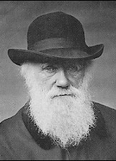
History of Psychometrics: Individual Differences, Darwin and Galton
Individual differences – despite our similarities, no two humans are exactly alike.
Why?
Darwin
some of these individual differences are more “adaptive” than others
these individual differences, over time, lead to more complex, intelligent organisms

Slide 23
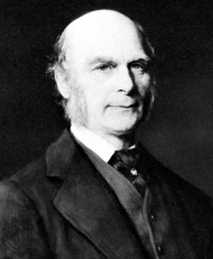
History of Psychometrics: Individual Differences, Darwin and Galton
Galton - cousin of Darwin
“Applied Darwinist”: some people possessed characteristics that made them “more fit” than others.
Wrote Hereditary Genius (1869)
Sets up an anthropometric laboratory at the International Exposition of 1884
For 3 pence, visitors could be measured with:
The Galton Bar - visual discrimination of length
The Galton Whistle (aka “dog whistle” - determining highest audible pitch)

Slide 24
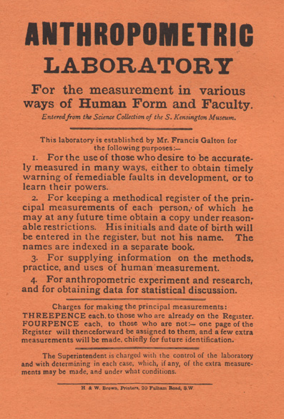
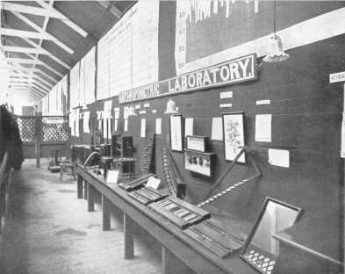
History of Psychometrics: Individual Differences, Darwin and Galton
Galton’s Anthropometric Lab

Slide 25
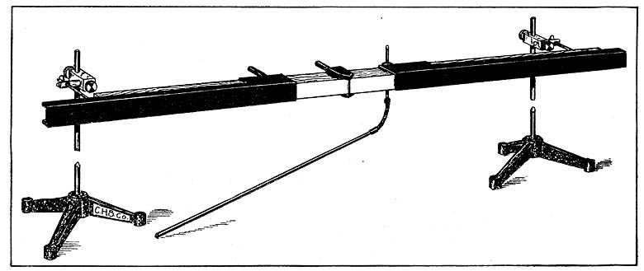
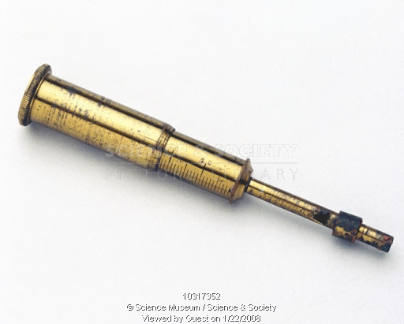
History of Psychometrics: Individual Differences, Darwin and Galton
Galton Whistle (circa 1900)
Galton Bar

Slide 26
Individual Differences: Darwin and Galton
Galton also noted that persons with mental retardation also tend to have diminished ability to discriminate among heat, cold & pain.
Other advances (?) of Galton’s:
Considered by some the founder of psychometrics
pioneered rating scales & questionnaires
first to document individuality of fingerprints
studied efficacy of prayer
first to apply statistics in the measurement of humans
Founder of eugenics (What is Eugenics?)
Notes:
Eugenics is a social philosophy which advocates the improvement of human hereditary traits through various forms of intervention.[1] Throughout history, eugenics has been regarded by its various advocates as a social responsibility, an altruistic stance of a society, meant to create healthier and more intelligent people, to save resources, and lessen human suffering.

Slide 27
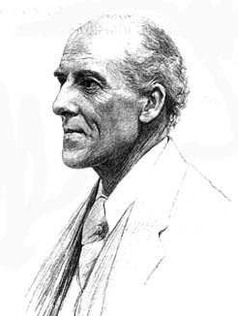
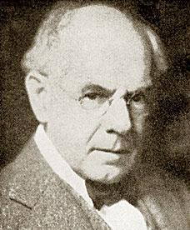
History of Psychometrics: Galton’s Famous Students
Karl Pearson
Does the name Pearson sound familiar?
student of Galton
extended Galton’s early work with statistical regression
James McKeen Cattell
first to use the term “mental test”
U.S. dissertation on reaction time based upon Galton’s work

Slide 28
History of Psychometrics: Early Experimental Psychologists
Early 19th century scientists, generally interested in identifying common aspects, rather than individual differences.
Differences between individuals was considered a source of error which rendered human measurement inexact.
Sounds a lot like things from your past (e.g. ANOVA) and your coming future

Slide 29
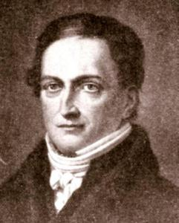
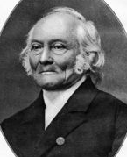
History of Psychometrics: Early Experimental Psychologists
Johan Friedrich Herbart - mathematical models of the mind; founder of pedagogy as an academic discipline; went against Kant’s theories
Ernst Heinrich Weber - sensory thresholds; just noticeable difference (JND)
Notes:
Weber-Fechner law – the strength of a sensation grows as the logarithm of the stimulus intensity

Slide 30
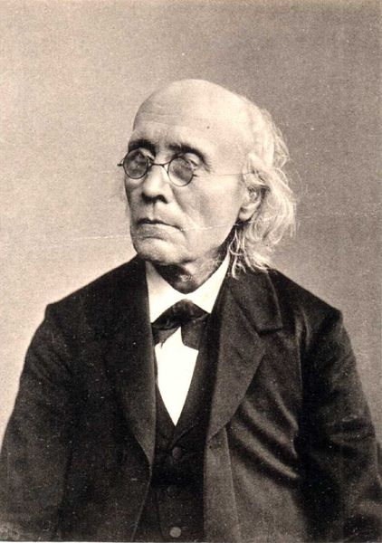
History of Psychometrics: Early Experimental Psychologists
Gustav Theodor Fechner - mathematics of sensory thresholds of experience; founder of psychophysics; considered of one founders of experimental psychology; Weber-Fechner Law first to relate sensation and stimulus; considered by some the founder of psychometrics

Slide 31
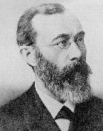
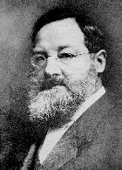
History of Psychometrics: Early Experimental Psychologists
Fechner influenced many prominent psychologists (e.g. Wundt, Freud)
Wilhelm Wundt – considered one of the founders of psychology; first to set up a psych laboratory
Edward Titchner – succeeded Wundt; brought Structuralism to America; His brain is still on display in the psychology department at Cornell

Slide 32
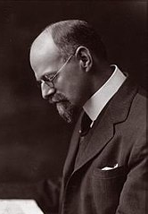
History of Psychometrics: Early Experimental Psychologists
Fechner influenced many prominent psychologists (e.g. Wundt, Freud)
Guy Montrose Whipple –
Student of Titchner’s
Pioneer of human ability testing
Conducted seminars that changed the field of psych testing
APA issued its first set of standards for professional psychological testing because of his criticisms

Slide 33
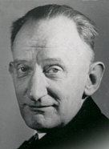
History of Psychometrics: Early Experimental Psychologists
Fechner influenced many prominent psychologists (e.g. Wundt, Freud)
Louis Leon Thurstone –
Large contributor to factor analysis
attended Whipple’s seminars
approach to measurement was termed the law of comparative judgment

Slide 34
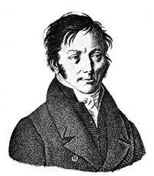
History of Psychometrics: Interest in Mental Deficiency
1805 – Jean-Étienne Esquirol, French Physician
Favorite Student of Philippe Pinel (founder of psychiatry)
Manuscript on “mental retardation.”
differentiated between insanity & mental retardation
E.g., insanity had a period of normal intellectual functioning
Many degrees to mental retardation
normality to “low-grade idiocy”
Attempted to develop system to classify people into these many degrees but found that the individual’s use of language provided the most dependable continuum

Slide 35
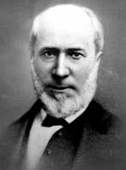
History of Psychometrics: Interest in Mental Deficiency
1840s - Edouard Seguin, French Physician
Pioneer in training mentally-retarded persons.
Rejected the notion of incurably MR
1837: opens first school devoted to teaching MR children.
1848: emigrates to USA, wide acceptance of theories
1866: experiments with physiological training of MR
sense-training / muscle-training still used today
leads to nonverbal tests of intelligence (i.e., Seguin Form Board)

Slide 36
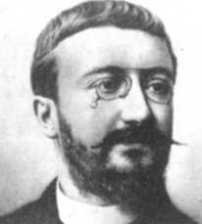
History of Psychometrics: Intelligence Testing
Alfred Binet
50 years after Esquirol & Seguin -- 1905
French Society for the Psychological Study of the Child urged French ministers to develop special classes for children who failed to respond to normal schooling.
Ministers required a way to identify the children

Slide 37
History of Psychometrics: Intelligence Testing
Alfred Binet
First Intelligence Test: Binet-Simon Scale of 1905
30 items of increasing difficulty
Standardized administration
Same instructions & format for ALL children
Standardization sample
created norms by which performance one child can be compared with other children.

Slide 38
History of Psychometrics: Intelligence Testing
Alfred Binet
Standardization Sample
50 Normal children aged 3-11yrs
“Some” mentally retarded children and adults
1908 Binet-Simon Scale
More items (greater reliability)
Better standardization sample (300 normal children)
Introduction of Mental Age

Slide 39
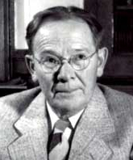
History of Psychometrics: Intelligence Testing
Alfred Binet’s legacy
1911 Binet-Simon, minor revision
Binet dies
1912 Kuhlmann-Binet revision
Extends testing downward to 3 months of age
1916 Lewis Madison Terman & Stanford Colleagues revise Binet’s test for use in the United States
More psychometrically sound
Introduction of the term IQ
Mental Age / Chronological Age = IQ
Terman was a Eugenicist
Notes:
Terman was a eugenicist.

Slide 40
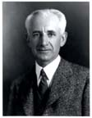
History of Psychometrics: Intelligence Testing
World War I - Robert Yerkes
Need for large-scale group administered ability tests by the army
Army commissions Yerkes, then head of the American Psychological Association, to develop two structured tests of human abilities
Army Alpha - required reading ability
Army Beta - did not require reading ability
Testing “frenzy” hits between World War I and the 1930s.

Slide 41
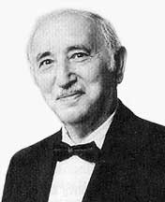
History of Psychometrics: Intelligence Testing
Testing Frenzy of the 1930’s
1937 Revision of the Stanford-Binet includes over 3000 individuals in standardization
1939 Wechsler-Bellevue Intelligence Scale
David Wechsler →
Subcales were “adopted” from the Army Scales
Produces several scores of intellectual ability rather than Binet’s single scores (e.g. Verbal, Performance, Full-Scale)
Evolves into the Wechsler Series of intelligence tests (e.g. WAIS, WISC, etc.)

Slide 42
History of Psychometrics: Personality Testing
Rise – 1920s, Fall – 1930s, Slow Rise – 1940s
Intended to measure personality traits
Trait: relatively enduring dispositions (tendencies to act, think or feel in a certain manner in any given circumstance)
NOT temporary states

Slide 43
History of Psychometrics: Personality Testing
First Rise and Fall: Structured Tests
Woodworth Personal Data Sheet
First objective personality test meant to aid in psychiatric interviews
Developed during World War I
Designed to screen out soldiers unfit for duty
Mistakenly assumed that a subjects’ responses could be taken at face value (i.e., no faking)

Slide 44
History of Psychometrics: Personality Testing
Woodworth Personal Data Sheet

Slide 45
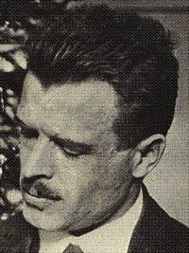
History of Psychometrics: Personality Testing
Slow Rise: Projective Tests
Herman Rorschach inkblot test (1921)
Started with great suspicion; first serious study in 1932.
Symmetric colored & b/w inkblots.

Slide 46
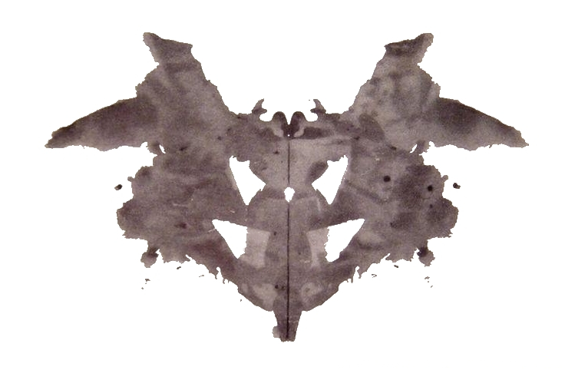
History of Psychometrics: Personality Testing
Rorschach inkblot example

Slide 47
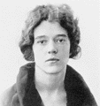
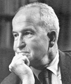
History of Psychometrics: Personality Testing
Thematic Apperception Test
Henry Murray and Christina Morgan (1935)
“Ambiguous” pictures, though considerably more structured than the Rorschach
Subjects are shown the pictures and asked to write a story including:
what has led up to the event shown
what is happening at the moment
what the characters are feeling and thinking, and
what the outcome of the story was.

Slide 48
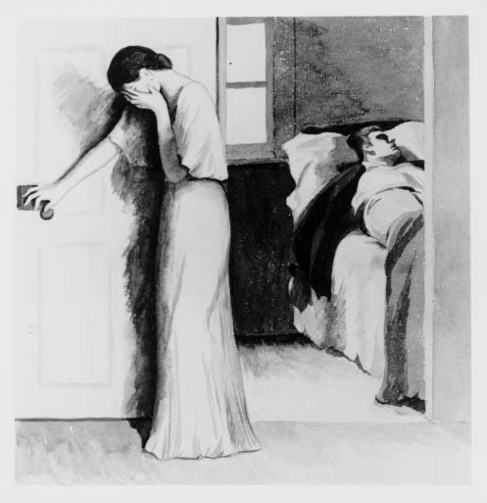
History of Psychometrics: Personality Testing
Thematic Apperception Test Example

Slide 49
History of Psychometrics: Personality Testing
Second coming of the Structured Test
Early 1940s – Structured Tests were being developed based on better psychometric properties.
Minnesota Multiphasic Personality Inventory (MMPI; 1943)
Tests like the Woodworth made too many assumptions
The meaning of the test response could only be determined by empirical research
Most widely used (MMPI-2, MMPI-A)

Slide 50
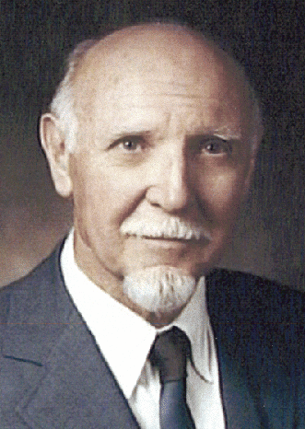
History of Psychometrics: Personality Testing
Sixteen Personality Factor Questionnaire
Raymond B. Cattell (early 1940s)
Based on Factor Analysis – method for finding the minimum number of dimensions (factors) for explaining the largest number of variables (more on this later)

Slide 51
The Period of Rapid Changes in the Status of Testing
Federal funding was used to provide paid, supervised training for clinically oriented psychologists
The 1947 report noted that psychological testing was a unique function of a clinical psychologist; ought to be taught to doctoral students
APA report in 1954 affirmed this position
The relationship between psychologists and physicians grew complex over these issues
Psychologists often felt they had a “secondary role” to physicians
Testing declined again from the 1950s to 1970s

Slide 52
The Current Environment
As different areas of applied psychology have emerged since the 1980s, testing has enjoyed a new enthusiasm
Neuropsychology
Health psychology
Forensic psychology
Child psychology
Testing is now a major part of psychology training and extends beyond the field of psychology

