Slide 1

Cal State Northridge
Ψ427
Andrew Ainsworth PhD

Slide 2
Statistics AGAIN?
What do we want to do with statistics?
  Organize and Describe patterns in data
    Taking incomprehensible data and converting it to:
      Tables that summarize the data
      Graphs
  Extract (i.e. INFER) meaning from data
    Infer POPULATION values from SAMPLES
    Hypothesis Testing – Groups
    Hypothesis Testing – Relation/Prediction
Psy 427 - Cal State Northridge

Slide 3
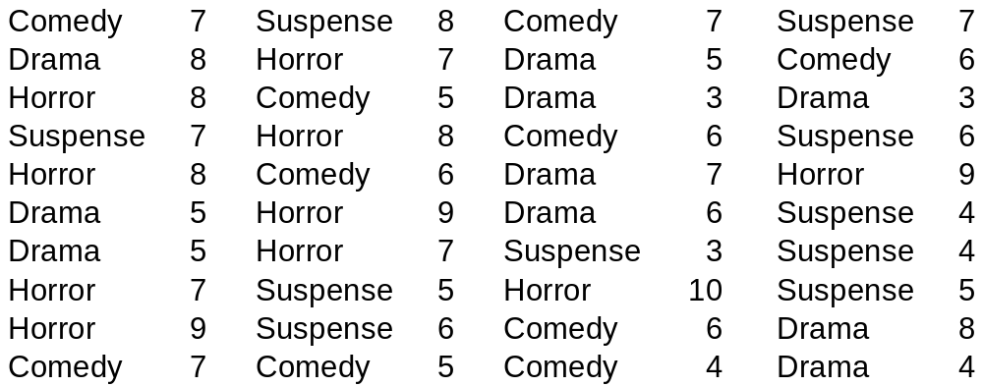
Descriptives
Disorganized Data
Psy 427 - Cal State Northridge

Slide 4
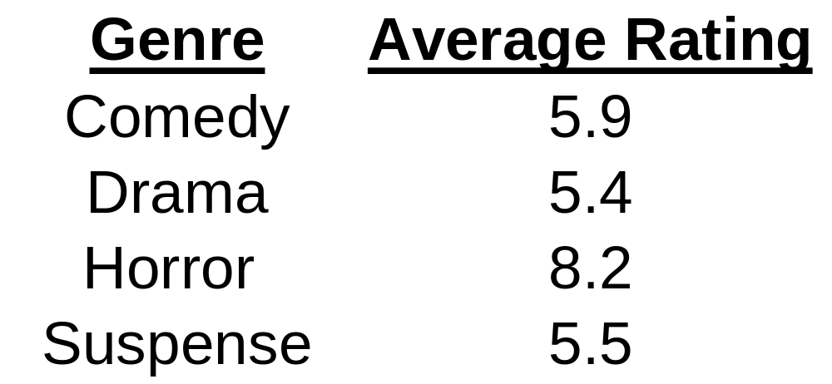
Descriptives
Reducing and Describing Data
Psy 427 - Cal State Northridge

Slide 5
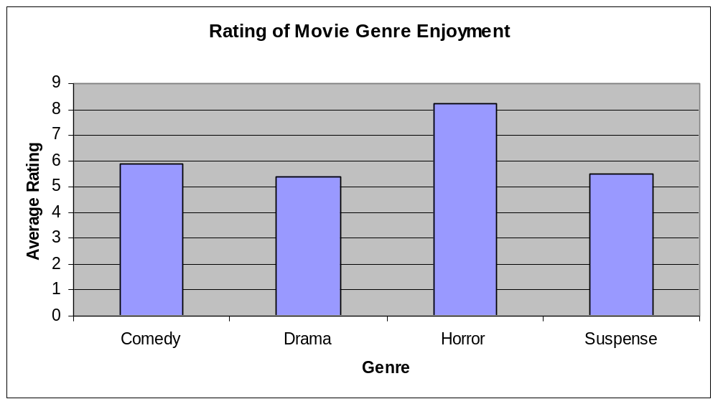
Descriptives
Displaying Data
Psy 427 - Cal State Northridge

Slide 6
Inferential
Inferential statistics:
  Is a set of procedures to infer information about a population based upon characteristics from samples.
  Samples are taken from Populations
  Sample Statistics are used to infer population parameters
Psy 427 - Cal State Northridge

Slide 7


Inferential
Population is the complete set of people, animals, events or objects that share a common characteristic
A sample is some subset or subsets, selected from the population.
  representative
  simple random sample.
Psy 427 - Cal State Northridge
Notes:
Population is the complete set of people, animals, events or objects that share a common characteristic, e.g.,
All men over 50 yrs old in the USA
All cars in Russia that cost less than $10,000
All republicans in the state of Rhode Island.
A sample is some subset or subsets, selected from the population.
Preferably, this sample is selected in such a way as to be representative of the population as a whole.
One way to obtain such a representative sample is to draw a simple random sample.
A simple random sample is one in which every datum, or observation of the population has an equal chance of being selected for the sample AND the selection of one member is independent of the selection of any other member.

Slide 8
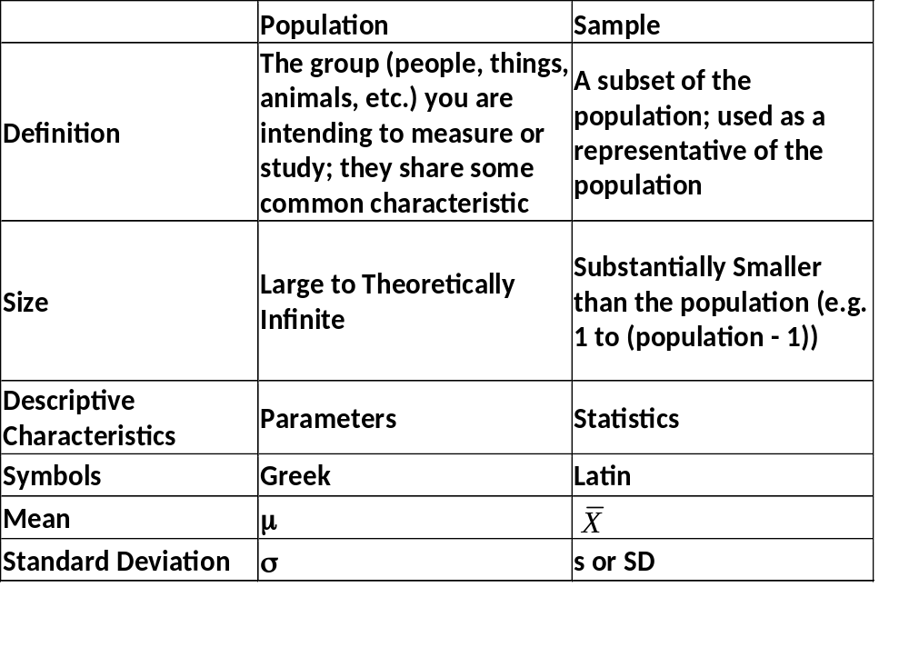
Psy 427 - Cal State Northridge

Slide 9
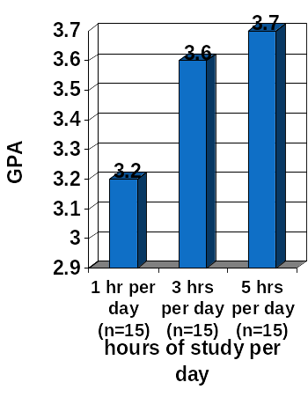
Inferential
Does the number of hours students study per day affect the grade they are likely to receive in statistics (Ψ320)?
Psy 427 - Cal State Northridge

Slide 10
Inferential
Sometimes manipulation is not possible
Is prediction possible?
Can a relationship be established?
  E.g., number of cigarettes smoked by per and the likelihood of getting lung cancer,
  The level of child abuse in the home and the severity of later psychiatric problems.
  Use of the death penalty and the level of crime.
Psy 427 - Cal State Northridge

Slide 11
Inferential
Measured constructs can be assessed for co-relation (where the “coefficient of correlation” varies between -1 to +1)
“Regression analysis” can be used to assess whether a measured construct predicts the values on another measured construct (or multiple) (e.g., the level of crime given the level of death penalty usage).
-1
0
1
Psy 427 - Cal State Northridge

Slide 12
Measurement
Statistical analyses depend upon the measurement characteristics of the data.
Measurement is a process of assigning numbers to constructs following a set of rules.
We normally measure variables into one of four different levels of measurement:
  Nominal
  Ordinal
  Interval
  Ratio
Psy 427 - Cal State Northridge

Slide 13
Ordinal Measurement
Where Numbers Representative Relative Size Only
Contains 2 pieces of information
D
C
B
SIZE
Psy 427 - Cal State Northridge

Slide 14
Interval Measurement:
Where Equal Differences Between Numbers Represent Equal Differences in Size
D
C
B
Numbers representing Size
1
2
3
Diff in numbers 2-1=1 3-2=1
Diff in size Size C – Size B =Size X Size D – Size C = Size X
SIZE
Psy 427 - Cal State Northridge

Slide 15
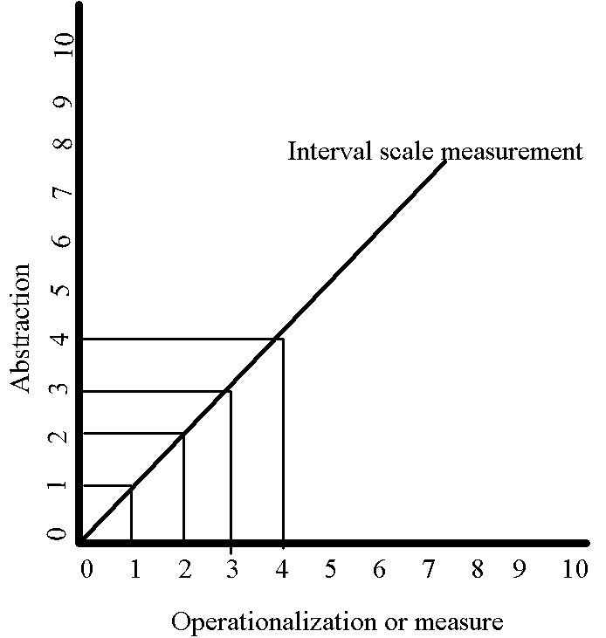
Psy 427 - Cal State Northridge

Slide 16
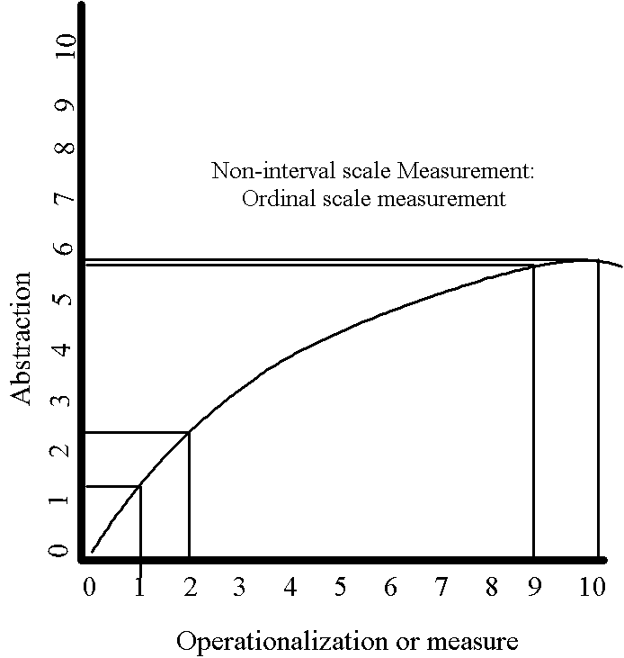
Psy 427 - Cal State Northridge

Slide 17
Measurement
Ratio Scale Measurement
  In ratio scale measurement there are four kinds of information conveyed by the numbers assigned to represent a variable:
    Everything Interval Measurement Contains Plus
    A meaningful 0-point and therefore meaningful ratios among measurements.
Psy 427 - Cal State Northridge

Slide 18

True Zero point
Psy 427 - Cal State Northridge

Slide 19
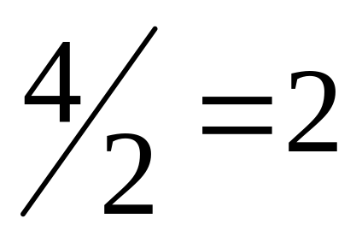
Measurement
Ratio Scale Measurement
  If we have a true ratio scale, where 0 represents an a complete absence of the variable in question, then we form a meaningful ratio among the scale values such as:
  However, if 0 is not a true absence of the variable, then the ratio 4/2 = 2 is not meaningful.
Psy 427 - Cal State Northridge

Slide 20
Percentiles and Percentile Ranks
A percentile is the score at which a specified percentage of scores in a distribution fall below
  To say a score 53 is in the 75th percentile is to say that 75% of all scores are less than 53
The percentile rank of a score indicates the percentage of scores in the distribution that fall at or below that score.
  Thus, for example, to say that the percentile rank of 53 is 75, is to say that 75% of the scores on the exam are less than 53.
Psy 427 - Cal State Northridge

Slide 21
Percentile
Scores which divide distributions into specific proportions
  Percentiles = hundredths
P1, P2, P3, … P97, P98, P99
  Quartiles = quarters
  Q1, Q2, Q3
  Deciles = tenths
  D1, D2, D3, D4, D5, D6, D7, D8, D9
Percentiles are the SCORES
Psy 427 - Cal State Northridge

Slide 22
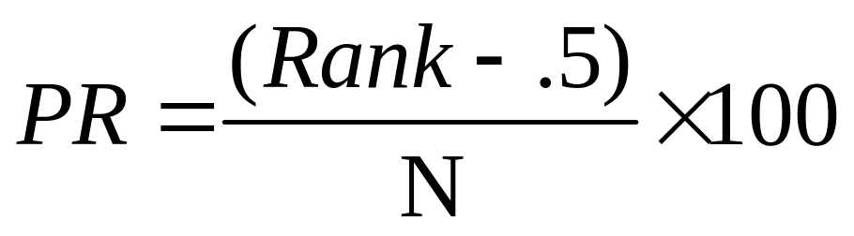
Percentile Rank
What percent of the scores fall below a particular score?
Percentile Ranks are the Ranks not the scores
Psy 427 - Cal State Northridge

Slide 23
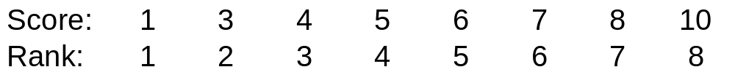
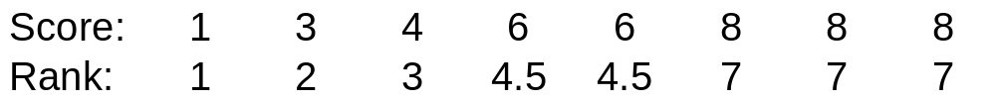
Example: Percentile Rank
Ranking no ties – just number them
Ranking with ties - assign midpoint to ties
Psy 427 - Cal State Northridge

Slide 24
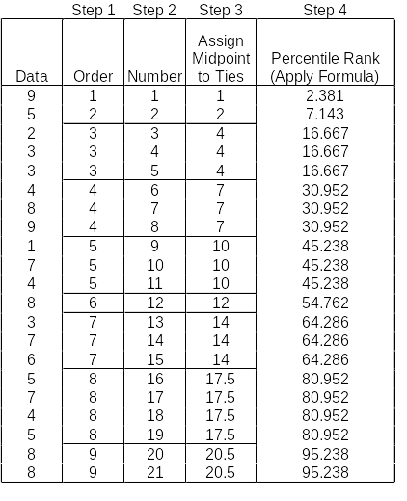
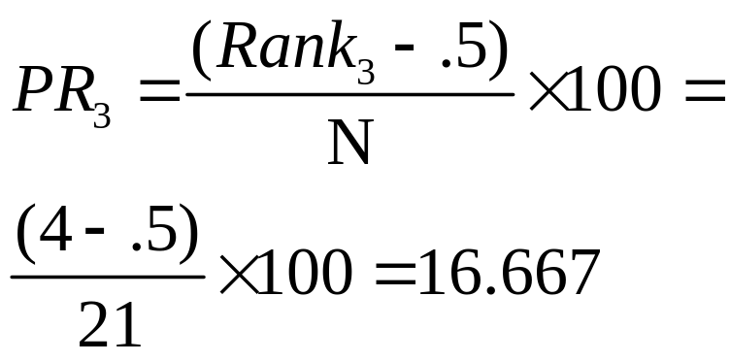
Steps to Calculating Percentile Ranks
Example:
Psy 427 - Cal State Northridge

Slide 25
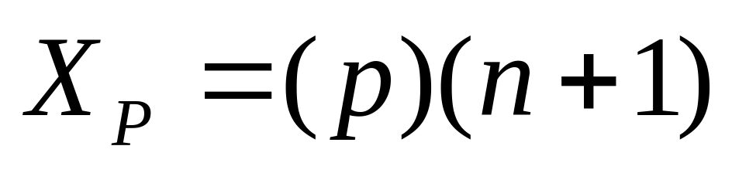
Percentile
Where X_{P} is the score at the desired percentile, p is the desired percentile (a number between 0 and 1) and n is the number of scores)
If the number is an integer, than the desired percentile is that number
If the number is not an integer than you can either round or interpolate; for this class we’ll just round (round up when p is below .50 and down when p is above .50)
Psy 427 - Cal State Northridge

Slide 26
Percentile
Apply the formula
  You’ll get a number like 7.5 (think of it as place1.proportion)
  Start with the value indicated by place1 (e.g. 7.5, start with the value in the 7th place)
  Find place2 which is the next highest place number (e.g. the 8th place) and subtract the value in place1 from the value in place2, this distance1
  Multiple the proportion number by the distance1 value, this is distance2
  Add distance2 to the value in place1 and that is the interpolated value
Psy 427 - Cal State Northridge

Slide 27
Example: Percentile
Example 1: 25th percentile:
{1, 4, 9, 16, 25, 36, 49, 64, 81}
X₂₅ = (.25)(9+1) = 2.5
  place1 = 2, proportion = .5
  Value in place1 = 4
  Value in place2 = 9
  distance1 = 9 – 4 = 5
  distance2 = 5 * .5 = 2.5
  Interpolated value = 4 + 2.5 = 6.5
  6.5 is the 25th percentile
Psy 427 - Cal State Northridge

Slide 28
Example: Percentile
Example 2: 75th percentile
{1, 4, 9, 16, 25, 36, 49, 64, 81}
X₇₅ = (.75)(9+1) = 7.5
  place1 = 7, proportion = .5
  Value in place1 = 49
  Value in place2 = 64
  distance1 = 64 – 49 = 15
  distance2 = 15 * .5 = 7.5
  Interpolated value = 49 + 7.5 = 56.5
  56.5 is the 75th percentile
Psy 427 - Cal State Northridge

Slide 29
Quartiles
To calculate Quartiles you simply find the scores the correspond to the 25, 50 and 75 percentiles.
Q₁ = P₂₅, Q₂ = P₅₀, Q₃ = P₇₅
Psy 427 - Cal State Northridge

Slide 30
Reducing Distributions
Regardless of numbers of scores, distributions can be described with three pieces of info:
  Central Tendency
  Variability
  Shape (Normal, Skewed, etc.)
Psy 427 - Cal State Northridge

Slide 31
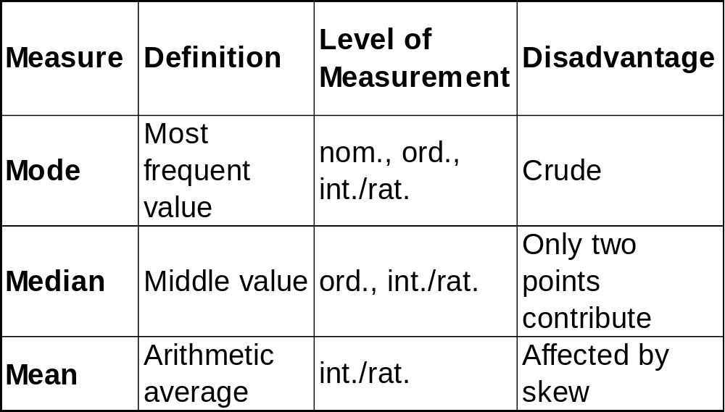
Measures of Central Tendency
Psy 427 - Cal State Northridge

Slide 32
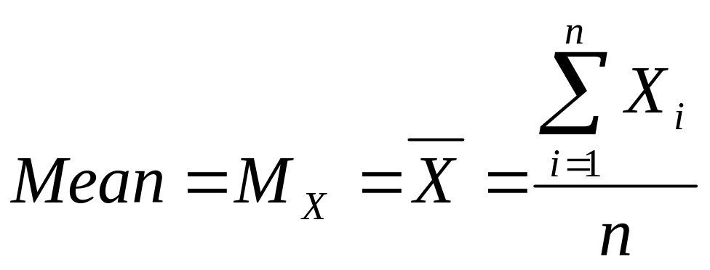
The Mean
Only used for interval & ratio data.
Major advantages:
  The sample value is a very good estimate of the population value.
Psy 427 - Cal State Northridge

Slide 33
Reducing Distributions
Regardless of numbers of scores, distributions can be described with three pieces of info:
  Central Tendency
  Variability
  Shape (Normal, Skewed, etc.)
Psy 427 - Cal State Northridge

Slide 34
How do scores spread out?
Variability
  Tell us how far scores spread out
  Tells us how the degree to which scores deviate from the central tendency
Psy 427 - Cal State Northridge

Slide 35
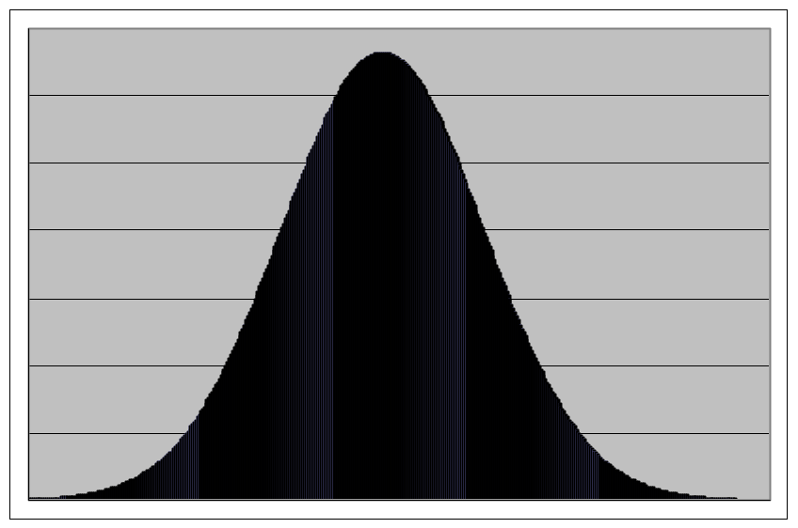
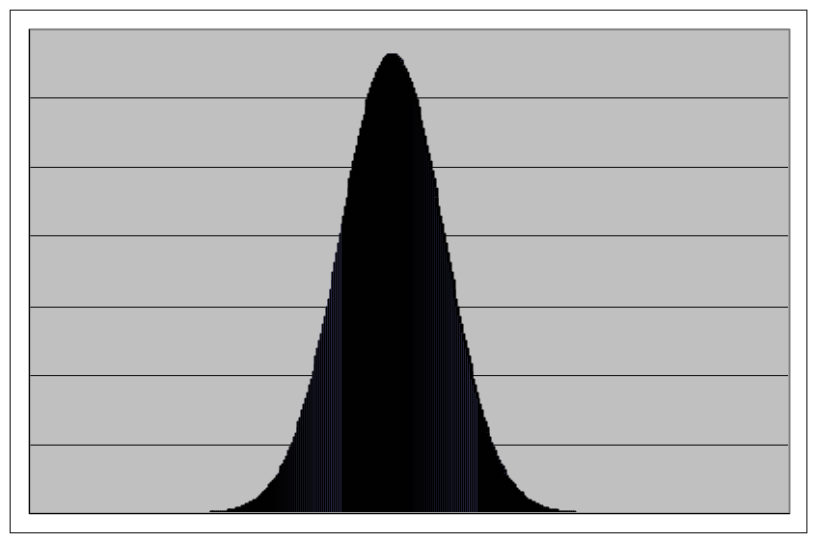
How are these different?
Mean = 10
Mean = 10
Psy 427 - Cal State Northridge

Slide 36
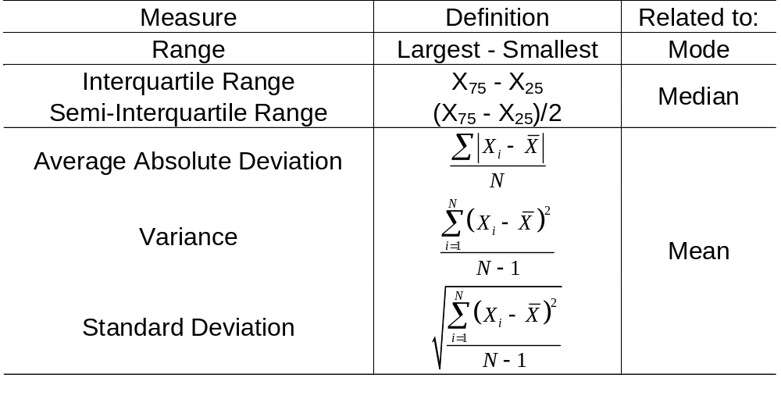
Measure of Variability
Psy 427 - Cal State Northridge

Slide 37
The Range
The simplest measure of variability
  Range (R) = X_{highest} – X_{lowest}
  Advantage – Easy to Calculate
  Disadvantages
    Like Median, only dependent on two scores → unstable
  {0, 8, 9, 9, 11, 53} Range = 53
  {0, 8, 9, 9, 11, 11} Range = 11
    Does not reflect all scores
Psy 427 - Cal State Northridge

Slide 38
Variability: IQR
Interquartile Range
  = P₇₅ – P₂₅ or Q₃ – Q₁
  This helps to get a range that is not influenced by the extreme high and low scores
  Where the range is the spread across 100% of the scores, the IQR is the spread across the middle 50%
Psy 427 - Cal State Northridge

Slide 39
Variability: SIQR
Semi-interquartile range
  =(P₇₅ – P₂₅)/2 or (Q₃ – Q₁)/2
  IQR/2
  This is the spread of the middle 25% of the data
  The average distance of Q1 and Q3 from the median
  Better for skewed data
Psy 427 - Cal State Northridge

Slide 40
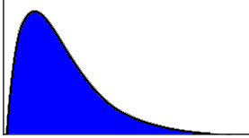
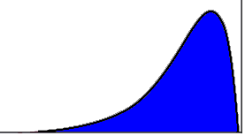
Variability: SIQR
Semi-Interquartile range
Q₁ Q₂ Q₃
Q₁ Q₂ Q₃
Psy 427 - Cal State Northridge

Slide 41
Variance
The average squared distance of each score from the mean
Also known as the mean square
Variance of a sample: s²
Variance of a population: σ²
Psy 427 - Cal State Northridge

Slide 42
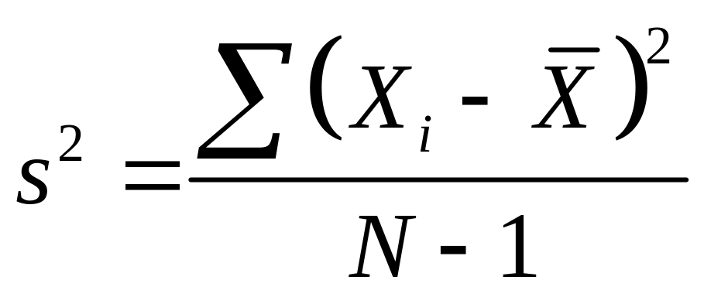
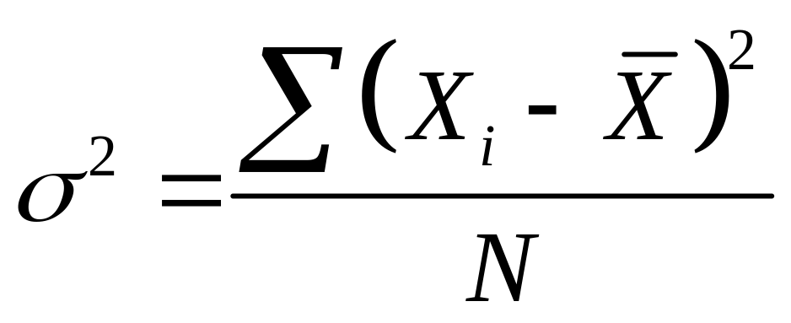
Variance
When calculated for a sample
When calculated for the entire population
Psy 427 - Cal State Northridge

Slide 43
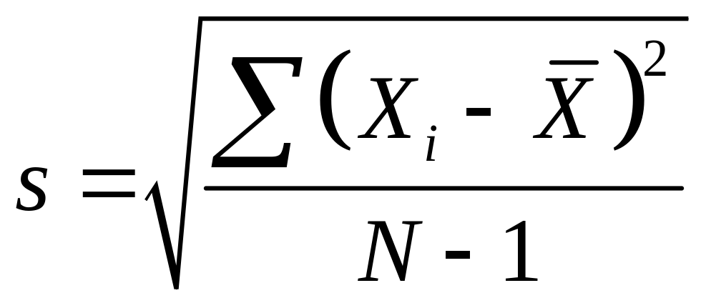
Standard Deviation
Variance is in squared units
What about regular old units
Standard Deviation = Square root of the variance
Psy 427 - Cal State Northridge

Slide 44
Standard Deviation
Uses measure of central tendency (i.e. mean)
Uses all data points
Has a special relationship with the normal curve
Can be used in further calculations
Standard Deviation of Sample = SD or s
Standard Deviation of Population = σ
Psy 427 - Cal State Northridge

Slide 45
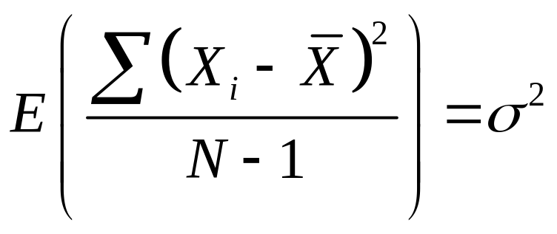
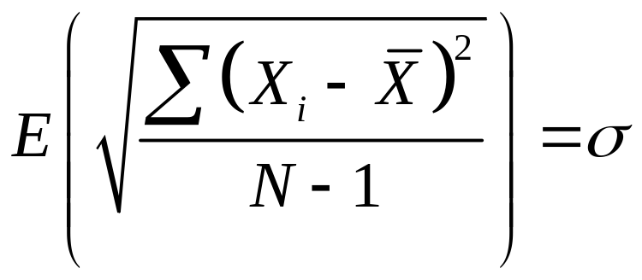
Why N-1?
When using a sample (which we always do) we want a statistic that is the best estimate of the parameter
Psy 427 - Cal State Northridge

Slide 46
Degrees of Freedom
Usually referred to as df
Number of observations minus the number of restrictions
__+__+__+__=10 - 4 free spaces
2 +__+__+__=10 - 3 free spaces
2 + 4 +__+__=10 - 2 free spaces
2 + 4 + 3 +__=10
Last space is not free!! Only 3 dfs.
Psy 427 - Cal State Northridge

Slide 47
Reducing Distributions
Regardless of numbers of scores, distributions can be described with three pieces of info:
  Central Tendency
  Variability
  Shape (Normal, Skewed, etc.)
Psy 427 - Cal State Northridge

Slide 48
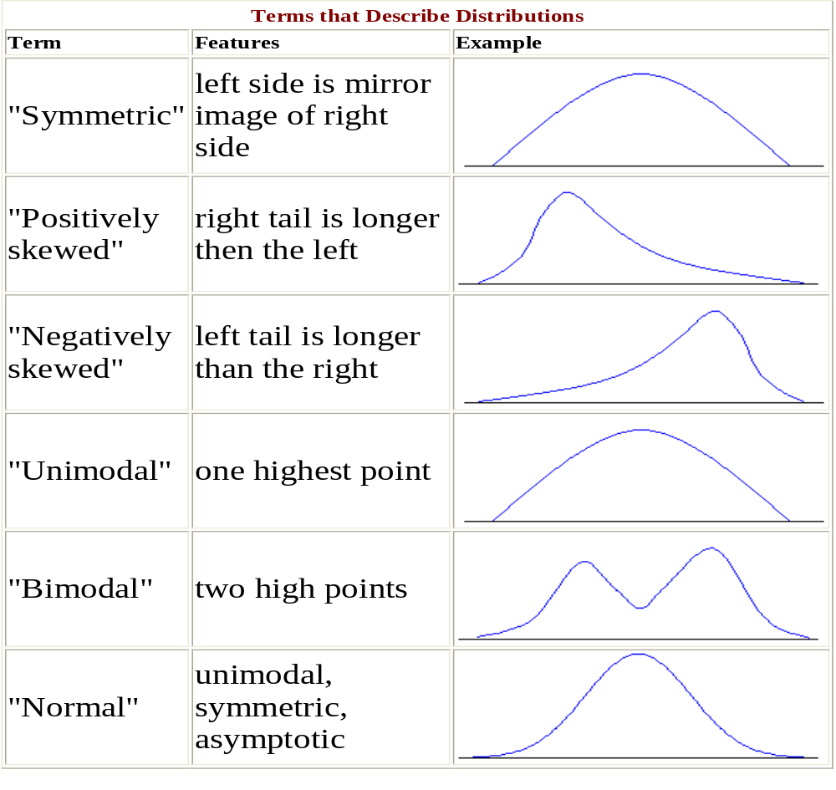
Psy 427 - Cal State Northridge

Slide 49
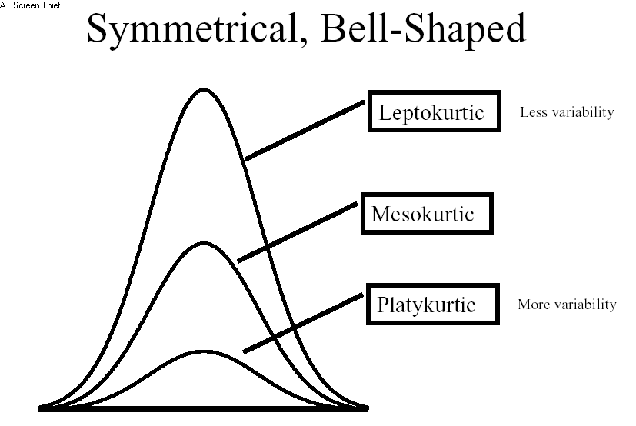
Psy 427 - Cal State Northridge

Slide 50
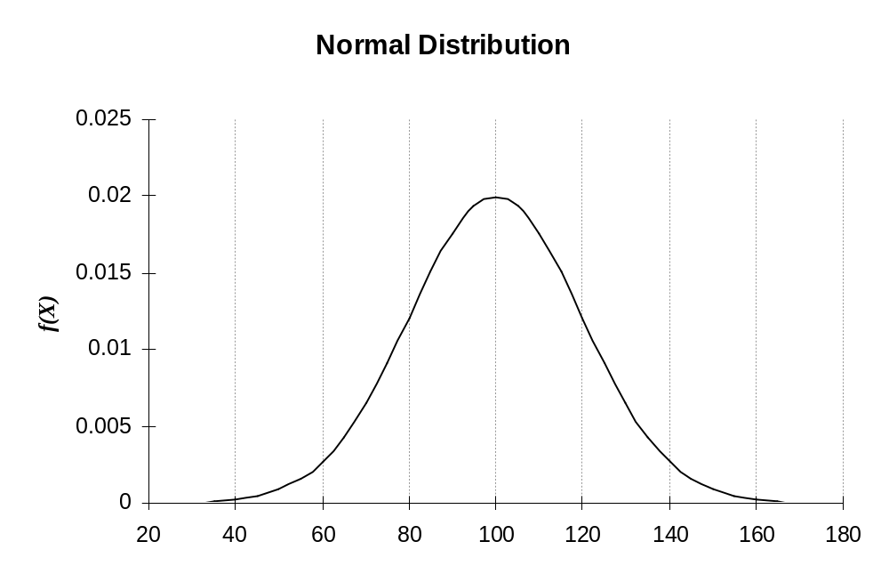
Example: The Mean = 100 and the Standard Deviation = 20
Psy 427 - Cal State Northridge

Slide 51
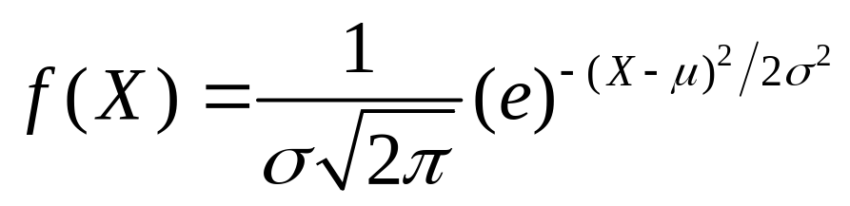
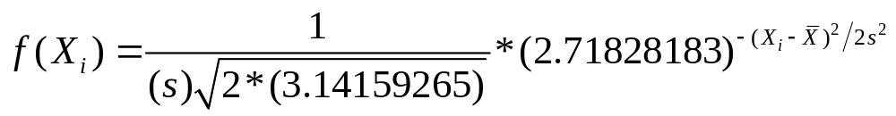
Normal Distribution (Characteristics)
Horizontal Axis = possible X values
Vertical Axis = density (i.e. f(X) related to probability or proportion)
Defined as
The distribution relies on only the mean and s
Psy 427 - Cal State Northridge

Slide 52
Normal Distribution (Characteristics)
Bell shaped, symmetrical, unimodal
Mean, median, mode all equal
No real distribution is perfectly normal
But, many distributions are approximately normal, so normal curve statistics apply
Normal curve statistics underlie procedures in most inferential statistics.
Psy 427 - Cal State Northridge

Slide 53
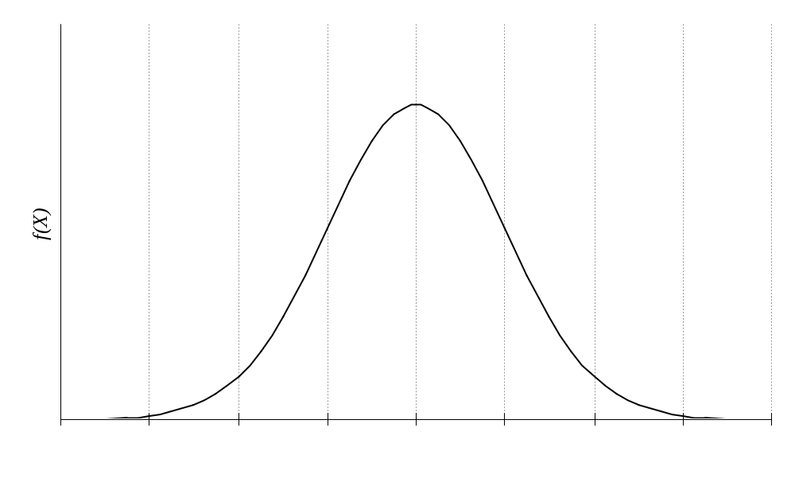
Normal Distribution
μ
μ − 4sd
μ − 3sd
μ − 2sd
μ − 1sd
μ + 1sd
μ + 2sd
μ + 3sd
μ + 4sd
Psy 427 - Cal State Northridge

Slide 54
The standard normal distribution
A normal distribution with the added properties that the mean = 0 and the s = 1
Converting a distribution into a standard normal means converting raw scores into Z-scores
Psy 427 - Cal State Northridge

Slide 55
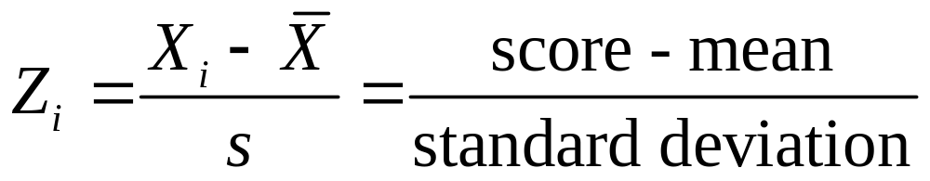
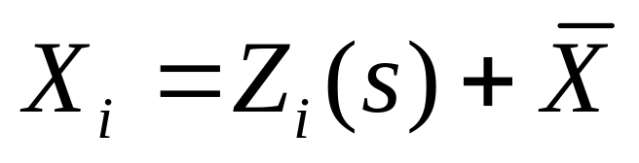
Z-Score Formula
Raw score → Z-score
Z-score → Raw score
Psy 427 - Cal State Northridge

Slide 56
Properties of Z-Scores
Z-score indicates how many SD’s a score falls above or below the mean.
Positive z-scores are above the mean.
Negative z-scores are below the mean.
Area under curve → probability
Z is continuous so can only compute probability for range of values
Psy 427 - Cal State Northridge

Slide 57
Properties of Z-Scores
Most z-scores fall between -3 and +3 because scores beyond 3sd from the mean
Z-scores are standardized scores → allows for easy comparison of distributions
Psy 427 - Cal State Northridge

Slide 58

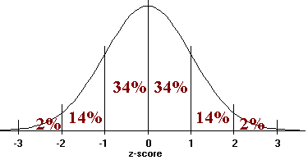
Rough estimates of the SND (i.e. Z-scores):
Psy 427 - Cal State Northridge

Slide 59
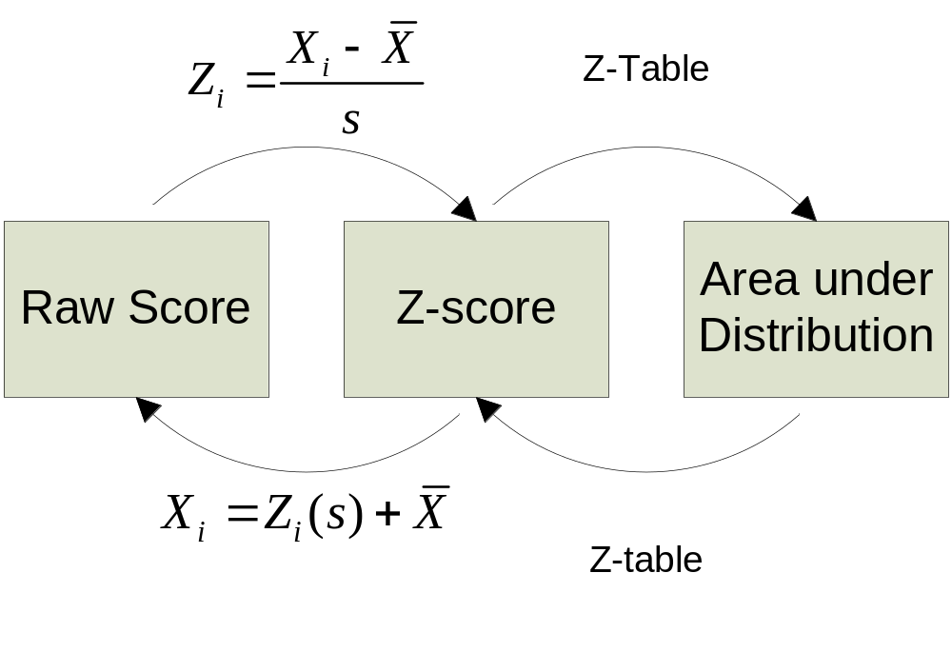
Have→Need Chart
When rough estimating isn’t enough
Psy 427 - Cal State Northridge

Slide 60
What about negative Z values?
Since the normal curve is symmetric, areas beyond, between, and below positive z scores are identical to areas beyond, between, and below negative z scores.
There is no such thing as negative area!
Psy 427 - Cal State Northridge

Slide 61
Norms and Norm-Referenced Tests
Norm - statistical representations of a population (e.g. mean, median).
Norm-referenced test (NRT) – Compares an individual's results on the test with the pre-established norm
Made to compare test-takers to each other
I.E. - The Normal Curve
Psy 427 - Cal State Northridge

Slide 62
Norms and Norm-Referenced Tests
Normally rather than testing an entire population, the norms are inferred from a representative sample or group (inferential stats revisited).
Norms allow for a better understanding of how an individual's scores compare with the group with which they are being compared
Examples: WAIS, SAT, MMPI, Graduate Record Examination (GRE)
Psy 427 - Cal State Northridge

Slide 63
Criterion-Referenced Tests
Criterion-referenced tests (CRTs) - intended to measure how well a person has mastered a specific knowledge set or skill
Cutscore – point at which an examinee passes if their score exceeds that point; can be decided by a panel or by a single instructor
Criterion – the domain in which the test is designed to assess
Psy 427 - Cal State Northridge

