Slide 1
Correlation and Regression
PsychTesting
Ainsworth

Slide 2
Correlation
Are 2 variables related?

Slide 3
Major Points - Correlation
Questions answered by correlation
Scatterplots
An example
The correlation coefficient
Other kinds of correlations
Factors affecting correlations
Testing for significance

Slide 4
The Question
Are two variables related?
Does one increase as the other increases?
e. g. skills and income
Does one decrease as the other increases?
e. g. health problems and nutrition
How can we get a numerical measure of the degree of relationship?

Slide 5
Scatterplots
AKA scatter diagram or scattergram.
Graphically depicts the relationship between two variables in two dimensional space.

Slide 6
Direct Relationship

Slide 7
Inverse Relationship

Slide 8
An Example
Does smoking cigarettes increase systolic blood pressure?
Plotting number of cigarettes smoked per day against systolic blood pressure
Fairly moderate relationship
Relationship is positive

Slide 9
Trend?

Slide 10
Smoking and BP
Note relationship is moderate, but real.
Why do we care about relationship?
What would conclude if there were no relationship?
What if the relationship were near perfect?
What if the relationship were negative?

Slide 11
Heart Disease and Cigarettes
Data on heart disease and cigarette smoking in 21 developed countries (Landwehr and Watkins, 1987)
Data have been rounded for computational convenience.
The results were not affected.
Notes:
Landwehr, J.M. & Watkins, A.E. (1987) Exploring Data: Teacher’s Edition. Palo Alto, CA: Dale Seymour Publications.

Slide 12
The Data
Surprisingly, the U.S. is the first country on the list--the country
with the highest consumption and highest mortality.

Slide 13
Scatterplot of Heart Disease
CHD Mortality goes on ordinate (Y axis)
Why?
Cigarette consumption on abscissa (X axis)
Why?
What does each dot represent?
Best fitting line included for clarity

Slide 14
{X = 6, Y = 11}

Slide 15
What Does the Scatterplot Show?
As smoking increases, so does coronary heart disease mortality.
Relationship looks strong
Not all data points on line.
This gives us “residuals” or “errors of prediction”
To be discussed later

Slide 16
Correlation
Co-relation
The relationship between two variables
Measured with a correlation coefficient
Most popularly seen correlation coefficient: Pearson Product-Moment Correlation

Slide 17
Types of Correlation
Positive correlation
High values of X tend to be associated with high values of Y.
As X increases, Y increases
Negative correlation
High values of X tend to be associated with low values of Y.
As X increases, Y decreases
No correlation
No consistent tendency for values on Y to increase or decrease as X increases

Slide 18
Correlation Coefficient
A measure of degree of relationship.
Between 1 and -1
Sign refers to direction.
Based on covariance
Measure of degree to which large scores on X go with large scores on Y, and small scores on X go with small scores on Y
Think of it as variance, but with 2 variables instead of 1 (What does that mean??)

Slide 19
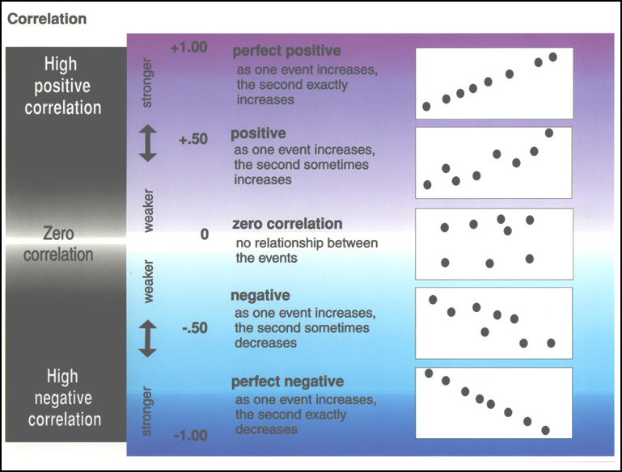

Slide 20
Covariance
Remember that variance is:
The formula for co-variance is:
How this works, and why?
When would covXY be large and positive? Large and negative?

Slide 21
Example

Slide 22
Example
What the heck is a covariance?
I thought we were talking about correlation?

Slide 23
Correlation Coefficient
Pearson’s Product Moment Correlation
Symbolized by r
Covariance ÷ (product of the 2 SDs)
Correlation is a standardized covariance

Slide 24
Calculation for Example
CovXY = 11.126
sX = 2.334
sY = 6.690

Slide 25
Example
Correlation = 0.713
Sign is positive
Why?
If sign were negative
What would it mean?
Would not alter the degree of relationship.

Slide 26
Testing Correlations
So you have a correlation. Now what?
In terms of magnitude, how big is big?
Small correlations in large samples are “big.”
Large correlations in small samples aren’t always “big.”
Depends upon the magnitude of the correlation coefficient
AND
The size of your sample.

Slide 27
Testing r
Population parameter = ρ
Null hypothesis H0: ρ = 0
Test of linear independence
What would a true null mean here?
What would a false null mean here?
Alternative hypothesis (H1) ρ ≠ 0
Two-tailed

Slide 28
Tables of Significance
We can convert r to t and test for significance:
Where DF = N-2

Slide 29
Tables of Significance
In our example r was 0.713
N - 2 = 21 – 2 = 19
T-crit (19) = 2.09
Since 6.90 is larger than 2.09 reject r = 0.

Slide 30
Regression
Predicting Y from X
Notes:
With updates on slides – 23, 25, 27, 29, 35, 36

Slide 31
What is regression?
How do we predict one variable from another?
How does one variable change as the other changes?
Influence

Slide 32
Linear Regression
A technique we use to predict the most likely score on one variable from those on another variable
Uses the nature of the relationship (i.e. correlation) between two variables to enhance your prediction

Slide 33
Linear Regression: Parts
Y - the variables you are predicting
i.e. dependent variable
X - the variables you are using to predict
i.e. independent variable
- your predictions (also known as Y’)

Slide 34
Why Do We Care?
We may want to make a prediction.
More likely, we want to understand the relationship.
How fast does CHD mortality rise with a one unit increase in smoking?
Note: we speak about predicting, but often don’t actually predict.

Slide 35
An Example
Cigarettes and CHD Mortality again
Data repeated on next slide
We want to predict level of CHD mortality in a country averaging 10 cigarettes per day.
Notes:
Landwehr, J.M. & Watkins, A.E. (1987) Exploring Data: Teacher’s Edition. Palo Alto, CA: Dale Seymour Publications.

Slide 36
The Data
Based on the data we have what would we predict the rate of CHD be in a country that smoked 10 cigarettes on average?
First, we need to establish a prediction of CHD from smoking…

Slide 37
We predict a CHD rate of about 14
Regression Line
For a country that smokes 6 C/A/D…

Slide 38
Regression Line
Formula
= the predicted value of Y (e.g. CHD mortality)
X = the predictor variable (e.g. average cig./adult/country)

Slide 39
Regression Coefficients
“Coefficients” are a and b
b = slope
Change in predicted Y for one unit change in X
a = intercept
value of when X = 0

Slide 40
Calculation
Slope
Intercept

Slide 41
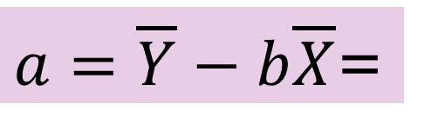
For Our Data
Cov_{XY} = 11.126
Mean Y = 14.524; Mean X = 5.925
s²_{X} = 2.334 = 5.448
$a=\overline{Y}−b\overline{X}$=

Slide 42
Making a Prediction
Second, once we know the relationship we can predict
We predict _______ people/10,000 in a country with an average of 10 C/A/D will die of CHD

Slide 43
Coefficient of Determination
It is a measure of the percent of predictable variability
The percentage of the total variability share by X and Y

Slide 44
r² for our example
r = 0.713
r² = 0.713² = 0.508
Approximately 50% in variability of incidence of CHD mortality is associated with variability in smoking.

Slide 45
Coefficient of Alienation
It is defined as 1 - r² or
Example
1 - 0.508 = 0.492

