Slide 1
Test Items and Item Analysis
PsychTesting
Cal State Northridge
Andrew Ainsworth PhD

Slide 2
Item Formats
Dichotomous Format
Two alternatives
True/False
e.g., MMPI/2; MMPI/A
Polytomous or Polychotomous Format
More than two alternatives
Multiple choice
Psy427 Midterm, SAT, GRE,

Slide 3
Item Formats
Distractors
Item Formats
Incorrect choices on a polychotomous test
Best to have three or four
BUT -
one study (Sidick, Barret, & Doverspike, 1994) found equivalent validity and reliability for a test with two distractors (three items) as one with four distractors (five items).
SO, best might be to have two to four (further study is needed)

Slide 4
Should you guess on polytomous tests?
Depends… Correction for guessing:
R is the number correct
W is the number incorrect
n is the number of polytomous choices
If no correction for guessing, guess away.
If there is a correction for guessing, better to leave some blank (unless you can beat the odds)

Slide 5
Other Test Items
Likert scales
On a rating scale of 1-5, or 1-6, 1-7, etc. where
1 = strongly disagree
2 = moderately disagree
3 = mildly disagree
4 = mildly agree
5 = moderately agree
6 = strongly agree
rate the following statements….

Slide 6
Other Test Items
Likert scales
Even vs. odd number of choices
Even numbers prevents “fence-sitting”
Odd numbers allows people to be neutral
Likert items are VERY popular measurement items in psychology.
Technically ordinal but are often assumed continuous if 5 or more choices
With that assumption we can calculate means, factor analyze, etc.

Slide 7
Other Test Items
Category format
Like Likert, but with MANY more categories
e.g., 10-point scale
Best if used with anchors
Research supports use of 7-point scales to 21-point scales

Slide 8
Other Test Items
Visual Analogue Scale
No Headache Worst Headache
Also used in research
dials, knobs
time sampling

Slide 9
Checklists & Q-Sorts
Both used in qualitative research as well as quantitative research
Checklists
Present list of words (adjectives)
Have person choose to endorse each item
Can determine perceptions of concepts using checklists.

Slide 10
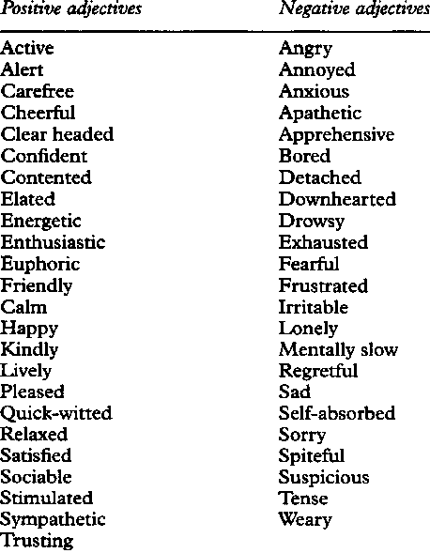
Checklists & Q-Sorts
Adjective Checklists
In psychometrics, any list of adjectives that can be marked as applicable or not applicable
to oneself
to one's ideal self
to another person, OR
to some other entity or concept.

Slide 11
Checklists & Q-Sorts
Checklists
When written with initial uppercase letters (ACL), the term denotes more specifically a measure consisting of a list of 300 adjectives, from absent-minded to zany
Selected by the US psychologist Harrison G. Gough (born 1921) and introduced as a commercial test in 1952.
The test yields 24 scores, including measures of personal adjustment, self-confidence, self-control, lability, counselling readiness, some response styles, and 15 personality needs, such as achievement, dominance, and endurance.

Slide 12
Checklists & Q-Sorts
Q-Sorts
Introduced by William Stephenson in 1935
PhD in physics 1926; PhD in psychology in 1929
Student of Charles Spearman
Goal: to get a quantitative description of a person’s perceptions of a concept
Process: give subject a pile of numbered “cards” & have them sort them into piles
Piles represent graded degrees of description (most descriptive to least descriptive).

Slide 13
Checklists & Q-Sorts
Q-Sorts
Means of self-evaluation of client’s current status
The Q-Sort consists of a number of cards, often as many as 40 or 50, even 100 items each consisting of a single trait, belief, or behavior.
The goal is to sort these cards into one of five columns ranging from statements such as, ‘very much like me’ to ‘not at all like me.’
There are typically a specific number of cards allowed for each column, forcing the client to balance the cards evenly.
Example:
California Q-sort , Attachment Q-sort

Slide 14
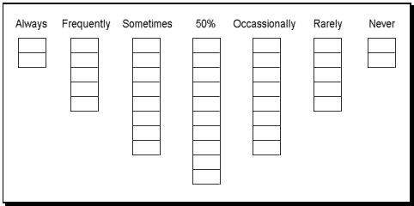
Example Q-sort

Slide 15
California Q-Sort
California Q-sort

Slide 16
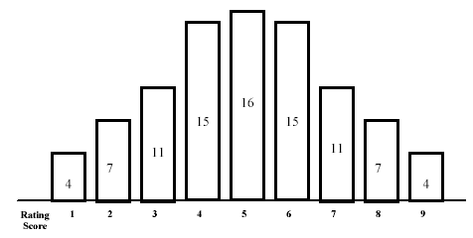
Attachment Q-sort
Attachment Q-sort
Attachment Q-sort Distribution (number of items per pile designated)

Slide 17
Item Analysis
Methods used to evaluate test items.
What are good items?
Techniques
Item Difficulty (or easiness)
Discriminability
Extreme Group
Item/Total Correlation
Item Characteristic Curves
Item Response Theory
Criterion-Referenced Testing

Slide 18
Item Difficulty
The proportion of people who get a particular item correct or that endorse an item (if there is no “correct” response, e.g. MMPI)
Often thought of as the item’s easiness because it is based on the number correct/endorsed

Slide 19
Item Difficulty
The difficulty can be given in proportion form or it can be standardized in to a Z-value

Slide 20
Item Difficulty
For example a test with the difficulty of .84

Slide 21
Difficult Item (35%)
If you are taking a criterion referenced test in a social psychology course and you need to score a 92 in order to get an A, the criterion is
Social Psychology *
Scoring a 92
Getting an A
Not enough info.

Slide 22
Difficult Item (35%)

Slide 23
Moderate Item (51%)
The correlation between X and is .54. X has a SD of 1.2 and Y has a SD of 5.4. What is the regression coefficient (b) when Y is predicted by X?
.12
2.43*
.375
.45

Slide 24
Difficult Item (51%)

Slide 25
Easy Item (100%)
For the following set of data [5 9 5 5 2 4 ], the mean is
4
5*
4.5
6

Slide 26
Difficult Item (100%)

Slide 27
Optimum Difficulty
Mathematically: half-way between chance and 100%.
Steps (assuming a 5-choice test)
Find half-way between 100% and chance
1 - .2 = .8, .8/2 = .4
Add this value to chance alone
.4 + .2 = .6
Alternately: Chance + 1.0 / 2 = optimum difficulty
A good test will have difficulty values between .30 and .70

Slide 28
Discriminability
Can be defined in 2 ways:
How well does each item distinguish (discriminate) between individuals who are scoring high and low on the test as a whole (e.g. the trait of interest).
Or simply how well is each item related to the trait (e.g. loadings in factor analysis)
1 and 2 are really the same the more an item is related to the trait the better it can distinguish high and low scoring individuals

Slide 29
Discriminability
Extreme Group Method
First
Identify two “extreme” groups
Top third vs. bottom third
Second
Compute “Difficulty” for the top group
Compute “Difficulty” for the bottom group
Compute the difference between Top Difficulty and Bottom Difficulty
Result = Discriminability Index

Slide 31
Discriminability
Item/Total Correlation
Let the total test score “stand in” for the trait of interest; a roughly estimated “factor” of sorts
Correlate each item with the total test score; items with higher item/total correlations are more discriminating
These correlations are like rough factor loadings

Slide 32
Discriminability
Point Biserial Method
If you have dichotomous scored items (e.g. MMPI) or items with a correct answer
Correlate the proportion of people getting each item correct with total test score.
One dichotomous variable (correct/incorrect) correlated with one continuous variable (total score) is a Point-Biserial correlation
Measures discriminability

Slide 33
Discriminability
Point Biserial Method

Slide 34
Discriminability
The discimination can be standardized in to a Z-value as well

Slide 35
Discriminability
The discimination can be standardized in to a Z-value as well

Slide 36
Discriminability

Slide 37
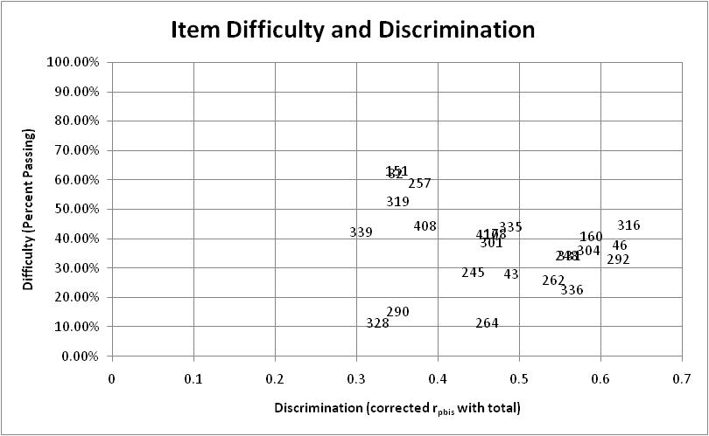
Selecting Items
Using Difficulty and Discrimination together

Slide 38
Item Characteristic Curves
A graph of the proportion of people getting each item correct, compared to total scores on the test.
Ideally, lower test scores should go along with lower proportions of people getting a particular item correct.
Ideally, higher test scores should go along with higher proportions of people getting a particular item correct.

Slide 39
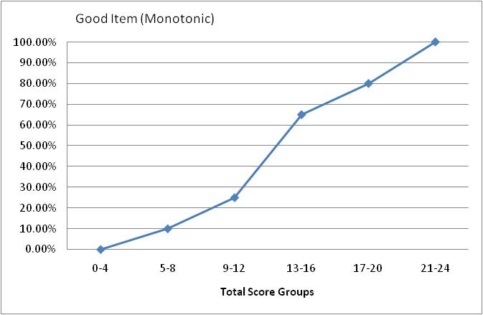
Item Characteristic Curves

Slide 40
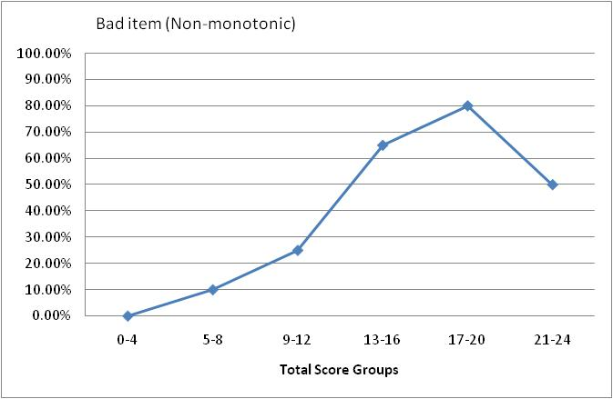
Item Characteristic Curves

Slide 41
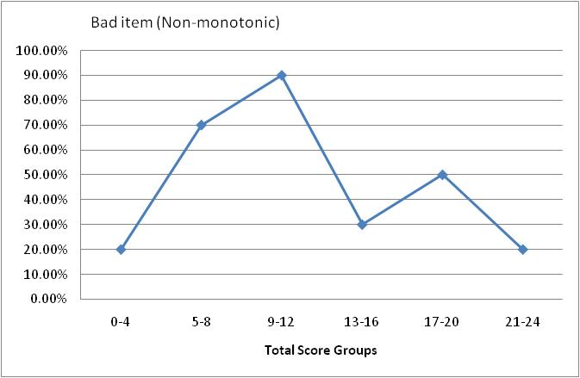
Item Characteristic Curves

Slide 42
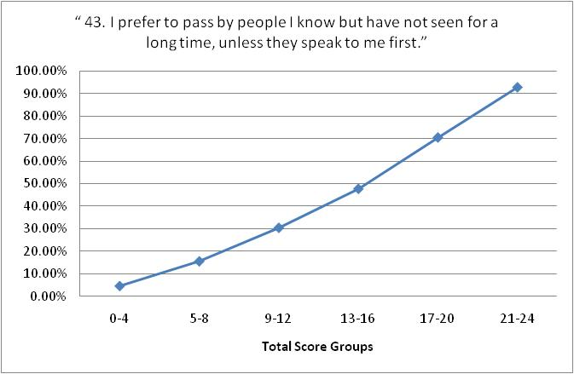
Item Characteristic Curves

Slide 43
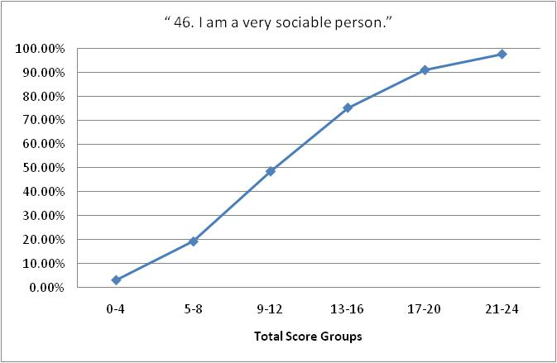
Item Characteristic Curves

Slide 44
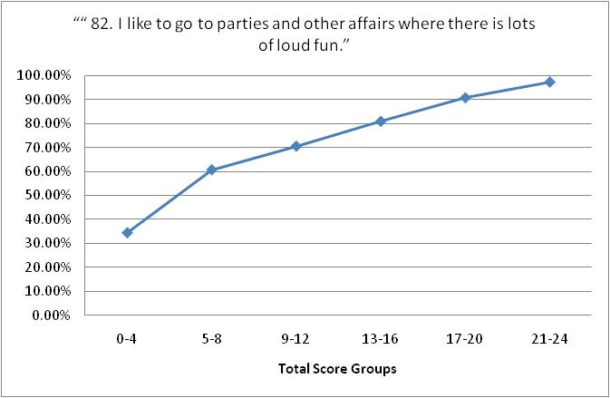
Item Characteristic Curves

Slide 45
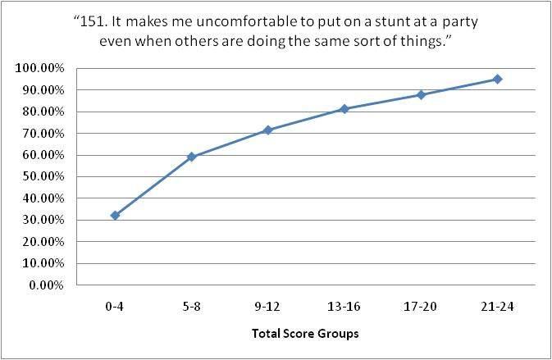
Item Characteristic Curves

Slide 46
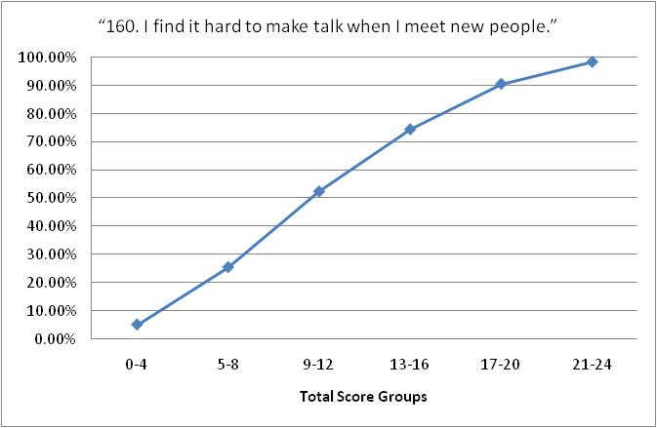
Item Characteristic Curves

Slide 47
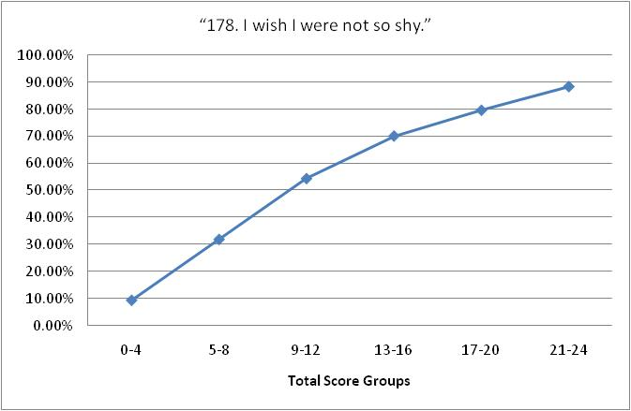
Item Characteristic Curves

Slide 48
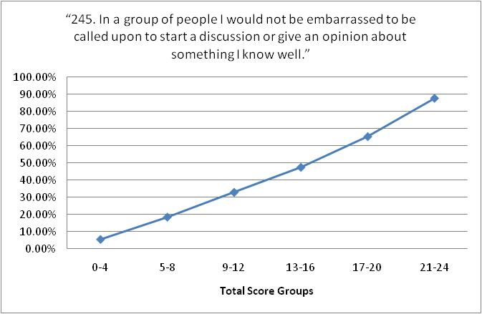
Item Characteristic Curves

Slide 49
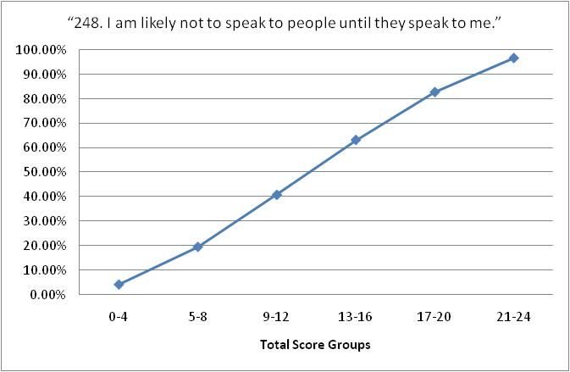
Item Characteristic Curves

Slide 50
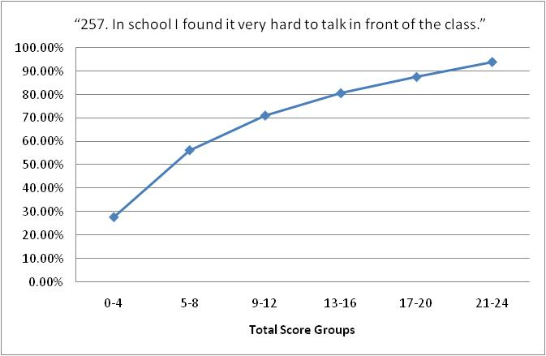
Item Characteristic Curves

Slide 51
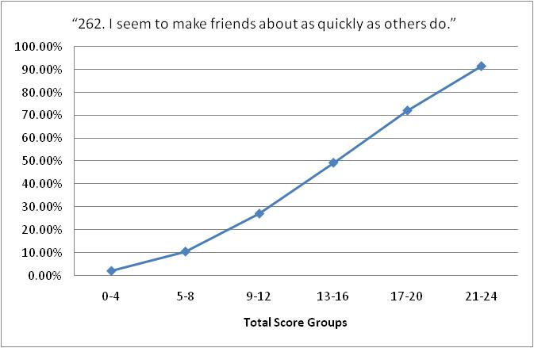
Item Characteristic Curves

Slide 52
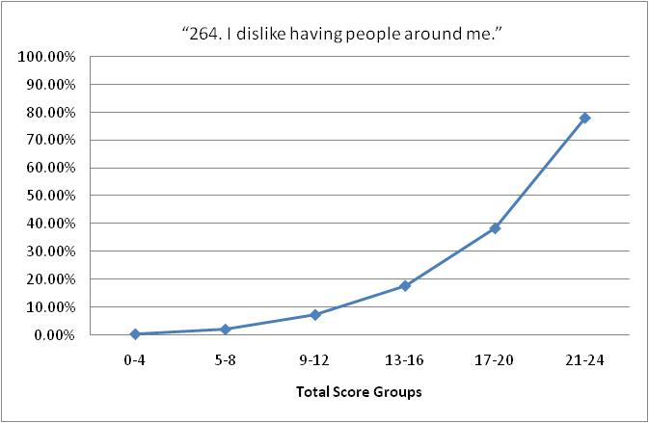
Item Characteristic Curves

Slide 53
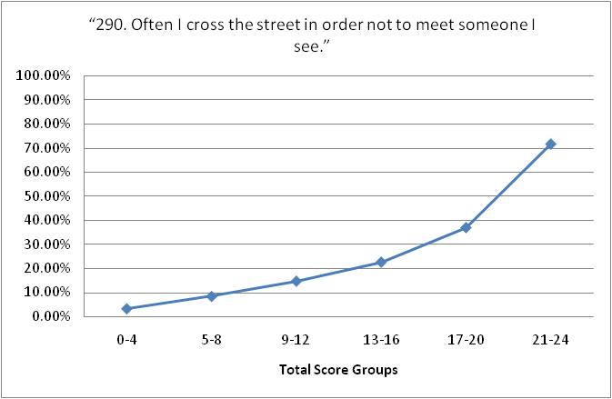
Item Characteristic Curves

Slide 54
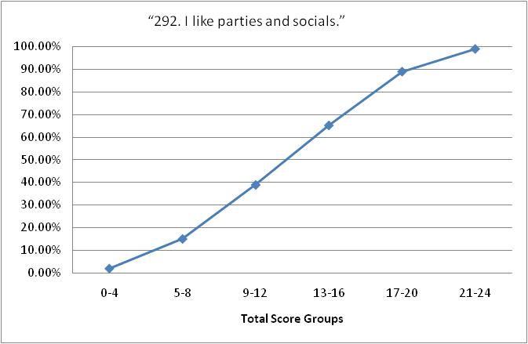
Item Characteristic Curves

Slide 55
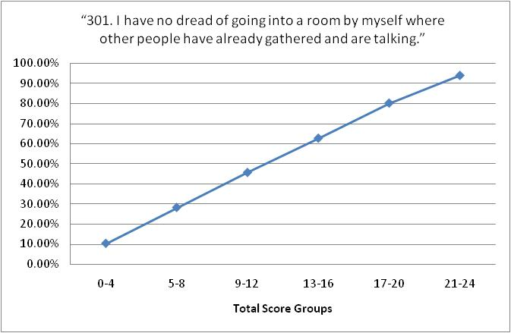
Item Characteristic Curves

Slide 56
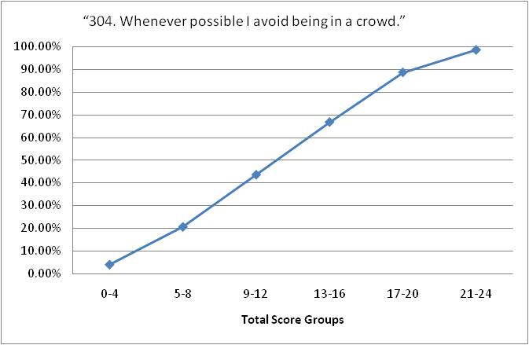
Item Characteristic Curves

Slide 57
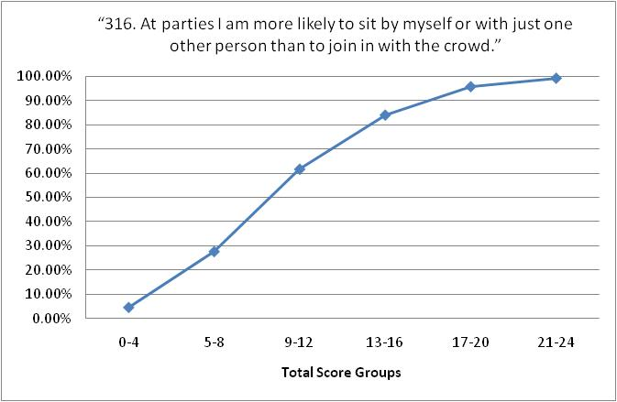
Item Characteristic Curves

Slide 58
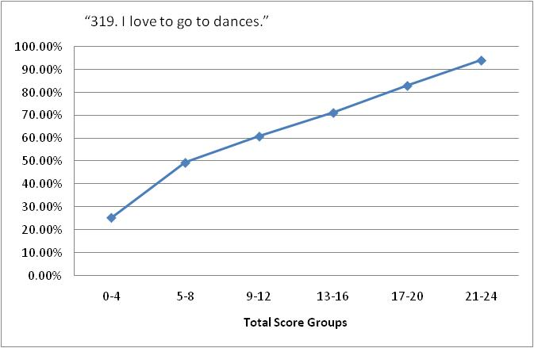
Item Characteristic Curves

Slide 59
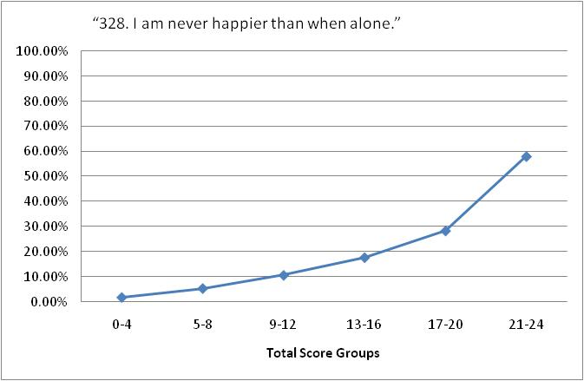
Item Characteristic Curves

Slide 60
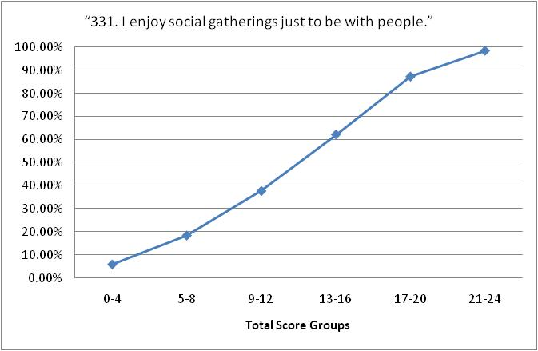
Item Characteristic Curves

Slide 61
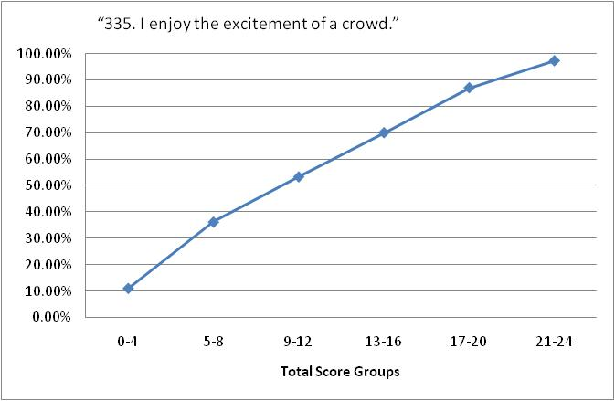
Item Characteristic Curves

Slide 62
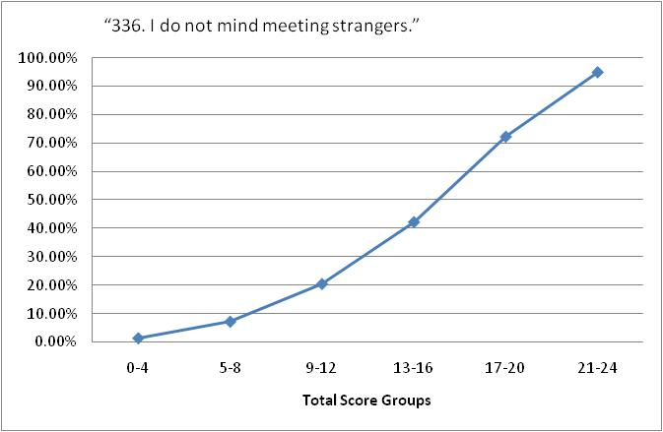
Item Characteristic Curves

Slide 63
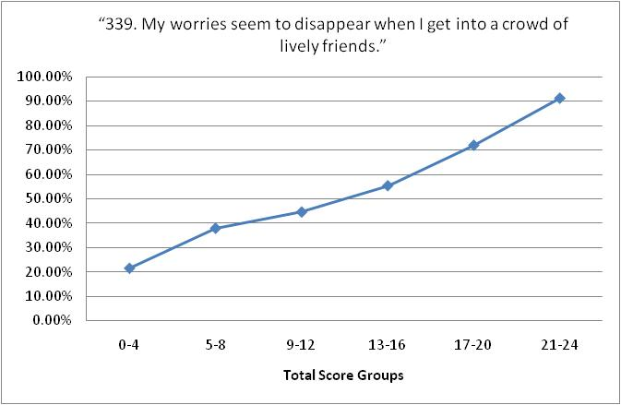
Item Characteristic Curves

Slide 64
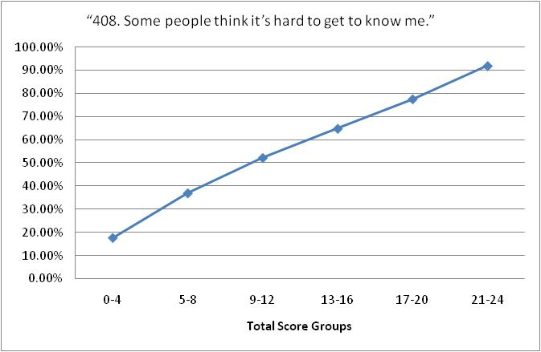
Item Characteristic Curves

Slide 65
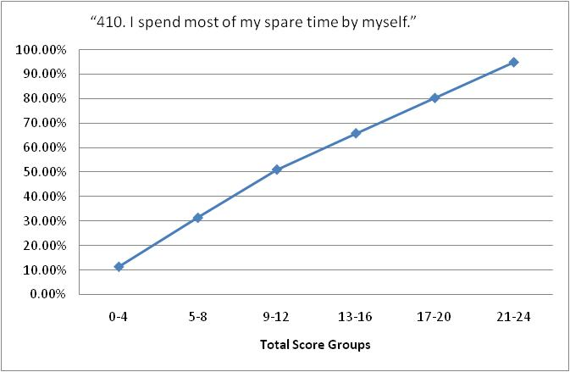
Item Characteristic Curves

Slide 66
Other Evaluation Techniques
Factor Analysis
Focuses on Item Discrimination (Loadings)
Next topic
Item Response Theory
viewing item response curves at different levels of difficulty
Looks at standard error at different ranges of the trait you are trying to measure

Slide 67
Other Evaluation Techniques
Criterion-Referenced Tests
Instead of comparing a score on a test or scale to other respondents’ scores we can compare each individual to what they “should have scored”.
Requires that there is a set objective in order to assess whether the objective has been met
E.g. In intro stats students should learn how to run an independent samples t-test a criterion referenced test could be used to test this. This needs to be demonstrated before moving on to another objective.

Slide 68
Other Evaluation Techniques
Criterion-Referenced Tests
To evaluate CRT items
Give the test to 2 groups one exposed to the material and one that has not seen the material
Distribute the scores for the test in a frequency polygon
The antimode (leasts frequent value) represents the cut score between those who were exposed to the material and those who weren’t
Scores above the cut score are assumed to have mastered the material, and vice versa

Slide 69
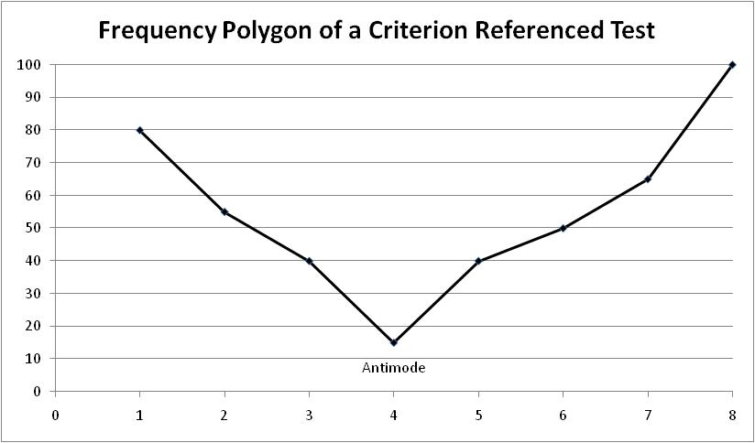
Criterion Referenced Test
Not exposed to material
Exposed to material

Slide 70
Other Evaluation Techniques
Criterion-Referenced Tests
Often used with Mastery style learning
Once a student indicates they’ve “mastered” the material he/she moves on to the next “module” of material
If they do not pass the cut score for mastery they receive more instruction until they can master the material

