Slide 1
Factor Analysis
PsychTesting
Cal State Northridge
Andrew Ainsworth PhD

Slide 2
Topics so far…
Defining Psychometrics and History
Basic Inferential Stats and Norms
Correlation and Regression
Reliability
Validity

Slide 3
Putting it together
“Goal” of psychometrics
To measure/quantify psychological phenomenon
To try and use measurable/quantifiable items (e.g. questionnaires, behavioral observations) to “capture” some metaphysical or at least directly un-measurable concept

Slide 4
Putting it together
To reach that goal we need…
Items that actually relate to the concept that we are trying to measure (that’s validity)
And for this we used correlation and prediction to show criterion (concurrent and predictive) and construct (convergent and discriminant) related evidence for validity
Note: The criteria we use in criterion related validity is not the concept directly either, but another way (e.g. behavioral, clinical) of measuring the concept.
Content related validity is decided separately

Slide 5
Putting it together
To reach that goal we need…
Items that consistently measure the construct across samples and time and that are consistently related to each other (that’s reliability)
We used correlation (test-retest, parallel forms, split-half) and the variance sum law (coefficient alpha) to measure reliability
We even talked about ways of calculating the number of items needed to reach a desired reliability

Slide 6
Putting it together
Why do we want consistent items?
Domain sampling says they should be
If the items are reliably measuring the same thing they should all be related to each other
Because we often want to create a single total score for each individual person (scaling)
How can we do that? What’s the easiest way? Could there be a better way?

Slide 7
Problem #1
Composite = Item1 + Item2 + Item3 + … + Itemk
Calculating a total score for any individual is often just a sum of the item scores which is essentially treating all the items as equally important (it weights them by 1)
Composite = (1*Item1) + (1*Item2) + (1*Item3) + … + (1*Itemk), etc.
Is there a reason to believe that every item would be equal in how well it relates to the intended concept?

Slide 8
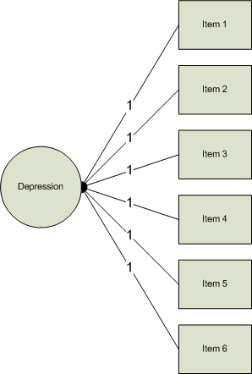

Slide 9
Problem #1
Regression
Why not develop a regression model that predicts the concept of interest using the items in the test?
What does each b represent? a?
What’s wrong with this picture? What’s missing?

Slide 10
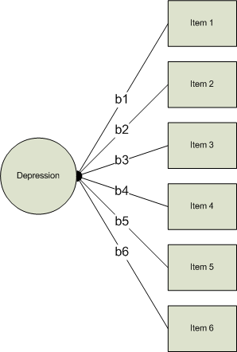

Slide 11
Problem #2
Tests that we use to measure a concept/construct typically have a moderate to large number of items (i.e. domain sampling)
With this comes a whole mess of relationships (i.e. covariances/correlations)
Alpha just looks for one consistent pattern, what if there are more patterns? And what if some items relate negatively (reverse coded)?

Slide 12
Correlation Matrix - MAS

Slide 13
Problem #2
So alpha can give us a single value that illustrates the relationship among the items as long as there is only one consistent pattern
If we could measure the concept directly we could do this differently and reduce the entire matrix on the previous page down to a single value as well; a single correlation

Slide 14
Multiple Correlation
Remember that:

Slide 15
30
Residual
20
CHD Mortality per 10,000
Prediction
10
0
2
4
6
8
10
12
Cigarette Consumption per Adult per Day

Slide 16
Multiple Correlation
So, that means that Y-hat is the part of Y that is related to ALL of the Xs combined
The multiple correlation is simple the correlation between Y and Y-hat
Let’s demonstrate

Slide 17
Multiple Correlation
We can even square the value and get the Squared Multiple Correlation (SMC), which will tell us the proportion of Y that is explained by the Xs
So, (importantly) if Y is the concept/criterion we are trying to measure and the Xs are the items of a test this would give us a single measure of how well the items measure the concept

Slide 18
What to do???
Same problem, if we can’t measure the concept directly we can’t apply a regression equation to establish the optimal weights for adding items up and we can’t reduce the number of patterns (using R) because we can’t measure the concept directly
If only there were a way to handle this…

Slide 19
What is Factor Analysis (FA)?
FA and PCA (principal components analysis) are methods of data reduction
Take many variables and explain them with a few “factors” or “components”
Correlated variables are grouped together and separated from other variables with low or no correlation

Slide 20
What is FA?
Patterns of correlations are identified and either used as descriptive (PCA) or as indicative of underlying theory (FA)
Process of providing an operational definition for latent construct (through a regression like equation)

Slide 21
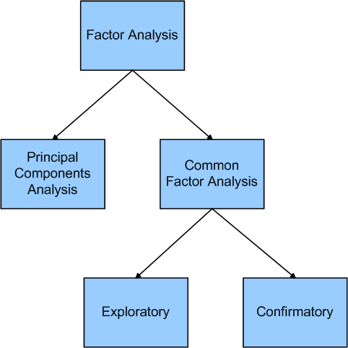

Slide 22
General Steps to FA
Step 1: Selecting and Measuring a set of items in a given domain
Step 2: Data screening in order to prepare the correlation matrix
Step 3: Factor Extraction
Step 4: Factor Rotation to increase interpretability
Step 5: Interpretation
Step 6: Further Validation and Reliability of the measures

Slide 23
Factor Analysis Questions
Three general goals: data reduction, describe relationships and test theories about relationships (next chapter)
How many interpretable factors exist in the data? or How many factors are needed to summarize the pattern of correlations?
What does each factor mean? Interpretation?
What is the percentage of variance in the data accounted for by the factors?

Slide 24
Factor Analysis Questions
Which factors account for the most variance?
How well does the factor structure fit a given theory?
What would each subject’s score be if they could be measured directly on the factors?

Slide 25
Types of FA
Exploratory FA
Summarizing data by grouping correlated variables
Investigating sets of measured variables related to theoretical constructs
Usually done near the onset of research
The type we are talking about in this lecture

Slide 26
Types of FA
Confirmatory FA
More advanced technique
When factor structure is known or at least theorized
Testing generalization of factor structure to new data, etc.
This is often tested through Structural Equation Model methods (beyond this course)

Slide 27
Remembering CTT
Assumes that every person has a true score on an item or a scale if we can only measure it directly without error
CTT analyses assumes that a person’s test score is comprised of their “true” score plus some measurement error.
This is the common true score model

Slide 28
Common Factor Model
The common factor model is like the true score model where
Except let’s think of it at the level of variance for a second

Slide 29
Common Factor Model
Since we don’t know T let’s replace that with what is called the “common variance” or the variance that this item shares with other items in the test
This is called communality and is indicated by h-squared

Slide 30
Common Factor Model
Instead of thinking about E as “error” we can think of it as the variance that is NOT shared with other items in the test or that is “unique” to this item
The unique variance (u-squared) is made up of variance that is specific to this item and error (but we can’t pull them apart)

Slide 31
Common Factor Model

Slide 32
Common Factor Model
The common factor model assumes that the commonalities represent variance that is due to the concept (i.e. factor) you are trying to measure
That’s great but how do we calculate communalities?

Slide 33
Common Factor Model
Let’s rethink the regression approach
The multiple regression equation from before:
Or it’s more general form:
Now, let’s think about this more theoretically

Slide 34
Common Factor Model
Still rethinking regression
So, theoretically items don’t make up a factor (e.g. depression), the factor should predict scores on the item
Example: if you know someone is “depressed” then you should be able to predict how they will respond to each item on the CES-D

Slide 35
Common Factor Model
Regression Model Flipped Around
Let’s predict the item from the Factor(s)
Where is the item on a scale
is the relationship (slope) b/t factor and item
is the Factor
is the error (residual) predicting the item from the factor

Slide 36
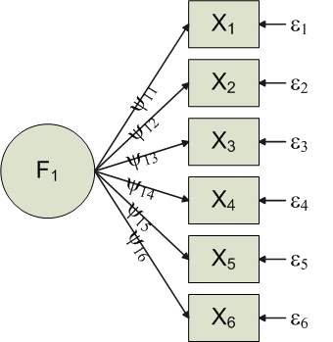
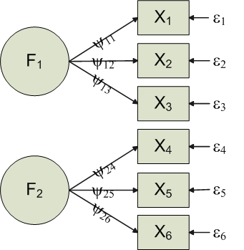
Notice the change in the direction of the arrows to indicate the flow of theoretical influence.

Slide 37
Common Factor Model
Communality
The communality is a measure of how much each item is explained by the Factor(s) and is therefore also a measure of how much each item is related to other items.
The communality for each item is calculated by
Whatever is left in an item is the uniqueness

Slide 38
Common Factor Model
The big burning question
How do we predict items with factors we can’t measure directly?
This is where the mathematics comes in
Long (very long) story short, we use a mathematical procedure to piece together “super variables” that we use as a fill-in for the factor in order to estimate the previous formula

Slide 39
Common Factor Model
Factors come from geometric decomposition
Eigenvalue/Eigenvector Decomposition (sometimes called Singular Value Decomposition)
A correlation matrix is broken down into smaller “chunks”, where each “chunk” is a projection into a cluster of data points (eigenvectors)
Each vector (chunk) is created to explain the maximum amount of the correlation matrix (the amount variability explained is the eigenvalue)

Slide 40
Common Factor Model
Factors come from geometric decomposition
Each eigenvector is created to maximize the relationships among the variables (communality)
Each vector “stands in” for a factor and then we can measure how well each item is predicted by (related to) the factor (i.e. the common factor model)

Slide 41
Factor Analysis Terms
Observed Correlation Matrix – is the matrix of correlations between all of your items
Reproduced Correlation Matrix – the correlation that is “reproduced” by the factor model
Residual Correlation Matrix – the difference between the Observed and Reproduced correlation matrices

Slide 42
Factor Analysis Terms
Extraction – refers to 2 steps in the process
Method of extraction (there are dozens)
PCA is one method
FA refers to a whole mess of them
Number of factors to “extract”
Loading – is a measure of relationship (analogous to correlation) between each item and the factor(s); the Ψ’s in the common factor model

Slide 43
Matrices

Slide 44
Matrices

Slide 45
Factor Analysis Terms
Factor Scores – the factor model is used to generate a combination of the items to generate a single score for the factor
Factor Coefficient matrix – coefficients used to calculate factor scores (like regression coefficients)

Slide 46
Factor Analysis Terms
Rotation – used to mathematically convert the factors so they are easier to interpret
Orthogonal – keeps factors independent
There is only one matrix and it is rotated
Interpret the rotated loading matrix
Oblique – allows factors to correlate
Factor Correlation Matrix – correlation between the factors
Structure Matrix – correlation between factors and variables
Pattern Matrix – unique relationship between each factor and an item uncontaminated by overlap between the factors (i.e. the relationship between an item an a factor that is not shared by other factors); this is the matrix you interpret

Slide 47
Factor Analysis Terms
Simple Structure – refers to the ease of interpretability of the factors (what they mean).
Achieved when an item only loads highly on a single factor when multiple factors exist (previous slide)
Lack of complex loadings (items load highly on multiple factors simultaneously

Slide 48
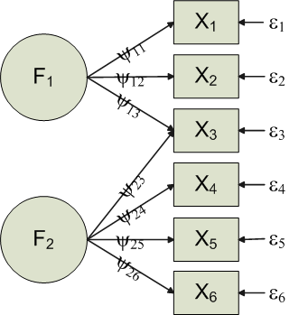
Simple vs. Complex Loading

Slide 49
FA vs. PCA
FA produces factors; PCA produces components
Factors cause variables; components are aggregates of the variables

Slide 50
Conceptual FA vs. PCA

Slide 51
FA vs. PCA
FA analyzes only the variance shared among the variables (common variance without unique variance)
PCA analyzes all of the variance
FA: “What are the underlying processes that could produce these correlations?”
PCA: Just summarize empirical associations, very data driven

Slide 52
FA vs. PCA
PCA vs. FA (family)
PCA begins with 1s in the diagonal of the correlation matrix
All variance extracted
Each variable giving equal weight initially
Commonalities are estimated as the output of the model and are typically inflated
Can often lead to an over extraction of factors as well

Slide 53
FA vs. PCA
PCA vs. FA (family)
FA begins by trying to only use the common variance
This is done by estimating the communality values (e.g. SMC) and placing them in the diagonal of the correlations matrix
Analyzes only common variance
Outputs a more realistic (often smaller) communality estimate
Usually results in far fewer factors overall

Slide 54
What else?
How many factors do you extract?
How many do you expect?
One convention is to extract all factors with eigenvalues greater than 1 (Kaiser Criteria)
Another is to extract all factors with non-negative eigenvalues
Yet another is to look at the scree plot
Try multiple numbers and see what gives best interpretation.

Slide 55
Eigenvalues greater than 1

Slide 56
Scree Plot

Slide 57
What else?
How do you know when the factor structure is good?
When it makes sense and has a (relatively) simple structure.
When it is the most useful.
How do you interpret factors?
Good question, that is where the true art of this come in.

