Slide 1
Introduction to Item Response Theory
Psy 427
Cal State Northridge
Andrew Ainsworth, PhD

Slide 2
Contents
Item Analysis in General
Classical Test Theory
Item Response Theory Basics
Item Response Functions
Item Information Functions
Invariance
IRT Assumptions
Parameter Estimation in IRT
Scoring
Applications

Slide 3
What is item analysis in general?
Item analysis provides a way of measuring the quality of questions
e.g., difficulty and discrimination
how appropriate were the questions for respondents and how well did they measure their ability/trait.
It also provides a way of re-using items over and over again in different tests with prior knowledge of how they are going to perform
creating a population of questions with known properties (e.g. test bank)

Slide 4
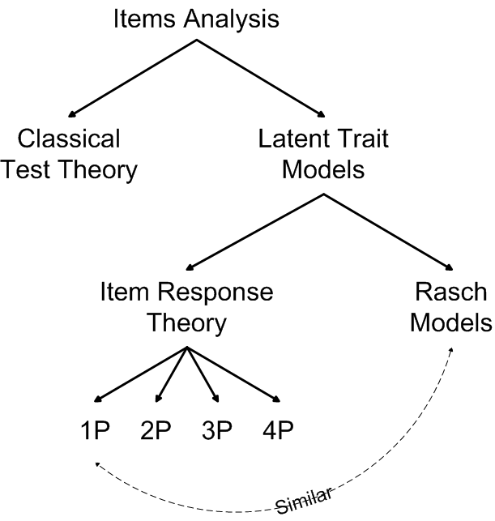

Slide 5
Classical Test Theory - Review
CTT Refresher

Slide 6
Classical Test Theory
Classical Test Theory (CTT) - analyses are the easiest and most widely used form of analyses.
The statistics can be computed by readily available statistical packages (or even by hand)
Classical Analyses are performed on the test as a whole rather than on the item
Although item statistics can be generated, they apply only to that group of students on that collection of items

Slide 7
Classical Test Theory
CTT is based on the true score model
In CTT we assume that the error :
Is normally distributed
Uncorrelated with true score
Has a mean of Zero

Slide 8
Classical Test Theory Statistics
Difficulty (item level statistic)
Discrimination (item level statistic)
Reliability (test level statistic)

Slide 9
Classical Test Theory vs. Latent Trait Models
Classical analysis has the test (not the item) as its basis.
Although the statistics generated are often generalised to similar students taking a similar test
they only really apply to those students taking that test
Latent trait models aim to look beyond that at the underlying traits which are producing the test performance.
They are measured at item level and provide sample-free measurement

Slide 10
Latent Trait Models
Latent trait models have been around since the 1940s, but were not widely used until the 1960s.
Although theoretically possible, it is practically unfeasible to use these without specialized software.
They aim to measure the underlying ability (or trait) which is producing the test performance rather than measuring performance per se.
This leads to them being sample-free. As the statistics are not dependant on the test situation which generated them, they can be used more flexibly

Slide 11
Item Response Theory
What we’re here for

Slide 12
Item Response Theory
Item Response Theory (IRT) – refers to a family of latent trait models used to establish psychometric properties of items and scales
Sometimes referred to as modern psychometrics because in large-scale education assessment, testing programs and professional testing firms IRT has almost completely replaced CTT as method of choice
IRT has many advantages over CTT that have brought IRT into more frequent use

Slide 13
Three Basics Components of IRT
Item Response Function (IRF) – Mathematical function that relates the latent trait to the probability of endorsing an item
Item Information Function – an indication of item quality; an item’s ability to differentiate among respondents
Invariance – position on the latent trait can be estimated by any items with know IRFs and item characteristics are population independent within a linear transformation

Slide 14
IRT: Item Response Functions
The backbone of IRT

Slide 15
IRT - Item Response Function
Item Response Function (IRF) - characterizes the relation between a latent variable (i.e., individual differences on a construct) and the probability of endorsing an item.
The IRF models the relationship between examinee trait level, item properties and the probability of endorsing the item.
Examinee trait level is signified by the greek letter theta (θ) and typically has mean = 0 and a standard deviation = 1

Slide 16
IRT - Item Characteristic Curves
IRFs can then be converted into Item Characteristic Curves (ICC)
graphical functions that represents the respondents ability as a function of the probability of endorsing the item

Slide 17
IRF – Item Parameters: Location (b)
An item’s location is defined as the amount of the latent trait needed to have a .5 probability of endorsing the item.
The higher the “b” parameter the higher on the trait level a respondent needs to be in order to endorse the item
Analogous to difficulty in CTT
Like Z scores, the values of b typically range from -3 to +3

Slide 18
IRF – Item Parameters: Discrimination (a)
Indicates the steepness of the IRF at the items location
An items discrimination indicates how strongly related the item is to the latent trait like loadings in a factor analysis
Items with high discriminations are better at differentiating respondents around the location point; small changes in the latent trait lead to large changes in probability
Vice versa for items with low discriminations

Slide 22
IRF – Item Parameters: Guessing (c)
The inclusion of a “c” parameter suggests that respondents very low on the trait may still choose the correct answer.
In other words respondents with low trait levels may still have a small probability of endorsing an item
This is mostly used with multiple choice testing…and the value should not vary excessively from the reciprocal of the number of choices.

Slide 24
IRF – Item Parameters: Upper asymptote (d)
The inclusion of a “d” parameter suggests that respondents very high on the latent trait are not guaranteed (i.e. have less than 1 probability) to endorse the item
Often an item that is difficult to endorse (e.g. suicide ideation as an indicator of depression)

Slide 26
IRT - Item Response Function
The 4-parameter logistic model
Where
θ represents examinee trait level
b is the item difficulty that determines the location of the IRF
a is the item’s discrimination that determines the steepness of the IRF
c is a lower asymptote parameter for the IRF
d is an upper asymptote parameter for the IRF

Slide 27
IRT - Item Response Function
The 3-parameter logistic model
If the upper asymptote parameter is set to 1.0, then the model is termed a 3PL.
In this model, individuals at low trait levels have a non-zero probability of endorsing the item.

Slide 28
IRT - Item Response Function
The 2-parameter logistic model
If in addition the lower asymptote parameter is constrained to zero, then the model is termed a 2PL.
In the 2PLM, IRFs vary both in their discrimination and difficulty (i.e., location) parameters.

Slide 29
IRT - Item Response Function
The 1-parameter logistic model
If the item discrimination is set to 1.0 (or any constant) the result is a 1PL
A 1PL assumes that all scale items relate to the latent trait equally and items vary only in difficulty (equivalent to having equal factor loadings across items).

Slide 30
Quick Detour: Rasch Models vs. Item Response Theory Models
Mathematically, Rasch models are identical to the most basic IRT model (1PL), however there are some (important) differences
In Rasch the model is superior. Data which does not fit the model is discarded
Rasch does not permit abilities to be estimated for extreme items and persons
And other differences

Slide 31
IRT - Test Response Curve
Test Response Curves (TRC) - Item response functions are additive so that items can be combined to create a TRC.
A TRC is the latent trait relative to the number of items

Slide 32
IRT - Test Response Curve

Slide 33
IRT: Item Information Functions
Item Reliability

Slide 34
IRT – Item Information Function
Item Information Function (IIF) – Item reliability is replaced by item information in IRT.
Each IRF can be transformed into an item information function (IIF); the precision an item provides at all levels of the latent trait.
The information is an index representing the item’s ability to differentiate among individuals.

Slide 35
IRT – Item Information Function
The standard error of measurement (which is the variance of the latent trait level) is the reciprocal of information, and thus, more information means less error.
Measurement error is expressed on the same metric as the latent trait level, so it can be used to build confidence intervals.

Slide 36
IRT – Item Information Function
Difficulty parameter - the location of the highest information point
Discrimination - height of the information.
Large discriminations - tall and narrow IIFs; high precision/narrow range
Low discrimination - short and wide IIFs; low precision/broad range.

Slide 39
IRT – Test Information Function
Test Information Function (TIF) – The IIFs are also additive so that we can judge the test as a whole and see at which part of the trait range it is working the best.

Slide 42
Item Response Theory - Example
The same 24 items from the MMPI-2 that assess Social Discomfort
Dichotomous Items; 1 represents an endorsement of the item in the direction of discomfort
2pl IRT model of the data to look at the difficulty, discrimination and information for each item

Slide 43
MMPI2 Items
C1 | I prefer to pass by people I know but have not seen for a long time, unless they speak to me first.
C2 | I am a very sociable person.
C3 | I like to go to parties and other affairs where there is lots of loud fun.
C4 | It makes me uncomfortable to put on a stunt at a party even when others are doing the same sort of things.
C5 | I find it hard to make small talk when I meet new people.
C6 | I wish I were not so shy.
C7 | In a group of people, I would not be embarrassed to be called upon to start a discussion or give an opinion about something I know well.
C8 | I am likely not to speak to people until they speak to me.
C9 | In school I found it very hard to talk in front of the class.
C10 | I seem to make friends about as quickly as others do.
C11 | I dislike having people around me.
C12 | Often, I cross the street in order not to meet someone I see.
C13 | I like parties and socials.
C14 | I have no dread of going into a room by myself where other people have already gathered and are talking.
C15 | Whenever possible I avoid being in a crowd.
C16 | At parties I am more likely to sit by myself or with just one other person than to join in with the crowd.
C17 | I love to go to dances.
C18 | I am never happier than when alone.
C19 | I enjoy social gatherings just to be with people.
C20 | I enjoy the excitement of a crowd.
C21 | I do not mind meeting strangers.
C22 | My worries seem to disappear when I get into a crowd of lively friends.
C23 | Some people think it’s hard to get to know me.
C24 | I spend most of my spare time by myself.

Slide 44
MIRT (R) syntax
mmpi <- read.spss("MMPI2.sav", use.value.labels = TRUE, to.data.frame = TRUE)
names(mmpi) <- tolower(names(mmpi))
socanx <- mmpi[ ,7:30]
unimodel <- mirt.model('F1 = 1-24')
unisocanx <- mirt(data = socanx, model = unimodel)
summary(unisocanx)
coef(unisocanx, irtPars = TRUE, simplify = TRUE)
itemplot(unisocanx, 2, type = 'trace')
itemplot(unisocanx, 2, type = 'infoSE’)
plot(unisocanx, type = 'infoSE')

Slide 45
MIRT (R) - Summary
Iteration: 31, Log-Lik: -1007255.535, Max-Change: 0.00010
F1 h2
c1 0.668 0.447
c2 0.813 0.661
c3 0.484 0.234
c4 0.477 0.227
c5 0.775 0.601
c6 0.627 0.393
c7 0.598 0.357
c8 0.741 0.549
c9 0.520 0.270
c10 0.742 0.551
c11 0.765 0.585
c12 0.562 0.316
F1 h2
c13 0.802 0.644
c14 0.609 0.371
c15 0.761 0.579
c16 0.829 0.688
c17 0.467 0.218
c18 0.574 0.330
c19 0.734 0.539
c20 0.640 0.410
c21 0.783 0.613
c22 0.394 0.155
c23 0.510 0.260
c24 0.606 0.367
SS loadings: 10.365
Proportion Var: 0.432

Slide 46
MIRT (R) - Coefficients
$items
a1 d g u
c1 1.529 -1.312 0 1
c2 2.377 -0.871 0 1
c3 0.941 0.601 0 1
c4 0.923 0.532 0 1
c5 2.087 -0.615 0 1
c6 1.369 -0.438 0 1
c7 1.269 -1.176 0 1
c8 1.878 -1.002 0 1
c9 1.036 0.440 0 1
c10 1.885 -1.630 0 1
c11 2.020 -3.229 0 1
c12 1.156 -2.105 0 1
a1 d g u
c13 2.288 -1.229 0 1
c14 1.307 -0.600 0 1
c15 1.998 -0.916 0 1
c16 2.527 -0.387 0 1
c17 0.898 0.133 0 1
c18 1.194 -2.535 0 1
c19 1.840 -0.998 0 1
c20 1.419 -0.309 0 1
c21 2.141 -2.040 0 1
c22 0.730 -0.341 0 1
c23 1.010 -0.271 0 1
c24 1.296 -0.447 0 1

Slide 47
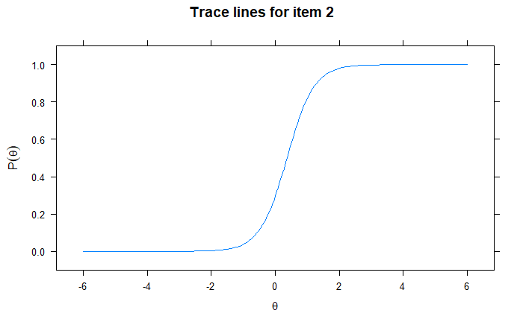
Lavaan – ICC for item 2

Slide 48
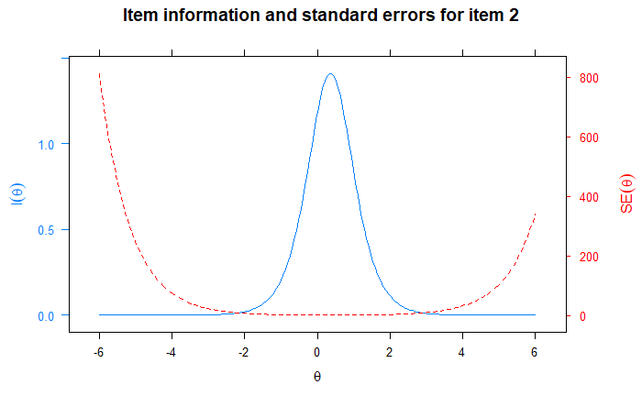
Lavaan – IIC and SE for Item 2

Slide 49
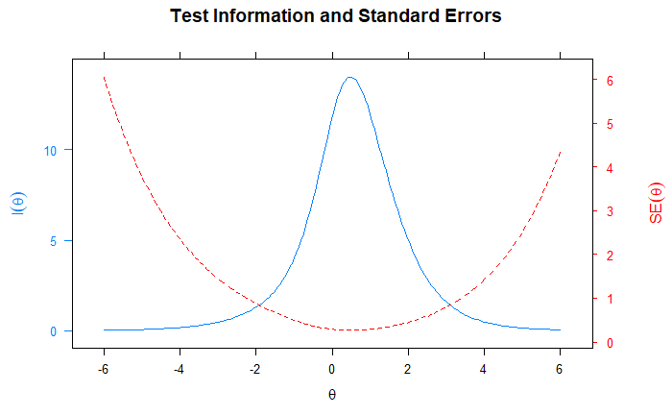
Lavaan – Test Information Curve with SE

Slide 50
IRT: Invariance
Say what?

Slide 51
IRT - Invariance
Invariance - IRT model parameters have an invariance property
Examinee trait level estimates do not depend on which items are administered, and in turn, item parameters do not depend on a particular sample of examinees (within a linear transformation).
Invariance allows researchers to: 1) efficiently “link” different scales that measure the same construct, 2) compare examinees even if they responded to different items, and 3) implement computerized adaptive testing.

Slide 52
IRT: Assumptions
When you assume…

Slide 53
IRT - Assumptions
Monotonicity - logistic IRT models assume a monotonically increasing functions (as trait level increases, so does the probability of endorsing an item).
If this is violated, then it makes no sense to apply logistic models to characterize item response data.

Slide 54
IRT - Assumptions
Unidimensionality – In the IRT models described above, individual differences are characterized by a single parameter, theta.
Multidimensional IRT models exist but are not as commonly applied
Commonly applied IRT models assume that a single common factor (i.e., the latent trait) accounts for the item covariance.
Often assessed using specialized Factor Analytic models for dichotomous items

Slide 55
IRT - Assumptions
Local independence - The Local independence (LI) assumption requires that item responses are uncorrelated after controlling for the latent trait.
When LI is violated, this is called local dependence (LD).
LI and unidimensionality are related
Highly univocal scales can still have violations of local independence (e.g. item content, etc.).

Slide 56
IRT - Assumptions
Local dependence:
distorts item parameter estimates (i.e., can cause item slopes to be larger than they should be),
causes scales to look more precise than they really are, and
when LD exists, a large correlation between two or more items can essentially define or dominate the latent trait, thus causing the scale to lack construct validity.

Slide 57
IRT - Assumptions
Once LD is identified, the next step is to address it:
Form testlets (Wainer & Kiely, 1987) by combining locally dependent items
Delete one or more of the LD items from the scale so local independence is achieved.

Slide 58
IRT - Assumptions
Qualitatively homogeneous population - IRT models assume that the same IRF applies to all members of the population
Differential item functioning (DIF) is a violation of this and means that there is a violation of the invariance property
DIF occurs when an item has a different IRF for two or more groups; therefore examinees that are equal on the latent trait have different probabilities (expected scores) of endorsing the item.
No single IRF can be applied to the population

Slide 59
IRT: Applications
How do we use it?

Slide 60
Applications
Ordered Polytomous Items
IRT models exist for data that are not dichotomously scored
With dichotomous items there is a single difficulty (location) that indicates the threshold at which the probability switches from favoring one choice to favoring the other
With polytomous items a separate difficulty exists as thresholds between each sets of ordered categories

Slide 64
Applications
Differential Item Functioning
How can age groups, genders, cultures, ethnic groups, and socioecomonic backgrounds be meaningfully compared?
Can be a research goal as opposed to just a test of an assumption
Test equivalency of test items translated into multiple languages
Test items influenced by cultural differences
Test for intelligence items that gender biased
Test for age differences in response to personality items

Slide 65
“Don’t care about life”

Slide 66
Applications
Scaling individuals for further analysis
We often collect data in multifaceted forms (e.g. multi-items surveys) and then collapse them into a single raw score
IRT based scores represent an optimal scaling of individuals on the trait
Most sophisticated analyses require at-least interval level measurement and IRT scores are closer to interval level than raw scores
Using scaled scores as opposed to raw scores has been shown to reduce spurious results

Slide 67
Applications
Scale Construction and Modification
The focus is changing from creating fixed length, paper/pencil tests to creating a “universe” of items with known IRF’s that can be used interchangeably
Scales are being designed based around IRT properties
Pre-existing scales that were developed using CTT are being “revamped” using IRT

Slide 68
Applications
Computer Adaptive Testing (CAT)
As an extension of the previous slide, once a “universe” (i.e. test bank) of items with known IRFs is created they can be used to measure traits in a computer adaptive form
An item is given to the participant (usually easy to moderate difficulty) and their answer allows their trait score to be estimated, so that the next item is chosen to target that trait level
After the second item is answered their trait score is re-estimated, etc.

Slide 69
Applications
Computer Adaptive Testing (CAT)
CA tests are at least twice as efficient as their paper and pencil counterparts with no loss of precision
Primary testing approach used by ETS
Adaptive form of the Headache Impact Survey outperformed the P and P counterpart in reducing patient burden, tracking change and in reliability and validity (Ware et al., 2003)

Slide 70
Applications
Test Equating
Participants that have taken different tests measuring the same construct (e.g. Beck depression vs. CESD), but both have items with known IRFS, can be placed on the same scale and compared or scored equivalently
Equating across grades on math ability
Equating across years for placement or admissions tests

