Slide 1
Structured Personality Tests
PsychTesting
Andrew Ainsworth PhD

Slide 2
Some Definitions
Personality
relatively stable & distinctive patterns of behavior that characterize an individual and his or her reactions to the environment.
Personality tests attempt to measure personality traits, states, types, and other aspects of personality (such as self concept).

Slide 3
Some Definitions
Personality Traits
relatively enduring dispositions
tendencies to act, think, or feel in a certain manner under any given circumstance
distinguish one person from another
Personality States
predominantly emotional reactions that vary from one situation to another.

Slide 4
Some Definitions
Personality Types
refer to general descriptions of people
e.g., avoidant, depressive
Self-Concept
a person’s self-definition; an organized set of assumptions one has about him or herself.
Most structured personality tests attempt to assign a personality type based upon measurements of someone’s personality traits.

Slide 5
Strategies to Structured Tests
In general, subject is asked to respond to an objective, written statement that is designed to minimize ambiguity.
Different from projective tests, where subjects respond to purposely ambiguous stimuli.
Two approaches to structured tests
Deductive
Empirical

Slide 6
Strategies to Structured Tests – Types & Subtypes
Deductive
Logical Content
Content Approach
Intuitive Approach
Rational Approach
Theoretical
Empirical
Criterion Group
Contrasted-Group
External strategy
Empirical strategy
Criterion-keying
Factor Analytic

Slide 7
Deductive Strategies – Logical Content vs. Theoretical
Logical-content
Uses reason and deductive logic in the development of personality measures.
Test designer attempts to logically deduce the type of question that should be asked to measure the hypothetical concept.
e.g.,
I frequently worry about my weight. T/F
I feel bad after I’ve eaten a good meal. T/F
Relies heavily on face validity.
Does not rely heavily on psychometric development

Slide 8
Deductive Strategies
Theoretical
Start with a theory
Ask questions that are consistent with the theory.
Assume that every item in a scale is related to a characteristic that you are measuring.
Attempt to create homogeneous scales
Frequently use item analyses to confirm

Slide 9
Empirical Strategies – Criterion-group vs. Factor Analysis
Criterion-group strategy
start with a group of people who share a common characteristic (e.g., aggressiveness, depression)
select and administer a group of items to everybody in the criterion-group and a control group
choose those items that distinguish between the criterion and control groups; which items best contrast the groups

Slide 10
Empirical Strategies
Factor Analytic Strategy
uses factor analysis to derive empirically the basic dimensions of personality
asks a large number of questions
looks for correlations among questions
if groups of questions correlate with each other, this is evidence of an underlying latent factor

Slide 11
Logical Content Test Example
Woodworth Personal Data Sheet
The first personality inventory
Based on faulty assumption that responses can be taken on face value
Produced a single score

Slide 12
Logical Content Tests – Early Scales (30s-50s)
First multidimensional scales
Bell Adjustment Inventory (1934)
Assessed adjustment in different areas of life (e.g. home life, social life, emotional functioning)
Bernreuter Personality Inventory (1958)
Items pertaining to six personality traits (e.g. introversion, confidence, sociability)
Mooney Problem Checklist (1950)
One of few still in use
Much like the Woodworth
Bell Adjust Inventory Items
Do you have many headaches?
Is your mother the dominant member of the family?
Have you ever felt that someone was hypnotizing you and making you act against your will?
Do you ever feel that there has been a lack of real affection and love in your home.
Bernreuter Personality Inventory Items
Do you like to be with people a great deal?
Do you usually avoid asking for advice?
Mooney Problem Checklist Items
Don’t get enough sleep
Girls don’t seem to like me
Parents favoring brother or sister

Slide 13
Criterion-Group Tests
Minnesota Multiphasic Personality Inventory (MMPI; originally developed in 1943)
More detail to come
California Psychological Inventory (CPI; originally developed in the late ‘50s; circa ‘56/ ‘57)
Originally developed to identify personality traits of normally adjusted individuals
Uses criterion groups for some of the subscales
Compared (men and women, homosexual men and heterosexual men)
Produces 20 personality continuums (e.g. intro-extroverted, conventional vs. unconventional, Dominance, Capacity for Status, Sociability, etc.)
Shares over 100 items with the MMPI
CPI Items
I like tall women
I certainly feel useless at times
Anyone who is able to work hard has a good chance of succeeding

Slide 14
The MMPI
MMPI: Minnesota Multiphasic Personality Inventory (MMPI, MMPI-2, MMPI-A)
MMPI: original MMPI 1943
MMPI - 2: first revision in 1989
MMPI - A: adolescent form
Purpose - to distinguish “normals” from “abnormals”

Slide 15
The MMPI
MMPI - 2 requires an 8th grade reading level
original MMPI required a 6th grade reading level (!)
Reading skills since 1943 have dropped.
8th grade 1989 reading level = 6th grade 1943 level
average reading difficulty for the MMPI-2 items is approximately 5th grade although
90% of the items require less than a 9th grade education.
Auditory or interview forms are available.

Slide 16
The MMPI
Original MMPI began with a pool of 1000 questions drawn from case histories, psychological reports, textbooks, and existing tests of
Starke Hathaway - medical psychologist
Jovian McKinley - neuropsychiatrist
both of the University of Minnesota Hospitals
Narrowed pool down to 504 items thought to be relatively independent.

Slide 17
The MMPI
These 504 questions were administered to 800 patients representing the following psychopathologies:
Hypochondriacs: patients who are overly oncerned with bodily symptoms and express conflicts through bodily (somatic) symptoms.
Depressives: patients with depressed mood, loss of appetite, anhedonia, suicidality
Psychopathic Deviates: patients who are antisocial and rebellious & exploit others without remorse or anxiety.

Slide 18
The MMPI
These 504 questions were administered to 800 patients representing the following psychopathologies:
Paranoids: patients who show extreme suspicions and delusions
Psychasthenics: patients plagued by excessive self-doubts, obsessive thoughts, anxiety, and low energy
Schizophrenics: patients who are disorganized, highly disturbed, out of contact with reality, hallucinating, and have poor relatedness skills

Slide 19
The MMPI
These 504 questions were administered to 800 patients representing the following psychopathologies:
Hypomanics: patients who are in a highenergy, agitated state with poor impulse control, inability to sleep, and poor judgment.
In addition, 700 controls - visitors and relatives of patients at the University of Minnesota Hospital - were also administered the same 504 questions.

Slide 20
The MMPI
After an item analysis, items that separated the patients from the non-patients were included on one or more of the clinical scales.
The items were then cross-validated on independent samples of the criterion and control groups (administered again).
Those items that discriminated between the two groups significantly were retained.

Slide 21
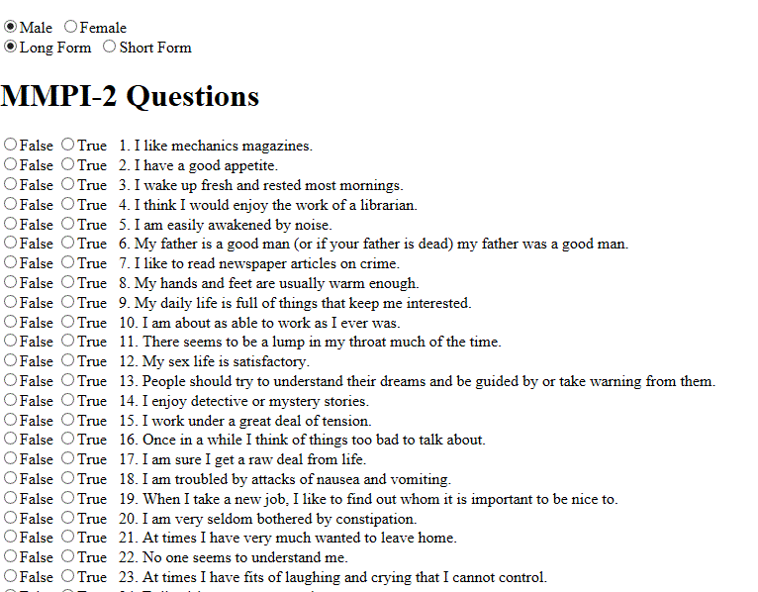
MMPI Example Items

Slide 22
The MMPI
In addition to the eight clinical scales, two additional scales were later added:
Masculinity-Femininity (MF): containing items differentially endorsed by men and women.
Social Introversion (Si): measures introversion and extraversion.

Slide 23
The MMPI
Finally, three validity scales were also included, to address concerns regarding the logical-content approach.
Lie (L)
Infrequency (F)
Defensiveness (K)

Slide 24
The MMPI
Lie (L)
designed to detect individuals who attempt to present themselves in a favorable light (fake good).
Not empirically constructed but logically constructed.
Infrequency (F)
designed to detect individuals who attempt to present themselves in an unfavorable light (fake bad)

Slide 25
The MMPI
Defensiveness (K)
Measured test-taking attitude
Designed to detect those who were trying to “fake normal”
To create the K scale, Hathaway & McKinley examined protocols of disturbed individuals who produced normal MMPI patterns.
Those items “left over” that differentiated between the two groups were included in the K scale.

Slide 26
MMPI Scales

Slide 27
Scoring the MMPI
Questions that contribute to each scale are added up to obtain raw scores.
Raw scores are then converted to McCall’s T scores (mean 50, SD 10) based upon scores from the control group.
Scores above T=65 are considered clinically significant.

Slide 28
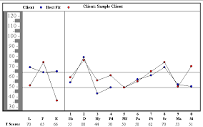
Scoring the MMPI
Original goal - a single “spike” in a patients scores will lead to a clinical diagnosis.
E.g Schizophrenics would show a spike on the schizophenia scale
E.g. hysterics would show an elevation on the hysteria scale
This assumption turned out to be false in that in reality most profiles produced multiple “spikes”
Sometimes a person would show elevated levels on all of the scales (????)

Slide 29
Interpreting the MMPI
Single scale interpretation is therefore generally not possible.
Configural Interpretation (pattern analysis)
Meehl (1951): Two-Point Code
Started research looking for common characteristics of individual profiles with common two highest T-score scales.
General strategy: if there is a defined “spike”, interpret it first. Then look for two-point codes.

Slide 30
MMPI-2
The MMPI was re-standardized in 1982 and what resulted was the 2nd version
Purpose
Revise the norms

Slide 31
MMPI Psychometrics
Median split-half reliability coefficients run in the .70s, some as high as .96, most lower.
Median test-retest reliability coefficients range between .50 and .90 (median .80s).
Factor analytic coefficients running in the high .90s.
Reliability is generally considered adequate for a psychological measure.

Slide 32
MMPI Psychometrics
Tens of thousands of validity studies point to diagnostic specificity for a range of problems including
substance use, alcoholism, post-traumatic stress, delinquent behaviors.
Probably the most widely studied personality test world wide.

Slide 33
Factor Analytic Strategy
Cattell’s 16PF
Began with all adjectives applicable to humans
4504 “real” traits (Allport and Odbert, 1936)
Cattell reduced to 171 items he believed accounted for all the other items
The 171 items were administered and came back with 36 surface traits
Subsequent factor analysis produced 16 distinct factors that accounted for all the variables

Slide 34
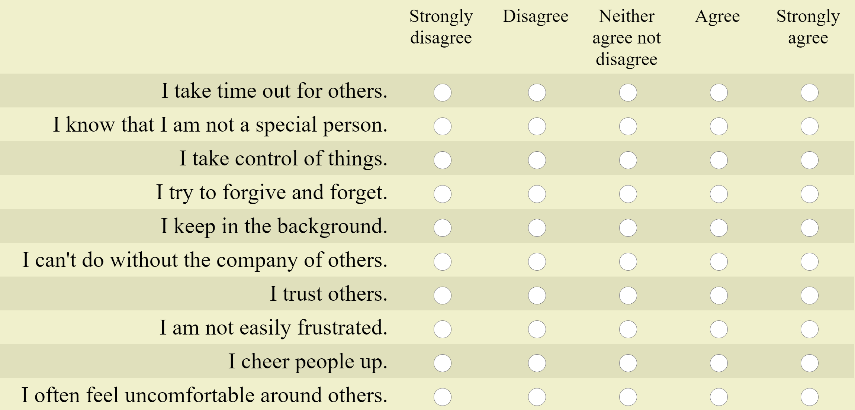
Cattell 16PF Example Items

Slide 35
Factor Analytic Strategy
Problems with the factor analytic strategy
The subjective nature of naming factors
Since the main goal of factor analysis is to identify common variance, what is identified as common as opposed to unique may be a product of which items are being utilized, the extraction, the rotation, etc.

