Slide 1
Correlation and Regression
Cal State Northridge
Ψ427
Ainsworth

Slide 2
Major Points - Correlation
Questions answered by correlation
Scatterplots
An example
The correlation coefficient
Other kinds of correlations
Factors affecting correlations
Testing for significance

Slide 3
The Question
Are two variables related?
Does one increase as the other increases?
e. g. skills and income
Does one decrease as the other increases?
e. g. health problems and nutrition
How can we get a numerical measure of the degree of relationship?

Slide 4
Scatterplots
AKA scatter diagram or scattergram.
Graphically depicts the relationship between two variables in two dimensional space.

Slide 5
Direct Relationship

Slide 6
Inverse Relationship

Slide 7
An Example
Does smoking cigarettes increase systolic blood pressure?
Plotting number of cigarettes smoked per day against systolic blood pressure
Fairly moderate relationship
Relationship is positive

Slide 8
Trend?

Slide 9
Smoking and BP
Note relationship is moderate, but real.
Why do we care about relationship?
What would conclude if there were no relationship?
What if the relationship were near perfect?
What if the relationship were negative?

Slide 10
Heart Disease and Cigarettes
Data on heart disease and cigarette smoking in 21 developed countries (Landwehr and Watkins, 1987)
Data have been rounded for computational convenience.
The results were not affected.
Notes:
Landwehr, J.M. & Watkins, A.E. (1987) Exploring Data: Teacher’s Edition. Palo Alto, CA: Dale Seymour Publications.

Slide 11
The Data
Surprisingly, the U.S. is the first country on the list--the country
with the highest consumption and highest mortality.

Slide 12
Scatterplot of Heart Disease
CHD Mortality goes on ordinate (Y axis)
Why?
Cigarette consumption on abscissa (X axis)
Why?
What does each dot represent?
Best fitting line included for clarity

Slide 13
{X = 6, Y = 11}

Slide 14
What Does the Scatterplot Show?
As smoking increases, so does coronary heart disease mortality.
Relationship looks strong
Not all data points on line.
This gives us “residuals” or “errors of prediction”
To be discussed later

Slide 15
Correlation
Co-relation
The relationship between two variables
Measured with a correlation coefficient
Most popularly seen correlation coefficient: Pearson Product-Moment Correlation

Slide 16
Types of Correlation
Positive correlation
High values of X tend to be associated with high values of Y.
As X increases, Y increases
Negative correlation
High values of X tend to be associated with low values of Y.
As X increases, Y decreases
No correlation
No consistent tendency for values on Y to increase or decrease as X increases

Slide 17
Correlation Coefficient
A measure of degree of relationship.
Between 1 and -1
Sign refers to direction.
Based on covariance
Measure of degree to which large scores on X go with large scores on Y, and small scores on X go with small scores on Y
Think of it as variance, but with 2 variables instead of 1 (What does that mean??)

Slide 18
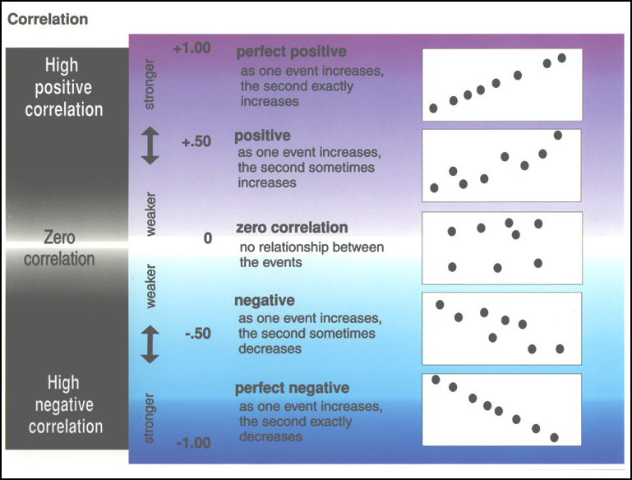

Slide 19
Covariance
Remember that variance is:
The formula for co-variance is:
How this works, and why?
When would cov_{XY} be large and positive? Large and negative?

Slide 20
Example

Slide 21
Example
What the heck is a covariance?
I thought we were talking about correlation?

Slide 22
Correlation Coefficient
Pearson’s Product Moment Correlation
Symbolized by r
Covariance ÷ (product of the 2 SDs)
Correlation is a standardized covariance

Slide 23
Calculation for Example
Cov_{XY} = 11.12
s_{X} = 2.33
s_{Y} = 6.69

Slide 24
Example
Correlation = .713
Sign is positive
Why?
If sign were negative
What would it mean?
Would not alter the degree of relationship.

Slide 25
Other calculations
Z-score method
Computational (Raw Score) Method

Slide 26
Other Kinds of Correlation
Spearman Rank-Order Correlation Coefficient (r_{sp})
used with 2 ranked/ordinal variables
uses the same Pearson formula

Slide 27
Other Kinds of Correlation
Point biserial correlation coefficient (r_{pb})
used with one continuous scale and one nominal or ordinal or dichotomous scale.
uses the same Pearson formula

Slide 28
Other Kinds of Correlation
Phi coefficient (Φ)
used with two dichotomous scales.
uses the same Pearson formula

Slide 29
Factors Affecting r
Range restrictions
Looking at only a small portion of the total scatter plot (looking at a smaller portion of the scores’ variability) decreases r.
Reducing variability reduces r
Nonlinearity
The Pearson r (and its relatives) measure the degree of linear relationship between two variables
If a strong non-linear relationship exists, r will provide a low, or at least inaccurate measure of the true relationship.

Slide 30
Factors Affecting r
Heterogeneous subsamples
Everyday examples (e.g. height and weight using both men and women)
Outliers
Overestimate Correlation
Underestimate Correlation

Slide 31
Countries With Low Consumptions
Data With Restricted Range
Truncated at 5 Cigarettes Per Day
20
18
16
14
12
CHD Mortality per 10,000
10
8
6
4
2
2.5
3.0
3.5
4.0
4.5
5.0
5.5
Cigarette Consumption per Adult per Day

Slide 32
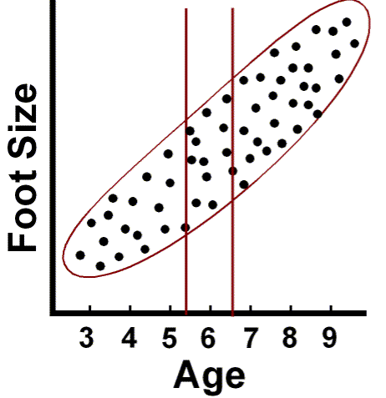
Truncation

Slide 33
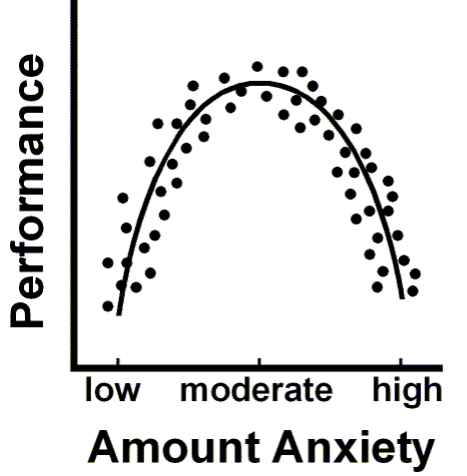
Non-linearity

Slide 34
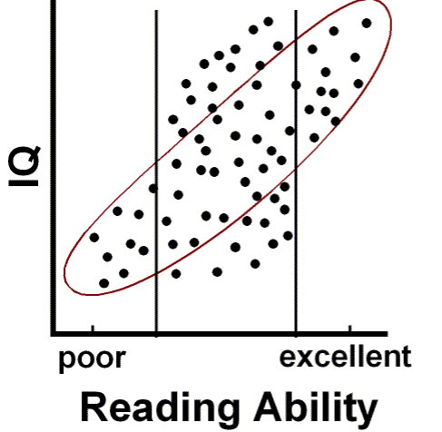
Heterogenous samples

Slide 35
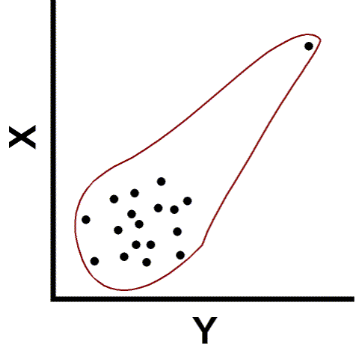
Outliers

Slide 36
Testing Correlations
So you have a correlation. Now what?
In terms of magnitude, how big is big?
Small correlations in large samples are “big.”
Large correlations in small samples aren’t always “big.”
Depends upon the magnitude of the correlation coefficient
AND
The size of your sample.

Slide 37
Testing r
Population parameter = ρ
Null hypothesis H₀: ρ = 0
Test of linear independence
What would a true null mean here?
What would a false null mean here?
Alternative hypothesis (H₁) ρ ≠ 0
Two-tailed

Slide 38
Tables of Significance
We can convert r to t and test for significance:
Where DF = N-2

Slide 39
Tables of Significance
In our example r was .71
N-2 = 21 – 2 = 19
T-crit (19) = 2.09
Since 6.90 is larger than 2.09 reject ρ = 0.

Slide 40
Computer Printout
Printout gives test of significance.

Slide 41
Regression
Notes:
With updates on slides – 23, 25, 27, 29, 35, 36

Slide 42
What is regression?
How do we predict one variable from another?
How does one variable change as the other changes?
Influence

Slide 43
Linear Regression
A technique we use to predict the most likely score on one variable from those on another variable
Uses the nature of the relationship (i.e. correlation) between two variables to enhance your prediction

Slide 44
Linear Regression: Parts
Y - the variables you are predicting
i.e. dependent variable
X - the variables you are using to predict
i.e. independent variable
- your predictions (also known as Y’)

Slide 45
Why Do We Care?
We may want to make a prediction.
More likely, we want to understand the relationship.
How fast does CHD mortality rise with a one unit increase in smoking?
Note: we speak about predicting, but often don’t actually predict.

Slide 46
An Example
Cigarettes and CHD Mortality again
Data repeated on next slide
We want to predict level of CHD mortality in a country averaging 10 cigarettes per day.
Notes:
Landwehr, J.M. & Watkins, A.E. (1987) Exploring Data: Teacher’s Edition. Palo Alto, CA: Dale Seymour Publications.

Slide 47
The Data
Based on the data we have what would we predict the rate of CHD be in a country that smoked 10 cigarettes on average?
First, we need to establish a prediction of CHD from smoking…

Slide 48
We predict a CHD rate of about 14
Regression Line
For a country that smokes 6 C/A/D…

Slide 49
Regression Line
Formula
= the predicted value of Y (e.g. CHD mortality)
X = the predictor variable (e.g. average cig./adult/country)

Slide 50
Regression Coefficients
“Coefficients” are a and b
b = slope
Change in predicted Y for one unit change in X
a = intercept
value of when X = 0

Slide 51
Calculation
Slope
Intercept

Slide 52
For Our Data
Cov_{XY} = 11.12
s²_{X} = 2.33² = 5.447
b = 11.12/5.447 = 2.042
a = 14.524 - 2.042*5.952 = 2.32
See SPSS printout on next slide
Answers are not exact due to rounding error and desire to match SPSS.

Slide 53
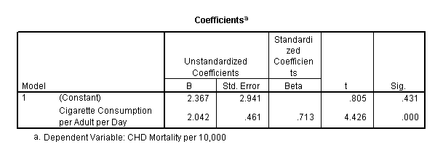
SPSS Printout

Slide 54
Note:
The values we obtained are shown on printout.
The intercept is the value in the B column labeled “constant”
The slope is the value in the B column labeled by name of predictor variable.

Slide 55
Making a Prediction
Second, once we know the relationship we can predict
We predict 22.77 people/10,000 in a country with an average of 10 C/A/D will die of CHD

Slide 56
Accuracy of Prediction
Finnish smokers smoke 6 C/A/D
We predict:
They actually have 23 deaths/10,000
Our error (“residual”) =
23 - 14.619 = 8.38
a large error

Slide 57
30
Residual
20
CHD Mortality per 10,000
Prediction
10
0
2
4
6
8
10
12
Cigarette Consumption per Adult per Day

Slide 58
Residuals
When we predict Ŷ for a given X, we will sometimes be in error.
Y – Ŷ for any X is a an error of estimate
Also known as: a residual
We want to Σ(Y- Ŷ) as small as possible.
BUT, there are infinitely many lines that can do this.
Just draw ANY line that goes through the mean of the X and Y values.
Minimize Errors of Estimate… How?

Slide 59
Minimizing Residuals
Again, the problem lies with this definition of the mean:
So, how do we get rid of the 0’s?
Square them.

Slide 60
Regression Line: A Mathematical Definition
The regression line is the line which when drawn through your data set produces the smallest value of:
Called the Sum of Squared Residual or SS_{residual}
Regression line is also called a “least squares line.”

Slide 61
Summarizing Errors of Prediction
Residual variance
The variability of predicted values

Slide 62
Standard Error of Estimate
Standard error of estimate
The standard deviation of predicted values
A common measure of the accuracy of our predictions
We want it to be as small as possible.

Slide 63
Example

Slide 64
Regression and Z Scores
When your data are standardized (linearly transformed to z-scores), the slope of the regression line is called β
DO NOT confuse this β with the β associated with type II errors. They’re different.
When we have one predictor, r = β
Z_{y} = βZ_{x}, since A now equals 0

Slide 65
Partitioning Variability
Sums of square deviations
Total
Regression
Residual we already covered
SS_{total} = SS_{regression} + SS_{residual}

Slide 66
Partitioning Variability
Degrees of freedom
Total
df_{total} = N - 1
Regression
df_{regression} = number of predictors
Residual
df_{residual} = df_{total} – df_{regression}
df_{total} = df_{regression} + df_{residual}

Slide 67
Partitioning Variability
Variance (or Mean Square)
Total Variance
s²_{total} = SS_{total}/ df_{total}
Regression Variance
s²_{regression} = SS_{regression}/ df_{regression}
Residual Variance
s²_{residual} = SS_{residual}/ df_{residual}

Slide 68
Example

Slide 69
Example

Slide 70
Coefficient of Determination
It is a measure of the percent of predictable variability
The percentage of the total variability in Y explained by X

Slide 71
r ² for our example
r = .713
r ² = .713² =.508
or
Approximately 50% in variability of incidence of CHD mortality is associated with variability in smoking.

Slide 72
Coefficient of Alienation
It is defined as 1 - r ² or
Example
1 - .508 = .492

Slide 73
r², SS and s_{Y-Y’}
r² * SS_{total} = SS_{regression}
(1 - r²) * SS_{total} = SS_{residual}
We can also use r² to calculate the standard error of estimate as:

Slide 74
Testing Overall Model
We can test for the overall prediction of the model by forming the ratio:
If the calculated F value is larger than a tabled value (F-Table) we have a significant prediction

Slide 75
Testing Overall Model
Example
F-Table – F critical is found using 2 things df_{regression} (numerator) and df_{residual.}(demoninator)
F-Table our F_{crit} (1,19) = 4.38
19.594 > 4.38, significant overall
Should all sound familiar…

Slide 76
SPSS output

Slide 77
Testing Slope and Intercept
The regression coefficients can be tested for significance
Each coefficient divided by it’s standard error equals a t value that can also be looked up in a t-table
Each coefficient is tested against 0

Slide 78
Testing the Slope
With only 1 predictor, the standard error for the slope is:
For our Example:

Slide 79
Testing Slope and Intercept
These are given in computer printout as a t test.

Slide 80
Testing
The t values in the second from right column are tests on slope and intercept.
The associated p values are next to them.
The slope is significantly different from zero, but not the intercept.
Why do we care?

Slide 81
Testing
What does it mean if slope is not significant?
How does that relate to test on r?
What if the intercept is not significant?
Does significant slope mean we predict quite well?

