Slide 1
Classical Test Theory and Reliability
Cal State Northridge
Psy 320
Andrew Ainsworth, PhD

Slide 2
Basics of Classical Test Theory
Theory and Assumptions
Types of Reliability
Example

Slide 3
Classical Test Theory
Classical Test Theory (CTT) – often called the “true score model”
Called classic relative to Item Response Theory (IRT) which is a more modern approach
CTT describes a set of psychometric procedures used to test items and scales reliability, difficulty, discrimination, etc.

Slide 4
Classical Test Theory
CTT analyses are the easiest and most widely used form of analyses. The statistics can be computed by readily available statistical packages (or even by hand)
CTT Analyses are performed on the test as a whole rather than on the item and although item statistics can be generated, they apply only to that group of students on that collection of items

Slide 5
Classical Test Theory
Assumes that every person has a true score on an item or a scale if we can only measure it directly without error
CTT analyses assumes that a person’s test score is comprised of their “true” score plus some measurement error.
This is the common true score model

Slide 6
Classical Test Theory
Based on the expected values of each component for each person we can see that
E and X are random variables, t is constant
However this is theoretical and not done at the individual level.

Slide 7
Classical Test Theory
If we assume that people are randomly selected then t becomes a random variable as well and we get:
Therefore, in CTT we assume that the error :
Is normally distributed
Uncorrelated with true score
Has a mean of Zero

Slide 8
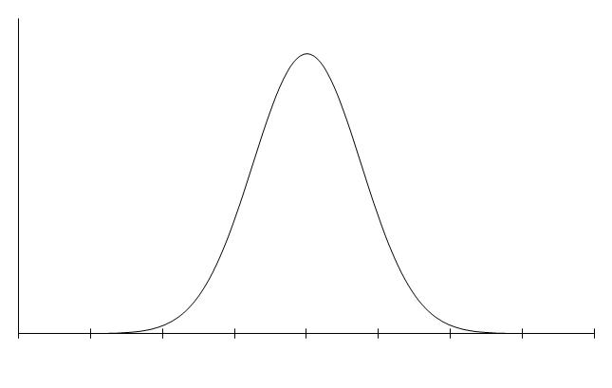
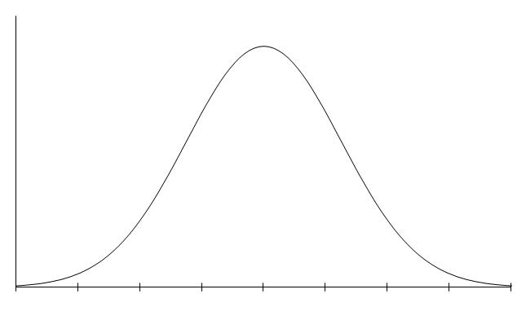
T
X=T+E

Slide 9
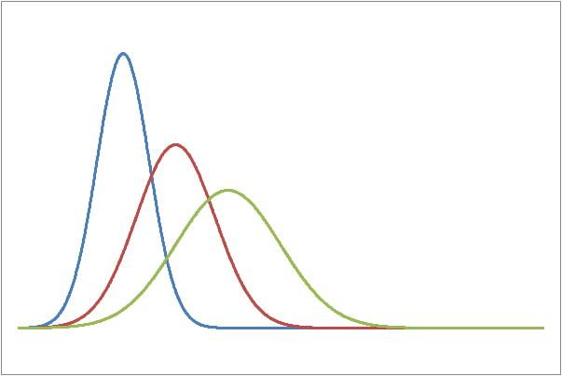
True Scores
Measurement error around a T can be large or small
T₁
T₂
T₃

Slide 10
Domain Sampling Theory
Another Central Component of CTT
Another way of thinking about populations and samples
Domain - Population or universe of all possible items measuring a single concept or trait (theoretically infinite)
Test – a sample of items from that universe

Slide 11
Domain Sampling Theory
A person’s true score would be obtained by having them respond to all items in the “universe” of items
We only see responses to the sample of items on the test
So, reliability is the proportion of variance in the “universe” explained by the test variance

Slide 12
Domain Sampling Theory
A universe is made up of a (possibly infinitely) large number of items
So, as tests get longer they represent the domain better, therefore longer tests should have higher reliability
Also, if we take multiple random samples from the population we can have a distribution of sample scores that represent the population

Slide 13
Domain Sampling Theory
Each random sample from the universe would be “randomly parallel” to each other
Unbiased estimate of reliability
= correlation between test and true score
= average correlation between the test and all other randomly parallel tests

Slide 14
Classical Test Theory Reliability
Reliability is theoretically the correlation between a test-score and the true score, squared
Essentially the proportion of X that is T
This can’t be measured directly so we use other methods to estimate

Slide 15
CTT: Reliability Index
Reliability can be viewed as a measure of consistency or how well as test “holds together”
Reliability is measured on a scale of 0-1. The greater the number the higher the reliability.

Slide 16
CTT: Reliability Index
The approach to estimating reliability depends on
Estimation of “true” score
Source of measurement error
Types of reliability
Test-retest
Parallel Forms
Split-half
Internal Consistency

Slide 17
CTT: Test-Retest Reliability
Evaluates the error associated with administering a test at two different times.
Time Sampling Error
How-To:
Give test at Time 1
Give SAME TEST at Time 2
Calculate r for the two scores
• Easy to do; one test does it all.

Slide 18
CTT: Test-Retest Reliability
Assume 2 administrations X₁ and X₂
The correlation between the 2 administrations is the reliability

Slide 19
CTT: Test-Retest Reliability
Sources of error
random fluctuations in performance
uncontrolled testing conditions
extreme changes in weather
sudden noises / chronic noise
other distractions
internal factors
illness, fatigue, emotional strain, worry
recent experiences

Slide 20
CTT: Test-Retest Reliability
Generally used to evaluate constant traits.
Intelligence, personality
Not appropriate for qualities that change rapidly over time.
Mood, hunger
Problem: Carryover Effects
Exposure to the test at time #1 influences scores on the test at time #2
Only a problem when the effects are random.
If everybody goes up 5pts, you still have the same variability

Slide 21
CTT: Test-Retest Reliability
Practice effects
Type of carryover effect
Some skills improve with practice
Manual dexterity, ingenuity or creativity
Practice effects may not benefit everybody in the same way.
Carryover & Practice effects more of a problem with short inter-test intervals (ITI).
But, longer ITI’s have other problems
developmental change, maturation, exposure to historical events

Slide 22
CTT: Parallel Forms Reliability
Evaluates the error associated with selecting a particular set of items.
Item Sampling Error
How To:
Develop a large pool of items (i.e. Domain) of varying difficulty.
Choose equal distributions of difficult / easy items to produce multiple forms of the same test.
Give both forms close in time.
Calculate r for the two administrations.

Slide 23
CTT: Parallel Forms Reliability
Also Known As:
Alternative Forms or Equivalent Forms
Can give parallel forms at different points in time; produces error estimates of time and item sampling.
One of the most rigorous assessments of reliability currently in use.
Infrequently used in practice – too expensive to develop two tests.

Slide 24
CTT: Parallel Forms Reliability
Assume 2 parallel tests X and X’
The correlation between the 2 parallel forms is the reliability

Slide 25
CTT: Split Half Reliability
What if we treat halves of one test as parallel forms? (Single test as whole domain)
That’s what a split-half reliability does
This is testing for Internal Consistency
Scores on one half of a test are correlated with scores on the second half of a test.
Big question: “How to split?”
First half vs. last half
Odd vs Even
Create item groups called testlets

Slide 26
CTT: Split Half Reliability
How to:
Compute scores for two halves of single test, calculate r.
Problem:
Considering the domain sampling theory what’s wrong with this approach?
A 20 item test cut in half, is 2 10-item tests, what does that do to the reliability?
If only we could correct for that…

Slide 27
Spearman Brown Formula
Estimates the reliability for the entire test based on the split-half
Can also be used to estimate the affect changing the number of items on a test has on the reliability
Where r* is the estimated reliability, r is the correlation between the halves, j is the new length proportional to the old length

Slide 28
Spearman Brown Formula
For a split-half it would be
Since the full length of the test is twice the length of each half

Slide 29
Spearman Brown Formula
Example 1: a 30 item test with a split half reliability of .65
The .79 is a much better reliability than the .65

Slide 30
Spearman Brown Formula
Example 2: a 30 item test with a test re-test reliability of .65 is lengthened to 90 items
Example 3: a 30 item test with a test re-test reliability of .65 is cut to 15 items

Slide 31
Detour 1: Variance Sum Law
Often multiple items are combined in order to create a composite score
The variance of the composite is a combination of the variances and covariances of the items creating it
General Variance Sum Law states that if X and Y are random variables:

Slide 32
Detour 1: Variance Sum Law
Given multiple variables we can create a variance/covariance matrix
For 3 items:

Slide 33
Detour 1: Variance Sum Law
Example Variables X, Y and Z
Covariance Matrix:
By the variance sum law the composite variance would be:

Slide 34
Detour 1: Variance Sum Law
By the variance sum law the composite variance would be:

Slide 35
CTT: Internal Consistency Reliability
If items are measuring the same construct they should elicit similar if not identical responses
Coefficient OR Cronbach’s Alpha is a widely used measure of internal consistency for continuous data
Knowing the a composite is a sum of the variances and covariances of a measure we can assess consistency by how much covariance exists between the items relative to the total variance

Slide 36
CTT: Internal Consistency Reliability
Coefficient Alpha is defined as:
is the composite variance (if items were summed)
is covariance between the ith and jth items where i is not equal to j
k is the number of items

Slide 37
CTT: Internal Consistency Reliability
Using the same continuous items X, Y and Z
The covariance matrix is:
The total variance is 254.41
The sum of all the covariances is 152.03

Slide 38
CTT: Internal Consistency Reliability
Coefficient Alpha can also be defined as:
is the composite variance (if items were summed)
is variance for each item
k is the number of items

Slide 39
CTT: Internal Consistency Reliability
Using the same continuous items X, Y and Z
The covariance matrix is:
The total variance is 254.41
The sum of all the variances is 102.38

Slide 40
CTT: Internal Consistency Reliability
From SPSS
****** Method 1 (space saver) will be used for this analysis ******
R E L I A B I L I T Y A N A L Y S I S - S C A L E (A L P H A)
Reliability Coefficients
N of Cases = 100.0 N of Items = 3
Alpha = .8964

Slide 41
CTT: Internal Consistency Reliability
Coefficient Alpha is considered a lower-bound estimate of the reliability of continuous items
It was developed by Cronbach in the 50’s but is based on an earlier formula by Kuder and Richardson in the 30’s that tackled internal consistency for dichotomous (yes/no, right/wrong) items

Slide 42
Detour 2: Dichotomous Items
If Y is a dichotomous item:
P = proportion of successes OR items answer correctly
Q = proportion of failures OR items answer incorrectly
= P, observed proportion of successes
= PQ

Slide 43
CTT: Internal Consistency Reliability
Kuder and Richardson developed the KR₂₀ that is defined as
Where pq is the variance for each dichotomous item
The KR₂₁ is a quick and dirty estimate of the KR₂₀

Slide 44
CTT: Reliability of Observations
What if you’re not using a test but instead observing individual’s behaviors as a psychological assessment tool?
How can we tell if the judge’s (assessor’s) are reliable?

Slide 45
CTT: Reliability of Observations
Typically a set of criteria are established for judging the behavior and the judge is trained on the criteria
Then to establish the reliability of both the set of criteria and the judge, multiple judges rate the same series of behaviors
The correlation between the judges is the typical measure of reliability
But, couldn’t they agree by accident? Especially on dichotomous or ordinal scales?

Slide 46
CTT: Reliability of Observations
Kappa is a measure of inter-rater reliability that controls for chance agreement
Values range from -1 (less agreement than expected by chance) to +1 (perfect agreement)
+.75 “excellent”
.40 - .75 “fair to good”
Below .40 “poor”

Slide 47
Standard Error of Measurement
So far we’ve talked about the standard error of measurement as the error associated with trying to estimate a true score from a specific test
This error can come from many sources
We can calculate it’s size by:
s is the standard deviation; r is reliability

Slide 48
Standard Error of Measurement
Using the same continuous items X, Y and Z
The total variance is 254.41
s = SQRT(254.41) = 15.95
α = .8964

Slide 49
CTT: The Prophecy Formula
How much reliability do we want?
Typically we want values above .80
What if we don’t have them?
The Spearman-Brown can be algebraically manipulated to achieve
j = # of tests at the current length,
r_{d} = desired reliability, r_{o} = observed reliability

Slide 50
CTT: The Prophecy Formula
Using the same continuous items X, Y and Z
α = .8964
What if we want a .95 reliability?
We need a test that is 2.2 times longer than the original
Nearly 7 items to achieve .95 reliability

Slide 51
CTT: Attenuation
Correlations are typically sought at the true score level but the presence of measurement error can cloud (attenuate) the size the relationship
We can correct the size of a correlation for the low reliability of the items.
Called the Correction for Attenuation

Slide 52
CTT: Attenuation
Correction for attenuation is calculated as:
is the corrected correlation
is the uncorrected correlation
the reliabilities of the tests

Slide 53
CTT: Attenuation
For example X and Y are correlated at .45, X has a reliability of .8 and Y has a reliability of .6, the corrected correlation is

