Slide 1
Factor Analysis
Psy 427
Cal State Northridge
Andrew Ainsworth PhD

Slide 2
Topics so far…
Defining Psychometrics and History
Basic Inferential Stats and Norms
Correlation and Regression
Reliability
Validity

Slide 3
Putting it together
“Goal” of psychometrics
To measure/quantify psychological phenomenon
To try and use measurable/quantifiable items (e.g. questionnaires, behavioral observations) to “capture” some metaphysical or at least directly un-measurable concept

Slide 4
Putting it together
To reach that goal we need…
Items that actually relate to the concept that we are trying to measure (that’s validity)
And for this we used correlation and prediction to show criterion (concurrent and predictive) and construct (convergent and discriminant) related evidence for validity
Note: The criteria we use in criterion related validity is not the concept directly either, but another way (e.g. behavioral, clinical) of measuring the concept.
Content related validity is decided separately

Slide 5
Putting it together
To reach that goal we need…
Items that consistently measure the construct across samples and time and that are consistently related to each other (that’s reliability)
We used correlation (test-retest, parallel forms, split-half) and the variance sum law (coefficient alpha) to measure reliability
We even talked about ways of calculating the number of items needed to reach a desired reliability

Slide 6
Putting it together
Why do we want consistent items?
Domain sampling says they should be
If the items are reliably measuring the same thing they should all be related to each other
Because we often want to create a single total score for each individual person (scaling)
How can we do that? What’s the easiest way? Could there be a better way?

Slide 7
Problem #1
Composite = Item1 + Item2 + Item3 + … + Itemk
Calculating a total score for any individual is often just a sum of the item scores which is essentially treating all the items as equally important (it weights them by 1)
Composite = (1*Item1) + (1*Item2) + (1*Item3) + … + (1*Itemk), etc.
Is there a reason to believe that every item would be equal in how well it relates to the intended concept?

Slide 8
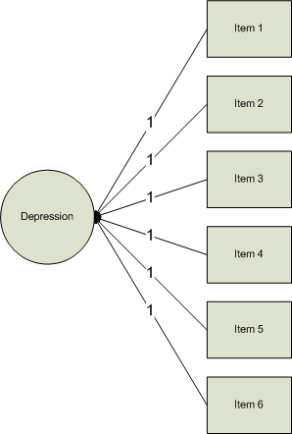

Slide 9
Problem #1
Regression
Why not develop a regression model that predicts the concept of interest using the items in the test?
What does each b represent? a?
What’s wrong with this picture? What’s missing?

Slide 10
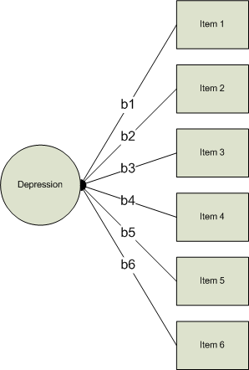

Slide 11
Problem #2
Tests that we use to measure a concept/construct typically have a moderate to large number of items (i.e. domain sampling)
With this comes a whole mess of relationships (i.e. covariances/correlations)
Alpha just looks for one consistent pattern, what if there are more patterns? And what if some items relate negatively (reverse coded)?

Slide 12
Correlation Matrix - MAS

Slide 13
Problem #2
So alpha can give us a single value that illustrates the relationship among the items as long as there is only one consistent pattern
If we could measure the concept directly we could do this differently and reduce the entire matrix on the previous page down to a single value as well; a single correlation

Slide 14
Multiple Correlation
Remember that:

Slide 15
30
Residual
20
CHD Mortality per 10,000
Prediction
10
0
2
4
6
8
10
12
Cigarette Consumption per Adult per Day

Slide 16
Multiple Correlation
So, that means that Y-hat is the part of Y that is related to ALL of the Xs combined
The multiple correlation is simple the correlation between Y and Y-hat
Let’s demonstrate

Slide 17
Multiple Correlation
We can even square the value and get the Squared Multiple Correlation (SMC), which will tell us the proportion of Y that is explained by the Xs
So, (importantly) if Y is the concept/criterion we are trying to measure and the Xs are the items of a test this would give us a single measure of how well the items measure the concept

Slide 18
What to do???
Same problem, if we can’t measure the concept directly we can’t apply a regression equation to establish the optimal weights for adding items up and we can’t reduce the number of patterns (using R) because we can’t measure the concept directly
If only there were a way around this…

Slide 19
What is Factor Analysis (FA)?
FA and PCA (principal components analysis) are methods of data reduction
Take many variables and explain them with a few “factors” or “components”
Correlated variables are grouped together and separated from other variables with low or no correlation

Slide 20
What is FA?
Patterns of correlations are identified and either used as descriptives (PCA) or as indicative of underlying theory (FA)
Process of providing an operational definition for latent construct (through regression equation)

Slide 21
What is FA?
FA and PCA are not much different than canonical correlation in terms of generating canonical variates from linear combinations of variables
Although there are now no “sides” of the equation
And your not necessarily correlating the “factors”, “components”, “variates”, etc.

Slide 22
General Steps to FA
Step 1: Selecting and Measuring a set of variables in a given domain
Step 2: Data screening in order to prepare the correlation matrix
Step 3: Factor Extraction
Step 4: Factor Rotation to increase interpretability
Step 5: Interpretation
Further Steps: Validation and Reliability of the measures

Slide 23
“Good Factor”
A good factor:
Makes sense
will be easy to interpret
simple structure
Lacks complex loadings

Slide 24
Problems w/ FA
Unlike many of the analyses so far there is no statistical criterion to compare the linear combination to
In MANOVA we create linear combinations that maximally differentiate groups
In Canonical correlation one linear combination is used to correlate with another

Slide 25
Problems w/ FA
It is more art than science
There are a number of extraction methods (PCA, FA, etc.)
There are a number of rotation methods (Orthogonal, Oblique)
Number of factors to extract
Communality estimates
ETC…
This is what makes it great…

Slide 26
Problems w/ FA
Life (researcher) saver
Often when nothing else can be salvaged from research a FA or PCA will be conducted

Slide 27
Types of FA
Exploratory FA
Summarizing data by grouping correlated variables
Investigating sets of measured variables related to theoretical constructs
Usually done near the onset of research
The type of FA and PCA we are talking about in this chapter

Slide 28
Types of FA
Confirmatory FA
More advanced technique
When factor structure is known or at least theorized
Testing generalization of factor structure to new data, etc.
This is tested through SEM methods discussed in the next chapter

Slide 29
Terminology
Observed Correlation Matrix
Reproduced Correlation Matrix
Residual Correlation Matrix

Slide 30
Terminology
Orthogonal Rotation
Loading Matrix – correlation between each variable and the factor
Oblique Rotation
Factor Correlation Matrix – correlation between the factors
Structure Matrix – correlation between factors and variables
Pattern Matrix – unique relationship between each factor and variable uncontaminated by overlap between the factors

Slide 31
Terminology
Factor Coefficient matrix – coefficients used to calculate factor scores (like regression coefficients)

Slide 32
FA vs. PCA conceptually
FA produces factors; PCA produces components
Factors cause variables; components are aggregates of the variables

Slide 33
Conceptual FA and PCA

Slide 34
FA vs. PCA conceptually
FA analyzes only the variance shared among the variables (common variance without error or unique variance); PCA analyzes all of the variance
FA: “What are the underlying processes that could produce these correlations?”; PCA: Just summarize empirical associations, very data driven

Slide 35
Questions
Three general goals: data reduction, describe relationships and test theories about relationships (next chapter)
How many interpretable factors exist in the data? or How many factors are needed to summarize the pattern of correlations?

Slide 36
Questions
What does each factor mean? Interpretation?
What is the percentage of variance in the data accounted for by the factors?

Slide 37
Questions
Which factors account for the most variance?
How well does the factor structure fit a given theory?
What would each subject’s score be if they could be measured directly on the factors?

Slide 38
Considerations (from Comrey and Lee, 1992)
Hypotheses about factors believed to underlie a domain
Should have 6 or more for stable solution
Include marker variables
Pure variables – correlated with only one factor
They define the factor clearly
Complex variables load on more than on factor and muddy the water

Slide 39
Considerations (from Comrey and Lee, 1992)
Make sure the sample chosen is spread out on possible scores on the variables and the factors being measured
Factors are known to change across sample and time points so samples should be tested separately before being pooled together

Slide 40
Assumptions
Assumes reliable correlations
Highly affected by missing data, outlying cases and truncated data
Data screening methods (e.g. transformations, etc.) can greatly improve poor factor analytic results

Slide 41
Assumptions
Sample Size and Missing Data
True missing data (MCAR) are handled in the usual ways (ch. 4) but regression methods may overfit
Factor analysis needs large samples and it is one of the only draw backs
The more reliable the correlations are the smaller the number of subjects needed
Need enough subjects for stable estimates

Slide 42
Assumptions
Comrey and Lee
50 very poor, 100 poor, 200 fair, 300 good, 500 very good and 1000+ excellent
Shoot for minimum of 300 usually
More highly correlated markers less subjects

Slide 43
Assumptions
Normality
Univariate - normally distributed variables make the solution stronger but not necessary
Multivariate – is assumed when assessing number of factors; usually tested univariately

Slide 44
Assumptions
No outliers – obvious influence on correlations would bias results
Multicollinearity/Singularity
In PCA it is not problem; no inversions
In FA, if det(R) or any eigenvalue approaches 0 -> multicollinearity is likely
Also investigate inter-item SMCs approaching 1

Slide 45
Assumptions
Factorable R matrix
Need inter-item correlations > .30 or FA is unlikely
Large inter-item correlations does not guarantee solution either
Duos
Multidimensionality
Matrix of partials adjusted for other variables
Other tests

Slide 46
Assumptions
Variables as outliers
Some variables don’t work
Explain very little variance
Relates poorly with factor
Low SMCs with other items
Low loadings

Slide 47
Extraction Methods
There are many (dozens at least)
All extract orthoganal sets of factors (components) that reproduce the R matrix
Different techniques – some maximize variance, others minimize the residual matrix (R – reproduced R)
With large stable sample they all should be relatively the same

Slide 48
Extraction Methods
Usually un-interpretable without rotation (next)
Differ in output depending on combinations of
Extraction method
Communality estimates
Number of factors extracted
Rotational Method

Slide 49
Extraction Methods
PCA vs. FA (family)
PCA begins with 1s in the diagonal of the correlation matrix; all variance extracted; each variable giving equal weight; outputs inflated communality estimate
FA begins with a communality estimates (e.g. SMC) in the diagonal; analyzes only common variance; outputs a more realistic communality estimate

Slide 50
Extraction Methods
PCA analyzes variance
FA analyzes covariance (communality)
PCA reproduces the R matrix (near) perfectly
FA is a close approximation to the R matrix

Slide 51
Extraction Methods
PCA – the goal is to extract as much variance with the least amount of factors
FA – the goal is to explain as much of the correlations with a minimum number of factors
PCA gives a unique solution
FA can give multiple solutions depending on the method and the estimates of communality

Slide 52
Extraction Methods
PCA
Extracts maximum variance with each component
First component is a linear combination of variables the maximizes component score variance for the cases
The second (etc.) extracts the max. variance from the residual matrix left over after extracting the first component (therefore orthogonal to the first)
If all components retained, all variance explained

Slide 53
Extraction Methods
Principal (Axis) Factors
Estimates of communalities (SMC) are in the diagonal; used as starting values for the communality estimation (iterative)
Removes unique and error variance
Solution depends on quality of the initial communality estimates

Slide 54
Extraction Methods
Maximum Likelihood
Computationally intensive method for estimating loadings that maximize the likelihood (probability) of the correlation matrix.
Unweighted least squares – ignores diagonal and tries to minimize off diagonal residuals
Communalites are derived from the solution
Originally called Minimum Residual method (Comrey)

Slide 55
Extraction Methods
Generalized (weighted) least squares
Also minimizes the off diagonal residuals
Variables with larger communalities are given more weight in the analysis
Many Other methods

Slide 56
Rotation Methods
After extraction (regardless of method) good luck interpreting result
Rotation is used to improve interpretability and utility
A orthogonally rotated solution is mathematically equivalent to un-rotated and other orthogonal solutions
Stable and large N -> same result

Slide 57
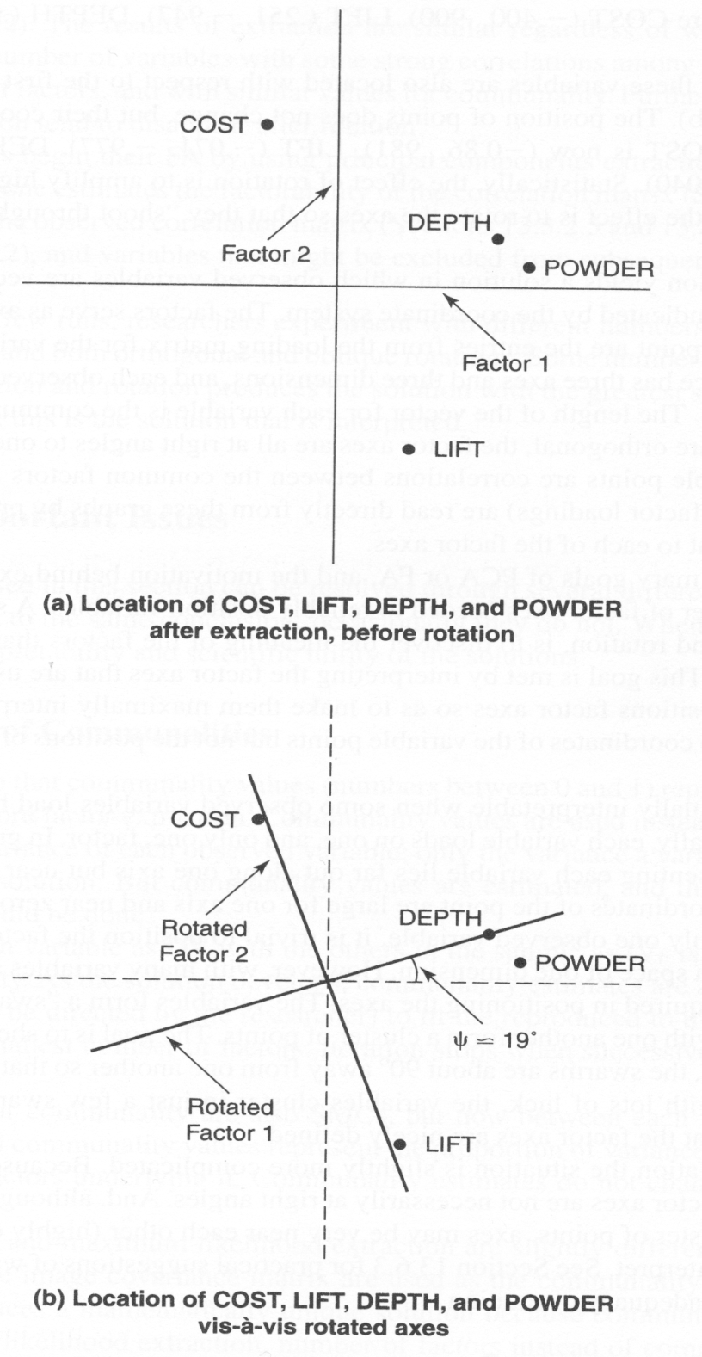
Geometric Rotation

Slide 58
Geometric Rotation
Factor extraction equivalent to coordinate planes
Factors are the axes
Length of the line from the origin to the variable coordinates is equal to the communality for that variable
Orthogonal Factors are at right angles

Slide 59
Geometric Rotation
Factor loadings are found by dropping a line from the variable coordinates to the factor at a right angle
Repositioning the axes changes the loadings on the factor but keeps the relative positioning of the points the same

Slide 60
Rotation Methods
Orthogonal vs. Oblique
Orthogonal rotation keeps factors un-correlated while increasing the meaning of the factors
Oblique rotation allows the factors to correlate leading to a conceptually clearer picture but a nightmare for explanation

Slide 61
Rotation Methods
Orthogonal Rotation Methods
Varimax – most popular
Simple structure by maximizing variance of loadings within factors across variables
Makes large loading larger and small loadings smaller
Spreads the variance from first (largest) factor to other smaller factors

Slide 62
Rotation Methods
Orthogonal Rotation Methods
Quartimax
Opposite of Varimax
Simplifies variables by maximizing variance with variables across factors
Varimax works on the columns of the loading matrix; Quartimax works on the rows
Not used as often; simplifying variables is not usually a goal

Slide 63
Rotation Methods
Orthogonal Rotation Methods
Equamax is a hybrid of the earlier two that tries to simultaneously simplify factors and variables
Not that popular either

Slide 64
Rotation Methods
Oblique Rotation Techniques
Direct Oblimin
Begins with an unrotated solution
Has a parameter (gamma in SPSS) that allows the user to define the amount of correlation acceptable; gamma values near -4 -> orthogonal, 0 leads to mild correlations (also direct quartimin) and 1 highly correlated

Slide 65
Rotation Methods
Oblique Rotation Techniques
Promax – most recommended
Solution is rotated maximally with an orthogonal rotation
This is followed by oblique rotation
Orthogonal loadings are raised to powers in order to drive down small loadings
Simple structure is reached
Easy and quick method

Slide 66
What else?
How many factors do you extract?
One convention is to extract all factors with eigenvalues greater than 1
Another is to extract all factors with non-negative eigenvalues
Yet another is to look at the scree plot
Try multiple numbers and see what gives best interpretation.

Slide 67
Eigenvalues greater than 1

Slide 68
Scree Plot

Slide 69
What else?
How do you know when the factor structure is good?
When it makes sense and has a simple (relatively) structure.
How do you interpret factors?
Good question, that is where the true art of this come in.

