Slide 1
Theories of Intelligence I: The Binet Scales
Psy 427
Cal State Northridge
Andrew Ainsworth PhD

Slide 2
Defining Intelligence
Like any concept in psychology one of the principal challenges is defining intelligence
In the face of this challenge there are many working definitions of intelligence proposed

Slide 3
Defining Intelligence
Binet
“ the tendency to take and maintain a definite direction; the capacity to make adaptations for the purpose of attaining a desired end, and the power of autocriticism”
Spearman
The ability to educe either relations or correlates
Gardner
The ability “to resolve genuine problems or difficulties as they are encountered”

Slide 4
Defining Intelligence
There are many definitions and each tends to portray a general theory followed by the researcher
Three independent research traditions in the study of intelligence
Psychometric – test structure (this and next chapter)
Information processing – learning and problem solving (Chapter 15)
Cognitive Approaches – adaptation to real-world demands (Chapter 15)

Slide 5
Instigating Intelligence Testing
In France at the end of the 19th century
French minister made a controversial decision to try and identify intellectually limited children in order to remove them from regular classes
Supposedly, so they could receive specialized training to help bring them up to the intellect of their same-aged counterparts
1904 the minister appoints a committee to recommend a procedure for identifying intellectually limited children

Slide 6
Two Early Principles
Age differentiation
one can differentiate older children from younger children based upon their mental capacities
older children have greater skills than younger children
Mental age – knowledge and task ability of a specific age group
These abilities were assessed and each respondent compared in the past
Today IRT is used to calculate the ability levels

Slide 7
Two Early Principles
General Mental Ability
intelligence may be composed of several individual factors, but
Binet was interested in measuring the sum total of them all
Considered general intelligence

Slide 8
General Mental Ability
First proposed by Galton (Hereditary Genius)
Also independently proposed by Charles Spearman
Intelligence consists of one general factor (g) plus a large number of specific factors

Slide 9
Spearman’s g
g acts like a single general factor
The higher some scores on g the higher they are on the specific intelligences
Approximately 50% of the variance in a set of diverse mental tests is represented by the g factor
Spearman developed factor analysis because he noticed that most, seemingly unrelated, abilities were positively correlated; this is known as positive manifold

Slide 10
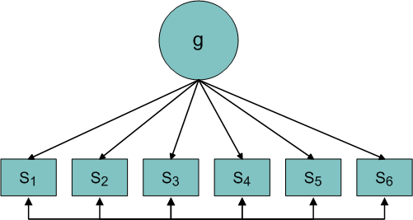
S = verbal ability, math ability, visual spatial relations, vocabulary, etc.

Slide 11
Other Theories of Intelligence
Howard Gardner – Multiple Intelligences
Eight different kinds of intelligence
Linguistic: the ability to use with clarity the core operations of language
politicians
Logical-Mathematical: logical, mathematical, and scientific ability
scientists
Intrapersonal: the ability to form an accurate model of oneself and to use that model to operate effectively in life
therapists, novelists

Slide 12
Other Theories of Intelligence
Howard Gardner – Multiple Intelligences
Eight different kinds of intelligence
Interpersonal: the ability to notice and make distinctions among other individuals’ moods, temperaments, motivations
politicians, religious leaders, therapists
Musical: the ability to use the core set of musical elements (pitch, rhythm, timbre)
musicians, singers, composers
Spatial: the capacity to perceive the world accurately and to recreate one’s visual experience
sailors, engineers, sculptors, painters

Slide 13
Other Theories of Intelligence
Howard Gardner – Multiple Intelligences
Eight different kinds of intelligence
Bodily-kinesthetic: control of one’s bodily motions and the ability to handle objects skillfully
actors, dancers, acrobats, athletes
Naturalistic: the ability to comprehend, classify and understand things encountered in the world of nature
farmers, ranchers, animal handlers, zoo keepers

Slide 14
Other Theories of Intelligence
Horn & Noll (1977): gf-gc
gf: fluid intelligence
those abilities that allow us to reason, think, and acquire new knowledge
allows us to learn new things
gc: crystallized intelligence
knowledge and understanding that we have acquired
“combined wisdom”

Slide 15
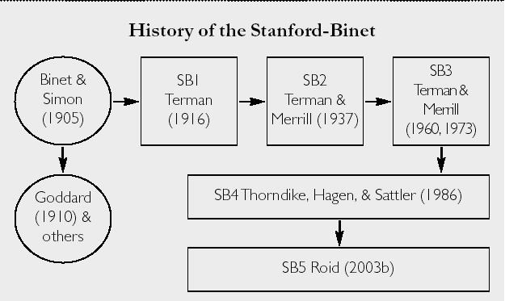
Binet Scales: History

Slide 16
Binet’s Beginnings
Binet begins with a unitary g model, one intelligence, in 1905.
30 items, age scale
3 levels of intellectual deficiency
Idiot – most severe impairment
Imbecile – moderate impairment
Moron – mild impairment
Problems
Question of unit
Small normative sample (50 children)
Limited Validity

Slide 17
Binet’s Beginnings
1908: age scale continues
Introduction of the term “mental age”
Described the level which an individual could reach on the 1908 scale
If you can perform tasks (e.g. answer questions) that can be performed by 2/3 to 3/4 of average 10 year olds, then you get a mental age of 10
Still, problems with single score & heavy verbal requirement

Slide 18
Binet’s Beginnings
1916: Binet’s test comes to the United States (via Lewis Terman of Stanford)
Increased standardization sample (although all children in sample were white, native-californians)
Retained the notion of age differentiation (used an age scale)
Retained the notion of mental age

Slide 19
Binet’s Beginnings
1916: Binet’s test comes to the United States (via Lewis Terman of Stanford)
combined mental age with chronological age to produce first intelligence quotient

Slide 20
Binet’s Beginnings
1916: Binet’s test comes to the United States (via Lewis Terman of Stanford)
Problems
Test topped out at a mental age of 19.5; everybody older than that would produce some kind of mental retardation (MA < CA)
So typically any mental age above 16 would be set at 16 (there was a belief at that time that Mental Age maxed at age 16)

Slide 21
Binet’s Beginnings
1937: Larger standardization sample
11 states in standardization sample
More urban subjects than rural
Only whites included in standardization sample
Alternate forms constructed: L and M
Problems:
Different sd’s at each age for the standardization sample.
Sd at age 6 = 12.5; SD at age 12 = 20.0
IQ’s at different ages were not comparable

Slide 22
Binet’s Beginnings
1960: Both forms of 1937 test combined to produce the Stanford Binet L-M
introduced the concept of a deviation IQ
mean 100; SD 16; deviation IQ determined by how far above/below the mean a person scored within a particular age band
1960 norms better, still all white
1972 - re-normed, included nonwhite standardization subjects for the first time

Slide 23
The Modern Binet Scales
1986/2003: Stanford Binet Intelligence Scale: Fourth and Fifth editions
Drastically revised items, and structure (hierarchical).
No longer dependent upon a unitary intelligence construct; theoretically-linked to the gf-gc and multiple intelligence model
Thurstone’s Multidimesional Model: intelligence is made up of primary mental abilities and these abilities in turn are driven by g.

Slide 24
Hierarchical Structure of SB4

Slide 25
The SB4 Intelligence Model: The Subtests
Routing Subtests used for “adaptive” testing
1986
Used to test knowledge of words and their meaning
Highest level attained on vocabulary test indicates starting point for remainder of tests
This is used to gauge “age group” for test
“Vocabulary loads highly on g”
2003
Added an additional non-verbal routing subtest

Slide 26
The SB4 Intelligence Model: The Subtests
Routing Subtests used for “adaptive” testing
Once an age range is established using the routing subtest(s)
This helped to choose the level of the remaining items; start point
Basal – level at which a minimum number of correct responses is obtained
Ceiling – number of incorrect responses that indicate that the items are too difficult

Slide 27
The SB4: 15 Subtests
Bead Memory
Two levels
Single & Double Bead displays for younger children
Sequential displays for older individuals
Used to test visual short-term memory
Quantitative
Items presented visually, subject responds verbally
Scrap paper is permitted
Used to test quantitative skills (mathematics)

Slide 28
The SB4: 15 Subtests
Memory for Sentences
Tests auditory short-term memory
Sentences are presented verbally, must be repeated verbally
Pattern Analysis
Tests visual-spatial and motor skills
Arrays of blocks presented visually, blocks must be assembled by hand to match patterns

Slide 29
The SB4: 15 Subtests
Comprehension
NOT a test of reading comprehension, but a test of social and moral reasoning
Items are presented verbally, must be answered verbally
Absurdities
Another test of social, logical reasoning
Items are presented visually, must be answered verbally

Slide 30
The SB4: 15 Subtests
Memory for Digits
Two subtests
digits forward
digits backward
BUT, both scores are combined for the subtest score
Taps short-term auditory memory and active working memory

Slide 31
The SB4: 15 Subtests
Copying
Two levels
Copying blocks for younger children
Paper and pencil for older children
Tests visual-motor integration and visual spatial skills
Memory for Objects
Tests sequential, visual, short-term memory
Matrices
Tests non-verbal, logical-deductive reasoning

Slide 32
The SB4: 15 Subtests
Number Series
Tests quantitative and logical-deductive reasoning
Scratch paper is allowed
Paper Folding and cutting
Tests visual-spatial reasoning
No actual cutting occurs in actual test items, only for sample items
Verbal Relations
Tests verbal, logical reasoning

Slide 33
The SB4: 15 Subtests
Equation Building
Tests quantitative, logical, deductive reasoning skills and active working memory

Slide 34
SB4 Scoring Subtests
Items in each subtest are administered to obtain basal and ceiling measures.
Highest number item administered minus number of failed items = Raw Score
Raw scores are converted into Standard Age Scores (Mean 50, SD of 8)
Subtests are then combined to produce Area Scores

Slide 35
The Four SB4 Scales
Verbal Reasoning Area
Vocabulary, Comprehension, Absurdities, Verbal relations
Abstract/Visual Reasoning Area
Pattern Analysis, Copying, Matrices, Paper Folding & Cutting
Quantitative Reasoning Area
Quantitative, Number Series, Equation Building
Short-Term Memory Area
Bead Memory, Memory for Sentences, Memory for Digits, Memory for Objects

Slide 36
SB4 Scales and Scores
Four Scales each produce their own Area Scores
Four Area Scores are combined to produce a “Test Composite”
Mean 100, SD 16

Slide 37
Advantages of the SB4
Based on modern theories of intelligence
gf-gc foundation
Tests wide range of intelligences
Tests wide range of ages with single instrument
Can test as young as 2 and as old as adulthood
Strong reliability & validity
More sensitive in higher end of abilities
Better to use for discrimination among gifted individuals
Tests short-term memory explicitly

Slide 38
Disadvantages of the SB4
Eliminated Age Scale for a point scale
“Cumbersome” test
Taps many areas, requires tester to be facile with all 15 scales
DOES NOT require tester to obtain basal and ceiling measures on all 15 tests
Possible ethnic/socio-economic biases
Older norms than other child-based tests (at present)

Slide 39
Hierarchical Structure of SB5

Slide 40
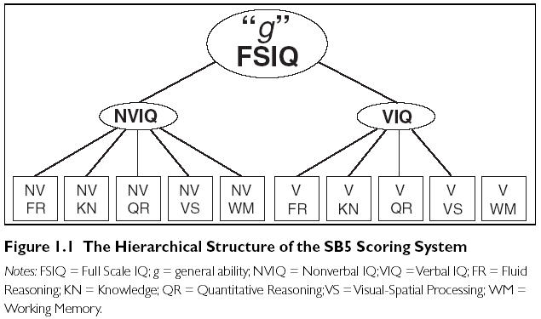
Scoring of the SB5

Slide 41
The SB5 Intelligence Model: The Subtests
Routing Subtests used for “adaptive” testing
2003
Added non-verbal routing subtest (i.e. Matrices) as an addition to the vocabulary test

Slide 42
The SB5: 10 Subtests
Contains many of the subtests of SB4 but they have been altered/combined
Represents abilities assessed by all former versions of the test
The Fifth Edition reintroduces the age-scale format for the body of the test
Presenting a variety of items at each level of the test.
Intended to provide a variety of content to
keep examinees involved in the testing experience
and to allow for the introduction of developmentally distinct items across levels
The points system was also retained

Slide 43
The SB5: 10 Subtests
The short-term memory was shifted over to a working memory model
The other subscales remained essentially the same except
The addition of Visual/Spatial Reasoning
And a few changes to the names of the subscales

Slide 44
Changes from SB4 to SB5

Slide 45
The SB5: 10 Subtests

Slide 46
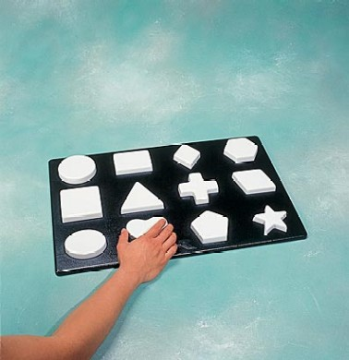
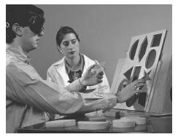
Form Boards

Slide 47
SB5 Information
Changed to using an SD of 15 instead of 16
Much more game oriented (e.g. toys, brightly colored)
Tapped into extremes in intelligence (2 – 85+ years)
Standardized by stratified sample of 4800 respondents

Slide 48
SB5 Information
Full-scale IQ reliability is .97 - .98 for each of age ranges
Average reliabilities for the 3 IQs are .98 (full-scale), .95 (non-verbal), and .96 (verbal)
Five factors range from .90 - .92
Test-retest range from the .7s to the .9s
Manual touts support for validity as well

