Slide 1
MANOVA Basics
Psy 524
Andrew Ainsworth, PhD
Psychology Department
California State University, Northridge

Slide 2
Multivariate Analysis of Variance
an extension of ANOVA in which main effects and interactions are assessed on a combination of DVs
MANOVA tests whether mean differences among groups on a combination of DVs is likely to occur by chance

Slide 3
Special case of canonical correlation
Continuous Ys on one side
Categorical Xs on the other

Slide 4
MANOVA
A new DV is created that is a linear combination of the individual DVs that maximizes the difference between groups.
In factorial designs a different linear combination of the DVs is created for each main effect and interaction that maximizes the group difference separately.
Also when the IVs have more than one level the DVs can be recombined to maximize paired comparisons

Slide 5
MANCOVA
is the multivariate extension of ANCOVA where the linear combination of DVs is adjusted for by one or more continuous covariates.
A covariate is a variable that is related to the DV, which you can’t manipulate, but you want to removes its (their) relationship from the DV before assessing differences on the IVs.

Slide 6
Basic requirements
2 or more DVs (I, R)
1 or more categorical IVs (N, O)
For MANCOVA you also need 1 or more continuous CVs (I, R)

Slide 7
MANOVA advantages over ANOVA
Diversification
With a single DV you “put all of your eggs in one basket”
Efficiency

Slide 8
MANOVA advantages over ANOVA
Using multiple ANOVAs inflates type 1 error rates and MANOVA helps control for the inflation
Under certain (rare) conditions MANOVA may find differences that do not show up under ANOVA

Slide 9
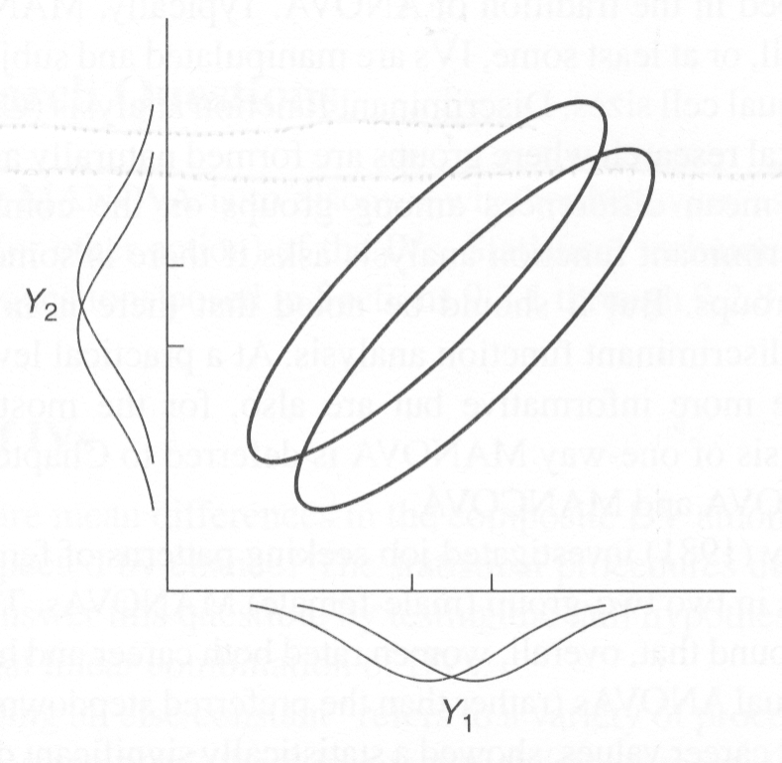
Under most circumstance the more complex an analysis becomes the less power there is

Slide 10
Kinds of Research Questions asked by MANOVA
Mainly the same as ANOVA just with linearly combined DVs

Slide 11
Multivariate: Are there any main effects?
Effect for 1 IV holding all other effects constant
Controlling for other effects by averaging over them in a factorial design
Holding extraneous variables constant or counterbalancing/randomizing their effects
Using covariates to adjust the composite DV in order to create a state of “pseudo equality”

Slide 12
Multivariate: Are there any main effects?
Tests of main effects are orthogonal if they are completely crossed and equal samples in each cell, they are only linked by a common error term

Slide 13
Multivariate: Are there any interactions among the IVs?
Does change in the linearly combined DV for one IV depend on the levels of another IV?
For example: Given three types of treatment, does one treatment work better for men and another work better for women?
If equal samples in each cell then one interaction is independent of main effects and other interactions.

Slide 14
Univariate: Which DVs are most important?
If there are any significant main effects or interactions, on which individual DV is there the most change (difference), if any, “caused” by the levels of the IV?
You can follow a significant MANOVA with individual ANOVAs in order to see on which DV is there large, medium, small or no effect.

Slide 15
Univariate: Which DVs are most important?
Another procedure is the Roy-Bargman step-down procedure which uses ANCOVA on each individual DV, with higher priority DVs as covariates.

Slide 16
What are the parameter estimates?
Marginal means are the best population estimates for the main effects and cell mean are the best estimates of interactions
When the Roy-Bargman step procedure is used then the interpretation is the best estimates of adjusted population values
All parameters are accompanied by standard error and/or confidence intervals.

Slide 17
Which levels of the IV are significantly different? – Follow up tests
Follow-up on significant main effects
Decompose any significant interactions

Slide 18
How strong is the IV(s)/composite DV association?
What is the proportion of the composite DV explained by each IV?
Can be measured multivariately and univariately (i.e., per DV)

Slide 19
Additional MANCOVA Question
Does use of covariates significantly adjust the composite DV scores?

Slide 20
Can MANOVA be used when assumptions are violated in repeated measure ANOVA?
The test of sphericity in repeated measures ANOVA is often violated
Corrections include:
adjustments of the degrees of freedom (e.g. Huynh-Feldt adjustment)
decomposing the test into multiple paired tests (e.g. trend analysis) or
treating the repeated levels as multiple DVs (e.g. profile analysis which we will talk about next)

Slide 21
Assumptions of MANOVA

Slide 22
Theoretical Considerations
The interpretation of MANOVA results are always taken in the context of the research design.
Once again, fancy statistics do not make up for poor design

Slide 23
Theoretical Considerations
Choice of DVs also needs to be carefully considered, highly correlated DVs severely weaken the power of the analysis.
Choice of the order in which DVs are entered in the stepdown analysis has an impact on interpretation, DVs that are causally (in theory) more important need to be given higher priority
Generalizability is limited to the population studied

Slide 24
Missing data, unequal samples, number of subjects and power
Missing data needs to be handled in the usual ways
Unequal samples cause non-orthogonality and the total sums of squares is less than all of the effects and error added up. This is handled by using either:
Type 3 sums of squares assumes the data was intended to be equal and the lack of balance does not reflect anything meaningful
Type 1 sums of square which weights the samples by size and emphasizes the difference in samples is meaningful

Slide 25
Missing data, unequal samples, number of subjects and power
You need more cases than DVs in every cell of the design and this can become difficult when the design becomes complex
If there are more DVs than cases in any cell the cell will become singular and cannot be inverted. If there are only a few cases more than DVs the assumption of equality of covariance matrices is likely to be rejected.

Slide 26
Missing data, unequal samples, number of subjects and power
Plus, with a small cases/DV ratio power is likely to be very small and the chance of finding a significant effect, even when there is one, is very unlikely
you can use programs like GANOVA to calculate power in MANOVA designs or you can estimate it by picking the DV with the smallest effect expected and calculate power on that variable in a univariate method

Slide 27
Missing data, unequal samples, number of subjects and power
Power in MANOVA also depends on the relationships among the DVs.
Power is highest when the pooled within cell correlation is high and negative. If the pooled within correlation is positive, zero or moderately negative the power is much less

Slide 28
Assumptions
Multivariate Normality
If there is at least 20 cases in the smallest cell the test is robust to violations of multivariate normality even when there is unequal n.
If you have smaller unbalanced designs than the assumption is assessed on the basis of researcher judgment.

Slide 29
assumptions
Absence of outliers - univariate and multivariate in every cell of the design
Linearity - MANOVA and MANCOVA assume linear relationships (DVs, CVs, DV/CV pairs)
Deviations from linearity reduce power:
Linear combinations do not maximize difference b/w groups
CVs do not maximally adjust the error

Slide 30
ASsumptions
Homogeneity of Regression
Reliability of CVs
Applies to DVs in stepdown procedure
No Multicollinearity/Singularity
Tested in each cell

Slide 31
ASsumptions
Homogeneity of Covariance Matrices - multivariate equivalent of homogeneity of variance.
Assumes that the variance/covariance matrix in each cell of the design is sampled from the same population so they can be reasonably pooled together to make an error term

Slide 32
assumptions
Homogeneity of Covariance Matrices –
If sample sizes are equal MANOVA has been shown to be robust to violations so Box’s M test can be ignored (it is highly sensitive anyway)

Slide 33
assumptions
Homogeneity of Covariance Matrices –
If sample sizes are unequal than evaluate Box’s M test at alpha < .001.
If this is met than a violation has occurred and the robustness of the test is questionable.

Slide 34
assumptions
Homogeneity of Covariance Matrices – if violated look then at the data:
If cells with larger samples have larger variances than the test is most likely robust
If the cells with fewer cases have larger variances than only null hypotheses are retained with confidence but to reject them is questionable. Use of a more stringent criterion (Pillai’s criteria instead of Wilk’s; more on this later)

Slide 35
MANOVA - Equations

Slide 36
Data design for MANOVA

Slide 37
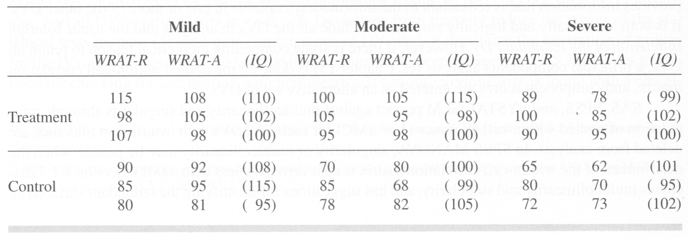
Data design for MANOVA

Slide 38
Steps to MANOVA
MANOVA is a multivariate generalization of ANOVA, so there are analogous parts to the simpler ANOVA equations

Slide 39
Steps to MANOVA
ANOVA –

Slide 40
Steps to MANOVA
When you have more than one IV the interaction looks something like this:

Slide 41
Steps to MANOVA
The full factorial design is:

Slide 42
Steps to MANOVA
MANOVA - You need to think in terms of matrices
Each subject now has multiple scores, there is a matrix of responses in each cell
Matrices of difference scores are calculated and the matrix squared
When the squared differences are summed you get a sum-of-squares-and-cross-products-matrix (S) which is the matrix counterpart to the sums of squares.
The determinants of the various S matrices are found and ratios between them are used to test hypotheses about the effects of the IVs on linear combination(s) of the DVs
In MANCOVA the S matrices are adjusted for by one or more covariates

Slide 43
Matrix Equations
If you take the three subjects in the treatment/mild disability cell:

Slide 44
Matrix Equations
You can get the means for disability by averaging over subjects and treatments

Slide 45
Matrix Equations
Means for treatment by averaging over subjects and disabilities

Slide 46
Matrix Equations
The grand mean is found by averaging over subjects, disabilities and treatments.

Slide 47
Matrix Equations
Differences are found by subtracting the matrices, for the first child in the mild/treatment group:

Slide 48
Matrix Equations
Instead of squaring the matrices you simply multiply the matrix by its transpose, for the first child in the mild/treatment group:

Slide 49
Matrix Equations
This is done on the whole data set at the same time, reorganizing the data to get the appropriate S matrices. The full break of sums of squares is:

Slide 50
Matrix Equations
If you go through this for every combination in the data you will get four S matrices (not including the S total matrix):

Slide 51
Test Statistic – Wilk’s Lambda
Once the S matrices are found the diagonals represent the sums of squares and the off diagonals are the cross products
The determinant of each matrix represents the generalized variance for that matrix
Using the determinants we can test for significance, there are many ways to this and one of the most is Wilk’s Lambda

Slide 52
Test Statistic – Wilk’s Lambda
this can be seen as the percent of non-overlap between the effect and the DVs.

Slide 53
Test Statistic – Wilk’s Lambda
For the interaction this would be:

Slide 54
Test Statistic – Wilk’s Lambda
Approximate Multivariate F for Wilk’s Lambda is

Slide 55
Test Statistic – Wilk’s Lambda
So in the example for the interaction:

Slide 56
Eta Squared

Slide 57
Partial Eta Squared

Slide 58
Multivariate Analysis of Covariance
The linear combination of DVs is adjusted for one or more Covariates.
The adjusted linear combinations of the DVs is the combination that would have been had all of the subjects scored the same on the CVs.

Slide 59
Multivariate Analysis of Covariance
Each subjects score is made up of the DVs and the CVs

Slide 60
Multivariate Analysis of Covariance
So that each S is a combination of the original S plus the SSCP for the CVs and the covariances between the DVs and the CVs.

Slide 61
Multivariate Analysis of Covariance

Slide 62
Multivariate Analysis of Covariance
Calculating Wilk’s Lambda is the same and for the most part the F-test is the same except calculating s and DF2:

Slide 63
Different Multivariate test criteria
Hotelling’s Trace
Wilk’s Lambda,
Pillai’s Trace
Roy’s Largest Root

Slide 64
Different Multivariate test criteria
When there are only two levels for an effect s=1 and all of the tests should be identical
When there are more than two levels the tests should be nearly identical but this is not always the case

Slide 65
Different Multivariate test criteria
When there are more than two levels there are multiple ways in which the data can be combined to separate the groups
(e.g. one dimension separates group 1 from groups 2 and 3, a second dimension separates group 2 from group 3, etc.)

Slide 66
Different Multivariate test criteria
Wilk’s Lambda, Hotelling’s Trace and Pillai’s trace all pool the variance from all the dimensions to create the test statistic.
Roy’s largest root only uses the variance from the dimension that separates the groups most (the largest “root” or difference).

Slide 67
Different Multivariate test criteria
The various formulas are (E is error and H is hypothesized effect):
Wilk’s Lambda - |E| |H + E| - It’s the ratio of error to effect plus error. Analogous to 1 – R2. Middle of the road in terms of how conservative a test it is.

Slide 68
Different Multivariate test criteria
The various formulas are (E is error and H is hypothesized effect):
Hotelling’s trace – Trace(H/E)=C and you look up C in a table to get the F value. It is analogous to an F-test. Very liberal test.

Slide 69
Different Multivariate test criteria
The various formulas are (E is error and H is hypothesized effect):
Pillai’s trace – Trace(H/(H + E)). Analogous to R2. Very conservative

Slide 70
Different Multivariate test criteria
The various formulas are (E is error and H is hypothesized effect):
Roy’s Largest Root - (H/(H + E)) and it looks for the biggest difference. It is variable in terms of how conservative it is.

Slide 71
Which do you choose?
For the most part stick with Wilk’s lambda. It’s the most widely used
Use Hotelling’s Trace if
Manipulated (experimental) variables
Very clean design with no internal validity problems
Pillai’s trace is the most conservative, but if your design has many problems (e.g. unbalanced, assumption violation, etc) pillai’s is supposed to be robust to these problems

Slide 72
Assessing DVs
If multivariate test is significant
Run multiple univariate F-tests (one per DV) in order to see on which DVs there are group differences, this assumes uncorrelated DVs.

Slide 73
Assessing DVs
The overall alpha level should be controlled for considering the multiple tests
The alpha levels can be divided equally or they can be set up to give more important tests a more liberal alpha level.

Slide 74
Assessing DVs
If DVs are correlated than individual F-tests are problematic but usually this is ignored and univariate Fs interpreted anyway

Slide 75
Assessing DVs
Roy-Bargman step down procedure
Can be used as follow-up to MANOVA or MANCOVA with correlated DVs or as alternative to multivariate analysis all together.

Slide 76
Assessing DVs
Roy-Bargman step down procedure
The theoretically most important DV is analyzed as an individual univariate test (DV1).
The next DV (DV2), in terms of theoretical importance, is then analyzed using DV1 as a covariate. This controls for the relationship between the two DVs.
DV3 (in terms of importance) is assessed with DV1 and DV2 as covariates, etc.

Slide 77
Assessing DVs
Discriminant Function analysis –
We will discuss this more later but…
It uses group membership as the DV and the MANOVA DVs as predictors of group membership
Using this as a follow up to MANOVA will give you the relative importance of each DV predicting group membership (in a multiple regression sense)

Slide 78
Specific Comparisons and Trend Analysis
With a significant multivariate (and univariate) test and more than two groups, this needs to be followed with comparisons of the individual groups.

Slide 79
Specific Comparisons and Trend Analysis
Just like any test discussed previously, this can be done with planned or post hoc comparisons.
Planned comparisons can be written into SPSS syntax and if post hoc you can adjust the test by the degrees of freedom to get a Scheffe adjustment.

