Slide 1
Multilevel Linear Models
Aka → Multilevel regression, Hierarchical Linear models, mixed models, random effects models, etc.
Dr. Andrew Ainsworth
Psy524/L
California State University, Northridge

Slide 2
Linear regression
In typical linear regression we estimate a single intercept value and one slope value per predictor.
This assumes “one-size-fits-all” for everyone in the data set
Any deviation of Y from Y’ is considered error and contributes to the standard error of estimate

Slide 3
Data example – “Popular” dataset from joop hox (2010)
Predicting a student’s self-rated popularity (continuous) from extraversion (continuous), female (0=male,1=female) and teacher’s experience (continuous)
Preview of 20 out of the 2000 cases in the data set →
Open up popular.sav to play along

Slide 4
Data example – “Popular” dataset from joop hox (2010)
Based on what we know of linear regression we can put together a multiple regression equation:
Solve for a and the bs
Any deviation of y-predicted from y is assumed to be a residual and random

Slide 5
Having a single intercept and one slope per predictor assumes that
all participants are from a single homogenous group (i.e., from a single population)
based around a single intercept/mean (i.e., Mu)
And that the impact that each X has on Y is consistent for all people in the dataset.
What about the sexes? Aren’t those separate groups?

Slide 6
What if the data were collected in groups and the participants were not randomly assigned to those groups (i.e., sounds like random effects anova)
In linear regression, as we have talked about it so far, how can we handle this?
In regular regression we assume a homogenous sample (i.e., the model applies the same for everyone) so option 1 is to ignore the grouping.
Let’s look at popular predicted by just extraversion (extrav)

Slide 7
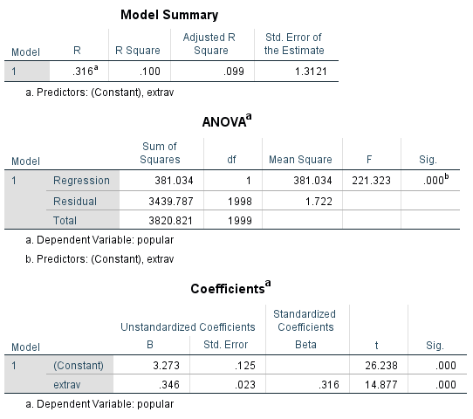
Data example – “Popular” dataset from joop hox (2010)
Ignoring groups/classes we get:
a = 3.273
b_{extrav} = .346
How do we interpret the intercept and slope values?

Slide 8
What if the data were collected in groups and the participants were not randomly assigned to those groups (i.e., sounds like random effects anova)
In linear regression as we have talked about it so far how can we handle this?
In regular regression we assume a homogenous sample (i.e., the model applies the same for everyone) so option 2 is to run a separate regression in each group.
We can create a separate regression equation for each group/class predicting popular from extrav

Slide 9
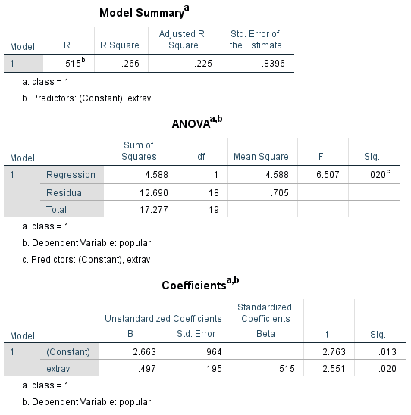
Data example – “Popular” dataset from joop hox (2010)
For group/class 1 we get:
a = 2.663
b_{extrav} = .497

Slide 10
Data example – “Popular” dataset from joop hox (2010)
100 regression models were computed
The average intercept is 2.394 with a StDev = 2.142
The average intercept is smaller (2.394 vs. 3.273) than the overall model
The average slope for extrav is 0.498 with a StDev = 0.277
The average slope is larger (.498 vs. .346) than the overall model
On average the models are not significant (however this could be because of power)

Slide 11
Data example – “Popular” dataset from joop hox (2010)
100 regression models were computed
Because we now have 100 intercept and slope estimates with some variability we can use that as data
For example, we can predict the intercepts and slopes by teacher experience (texp)
Does amount of time the teacher has been teaching account for variability in the intercepts and slopes?
Open up popular2.sav; preview of file →

Slide 12
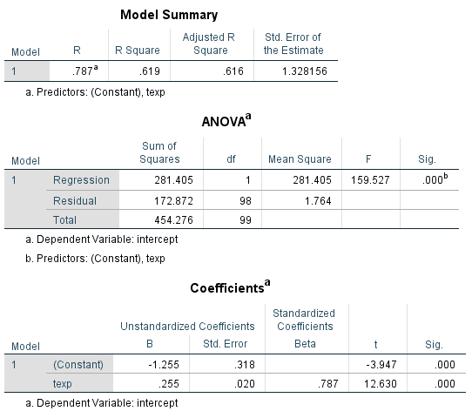
Data example – “Popular” dataset from joop hox (2010)
Predicting the intercepts from texp
Constant of -1.255 and a slope of 0.255
Both are significant
How do I interpret these?

Slide 13
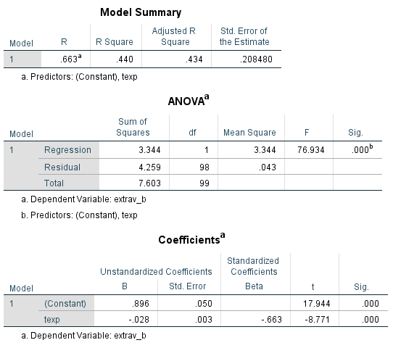
Data example – “Popular” dataset from joop hox (2010)
Predicting the slopes from texp
Constant of 0.896 and a slope of -0.028
Both are significant
How do I interpret these?

Slide 14
Reviewing the options
When data are grouped (e.g., clustered, collected within classes) we can:
Ignore the grouping and estimate 1 set of coefficients for everyone (i.e., one-size-fits-all)
Estimate 1 set of coefficients for each group; which will give us a distribution of intercepts and slopes

Slide 15
Fixed vs. random effects
Fixed Effects → When data are grouped and you chose to ignore the grouping and estimate one set of coefficients
Random Effects → Estimating a separate set of coefficients for each group
Fixed effects are generally simpler and provide more generalizability (i.e., the effect is the same for all groups)
Random effects create coefficients for each group which are then treated as random variables and can be used to test further hypotheses
Models can be a combination of fixed and random (i.e., fixed intercept, random slope)

Slide 16
Multilevel model (mlm)
Multilevel models are used when data are organized at more than one level
For example, the “popular” outcome was measured for pupils (level 1) within classrooms (level 2)
Multiple responses (level 1) from the same respondent (level 2)
Voting behavior of voters (level 1), within their voting precinct (level 2), within their city (level 3) and within their state (level 4)

Slide 17
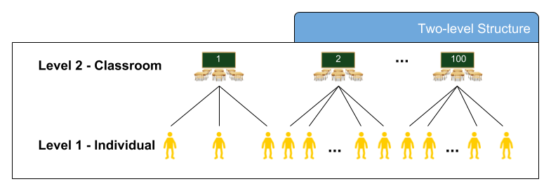
Multilevel model (mlm)

Slide 18
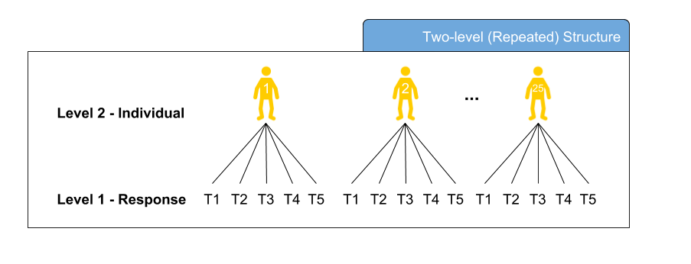
Multilevel model (mlm)

Slide 19
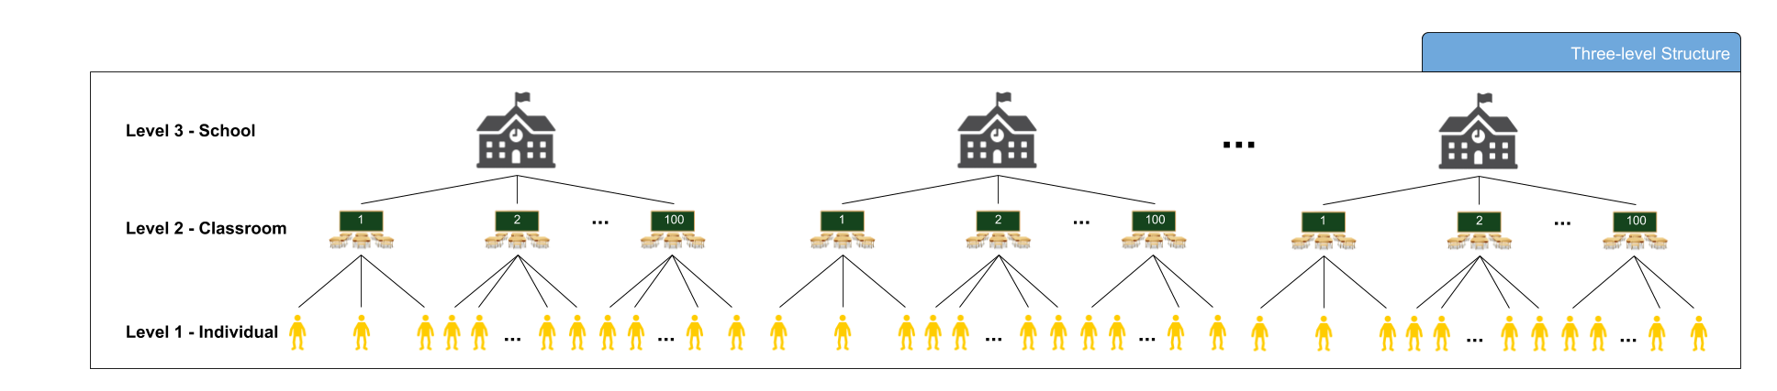
Multilevel model (mlm)

Slide 20
Advantages
Models can include variables that exist at different levels (e.g., student responses, teacher experience)
Shares many traits with random effects/nested designs
Can be used as an alternative to repeated measures analyses
Repeated measures analyses often have restrictive assumptions
Can estimate individual differences in growth over time
Can be used in place ANCOVA without the homogeneity of regression assumption
Does not have the independence of errors assumption

Slide 21
Research questions
Many of the questions you would ask in multiple regression apply but now you can ask additional, and super sexy, questions
Are groups different in mean/intercept?
Are groups different in slope?
Are their cross-level interactions?
Are their longitudinal trends (growth modeling)?
Are effects present when data are combined across studies (meta-analysis)?

Slide 22
Assumptions
As a linear model is shares many assumptions with multiple regression and data should be screened prior to analyses
Linearity
Normality
Outliers (both in and out of groups)
Missing data should be addressed (more of an issue in MLM)
No Multicollinearity/Singularity of predictors

Slide 23
Assumptions
Where MLM models differ from multiple regression
Unequal n across groups is OK
Power and sample size computations are more complicated (see the link in T&F for power calculator)
Maximum Likelihood (ML) approach (as opposed to least squares typical in multiple regression)
Larger sample size requirements (e.g., sample size requirements apply at all levels)

Slide 24
Assumptions
Where MLM models differ from multiple regression
No independence of errors assumption
accounting for the clustering/grouping addresses the dependencies
The intraclass correlation (ICC; coming soon) is a measure of the dependence of errors
The bigger the ICC the more bias (i.e., inflation of Type 1 error) is introduced if the clustering/grouping of responses is ignored.

Slide 25
Basic MLM Model
Single Level Fixed effect:
Multilevel Model
Level 1 (i.e., student):
Level 2 (i.e., class):

Slide 26
i = individuals, j = groups
Y_{ij} = DV scores at Level 1
X_{1ij} = Level 1 predictor
β_{0j} = intercept for DV in group j
β_{1j} = slope for DV in group j
e_{ij} = Level 1 error
γ₀₀ = overall/Level 2 intercept
W_{j} = Level 2 predictor (i.e., varies across groups but constant within groups)
γ₀₁ = slope predicting DV from Level 2 predictor W_{j}
u_{0j} = random error of group intercepts around γ₀₀
γ₁₀ = overall/Level 2 regression coefficient for X₁
u_{1j} = random error of group slopes around γ₁₀

Slide 27
Tau (τ) matrix of covariances (e.g., relationships between random effects)
τ ₀₀ = variance among random intercepts (i.e., variance around γ₀₀)
τ ₁₁ = variance among random slopes (i.e., variance around γ₁₀)
τ ₁₀ = covariance between random intercepts and random slopes (i.e., the degree that variability in slope relates to variability in intercepts)

Slide 28
Model building/testing
Unlike standard regression approaches that put all predictors in at once MLM models are often tested in steps; each step is tested to see if it is an improvement over the previous step (more on this in a moment)
Fixed-Intercept Only Model (Model 0)
Random-Intercepts Only Model
Random-Intercept Fixed-Slopes
Random-Intercept Random-Slopes
Cross-Level Predictions, interactions, etc.

Slide 29
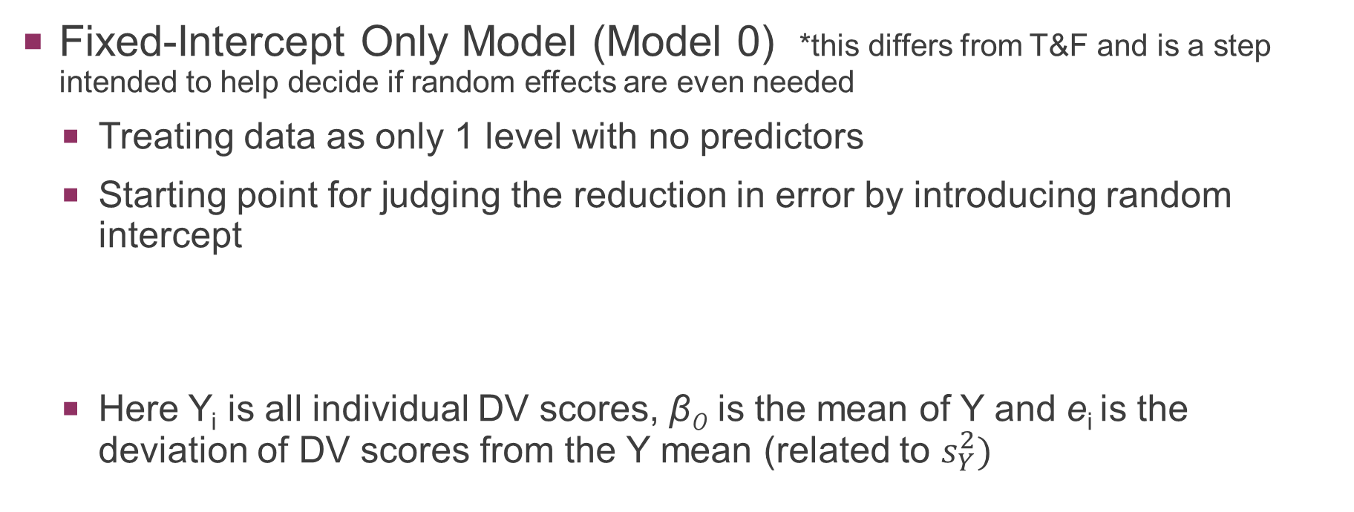
Model building/testing – “popular”
Fixed-Intercept Only Model (Model 0) *this differs from T&F and is a step intended to help decide if random effects are even needed
Treating data as only 1 level with no predictors
Starting point for judging the reduction in error by introducing random intercept
Here Y_{i} is all individual DV scores, β₀ is the mean of Y and e_{i} is the deviation of DV scores from the Y mean (related to $s_{Y}^{2})$

Slide 30
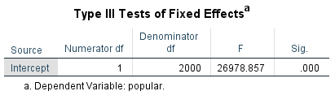
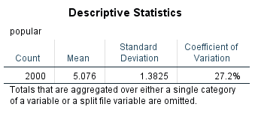
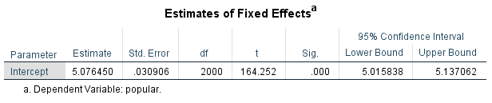
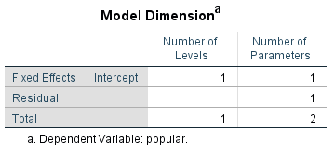
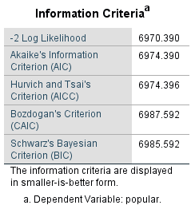
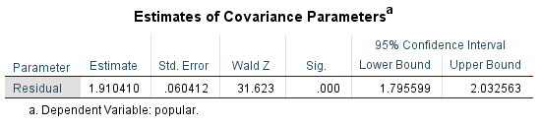

MIXED popular
/FIXED=| SSTYPE(3)
/METHOD=ML
/PRINT=DESCRIPTIVES SOLUTION.
β₀
$$s_{e_{i}}^{2}$$

Slide 31
Model building/testing – “popular”
Random-Intercepts Only Model (Model 1)
Treating data as 2 levels where every group gets their own intercept
First model included in T&F
Level 1:
Level 2:
β_{0j} are group means, e_{ij} now the deviation of subjects from the group mean (i.e., within subjects deviation), γ₀₀ is the Grand Mean and u_{0j} is the deviation of group means from the grand mean (i.e., between groups deviation) *should remind you of random effects anova.

Slide 32
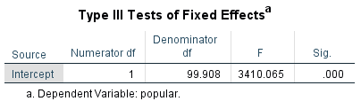
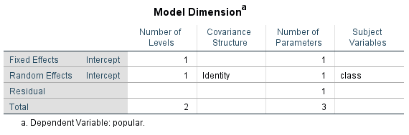
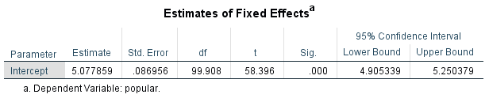
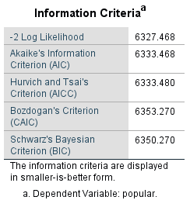
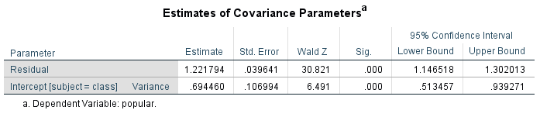


MIXED popular
/FIXED=| SSTYPE(3)
/METHOD=ML
/PRINT=SOLUTION TESTCOV
/RANDOM=INTERCEPT | SUBJECT(class) COVTYPE(UN).
γ₀₀
$${Average s}_{e_{ij}}^{2}$$
$$τ_{00} OR s_{u_{0j}}^{2}$$

Slide 33
Model building/testing – “popular”
Is Model 1 (Random Intercept) better than Model 0 (Fixed Intercept)?
Do we really need a multilevel model at all?
Intraclass Correlation (ICC)
Likelihood Difference Test
Aikake Information Criteria (AIC)

Slide 34
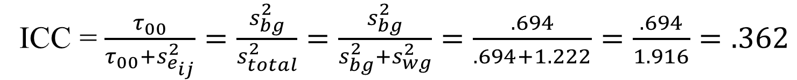
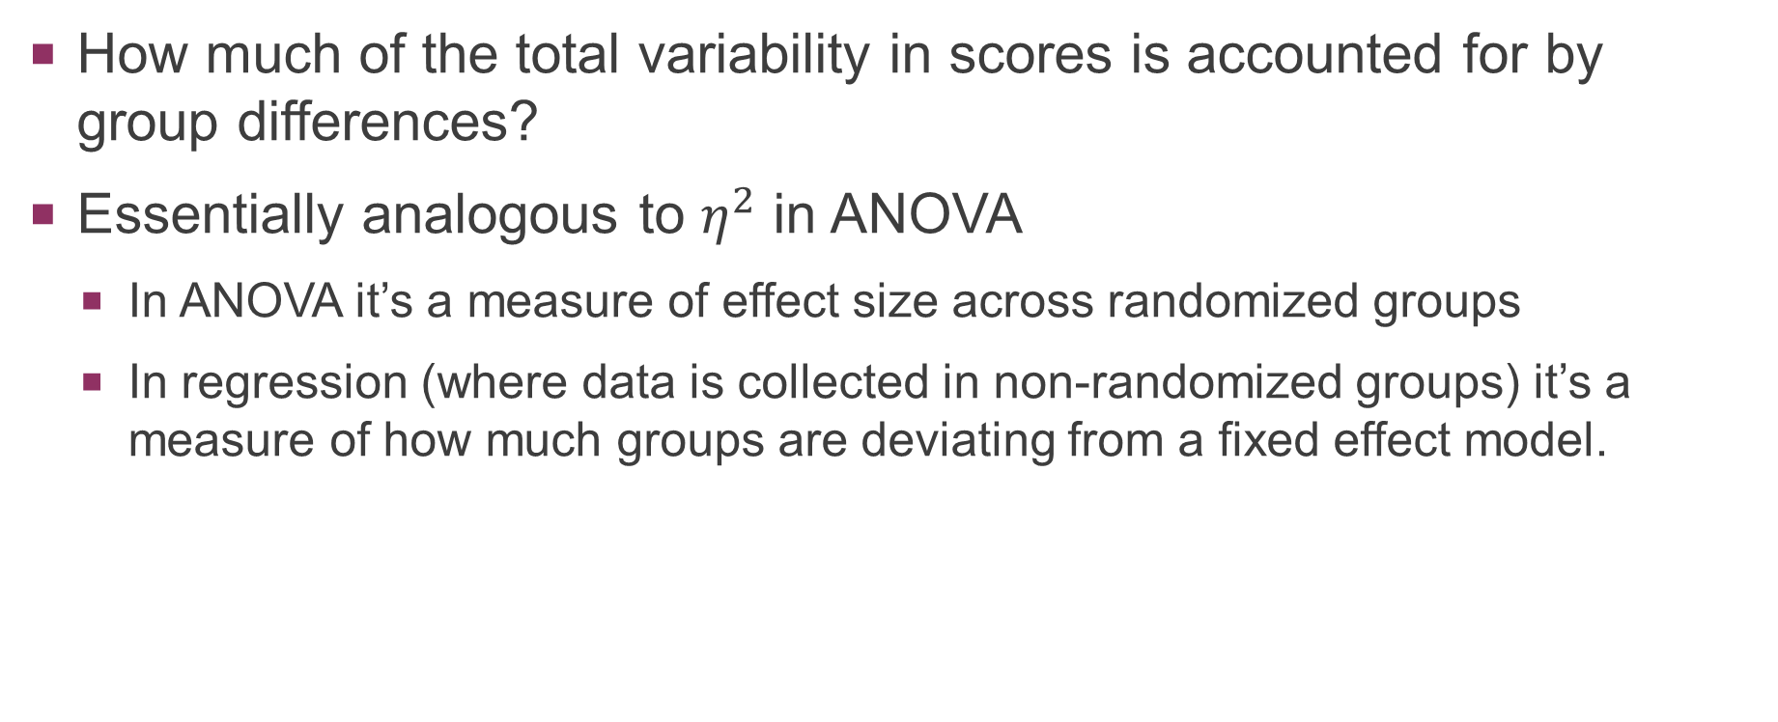
Intraclass correlation (ICC) – “popular”
How much of the total variability in scores is accounted for by group differences?
Essentially analogous to $η^{2}$ in ANOVA
In ANOVA it’s a measure of effect size across randomized groups
In regression (where data is collected in non-randomized groups) it’s a measure of how much groups are deviating from a fixed effect model.
ICC = $\frac{τ_{00}}{τ_{00}+s_{e_{ij}}^{2}}=\frac{s_{bg}^{2}}{s_{total}^{2}}=\frac{s_{bg}^{2}}{s_{bg}^{2}+s_{wg}^{2}}=\frac{.694}{.694+1.222}=\frac{.694}{1.916}=.362$

Slide 35
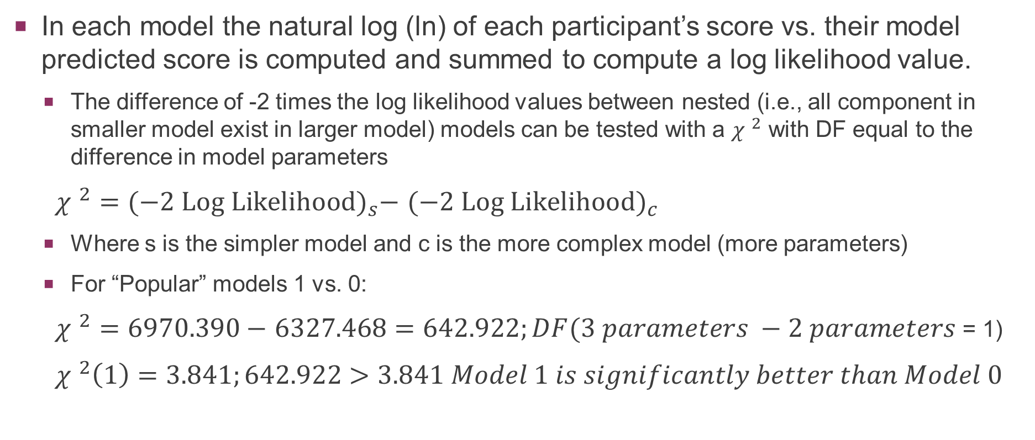
Likelihood Difference test – “popular”
In each model the natural log (ln) of each participant’s score vs. their model predicted score is computed and summed to compute a log likelihood value.
The difference of -2 times the log likelihood values between nested (i.e., all component in smaller model exist in larger model) models can be tested with a ${χ }^{2}$ with DF equal to the difference in model parameters
${χ }^{2}={(−2 Log Likelihood)}_{s}−$ ${(−2 Log Likelihood)}_{c}$
Where s is the simpler model and c is the more complex model (more parameters)
For “Popular” models 1 vs. 0:
${χ }^{2}=6970.390−$ $6327.468=642.922;DF(3 parameters −2 parameters$ = 1)
${χ }^{2}\left(1\right)=3.841;642.922>3.841 Model 1 is significantly better than Model 0$

Slide 36
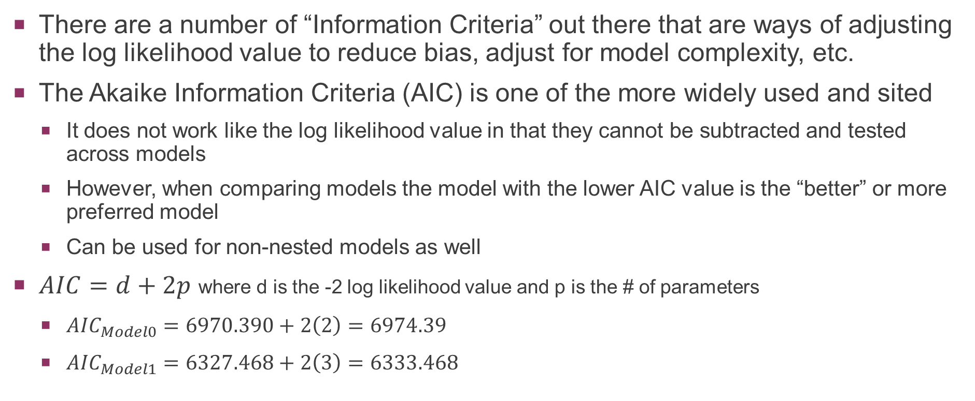
Akaike Information Criteria (AIC) – “popular”
There are a number of “Information Criteria” out there that are ways of adjusting the log likelihood value to reduce bias, adjust for model complexity, etc.
The Akaike Information Criteria (AIC) is one of the more widely used and sited
It does not work like the log likelihood value in that they cannot be subtracted and tested across models
However, when comparing models the model with the lower AIC value is the “better” or more preferred model
Can be used for non-nested models as well
$AIC=d+2p$ where d is the -2 log likelihood value and p is the # of parameters
${AIC}_{Model0}=6970.390+2\left(2\right)=6974.39$
${AIC}_{Model1}=6327.468+2\left(3\right)=6333.468$

Slide 37
Adding predictors
Just like with linear regression predictors that you want to add to the model should be:
Screened for outliers, normality, etc.
Centered so that the intercept(s) is/are meaningful
Added thoughtfully as the interpretation of the slopes will be impacted by
The order they are added in
The presence or absence of other relevant variables

Slide 38
Model building/testing – “popular”
Random-Intercepts Fixed Slopes (Model 2)
Treating data as 2 levels where every group gets their own intercept but a fixed slope
Level 1:
Level 2:

Slide 39
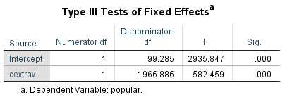
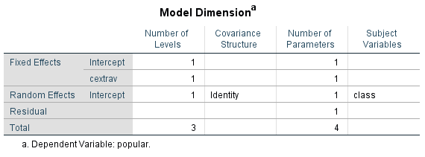
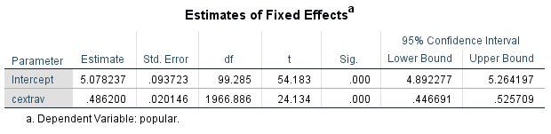

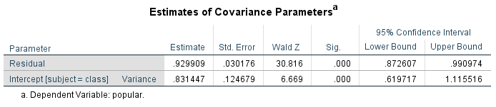


MIXED popular WITH cextrav
/FIXED=cextrav | SSTYPE(3)
/METHOD=ML
/PRINT=SOLUTION TESTCOV
/RANDOM=INTERCEPT | SUBJECT(class) COVTYPE(UN).
γ₀₀
β₁
$${Average s}_{e_{ij}}^{2}$$
$$τ_{00} OR s_{u_{0j}}^{2}$$

Slide 40
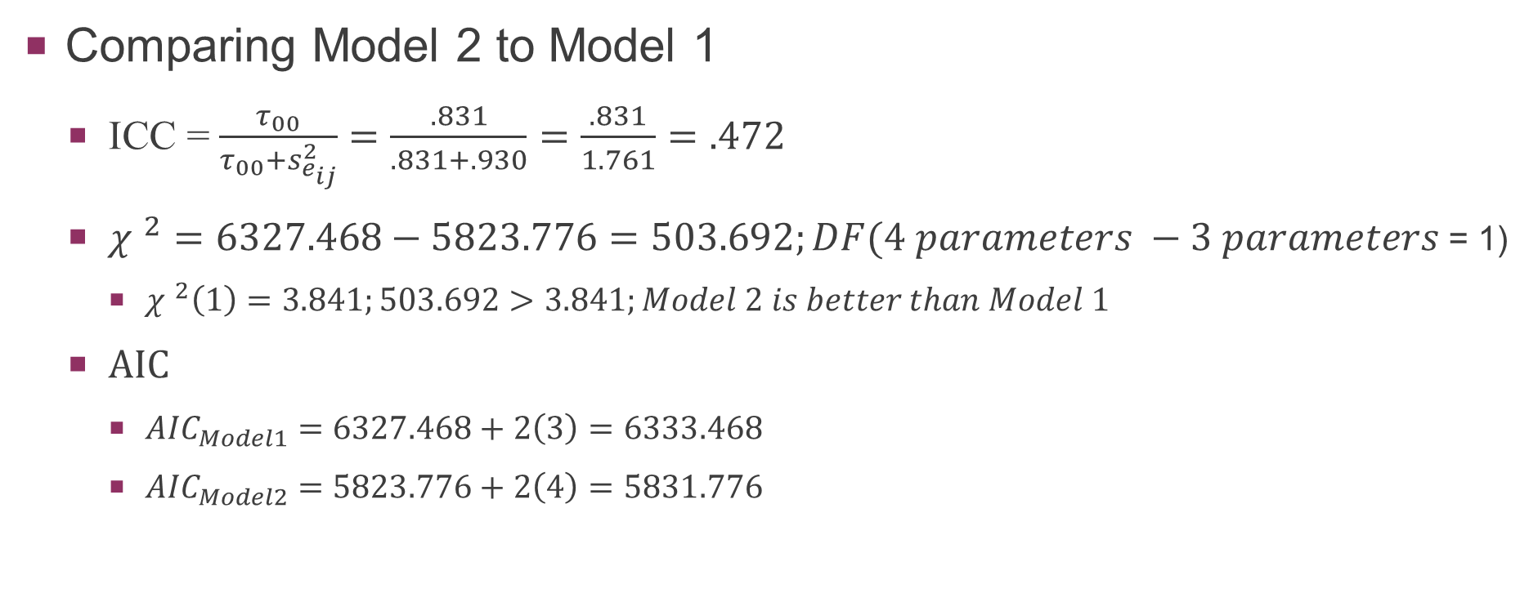
Model building/testing – “popular”
Comparing Model 2 to Model 1
ICC = $\frac{τ_{00}}{τ_{00}+s_{e_{ij}}^{2}}=\frac{.831}{.831+.930}=\frac{.831}{1.761}=.472$
${χ }^{2}=6327.468−5823.776=503.692;DF(4 parameters −3 parameters$ = 1)
${χ }^{2}\left(1\right)=3.841;503.692>3.841;Model 2 is better than Model 1$
AIC
${AIC}_{Model1}=6327.468+2\left(3\right)=6333.468$
${AIC}_{Model2}=5823.776+2\left(4\right)=5831.776$

Slide 41
Model building/testing – “popular”
Random-Intercepts Random-Slopes (Model 3)
Treating data as 2 levels where every group gets their own intercept and their own slope
Level 1:
Level 2:

Slide 42

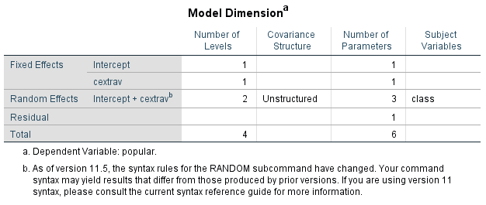
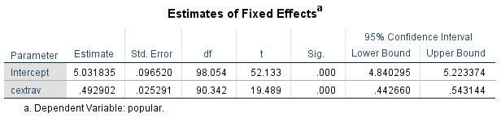
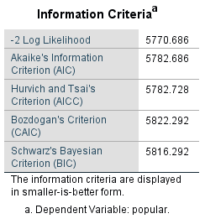
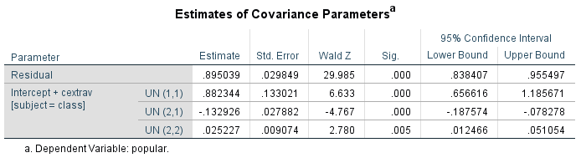




MIXED popular WITH cextrav
/FIXED=cextrav | SSTYPE(3)
/METHOD=ML
/PRINT=SOLUTION TESTCOV
/RANDOM=INTERCEPT cextrav | SUBJECT(class) COVTYPE(UN).
γ₀₀
γ ₁₀
$${Average s}_{e_{ij}}^{2}$$
$$τ_{00} OR s_{u_{0j}}^{2}$$
$$τ_{11} OR s_{u_{1j}}^{2}$$
$$τ_{10} OR {COV}_{Slopes/Inter}$$

Slide 43
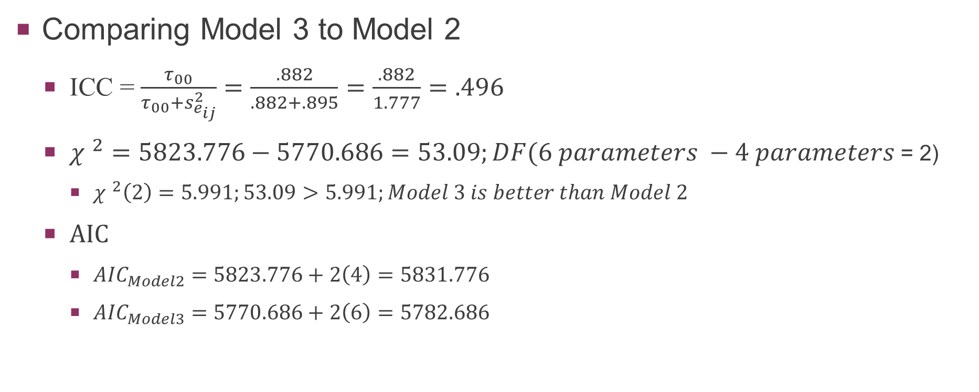
Model building/testing – “popular”
Comparing Model 3 to Model 2
ICC = $\frac{τ_{00}}{τ_{00}+s_{e_{ij}}^{2}}=\frac{.882}{.882+.895}=\frac{.882}{1.777}=.496$
${χ }^{2}=5823.776−5770.686=53.09;DF(6 parameters −4 parameters$ = 2)
${χ }^{2}\left(2\right)=5.991;53.09>5.991;Model 3 is better than Model 2$
AIC
${AIC}_{Model2}=5823.776+2\left(4\right)=5831.776$
${AIC}_{Model3}=5770.686+2\left(6\right)=5782.686$

Slide 44
Model building/testing – “popular”
Random-Intercepts Random-Slopes Plus Level 2 Predictor (Model 4)
Treating data as 2 levels where every group gets their own intercept and their own slope AND adding in a predictor that exists only at Level 2
Level 1:
Level 2:

Slide 45
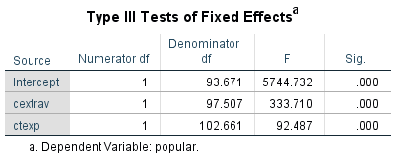
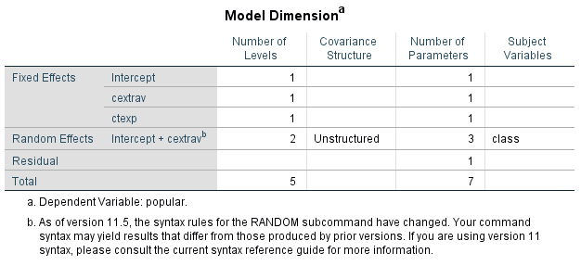
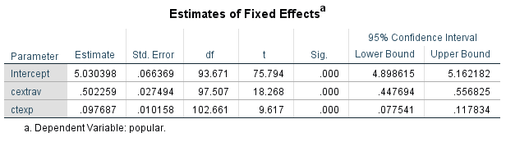

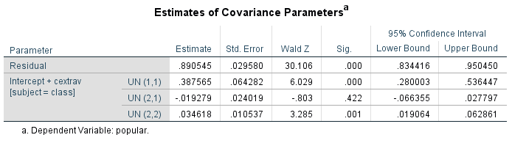
MIXED popular WITH cextrav ctexp
/FIXED=cextrav ctexp | SSTYPE(3)
/METHOD=ML
/PRINT=SOLUTION TESTCOV
/RANDOM=INTERCEPT cextrav | SUBJECT(class) COVTYPE(UN).
γ₀₀
γ ₁₀
γ ₀₁
$${Average s}_{e_{ij}}^{2}$$
$$τ_{00} OR s_{u_{0j}}^{2}$$
$$τ_{11} OR s_{u_{1j}}^{2}$$
$$τ_{10} OR {COV}_{Slopes/Inter}$$

Slide 46
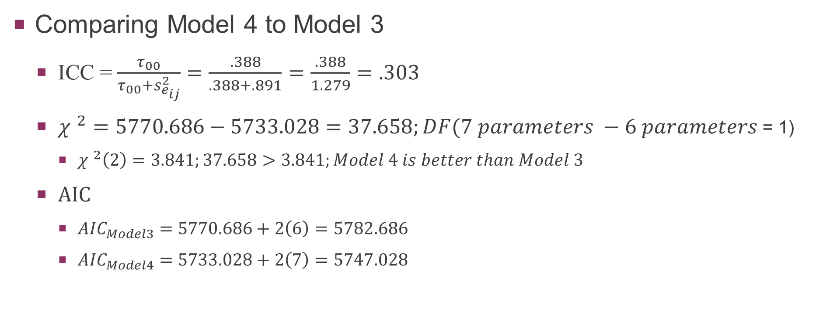
Model building/testing – “popular”
Comparing Model 4 to Model 3
ICC = $\frac{τ_{00}}{τ_{00}+s_{e_{ij}}^{2}}=\frac{.388}{.388+.891}=\frac{.388}{1.279}=.303$
${χ }^{2}=5770.686−5733.028=37.658;DF(7 parameters −6 parameters$ = 1)
${χ }^{2}\left(2\right)=3.841;37.658>3.841;Model 4 is better than Model 3$
AIC
${AIC}_{Model3}=5770.686+2\left(6\right)=5782.686$
${AIC}_{Model4}=5733.028+2\left(7\right)=5747.028$

Slide 47
Repeated Measures via mlm
More flexibility… once you get used to it.

Slide 48
Mlm can handle a variety of repeated measures data
Pre-Post Data
Multiple Pres vs. Multiple Posts
Mixed Between and Repeated Designs
Longitudinal Designs
But we’ll need to look at it a little differently…

Slide 49
Mlm repeated measures
Repeated measures and Mixed ANOVAs are often used to analyze repeated data (we spend a large chunk of 485 talking about it)
They are simple and require very low level computing power (i.e., we can do it by hand)
But, what makes it simple is that it has very restrictive assumptions (i.e., sphericity) that are rarely met
Sphericity is the assumption of homogeneity of variance for differences between levels of the RM IV.
Often violated because levels closer in time are more related than levels farther apart in time
Related to compound symmetry (i.e., combination of homogeneity of variance and covariance)

Slide 50
Mlm repeated measures
MLM is much more flexible in how you handle the data and what assumptions you are making about the variances and covariances
This is nice but comes at a much higher computational cost (e.g., ML)
Can be analyzed with the same assumptions as RM ANOVA
Then reanalyzed with different assumptions to see if the model fit (e.g., log likelihood difference test) is improved
As a regression like approach we can look at main effects and interactions plus run the effects sequentially…
This just means we need to carefully choose the coding for grouped predictors

Slide 51
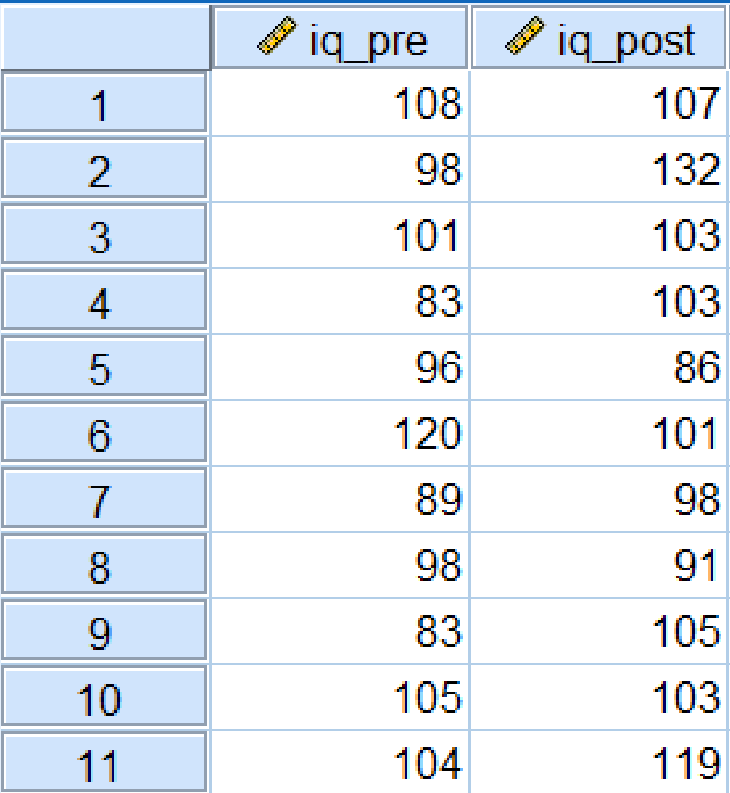
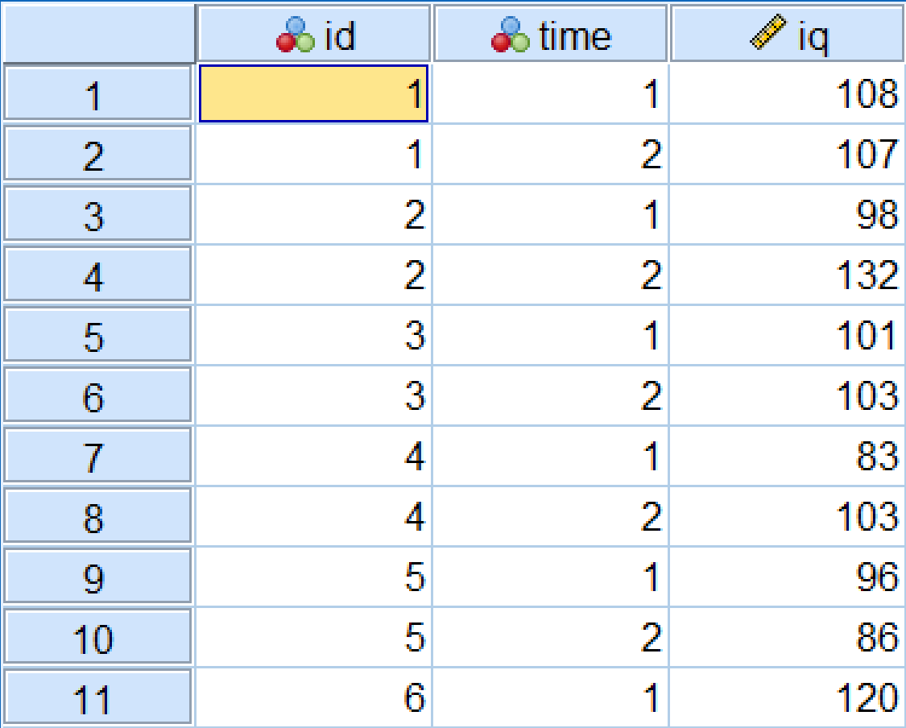
Mlm Repeated – simple dependent samples t-test
The MLM approach can be used to compute a t-value in a simple pre-post design…with a little data restructuring.
Restructure “Wide” data into “Long” data
SPSS iqplus example using “Restructure” →
Wide Format
Long Format

Slide 52
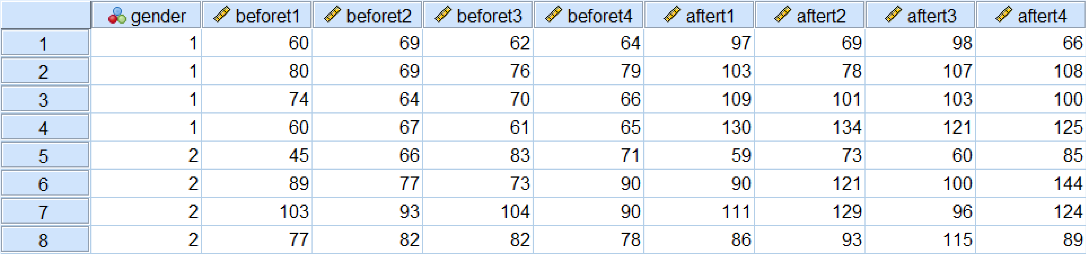
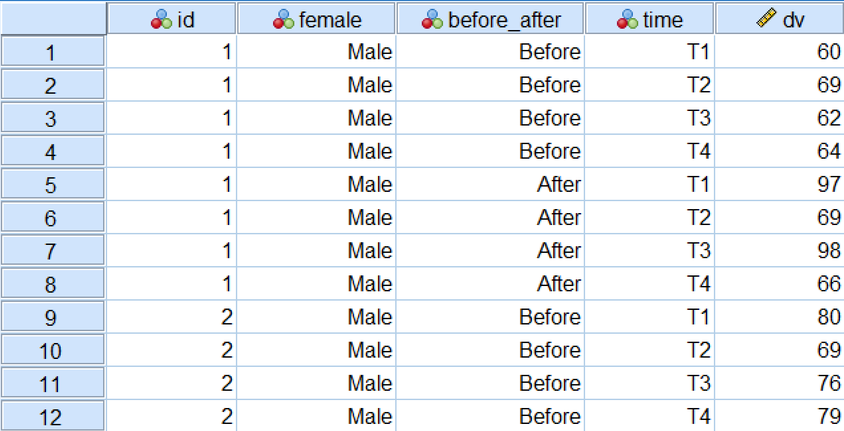
mLM – Multiple pres and posts – “anova4” example

Slide 53
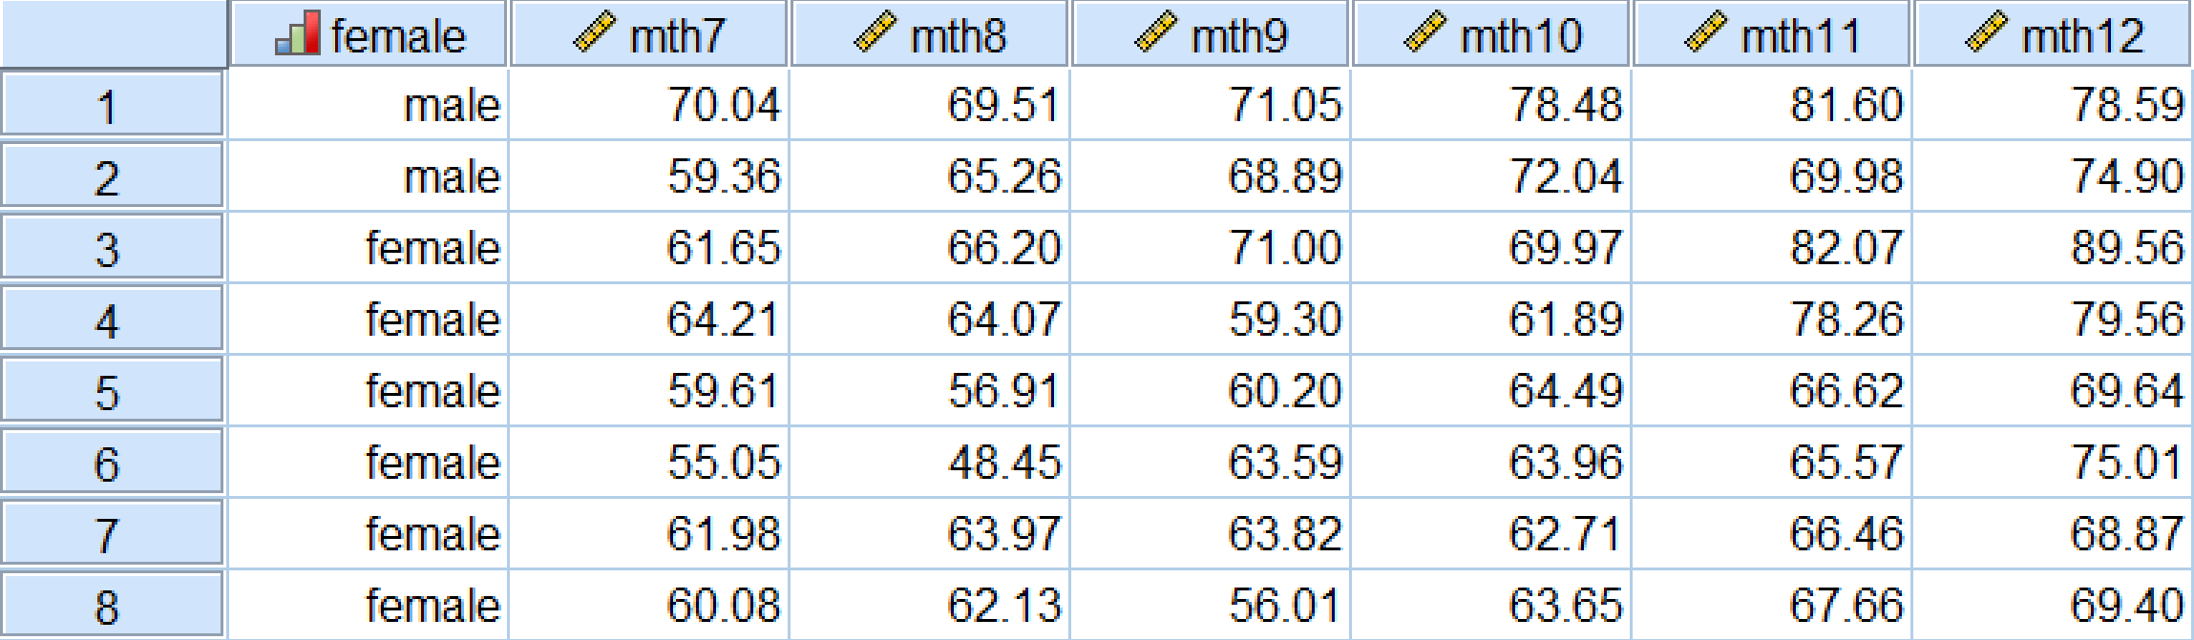
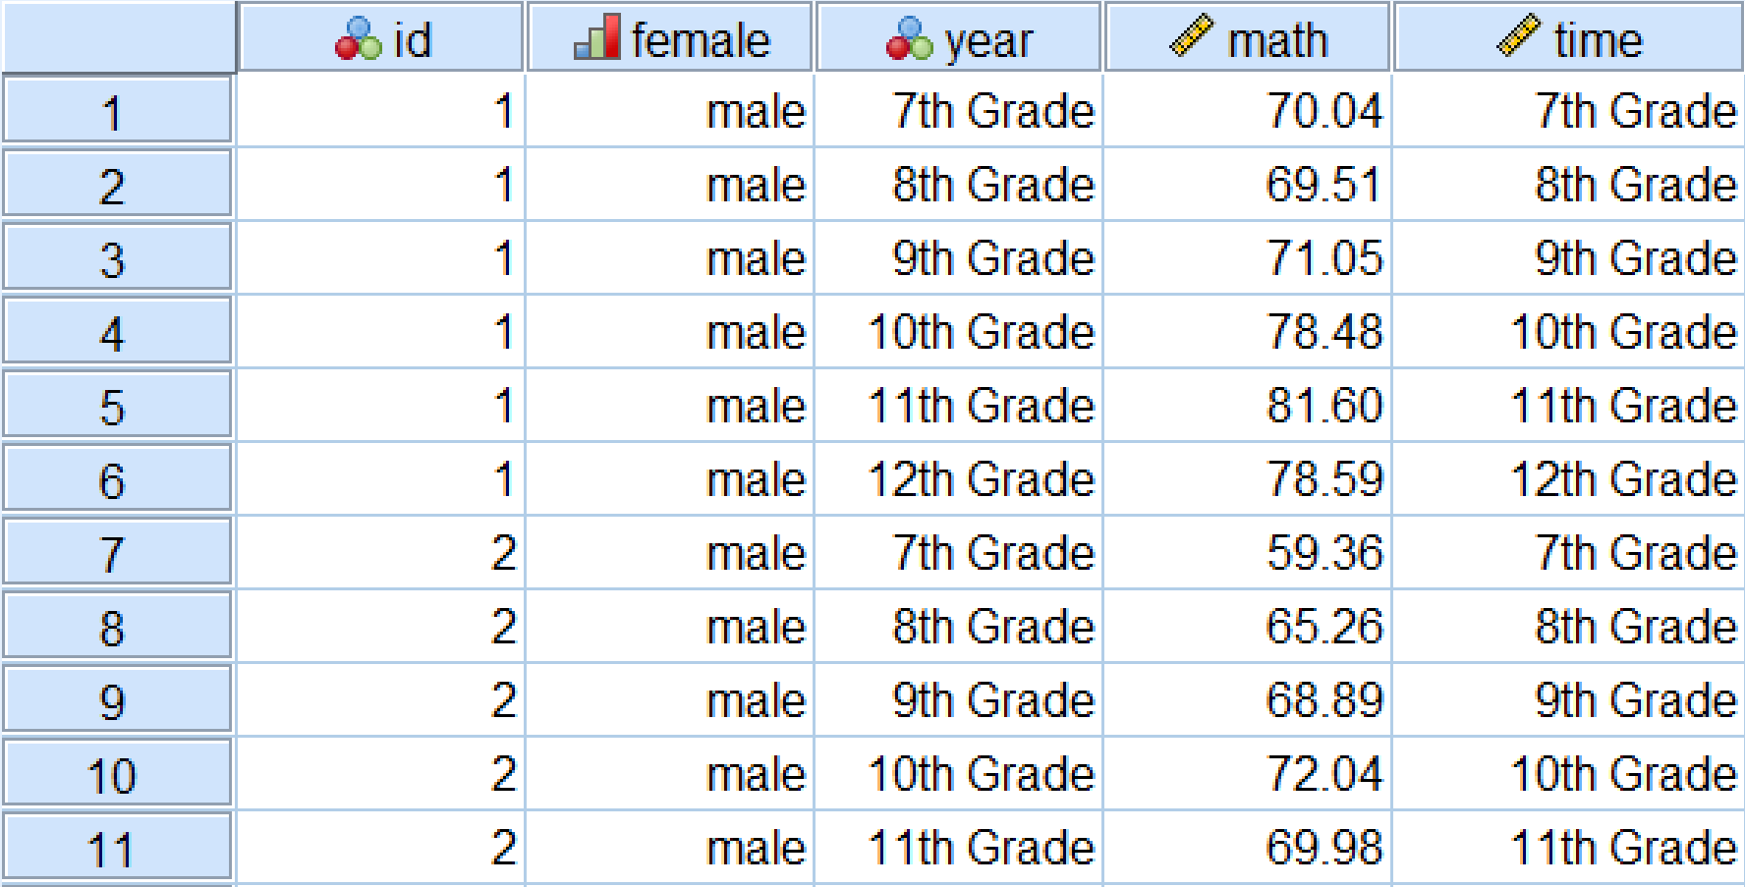
Mlm – longitudinal data – “lsay” example

