Slide 1
Multiple Regression
When simple regression just isn’t enough

Slide 2
Multiple Regression (MR)
Predicting one DV from a set of predictors, the DV should be interval/ratio or at least assumed I/R if using Likert scale for instance

Slide 3
Assumptions
Y must be normally distributed (no skewness or outliers)
X’s
do not need to be normally distributed, but if they are it makes for a stronger interpretation
linear relationship w/ Y
no multivariate outliers among Xs predicting Y

Slide 4
MV Outliers
Leverage – distance of score from distribution
Discrepancy – misalignment of score and the rest of the data
Influence – change in regression equation with and without value
Mahalanobis distance and χ²

Slide 5
Homoskedasticity
Homoskedasticity – variance on Y is the same at all values of X
When predictors are categorical this is referred to as homogeneity of variance

Slide 6
Multicollinearity/Singularity
Tolerance = 1 – SMC (Squared Multiple Correlation)
Low tolerance values <.01 indicate problems
Condition Index and Variance
Condition Index > 30
Plus variance on two separate variables > .50.

Slide 7
Regression Equation
What is a?
What are the Bs?
Why y predicted and not y?

Slide 8
Questions asked by Multiple Regression
“Like, why am I doing this?”

Slide 9
Can you predict Y given the set of Xs?
Anova summary table – significance test
R² (multiple correlation squared) – variation in Y accounted for by the set of predictors
Adjusted R² – sample variation around R² can only lead to inflation of the value. The adjustment takes into account the size of the sample and number of predictors to adjust the value to be a better estimate of the population value.
R² is similar to η² value but will be a little smaller because R² only looks at linear relationship while η² will account for non-linear relationships.

Slide 10
Is each X contributing to the prediction of Y?
Test if each regression coefficient is significantly different than zero given the variables standard error.
T-test for each regression coefficient,

Slide 11
Which X is contributing the most to the prediction of Y?
Cannot interpret relative size of Bs because each are relative to the variables scale but Betas (standardized Bs) can be interpreted.
a being the grand mean on y a is zero when y is standardized

Slide 12
Can you predict future scores?
Can the regression be generalized to other data
Can be done by randomly separating a data set into two halves,
Estimate regression equation with one half
Apply it to the other half and see if it predicts

Slide 13
Sample size for MR
There is no exact number to consider
Need enough subjects for a “stable” correlation matrix
T and F recommend 50 + 8m, where m is the number of predictors
If there is a lot of “noise” in the data you may need more than that
If little noise you can get by with less
If interested generalizing prediction than you need at least double the recommended subjects.

Slide 14
GLM and Matrix Algebra Ch. 18 and Appendix A (T and F, 2019 )
General Linear Model
Think of it as a generalized form of regression

Slide 15
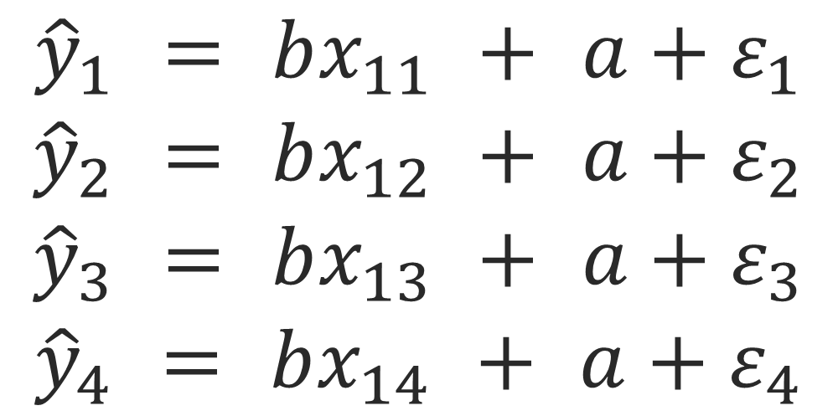
Regular old linear regression
With four observations is:

Slide 16
Regular old linear regression
We know y and we know the predictor values, the unknown is the weights so we need to solve for it
This is where matrix algebra comes in

Slide 17
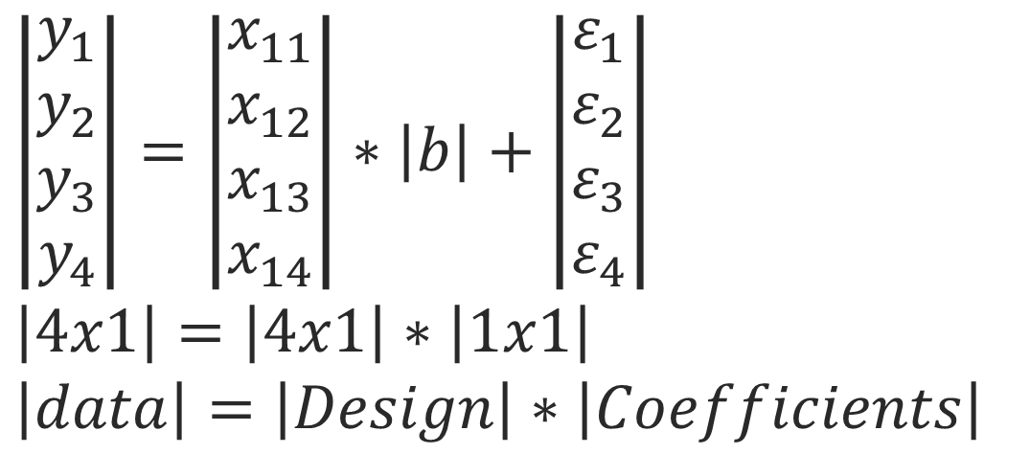
Regression and Matrix Algebra
The above can also be conceptualized as:
But what’s missing?

Slide 18
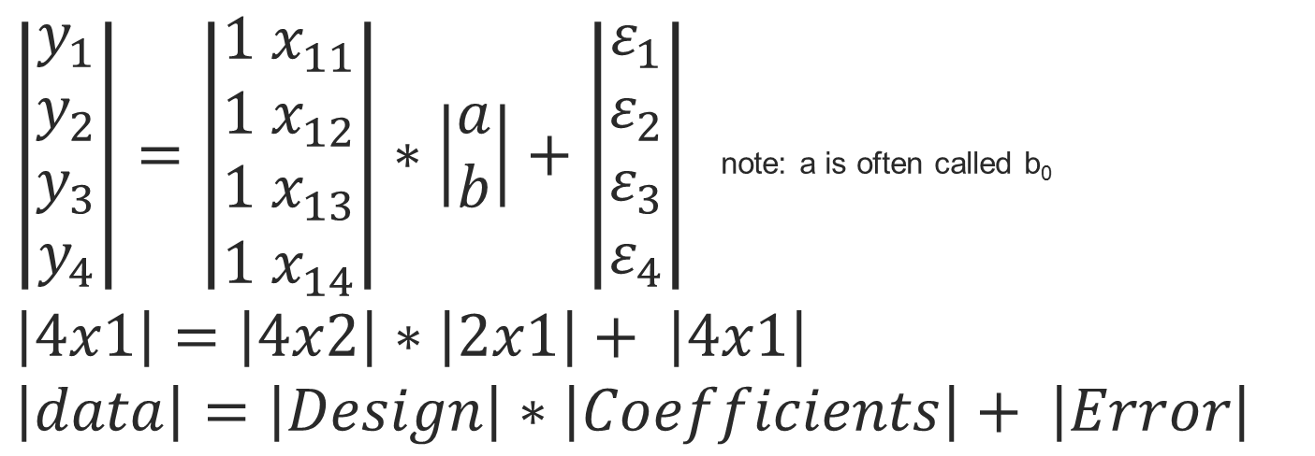
Regression and Matrix Algebra
We can bring the intercept in by simply altering the design matrix with a column of 1s:

Slide 19
Column of 1s???
In regression, if you regress an outcome onto a constant of 1s you get back the mean of that variable.
This only works in the matrix approach, if you try the “by hand” approach to regressing an outcome onto a constant you’ll get zero
Computer programs like SPSS, Excel, etc. use the matrix approach

Slide 20
Example
Here is a small sample data set

Slide 21
Example - normal

Slide 22
Example – constant only

Slide 23
Example - normal

Slide 24
Solving for Bs Matrix Style
In regular algebra you can solve for b y = x * b -> y/x = b
Another way to divide is to multiply by 1/x (inverse)
Can’t just divide in matrix algebra you must multiply by inverse of the X matrix:
B = Y * X⁻¹
But in order to take the inverse the X matrix must be a square matrix (which rarely, if ever, happens)

Slide 25
Pseudoinverse/Generalized Inverse
A pseudoinverse is a matrix that acts like an inverse matrix for non-square matrices:
Example: The Moore-Penrose pseudoinverse
A^{pseudo-1}=(A’A)⁻¹ *A’
The inverse of (A’A) is defined because it is square (so long as A is full rank, in other words no multicollinearity/singularity)

Slide 27
Estimation
The goal of an estimator is to provide an estimate of a particular statistic based on the data
There are several ways to characterize estimators

Slide 28
B Estimators
bias
an unbiased estimator converges to the true value with large enough sample size
Each parameter is neither consistently over or under estimated

Slide 29
B Estimators
likelihood
the maximum likelihood (ML) estimator is the one that makes the observed data most likely
ML estimators are not always unbiased for small N

Slide 30
B Estimators
variance
an estimator with lower variance is more efficient, in the sense that it is likely to be closer to the true value over samples
the “best” estimator is the one with minimum variance of all estimators

Slide 31
Types of Regression Analysis
Doing it standard, forward and backward

Slide 32
Standard Regression
Standard or Simultaneous Regression
Put all of the predictors in at one time and the coefficients are calculated for all of them controlling for all others
Method equals enter in SPSS Sequential

Slide 33
Forward Sequential
What does a predictor add to the prediction equation, over and above the variables already in the equation?
You think the X1 is a more important predictor and your interest in X2 is what does it add to the X1 -> Y prediction
Real Forward Sequential in SPSS is setting it to Enter and using the blocks function (user specified)

Slide 34
Statistical Forward Sequential
Starts with Y’=a, all potential predictors are assessed and compared to an Entry Criterion; the variable with the lowest F probability (p<.05) enters it into the equation
Remaining predictors are re-evaluated given the new equation (Y’=a + Xfirst entered) and the next variable with the lowest probability enters, etc…
This continues until either all of the variables are entered or no other variables meet the entry criterion.
Once variables enter the equation they remain.
Method equals Forward in SPSS

Slide 35
Backward Sequential
Can predictors be removed from an equation without hurting the prediction of Y? In other words, can a prediction equation be simplified?
You know there are a set of predictors of a certain variable and you want to know if any of them can be removed without weakening the prediction
In SPSS put all predictors in block one method equals enter, in block 2 any variables you want removed method equals removed, etc…

Slide 36
Statistical backward sequential
All variables entered in and then each are tested against an Exit Criteria; F probability is above a set criteria (p>.10).
The variable with the worst probability is then removed.
Re-evaluation of remaining variables given the new equation and the next variable with the worst probability is then removed.
This continues until all variables meet the criteria or all variables removed.
In SPSS this is setting method equals backward.

Slide 37
Stepwise (Purely Statistical Regression)
at each step of the analysis variables are tested for both entry and exit criteria.
Starts with intercept only then tests all of the variables to see if any match entry criteria.
Any matches enter the equation
The next step tests un-entered variables for both entry and entered variables for exit criteria, and so on…

Slide 38
Stepwise
This cycles through adding and removing variables until none meet the entry or exit criteria
Variables can be added or removed over and over given the new state of the equation each time.
Considered a very post-hoc type of analysis and is not recommended

Slide 39
Types of Correlations
Partials, Parts, Semi-partials

Slide 40
Ballantine
Regular Correlation
(Zero – Order, Pearson)

Slide 41
Standard Regression
Partial Correlation
correlation between Y and X1 with the influence of X2 removed from both
Yres, X1res
area a/(a + e) for x1 and b/(b + e) for x2 in the ballantine

Slide 42
Semipartial or Part Correlation
correlation between Y and X1 with the influence of X2 removed from X1 only
Y, X1res
area a/(a + b + c + e) for x1 and b/(a + b + c +e) for x2

Slide 43
Semipartials and Bs
Bs and semipartials are very similar
B is the amount of change in Y for every unit change in X, while controlling for other Xs on Xi.
Semipartials are measures of the relationship between Y and Xi controlling for other Xs on Xi.

Slide 44
Sequential
Assuming x1 enters first
The partial correlations would be
(a + c)/(a + c + e) for x1 and unchanged for x2
The part correlation would be
(a + c)/(a + b + c + e) for x1 and x2 is unchanged.

Slide 45
Advanced Regression
Moderation, Mediation and Curve Estimation

Slide 46
Centering the data
If you want to include powers, Moderation (interactions) or mediation you should first center the data
Subtract the mean from every score
You don’t need to standardize by dividing by the SD
This helps form creating multicollinearity in the data

Slide 47
Moderation (interaction)
Testing for moderation can be accomplished by simply cross multiplying the variables and adding the new variable in as another predictor
If A and B are predictors of Y
First Center A and B separately (if they don’t already have a meaningful zero)
Multiply the Centered A and B variables to create AB
Use A, B and AB as predictors of Y
If the slope predicting Y from AB is significant than A moderates B and vice versa (i.e., there is an interaction)

Slide 48
Mediation
Regression can be used to test if a mediating effect is present in the data
Defined - a given variable functions as a mediator to the extent that it accounts for the relation between a predictor and an outcome variable
Often though of as an indirect effect of one variable on another.
X predicts Y through Z

Slide 49


Mediation
C is the total effect of X on Y

Slide 50



Mediation
C is the total effect of X on Y
A*B is the indirect effect
C’ is the direct effect

Slide 51
Mediation
4 steps to establishing mediation (Baron and Kenny/ Regression Method)
Establish x predicts y significantly
Establish z predicts y significantly
Establish x predicts z significantly
Establish that x no longer predicts y when both x and z are in the prediction (C’ is zero or at least non-significant)
Partial Mediation – steps 1-3 are the same but in step 4 C’ is less than C but still significant

Slide 52
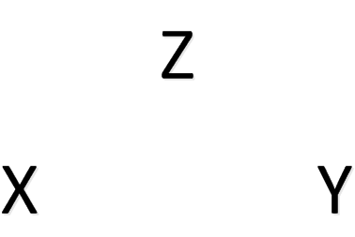

Mediation
Baron and Kenny

Slide 53

Mediation
Baron and Kenny

Slide 54

Mediation
Baron and Kenny

Slide 55


Mediation
Baron and Kenny

Slide 56
Mediation
Sobel Method – Indirect Effect
Where a and b are the unstandardized regression coefficients for paths a and b
And sa and sb are the standard errors for paths a and b

Slide 57
Powers
Even though we’re talking about linear regression the equations can be altered to account for curves and interactions between variables
Adding squares, cubes, etc. to account for curves in the relationship
If you think X can predict an curved Y simply square X and add X2 as an additional predictor

