Slide 1
Multilevel Linear Models – Part 2
Aka → Multilevel regression, Hierarchical Linear models, mixed models, random effects models, etc.
Dr. Andrew Ainsworth
Psy524/L
California State University, Northridge

Slide 2
i = individuals, j = groups
Y_{ij} = DV scores at Level 1
X_{1ij} = Level 1 predictor
β_{0j} = intercept for DV in group j
β_{1j} = slope for DV in group j
e_{ij} = Level 1 error
γ₀₀ = overall/Level 2 intercept
W_{j} = Level 2 predictor (i.e., varies across groups but constant within groups)
γ₀₁ = slope predicting DV from Level 2 predictor W_{j}
u_{0j} = random error of group intercepts around γ₀₀
γ₁₀ = overall/Level 2 regression coefficient for X₁
u_{1j} = random error of group slopes around γ₁₀

Slide 3
Tau (τ) matrix of covariances (e.g., relationships between random effects)
τ ₀₀ = variance among random intercepts (i.e., variance around γ₀₀)
τ ₁₁ = variance among random slopes (i.e., variance around γ₁₀)
τ ₁₀ = covariance between random intercepts and random slopes (i.e., the degree that variability in slope relates to variability in intercepts)

Slide 4
Model building/testing
Unlike standard regression approaches that put all predictors in at once MLM models are often tested in steps; each step is tested to see if it is an improvement over the previous step (more on this in a moment)
Fixed-Intercept Only Model (Model 0)
Random-Intercepts Only Model
Random-Intercept Fixed-Slopes
Random-Intercept Random-Slopes
Cross-Level Predictions, interactions, etc.

Slide 5
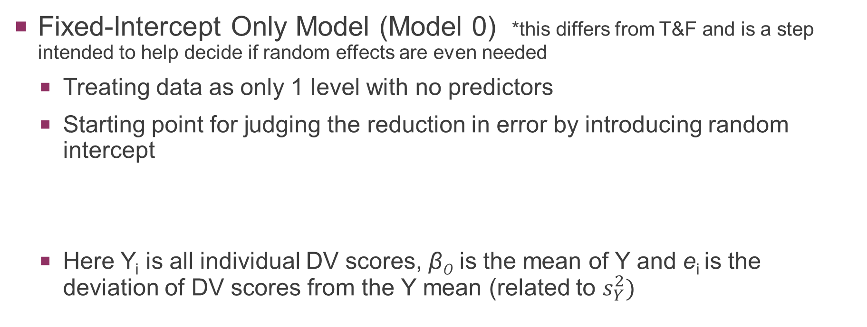
Model building/testing – “popular”
Fixed-Intercept Only Model (Model 0) *this differs from T&F and is a step intended to help decide if random effects are even needed
Treating data as only 1 level with no predictors
Starting point for judging the reduction in error by introducing random intercept
Here Y_{i} is all individual DV scores, β₀ is the mean of Y and e_{i} is the deviation of DV scores from the Y mean (related to $s_{Y}^{2})$

Slide 6
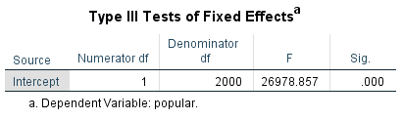
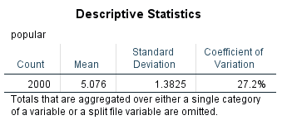
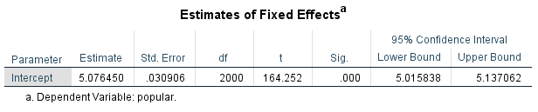
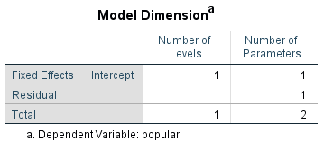
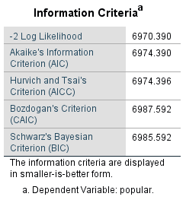
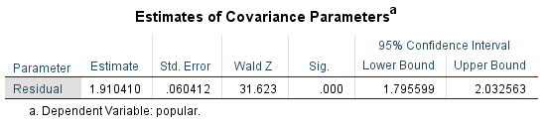

MIXED popular
/FIXED=| SSTYPE(3)
/METHOD=ML
/PRINT=DESCRIPTIVES SOLUTION.
β₀
$$s_{e_{i}}^{2}$$

Slide 7
Model building/testing – “popular”
Random-Intercepts Only Model (Model 1)
Treating data as 2 levels where every group gets their own intercept
First model included in T&F
Level 1:
Level 2:
β_{0j} are group means, e_{ij} now the deviation of subjects from the group mean (i.e., within subjects deviation), γ₀₀ is the Grand Mean and u_{0j} is the deviation of group means from the grand mean (i.e., between groups deviation) *should remind you of random effects anova.

Slide 8
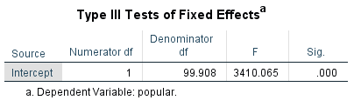
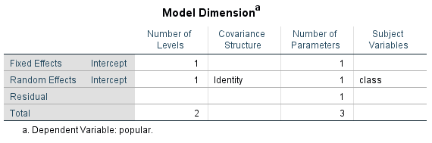
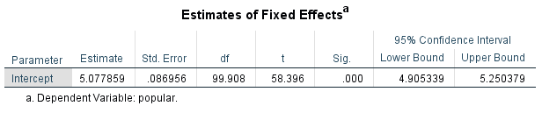
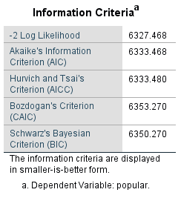
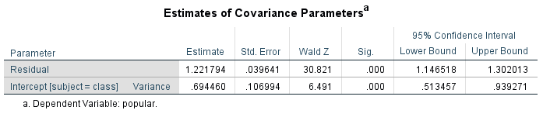


MIXED popular
/FIXED=| SSTYPE(3)
/METHOD=ML
/PRINT=SOLUTION TESTCOV
/RANDOM=INTERCEPT | SUBJECT(class) COVTYPE(UN).
γ₀₀
$${Average s}_{e_{ij}}^{2}$$
$$τ_{00} OR s_{u_{0j}}^{2}$$

Slide 9
Model building/testing – “popular”
Is Model 1 (Random Intercept) better than Model 0 (Fixed Intercept)?
Do we really need a multilevel model at all?
Intraclass Correlation (ICC)
Likelihood Difference Test
Aikake Information Criteria (AIC)

Slide 10
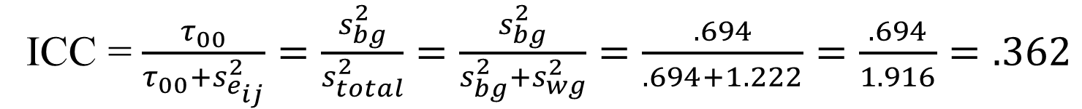
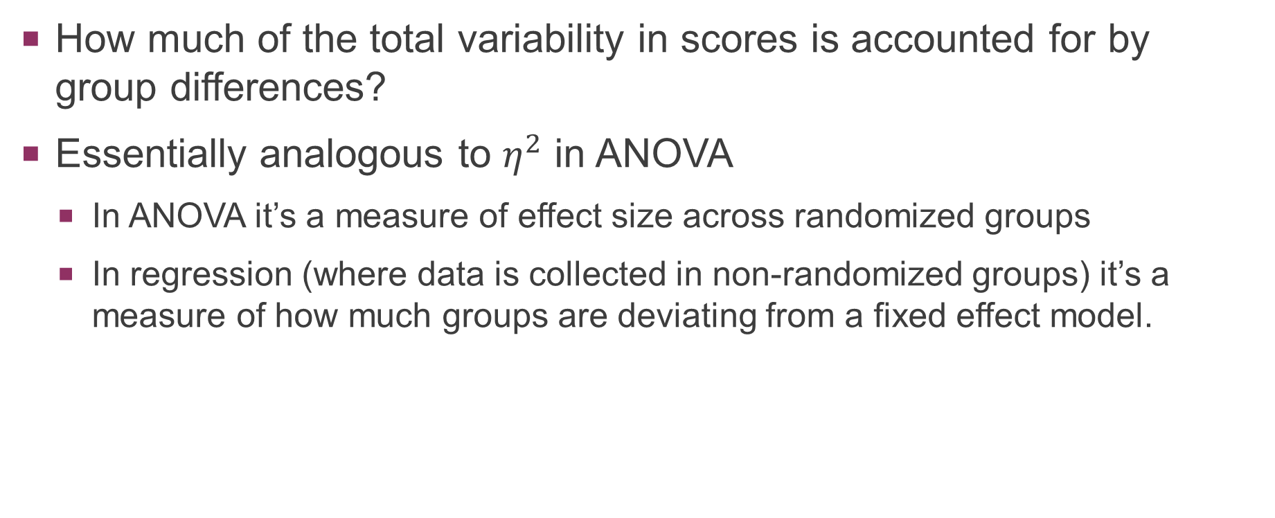
Intraclass correlation (ICC) – “popular”
How much of the total variability in scores is accounted for by group differences?
Essentially analogous to $η^{2}$ in ANOVA
In ANOVA it’s a measure of effect size across randomized groups
In regression (where data is collected in non-randomized groups) it’s a measure of how much groups are deviating from a fixed effect model.
ICC = $\frac{τ_{00}}{τ_{00}+s_{e_{ij}}^{2}}=\frac{s_{bg}^{2}}{s_{total}^{2}}=\frac{s_{bg}^{2}}{s_{bg}^{2}+s_{wg}^{2}}=\frac{.694}{.694+1.222}=\frac{.694}{1.916}=.362$

Slide 11
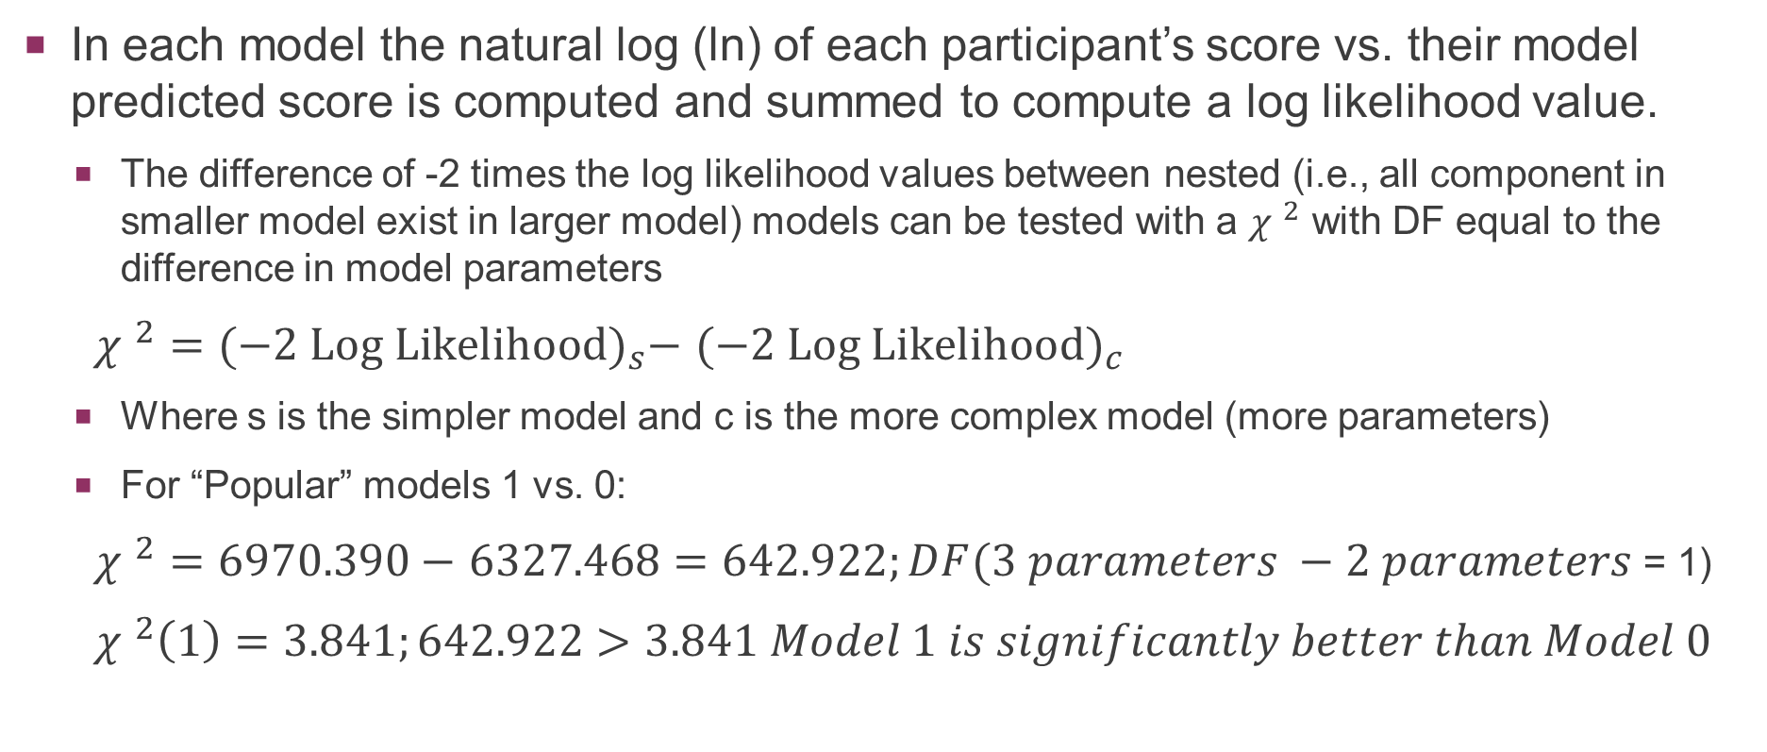
Likelihood Difference test – “popular”
In each model the natural log (ln) of each participant’s score vs. their model predicted score is computed and summed to compute a log likelihood value.
The difference of -2 times the log likelihood values between nested (i.e., all component in smaller model exist in larger model) models can be tested with a ${χ }^{2}$ with DF equal to the difference in model parameters
${χ }^{2}={(−2 Log Likelihood)}_{s}−$ ${(−2 Log Likelihood)}_{c}$
Where s is the simpler model and c is the more complex model (more parameters)
For “Popular” models 1 vs. 0:
${χ }^{2}=6970.390−$ $6327.468=642.922;DF(3 parameters −2 parameters$ = 1)
${χ }^{2}\left(1\right)=3.841;642.922>3.841 Model 1 is significantly better than Model 0$

Slide 12
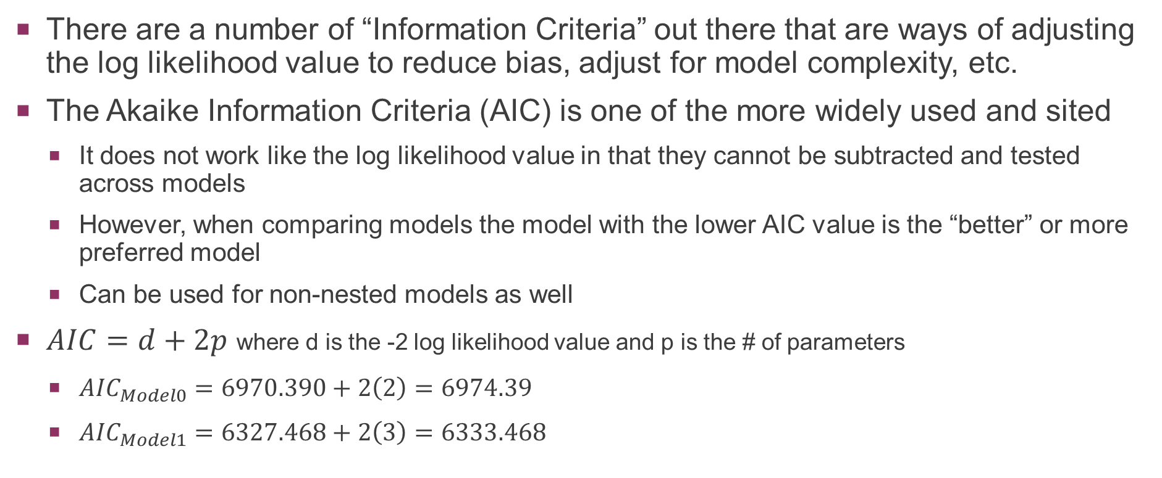
Akaike Information Criteria (AIC) – “popular”
There are a number of “Information Criteria” out there that are ways of adjusting the log likelihood value to reduce bias, adjust for model complexity, etc.
The Akaike Information Criteria (AIC) is one of the more widely used and sited
It does not work like the log likelihood value in that they cannot be subtracted and tested across models
However, when comparing models the model with the lower AIC value is the “better” or more preferred model
Can be used for non-nested models as well
$AIC=d+2p$ where d is the -2 log likelihood value and p is the # of parameters
${AIC}_{Model0}=6970.390+2\left(2\right)=6974.39$
${AIC}_{Model1}=6327.468+2\left(3\right)=6333.468$

Slide 13
Adding predictors
Just like with linear regression predictors that you want to add to the model should be:
Screened for outliers, normality, etc.
Centered so that the intercept(s) is/are meaningful
Added thoughtfully as the interpretation of the slopes will be impacted by
The order they are added in
The presence or absence of other relevant variables

Slide 14
Model building/testing – “popular”
Random-Intercepts Fixed Slopes (Model 2)
Treating data as 2 levels where every group gets their own intercept but a fixed slope
Level 1:
Level 2:

Slide 15
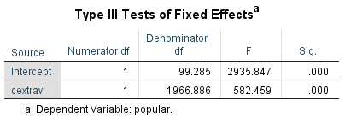
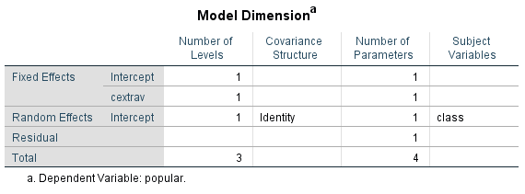
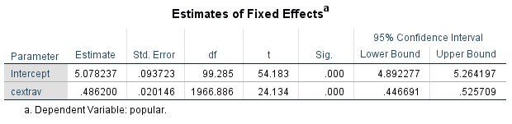

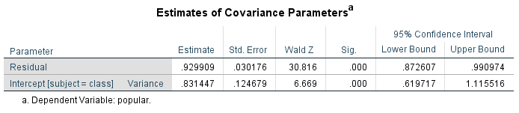


MIXED popular WITH cextrav
/FIXED=cextrav | SSTYPE(3)
/METHOD=ML
/PRINT=SOLUTION TESTCOV
/RANDOM=INTERCEPT | SUBJECT(class) COVTYPE(UN).
γ₀₀
β₁
$${Average s}_{e_{ij}}^{2}$$
$$τ_{00} OR s_{u_{0j}}^{2}$$

Slide 16
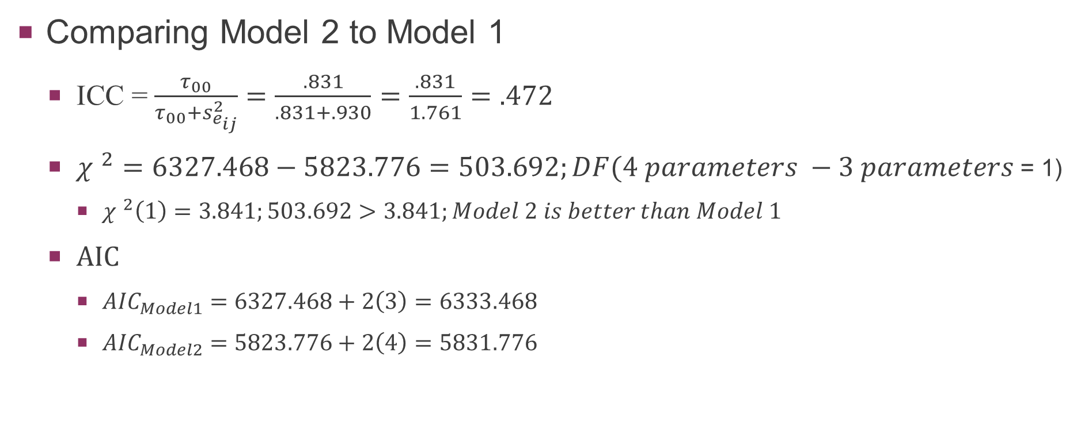
Model building/testing – “popular”
Comparing Model 2 to Model 1
ICC = $\frac{τ_{00}}{τ_{00}+s_{e_{ij}}^{2}}=\frac{.831}{.831+.930}=\frac{.831}{1.761}=.472$
${χ }^{2}=6327.468−5823.776=503.692;DF(4 parameters −3 parameters$ = 1)
${χ }^{2}\left(1\right)=3.841;503.692>3.841;Model 2 is better than Model 1$
AIC
${AIC}_{Model1}=6327.468+2\left(3\right)=6333.468$
${AIC}_{Model2}=5823.776+2\left(4\right)=5831.776$

Slide 17
Model building/testing – “popular”
Random-Intercepts Random-Slopes (Model 3)
Treating data as 2 levels where every group gets their own intercept and their own slope
Level 1:
Level 2:

Slide 18

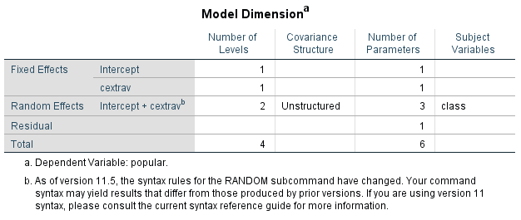
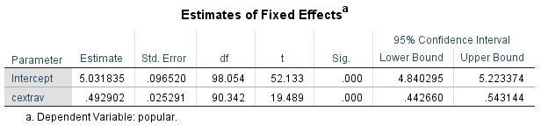
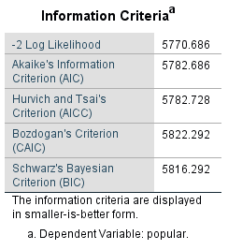
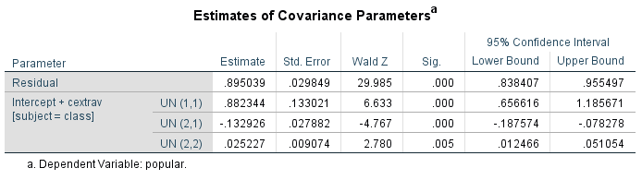




MIXED popular WITH cextrav
/FIXED=cextrav | SSTYPE(3)
/METHOD=ML
/PRINT=SOLUTION TESTCOV
/RANDOM=INTERCEPT cextrav | SUBJECT(class) COVTYPE(UN).
γ₀₀
γ ₁₀
$${Average s}_{e_{ij}}^{2}$$
$$τ_{00} OR s_{u_{0j}}^{2}$$
$$τ_{11} OR s_{u_{1j}}^{2}$$
$$τ_{10} OR {COV}_{Slopes/Inter}$$

Slide 19
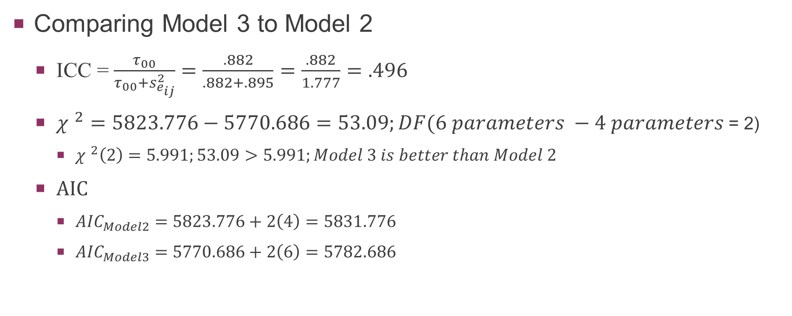
Model building/testing – “popular”
Comparing Model 3 to Model 2
ICC = $\frac{τ_{00}}{τ_{00}+s_{e_{ij}}^{2}}=\frac{.882}{.882+.895}=\frac{.882}{1.777}=.496$
${χ }^{2}=5823.776−5770.686=53.09;DF(6 parameters −4 parameters$ = 2)
${χ }^{2}\left(2\right)=5.991;53.09>5.991;Model 3 is better than Model 2$
AIC
${AIC}_{Model2}=5823.776+2\left(4\right)=5831.776$
${AIC}_{Model3}=5770.686+2\left(6\right)=5782.686$

Slide 20
Model building/testing – “popular”
Random-Intercepts Random-Slopes Plus Level 2 Predictor (Model 4)
Treating data as 2 levels where every group gets their own intercept and their own slope AND adding in a predictor that exists only at Level 2
Level 1:
Level 2:

Slide 21
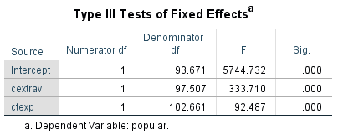
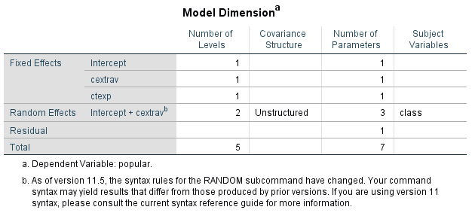
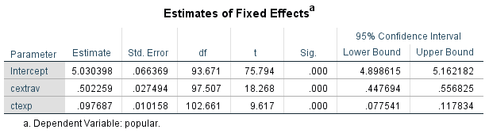

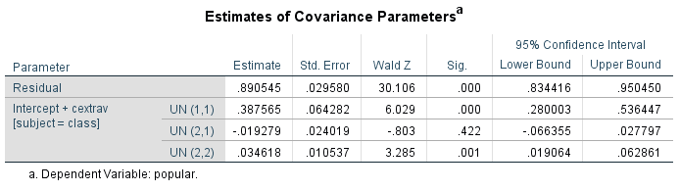
MIXED popular WITH cextrav ctexp
/FIXED=cextrav ctexp | SSTYPE(3)
/METHOD=ML
/PRINT=SOLUTION TESTCOV
/RANDOM=INTERCEPT cextrav | SUBJECT(class) COVTYPE(UN).
γ₀₀
γ ₁₀
γ ₀₁
$${Average s}_{e_{ij}}^{2}$$
$$τ_{00} OR s_{u_{0j}}^{2}$$
$$τ_{11} OR s_{u_{1j}}^{2}$$
$$τ_{10} OR {COV}_{Slopes/Inter}$$

Slide 22
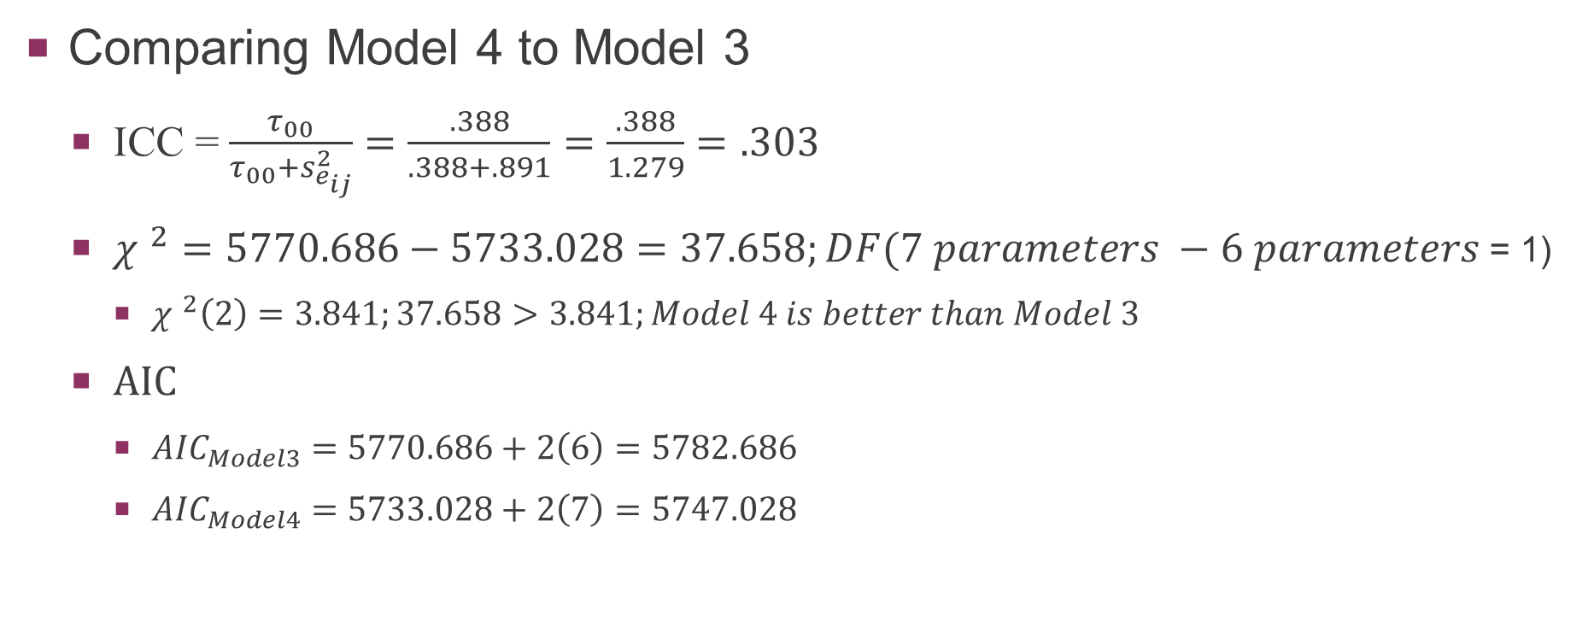
Model building/testing – “popular”
Comparing Model 4 to Model 3
ICC = $\frac{τ_{00}}{τ_{00}+s_{e_{ij}}^{2}}=\frac{.388}{.388+.891}=\frac{.388}{1.279}=.303$
${χ }^{2}=5770.686−5733.028=37.658;DF(7 parameters −6 parameters$ = 1)
${χ }^{2}\left(2\right)=3.841;37.658>3.841;Model 4 is better than Model 3$
AIC
${AIC}_{Model3}=5770.686+2\left(6\right)=5782.686$
${AIC}_{Model4}=5733.028+2\left(7\right)=5747.028$

