Slide 1
Multilevel Linear Models
Aka → Multilevel regression, Hierarchical Linear models, mixed models, random effects models, etc.
Dr. Andrew Ainsworth
Psy524/L
California State University, Northridge

Slide 2
Linear regression
In typical linear regression we estimate a single intercept value and one slope value per predictor.
This assumes “one-size-fits-all” for everyone in the data set
Any deviation of Y from Y’ is considered error and contributes to the standard error of estimate

Slide 3
Data example – “Popular” dataset from joop hox (2010)
Predicting a student’s self-rated popularity (continuous) from extraversion (continuous), female (0=male,1=female) and teacher’s experience (continuous)
Preview of 20 out of the 2000 cases in the data set →
Open up popular.sav to play along

Slide 4
Data example – “Popular” dataset from joop hox (2010)
Based on what we know of linear regression we can put together a multiple regression equation:
Solve for a and the bs
Any deviation of y-predicted from y is assumed to be a residual and random

Slide 5
Having a single intercept and one slope per predictor assumes that
all participants are from a single homogenous group (i.e., from a single population)
based around a single intercept/mean (i.e., Mu)
And that the impact that each X has on Y is consistent for all people in the dataset.
What about the sexes? Aren’t those separate groups?

Slide 6
What if the data were collected in groups and the participants were not randomly assigned to those groups (i.e., sounds like random effects anova)
In linear regression, as we have talked about it so far, how can we handle this?
In regular regression we assume a homogenous sample (i.e., the model applies the same for everyone) so option 1 is to ignore the grouping.
Let’s look at popular predicted by just extraversion (extrav)

Slide 7
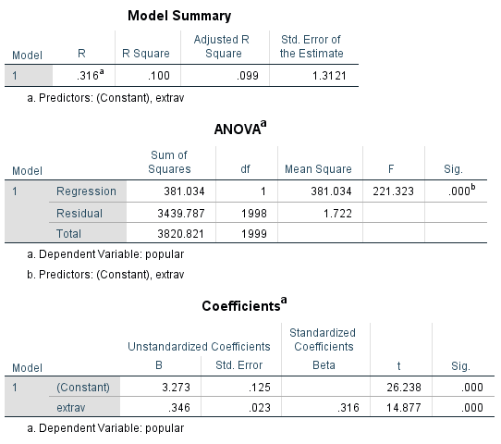
Data example – “Popular” dataset from joop hox (2010)
Ignoring groups/classes we get:
a = 3.273
b_{extrav} = .346
How do we interpret the intercept and slope values?

Slide 8
What if the data were collected in groups and the participants were not randomly assigned to those groups (i.e., sounds like random effects anova)
In linear regression as we have talked about it so far how can we handle this?
In regular regression we assume a homogenous sample (i.e., the model applies the same for everyone) so option 2 is to run a separate regression in each group.
We can create a separate regression equation for each group/class predicting popular from extrav

Slide 9
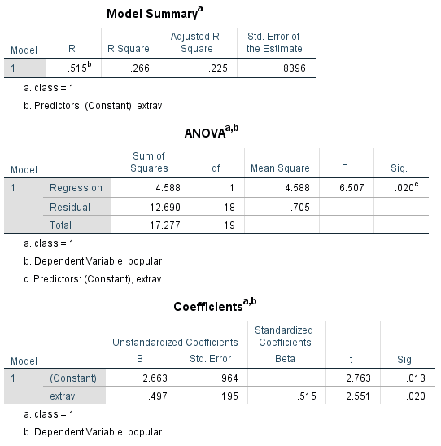
Data example – “Popular” dataset from joop hox (2010)
For group/class 1 we get:
a = 2.663
b_{extrav} = .497

Slide 10
Data example – “Popular” dataset from joop hox (2010)
100 regression models were computed
The average intercept is 2.394 with a StDev = 2.142
The average intercept is smaller (2.394 vs. 3.273) than the overall model
The average slope for extrav is 0.498 with a StDev = 0.277
The average slope is larger (.498 vs. .346) than the overall model
On average the models are not significant (however this could be because of power)

Slide 11
Data example – “Popular” dataset from joop hox (2010)
100 regression models were computed
Because we now have 100 intercept and slope estimates with some variability we can use that as data
For example, we can predict the intercepts and slopes by teacher experience (texp)
Does amount of time the teacher has been teaching account for variability in the intercepts and slopes?
Open up popular2.sav; preview of file →

Slide 12
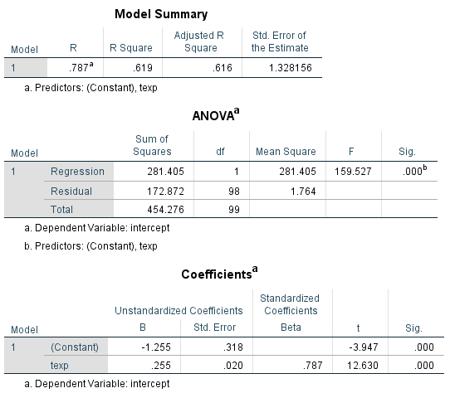
Data example – “Popular” dataset from joop hox (2010)
Predicting the intercepts from texp
Constant of -1.255 and a slope of 0.255
Both are significant
How do I interpret these?

Slide 13
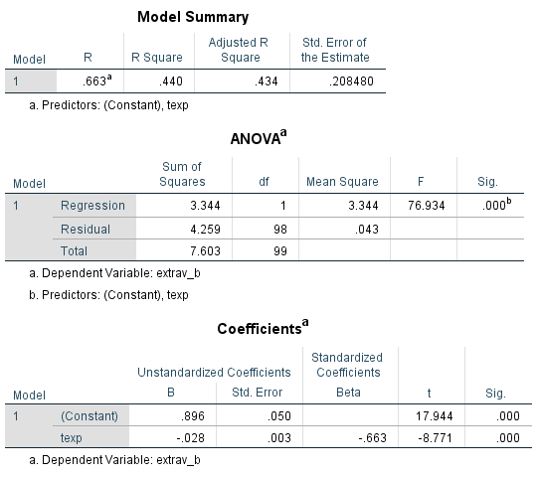
Data example – “Popular” dataset from joop hox (2010)
Predicting the slopes from texp
Constant of 0.896 and a slope of -0.028
Both are significant
How do I interpret these?

Slide 14
Reviewing the options
When data are grouped (e.g., clustered, collected within classes) we can:
Ignore the grouping and estimate 1 set of coefficients for everyone (i.e., one-size-fits-all)
Estimate 1 set of coefficients for each group; which will give us a distribution of intercepts and slopes

Slide 15
Fixed vs. random effects
Fixed Effects → When data are grouped and you chose to ignore the grouping and estimate one set of coefficients
Random Effects → Estimating a separate set of coefficients for each group
Fixed effects are generally simpler and provide more generalizability (i.e., the effect is the same for all groups)
Random effects create coefficients for each group which are then treated as random variables and can be used to test further hypotheses
Models can be a combination of fixed and random (i.e., fixed intercept, random slope)

Slide 16
Multilevel model (mlm)
Multilevel models are used when data are organized at more than one level
For example, the “popular” outcome was measured for pupils (level 1) within classrooms (level 2)
Multiple responses (level 1) from the same respondent (level 2)
Voting behavior of voters (level 1), within their voting precinct (level 2), within their city (level 3) and within their state (level 4)

Slide 17
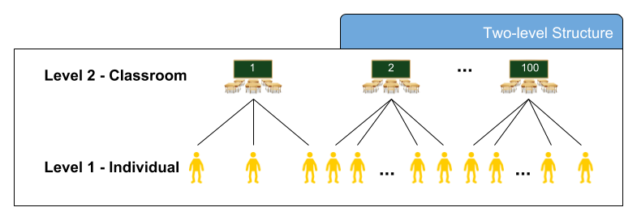
Multilevel model (mlm)

Slide 18
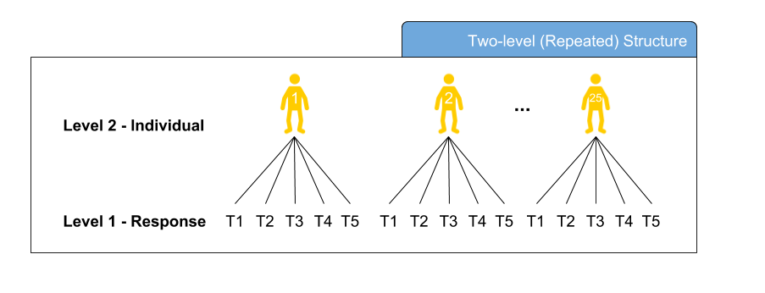
Multilevel model (mlm)

Slide 19
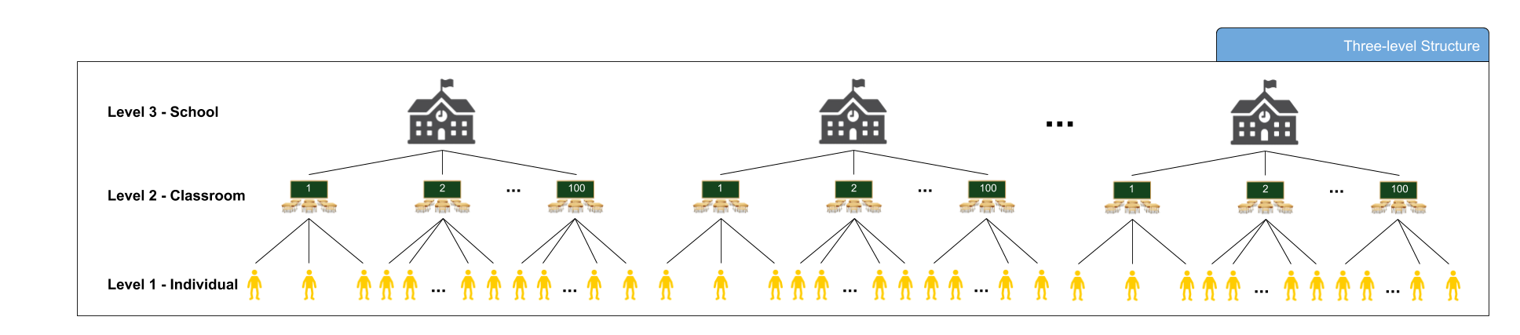
Multilevel model (mlm)

Slide 20
Advantages
Models can include variables that exist at different levels (e.g., student responses, teacher experience)
Shares many traits with random effects/nested designs
Can be used as an alternative to repeated measures analyses
Repeated measures analyses often have restrictive assumptions
Can estimate individual differences in growth over time
Can be used in place ANCOVA without the homogeneity of regression assumption
Does not have the independence of errors assumption

Slide 21
Research questions
Many of the questions you would ask in multiple regression apply but now you can ask additional, and super sexy, questions
Are groups different in mean/intercept?
Are groups different in slope?
Are their cross-level interactions?
Are their longitudinal trends (growth modeling)?
Are effects present when data are combined across studies (meta-analysis)?

Slide 22
Assumptions
As a linear model is shares many assumptions with multiple regression and data should be screened prior to analyses
Linearity
Normality
Outliers (both in and out of groups)
Missing data should be addressed (more of an issue in MLM)
No Multicollinearity/Singularity of predictors

Slide 23
Assumptions
Where MLM models differ from multiple regression
Unequal n across groups is OK
Power and sample size computations are more complicated (see the link in T&F for power calculator)
Maximum Likelihood (ML) approach (as opposed to least squares typical in multiple regression)
Larger sample size requirements (e.g., sample size requirements apply at all levels)

Slide 24
Assumptions
Where MLM models differ from multiple regression
No independence of errors assumption
accounting for the clustering/grouping addresses the dependencies
The intraclass correlation (ICC; coming soon) is a measure of the dependence of errors
The bigger the ICC the more bias (i.e., inflation of Type 1 error) is introduced if the clustering/grouping of responses is ignored.

Slide 25
Basic MLM Model
Single Level Fixed effect:
Multilevel Model
Level 1 (i.e., student):
Level 2 (i.e., class):

