Slide 1
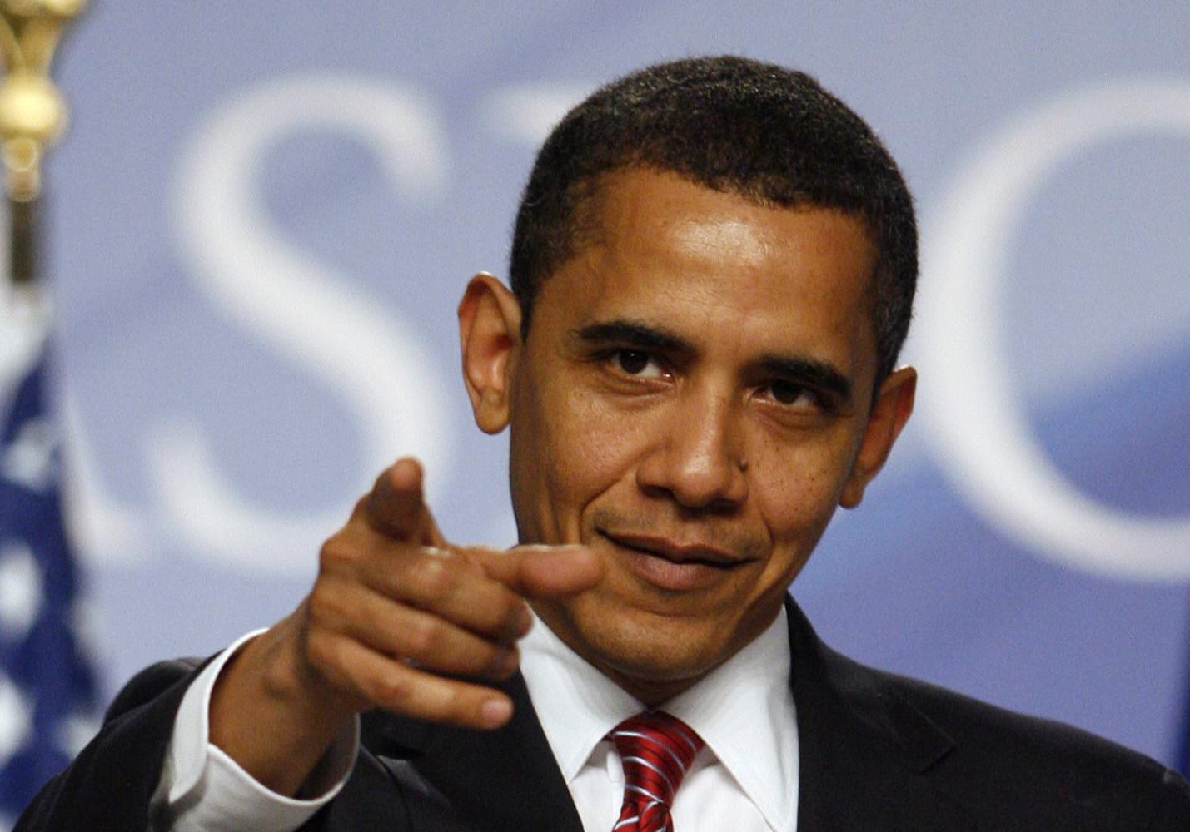
7.2.2
Your Turn
Complete the Merge Sort diagram provided below
10 | 3 | 5 | 6 | 1 | 4 | 8 | 7
10 | 5 | 1 | 8
3 | 6 | 4 | 7
10 | 1
5 | 8
3 | 4
6 | 7
10
1
5
8
3
4
6
7
1 | 10
5 | 8
3 | 4
6 | 7
1 | 5 | 8 | 10
3 | 4 | 6 | 7
1 | 3 | 4 | 5 | 6 | 7 | 8 | 10

Slide 2
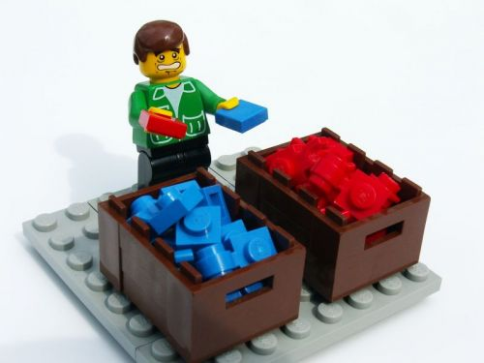
7.2.5
Odd Number of Elements
Complete the merge sort diagram provided below
Remember the rules for splitting
7 | 3 | 5 | 13 | 1 | 9 | 11
7 | 5 | 1 | 11
3 | 13 | 9
7 | 1
5 | 11
3 | 9
13
7
1
5
11
3
9
13
1 | 7
5 | 11
3 | 9
13
1 | 5 | 7 | 11
3 | 9 | 13
1 | 3 | 5 | 7 | 9 | 11 | 13

Slide 3
7.2.10
Already Sorted
Complete the following merge sort diagram
Make note of how many steps it took to complete
2 | 4 | 6 | 8 | 9 | 11 | 13 | 15
2 | 6 | 9 | 13
4 | 8 | 11 | 15
2 | 6
9 | 13
4 | 8
11 | 15
2
6
9
13
4
8
11
15
2 | 6
9 | 13
4 | 8
11 | 15
2 | 6 | 9 | 13
4 | 8 | 11 | 15
2 | 4 | 6 | 8 | 9 | 11 | 13 | 15

Slide 4
7.3.2
Your Turn
Complete the Quicksort diagram provided below
10 | 3 | 5 | 6 | 1 | 4 | 8 | 7
3 | 5 | 6 | 1 | 4 | 8 | 7 | 10
1 | 3 | 5 | 6 | 4 | 8 | 7 | 10
1 | 3 | 4 | 5 | 6 | 8 | 7 | 10
1 | 3 | 4 | 5 | 6 | 7 | 8 | 10
1 | 3 | 4 | 5 | 6 | 7 | 8 | 10
1 | 3 | 4 | 5 | 6 | 7 | 8 | 10

Slide 5
7.3.6
Duplicates
Complete the quicksort diagram provided below
3 | 1 | 4 | 2 | 3 | 5 | 1 | 4
1 | 2 | 1 | 3 | 3 | 4 | 5 | 4
1 | 1 | 2 | 3 | 3 | 4 | 5 | 4
1 | 1 | 2 | 3 | 3 | 4 | 4 | 5
1 | 1 | 2 | 3 | 3 | 4 | 4 | 5
The quicksort algorithm works with duplicate values
For the same array, add all pivot value to it and mark them all as pivot
For all other values, partition works the same as normal

Slide 6
7.3.9
Already Sorted
Complete the following quicksort diagram
Make note of how many steps it took to complete
2 | 4 | 6 | 8 | 9 | 11 | 13 | 15
An already sorted list is a common edge case for sorting algorithms
2 | 4 | 6 | 8 | 9 | 11 | 13 | 15
2 | 4 | 6 | 8 | 9 | 11 | 13 | 15
2 | 4 | 6 | 8 | 9 | 11 | 13 | 15
2 | 4 | 6 | 8 | 9 | 11 | 13 | 15
2 | 4 | 6 | 8 | 9 | 11 | 13 | 15
2 | 4 | 6 | 8 | 9 | 11 | 13 | 15
2 | 4 | 6 | 8 | 9 | 11 | 13 | 15
Let's see how well quicksort handles it

