Slide 1
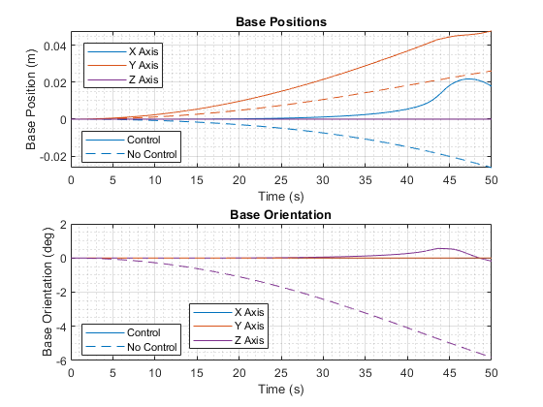
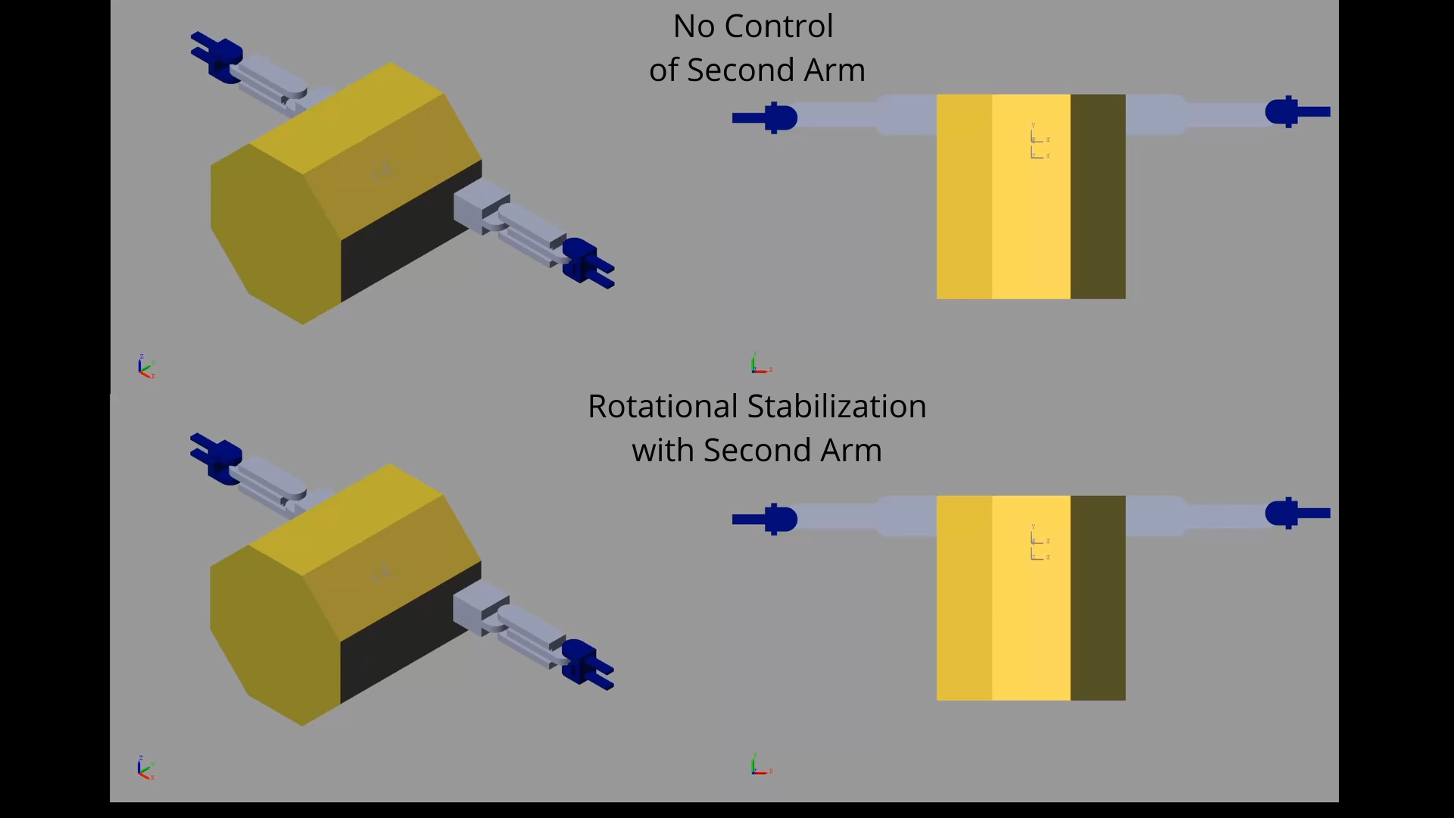
Exploration of dual-arm stabilization techniques
One arm completes a task while a second arm is used to stabilize the base spacecraft
Simple scenario with identical 2-DOF planar arms attached to a 6-DOF free-floating base. Task arm moves under a constant torque
When the second arm is held stationary the base rotates nearly 6 degrees in 50 seconds, with stabilization, the maximum rotation is 0.55 degrees
Simple case like this is used to validate our simulation and control algorithm development
Video shown at 4x speed

