Slide 1
Problem Description
Using Reinforcement Learning (RL) to train a cubesat to follow a pre-defined relative orbit about a target object
Proximal Policy Optimization (PPO) learning algorithm is used to develop a control policy to track a reference trajectory
Cubesat can issue thrust at each timestep in the simulation
System parameters
Cubesat mass: 3 kg
Thrust limit: +/- 0.02 (no restriction on duty cycle)
Training parameters
Three policies trained simultaneously, each for a different reference orbit
10 m, 15 m, 20 m (each circular about target)
Reference orbit period: 6 minutes
Training performed in batches of 10 for 5,000 iterations
Total of 50,000 orbits simulated per cubesat

Slide 2
Actions and Observations
Actions
Torque for each manipulator joint
Observations
End effector errors (position, orientation)
Joint angles
Joint rates

Slide 3
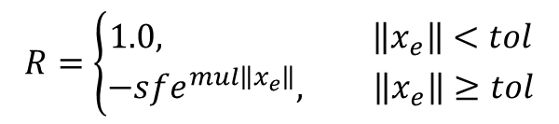

Reward Function
Total reward is the sum of 3 components
position error, velocity error, control effort
Reward is issued on each time step of the simulation
Position and velocity rewards (R) are positive 1.0 when the errors (x_{e}) are below a tolerance (tol) then exponentially decrease when above the tolerance
Exponential rewards configured through scale factor and multiplier parameters
Control reward is a simple linear multiplier on the total thrust (F)
$$R=−sf\left\|F\right\|$$
$$R=\left\{\begin{aligned}1.0, \left\|x_{e}\right\|<tol \\ &−sfe^{mul\left\|x_{e}\right\|}, \left\|x_{e}\right\|≥tol\end{aligned}\right.$$

Slide 4
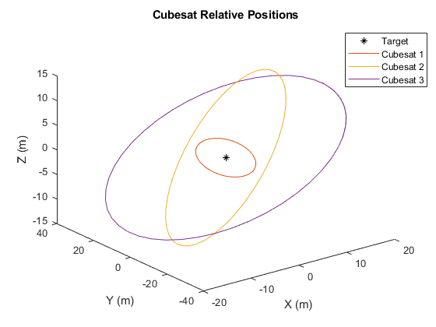
Cubesat Initial Conditions
Cubesat | r (m) | X (m) | Y (m) | Z (m) | xDot (m/s) | yDot (m/s) | zDot (m/s)
1 | 10 | -10 | 0 | 0 | 0 | -0.1745 | 0
2 | 15 | -15 | 0 | 0 | 0 | -0.2611 | 0
3 | 20 | -20 | 0 | 0 | 0 | -0.3491 | 0
2D orbits
Orbit Period = 6 minutes
Performance after 10,000 training orbits
Performance after training complete 50,000 orbits

