Slide 1
Basic Shiny applications
13MAY20

Slide 2
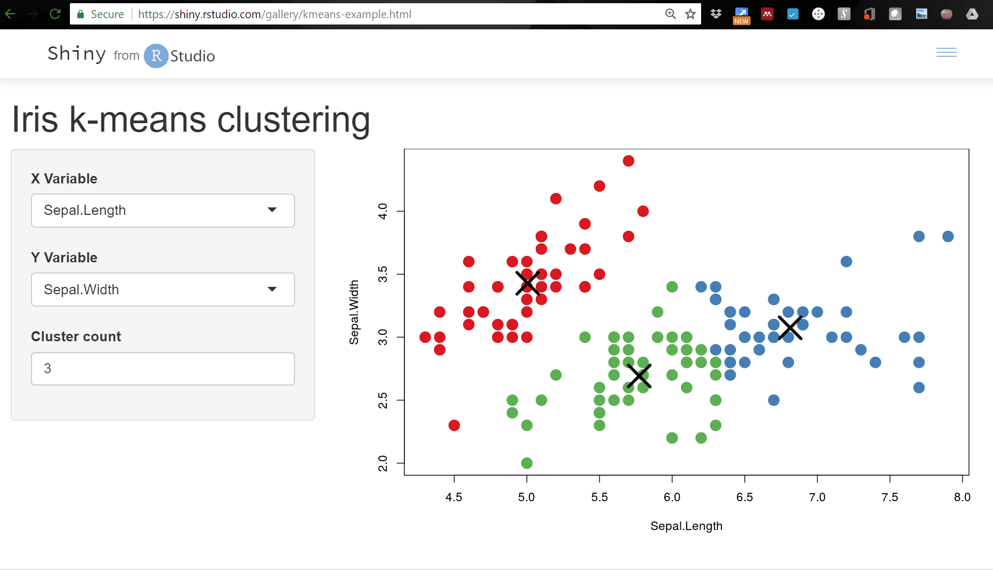
Shiny
Shiny is a basic web-development tool for building interactive applications using R.
Basic HTML web page with a server running R in the background.

Slide 3
Why use Shiny?
Initeractive “release” of data to public.
Public does not need to recreate analysis pipeline to recreate or modify your analysis.
Collaborations.
Rather than require back-and-forth between contributors with and without access to data and plotting tools, an application can let everyone play with basic visualizations at leisure.
Streamlining data exploration.
Plotting/tabulating functions are easy to incorporate into a basic UI, which can save time over endlessly adding to a script or markdown.

Slide 4
Application basics
Can be designed with a single script, but as applications become more complex this seems to get convoluted quickly.
Often compartmentalized into three files:
User interface
Basic HTML conversion.
Built-in “widgets”, fonts, themes, etc.
Input values and defaults.
Place holders for plots, etc.
server.R
global.R
ui.R
app.R
Server
Background code.
Makes tables, draws plots, etc.
Global
Optional, but runs when the app starts.
Only runs once.

Slide 5
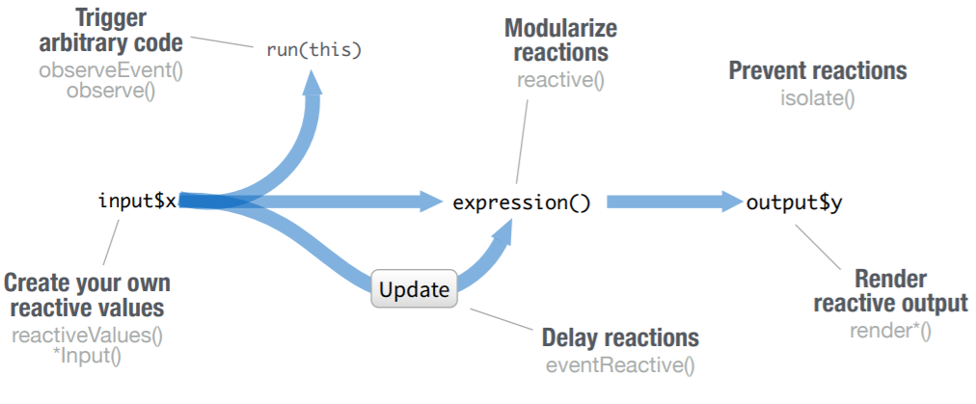
Shiny keeps track of dependencies on its own.

Slide 6
Shiny keeps track of dependencies on its own.
Input 1
Plot 1
ui.R
Plot 2
Input 2
Table 1

Slide 7
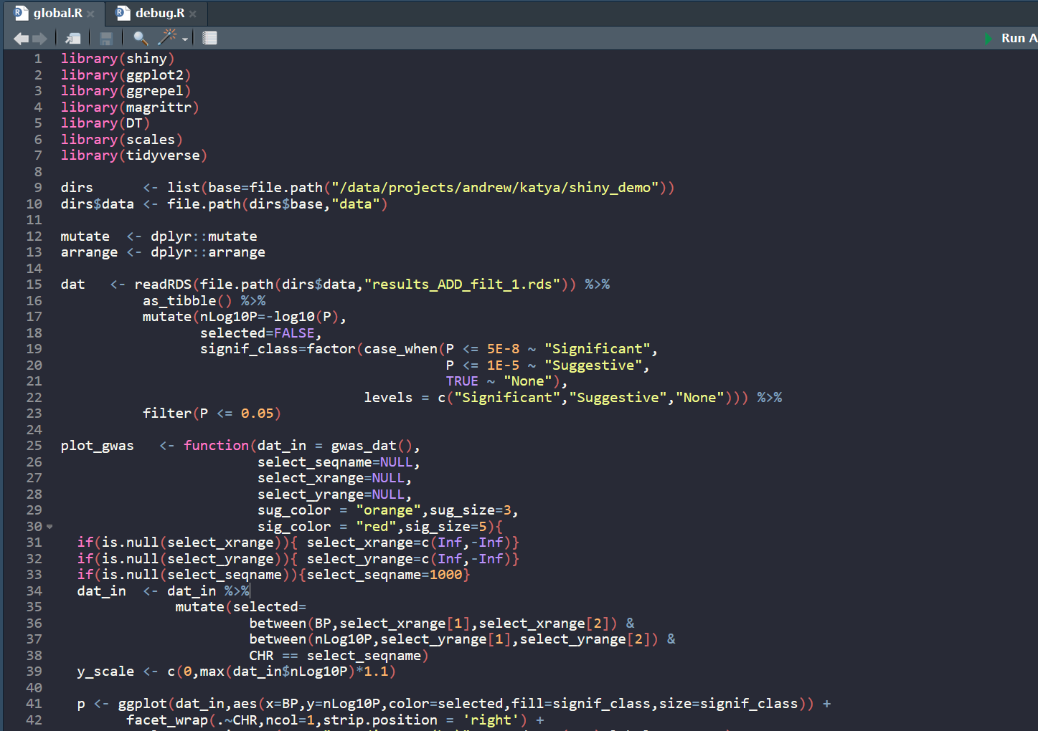
Global file (ui.R)
Optional, but if found in the same directory as ui.R and server.R.
Will be run first.
Setup can vary, but (I think) a good place to:
Load libraries.
Declare / source functions.
Load and format initial data objects.

Slide 8
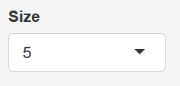
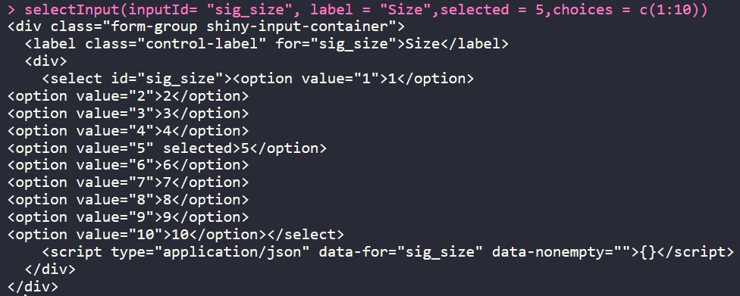
User Interface file (ui.R)
Shiny scripts are basically nested R functions that act like HTML translators.
Specific functions create specific page components (buttons, sliders, text boxes, plot spaces).
In addition to providing the input widgets, the UI typically specifies default values as well.
All widget input values are added to an “input” list object, which is passed to the server.
Anything (plots, tables, etc.) that refers to “input” is automatically updated when that input changes.
input$sig_size

Slide 9
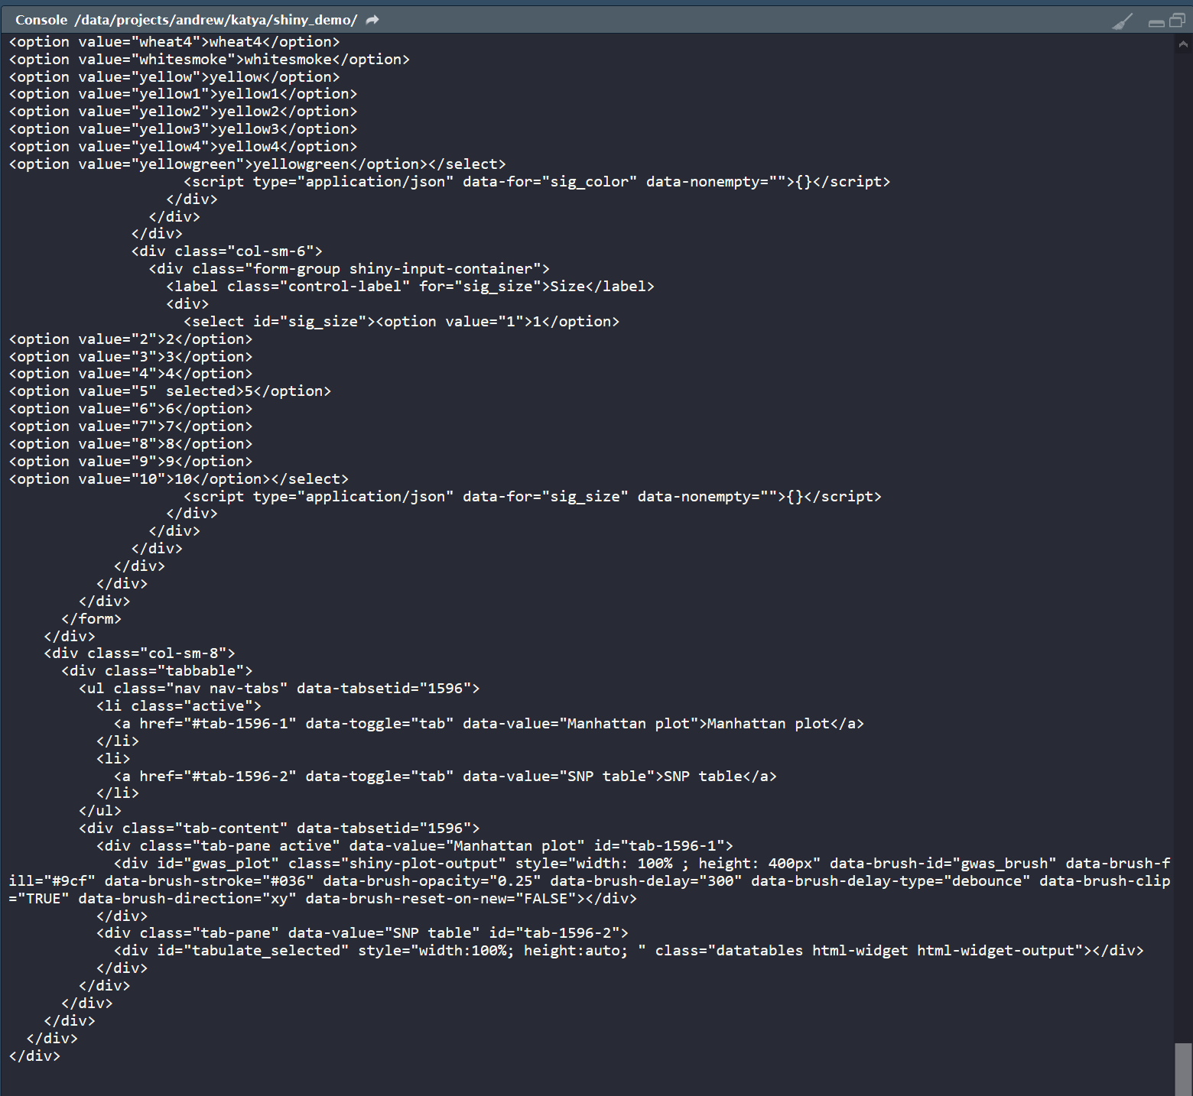
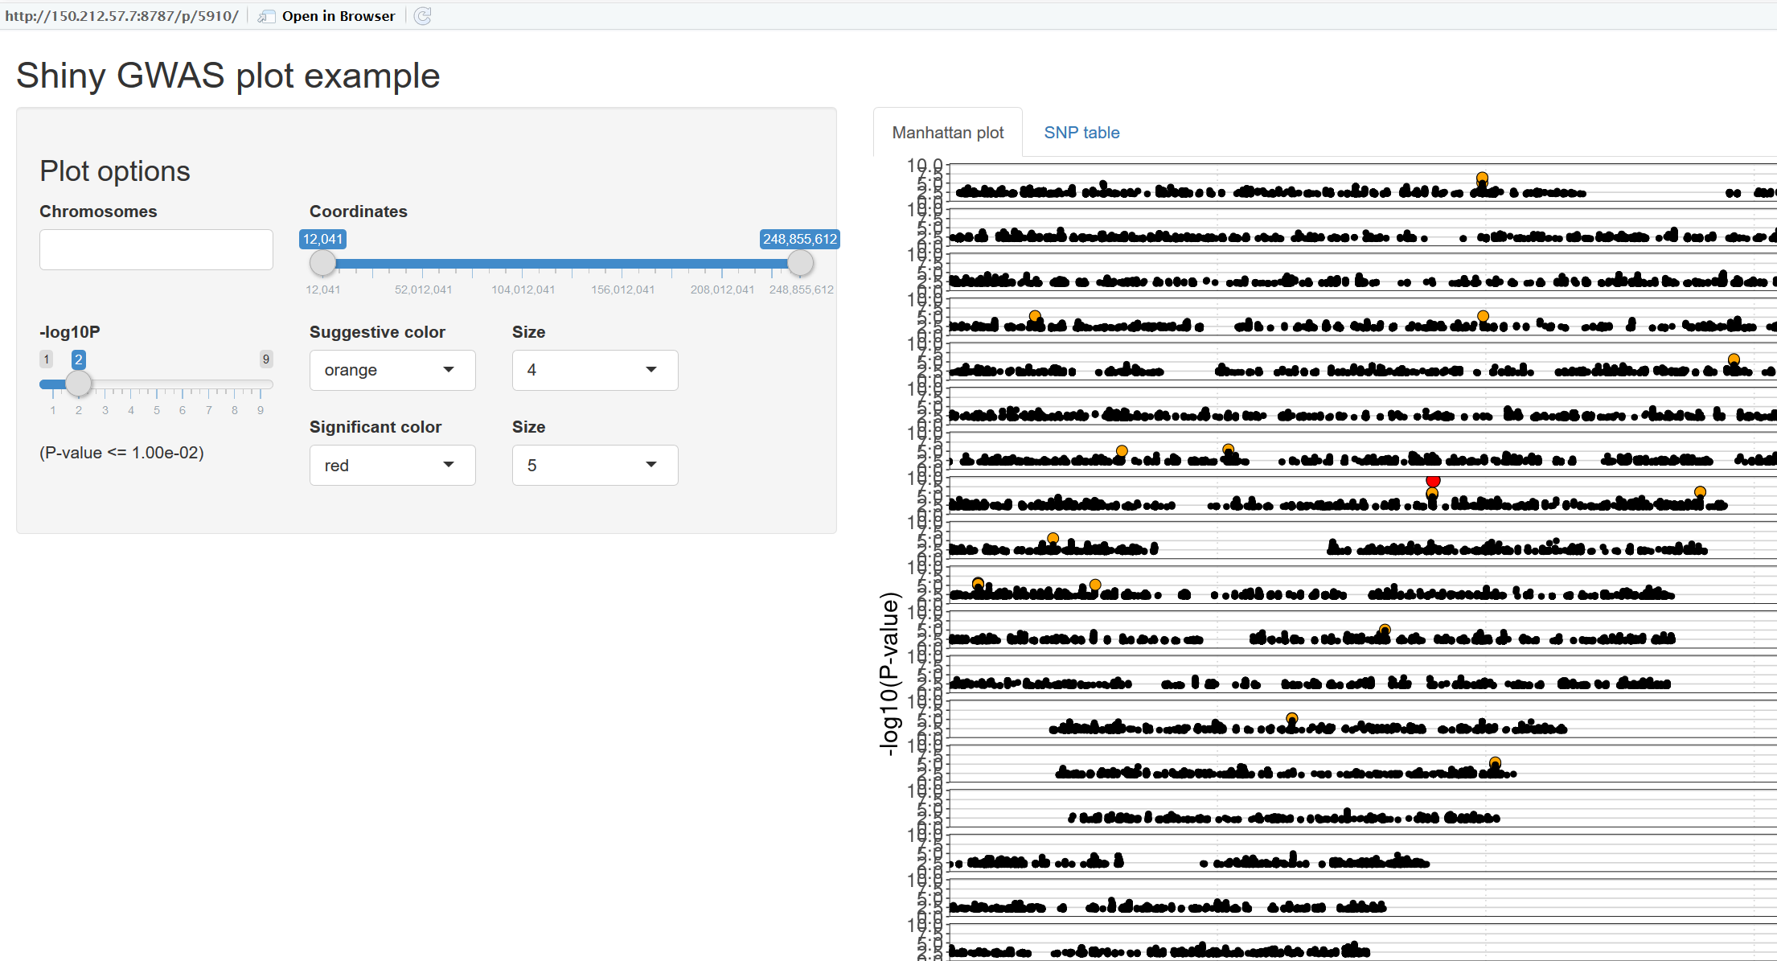
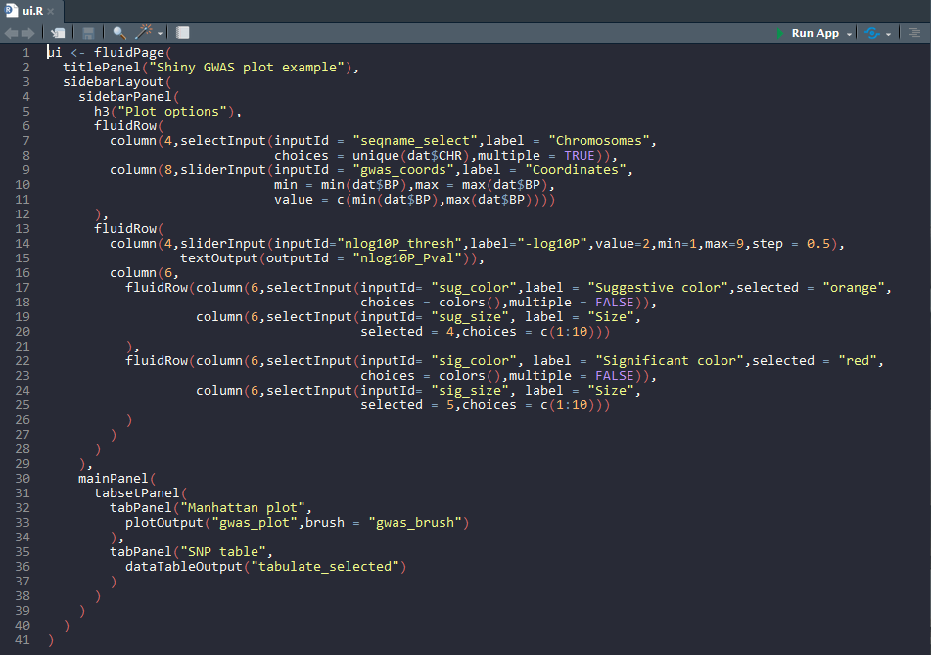
User Interface file (ui.R)

Slide 10
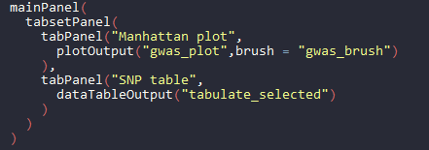
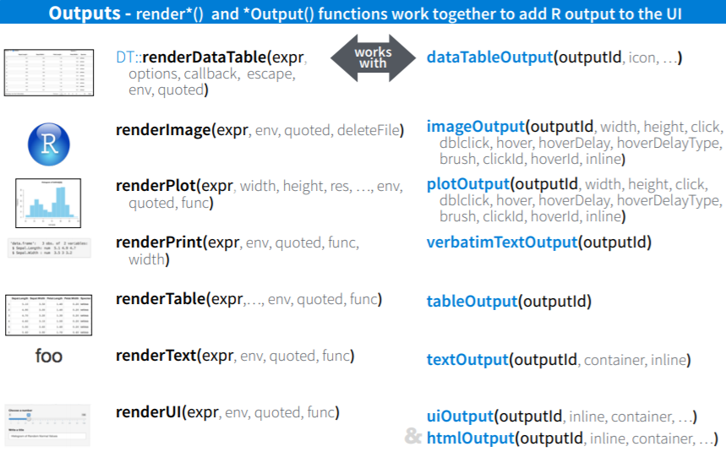
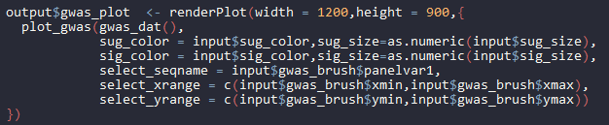
Server file (server.R)
Server is an all-encompassing function that includes all operations on the web page.
Uses input from UI and all loaded data objects to make plots, tables, generate text messages, etc.
Where ui.R specifies place-holders, server.R fills these in with actual figures.
UI placeholder
Server output:

Slide 11
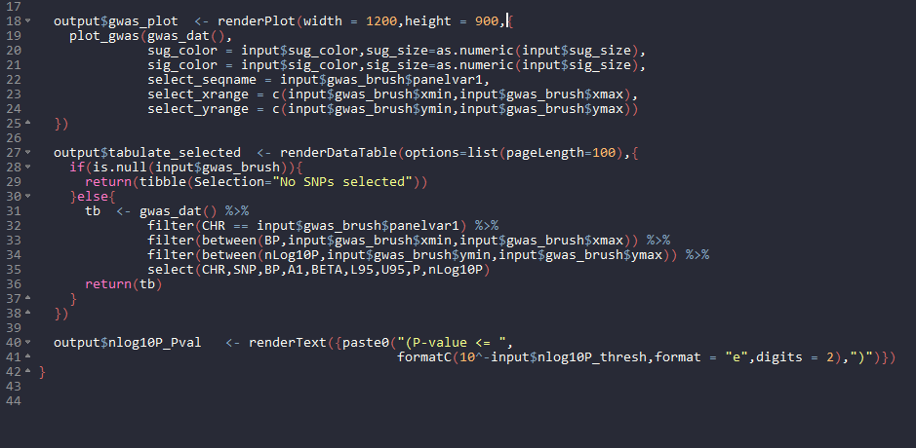
Server file (server.R)
Where ui.R packages inputs into a list object called “input,” the server packages output into a list object called “output.”

Slide 12
Shiny’s server function keeps track of dependencies.
Input 1
Plot 1
server.R
ui.R
Plot 2
Input 2
Table 1
Any server object that depends on an input is made “dependent.”
Whenever that input changes, the server updates all dependencies while ignoring others.

Slide 13
server.R --> ui.R interactions
Normally, the output cannot affect the UI as the UI is generated once at run time.
Cannot make options in a selection box depend on a table generated in server.R, for example.
Specific functions are available to make updates to the UI possible later, such as:
conditionalPanel(): A UI panel that only appears in certain conditions determined by the server (i.e. specific tab selected, etc.).
renderUI(): Add or remove specific components as needed.
updateSelectInput(): Change options available in a selectInput() box.
Etc.
Easier alternative: use global.R to specify UI defaults, then use specific R functions to update them as needed.

Slide 14
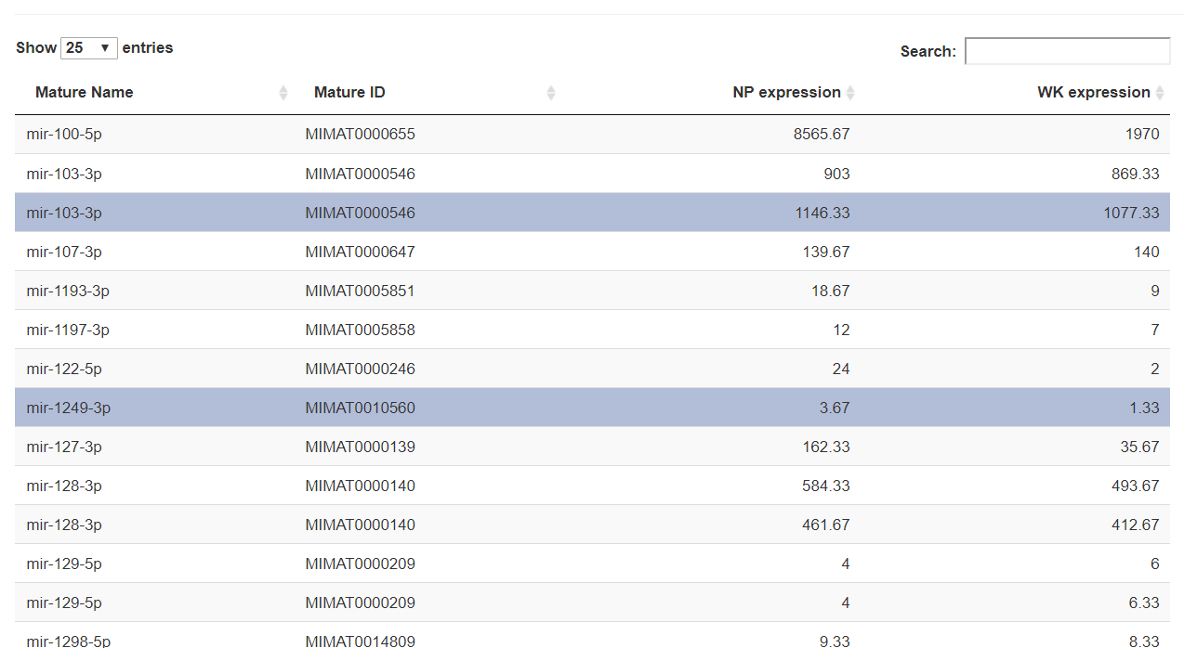
server.R --> ui.R interactions
The specific case of interactive tables requires a “proxy” table using dataTableProxy().
User selects row in table.
Server gets selected row number from UI.
Server updates selection of proxy table.
All subsequent server functions refer to proxy table.

Slide 15
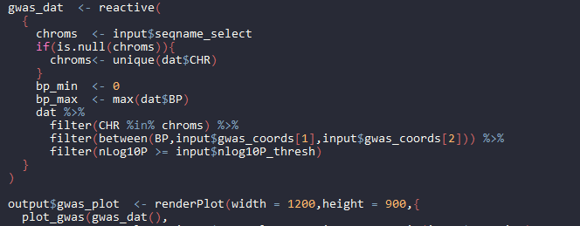
Reactive objects
Reactive objects are data objects that depend on input, and are updated in the background.
In effect, telling Shiny’s server to watch something manually.
Should be used in place of regular variables.
Plots are essentially “reactives” by default.

Slide 16
miRLink setup
Analyses
gwas_data
gwas_dat()
global.R
ui.R
plot_gwas()
server.R
GWAS data
(.rds)
tabulate_snps()

Slide 17
miRLink setup
Input CSV
Input CSV
Input CSV
Input CSV
miRNA data
miRNA Expression
miRNA expression
(Subset)
miRNA table
global.R
miRNA plots
miRNA targets (TargetScan)
mRNA table
mRNA targets
mRNA targets (Subset)
mRNA plots
Input CSV
Input CSV
Input CSV
Input CSV
mRNA data
Reactive Objects
ui.R
Inputs

Slide 18
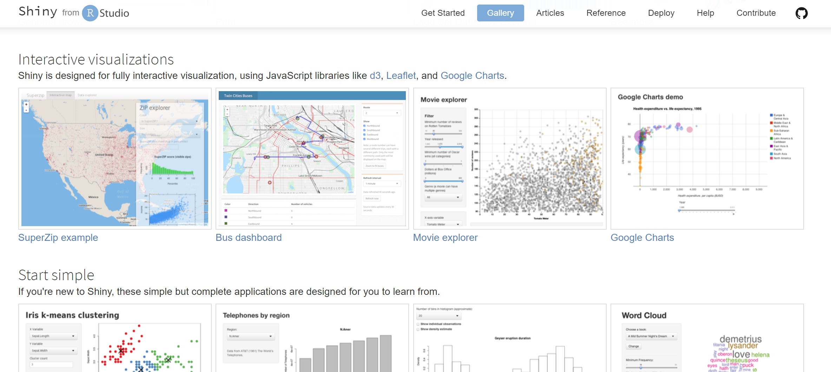
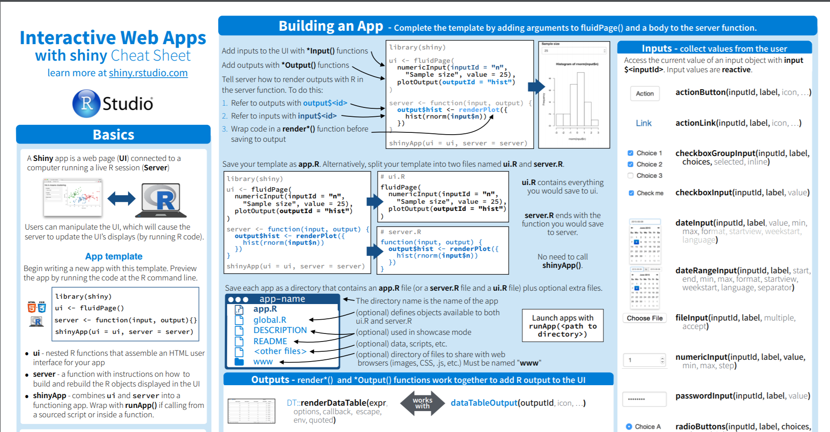
Getting started
Shiny has a variety of tutorials and interactive examples in the Shiny gallery.
Shiny cheat sheet quite handy as well.

Slide 19
Getting started
Hosting Shiny applications requires a public-facing server.
Our lab has used a cloud-based server, costs ~$25 per month
Alternatively, you can share apps between users, but this requires everyone to know their way around R and R dependencies.

