Slide 1
CS 4320 / 7320 Software Engineering
Requirements

Slide 2
What is the SDLC? Where does Requirements Analysis fit?
Requirements
Analysis
Design
Requirements
Analysis
Requirements
Analysis
Design
Requirements
Analysis
Design
Problem
Design
Problem
Problem
Problem
Release
Testing
Implementation
Release
Testing
Testing
Implementation
Implementation
Maintenance
Problem

Slide 3
What is a software requirement?
A requirement is a property that must be exhibited by the software system in question in order to solve some problem in the real world.
Each requirement must be verifiable within available resource constraints.

Slide 4
A requirement is either a …
Product Requirement
A need or constraint on the software being developed
Ex: The software shall verify a student meets all prerequisites before registering for a course.
Process Requirement
A constraint on the development of the software
Ex: The software shall be developed using a FDD process.

Slide 5
Product requirements may be…
Functional
Capabilities, features, or functions the software will execute
Finite test steps can be written for it
A description of a behavior that a system will exhibit under specific conditions. [Wiegers]
Non-functional
Constraints on the solution
Quality attributes
Performance Security
Maintainability Interoperability
Reliability Etc…
A description of a property or characteristic that a system must exhibit or a constraint that it must respect. [Wiegers]

Slide 6
System Requirements
A system is an interacting combination of elements to accomplish a defined objective. These include hardware, software, firmware, people, information, techniques, facilities, services, and other support elements.
System requirements are requirements for the system as a whole.
Software requirements are derived from system requirements. [SWEBOK 1.6]
A system requirements is a top-level requirement for a product that contains multiple subsystems, which could be all software or software and hardware. [Wiegers]

Slide 7
System Requirements
Pre-requisites that often define the operating environment
Architecture
Hardware
Storage
Memory
CPU
Connectivity etc.
Notes:
----- Meeting Notes (2/2/17 15:06) -----
this slide needs ot have some of the sociotechnical elements from the previous slide.

Slide 8
User Requirements
Identify the different classes of user in your system
What are the goals of that user? What do they want to be able to do?
A prospective customer shall be able to add items to a shopping cart.
A customer shall be able to check out.

Slide 9
Requirements are refined
Business Requirements – WHY is the business starting this project?
Vision and Scope
User Requirements – WHAT does the user need to do?
Most often represented with Use Cases
Functional Requirements – WHAT does the developer implement? (Not HOW)
Derived from User Requirements, influenced by System Requirements and Non-Functional Requirements
Gives the developer enough detail to know what to implement

Slide 10
Example: User Requirements to Functional Requirements
User Requirement for a Web Browser:
The user shall be able to edit bookmarks.
Functional Requirements for a Web Browser:
The system shall display bookmarks as a collapsible and expandable hierarchical tree.
The user shall be able to resequence bookmarks.
The system shall display bookmark properties.
The user shall be able to modify a bookmark’s name, URL, and description. [Wiegers]

Slide 11
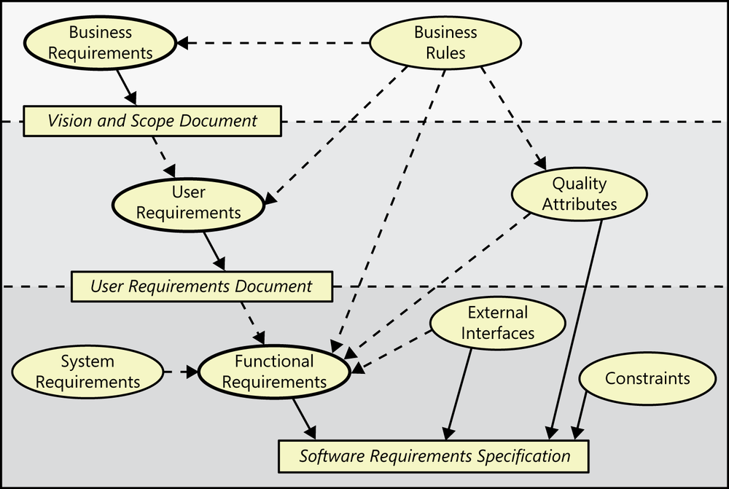
Non-functional Requirements
Represented with Use Cases
Are the origin of
Influence
Figure 1-1. Relationships among several types of requirements information. Solid arrows mean “are stored in”; dotted arrows mean “are the origin of” or “influence.” Source: K. E. Wiegers and J. Beatty, Software Requirements, 3rd ed., Redmond, Washington: Microsoft Press, 2013.

Slide 12
Excellent requirement specs are…
Complete – nothing missing (hard to tell!)
Consistent – does not conflict with other requirements
Correct – accurately states a user or external need (customer is the judge)
Feasible – can be implemented within known constraints
Modifiable – can be changed, with history, when necessary (unique identifiers, changelog or source control history)
Source: Video 24 - Characteristics of Excellent Requirements by Enfocus Solutions, https://www.youtube.com/watch?v=6RSkUhZkPJM

Slide 13
Excellent requirement specs are…
Prioritized – ranked as to importance of inclusion in product
Necessary – documents what users really need (need ≠ want)
Traceable – can be linked to system or user requirements, designs, code, and tests
Unambiguous – one possible meaning to all readers
Verifiable –testing, inspection, analysis, or demonstration can determine correct implementation.
Source: Video 24 - Characteristics of Excellent Requirements by Enfocus Solutions, https://www.youtube.com/watch?v=6RSkUhZkPJM

Slide 14
Verifiable Requirements are (usually) Quantifiable
Some Requirements …
The software shall be reliable.
The call center will have better throughput.
What does that mean? How do I know if I’ve achieved that?
Verifiable Requirements…
The software system shall have a probability of generating a fatal error during any hour of operation of less than 1*10⁻⁸.
The call center software must increase the center’s throughput by 20%.
[SWEBOK 1.5]

Slide 15
A few practical properties…
Priority rating
to enable trade-offs when faced with finite resources
Status value
to enable project progress tracking
Unique identifier
to enable tracking and configuration management
Proposed
Approved
Imple-mented
Verified
1.2a

Slide 16
Requirements Process
Elicitation
Analysis
Specification
Validation
Confirm and Correct
Re-evaluate
Clarify
Close Gaps
Rewrite

Slide 17
Requirements Elicitation Sources
Goals (Business Requirements)
Domain Knowledge
Stakeholders
Business Rules
Operational Environment
Organizational Environment

Slide 18
Requirements Elicitation Techniques
Interviews
Scenarios (use cases)
Prototypes
Facilitated meetings
Observation
User Stories
Analyzing competitor products
Analyzing existing system being replaced

Slide 19
Requirements Analysis – Why?
Detect and resolve conflicts
Discover the bounds of the software and how it must interact with its organizational and operational environment
Elaborate system requirements to derive software requirements

Slide 20
Requirements Analysis – How?
Classify requirements
to help think about them in an organized way
Functional vs non-functional
Derived from stakeholder or emergent
Product or process
Priority
Scope
Volatility/stability

Slide 21
Requirements Analysis – How?
Organize requirements
to help track them and look for interactions
By Business Process? Features? Subsystems?
Leave room in your identifiers for additions and changes
Conceptual modeling to understand the problem
Use Case diagrams, data models, others as deemed useful

Slide 22
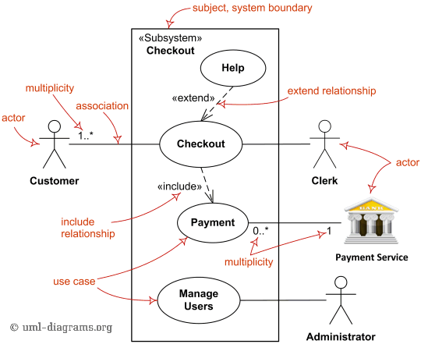
Use Case Diagram
Actors
Use cases (functions)
Included functions (required)
Extended functions (optional)

Slide 23
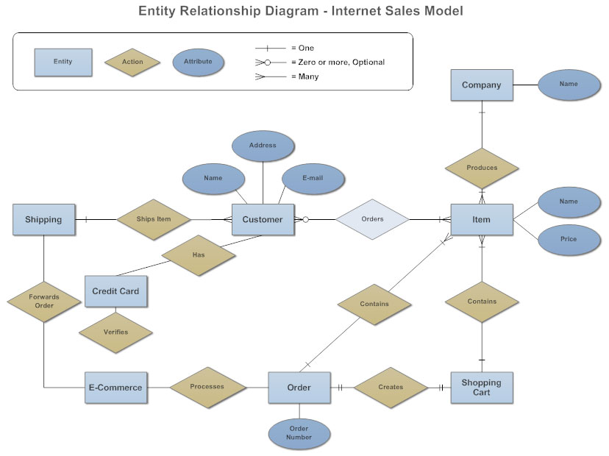
ERD
At Conceptual Level
Use to understand the data
Even if you’re using NoSQL!
Entities
Relationships
Cardinality
Attributes
Source: https://www.smartdraw.com/entity-relationship-diagram/

Slide 24
Requirements Analysis – How?
Architectural Design and Requirements Allocation
Overlaps with design
Which components will satisfy which requirements?
Look for interactions
Requirements Negotiation (Conflict resolution)
Prioritization and customer involvement is key

Slide 25
Requirements Specification
Requirements documents
Can be reviewed, evaluated, and approved.
Has published versions, with changelogs noting changes made.
Complex Projects
System Definition Document
System Requirements Specification
Software Requirements Specification
Simple Projects
Software Requirements Specification

Slide 26
Requirements Validation
Clear? –unambiguous; one possible meaning to all readers
Correct? – accurately states a user or external need
Consistent? – no conflicts or contradictions
Complete? – nothing missing
Feasible? – can be implemented within resource constraints
Verifiable? – we can tell if the requirement has been achieved

Slide 27
Requirements Validation
Requirements reviews
Include a customer representative
Prototyping
Espec. for dynamic behaviors, user interfaces, critical features
Use low-quality prototypes to keep focus on topic
Model Validation
Acceptance Tests
Identifying and designing acceptance tests

Slide 28
Requirements Management
What to manage:
Documentation
Tracing - connecting up requirements, design, code, testing
Change Management
How to manage:
Specialized tools
Simpler, cheaper, but less satisfactory: spreadsheets

Slide 29
References
P. Bourque and R. E. Fairley, Eds., SWEBOK v3.0: Guide to the Software Engineering Body of Knowledge, IEEE, 2014. K. E. Wiegers and J. Beatty, Software Requirements, 3rd ed., Redmond, Washington: Microsoft Press, 2013.

