Slide 1
CS 4320 / 7320 Software Engineering
Advanced Software Requirements Specifications

Slide 2
Agenda for this week
We will revisit (briefly) how to define detailed functional requirements, from use-cases and system feature definitions.
We will discuss how we evaluate requirements:
We will examine the role of test plans.
We will look at forward and backward traceability, as well as validation and verification of requirements.
We will examine a number of requirements specification quality attributes that may prove useful in determining how "good" our specification is, and additional methods for detecting defects in requirements specifications.
Notes:
The agenda for this week.

Slide 3
Requirements Validation -- Framework
(Possible)
GOAL
Requirements
(Possible)
TASK
Requirements
(Possible)
FUNCTIONAL
Requirements
(Possible)
SYSTEM
Requirements
User needs &
objectives
within an
organizational/
environmental
context
(organizational
requirements)
e.g.
Task activities
and sub-objectives:
where improvements
can be made to
achieve goal reqs.
implies range of
information and
decision requirements.
e.g.
General system
functions and
capabilities for helping users achieve their task
requirements
e.g.
What the system
needs to do to
implement the
required capabilities
to achieve task & goal requirements. Included here are
knowledge-base
requirements
e.g.
COA Development
COA Wargaming
COA Selection & Justification
Attrition Projector
Combat Power
Ratio Calculator
Time and Distance
Calculator
Battlefield
Synchronization
Tool
System Specs. for Attrition Projector
Combat Power
Ratio Calculator
Time & Distance
Calculator
Battlefield Sync.
Tool
Develop Better
Plans
Notes:
44
It shows how the different levels of requirements that we specify fit together. To validate the requirements, you must validate the high-level (goal and task-level) requirements and then ensure that the low-level (functional and system) requirements are consistently verified in accordance with these,
Note that our “feature” definitions link together Task Requirements and Functional Requirements.
• This is a pictorial representation of the RV conceptual framework for linking together goal, task, functional, and system requirements
• The view graph presents a simplified, illustrative example. In this example, the organizational goal is to develop better battle plans. (Is this the right goal? Should others be considered? What does “better” mean?)
• To achieve this goal, organizational decision makers believe that performance needs to be improved on three tasks. (Are these the right tasks? What kind of improvement do we mean?)
• To achieve these task improvements, they are considering decision aids with the following functional capabilities: attrition projection, combat power ratio calculation, a time and distance calculator, and a battlefield synchronization tool. (Will these functional requirements meet the performance requirements for the tasks Are others better?)
• Assuming that these are the right functional requirements, do we have accurate and complete specifications for implementing them?
205

Slide 4
Requirements Validation -- Framework
(Possible)
GOAL
Requirements
(Possible)
TASK
Requirements
(Possible)
FUNCTIONAL
Requirements
(Possible)
SYSTEM
Requirements
User needs &
objectives
within an
organizational/
environmental
context
(organizational
requirements)
e.g.
Task activities
and sub-objectives:
where improvements
can be made to
achieve goal reqs.
implies range of
information and
decision requirements.
e.g.
General system
functions and
capabilities for helping users achieve their task
requirements
e.g.
What the system
needs to do to
implement the
required capabilities
to achieve task & goal requirements. Included here are
knowledge-base
requirements
e.g.
???
Pick one
Of your
Group’s
Goals
????
????
Fill in the Question Marks
Notes:
44
It shows how the different levels of requirements that we specify fit together. To validate the requirements, you must validate the high-level (goal and task-level) requirements and then ensure that the low-level (functional and system) requirements are consistently verified in accordance with these,
Note that our “feature” definitions link together Task Requirements and Functional Requirements.
• This is a pictorial representation of the RV conceptual framework for linking together goal, task, functional, and system requirements
• The view graph presents a simplified, illustrative example. In this example, the organizational goal is to develop better battle plans. (Is this the right goal? Should others be considered? What does “better” mean?)
• To achieve this goal, organizational decision makers believe that performance needs to be improved on three tasks. (Are these the right tasks? What kind of improvement do we mean?)
• To achieve these task improvements, they are considering decision aids with the following functional capabilities: attrition projection, combat power ratio calculation, a time and distance calculator, and a battlefield synchronization tool. (Will these functional requirements meet the performance requirements for the tasks Are others better?)
• Assuming that these are the right functional requirements, do we have accurate and complete specifications for implementing them?
205

Slide 5
Rotate & Peer Review
Do you understand the progression?
Can you explain what you are seeing from the other group in both directions?
What questions do you need answered in order to be able to confidently explain the relationship in both directions? (You should really have a lot of questions for another team’s diagram. Think of it this way: You don’t really know the answer! These questions will help the other group know what else needs to be in the SRS, and to make these connections more clear!)

Slide 6
Types of requirements
Business goals and business logic
Purposeful requirements → system goals
Task-support requirements → business-logic usually analyzed as a business use-case or activity-sequence model
Business events and system feature definitions
System events are workflow tasks that require system support → system feature definitions
System features can be modeled using system use-cases → incorporate high-level system functional requirements.
Notes:
In the course, we have seen that there are different types of requirements, that are specified for different purposes. All of these must be specified clearly in the Software Requirements Specification.
1. Business goals provide purposeful requirements for the system (system goals, as distinct from business goals).
2. Business events provide a set of triggers for information system use that define a set of system features required to support the information-processing tasks of business workflows.
3. Each feature-definition can be modeled as a system use-case, that provides a set of functional requirements that the system must support.
4. User-support requirements provide a set of non-functional requirements, that specify how the system must perform the functional requirements.
5. Environment constraints and technical environment considerations provide a set of supplementary requirements, that specify technical aspects of the system quality.

Slide 7
Types of requirements
User support requirements and use-constraints
Consider the unique roles played by your system users and what this means for how they need to work, e.g.
Order of functions used (navigation → fit with expected task order)
Need to change or revisit functions, rather than working through pre-defined “scripts” (degree of autonomy allowed in configuring how they use the system)
Consider how they wish to have information presented and inputs validated. What does “ “usability” mean to each set of users?
These elements provide non-functional requirements, that define how the system will provide the functionality required
Environment constraints and technical environment considerations
Supplementary requirements (see reading provided) specify technical aspects of system quality (compatibility, performance, reliability, maintainability, etc.).
Notes:
Linking these together:
1. Business goals provide purposeful requirements for the system (system goals, as distinct from business goals).
2. Business events provide a set of triggers for information system use that define a set of system features required to support the information-processing tasks of business workflows.
3. Each feature-definition can be modeled as a system use-case, that provides a set of functional requirements that the system must support.
4. User-support requirements provide a set of non-functional requirements, that specify how the system must perform the functional requirements.
5. Environment constraints and technical environment considerations provide a set of supplementary requirements, that specify technical aspects of the system quality.

Slide 8
Why We Need A Complete Set of System Features
Business logic is modeled through analyzing the information-processing needs of people
Workflows (activity-sequences)
Business use-cases (showing decision-points)
System logic is modeled through analyzing the data-processing needs of the IT system
Data-flow or object domain models
System use-cases (showing data-processing logic)
Feature-definitions act as the interface between business logic and system logic
Defining IT data-processing needs in terms of the things that people need to do with the system means that there is some connection between business logic and system logic.
We have no other way to manage the disconnect.
Notes:
Feature definitions translate the business logic (human information processing) into system logic (data processing functions).

Slide 9
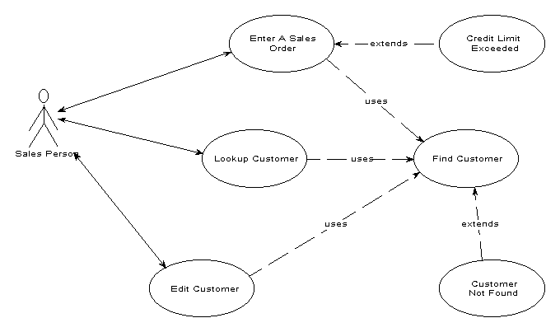
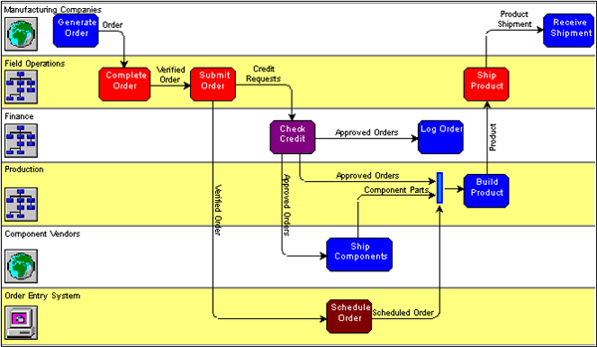
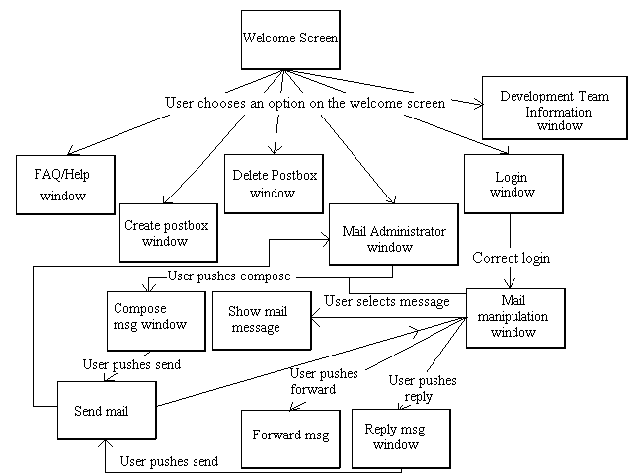
From Event-Lists To System Features & System Functions
Event -List
S/W components
Business logic
Event-handling
Decision support
System plus human information-processing
System Features
Functional specification:
System Use-cases
Activity-sequence diagrams (navigation)
IT System
External event handling
System interfaces
Action(s)
Action(s)
Functions
Notes:
We use a variety of techniques to elicit a complete set of feature definitions, to make sure that we don’t miss these. I have suggested a number of ways of modeling the system, that should be included in the SRS. The main elements are shown on this slide.
I must emphasize that NONE of these will ensure that you have every function that you need. There are two ways that you can check for this:
1. (Check internal consistency of your logic). Provide a DFD and use this to verify that you have all the functional processes required to “join the dots.”
2. (Check external consistency of your logic). Walk through the event-list against the high-level (activity-level workflow) swimlane model, that shows non-automated as well as automated user tasks. Use this walkthrough to verify that you have all the business events that are relevant to your system scope supported by system functions; then use the software component model to suggest all the administrative reporting and system management tasks that you have forgotten to include(!).

Slide 10
Lets Try to Reconcile an Example
1. (Check internal consistency of your logic). Provide a DFD and use this to verify that you have all the functional processes required to “join the dots.”
2. (Check external consistency of your logic). Walk through the event-list against the high-level (activity-level workflow) swimlane model, that shows non-automated as well as automated user tasks. Use this walkthrough to verify that you have all the business events that are relevant to your system scope supported by system functions; then use the software component model to suggest all the administrative reporting and system management tasks that you have forgotten to include(!).

Slide 11
Non-Functional Requirements
Non-functional requirements specify how the system will perform the functions required.
A non-functional requirement is only of use if it can be tested in some way:
If possible try to assign a measure – e.g. if fast performance is required, state that the system must respond in XX milliseconds.
If not possible to assign a measure, try to explain how this can be tested – e.g. a store clerk must be able to recall the sequence of commands for this function after a single training session, or 90% of users must be able to locate the record for a member using on-screen hints.
Notes:
These always seem to be left until last – an afterthought. This is thought to be one of the reasons why systems fail. Non-functional requirements are the system aspects that make people want to use the system or not – things like how fast the system responds, or whether it feels nice to use, or how long it takes to learn.
Experienced analysts tend to get these clear upfront. What are the system-use aspects that are make-or-break for the user? What makes a system good to use vs. OK (think Bannerweb here … ☺ ).

Slide 12
Specifying Non-Functional Requirements From Functional Requirements
Functional Requirements (Use-Case Functions):
UC1.1: The system will provide the store location of the video, when its title or ID is entered
UC1.2: The system will permit the user to check if a member has unpaid or overdue rentals .
UC1.3: The system will check if the video requested is already reserved.
Non-Functional Requirements:
General Non-Functional Requirements for this use-case are:
NF1 The system will display a response within 30 milliseconds.
The system will provide function UC1.1, in the following way:
NF1.1-1 The video will have a bar-code label, that indicates where it is shelved This information is stored in the video record. NF1.1-2 The location assigned to any bar-code can be configured by the user (requires additional function: UC 1.8).
The system will provide function UC1.2, in the following way:
NF1.2-1 the system will automatically flash a warning when the member ID is entered, if the member has overdue or unpaid rentals outstanding.
NF1.2-2 Management reports will be printed automatically on at a time specified by Managers and subject to change easily. (see function UC 1.6). Etc.
Notes:
So far, we have discussed functional requirements exclusively. Let’s move in to non-functional requirements.
Not all functional requirements will need Non-functional requirements to be specified. But many do – the non-functional requirements for the functional requirements shown here are decomposed on this slide.
Some non-functional requirements may be general across multiple functions (e.g. the system will display a response within 30 ms).
Some non-functional requirements may require that an additional function is specified to provide a system interface process to do this operation (see NF1.1-2 above).

Slide 13
Supplementary Requirements – System Data Use
DBMS Interface
Application Engine
(Model based on business rules)
Front end (GUI)
Back end (Database)
As databases and data stores are a fundamental part of any system architecture, so data-use specification is a fundamental part of any system specification.
Need to define:
External data sources and external data users (context diagram);
Internal data flows and uses (DFD);
Internal data types/relationships (ERD or class domain model).
Notes:
As databases and data stores are a fundamental part of any system architecture, so data-use specification is a fundamental part of any system specification. This element normally goes into the supplementary specification (which will be discussed more fully next week).
The slide shows a typical distributed system architecture. This suggests that there will be a set of functions to manage data in each component:
A Data Base Management System (DBMS) - probably from a 3rd party supplier such as Microsoft or Oracle),
A DBMS front-end (interface) that runs on the server and so needs a separate specification for these functions,
An application engine (the core of our system) that will be modeled as a set of use-cases,
A system front-end set of screens that will require specifying via a navigation model.
The first elements would probably be mentioned in the product overview and specified in the Supplementary Requirements section. The second element (DBMS front-end) would be specified as a set of server functions in the Functional Specification. The third element (application functions) would be specified through use-cases in section 3, while the GUI functions would be modeled in the user-navigation interface spec section (section 2). But the overall system architecture must be made clear in the system product overview – which is where I would place the model shown in the slide here.

Slide 14
The Context Diagram
A high-level context diagram places the system within the external data flows that constitute the information supply chain.
Notes:
A context diagram defines the major data-flows into and out of the system. It is helpful in identifying constraints or supplementary requirements for data cleanup or new data management procedures and interfaces to the system that you had forgotten(!). I would place this in section 3.2 System Domain Models (preferred) or section 3.3 Non-Functional and supplementary requirements (some engineers feel that data models belong in the supplementary requirement spec – I prefer having a separate section for the system domain models).
Remember that the data-flows at the system interface should be reflected in the high-level DFD!

Slide 15
A Data-Flow Diagram Validates The Use-Case List
Notes:
If you draw a high-level data-flow diagram, as in the example shown here, it both joins up the dots (making sure that you have not forgotten any essential use-cases) and also identifies the critical datastores required by your system. This permits you to do some “look-ahead” high-level design calculations, to make decisions that will avoid unforeseen design constraints -- for example, deciding to use a database management system product from a third-party provider that does not provide sufficient storage capacity or access points for your expected peak load number of users (let’s not mention Bannerweb here, huh?). This would follow the context diagram in section 3.2 or 3.3.

Slide 16
Entity-Relationship Diagram
Section 3.2.3: An ERD shows the main data entities that are used in system processing:
Notes:
By doing a very rushed (and to be repeated at design level) ERD, you can quickly identify data storage, capacity, and data processing throughput needs, for the supplementary specification (of which more next week).

Slide 17
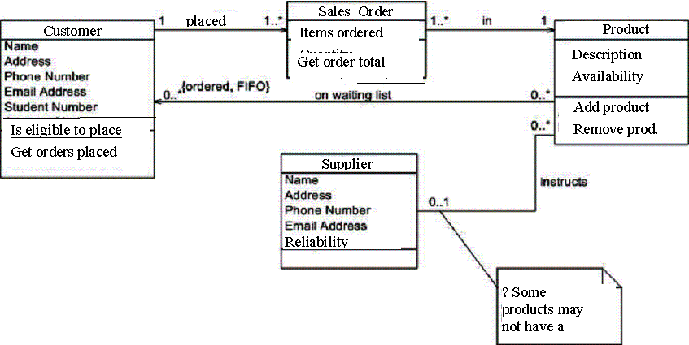
A Class-Domain Model
This model relates system (data) objects to each other and to the methods (derived from use-case functions) associated with each object. This allows you to check that all use-cases have been included in the spec. (but also requires you to engage in system design, in advance).
Can use ERD models as an alternative to this.
Notes:
If you prefer, a class domain model combines the DFD view with an ERD view. However, as this presents a “snapshot” view (in the same way as an ERD), it does not provide the same type of join-the-dots validation on your use-case set (did you remember to specify all use cases required?). To my knowledge, the DFD is the only way to provide a structured model that does this cross-check.

Slide 18
System Validation Vs. Verification
Verification requires confirmation by testing and the provision of objective evidence that the specified system requirements have been fulfilled.
Validation means establishing by various means of user/stakeholder evaluation that system (product) specifications conform with user needs and intended use(s).
Notes:
Next week, we will revisit system test and verification procedures. For this week, we are focusing on defining system requirements that we can test.

Slide 19
IEEE 830: Characteristics of a Good SRS
Nine Quality Measures:
Correct
Unambiguous
Complete
Consistent
Ranked for importance and stability
Verifiable
Modifiable
Traceable
Understandable
Notes:
The IEEE 830-1998 standard provides nine measures of quality for a good software requirements spec.
Last week, we examined three of these: Correct, Complete, Consistent.
I pointed out that the last of these only deals with internal consistency and suggested that we apply a higher standard of external consistency by modeling both external and internal views of the system at the ”product” level, then using these as a cross-check on system functionality.
I highlighted my two favorite “measures” in red. Let us start with ambiguity …

Slide 20
Correct
“A statement of requirements is correct if and only if every requirement stated therein represents something required of the system to be built.” (Davis, 1993)
User Needs
Stated Requirements
Some ideas for assessing correctness:
Walkthroughs with other analysts/designers
Validation from users (need a user-friendly representation)
Observe the new system in an operational setting! (Planned version rollout)
Notes:
I dealt with correctness last week in detail, so I will only summarize this here. Correct is the intersection between the user needs and the stated requirements (the SRS). Think about it …

Slide 21
Complete
Completeness can be assessed (but not proven) using:
Interaction with users to understand implicit requirements (observations, scenarios, workflow simulations)
User validation of the “big picture” (walkthroughs with users, prototype evaluation)
Walkthroughs with other developers.
Checklists of issues regarding usability, reliability, performance, supportability and system constraints.
Notes:
I also dealt with completeness extensively last week.

Slide 22
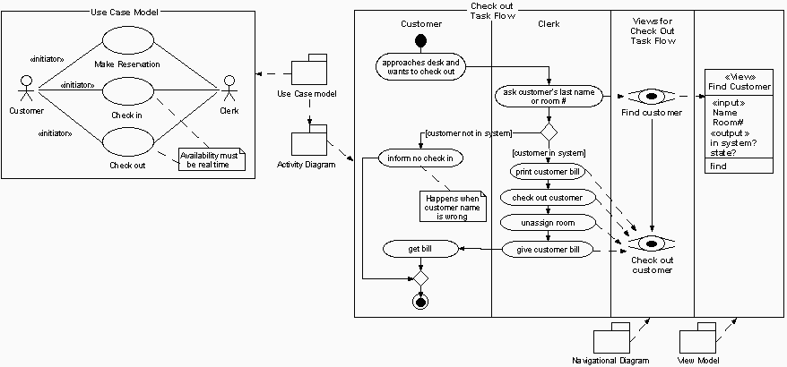
Consistent
Use-case and swim-lane views of a Hotel Reservation System:
Note that the processes in the UML system activity diagram are low-level (detailed) system features.
In the workflow analysis we used in the first half of the course, we defined tasks at a higher level than this (activity level). For this systems analysis, we define data-processing tasks.
Source: Nuno Jardim Nunes and João Falcão e Cunha, Detailing Use-Cases with Activity Diagrams and Object Views
Notes:
Consistency can be assessed (but not proven) using:
Multiple “views” of requirements, e.g. check ERDs against DFDs.
User walkthroughs: get the user to describe the sequence of events that constitutes their workflow and look for contradictions between your version of events and theirs.
User validation of prototypes.
Internal consistency is easily verified by using one system model as a cross-check on another view of the system, as shown here. But there is always the issue of external consistency – are we modeling what people do (rather than what they tell us they do)?
Do you remember what you did, to complete your last assignment (the vision document)?
- Could you explain it to me in detail (including all the “and then we remembered that we had not included XXX so we write that up and realized we had to go back and change YYY …”.
- Would you admit to everything that you did, to complete this assignment? … ☺

Slide 23
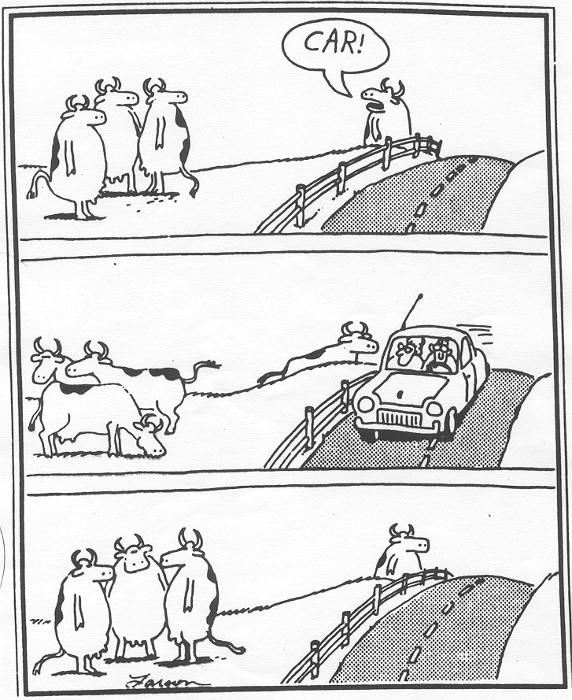
Consistency …. With What?
Notes:
This is one of my favorite cartoons indicating why we should worry about external consistency. People never behave the same when you are watching them as when they do their work!
People lie (consistently) about what they do. This is because the informal ways of doing things are so much more effective than the formal procedures they are supposed to follow. So if you automate the formal procedures (what they are supposed to use), no-one will use the system and everyone will hate you (!).
The learning point is to use mechanisms such as user walkthroughs and prototype evaluation to check that you are specifying what the client wants and the user needs. If a user is shown a prototype, they may not be able to tell you what they need it to do, but they can sure tell you what it does not do, that they need!

Slide 24
Unambiguous
How many of you understand everything that is required, for my assignments, without additional explanation?
(I’m an experienced systems requirements analyst!)
See the techniques for disambiguation discussed by Leffingwell & Widrig (Chapter 26)
Notes:
… Yup, one of my favorite engineering “measures.”
There is a hysterically funny section in the course textbook (Ch 26), which provides some techniques for disambiguation. It is worth reading this, if only to muse over how many meanings can be ascribed to a well known phrase ….

Slide 25
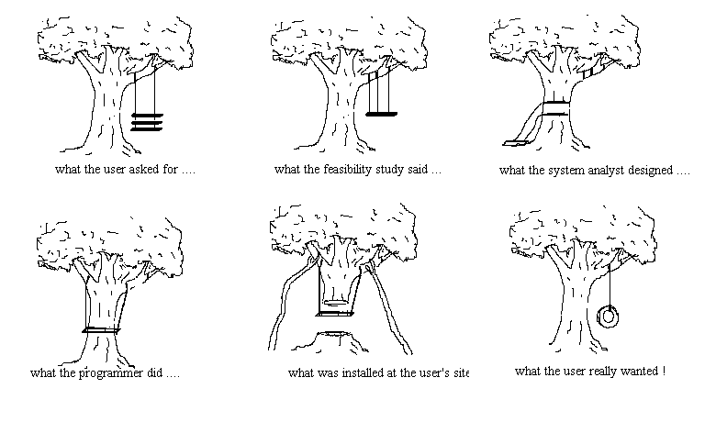
Understandable
specified
specified
e
What the programmer inadvertently revised the spec. to
What the user agreed to (acceptance testing)
Notes:
Let’s move to another of my favorite measures. Is the specification understandable – by all parties?
This slide really illustrates the precept that aiming the relevant sections of your SRS at the appropriate audience
Using models that each stakeholder will understand without any training, is essential to a high quality specification.
Which brings me to my point – a high quality systems analysis process validates the spec. This is as critical a part of requirements management as producing and verifying the functional requirements (which provides the main emphasis of most engineering approaches to software requirements specification).

Slide 26
Ranking For Importance & Stability
Feature:/Use-Case
Forecast the popularity of books and items that are offered by suppliers and automatically preorder books for sale, based on popularity forecast.
Assist in placing a customer order, checking the predicted dispatch date and issuing an order confirmation to the customer.
Directly place a customer order online, generating an order confirmation and a predicted dispatch date.
Assign a dispatch date for an order and automatically arrange delivery of items in an order, based on availability of items in inventory.
Manually schedule a delivery, linked to the availability of items in the order.
Confirm that inventory will be in stock, to fill an order by a specified date.
Track the status of an order and communicate order priority and progress
Easily check in received goods, so that inventory records are accurate.
Keep track of what is in stock and when more stock is due, for specific items.
Manage and track an appropriate sequence of order-processing activities (workflow processes)
Record what has been done, manually or automatically, to process each step of an order.
Stability
Low
High
High
Medium
Low
Medium
Low
Medium
High
High
High
Priority
Critical
Critical
Critical
Critical
Critical
Important
Important
Useful
Critical
Critical
Critical
Risk
Low
High
High
Medium
Medium
Medium
Low
Low
High
High
Low
Notes:
It is a good idea to rank functionality at the feature-level, rather than the functional level (at the functional level, you may encounter some areas of functionality that are more stable than others, but most of these relate back to specific features, rather than the functions that the system performs to provide those functions).
I used the Amazon order-processing features in the example here, to illustrate the logic of requirements ranking. The most important thing is to ask three questions (of your client and the specification generally): 1. Are we sure that we need this feature? (Is the requirement stable?)
2. How important is it to this release of the software (or to provide the basis for features required in future versions) that we implement this feature? (Is the requirement priority high?)
3. How sure are we that the detailed functional, non-functional, or supplementary requirements are not likely to change? (Is the requirement risk high)?
There is a discussion of this in Leffingwell and Widrig. But as a general principle, never include any features in version 1 that require further investigation, unless these are critical for the system to operate (in which case, build lots of prototypes to investigate these EARLY!). Roll these out to version 2 or 3, then you can investigate these further while you are building version 1.
Note that this type of table is not a one-off process, but an ongoing requirements management technique – this is an essential part of project management. [I did not spend much time working through the example, so you might disagree with me (and be right!). Just use this as an illustration of principle].

Slide 27
Verifiable
Some requirements are more verifiable than others …
Number of users
Speed of response
Aesthetic beauty
User-friendliness
Data validity (e.g. date must be in form MM/DD/YY)
Notes:
For every requirement that you specify, no matter how small, ask how you will verify that the system supports this requirement. If you can do that, it would go into the system test spec (see next week).
Some of the requirements above are more testable than others.
If you can’t define how to test a requirement, how can you verify that your specification has been met?

Slide 28
Verifiable
System use-cases must be specified from the user point of view.
Functional requirements should result from a thorough scenario analysis of how the system will be used.
This requires prototypes and discussions with real users!
Non-functional requirements should be made specific to the context of use.
Non-functional requirements include user-preferred use-case sequences, interaction considerations and performance considerations.
Vague statements about the system being “user-friendly”, “efficient” or “effective” serve no purpose. You cannot measure “user-friendly”.
What does a user understand by “user-friendly”? How do they define this?
How can you specify their definition, in terms of elements such as: * levels of menus, * number of keystrokes, * number of windows to be navigated to get back to a previous function, * acceptable response-time, * availability of context-specific help, * etc.?
HOW WILL YOU MEASURE SUCCESS, IN ACCEPTANCE TESTS?
Notes:
I do not want to see any requirement in the specification that you cannot test -- e.g. “the system will be user-friendly” is NOT a requirement, but an aspiration. The equivalent requirement might be “an average user can work out how to use all system functions from on-screen hints and design, without having to use the detailed Help system.”

Slide 29
Defining System Functions – Traceability and Modifiability
VID1: Check Availability
Indicates if a Title is available for rental, or issued (rented).
Input(s): ID – Video ID of video instance requested.
Output(s): Video availability (available, rented)
Processing: The video availability is checked, by determining whether the video is available for rent or is registered as rented in the rental database.
VID2: Locate Video
Provides details of where a video is shelved and whether it is available for rent.
Input(s): One of: Name - name of Movie or Program or ID – Video ID of video requested.
Output(s): May return multiple instances of: Video availability (available, rented) Usual video (shelf) location in store
Processing: The video is located, using either a video ID or a Movie name. The video availability is checked (Uses Vid1: Check_Avail) The video location is checked, by returning the location field in the video record.
Notes:
Which brings me to traceability. One of the most frequent causes of inconsistency in the specification (and one that is easily missed) is that one set of requirements change, while another set that are dependent on these requirements do not change. It is easy to overlook this. For example, the use-case shown here has two separate functional processes that may be expressed as two separate system-level use-cases: Locate_title and Reserve_title. Both of these use-cases includes Check_tape_availability.
If there is a cross-reference between the Reserve_title and the Locate-title use-case in both directions, then if someone wants to change how the availability is checked – for example what data is entered by the user, or what information is returned by this function -- they would consider the implications for both Locate_title and Reserve_title. But if there is only a cross-reference from Reserve_title use-case to the Locate_title use-case (which is typically what we do), then this might not be picked up by the person designing code for Locate_title.
So we need a traceability matrix, sp that changes to one part of the spec (which tend to occur frequently at the Design stage of the project), are verified against the needs of ALL functions that use the sub-function to be changed.

Slide 30
Requirements Traceability Matrix
RELATIONSHIPS | UC1 | UC2 | UC3 | UC4 | UC5 | UC6 | UC7
FEA1: Clerk can locate tape from partial movie details |  |  |  |  | ✓
FEA2: Clerk can track who has which tape |  | ✓ | ✓ | ✓
FEA3: Clerk can locate member info from rental info |  |  | ✓ | ✓
FEA4: Clerk can check-in returned tape easily and quickly | ✓ | ✓ |  |  |  |  | ✓
FEA5: Clerk can reserve a tape for rental once it is returned. | ✓ |  |  |  |  | ✓ | ✓
UC1: System identifies tape store-location
UC2: System identifies tape availability for rental
UC3: System retrieves tape rental record
UC4: System retrieves member details associated with a rental
UC5: System locates tape identity based on partial movie details.
UC6: System associates tape with member details to create reservation record
UC7: System will show tape as unavailable if rental or reservation record is current.
Notes:
This table shows the relationship between system requirements (both functional and non-functional) and system features or use-cases. I have chosen the use FEAn as a Feature identifier and UCn as a Use-Case Requirement identifier label here, but these could just as easily be UCn mapped against FRn/NFRn (for Functional or Non-Functional requirement n). It is therefore important to number the functional and non-functional requirements that you generate as part of the SRS, even if you do this within a use-case definition.

Slide 31
Using parent-child requirements for traceability
Parent: Use-Case 1 – Rent_Video [Description] The system will permit a store clerk to rent a video to a store member.
UC1.1: The system will provide the store location of the video, when its title or ID is entered
UC1.2: The system will permit the user to check if a member has unpaid or overdue rentals .
UC1.3: The system will check if the video requested is already reserved.
UC1.4: The system will record the rental of a specific video by a specific member for specific dates.
Parent Requirement 1
Child1.1 Requirement
Child1.2 Requirement
…
Child1.N Requirement
Notes:
Using parent-child relationships permits the management and numbering of requirements fairly easily, so these functional requirements (UC1.1 to UC 1.4) can be traced back to the “originating” use-case without the need for a traceability table. However, when another use-case uses one of these functions, a traceability table is required to track this relationship. If all relationships are not shown because you rely on numbering to do this job for you, it should be made quite clear in the text accompanying functional requirements in the SRS (section 3).

Slide 32
Non-Functional Requirements: Identifying & Numbering
System Functions:
UC1.1: The system will provide the store location of the video, when its title or ID is entered
UC1.2: The system will permit the user to check if a member has unpaid or overdue rentals .
UC1.3: The system will check if the video requested is already reserved.
Etc.
System Non-Functional Requirements:
General Non-Functional Requirements for this use-case are:
NF1 The system will be easy to use, in that it is designed for someone with little or no computer experience. …
The system will provide function UC1.1, in the following way:
NF1.1-1 The video will have a bar-code label, that indicates where it is shelved This information is stored in the video record. The location assigned to any bar-code can be configured by the user (Function UC1.8).
The system will provide function UC1.2, in the following way:
NF1.2-1 the system will automatically flash a warning when the member ID is entered, if the member has overdue or unpaid rentals outstanding.
NF1.2-2 Management reports will be printed automatically on at a time specified by Managers and subject to change easily. (see function UC 1.6) Etc.
Notes:
Use a numbering schema that clearly distinguishes functional requirements (or use-case sub-requirements) from non-functional requirements, from supplementary requirements. I have used UCn and NFn here, but you can use any ID convention that makes sense to you. Just make sure that you explain this convention in your SRS document.

Slide 33
Traceable
Number requirements
Define a consistent relationship between numbering schema used at different “levels” of requirements analysis and design:
Business case or Vision Doc.
Purposeful requirement 1
Software Requirements Specification
Functional requirement 1.1
Non-Functional requirement 1.1
Supplementary requirement 1.1
Software Design Specification
Design requirement 1.1.1
Design requirement 1.1.1
Notes:
Traceability is also important across specification documents. This slide shows the use of decomposition numbering to relate requirements across these different levels, so the original logic or rationale for each requirement can be traced.
This is where a traceability matrix comes into its own. Most software requirements management tools number and track requirements traceability automatically, as requirements are entered into the system, changed/modified, or removed. They will provide a warning if a requirement used elsewhere is about to be deleted.

Slide 34
Modifiable
Time-lag Between Developer And User Understanding Of New System
Notes:
Finally, remember that users do not understand system requirements as quickly, or in the same way as technical development staff. They have a much longer learning curve than you, as they do not share your technical background. When you are asking users to validate a spec. that is 80% complete and about to be frozen, the users will understand about 50% of the requirements (if you are lucky). So you need some way of (a) speeding up their learning curve, using prototypes, walkthroughs, and scenarios to allow them to learn about the new system functions, or (b) make the requirements modifiable. If you must freeze the spec. (we all have to build something at some time), then plan for their changes to go into the next version of the system. If you have less stable requirements (see above), explore these first. And finally, don’t treat users like idiots for “changing their minds.” They don’t. They just can only validate the parts of a specification that they understand.

Slide 35
Alternate Ways Of Representing Software Software Form & Function
Scenarios:
Tell a story. Walk through the sequence of events and processing, in words or pictures.
Storyboards:
Show the interfaces to the system, in sequence, with a brief verbal description of triggers and context.
Particularly useful in website design.
Sequence diagrams (e.g SRS Example)
Can represent any sequence that you like: dependent events, screens (to show navigation routes through a website), etc.
Prototypes
Throw-away vs. evolutionary.
Business Process Diagrams
High-level DFDs and a HIGH-LEVEL context diagram (critical)
Information or document diagrams
Can use high-level DFDs, hierarchical diagrams or high-level ERDs.
Notes:
This is a list of possible ways of speeding up the users’ learning curve. Remember that prototypes can be built as experimental (throw-away proof-of-concept) or evolutionary (you modify it then take it back to the user to explore their requirements further). Be clear about how you are using prototypes – a common form of arguments relates to features in a throw-away prototype that don’t make it into the final version of the system. Just simple things like screen layout can raise user expectations in ways that you cannot meet. So explain to users exactly how the prototype will feed into the new system – and make a note of things that they really like.

Slide 36
Critical Success Factors For Software Requirements
Goals:
Must be intelligible, meaningful and useful to three groups of document users:
Project management and sponsors
IT implementers
System users.
Must achieve a high-quality representation of system requirements (nine quality indicators).
Critical Success Factors:
Use models that different users of the SRS will understand.
Ensure that requirements are validated by key document stakeholders.
Check your requirements against quality “checklist”.
Use multiple representations of system as cross-checks, to ensure internal consistency, completeness, etc.
Notes:
Critical success factors are the critical things that need to be achieved or done, to achieve your goals.

