Slide 1
CS 4320 / 7320 Software Engineering
Design: Structure & Architecture, UI Design

Slide 2
Software Structure and Architecture: Architectural Design:
A problem-solving, creative process with decisions involving trade-offs, often on quality attributes

Slide 3
Software Structure and Architecture: Architectural Styles
General structures: layers, pipes, filters Distributed systems: client-server, 3-tiered, broker Interactive systems: Model-View-Controller, Presentation-Abstraction-Control Others…

Slide 4
Software Structure and Architecture: Architectural Styles
What do you know about architecture styles for a typical web application?

Slide 5
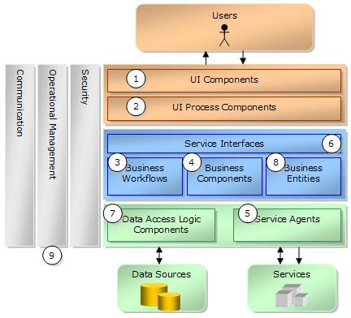
Typical Layered Design
Source: https://msdn.microsoft.com/en-us/library/ms954601.aspx

Slide 6
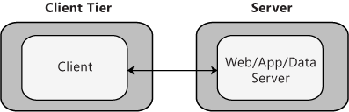
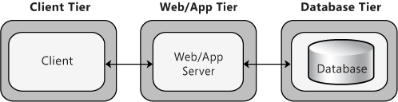
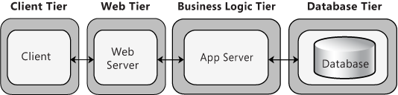
Distributed Deployment Patterns
Client-Server
3-tier
4-tier
Source: https://msdn.microsoft.com/en-us/library/ee658120.aspx

Slide 7

Software Structure and Architecture: Architectural Styles
Microsoft Application Architecture Guide, 2nd Edition by Microsoft Patterns & Practices Team
ISBN-13: 978-0735627109 ISBN-10: 073562710X
Publisher: Microsoft Press (November 22, 2009)
Online Book: https://msdn.microsoft.com/en-us/library/ff650706.aspx
Chapter 3: Architectural Patterns and Styles

Slide 8
Software Structure and Architecture: Design Patterns
Common solutions to a common problem
Object-oriented design patterns Creational: builder, factory, prototype, singleton Structural: adapter, bridge, composite, façade, proxy Behavioral: command, interpreter, iterator, observer

Slide 9
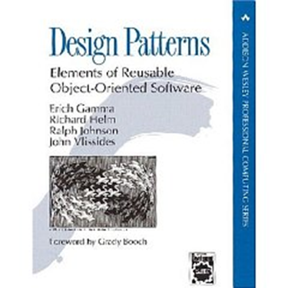
Software Structure and Architecture: Design Patterns
Design Patterns: Elements of Reusable Object-Oriented Software by ErichGamma, RichardHelm, RalphJohnson, and JohnVlissides (the GangOfFour) ISBN 978-0201633610, ISBN 0-201-63361-2 Publisher: AddisonWesley Professional (November 10, 1994)
http://wiki.c2.com/?DesignPatternsBook

Slide 10
Software Structure and Architecture: Frameworks
Framework: A software system providing some generic functionality to facilitate development of software solutions.
Examples: Sprint MVC (java), .Net Framework (Microsoft), Django (python), Bootstrap (html, css, js), many, many, more….

Slide 11
User Interface Design: General Principles
First, know your users. Then consider…
Learnability User familiarity Consistency Minimal surprise Recoverability (from errors) User guidance (feedback) User diversity (accessibility)

Slide 12


User Interface Design:
https://www.usability.gov/what-and-why/user-interface-design.html
https://www.w3.org/WAI/intro/accessibility.php

