Slide 1
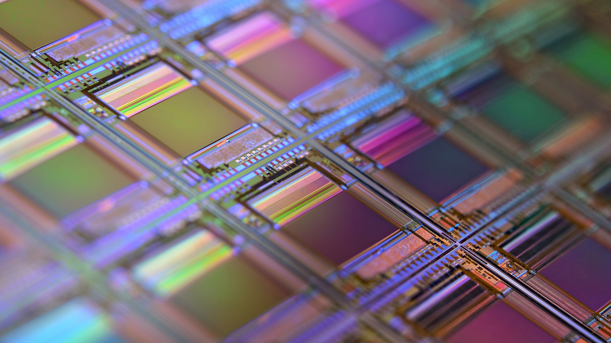

Project 2 – Cache CS6304 Computer Architecture
Chih-An Chang , William Chang,
CXC210017, CXC200006
Department of Computer Science

Slide 2
Outline
Cache Introduction
Gem5 Setup
CPI Result
Optimize CPI Result
Define Cost Function

Slide 3
Cache Introduction
Overview
What is Cache?
Why it is important?

Slide 4
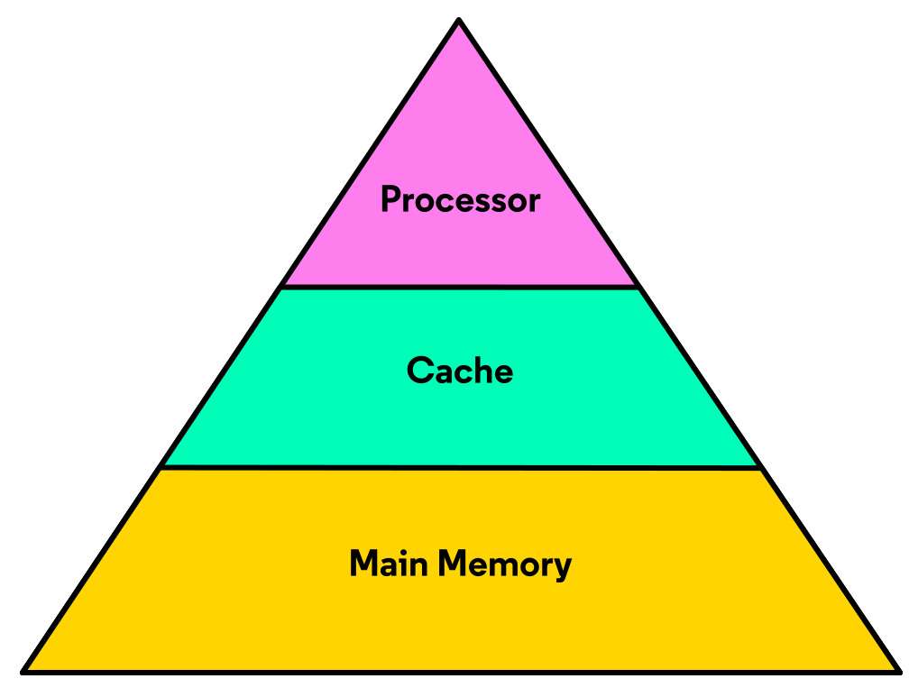
What is Cache?
Cache is memory placed in between the processor and main memory.
Cache is responsible for holding copies of main memory data for faster retrieval by the processor.

Slide 5
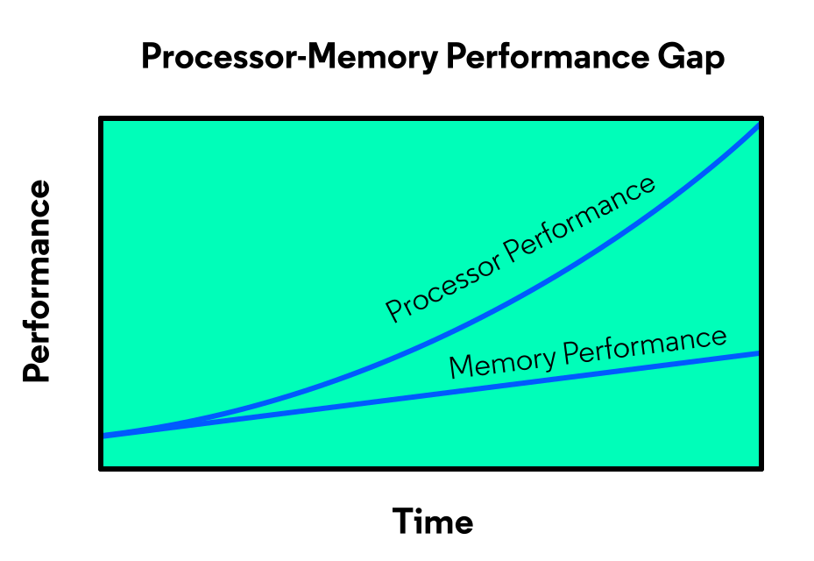
Why it so important?
The processor-memory performance gap and results in a computer that can process data much faster than it can retrieve data from memory.
Cache memory stores data for faster access times to help bridge the processor-memory performance gap.

Slide 6

Gem5
Cache
Overview
Setup
Configuration

Slide 7
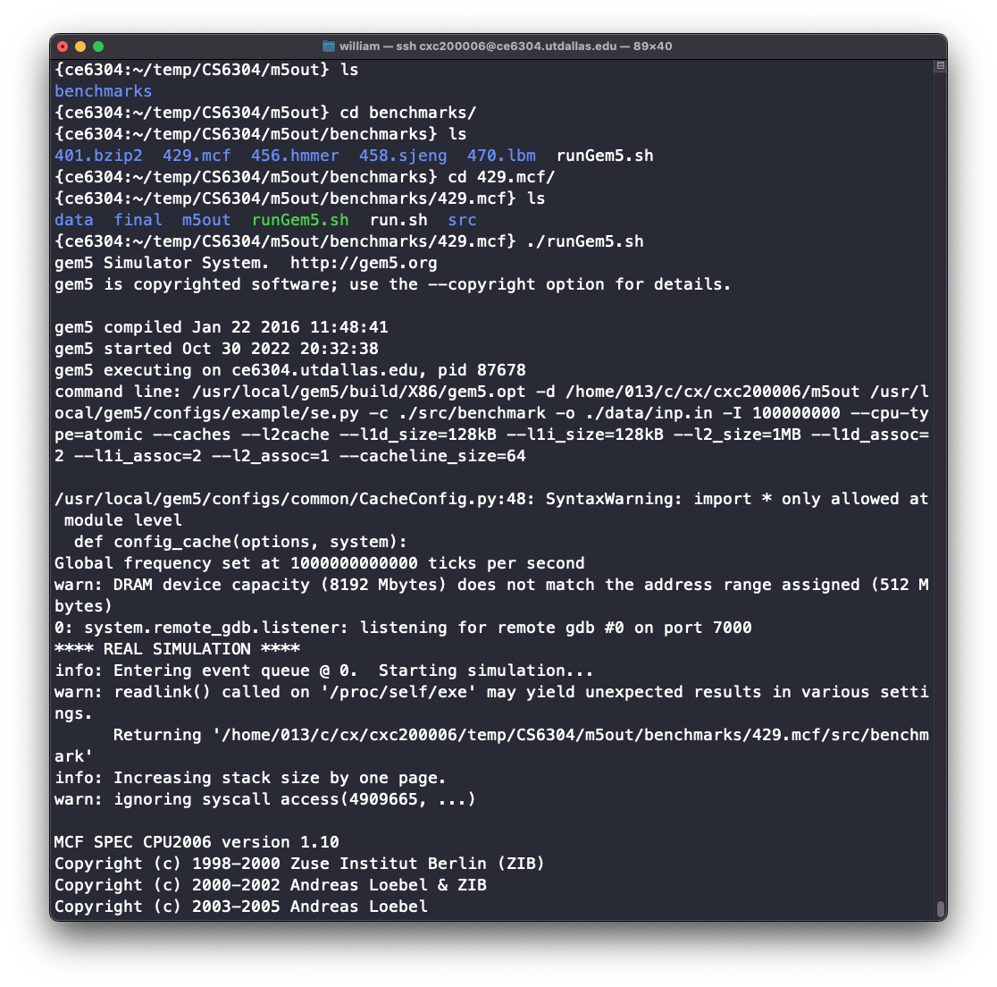
Gem5 Setup
1
Login to CE6304 linux server
ssh <net-id>@ce6304.utdallas.edu
2
Copy gem5 folder to your local directory
cp –rf /usr/local/gem5 /home/<netid>/<proj_folder>
3
Downloads the Benchmarks
git clone https://github.com/timberjack/Project1_SPEC
4
Building Gem5 X86 with Scons
scons build/X86/gem5.opt –j5
5
Give permission to run the script
chmod +x ./runGem5.sh

Slide 8
Cache Configuration
CPU Models
TimingSimpleCPU
Cache levels
2
L1 Cache Category
Separate
L2 Cache Category
Unified
L1 Data Cache Size
128 KB
L1 Instruction Cache Size
128 KB
Unified L2 Cache Size
1 MB
L1 Data Cache Associativity
2-Way
L1 Instruction Cache Associativity
2-Way
Unified L2 cache
Direct-mapped
Block size
64 bytes
Block replacement policy
Least Recent Used (LRU)

Slide 9
Command Line Parameters
$GEM5_DIR/build/X86/gem5.opt -d ./m5out $GEM5_DIR/configs/example/se.py -c $BENCHMARK -o $ARGUMENT -I 500000000
## CPU types --cpu-type=timing
## Cache Level setting --caches --l2cache
## Setting Cache size --l1d_size=128kB --l1i_size=128kB --l2_size=1MB
## Setting Associativity --l1d_assoc=2 --l1i_assoc=2 --l2_assoc=1
## Setting cache block size --cacheline_size=64

Slide 10
CPI Result
Overview
429.mcf
401.bzip2

Slide 11
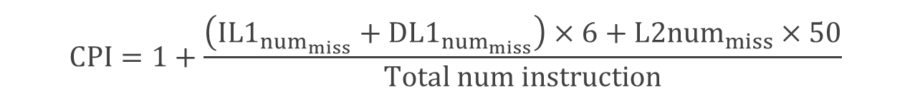
CPI Calculation
Using “system.cpu.icache.overall_miss_rate::total” × total number of instruction (500,000,000) to get the total miss count is incorrect. We realized that the total number of instructions for D-Cache and L2 Cache can not be 500,000,000.
Find “system.cpu.icache.overall_misses::total” in “stats.txt”
Substitute the parameters into the formula below
$$CPI=1+\frac{\left(IL1_{num_{miss}}+DL1_{num_{miss}}\right)×6+L2num_{miss}×50}{Total num instruction}$$

Slide 12


CPI for 429.mcf
L1 I-cache
Number of miss
676
L1 D-cache
Number of miss
10225985
L1 miss penalty
6
L2 cache Number of miss
6552122
L2 miss penalty
50
1
CPI
1.777932132
Total number of Inst
500,000,000

Slide 13
CPI for 401.bzip2
L1 I-cache
Number of miss
387
L1 D-cache
Number of miss
4,027,321
L1 miss penalty
6
L2 cache Number of miss
2,743,240
L2 miss penalty
50
1
CPI
1.3226633
Total number of Inst
500,000,000

Slide 14
Overview
How Do We Get Lowest Configuration?
Lowest CPI Configuration
Optimize CPI Result

Slide 15
How Do We Get Lowest CPI Configuration?
We changed each parameter one at a time, and select the lowest CPI setting
Except for Cacheline size and associativity, the rest of the parameters match the trend that the bigger the size the lower the CPI.

Slide 16
How Do We Get Lowest CPI Configuration? – cont.
CPI increases while increasing the Cacheline size
CPI increases while increasing the L2 associativity

Slide 17
Lowest CPI Configuration
 | L1 I-Cache Size | L1 D-Cache Size | L2 Cache | Cacheline Size | L1 I-Cache Associativity | L1 D-Cache Associativity | L2 Cache Associativity | CPI | Cost
401.bzip2 | 128 KB | 128 KB | 4 MB | 512 KB | 16 | 8 | 4096 | 1.07636 | 260.8
429.mcf | 128 KB | 128 KB | 4 MB | 256 KB | 16 | 8 | 4096 | 1.25182 | 260.8

Slide 18
Define Cost Function
Overview
Cost Function
Smallest Cost Configuration

Slide 19

Cost Function
Unit price
L1 unit price per KB
$0.05
L2 unit price per MB
$0.2
Associativity price per way
$0.06
Total Cost
L1-Cache Size (KB) × L1 unit price
L2-Cache Size (MB) × L2 unit price
Total number of associativity × Associativity price

Slide 20
Smallest Cost Configuration
 | L1 I-Cache Size | L1 D-Cache Size | L2 Cache | Cacheline Size | L1 I-Cache Associativity | L1 D-Cache Associativity | L2 Cache Associativity | CPI | Cost
401.bzip2 | 2 KB | 2 KB | 1 MB | 512 KB | 1 | 1 | 1 | 1.61455 | 0.58
429.mcf | 2 KB | 2 KB | 1 MB | 512 KB | 1 | 1 | 1 | 2.34459 | 0.58

Slide 21
Best Cost-Performance Ratio Configuration
Overview
Cost vs. CPI
Analysis and Conclusion
Best Cost-Performance Ratio Configuration

Slide 22
CPI vs. Price
Based on the plotted chart, we can choose the best cost performance ratio configuration
Bad cacheline size config
Bad associativity size config
Best config

Slide 23
Analysis and Conclusion
Associativity does not affect much for both benchmarks. In 429.mcf, an extremely high L2 associativity might even increase overall miss count.
Choosing an appropriate Cacheline Size is important. It can reduce the compulsory misses, but if Cacheline Size is set too big, it starts increasing the overall miss count.
For both L1 and L2 cache size, the rule is the bigger the better. However, increasing the size of L1 I-Cache is not wise because instruction misses in both benchmarks are low even when the L1 I-Cache size is small, and the cost of L1 cache is high.
Besides anomalies like extremely high associativity and inappropriate cache line size, investing more cost will give better performance.

Slide 24
Best Cost-Performance Ratio Configuration
 | L1 I-Cache Size | L1 D-Cache Size | L2 Cache | Cacheline Size | L1 I-Cache Associativity | L1 D-Cache Associativity | L2 Cache Associativity | CPI | Cost
401.bzip2 | 32 KB | 32 KB | 1 MB | 512 KB | 2 | 2 | 1 | 1.12874 | 3.7
429.mcf | 32 KB | 32 KB | 4 MB | 256 KB | 2 | 2 | 1 | 1.26722 | 4.3

Slide 25

Thank you

