Slide 1
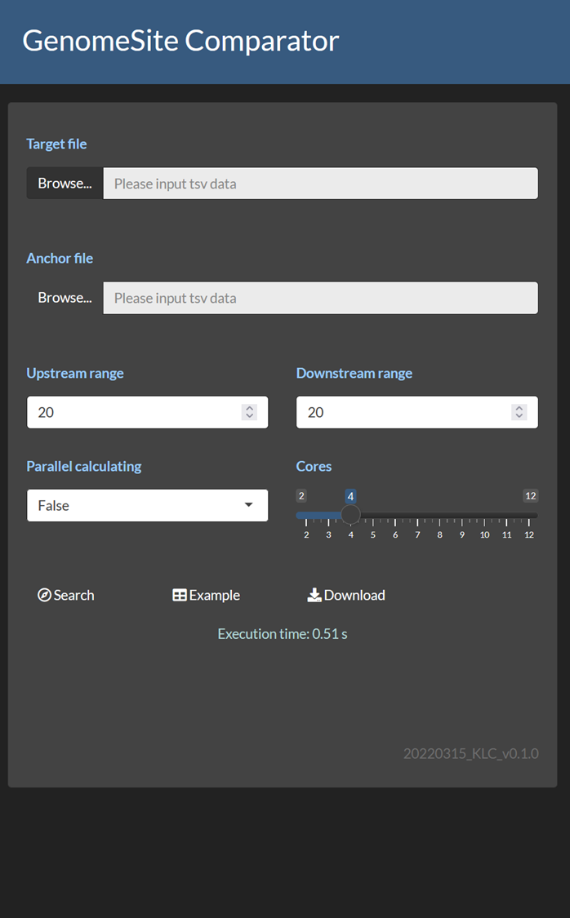
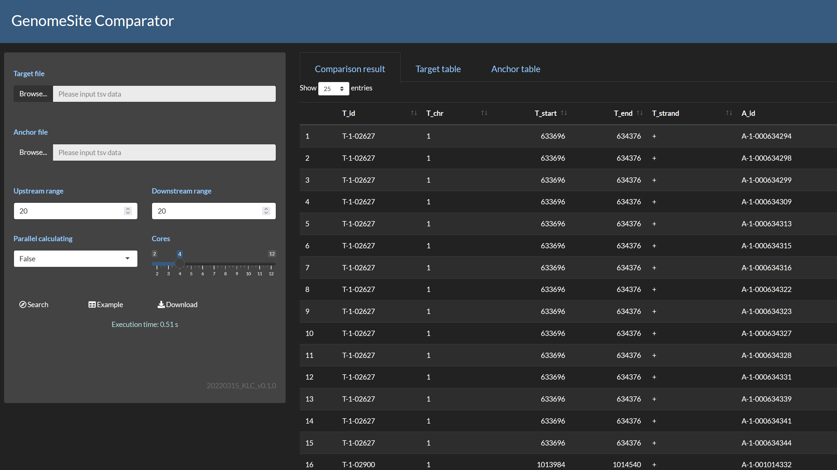


Slide 2








Slide 3

Genome reference (GRCh38)
Upstream (5’)
Downstream (3’)

Slide 4

Target: genes, exons, introns

Slide 5

Anchor: identified marker

Slide 6
Search range (nt)

Slide 7
Click to visit website
Both
Out of range
Different strand

Slide 8



