Slide 1
Predicting the Popularity of Songs on Spotify and YouTube
by Andrew Vieira

Slide 2
Project Statement
Project Statement: What qualities make some songs more popular than others? Can one use this information to predict the number of plays (streams or views) a song achieves on Spotify or YouTube?
Audience: While anyone interested in music would find the results interesting, the parties who would benefit the most are the ones who profit from popular music, such as musicians, songwriters, and recording companies.
Criteria for Success:
I can significantly narrow down the specific qualities that affect the number of plays and the ranges of values of these qualities that produce the most plays.
The errors for any models I create low enough to make the models practical.

Slide 3
Data Sources
Main dataset – Spotify_Youtube.csv
Source: https://www.kaggle.com/datasets/salvatorerastelli/spotify-and-youtube
20,718 rows (cleaned to 20,716) and 28 columns (cleaned to 29)
18,862 unique songs (cleaned to 18,860)
Spotify and YouTube statistics (streams, views, likes, etc.)
Measurable qualities about songs (see next slide)
Supplementary dataset – Final database.csv
Source: https://www.kaggle.com/datasets/pepepython/spotify-huge-database-daily-charts-over-3-years?select=Final+database.csv
170,633 rows (cleaned to 170,628) and 151 columns (cleaned to 152)
62,420 unique songs (cleaned to 62,419)
Measurable qualities about songs (some are in the main dataset, others are different)
Song genres – appended to 11,695 songs in main dataset

Slide 4
Song Metrics
Danceability: How suitable the track is for dancing, based on a combination of musical elements, including tempo, rhythm stability, beat strength, and overall regularity. (0.0 to 1.0)
Energy: Perceptual measure of intensity and activity. Typically, energetic tracks feel fast, loud, and noisy. (0.0 to 1.0)
Key: Key the track is in. Integers map to pitches using standard Pitch Class notation. E.g., 0 = C, 1 = C♯/D♭, 2 = D, and so on.
Loudness: Overall loudness of the track in decibels (dB).
Speechiness: Presence of spoken words in the track. The more exclusively speech-like the recording (e.g., talk show, audio book, poetry), the closer to 1.0. (0.0 – 1.0)
Acousticness: Whether the track is acoustic. (0.0 – 1.0)
Instrumentalness: Whether the track contains no vocals. (0.0 – 1.0)
Liveness: Presence of an audience in the recording. (0.0 – 1.0)
Valence: Musical positiveness conveyed by the track. Tracks with high valence sound more positive (e.g., happy, cheerful, euphoric), while tracks with low valence sound more negative (e.g., sad, depressed, angry). (0.0 – 1.0)
Tempo: Overall estimated tempo (the speed or pace of a given piece) of the track in beats per minute (BPM).
Duration_ms: Duration of the track in milliseconds (ms).

Slide 5
Assumptions
The three measures of the popularity of a song used in this project are Spotify streams, YouTube views, and YouTube likes.
The metrics on the last slide are the only factors for the popularity of a song.
The number of plays is not affected by how long the song has been on the platform. In reality, a newer song has had less time to get plays as an older song.
Plays per unit of time is a better measure. However, this cannot be determined without knowing when the song appeared on the platform.

Slide 6
Important Technical Terms
Root mean squared error: A common measure of the average error between the predicted values from a statical model and the actual values.
Linear regression model: A statistical model that uses a linear equation. That is, each input variable is multiplied by a certain value and then added together with another value.
Baseline: A standard (usually simple) to which to compare the model. For example, guessing the mean (average) value every time might be a baseline.

Slide 7
Model 1 – Spotify Streams
75% of the songs, chosen at random, were used as training data. The other 25% were test data.
Average number of streams for test songs = 131,186,291
The baseline model was guessing this average for each prediction.
Baseline RMSE = 232,646,553
My best model required removing outlier songs.
Number of streams greater than 1.5 billion
Tempo equal to 0 or greater than 230
A total of 109 songs, which is only 0.6% of the original dataset
The key column was replaced with dummy columns, each indicating whether the song is in a particular key. (0 = no, 1 = yes)
The final model is a linear regression.

Slide 8
Model 1 – Results
Streams = 258144754 + 46678395*Danceability - 91527675*Energy + 5140060*Loudness - 86702602*Speechiness -77627621*Acousticness - 43720965*Instrumentalness - 36207394*Liveness - 48573063*Valence - 26000*Tempo + 29.39*Duration_ms + 1806598*Key_1 - 10359527*Key_2 + 2625384*Key_3 - 3298022*Key_4 + 7309562*Key_5 - 476349*Key_6 - 14685578*Key_7 + 5825261*Key_8 - 14443331*Key_9 - 8621322*Key_10 - 534147*Key_11
RMSE for this model = 197,570,949, a 15% improvement over the baseline RMSE

Slide 9
Model 2 – YouTube Views
75% of the songs, chosen at random, were used as training data. The other 25% were test data.
Average number of views for test songs = 87,437,106
The baseline model was guessing this average for each prediction.
Baseline RMSE = 228,587,416
My best model required removing outlier songs.
Number of views greater than 2 billion
Tempo equal to 0 or greater than 230
Duration greater than 1 million ms (16 minutes and 40 seconds)
A total of 87 songs, which is only 0.47% of the original dataset
The final model is a linear regression. Key, valence, and tempo were excluded from this equation.

Slide 10
Model 2 – Results
Views = 85289684 + 62620690*Danceability - 52870681*Energy + 6014042*Loudness - 47042349*Speechiness - 15025558*Acousticness - 11792246*Instrumentalness + 3002845*Liveness + 200.46*Duration_ms
RMSE for this model = 181,045,436, a 21% improvement over the baseline RMSE

Slide 11
Model 3 – YouTube Likes
75% of the songs, chosen at random, were used as training data. The other 25% were test data.
Average number of likes for test songs = 623,573
The baseline model was guessing this average for each prediction.
Baseline RMSE = 1,751,936
My best model required removing outlier songs.
Number of likes greater than 20 million
Danceability equal to 0
Loudness less than -40 dB
Tempo equal to 0 or greater than 230
Duration greater than 1 million ms (16 minutes and 40 seconds)
A total of 61 songs, which is only 0.33% of the original dataset
The key column was replaced with dummy columns, each indicating whether the song is in a particular key. (0 = no, 1 = yes)
The final model is a linear regression.

Slide 12
Model 3 – Results
Likes = 747926 + 812171*Danceability - 423204*Energy + 48601*Loudness - 151361*Speechiness - 140015*Acousticness - 10726*Instrumentalness - 33322*Liveness - 371075*Valence + 566*Tempo + 0.71*Duration_ms + 35962*Key_1 - 55237*Key_2 + 29870*Key_3 + 38565*Key_4 + 106844*Key_5 + 49626*Key_6 - 61126*Key_7 + 121332*Key_8 - 23064*Key_9 + 52703*Key_10 + 22334*Key_11
RMSE for this model = 1,318,429, a 25% improvement over the baseline RMSE

Slide 13
Overall Results
The best models I created to guess the number of streams/views/likes are not great.
They are better than the baseline of simply guessing the average, and in practice, I would prefer these models to the baseline.
However, the RMSEs are even larger than the respective averages of streams/views/likes.
In reality, I would not use these models to predict how often a song is played based on the qualities used for this project.

Slide 14
Take Another Strategy
Instead of looking at all the attributes at once, inspect each one individually. Perhaps a single quality might reveal something.
Each metric can be charted in a boxplot to see the distribution of songs with each value of that metric.
Each metric can also be charted in a scatterplot against plays to show which metric values produce the highest number of plays.

Slide 15
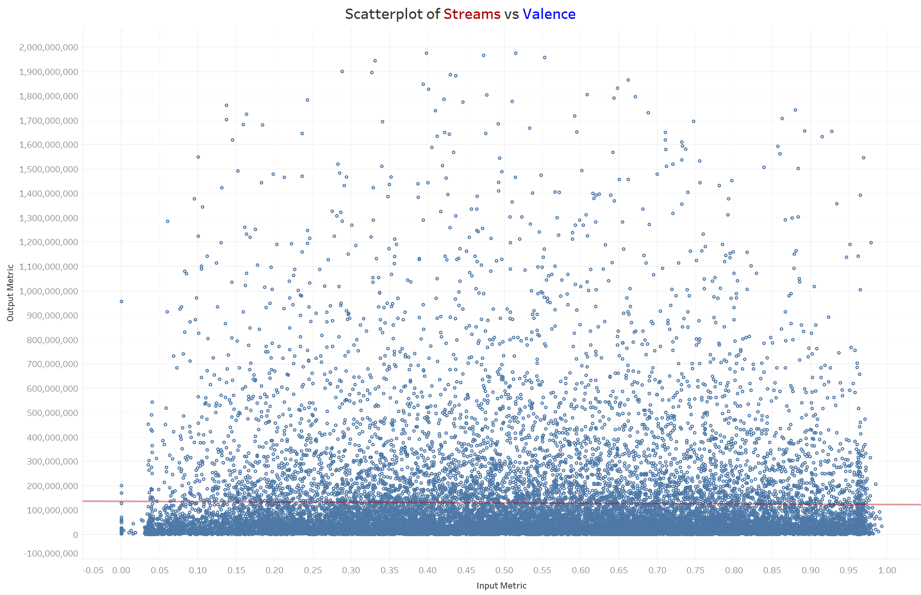
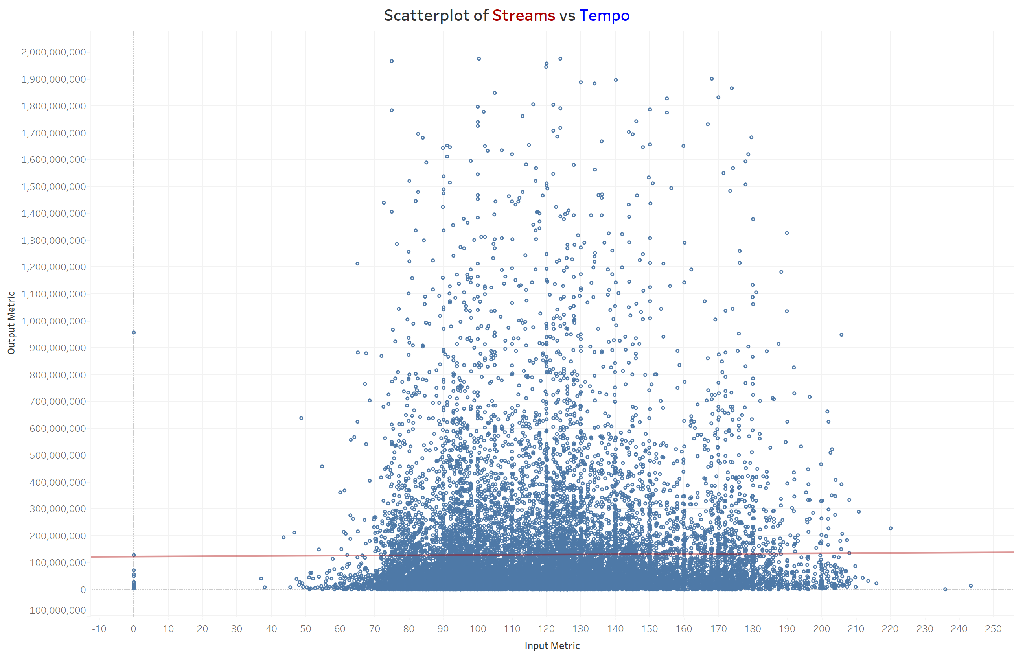
Examples That Are Not Useful
Some qualities do not appear to affect number of plays.
Example 1: Songs with both low and high Spotify streams appear throughout the entire range of valence values (0.0 to 1.0).
Example 2: Except for a few outliers, the tempo of most songs is between 50 and 210 bpm. However, the range of streams also vary greatly.
The charts for YouTube views and likes look similar.

Slide 16
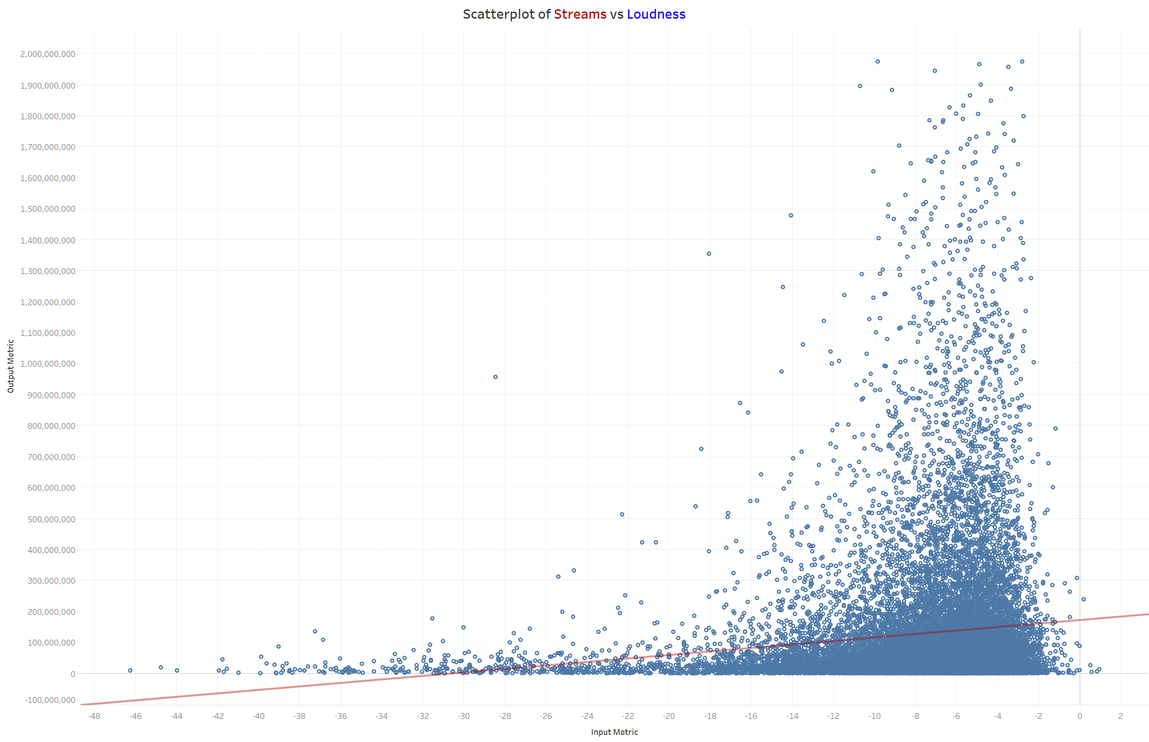
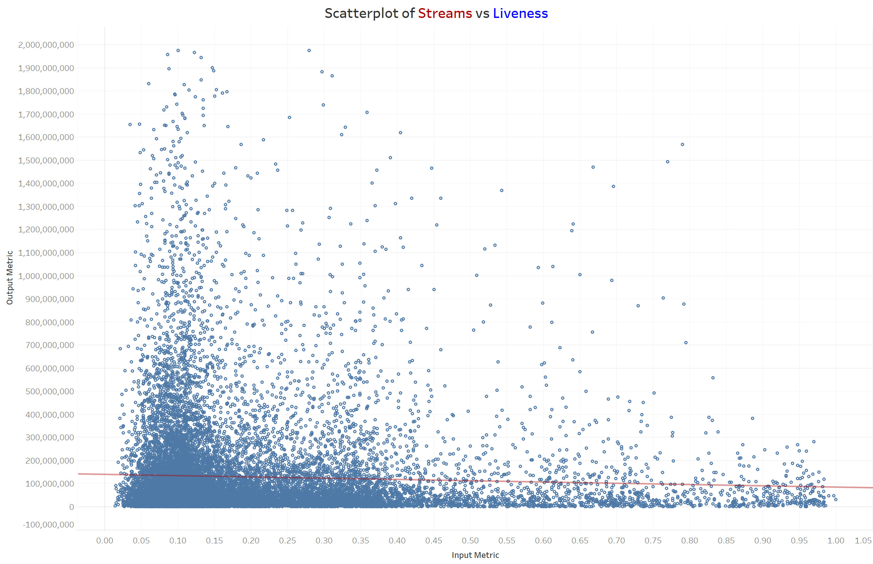
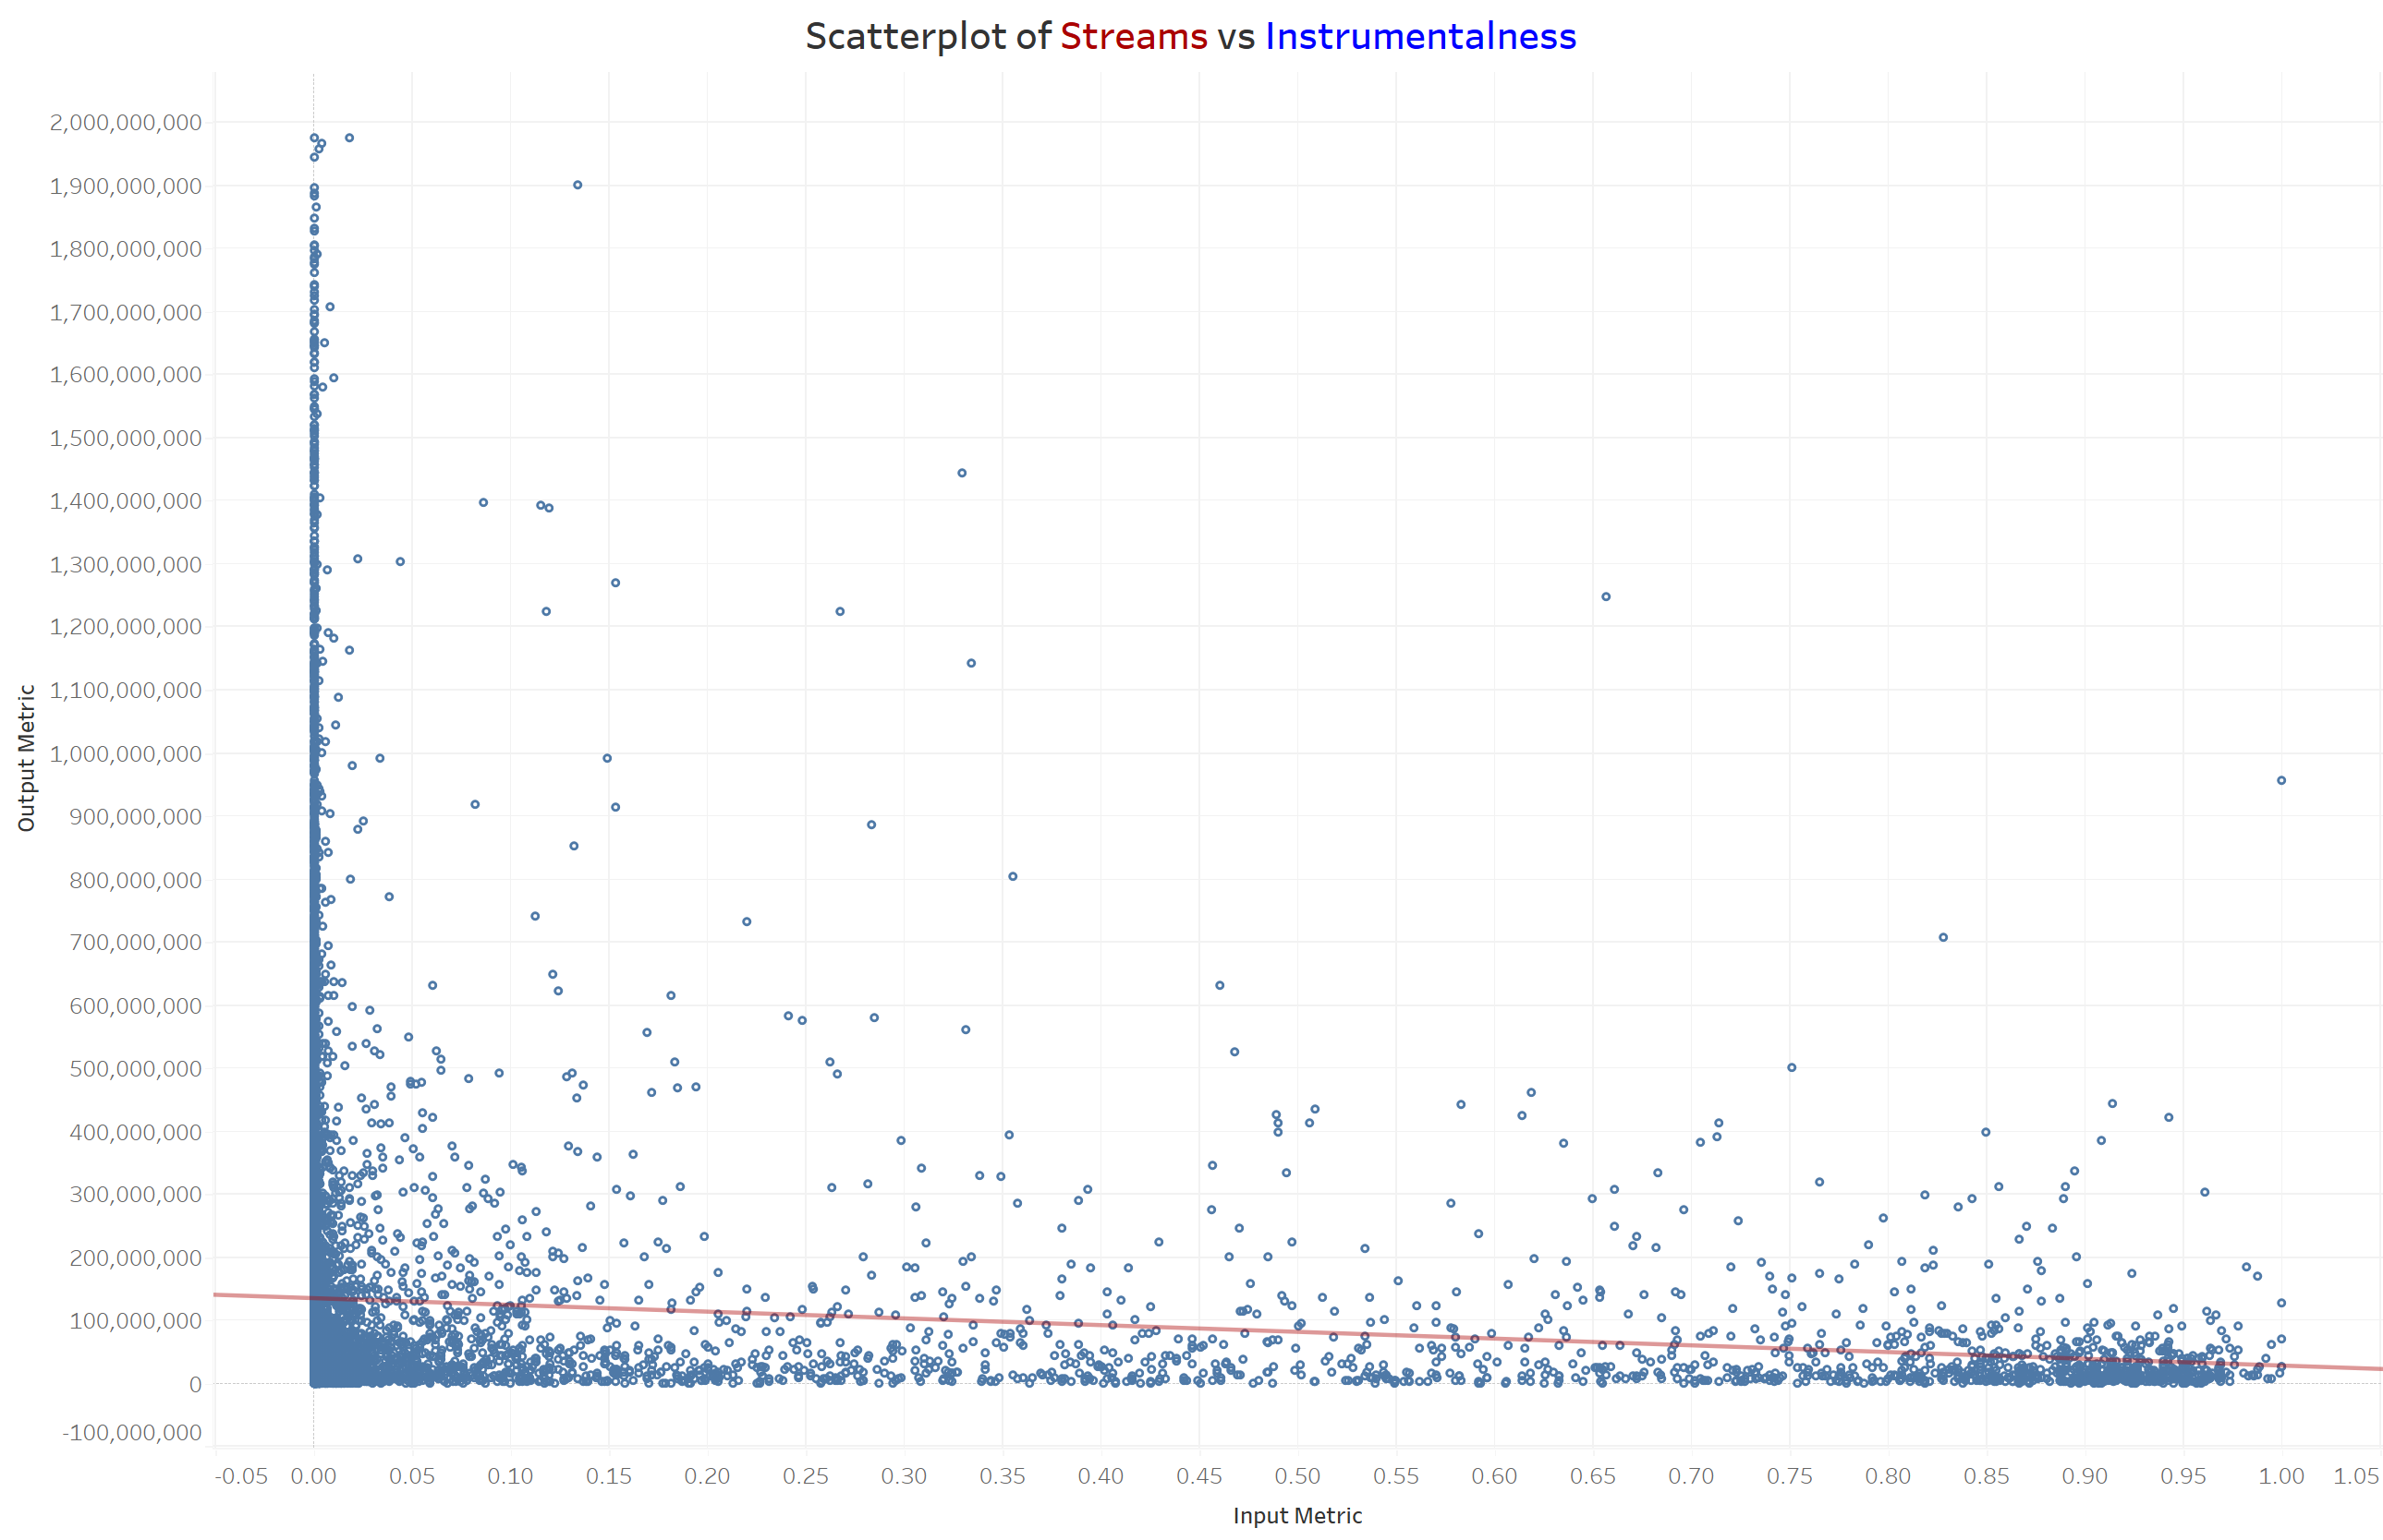
Examples That Are More Useful
However, for other qualities, the highest played songs are in a narrow range.
Example 1: Songs with high Spotify streams are concentrated where loudness is greater than -10 dB.
Example 2: Songs with high Spotify streams are concentrated where liveness is less than 0.15.
Example 3: Most songs with high Spotify streams have an instrumentalness of 0.0 (or at least less than 0.02).
The charts for YouTube views and likes look similar.

Slide 17
Conclusions from Scaterplots
For all metrics, the ranges with songs with high numbers of plays had even more songs with lower numbers of plays.
In the models, the high concentration of songs with fewer plays effectively cancels out the higher-played songs. Therefore, they generally predict a low number of plays for any song.
Good conclusion: Highly-played songs do have certain qualities. For example, most popular songs are above a certain loudness and below a certain liveness and a certain instrumentalness.
Bad conclusion: All songs with these qualities will be played a lot. They have a higher chance of a high number of plays, but the chance of low plays is still greater.

Slide 18
Including Genre in Analysis
A linear regression model to predict the number of streams which included genre had an RMSE of 231,250,408. This is an improvement over a linear regression model without genres (RMSE = 234,341,760), but by only 1.32%.
Linear regression models for each genre separately produced varying results compared to the model with all genres.
Example 1: The RSME for OPM (Original Pilipino Music) is a 68% improvement.
Example 2: The RSME for reggaeton is almost twice as large.
Note: Some genre sets were small; 8 had fewer than 100 songs (less than 1% of the total songs). Their RMSEs might not be accurate.

Slide 19
RMSEs by Genre
Genre | Number of Songs | RMSE of Genre | % Improvement over RMSE of entire set (231,250,408)
Bolero | 18 | 130292944 | +43.66
Boy band | 89 | 183340415 | +20.72
Country | 354 | 138432146 | +40.14
Dance/Electronic | 373 | 188574379 | +18.45
Else | 958 | 126107412 | +45.47
Funk | 211 | 110805127 | +52.08
Hip hop | 1251 | 226590448 | +2.02
House | 166 | 328642424 | -42.12
Indie | 473 | 251371125 | -8.70
Jazz | 39 | 141777413 | +38.69
K-pop | 233 | 182343920 | +21.15
Latin | 1397 | 147609993 | +36.17
Metal | 375 | 199992892 | +13.52
OPM | 40 | 72916273 | +68.47
Pop | 3098 | 276357991 | -19.51
R&B/Soul | 339 | 240699346 | -4.09
Rap | 399 | 292259341 | -26.38
Reggae | 60 | 220312459 | +4.73
Reggaeton | 69 | 456886003 | -97.57
Rock | 1363 | 246550667 | -6.62
Trap | 42 | 305542111 | -32.13

Slide 20
So what did I learn, anyway?
Unfortunately, I could not accurately predict how many times a song would be played based on certain features.
However, I did find a meaningful conclusion when I looked at the results differently.
Most popular songs have certain qualities, but not all songs with these qualities are guaranteed to be popular.
Much more importantly, I learned things beyond a hypothetical business situation. Through experience, I learned about the process of data analysis.

Slide 21
Practical Lesson from This Project
I need to interpret results carefully. For example, my data showed that popular songs have certain special qualities. They did not show that a song with these qualities is popular, which is what I hoped to discover.
Even with careful analysis, I will not always find the result I originally sought. I might discover something completely different—or nothing at all. But saying that two things might not be related is still a valid conclusion.
I experienced the stages of the data analytics workflow:
Extract: I discovered a source of datasets (Kaggle), learned how to use it, and downloaded a dataset that interested me.
Frame: I constructed a hypothesis to prove with the dataset. (Ideally, I should propose a question first, then find data to answer it.)
Wrangle/Prepare: I used Excel and Pandas to locate and handle missing values, remove duplicates, determine and change data types of columns, removed unnecessary columns, added new useful columns, and added values by joining tables.
Analyze: I used Pandas and Tableau to create charts to help me find patterns and models to (attempt to) predict further results.
Interpret: I used the charts and models to reach a conclusion. (Again, my assumption was wrong is a conclusion!)
Communicate: I selectively condensed the project into a ten-minute presentation that the class will understand and enjoy.

Slide 22
Recommendations to Stakeholders
Continue searching for a better model to predict streams, views, and likes. I might not find one, but I have an excuse to resume playing with these data. I would learn more about the tools I used in this class, and I might discover something else. For example, are any of the quality metrics related to each other?
Better yet, don’t make songs for sales and popularity! Create them to express a feeling (such as “I love my wife!”) or an opinion (such as “Violence is bad!”), or just for fun (such as “Let’s party!”).
Data analysis plays a vital role in business, but it can do so more, from saving lives to satisfying human curiosity.

Slide 23
Questions?

Slide 24
The End

