Slide 1

NUMBER BASEBALL GAME
Computer Network & programming
201835434 김주현
201835505 이하영
201835533 조현식

Slide 2
Computer Network
Number Baseball Game
1
Introduction
Implementation Purpose
Program’s Function
Architecture
Game
2
Game Server
Game Player
Game
Story Lines
3
Login & Sign up
Waiting Room
Game Ready & Game
Conclusion
4
Achievement of each Members
Q&A

Slide 3
Computer Network
Number Baseball Game
01 INTRODUCTION

Slide 4

Computer Network
Number Baseball Game
01/ INTRODUCTION
01 Implementation Purpose
02 Program’s Function
Made 1:1 Chatting Game
Login & Sign Up
Chatting (To All, Whisper Message)
Game request & Show player’s record
Ready
Game

Slide 5

Computer Network
Number Baseball Game
01/ INTRODUCTION
03 Game
Number Baseball Game
01 Server has random 4 digits
02 Players guess the number perfectly
03 When the number and position of the four digits
are the same, it would be STRIKE
04 When the numbers in the four digits are the same,
but the locations are different, it would be BALL

Slide 6
Computer Network
Number Baseball Game
02 ARCHITECTURE

Slide 7
Computer Network
Number Baseball Game
02/ ARCHITECTURE
01 login
LOGIN

Slide 8


Computer Network
Number Baseball Game
02/ ARCHITECTURE
01 login
GamePlayer
GameServer
Connect
Send ID
Send ID Success
or ID Fail
Check ID exists
ID Fail
Send PW
Send PW Success
or PW Fail
Encode PW &
Check PW right
PW Fail
Send ID
Send Name,ID,PW,
Win,Lose data
Check ID exists
Move to Waiting Room

Slide 9
Computer Network
Number Baseball Game
02/ ARCHITECTURE
02 SignUp
Sign Up

Slide 10
Computer Network
Number Baseball Game
02/ ARCHITECTURE
02 SignUp
SignUp
GameServer
Connect
Send Name
Send OK
Check ID condition
Send ID
ID Fail
Send ID Success
or ID Fail
Check ID exists
Check PW condition
& PW equals to pw check
Send PW
Encode PW &
Save Name, ID, PW
Send OK
Pop up with message
‘Reconnect Please’

Slide 11
Computer Network
Number Baseball Game
02/ ARCHITECTURE
03 Waiting Room
Waiting Room

Slide 12
Computer Network
Number Baseball Game
02/ ARCHITECTURE
03 Waiting Room - 1
WaitWindowView
GameServer
Send ‘Chatting Start’
Find out IDs
except sender’s ID
Send accessing IDs
Create an ID button and add it to playlist
Send ‘ID has joined’
Send other players
Send Chatting Message
Send other players

Slide 13
Computer Network
Number Baseball Game
02/ ARCHITECTURE
03 Waiting Room - 2
WaitWindowView
GameServer
Send Whisper & other player’s ID
Press ToAll button & type ID
Check ID exists &
Change the mode to Whisper
Send OK or NULL
Type Whisper Message
Send Whisper Message
Send Whisper Message
Show Whisper Message
to only recipient
Press Whisper button
Send Chatting Message
Send other players
Change the mode to ToAll

Slide 14
Computer Network
Number Baseball Game
02/ ARCHITECTURE
03 Waiting Room - 3
WaitWindowView
GameServer
Press ShowRecord button
Send other player’s ID
Send ID, Win, Lose
Find out ID, Win, Lose
Press RequestGame button
Send ‘Request Game’
Send ‘Request Game’ to other player
Press RequestGame button

Slide 15
Computer Network
Number Baseball Game
02/ ARCHITECTURE
03 Waiting Room - 4
WaitWindowView
GameServer
Press No button
Send ‘Cancel’
Send Cancel
to other player
Press Yes button
Send OK
Press Yes button
Send OK
Send ‘ID has left’
to other players
Check all players yes
Move to GameWaitingRoom
Move to GameWaitingRoom

Slide 16
Computer Network
Number Baseball Game
02/ ARCHITECTURE
03 Waiting Room - 4
WaitWindowView
GameServer
Press No button
Send ‘Cancel’
Send Cancel
to other player
Press Yes button
Send OK
Press Yes button
Send OK
Send ‘ID has left’
to other players
Check all players yes
Move to GameWaitingRoom
Move to GameWaitingRoom

Slide 17
Computer Network
Number Baseball Game
02/ ARCHITECTURE
03 Waiting Room - 5
WaitWindowView
GameServer
Press EXIT button
Send EXIT
Send ‘ID has left’
to other players
Subtract ID
Show message
LOG-OUT

Slide 18
Computer Network
Number Baseball Game
02/ ARCHITECTURE
04 GameWaiting Room
Game Waiting Room

Slide 19
Computer Network
Number Baseball Game
02/ ARCHITECTURE
04 GameWaitingRoom - 1
GameWaitingRoom
GameServer
Press Ready button
Send ‘Ready’
Press Ready button
Send ‘Ready’
Send OK
Check players are all ready
Move to Game
Move to Game
* Chatting function works same as ‘WaitingRoom’ *

Slide 20
Computer Network
Number Baseball Game
02/ ARCHITECTURE
04 GameWaitingRoom - 2
GameWaitingRoom
GameServer
Press Ready button
Send ‘Ready’
Press Cancel button
Send ‘Cancel’
Send Cancel
Check players are all ready
Stay at GameWaitingRoom
* Chatting function works same as ‘WaitingRoom’ *

Slide 21
Computer Network
Number Baseball Game
02/ ARCHITECTURE
04 GameWaitingRoom - 3
GameWaitingRoom
GameServer
Press Other button
Send ‘Other’
Find out other player’s win & lose data
Send ID,Win,Lose
Show ID, Win, Lose
* Chatting function works same as ‘WaitingRoom’ *

Slide 22
Computer Network
Number Baseball Game
02/ ARCHITECTURE
04 GameWaitingRoom - 4
WaitWindowView
GameServer
Press EXIT button
Send EXIT
Send Cancel
Send message to 2 players preparing for the game
Move to WaitingRoom
Move to WaitingRoom

Slide 23
Computer Network
Number Baseball Game
02/ ARCHITECTURE
05 Game
Game

Slide 24
Computer Network
Number Baseball Game
02/ ARCHITECTURE
05 Game - 1
Game
GameServer
Send message
Send Message & Result
Check numbers
Show the message & Result
Send the answer
Check numbers
Pops up the window
with message ‘You win’
Send ‘You win’
Pops up the window
with message ‘You lose’
Send ‘You lose’
Move to Waiting Room
Move to Waiting Room
* Chatting function works same as ‘WaitingRoom’ *

Slide 25
Computer Network
Number Baseball Game
02/ ARCHITECTURE
05 Game – 2
Game
GameServer
Press Surrender button
Send ‘Surrender’
Finish the Game
Pops up the window
with message ‘You lose’
Send ‘You lose’
Pops up the window
with message ‘You win’
Send ‘You win’
Move to Waiting Room
Move to Waiting Room
* Chatting function works same as ‘WaitingRoom’ *

Slide 26
Computer Network
Number Baseball Game
03 STORY LINES

Slide 27
Computer Network
Number Baseball Game
03/ STORY LINES
01 login & sign up
LOGIN & SIGN UP

Slide 28
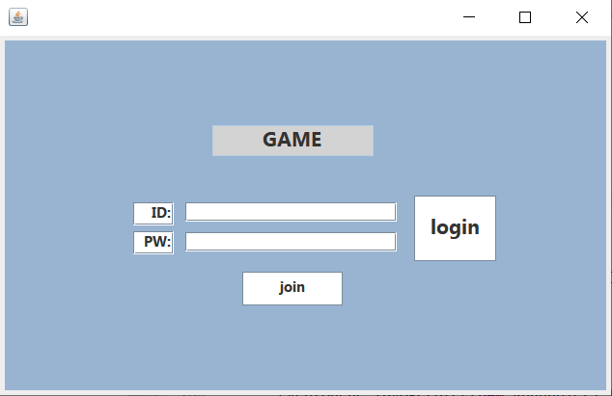
Computer Network
Number Baseball Game
03/ STORY LINES
01 login & sign up
Login Screen
LOGIN
Button’s function
LOGIN -> Wait Window View
JOIN -> Sign Up

Slide 29
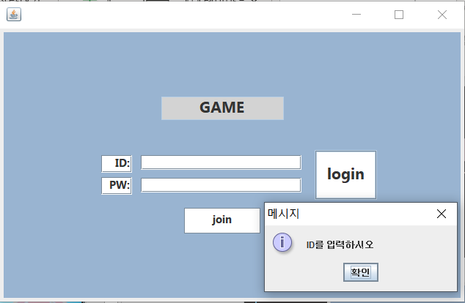
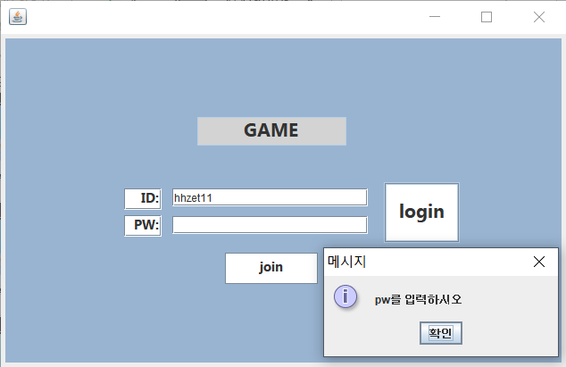
Computer Network
Number Baseball Game
03/ STORY LINES
01 login & sign up
When you push the login button
When you do not enter an ID
When you do not enter an PW
Pops up the pop-up window
with message asking ID
Pops up the pop-up window
with message asking PW

Slide 30
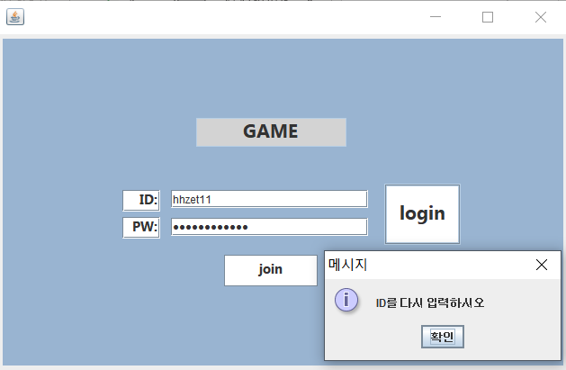
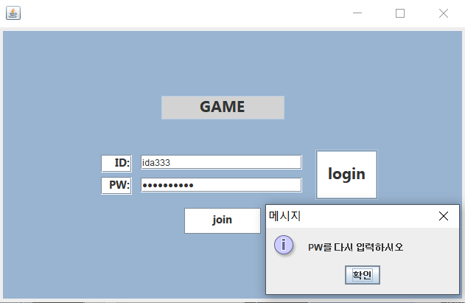
Computer Network
Number Baseball Game
03/ STORY LINES
01 login & sign up
When you push the login button
When you enter wrong ID
When you enter wrong PW
Pops up the pop-up window
with message typing right ID
Pops up the pop-up window
with message typing right PW

Slide 31
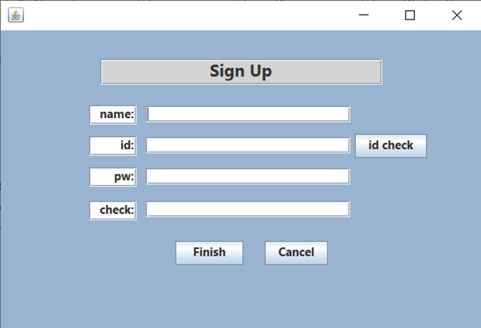
Computer Network
Number Baseball Game
03/ STORY LINES
01 login & sign up
Sign Up Screen – When you push join button on Login Screen
Sign Up
Button’s function
Id check -> check the id in server
Finish & Cancel -> pop up the window
with ‘Reconnect please’

Slide 32
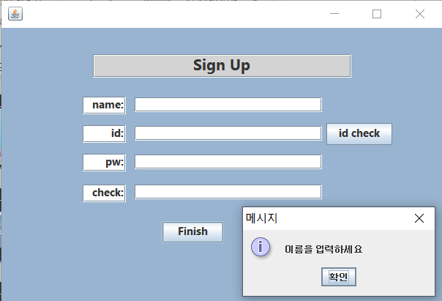
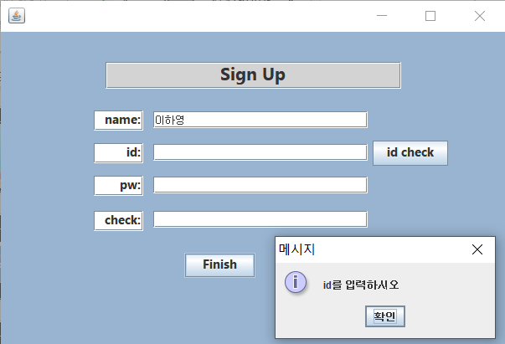
Computer Network
Number Baseball Game
03/ STORY LINES
01 login & sign up
When you push the finish button
When you do not enter NAME
When you do not enter an ID
Pops up the pop-up window
with message asking Name
Pops up the pop-up window
with message asking ID

Slide 33
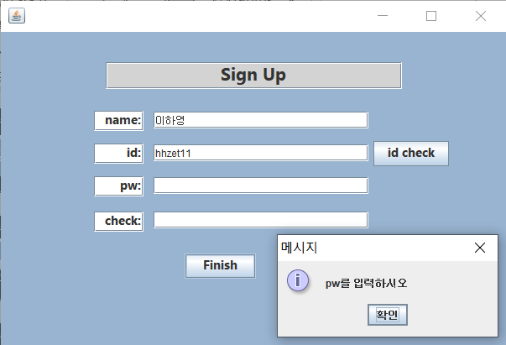
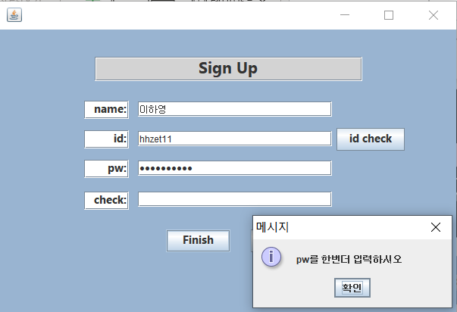
Computer Network
Number Baseball Game
03/ STORY LINES
01 login & sign up
When you push the finish button
When you do not enter an PW
When you do not enter an PW check
Pops up the pop-up window
with message asking pw
Pops up the pop-up window
with message asking ID

Slide 34
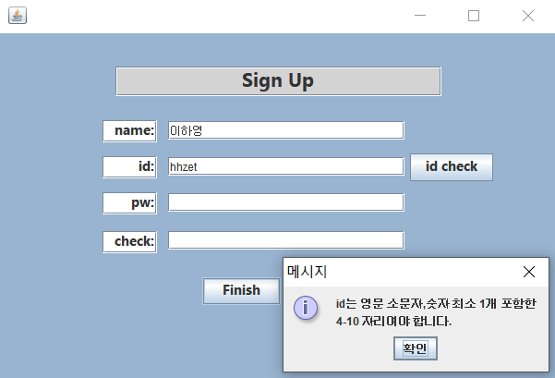
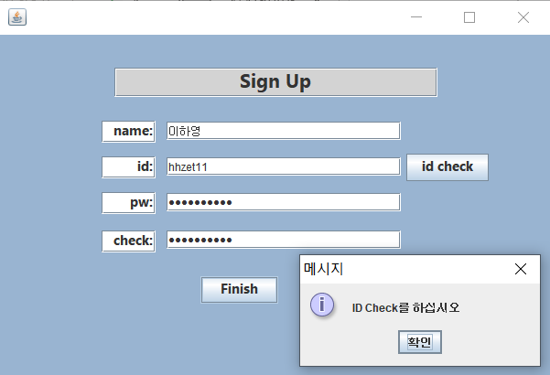
Computer Network
Number Baseball Game
03/ STORY LINES
01 login & sign up
Sign Up conditions
When ID don’t meet the conditions
When you do not check the ID
It must be 4-10 characters including
at least one lowercase letter in English and number
Make sure that the ID
you're trying to sign up for exists

Slide 35
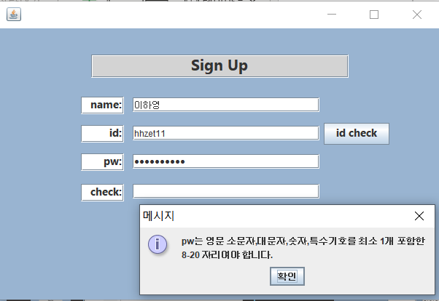
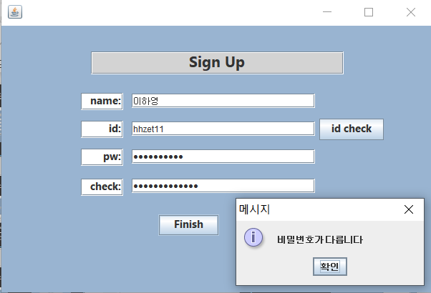
Computer Network
Number Baseball Game
03/ STORY LINES
01 login & sign up
Sign Up conditions
When PW don’t meet the conditions
When you do not check the PW
It must be 8-20 characters including
at least one lowercase, uppercase letter in English,
number and special signal
The passwords must match each other

Slide 36
Computer Network
Number Baseball Game
03/ STORY LINES
02 waiting room
WAITING ROOM

Slide 37
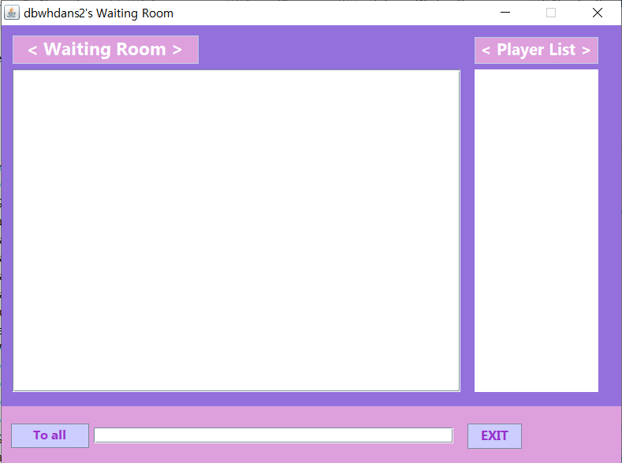
Computer Network
Number Baseball Game
03/ STORY LINES
02 waiting room
Waiting Room
Button’s function
To all / Whisper -> change send mode
EXIT -> Log out & close the window

Slide 38
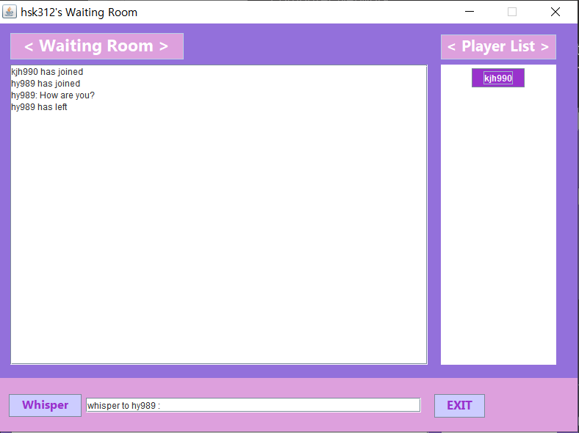
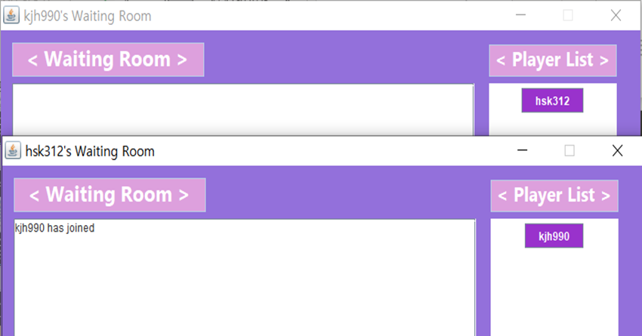
Computer Network
Number Baseball Game
03/ STORY LINES
02 waiting room
When players login into game
When you press ‘EXIT’ button
01 Notify that ‘player’ has joined
02 The Player name button is added
to the <Player List>
Player will log out and notify message
that the player has left

Slide 39
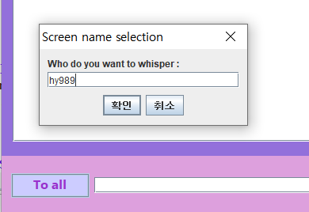
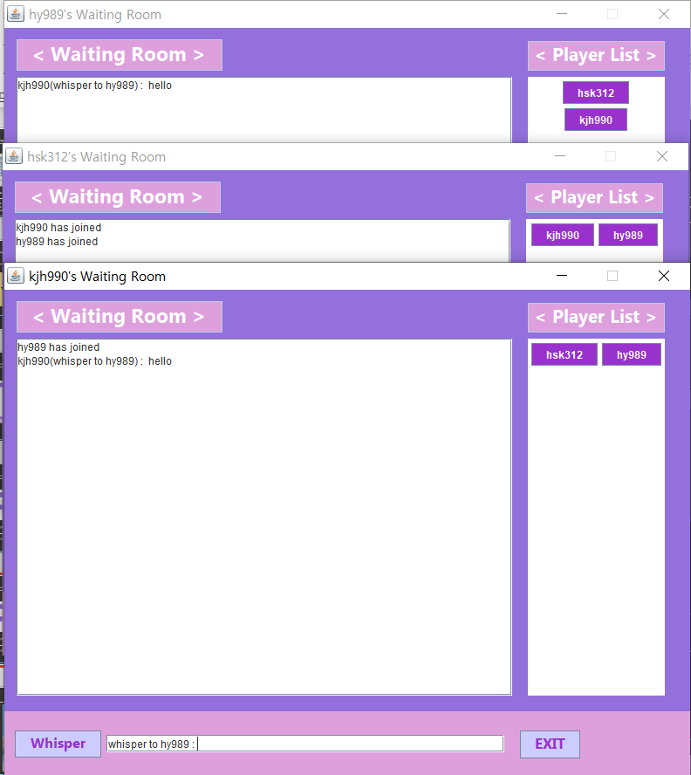

Computer Network
Number Baseball Game
03/ STORY LINES
02 waiting room
When player send whisper message
When player send whisper message
When you press ‘To all’ button
When you press ‘To all’ button
01 Change the textfield with the message
‘ Whisper to player_ID ’
02 Whisper message will send
to selected player
A pop-up window pops up to enter the person
to whom you want to send the whisper message

Slide 40
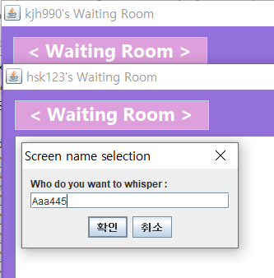
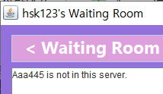
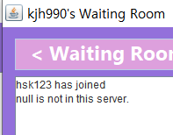

Computer Network
Number Baseball Game
03/ STORY LINES
02 waiting room
When you type ID
that is not connected
‘Player is not in this server’
Message will be shown

Slide 41
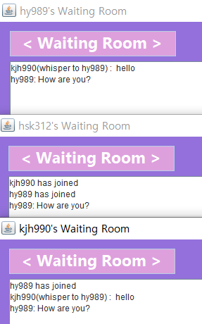

Computer Network
Number Baseball Game
03/ STORY LINES
02 waiting room
When you press ‘Whisper’ button
When you type message to all
The button will be changed to ‘To all’
Message will be showed to all

Slide 42
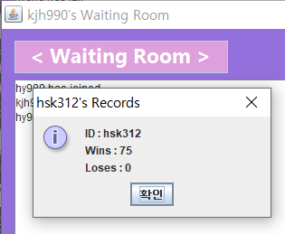
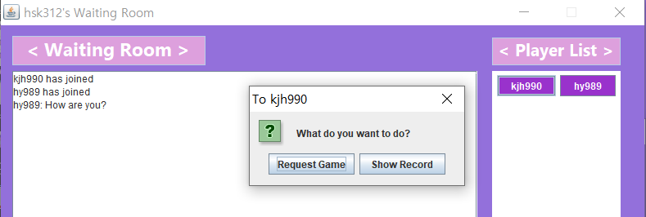
Computer Network
Number Baseball Game
03/ STORY LINES
02 waiting room
When you press ‘Player Name’ button
When you press ‘Show Record’ button
Request Game & Show Record
Buttons will pop up
ID, wins, loses data will pop up

Slide 43
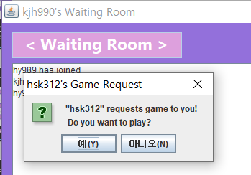
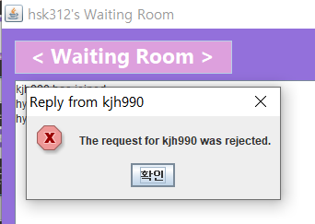
Computer Network
Number Baseball Game
03/ STORY LINES
02 waiting room
When you press ‘Request Game’ button
When you press ‘NO’ button
Game request message will be sent
Rejection Message will pops up

Slide 44
Computer Network
Number Baseball Game
03/ STORY LINES
02 waiting room
GAME WAITING ROOM

Slide 45
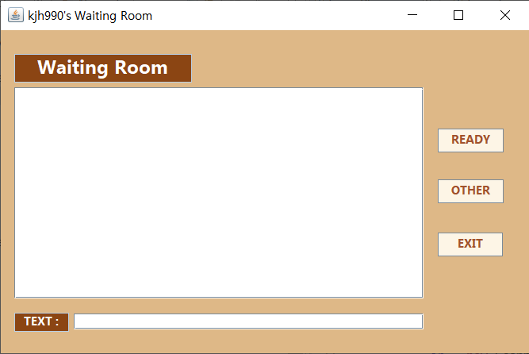
Computer Network
Number Baseball Game
03/ STORY LINES
02 waiting room
Game Waiting Room
Button’s function
Ready -> ready to game
Other -> Show other player is ready
Exit -> Go back to Waiting Room

Slide 46
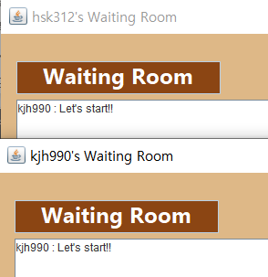
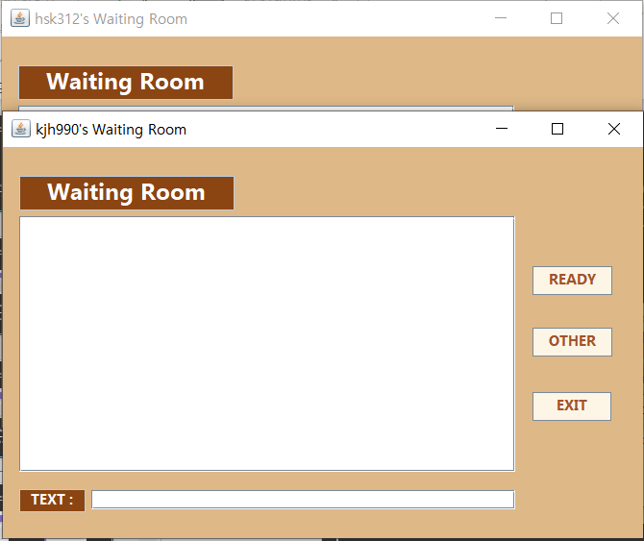

Computer Network
Number Baseball Game
03/ STORY LINES
02 waiting room
When you press ‘YES’ button
When you type text
Players will be moved to Game Waiting Room
Text message will be showed

Slide 47
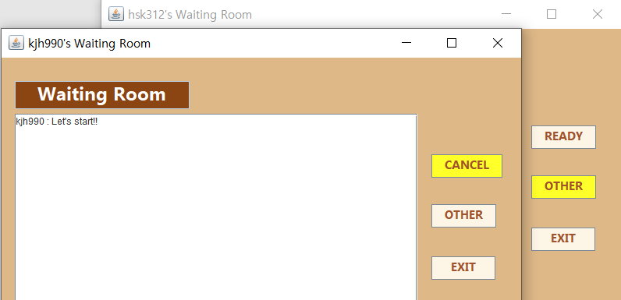
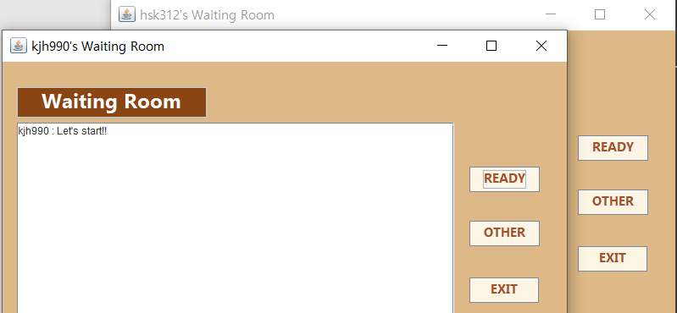
Computer Network
Number Baseball Game
03/ STORY LINES
02 waiting room
When you press ‘Ready’ button
When you press ‘Cancel’ button
01 In my waiting room, ready changed to cancel
02 In other’s waiting room, other will be colored
Go back to its initial state

Slide 48
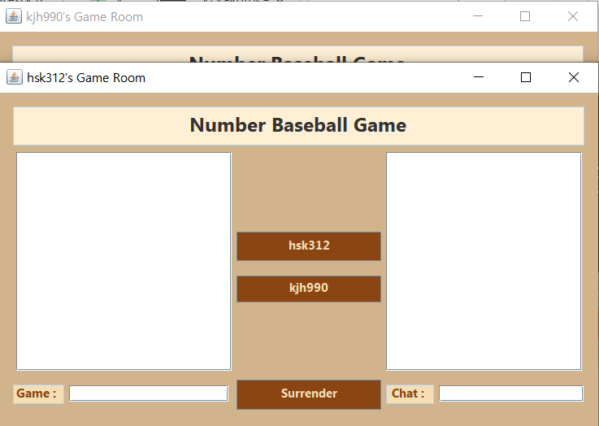
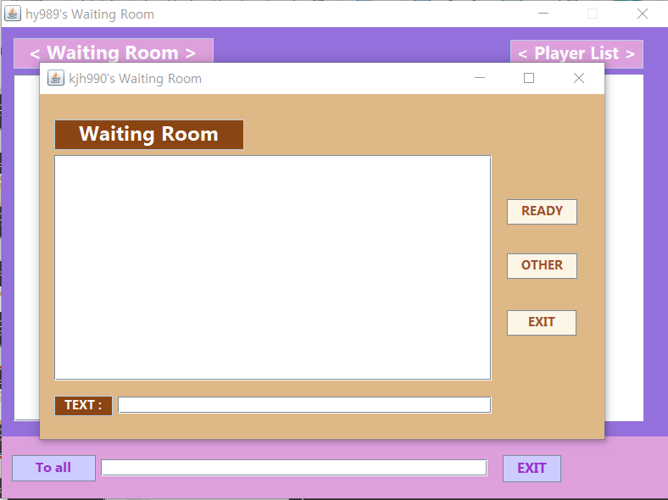
Computer Network
Number Baseball Game
03/ STORY LINES
02 waiting room
When all players press ‘READY’ button
When you press ‘EXIT’ button
All players will be moved to Game
All players will be moved to waiting room

Slide 49
Computer Network
Number Baseball Game
03/ STORY LINES
03 game
GAME

Slide 50
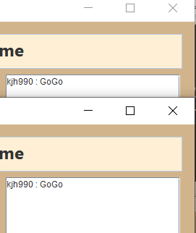
Computer Network
Number Baseball Game
03/ STORY LINES
03 game
When you text message at Chat
When you press ‘Cancel’ button
Message will be shown to all
Go back to its initial state

Slide 51
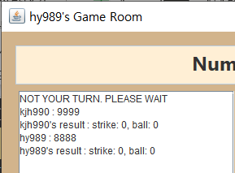
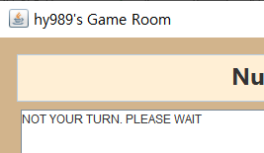
Computer Network
Number Baseball Game
03/ STORY LINES
03 game
When you type numbers at Game
When you break the order
Message & Result will be shown
Together to all players
‘Not your turn. Please wait’
Message will be shown

Slide 52
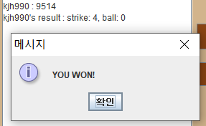
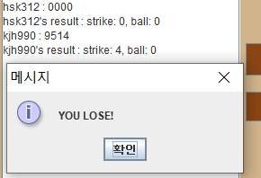
Computer Network
Number Baseball Game
03/ STORY LINES
03 game
When you lose the game
When you won the game
‘You won!’ message will pop up
And you will be moved to waiting room
‘You lose!’ message will pop up
And you will be moved to waiting room

Slide 53
Computer Network
Number Baseball Game
03/ STORY LINES
03 game
When you press ‘Surrender’ button
All players will be moved to waiting room

Slide 54
Computer Network
Number Baseball Game
03/ STORY LINES
04 GameServer
Game Server

Slide 55
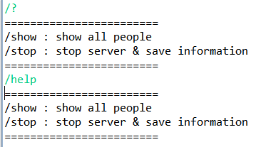
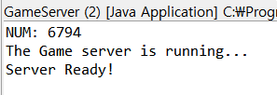
Computer Network
Number Baseball Game
03/ STORY LINES
04 GameServer
When you execute the GameServer
When you type ‘/?’ or ‘/help’
Game’s answer and Ready sentence
will be shown
Each one of these commands
tells us what they're doing

Slide 56
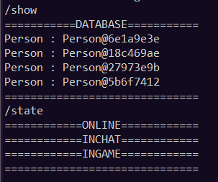

Computer Network
Number Baseball Game
03/ STORY LINES
04 GameServer
When you type ’/stop’
When you type ‘/show’
Save the information and
Stop the server
Person’s Id will be shown

Slide 57
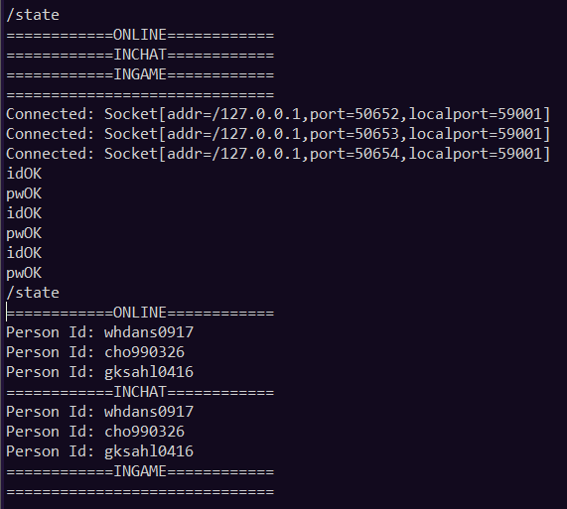
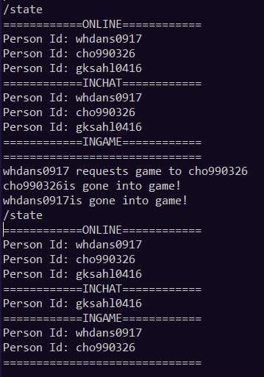
Computer Network
Number Baseball Game
03/ STORY LINES
04 GameServer
When you type ‘/state’
Show list of players that are connected,
and they're all state-specific
ONLINE : All players connected to the server
INCHAT : players who are chatting at WaitingRoom
INGAME : players who are gaming
Two players are moved to game >>

Slide 58
Computer Network
Number Baseball Game
04 CONCLUSION

Slide 59
Computer Network
Number Baseball Game
04/ CONCLUSION
01 Achievement of each Members
33.5%
33%
33.5%
김주현
이하영
조현식
Write waiting room code
Write GameWaitingRoom code
Make game server
Write login & sign up codes
Make game client
Make ppt
Write game code
Make game server & client
Do presentation
BRUNO MARS
BRUNO MARS
BRUNO MARS

Slide 60
THANK YOU
NETWORKING TEAMPROJECT

