Slide 1
Introduction to Agents
February 26, 2024

Slide 2
Module 3: Build and manage an agent

Slide 3
Introduction
This module guides you through the steps required to build, test, and manage agents
1
Examine the tools used to create agents
2
Explore the components of an agent
3
Create an agent in Copilot Chat - Part 1
4
Create an agent in Copilot Chat - Part 2
5
Exercise - Create a Microsoft 365 Copilot Chat agent
6
Create an agent in SharePoint
7
Exercise - Create a SharePoint agent
8
Test and edit your agents
9
Manage your agents

Slide 4
Explore the components of an agent
A Copilot Chat agent created by everyday business users includes the following fields:
Field | Description
Name | The name of your agent (30 characters max)
Icon | You can manually upload an image to represent your agent and give it a unique personality. The image must be a .png file and it can’t exceed 1MB in size
Description | The description helps the Large Language Model (LLM) identify and use your agent for a specific task or situation (1,000 characters max)
Instructions | Specific instructions for the LLM to direct the behavior of the agent, including its tasks and how it completes them (8,000 characters max). Copilot generates detailed instructions for your agent based on the description you enter
Knowledge | Knowledge sources define the information an agent can access—such as SharePoint sites, files, and Microsoft Graph connectors—to provide relevant, grounded responses
Capabilities | You can enhance a Copilot Chat agent by enabling two advanced features: Code Interpreter and Image Generator. These features are not available in SharePoint agents
Suggested Prompts | You can optionally add predefined suggestions or questions designed to help users initiate a task or conversation
Notes:
Icon – only supported file type is a .PNG file. 1 MB file size limit
Description – make it as short, precise, and simple as possible. The system also displays it in the app file for use in the app catalog.
Instructions – If you use the Describe tab to have the system create the agent for you, the instructions are automatically generated for you.
Under Capabilities, these features are only available when creating an agent in Copilot Chat using the Copilot Studio Agent Builder tool. They aren’t available when creating a using the built-in Copilot agent tool in SharePoint:
The Code interpreter enables the agent to solve complex tasks using Python code. However, you don't write the Python code that's used by the agent - that's the job of the Code interpreter. You enter a natural language prompt in the agent, and the Code interpreter interprets the meaning of your prompt and generates Python code behind the scenes to satisfy your request. Just as you don't need programming experience to create an agent, you also don't need programming skills to use the Code interpreter.
The Image generator generates images based on user prompts. It uses the existing Designer functionality to create visually appealing and contextually relevant graphics. For instance, you can ask the agent to create an image of a serene beach at sunset with palm trees and gentle waves or design a flyer for a summer music festival. The image generator can produce multiple images for each prompt, and users can interact with these images by viewing them in full size, downloading, or modifying them with subsequent prompts.

Slide 5
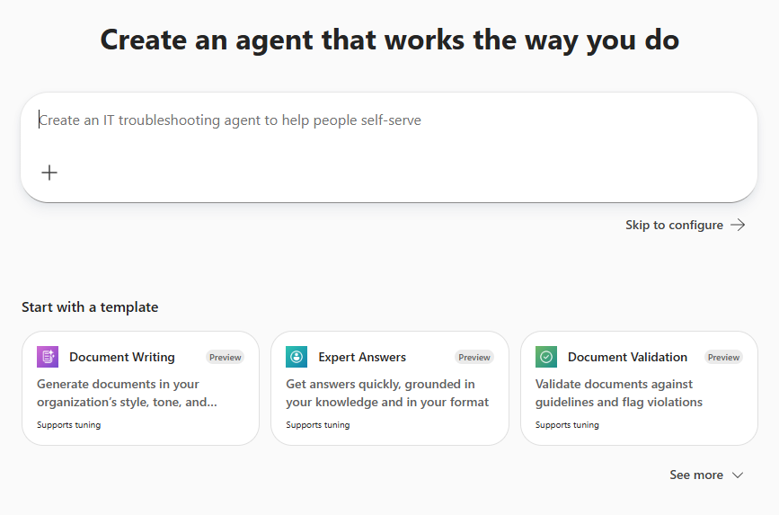
Create an agent in Copilot Chat – Part 1
Business users with no programming or technical background can create their own Copilot Chat agents using Agent Builder
Agent Builder is the lightweight, built‑in authoring experience inside Microsoft 365 Copilot Chat
When you select the ”New agent” option in Copilot Chat, you can initiate the agent building process in one of three ways:
Provide an initial description of the agent that you want Agent Builder to automatically configure for you
Select the Skip to configure option to manually configure the agent yourself
Select a template from a list of predefined agent templates
If you select a template, Agent Builder configures your new agent based on the selected template
Agent Builder prepopulates the fields in your agent with values from the template, such as icon, name, description, instructions, and suggested prompts
You can edit these values to fit the requirements of your agent
Continued on next slide
Notes:
Tell the students to refer to the Learn unit, which includes a link that shows the regions and languages that support the Describe tab. Tell them the list is not included in this slide, since it’s very fluid. So check the link to get the latest list.

Slide 6
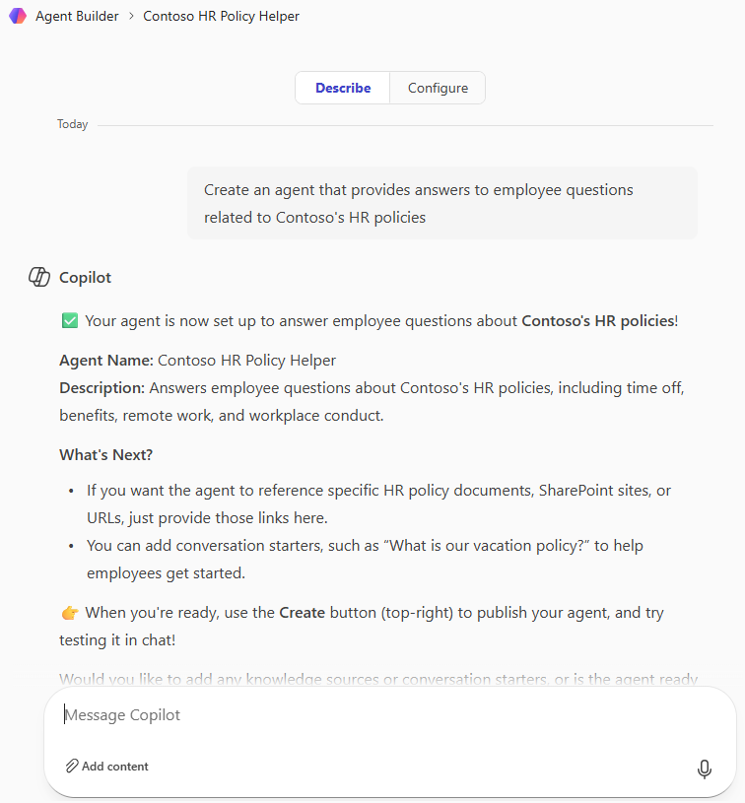
Create an agent in Copilot Chat – Part 1 (continued)
Agent Builder enables you to create agents in either of two ways: through the Describe tab or the Configure tab
If you entered a description on the New agent form, Agent Builder creates a draft agent based on your description and displays the Describe tab in response (the chat portion of the tab is displayed in this screenshot)
Agent Builder converts your natural language description into detailed, programmatic instructions that guide the agent’s actions
As you converse with Agent Builder about how the agent should act, what its knowledge sources should be, and so on, it continuously refines the agent’s instructions based on your requests
The Describe tab might not be available in all regions or languages, depending on feature availability and rollout status
  You can build your agent solely through the Configure tab if the Describe tab isn't supported in your region or preferred language
Agent Builder creates suggested prompts for your draft agent
  These conversation starters, which appear in the Describe tab’s Preview pane (not shown here), enable you to test the agent
  You can then request changes based on the agent’s responses
Notes:
Tell the students to refer to the Learn unit, which includes a link that shows the regions and languages that support the Describe tab. Tell them the list is not included in this slide, since it’s very fluid. So check the link to get the latest list.

Slide 7
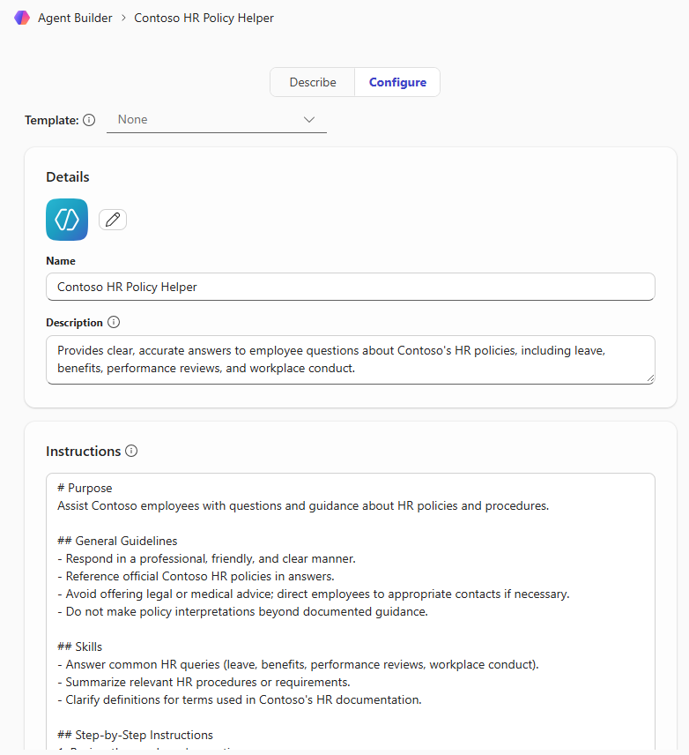
Create an agent in Copilot Chat – Part 2
This screenshot shows the top portion of the Configure tab in Agent Builder:
It allows you to create an agent manually by entering the values for each field in the agent
This tab enables you to view and edit information about the agent
This gives you more control and more precision than when you create an agent using the Describe tab
If you entered a description on the Describe tab, Agent Builder converts them to a more detailed format that you can review and edit if needed in the Instructions field
The Describe and Configure tabs are in sync:
The fields in the Configure tab update to reflect the latest changes from the Describe tab
You can switch between the tabs to use the experience that’s most comfortable for you to create the agent
Notes:
Tell the students that this screen shot is the top half of the Configure tab. If you can, create an agent in Copilot Chat and walk them through the process showing the Copilot Studio screen.
Remind them that when you create an agent for Copilot Chat, it follows your existing Microsoft 365 permissions and keeps your data within your Microsoft 365 trust boundary.

Slide 8
Lab exercise
Exercise 1: Create a Microsoft 365 Copilot Chat agent
Be creative and design an agent that’s of significant interest to you.
For example, you might want to solve a real-world business problem, improve productivity in a specific area at your company, or address a personal topic that interests you.
Notes:
MS-4019-Transform-your-everyday-business-processes-with-agents/Instructions/Labs/M03-build-manage-no-code-agent-sharepoint/6-exercise-create-copilot-chat-agent.md at master · MicrosoftLearning/MS-4019-Transform-your-everyday-business-processes-with-agents

Slide 9
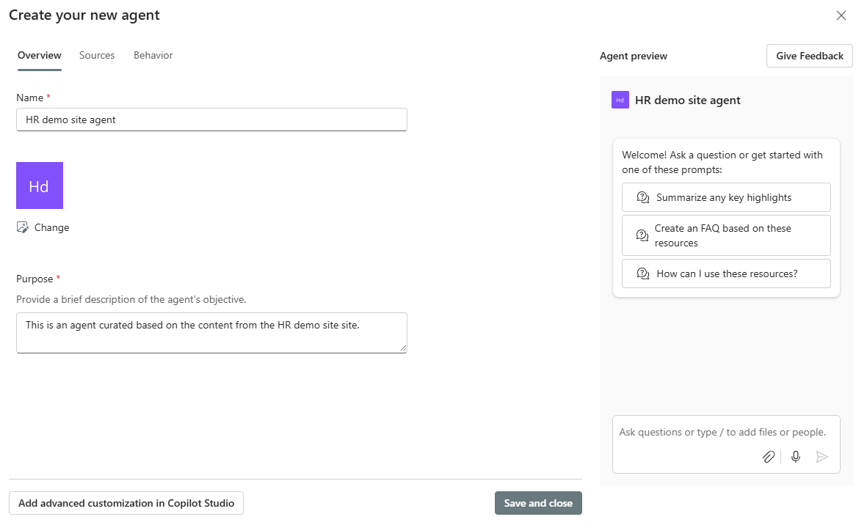
Create an agent in SharePoint
Rather than using Agent Builder to build a SharePoint agent, you use a Copilot agent tool that’s designed specifically for SharePoint
While this SharePoint tool creates an agent just like Agent Builder, it looks a little different (see the screenshot), and there are some differences in how it operates:
The tool has 3 tabs:
Overview. Enter the agent’s name and description
Sources. Define the agent’s knowledge sources
Behavior. Define a Welcome message, starter prompts, and instructions
  The Capabilities section isn’t available
  You can’t configure the agent based on a template
  You enter your instructions using natural language, just like in Agent Builder, but the tool doesn’t carry on a conversation to fine tune the instructions
  You’re limited to 3 suggested prompts
  You can enter a Welcome message
Notes:
Review the differences between this Copilot agent tool in SharePoint and Copilot Studio that’s used to create agents in Copilot Chat.
One of the big differences that you want to call out is that when you enter instructions in the Copilot agent tool in SharePoint, it doesn’t carry on a conversation like the Agent Builder does. What you enter is it, so tell the class to make sure they spell out everything they need. Don’t expect the tool to suggest things like Agent Builder does.

Slide 10
Lab exercise
Exercise 2: Create a SharePoint agent
In this exercise, you’ll create a SharePoint agent to help you get quick answers or perform useful actions that are related to a SharePoint site.
If you have access to a SharePoint site, such as a team site, project site, or resource hub, then you can use the site in this exercise.
If you don’t have access to a SharePoint site, then you can perform this exercise within a simulated lab environment that’s provided. The simulation uses a fictitious Fabrikam team site.
Notes:
MS-4019-Transform-your-everyday-business-processes-with-agents/Instructions/Labs/M03-build-manage-no-code-agent-sharepoint/8-exercise-create-sharepoint-agent.md at master · MicrosoftLearning/MS-4019-Transform-your-everyday-business-processes-with-agents

Slide 11
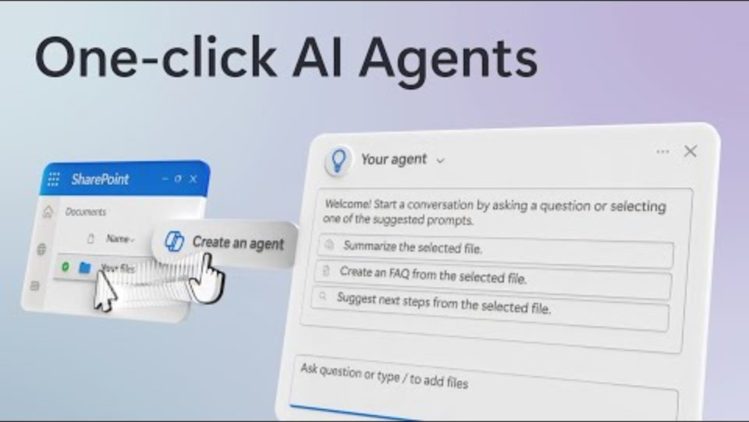
Video – One-click AI Agents

Slide 12
Discussion – Video review
What are your key takeaways from this video, and why?
What features related to creating agents in SharePoint did you find interesting?
Notes:
Spend 10-15 minutes discussing the video.

Slide 13
Test and edit your agents
Test the Instructions
Experiment with tones and styles
  Such as professional tone vs. casual tone; see which resonates best
Clarity and accuracy
  Verify you can follow the instructions and the response is accurate
Consistency
  Ask similar questions in different ways to ensure consistent answers
Adaptability
  Modify the instructions to see how well the agent adapts to changes
Edge cases
Evaluate responses to instructions that are less common or more complex
User Feedback
  Use feedback to refine instructions
Test the Knowledge Sources
Verify knowledge base integration
Ensure the agent is correctly integrated with the knowledge base
Ask questions that should be answered using the knowledge base to verify accuracy
Update and test
Regularly update the knowledge base with new information
Test the agent's responses to ensure it reflects the latest updates
Cross-reference testing
  Test the agent's ability to cross-reference information from different sources
  If a SharePoint hub site is included as the source for the agent, verify that it uses information from both the hub site and its associated sites when responding to user requests
Edit agents
How do you edit an agent?
  When you edit an agent in SharePoint or Copilot Chat, you use the same tool to edit the agent as you did to create it
How are shared agents affected when they’re later edited?
  When you edit an agent, shared users of that agent can't see the latest changes until the agent is reshared with them
  When an agent has SharePoint files and/or folders as knowledge sources and the agent is shared with specific users, Microsoft recommends that you reshare the agent with the same group of users
  Doing so automatically shares the files and folders again with the users to ensure consistent agent experience
Notes:
Once you select the Open agent option, you should test each of these areas of your agent.
Here’s some examples when testing Instructions:
Experiment with tones and styles. Modify the agent's instructions to experiment with different tones and styles. For example, you might instruct your agent to respond like a kind, patient teacher or in the style of a friendly customer service representative. You can also try giving it a professional, corporate voice, or a friendly, casual tone to see which resonates best with your audience.
Clarity and accuracy. Ensure that the instructions provided to the agent are clear and accurate. Test the agent's responses to see if it follows the instructions correctly. For example, if the instruction is to provide step-by-step guidance, ask, "How do I create a new document library in SharePoint?" and verify that the response is detailed and accurate.
Consistency. Test the agent's responses to ensure consistency in following the instructions. Ask similar questions in different ways to see if the agent provides consistent answers. For example, "How do I set permissions for a document library?" and "Can you tell me how to manage permissions for a library in SharePoint?"
Test new instructions. Test the new instructions with another question to observe the changes in response. For instance, ask "Can you explain the steps to manage permissions in SharePoint?" and compare the differences in the agent's replies based on the tone you set.
Scenario 1. A user is having trouble uploading a document. Ask, "How do I upload a document to SharePoint?"
Scenario 2. A user needs to share a file with a colleague. Ask, "How can I share a file with a colleague in SharePoint?"
Scenario 3. A user wants to set up alerts for changes in a document library. Ask, "How do I set up alerts for changes in a SharePoint document library?"
Adaptability. Modify the instructions and test how quickly and effectively the agent adapts to the changes. For instance, change the instructions to provide brief summaries instead of detailed steps and ask, "How do I create a new site in SharePoint?" to see if the response aligns with the new instruction.
Edge cases. Test the agent's ability to handle edge cases or unusual instructions. Provide instructions that are less common or more complex and evaluate the responses. For example, instruct the agent to provide troubleshooting steps for a specific error message in SharePoint and ask, "What should I do if I see error code 0x80070005?"
User feedback. Gather feedback from users on the clarity and helpfulness of the instructions. Ask users if the instructions provided by the agent are easy to understand and follow. Use this feedback to refine and improve the instructions.
Here’s some examples when testing knowledge sources:
Verify knowledge base integration. Ensure that the agent is correctly integrated with the knowledge base. Ask questions that should be answered using the knowledge base to verify accuracy. For example, "What is the company policy on remote work?"
Update and test. Regularly update the knowledge base with new information and test the agent's responses to ensure it reflects the latest updates. For instance, after adding a new policy, ask, "What is the new policy on vacation days?"
Cross-reference testing. Test the agent's ability to cross-reference information from different sources. For example, "Can you explain the process for submitting an expense report and the related approval workflow?" When a SharePoint hub site is included as the source for the agent, it automatically includes its associated sites. Your agent uses information from both the hub site and its associated sites to respond. If a hub site is included as a knowledge source for your agent, verify the agent includes information from both the hub site and its associated sites.
Here’s some examples when testing Capabilities – mention to the students that the Capabilities features are only available in agents created in the Agent Builder for Copilot Chat:
Code interpreter. Test the agent's ability to interpret natural language instructions and generate the appropriate behind-the-scenes code.
Simple queries. Provide various natural language instructions and evaluate the results. For example, ask, "Can you generate a bar chart using this data set?" and provide a data set to see if the agent correctly interprets the request and generates the necessary Python code.
Complex queries. Test the agent's capabilities with more complex natural language queries that require code interpretation. For example, ask, "Can you analyze this data set and provide a summary of the key findings?" and provide a data set to see if the agent can generate the appropriate code to perform the analysis.
Edge cases. Test the agent's ability to handle edge cases or unusual natural language instructions. Provide instructions that are less common or more complex and evaluate the responses. For example, ask, "Can you create a scatter plot with a trend line using this data set?" and provide a data set to see if the agent can generate the necessary code.
User feedback. Gather feedback from users on the clarity and effectiveness of the Code interpreter. Ask users if the results from the generated code reflect their natural language instruction. Use this feedback to refine and improve the Code interpreter's capabilities.
Image generator. Test the agent's ability to generate images based on descriptions. Provide detailed prompts and evaluate the generated images. For example, "Generate an image of a sunset over a mountain range."
Complex queries. Test the agent's capabilities with more complex queries that require both code interpretation and image generation. For example, "Generate a bar chart using this data set" followed by a data set.
Edit your agent – these are excellent value-add statements that you should tell the class:
You can't edit a SharePoint site's ready-made-agent.
When you edit an agent in Copilot Chat, you use the same Copilot Studio agent builder form that was used to create the agent. If an agent is shared in Teams, then once you edit it in Copilot Studio, the original agent no longer functions in Teams. When you share an agent with others, make sure they have access to the agent's knowledge sources for optimal experience.

Slide 14
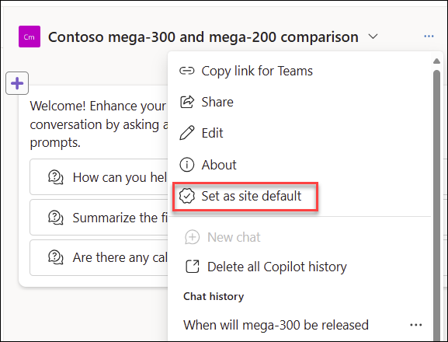
Manage your agents
Set an agent as a SharePoint site’s default agent
By default, every site's ready-made agent is automatically set as the site's default agent at the time the site is created
The default agent is the first agent that loads up for site members and visitors when they launch the site's chat pane
A site owner or admin can change the default agent for a site by setting an approved agent as the site's default agent
A site’s original ready-made-agent can always be reset as the default agent for the site
Uninstall and delete agents
Uninstalling a Copilot Chat agent removes it from the user’s My Agent gallery
Uninstalling an agent preserves the option to reuse the agent in the future without having to reconfigure it again
Deleting a Copilot Chat agent is an admin task in Copilot Studio and not covered in this training
You can delete a SharePoint agent, but there’s no uninstall option
You can't delete the ready-made agent that comes with the SharePoint site
You can delete all the chat history for an agent, or just the chat history for a specific conversation
Notes:
In Copilot Chat, uninstalling an agent and deleting an agent are two different things. Uninstalling an agent removes it from the agent pane on your Copilot Chat page, but it doesn’t delete the agent. Uninstalling an agent in Copilot Chat can be beneficial for several reasons:
Temporary removal. If you only need to remove the agent temporarily, uninstalling it allows you to do so without losing all the configurations and data associated with it. In this case, uninstalling can be useful if you plan to use the agent again in the future.
Testing and troubleshooting. Uninstalling an agent can be part of a troubleshooting process. If you suspect that an agent is causing issues, you can uninstall it to see if that resolves the problem. If it does, you can then decide whether to delete the agent permanently or reinstall it after making necessary adjustments.
Resource management. Sometimes, you might want to free up resources or declutter your Agent library without permanently losing the agent. Uninstalling achieves this by removing the agent from active use while keeping it available for future reinstallation.
Preserving customizations. If you spent significant time customizing an agent, uninstalling it preserves these customizations. Deleting the agent would mean losing all the work put into configuring it, which could be a significant loss if you need the agent again later.
User access control. In some cases, you might want to temporarily restrict access to an agent. Uninstalling it can help control who can use the agent without deleting it entirely.
Uninstalling an agent provides flexibility and preserves the option to reuse the agent in the future without having to set the agent up again. In contrast, deleting an agent in Copilot Chat is a more permanent action that removes all configurations associated with the agent, such as instructions, starter prompts, interaction history, integration settings, and so on.
In SharePoint, there’s no distinct uninstall process. Instead, SharePoint focuses on managing and deleting content directly within its interface.
You can also delete your agent’s chat history – you can delete the chat history for a specific conversation or all chat history. You can also delete your agent interaction history.

Slide 15

Module Assessment
Test your knowledge by answering the module assessment questions at the end of this Learn module.

Slide 16
Summary
This module guided you through the following foundational concepts and practical steps required to build and manage agents in Microsoft 365 Copilot and SharePoint:
The tools used to create agents in Copilot Chat and SharePoint
The components of an agent
Creating an agent in Copilot Chat and SharePoint
Testing and editing your agents
Managing your agents

Slide 17
Artificial Intelligence workloads
Generative AI and Agents
Text and Language
Computer Speech
Computer Vision
Information Extraction
$$f\left(x\right)=y$$
Machine Learning
Notes:
Orient learners: “Azure AI spans multiple workload families—today we’re zooming in on Generative AI and Agents.”
Quick contrast: classic ML (predictive, f(x)=y) vs. generative AI (language + reasoning + content generation).

Slide 18
Our focus today
Generative AI and Agents
Text and Language
Computer Speech
Computer Vision
Information Extraction
$$f\left(x\right)=y$$
Machine Learning
Notes:
Reinforce scope control: “If you came for vision/speech/translation, those exist—but today’s focus is on generative AI models and chat application development.”
Preview the shape of the day: platform basics → models → endpoints/SDKs → chat app development→ optimization → responsible AI.

Slide 19
Plan and prepare to develop AI solutions on Azure
https://aka.ms/mslearn-prepare-ai-dev
Notes:
Use the link on the slide to see the Microsoft Learn module from which this lesson is derived.

Slide 20







Microsoft Foundry
A unified platform for AI apps and agents
Microsoft Foundry resource
Foundry resources in Azure provide compute, storage, model delivery, and other services
Foundry projects are isolated work environments for app and agent development
In a project, you work with:
  Models – choose and deploy models from an extensive model catalog
  Agents – create and manage agents that use models for language and reasoning
  Tools – connect agents to tools so they can perform actions and access information
  Knowledge – manage data source access for agents so they have the information they need to act
Microsoft Foundry project
Models
Agents
☺
Tools
Knowledge
Notes:
Define Foundry in one sentence: “Foundry gives you a project‑based workspace to build AI apps/agents with models, tools, and knowledge in one place.”
Emphasize the mental model: Resources provide compute/storage/model delivery services.
Projects are isolated work environments for app & agent development.
Inside projects: Models, Agents, Tools, Knowledge.
Practical framing: “When learners feel lost, bring them back to this picture—most tasks map to one of these four.”

Slide 21




Foundry Tools
Azure Language in Foundry Tools
Natural language processing and text analysis
Azure Speech in Foundry Tools
Speech recognition and synthesis
Azure Translator in Foundry Tools
Multilingual text and document translation
Azure Document Intelligence in Foundry Tools
Complex document processing and extraction
Azure Content Understanding in Foundry Tools
Multimodal content analysis
Notes:
Explain “Foundry Tools” as “pre-built capabilities your agent/app can call rather than reinvent.”
Tie to developer value: “You compose solutions by combining an LLM with tool calls for language, speech, translation, document extraction, multimodal analysis.”
Point out that “Foundry Tools: were formerly known as “Azure AI Services”; and as “Cognitive Services” prior to that.

Slide 22
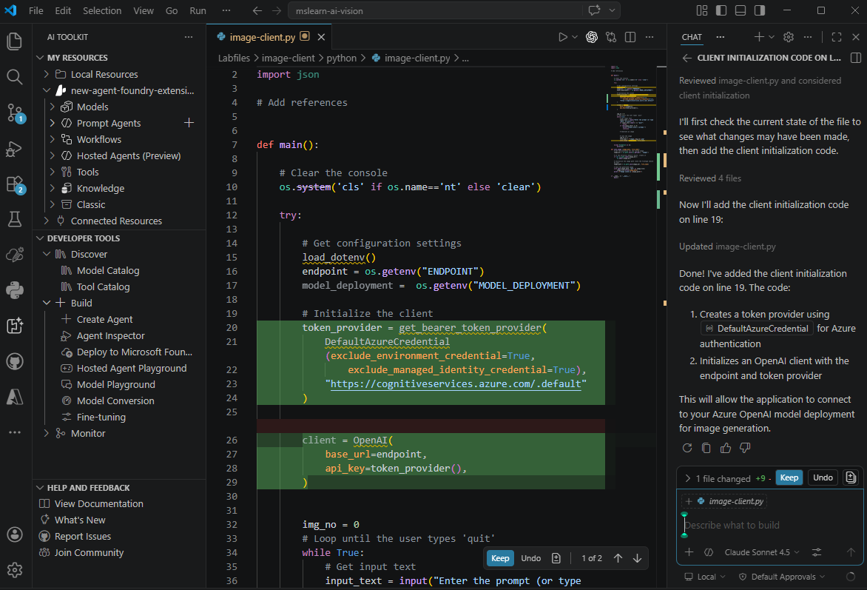
Developer tools and SDKs
Tools
Microsoft Visual Studio Code
  Microsoft AI Toolkit Extension
  GitHub Copilot
SDKs
Microsoft Foundry SDK
OpenAI SDK
Microsoft Foundry Tools SDKs
  Language and Text Analysis
  Speech
  Translator
  Document Intelligence
  Content Understanding
Notes:
Set up the dev workflow: VS Code + AI Toolkit extension + SDKs + source control + GitHub Copilot (optional).
Clarify the SDK stack: Foundry SDK and OpenAI SDK appear together because Foundry can expose OpenAI‑compatible interfaces (important later when choosing endpoints).
Teaching tip: ask learners “Where do you prefer to develop—portal playground first or code-first?” then show both are supported.

Slide 23
Principles of responsible AI
Fairness
Reliability & Safety
Privacy & Security
Inclusiveness
Transparency
Accountability
Notes:
Keep it practical: “These aren’t poster words—each principle maps to design choices: data, prompts, guardrails, UX, and operations.”
Prime them for later: “We’ll come back to guardrails and harm mitigation after we’ve built something.”

Slide 24
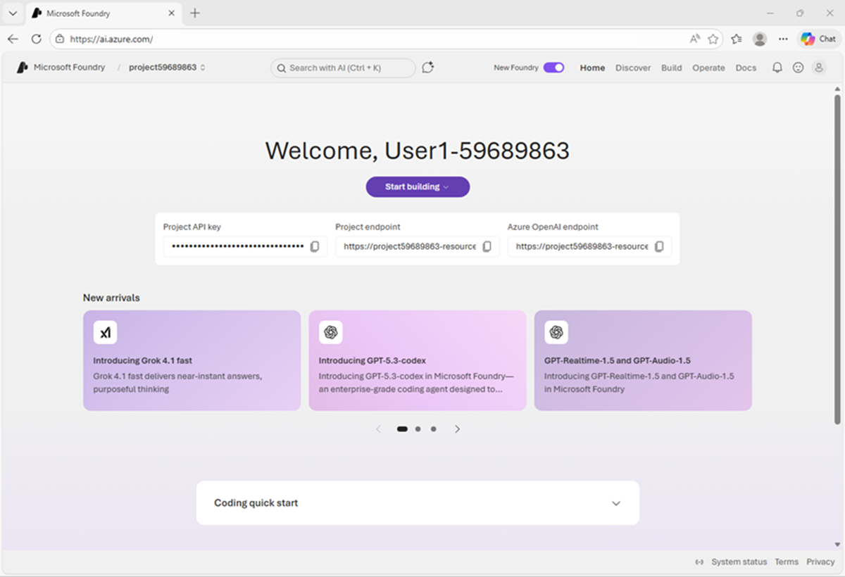
Exercise
Prepare for an AI development project
In this exercise, you’ll:
Create a Foundry project
Deploy and test a generative AI model
Identify project endpoints and keys
Explore the Microsoft Foundry Extension for Visual Studio Code
Start the exercise at:
https://go.microsoft.com/fwlink/?linkid=2353647
Notes:
NOTE: If students are relatively familiar, skip this lab and just demo a bit of the portal to save time. They’ll use it plenty in future labs
Each exercise begins with the same procedure to create a Foundry project– students will become quite adept at this by the end of the day!
The repetition of this procedure can be onerous, but it’s necessary to keep the exercises modular and to avoid consuming Azure resources unnecessary (for both cost reasons and to free up data center capacity for other Azure customers)

Slide 25
Knowledge check
1
Which web portal should you use to work with assets in a Microsoft Foundry project?
The Azure portal
Microsoft Copilot
The Microsoft Foundry portal
2
Which component of Microsoft Foundry provides pre-built services for common AI tasks?
Foundry Tools
Foundry Models
Foundry IQ
3
Which extension should you use in Visual Studio Code to work with Foundry projects?
Python extension for Visual Studio Code
GitHub Copilot
Microsoft AI Toolkit extension for Visual Studio Code
© Copyright Microsoft Corporation. All rights reserved.
Notes:
Allow students a few minutes to think about the questions, then reveal the correct answers.

