Slide 1
Introduction to Agents
https://aka.ms/mslearn-develop-ai-agents
April 2025
Notes:
Use the link on the slide to see the Microsoft Learn learning path from which this presentation is derived.

Slide 2
What is Artificial Intelligence?
Generative
AI
Agents and automation
Natural Language
Computer Vision
Information Extraction
Machine Learning
$$y=f(x)$$
Notes:
Use this slide to describe the broader AI landscape, which consists of multiple workloads all built on the foundation of machine learning.

Slide 3
Our focus today
Generative
AI
Agents and automation
Natural Language
Computer Vision
Information Extraction
Machine Learning
$$y=f(x)$$
Notes:
The focus for today is AI agents.

Slide 4
Get started with AI agent development on Azure
https://aka.ms/mslearn-get-started-agents
Notes:
Use the link on the slide to see the Microsoft Learn module from which this lesson is derived.

Slide 5
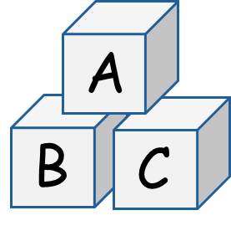
What are AI agents?
Smart software services that combine
Generative AI models
Contextual knowledge
Tools to automate tasks
?
!
Example: An expenses agent
A user asks the expense agent a question about expenses
The expenses agent accepts the question as a prompt
The agent uses knowledge of expenses policy information to ground the prompt
The agent uses a language model to interpret the prompt and generate a response
Based on the response, the agent can use its available tools to submit a claim to be processed and generate a check payment
Notes:
Challenge the students to think of other examples of how AI agents could be used to assist in workflows.

Slide 6





Options for agent development
Azure AI Foundry Agent Service
AG
AutoGen
OpenAI Assistants API
Semantic Kernel
Managed service in Azure for creating, managing, and using AI agents
Based on OpenAI Assistants API - more model choices, data integration, and enterprise security
Standard API for OpenAI agent development
Offers a subset of AI Agent Service features
Restricted to OpenAI models
Lightweight, open-source development kit for building AI agents
Supports OpenAI Assistant and Azure AI agents as well as native chat completion agents
Open-source framework for rapid agent development
Useful for research and ideation when experimenting with agents
Microsoft 365 Agents SDK
Copilot Studio
Agent Builder
Create self-hosted agents for various channels
Not limited to Microsoft 365; can be delivered through channels like Slack or Messenger
Low-code development environment for building and deploying agents
Integrates with Microsoft 365 ecosystem and common channels like Slack and Messenger
Declarative tool for business users to author basic agents in Microsoft Copilot Chat and other Copilot-based interfaces
Enables users to create agents by describing functionality or using a visual interface
Notes:
Point out that some of these tools are optimize for creating agents that integrate with Microsoft Copilot in a Microsoft 365 environment, while others are a better option for creating more generalized agents that can be delivered as custom apps or services on Azure.

Slide 7

Our focus in this course
Azure AI Foundry provides a platform for agent development:
  Project-based resource management and model catalog
  Visual agent design and test in Azure AI Foundry portal
  Agent development with Azure AI Foundry Agent Service SDK
  Azure AI Agent Service integration with Semantic Kernel
Azure AI Foundry
Platform for AI development on Azure
Azure AI Foundry Agent Service
Managed service for agents on Azure
Semantic Kernel
SDK with multi-agent orchestration
Notes:
The main focus for today is Azure AI Agent Service. We’ll also cover some elements of Semantic Kernel – primarily how to integrate it with Azure AI Agent Service agents and build multi-agent solutions.

Slide 8
Components of an agent
Model
Tools
Generative AI language model
Deployed from Azure AI model catalog
Interprets prompts
Knowledge tools
Search information sources, like Bing and enterprise data stores
Action tools
Automate tasks, for example by generating and running code
Chat sessions with an agent take place on a thread
Notes:
Point out that Azure AI Agent Service supports the use of a subset of the models available in the Azure AI model catalog.
Choosing an appropriate model for your agent is a key consideration that depends on a number of factors.
Refer students to https://aka.ms/mslearn-ai-models to learn more about the model catalog and model selection.

Slide 9
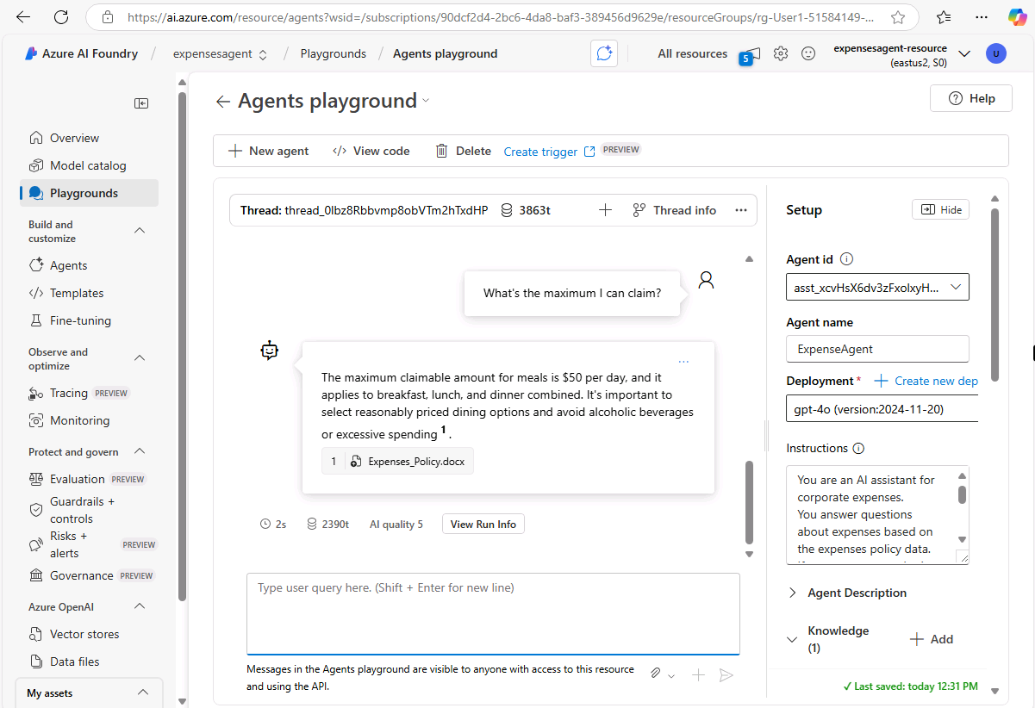
Creating an agent in Azure AI Foundry portal
Deploy a supported model
Create an agent and configure:
  Name
  Model deployment
  Instructions
  Tool connections
Test the agent in the playground
Connect to and consume your agent using code
Notes:
You can demo this if you like – bear in mind that students are about to do it for themselves in the exercise.

Slide 10
Exercise
Explore AI Agent development
In this exercise, you’ll use the Azure AI Foundry portal to:
Deploy a model
Create an agent
Configure a knowledge tool
Test the agent in the playground
Trainers:
Customize this slide to include the link to the hosted lab environment and any custom instructions.
(then remove this arrow)
Start the exercise at:
https://go.microsoft.com/fwlink/?linkid=2303870
Notes:
Each exercise begins with the same procedure to create an Azure AI Foundry Agent (which lives inside a project) – students will become quite adept at this by the end of the day!
The repetition of this procedure can be onerous, but its necessary to keep the exercises modular and to avoid consuming Azure resources unnecessary (for both cost reasons and to free up data center capacity for other Azure customers)

Slide 11
Knowledge check
1
Which of the following best describes an AI agent?
A developer who specializes in building generative AI solutions
A software service that uses AI to assist users with information and task automation
A marketplace for off-the-shelf AI software components
2
Which AI agent development service offers a choice of generative AI models from multiple vendors in the Azure AI Foundry model catalog?
Azure AI Foundry Agent Service
OpenAI Assistants API
Microsoft 365 Copilot Chat
3
What element of an Foundry Agent Service agent enables it to ground prompts with contextual data?
Model
Code interpreter tool
Knowledge
Notes:
Allow students a few minutes to think about the questions, then reveal the correct answers.

Slide 12
Develop an AI agent with Azure AI Foundry Agent Service
https://aka.ms/mslearn-develop-ai-agent
Notes:
Use the link on the slide to see the Microsoft Learn module from which this lesson is derived.

Slide 13
Why are AI agents useful?
Automation
Decision-Making
Scalability
24/7 Availability
Handle repetitive tasks.
Free up human workers.
Increase productivity and efficiency.
Analyze trends and predict outcomes.
Handle complex scenarios.
Provide actionable insights
Scale operations efficiently.
Reduce operational costs.
Support business growth.
Operate continuously.
Ensure prompt task completion.
Provide round-the-clock service
Use case examples
$
Personal productivity
Research
Sales
Customer service
Software development
Notes:
Share any additional benefits or scenarios you can think of; and encourage students to do the same.

Slide 14
Agent resource setup
Use bicep templates for basic and standard setup
Or create resources for a basic setup in Azure AI Foundry portal
Basic agent setup
Standard agent setup
Azure AI Foundry
Azure AI Hub
Project
Azure AI Project
Azure AI Services
Azure Key Vault
Azure AI Search
Azure AI Services
Azure Storage
Notes:
The bicep templates mentioned in the slide are available at https://github.com/Azure/azure-quickstart-templates/tree/master/quickstarts/microsoft.azure-ai-agent-service

Slide 15
Using the SDK to chat with an agent
Connect to the AI Foundry project
Get an existing agent, or create one specifying:
  Model
  Instructions
  Tools and resources it can use
Create a thread for the chat session
Add messages to the thread and invoke it with the agent
Check the thread status, and when ready, retrieve the messages. The thread includes all user and agent messages plus any other data that was generated (e.g. files created by tools)
Repeat…
When finished, delete the agent and the thread
AI Project
<name>.services.ai.azure.com/api/projects/<project_name>…
A
B
C
Notes:
Students will see how to implement this pattern in code during the exercise.

Slide 16
Using tools with your agent
Knowledge tools
Action tools
Bing Search: Uses Bing search results to ground prompts with real-time live data from the web
File search: Grounds prompts with data from files in a vector store
Azure AI Search: Grounds prompts with data from Azure AI Search query results
Microsoft Fabric: Uses the Fabric Data Agent to ground prompts with data from your Fabric data stores
Licensed data: Integrate third-party licensed data by using the OpenAPI Spec action tool
Code Interpreter: Sandbox for model-generated Python code that can access and process uploaded files
Function: Calls your custom function code – you must provide function definitions and implementations
Azure Function: Calls code in serverless Azure Functions
OpenAPI Spec: Calls external APIs based on the OpenAPI 3.0 spec
Notes:
We’ll use the Code Interpreter tool in the exercise.

Slide 17
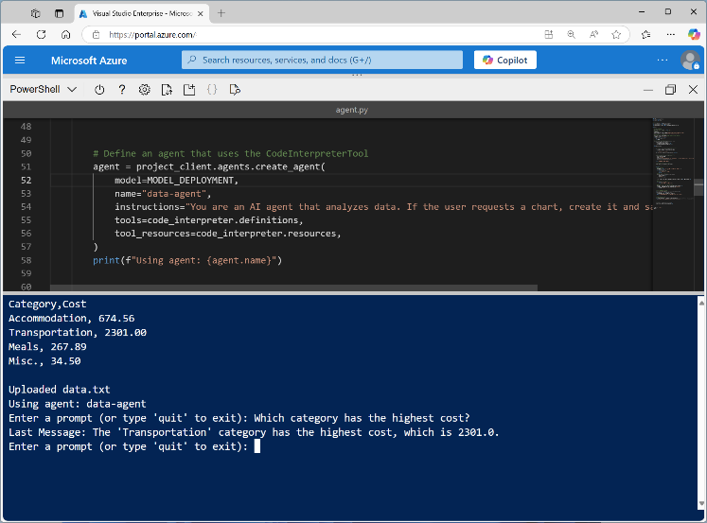
Exercise
Develop an AI agent
In this exercise, you’ll use the Foundry Agent SDK to:
Create an agent that uses a code completion tool
Invoke a chat session with the agent
Retrieve chat messages and output files
Trainers:
Customize this slide to include the link to the hosted lab environment and any custom instructions.
(then remove this arrow)
Start the exercise at:
https://go.microsoft.com/fwlink/?linkid=2305092
Notes:
Each exercise begins with the same procedure to create an Azure AI Foundry project – students will become quite adept at this by the end of the day!
The repetition of this procedure can be onerous, but its necessary to keep the exercises modular and to avoid consuming Azure resources unnecessary (for both cost reasons and to free up data center capacity for other Azure customers)

Slide 18
Knowledge check
1
What is the first step in setting up Azure AI Foundry Agent Service?
Deploy a compatible model
Create a project
Make API calls using SDKs
2
Which element of an agent definition is used to specify its behavior and restrictions?
Model
Instructions
Tools
3
Which tool should you use to enable an agent to dynamically generate code to perform tasks or access data in files?
Code Interpreter
Azure Functions
Azure AI Search
Notes:
Allow students a few minutes to think about the questions, then reveal the correct answers.

Slide 19
Integrate custom tools into your agent
https://aka.ms/mslearn-ai-agent-tools
Notes:
Use the link on the slide to see the Microsoft Learn module from which this lesson is derived.

Slide 20
Why use custom tools?
Enhance productivity
Improve accuracy
Create tailored solutions
Automate repetitive tasks and streamline workflows
Provide precise and consistent outputs with explicit code
Address specific business needs and optimize processes
Example
A user asks an agent about the weather conditions in a ski resort
The agent determines that is has access to a tool that can use an API to get meteorological information, and calls it
The tool returns the weather report, and the agent informs the user
?
Notes:
Try to think of additional examples; and encourage students to do the same.
In many cases, the built-in Code Interpreter tool can provide the functionality you need without the need for you to write custom functions. However, using a custom tool enables you to have more control over the specific logic used to implement a task or to enable your agent to leverage third-party services.

Slide 21
Options for integrating custom tool functionality
< >
Function calling
Azure Functions
OpenAPI Spec
Provide a set of callable functions in your agent code (multiple languages supported)
The agent dynamically identifies appropriate functions based on their definitions
Useful for integrating custom logic and workflows into AI agents
Provide trigger and binding details for Azure functions you want the agent to call
Useful for integrating scalable, event-driven serverless application logic into an agent solution
Connect to an external function using the OpenAPI 3.0 standard
Useful for integrating custom or third-party services into an agent solution
Notes:
One of the concepts related to agents and custom tools that developers often have difficulty with is the declarative nature of the solution. You don't need to write code that explicitly calls your custom tool functions - the agent itself decides to call tool functions based on messages in prompts. By providing the agent with functions that have meaningful names and well-documented parameters, the agent can "figure out" when and how to call the function all by itself!

Slide 22
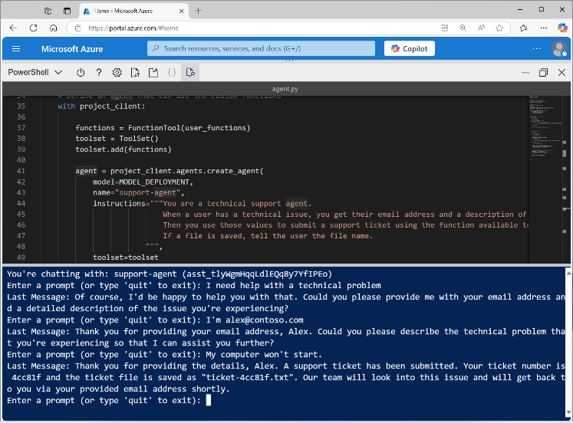
Exercise
Use a custom function in an AI agent
In this exercise, you’ll use the Foundry Agent SDK to:
Create a custom function for an agent to use
Create an agent that uses the custom function
Invoke a chat session with the agent
Trainers:
Customize this slide to include the link to the hosted lab environment and any custom instructions.
(then remove this arrow)
Start the exercise at:
https://go.microsoft.com/fwlink/?linkid=2309805
Notes:
Each exercise begins with the same procedure to create an Azure AI Foundry project – students will become quite adept at this by the end of the day!
The repetition of this procedure can be onerous, but its necessary to keep the exercises modular and to avoid consuming Azure resources unnecessary (for both cost reasons and to free up data center capacity for other Azure customers)

Slide 23
Knowledge check
1
What are custom tools, and how can they help you develop effective agents with Foundry Agent Service?
Callable functions that an agent can use to extend its capabilities
Extensions for Visual Studio Code that make it easier to create and deploy agents
Fine-tuned models that the agent can use to generate custom output
2
You need to integrate functionality from an OpenAPI 3.0-based web service into an agent solution. What should you do?
Add the JSON schema of the web service to the agent's instructions
Rewrite the web service as a Python function and hard-code it in your agent app
Add the web service as an OpenAPI specification tool to the agent definition
3
Your agent application code includes a local function that you want the agent to call. What kind of tool should you add to the agent's definition?
Function calling
Code interpreter
Azure Functions
Notes:
Allow students a few minutes to think about the questions, then reveal the correct answers.

Slide 24
Develop an AI agent with the Semantic Kernel SDK
https://aka.ms/mslearn-ai-semantic-kernel-agent
Notes:
Use the link on the slide to see the Microsoft Learn module from which this lesson is derived.

Slide 25
What is Semantic Kernel?
A platform for generative AI development that includes:
AI service connectors - connect the code to AI services from different providers under a common interface. Supported services include Chat Completion, Text Generation, and more.
Memory connectors - expose vector stores from other providers under a common interface.
Prompt templates - combine instructions, user input, and function outputs into a reusable format. Prompt templates allow AI models to execute predefined steps dynamically.
Functions and plugins - containers for functions that are registered with the kernel. Once registered, functions can be invoked by the AI or through prompt templates.
Filters - allow custom actions to be performed before and after a function or prompt is invoked.
Semantic Kernel Agent Framework:
An extension to the core Semantic Kernel platform with support for multiple kinds of agent:
Chat Completion Agent
OpenAI Assistant Agent
Azure AI Foundry Agent
Our focus today
Notes:
We’re focusing specifically on integration between Semantic Kernel and Foundry Agent Service.
Semantic Kernel, and it’s Agent framework offers a lot of functionality for developers building generative AI apps and agents; much of it overlapping with functionality in Azure AI Agent Service.

Slide 26

Why use Semantic Kernel with Foundry Agent Service?
Azure AI Agent Service provides a comprehensive platform for agent development. So why use Semantic Kernel?
Extend existing investments in Semantic Kernel development to Azure AI agents
Build solutions that leverage strengths of different kinds of agent with a consistent code base
Integrate Azure AI agents into multi-agent solutions
+
Notes:
Ask students if they have any experience with Semantic Kernel, or if they know of its use in their organization.
The ability to integrate it with Azure AI Foundry Agent Service provides flexibility to AI solution developers.

Slide 27
Creating an Azure AI agent with Semantic Kernel
Azure AI Foundry project
Use AzureAIAgentSettings to connect to your Azure AI Foundry project and create a client
Use the client to create an Azure AI agent definition, specifying:
  Model
  Instructions
  Tools
Create a Semantic Kernel AzureAIAgent based on the agent definition
Invoke the agent on an AzureAIAgentThread
AzureAIAgentSettings
Azure AI Agent client
Azure AI agent definition
Semantic Kernel AzureAIAgent
AzureAIAgentThread
Notes:
Note that Semantic Kernel Agent framework includes a number of classes that are specifically designed to work with Azure AI Agent Service.

Slide 28
Using plugins
In Semantic Kernel, plugins are functions that play a similar role to custom tool functions in Azure AI Agent Service
Define a plugin class, containing method functions annotated using the kernel_function decorator
Add the plugin to the agent’s plugins property, so it can identify and call functions as needed
Notes:
Plugins are the Semantic Kernel equivalent of Function calling in Azure AI Agent Service.
Note that you can use plugins as well as Azure AI Agent Service tools (like the code interpreter or Bing grounding) when working with Azure AI agents in Semantic Kernel SDK code.

Slide 29
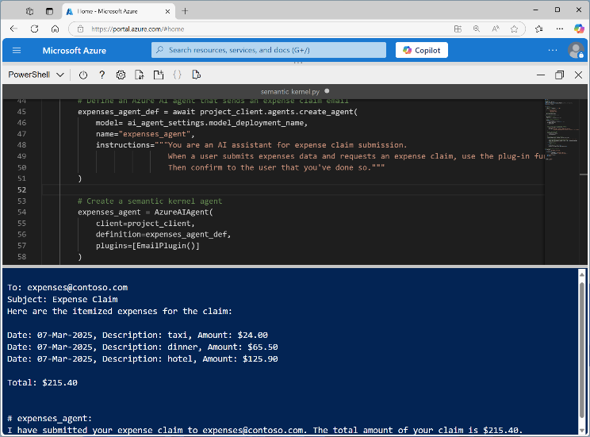
Exercise
Develop an Azure AI agent with the Semantic Kernel SDK
In this exercise, you’ll use the Semantic Kernel SDK to:
Create an Azure AI Agent
Use a plugin
Trainers:
Customize this slide to include the link to the hosted lab environment and any custom instructions.
(then remove this arrow)
Start the exercise at:
https://go.microsoft.com/fwlink/?linkid=2313222
Notes:
Each exercise begins with the same procedure to create an Azure AI Foundry project – students will become quite adept at this by the end of the day!
The repetition of this procedure can be onerous, but its necessary to keep the exercises modular and to avoid consuming Azure resources unnecessary (for both cost reasons and to free up data center capacity for other Azure customers)

Slide 30
Knowledge check
1
What is the main purpose of the AzureAIAgent class in Semantic Kernel?
To provide a low-level interface for directly managing AI models
To simplify the use of Azure AI Agent Service by abstracting complex operations
To replace the need for prompt templates in AI workflows
2
Which component in the Agent Framework manages conversation state and stores messages?
Agent threads
Agent chat
AI service connectors
3
Which step is necessary to enable an AzureAIAgent to use a plugin?
Modify the AI model's architecture to integrate the plugin
Configure the plugin in Azure portal before using it in Semantic Kernel
Define a class with methods annotated using the kernel_function decorator
Notes:
Allow students a few minutes to think about the questions, then reveal the correct answers.

Slide 31
Orchestrate a multi-agent solution using Semantic Kernel
https://aka.ms/mslearn-ai-multi-agent
Notes:
Use the link on the slide to see the Microsoft Learn module from which this lesson is derived.

Slide 32

What is a multi-agent solution?
A multi-agent solution allows agents to collaborate within the same conversation
For example, consider a DevOps monitoring and issue resolution solution
A monitoring agent continuously ingests logs and metrics, detects anomalies using natural language processing (NLP), and triggers alerts when issues arise.
A root cause analysis agent then correlates these anomalies with recent system changes, using machine learning models or predefined rules to pinpoint the root cause of the problem.
Once the root cause is identified, an automated deployment agent takes over to implement fixes or roll back problematic changes by interacting with CI/CD pipelines and executing deployment scripts.
Finally, a reporting agent generates detailed reports summarizing the anomalies, root causes, and resolutions, and notifies stakeholders via email or other communication channels.
Notes:
A key point to consider is that the agents in a multi-agent solution communicate with users and with one another using natural language prompts. There’s no API integration between the agents – messages are exchanged in the chat, and agents respond to them appropriately.

Slide 33
Agent selection strategy
In a multi-agent chat, how do we determine which agent should respond to a given message?
Sequential selection: Default strategy based on the order in which agents join the chat
Custom selection function: Derive a selection strategy class from a base class and implement your own logic
Kernel function from prompt: Create a dynamic function based on a prompt that describes agent selection criteria
Notes:
In simple multi-agent solutions, where there’s a single-turn conversation, the sequential selection strategy ensures that each agent takes their turn in the right order. In more complex, multi-turn conversations, you need to provide guidance for which agent should take the next turn. Usually this guidance is based on an examination of the message history and the next agent is determined based on the previous responder or on the contents of the message.

Slide 34
Termination strategy
In a multi-agent chat, how do we determine when the chat should be concluded?
Default termination: Default strategy that ends after a maximum number of iterations
Custom termination function: Derive a termination strategy class from a base class and implement your own logic
Kernel function from prompt: Create a dynamic function based on a prompt that describes termination criteria
Notes:
Like selection, termination criteria is usually based on the message history – often by looking for a keyword that an agent is instructed to respond with when the chat can be concluded.

Slide 35
Creating a group chat
Create the agents
Create a group chat, specifying:
  Agents who will participate
  Selection strategy to choose the next agent to respond
  Termination strategy to determine when to end the chat
Add a user message as an initial prompt
Invoke the chat and check the responses
Notes:
Students will implement this pattern in code during the exercise.

Slide 36
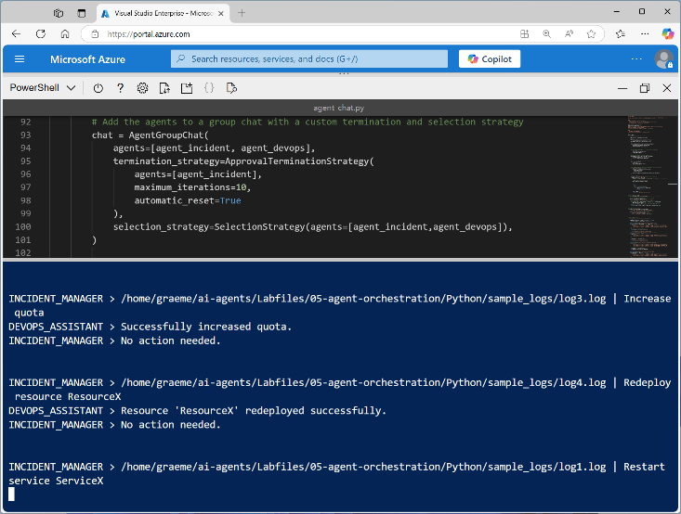
Exercise
Develop a multi-agent solution
In this exercise, you’ll use the Semantic Kernel SDK to:
Create multiple Azure AI Agents
Define selection and termination strategies
Implement a multi-agent group chat
Trainers:
Customize this slide to include the link to the hosted lab environment and any custom instructions.
(then remove this arrow)
Start the exercise at:
https://go.microsoft.com/fwlink/?linkid=2310729
Notes:
Each exercise begins with the same procedure to create an Azure AI Foundry project – students will become quite adept at this by the end of the day!
The repetition of this procedure can be onerous, but its necessary to keep the exercises modular and to avoid consuming Azure resources unnecessary (for both cost reasons and to free up data center capacity for other Azure customers)

Slide 37
Knowledge check
1
Which statement best describes AgentGroupChat in the Semantic Kernel AgentChat framework?
It only supports interactions between agents of the same type
It is an abstract class that must be subclassed to enable multi-agent interactions
It enables interaction between multiple agents and uses strategy-based approaches to manage conversation dynamics
2
In an agent group chat, how does the Semantic Kernel Agent Framework select the right agent for a task?
By random selection
Based on the user's intent and predefined rules
By the agent's physical location
3
What is the role of the Termination Strategy in the Semantic Kernel Agent Framework?
It determines when a conversation or task should end
It defines the flow of conversation
It decides which agent takes the next turn
Notes:
Allow students a few minutes to think about the questions, then reveal the correct answers.

