Slide 1
A taste of XS a Scala auto-GUI
Andrew Conway

Slide 2
Idea
Write some classes in Scala
Annotate, usually slightly
XS uses Scala 2.10 relflection API to provide
Hierarchical HTML5 editor
XML serialization/deserialization
This gives an idea of the data model
Read docs for more details.

Slide 3
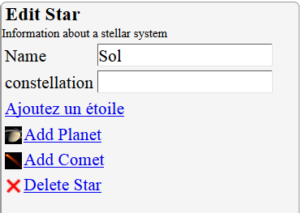
Very simple case
@XS
class Star(
@StringEditable val name:String,
@StringEditable @Multiline val constellation:Option[String],
@IndividuallyEditable val associated:List[HeavenlyBody]
) extends HeavenlyBody {
}
Star.properties
WholeForm=Edit Star
WholeForm.details=Information about a stellar system
Add=Add Star
Delete=Delete Star
name=Name
Star_fr.properties
Add=Ajoutez un étoile

Slide 4
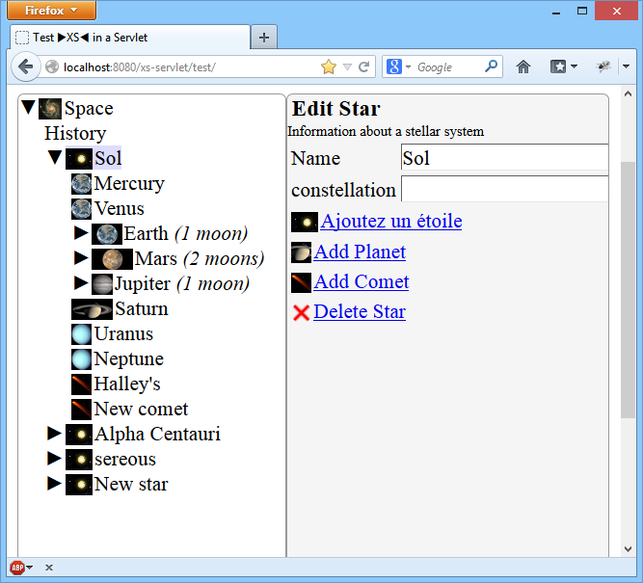
In context
@XS
@XSIcon("Star")
class Star(
@StringEditable @DefaultValue("New star") val name:String,
@StringEditable @Multiline val constellation:Option[String],
@IndividuallyEditable val associated:List[HeavenlyBody]
) extends HeavenlyBody {
override def toString = name
}
xsicons.manifest
[Star]
Copyright=NASA
Star.jpg

Slide 5
Polymorphism
How did it know there were three possibilities for field
val associated:List[HeavenlyBody]
@XS
@XSSubclasses(Array(classOf[Star],classOf[Planet],classOf[Comet]))
abstract class HeavenlyBody {
def name:String
}

Slide 6
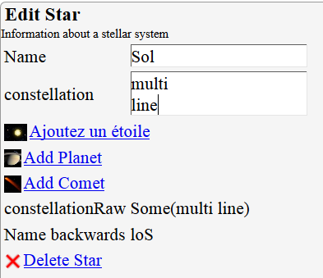
Computed display fields
@XS @XSIcon("Star")
class Star(…) extends HeavenlyBody { …
@ExtraDisplayField def nameReversed =
if (name==null) null else name.reverse
@ExtraDisplayField def constellationRaw =
""+constellation
}
Star.properties
…
nameReversed=Name backwards

Slide 7
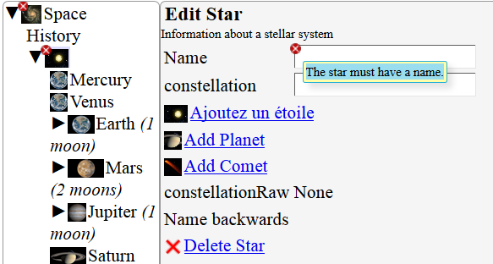
Simple errors
@XS @XSIcon("Star")
class Star(
@ErrorIfNotUniqueInParent @ErrorIfBlank
@StringEditable @DefaultValue("New star") val name:String,
…) extends HeavenlyBody { … }
Star.properties
…
name.ErrorIfBlank=The star must have a name.
Mouse hover tooltip

Slide 8

Explicit errors
@XS @XSIcon("Star")
class Star(…) extends HeavenlyBody { …
@ErrorCheck("name") private def checkName =
ErrorChecks.checkValidCharacters(name)
}
object ErrorChecks {
/** Do a check that every character in the string is a letter, a digit, or a space. */
def checkValidCharacters(s:String) : List[XSError] = {
val res = new ListBuffer[XSError]
for (i<-0 until s.length) {
val c=s(i)
if (!(c==' '||c.isLetterOrDigit))
res+=XSError.error("Illegal character "+c,i,i+1)
}
res.toList
}
}

Slide 9
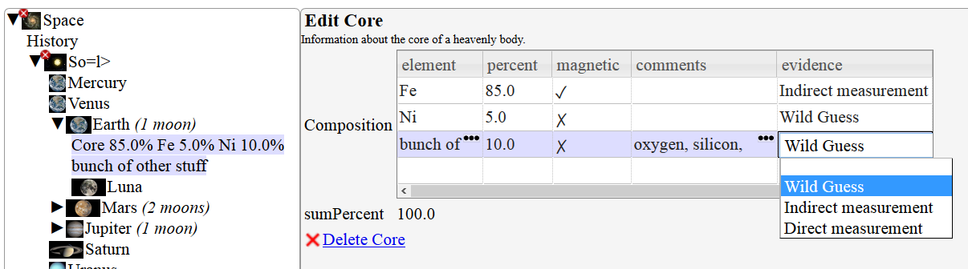
Tables
@XS class Core(@TableEditable val composition:List[CoreComposition]) {
override def toString = "Core "+composition.mkString(" ")
@ExtraDisplayField def sumPercent = composition.map{_.percent}.sum.toString
}
@XS class CoreComposition(
@StringEditable val element:String,
@StringEditable val percent:Double,
@BooleanEditable val magnetic:Boolean,
@StringEditable @Multiline val comments:String,
@StringEditable val evidence:Evidence) { ... }
}
Each instance becomes one row in table

Slide 10
Summary
This covers a small portion of features
Other big features
Dependency injection including external dynamic resources
Rich text, programmatic icons, visibility
Images as fields.
Multiple people editing same structure at once.
For a more detailed description of the data model read Introduction.html or the Javadocs
For how to package it into your web app, read Deployment.html

