Slide 1
Air Quality and Water Quality
Data Analysis Capstone
Python | Pandas | Jupyter Notebook | Anaconda | Matplotlib

Slide 2
Air VS Water
Does the quality of air affect the quality of water?
To what degree do they interact?
Can we improve both by improving one?

Slide 3
Air Quality Concepts
PM 2.5
The amount of particulates in the air
Hazardous to health, environment, and climate
Caused by burning fuels, or things like forest fires
Major contributor to poor air quality

Slide 4
Water Quality Concepts
Dissolved Oxygen
pH Level
The amount of oxygen in water
Good for plants and animals
Fluctuates seasonally
Mainly comes from the atmosphere
Measures acidic/basicness of water
Changes can corrode and hurt wildlife
Sea water wants to be around 8.0
Fluctuation negatively affects quality

Slide 5
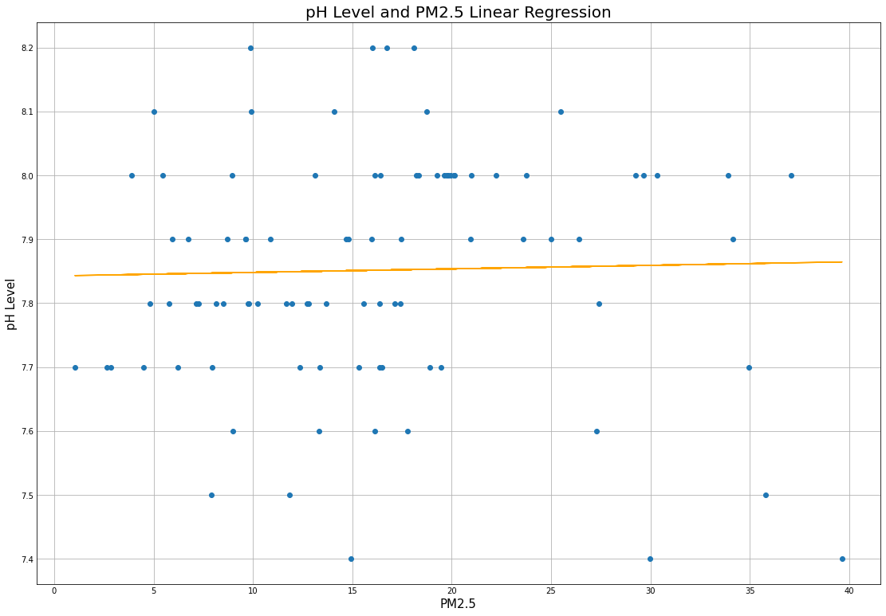
Fig 1. Data taken from the daily average of pH and PM2.5 in μm/m³ in the Lynchburg Canal water and surrounding air from the dates of 1/01/2022 to 4/01/2022

Slide 6
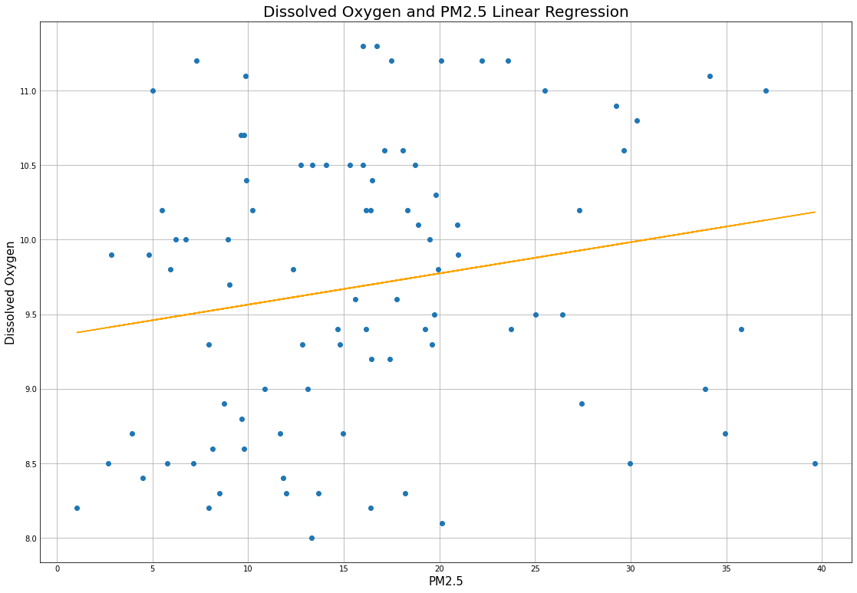
Fig 2. Data taken from the daily average of Dissolved Oxygen measured in and PM2.5 in μm/m3 in the Lynchburg Canal water and surrounding air from the dates of 1/01/2022 to 4/01/2022

Slide 7
Limits and Shortfalls
Environmental
Analytical
Air/Water constantly fluctuating
Only one location
No control
Low sample size (3 Months)
Daily averages
Lacking other key variables (ozone, salinity, etc)

Slide 8
Conclusions
Within the limited timeframe and limited area of our data
PM 2.5 might have no effect on the pH of surrounding water
PM 2.5 might have a beneficial effect on the dissolved oxygen of surrounding water

Slide 9
Further Study
Longer time frame
More Variables
More controlled environments

Slide 10
Sources
https://waterdata.usgs.gov/nwis
https://map.purpleair.com/
https://www.tceq.texas.gov/agency/data
https://github.com/AndrewCorry/Capstone_Specialization/blob/main/AirQualityAndWaterQuality.ipynb

