Slide 1

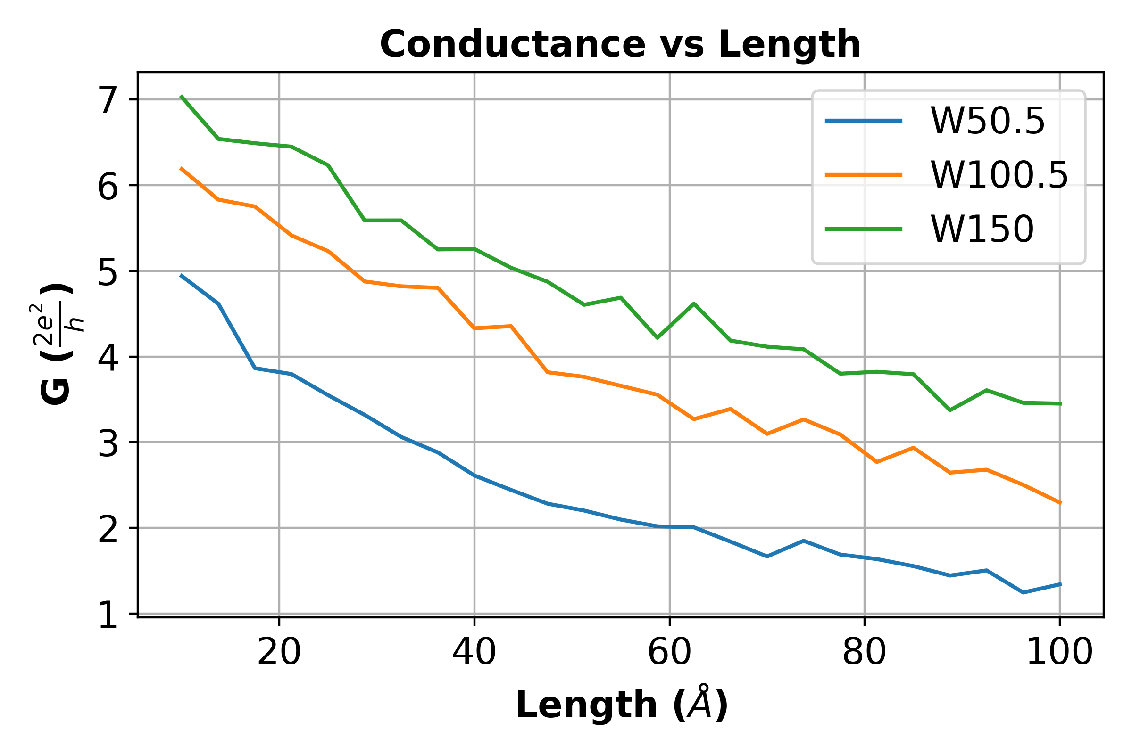
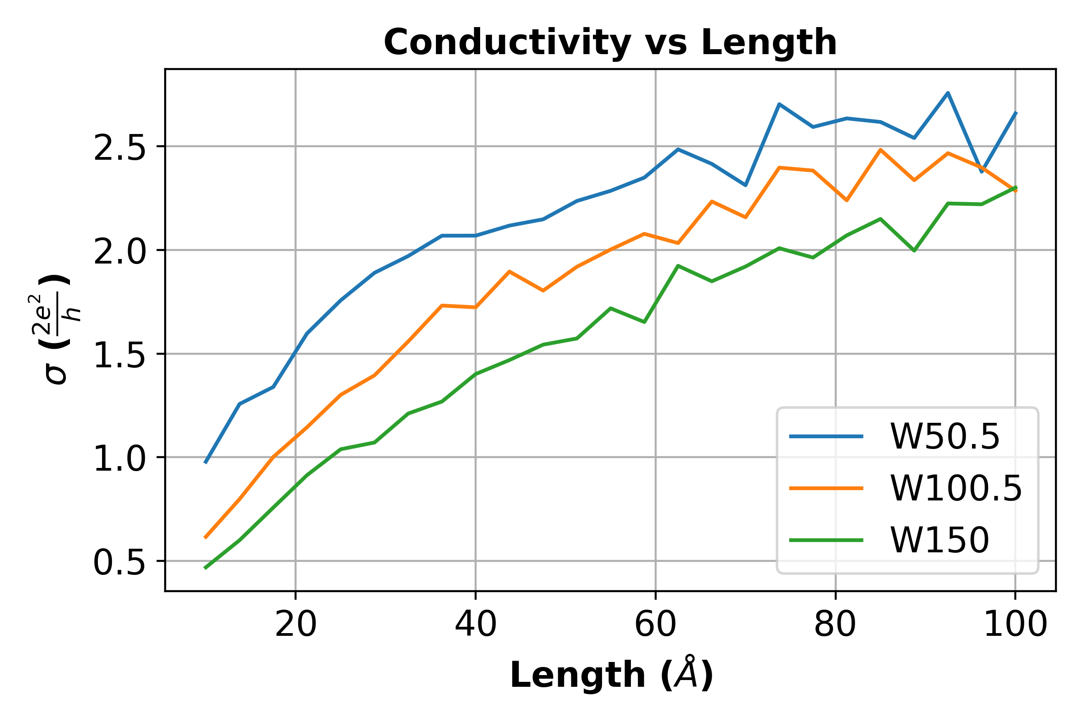
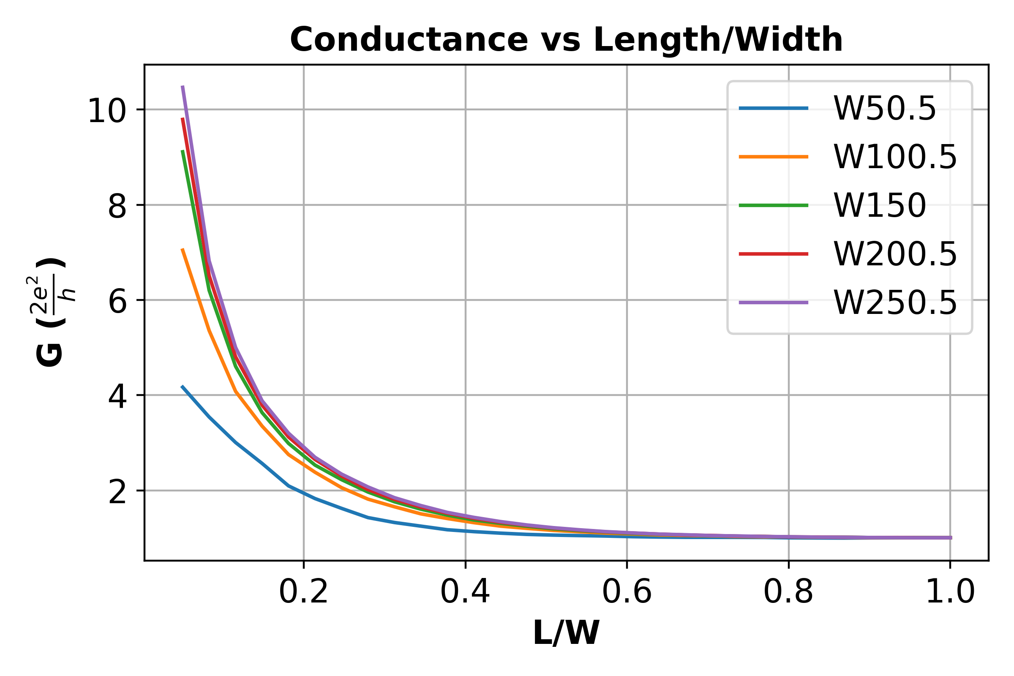
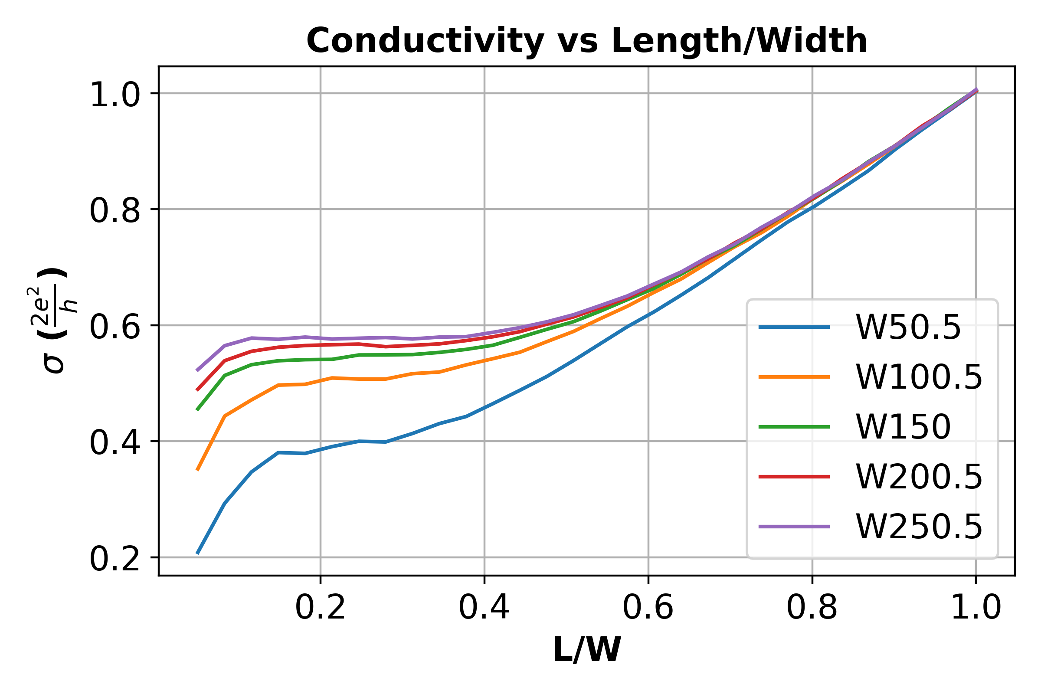
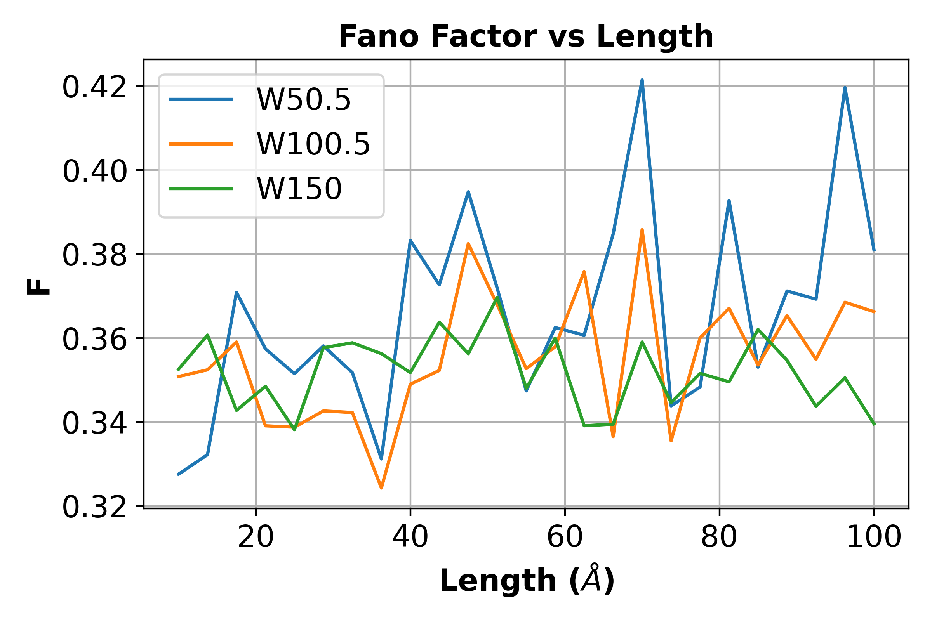
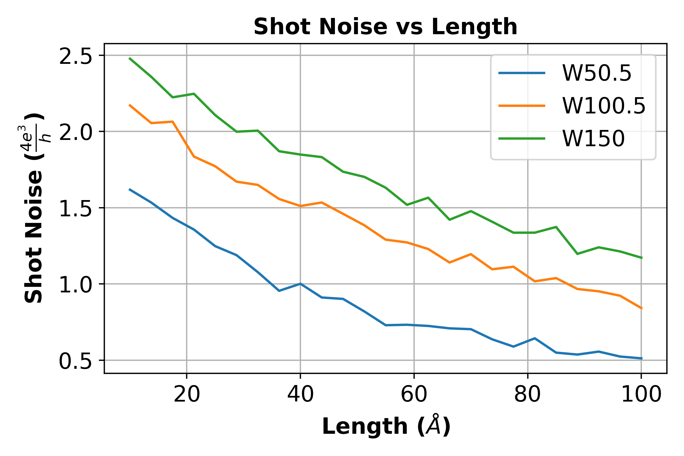
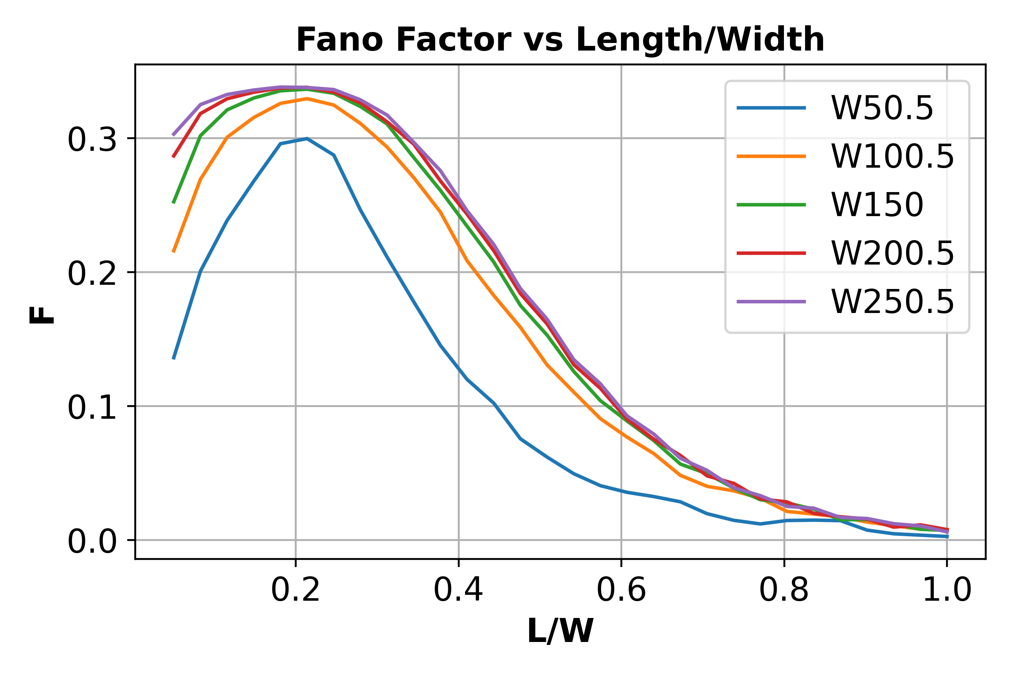
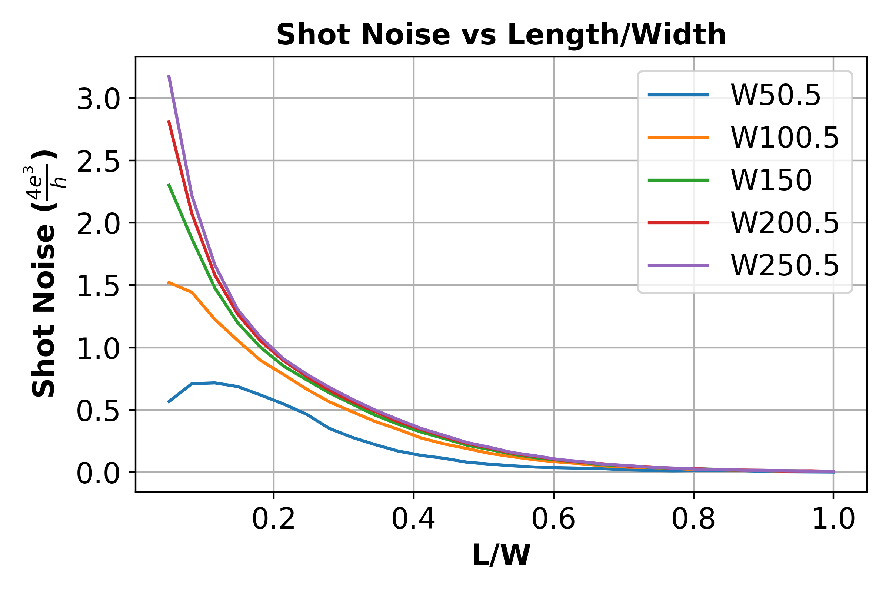
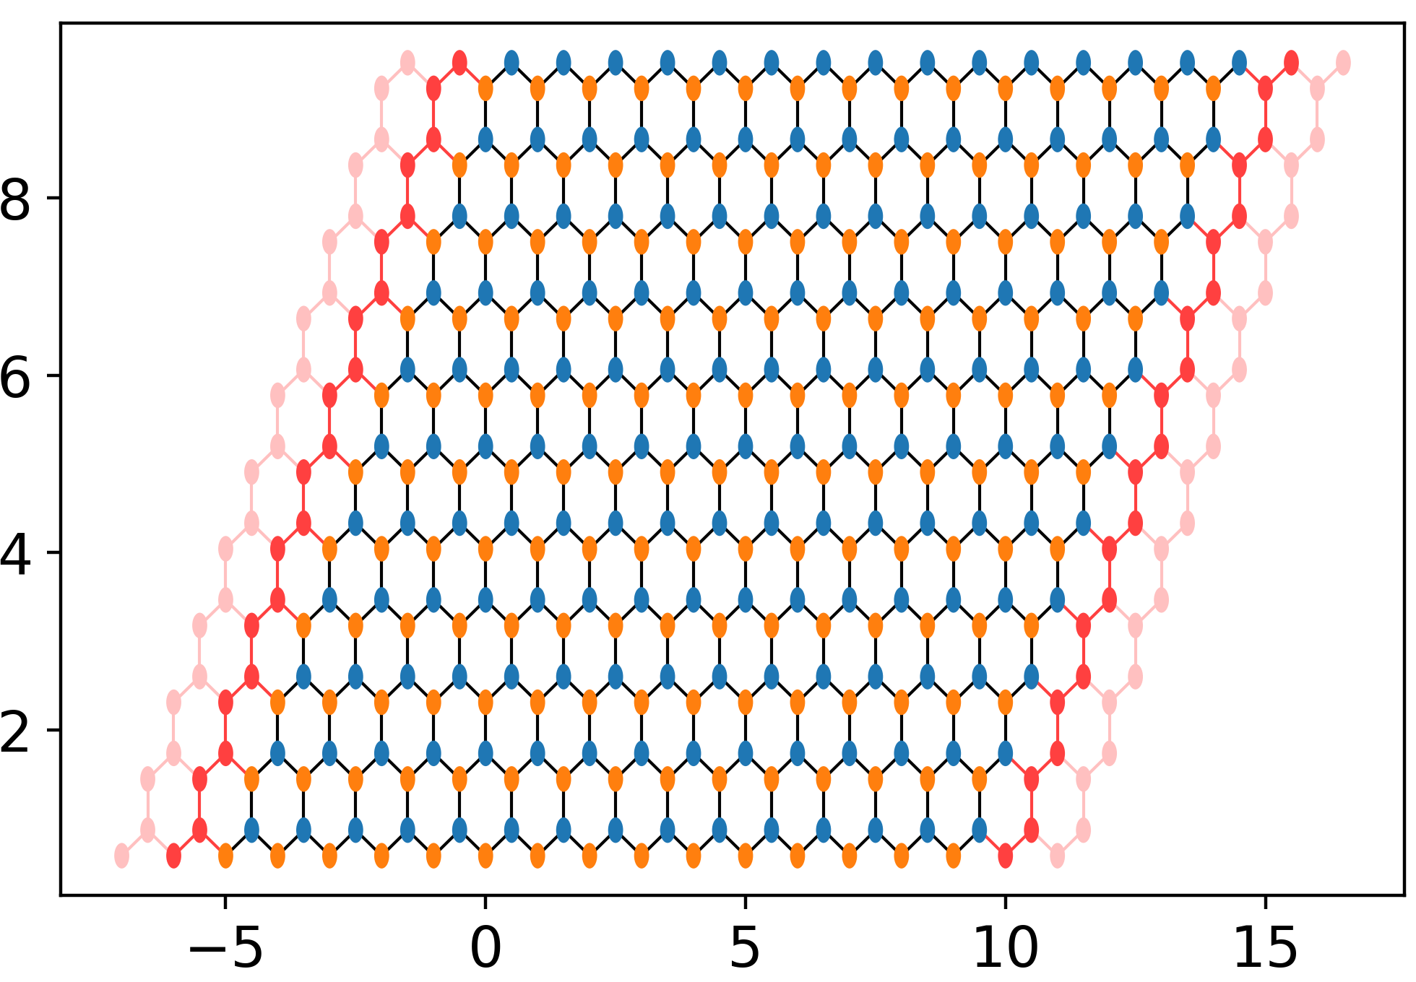
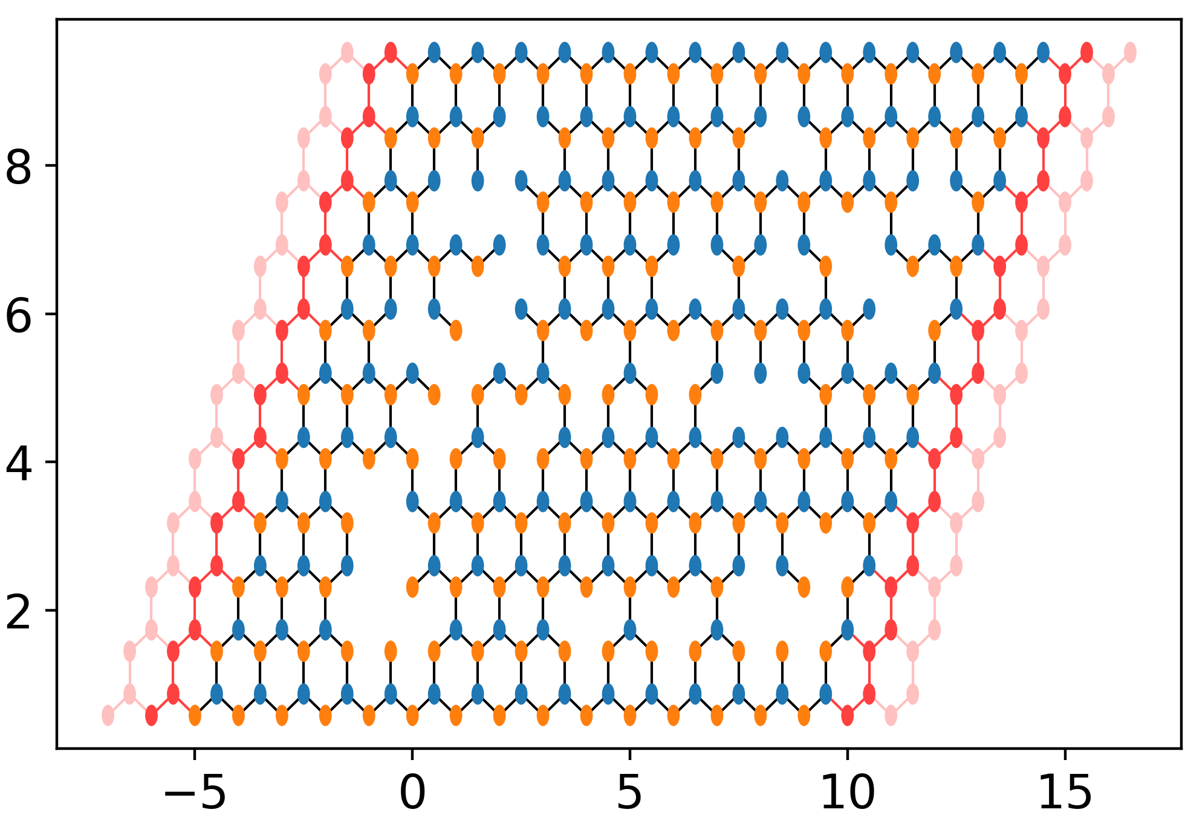
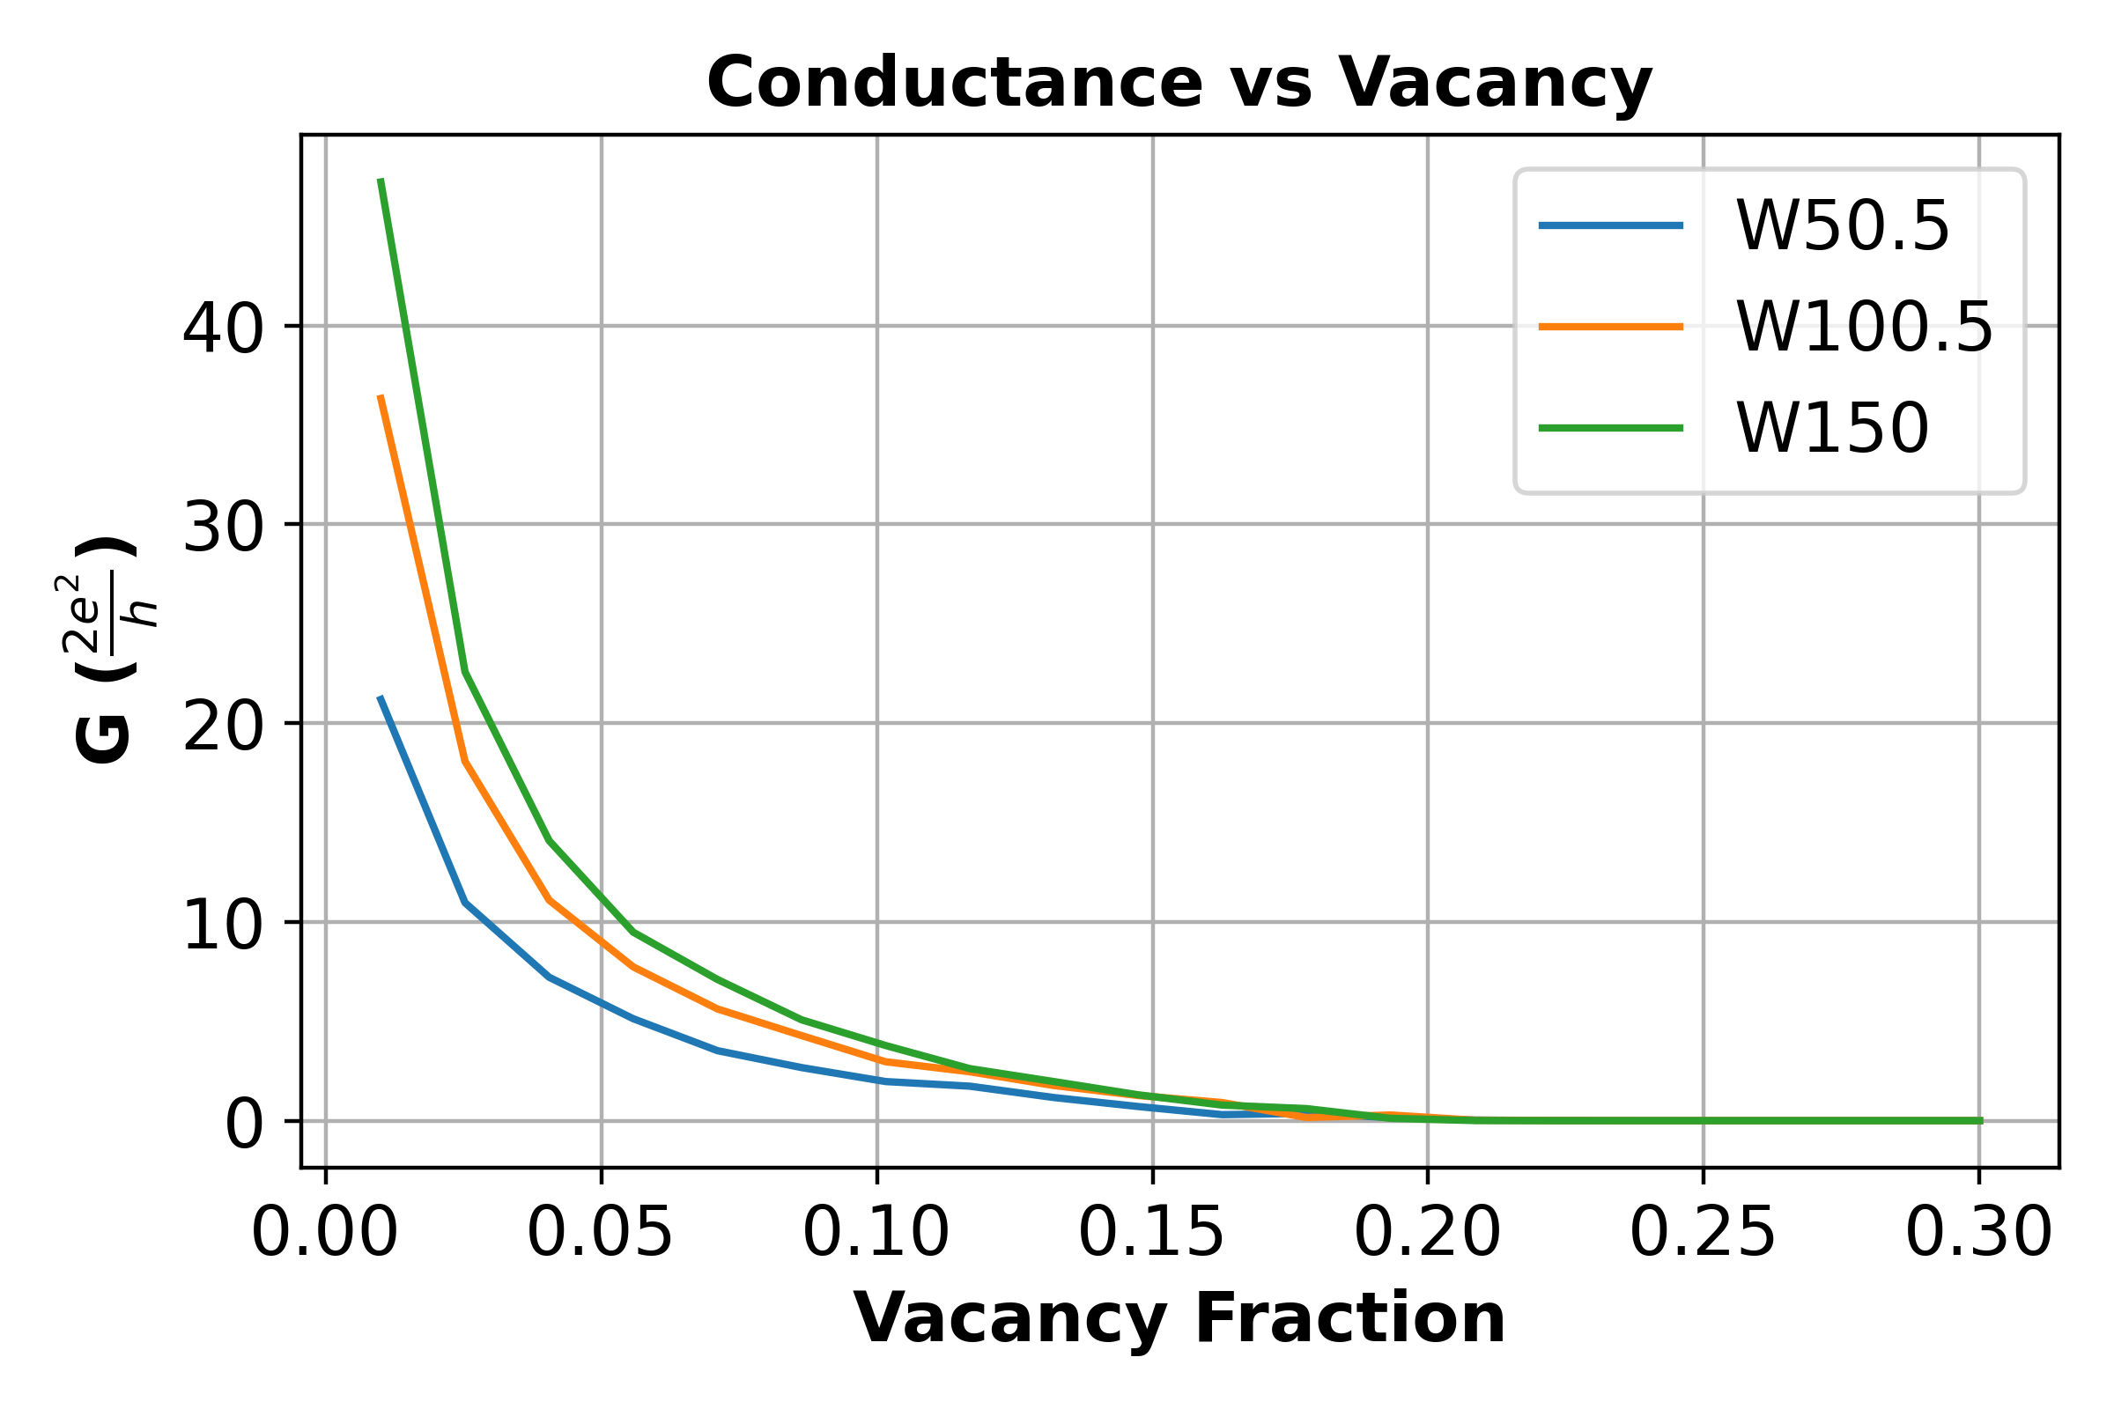
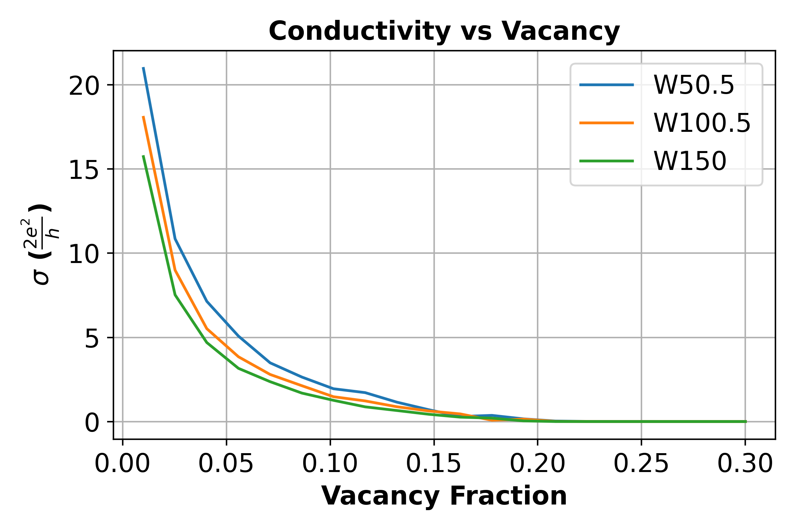
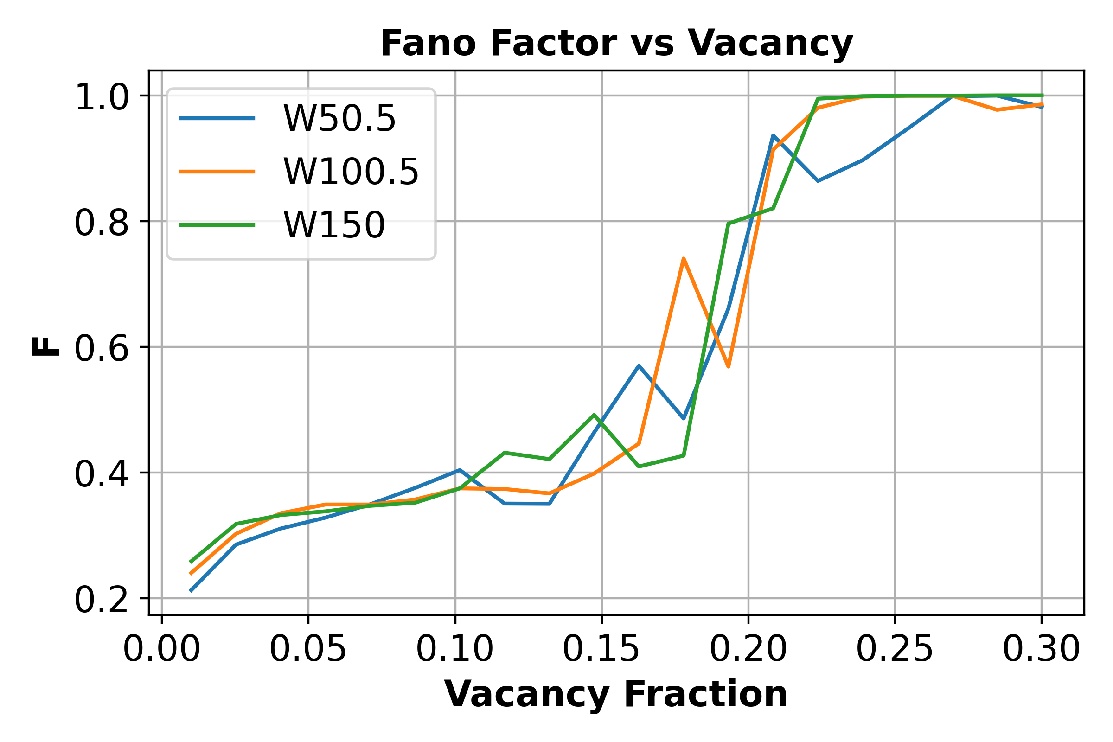
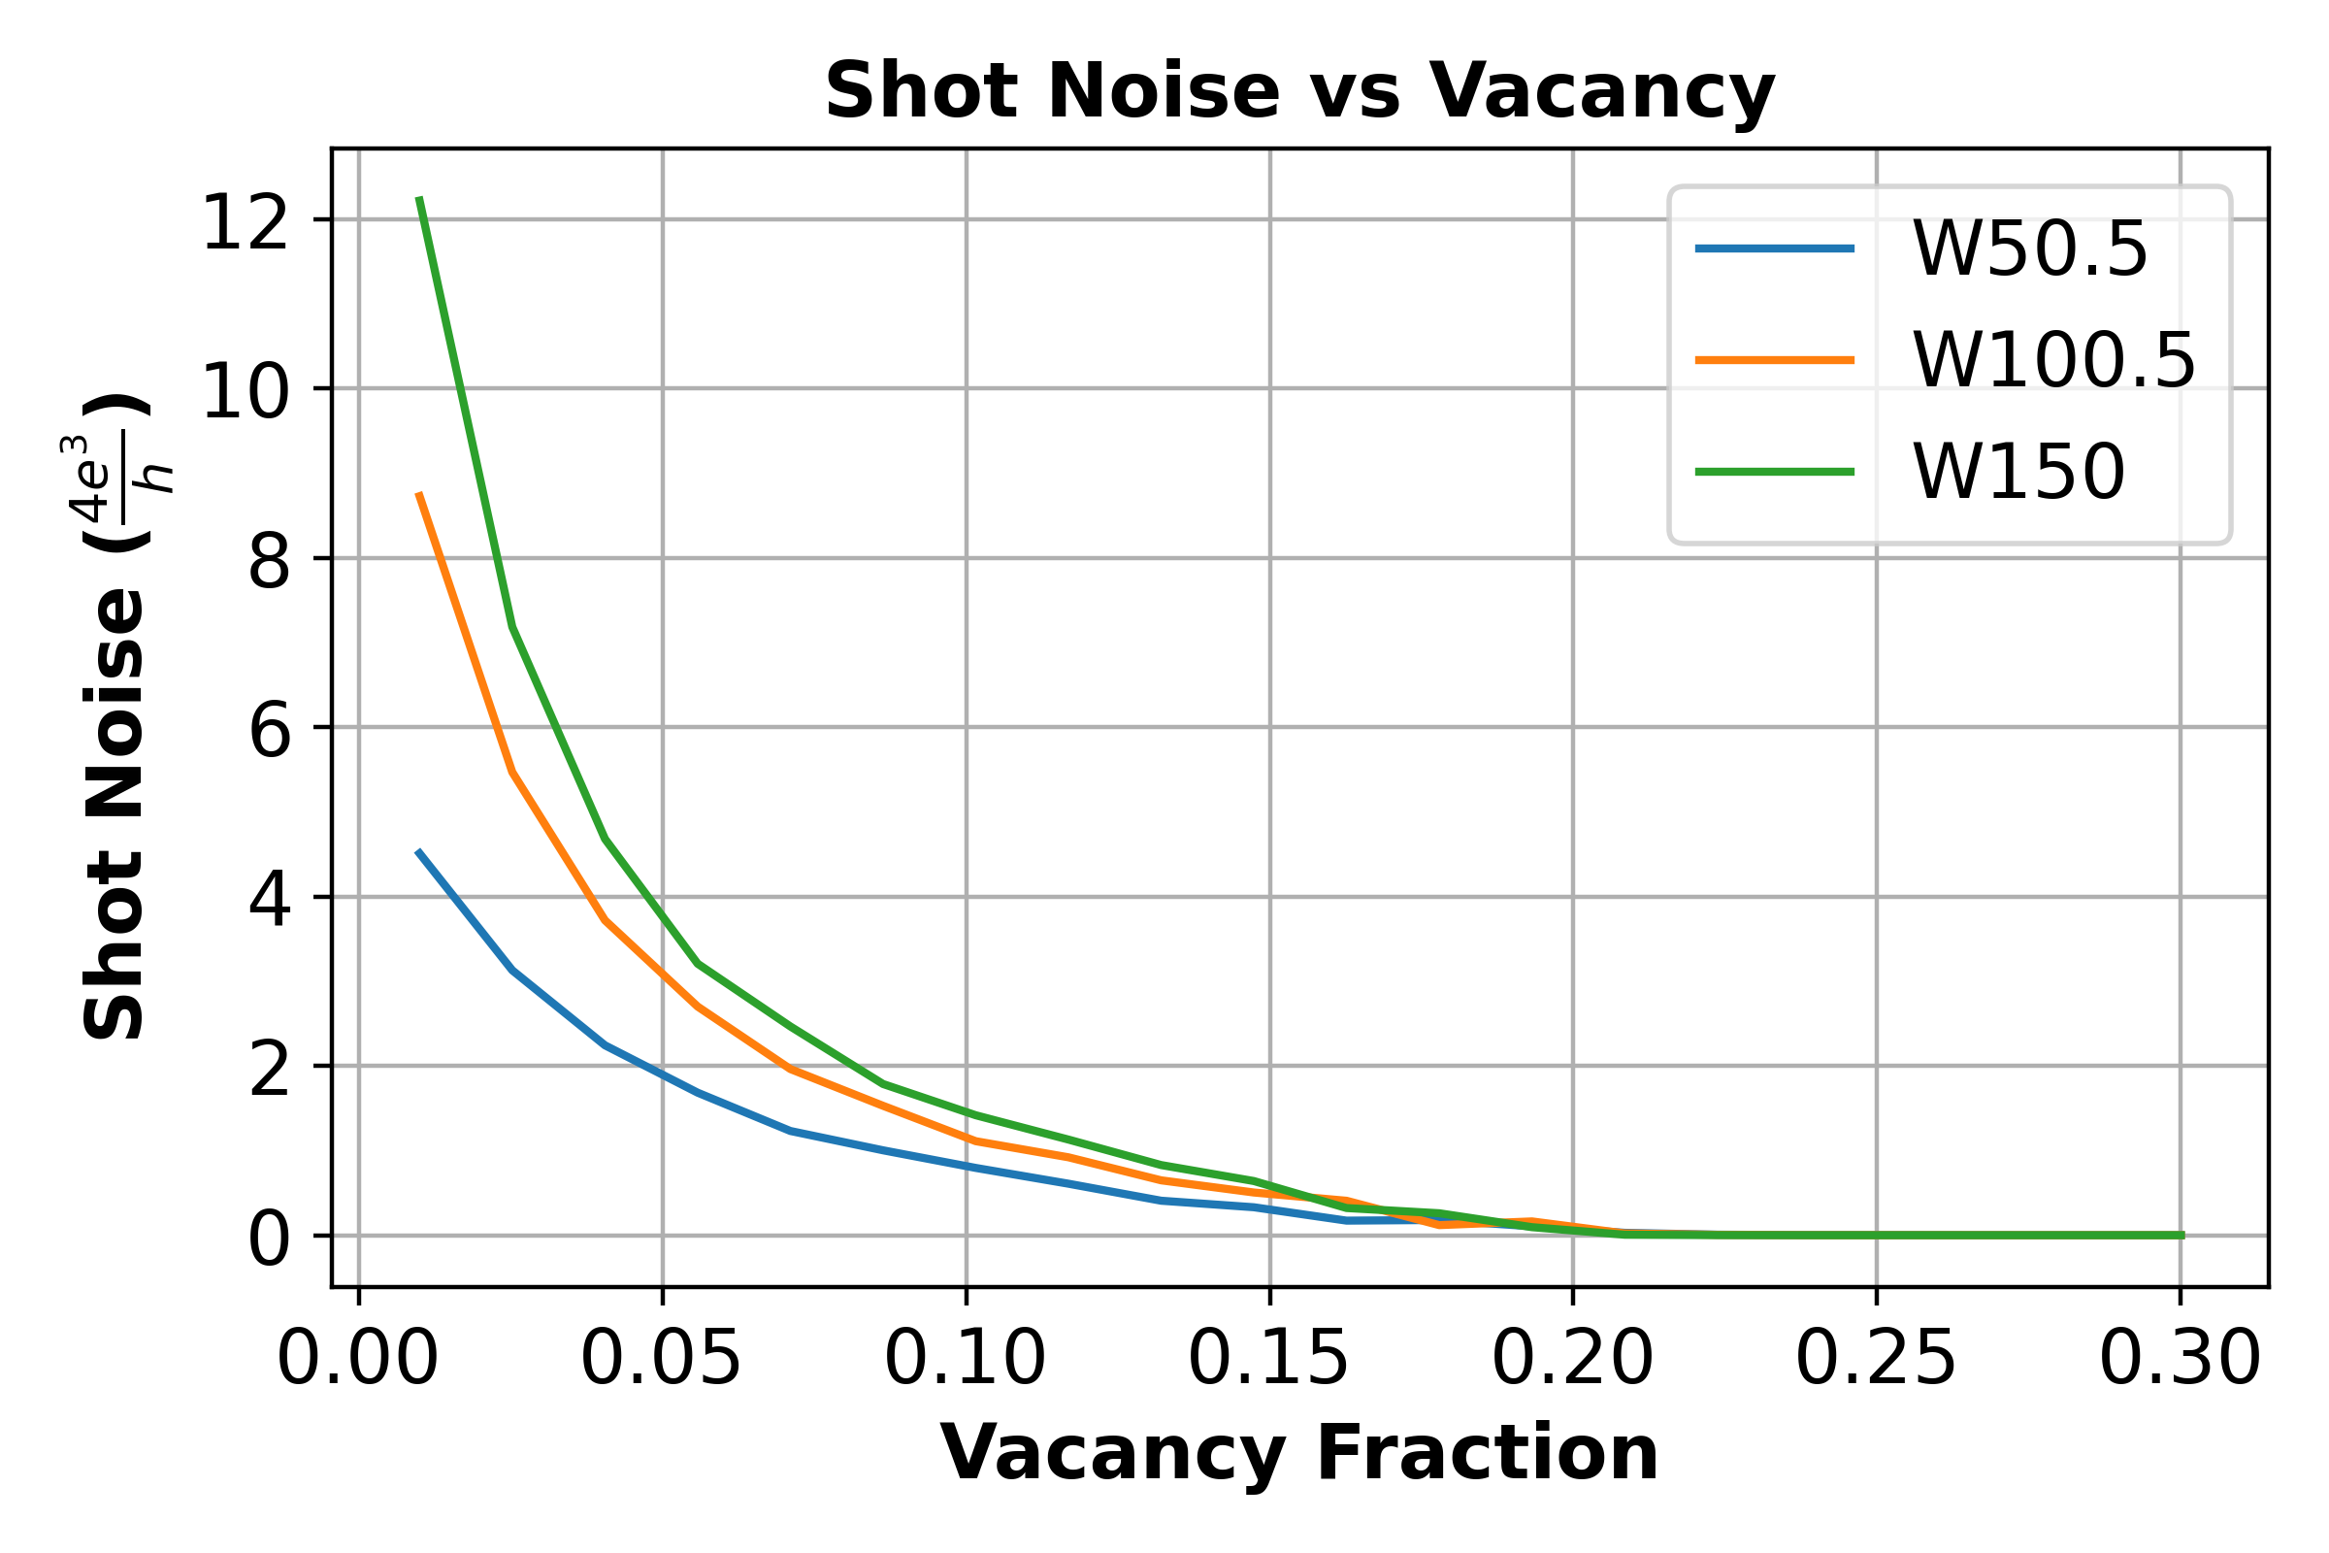
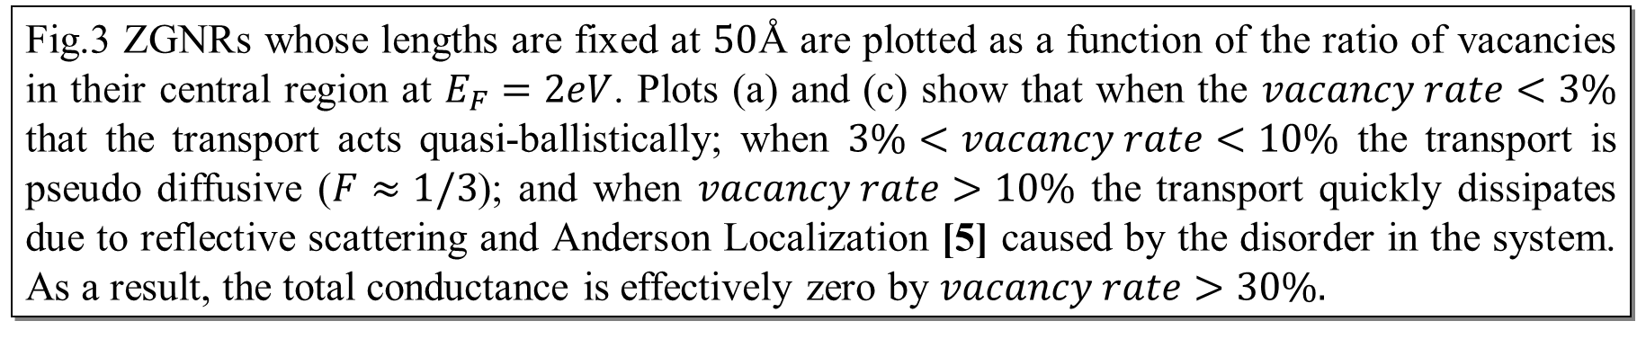
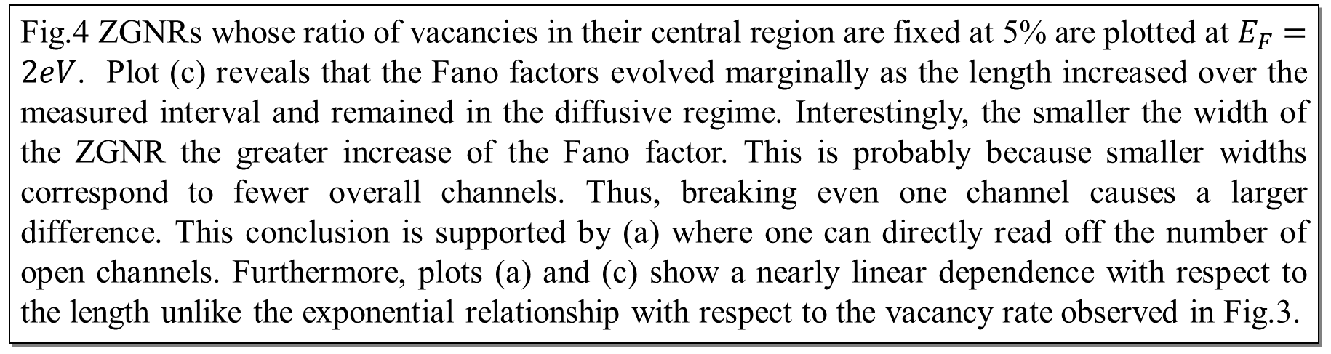
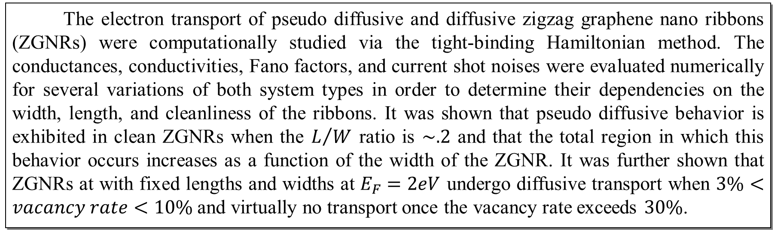
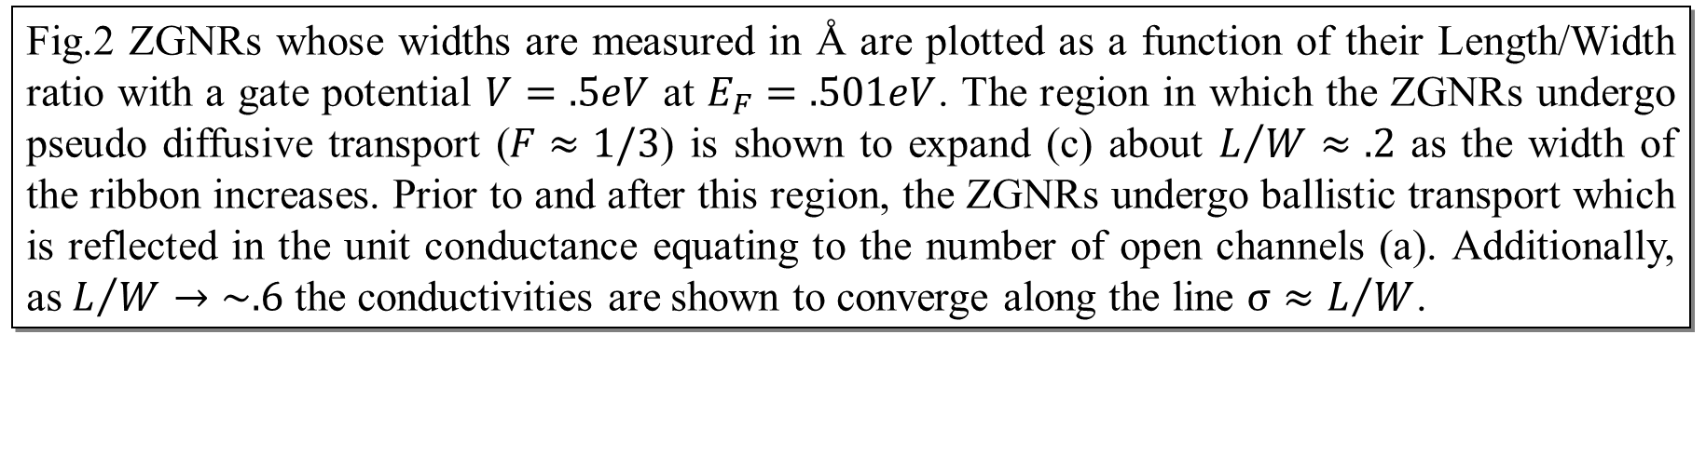
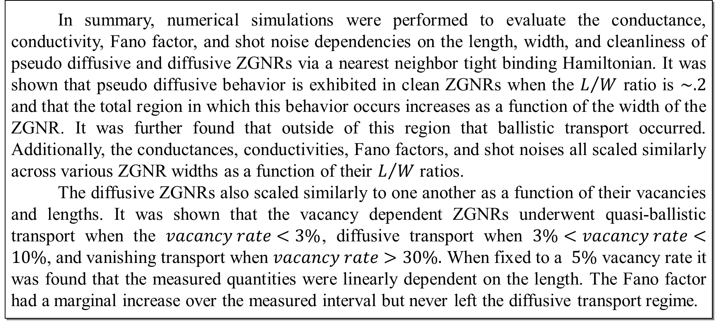
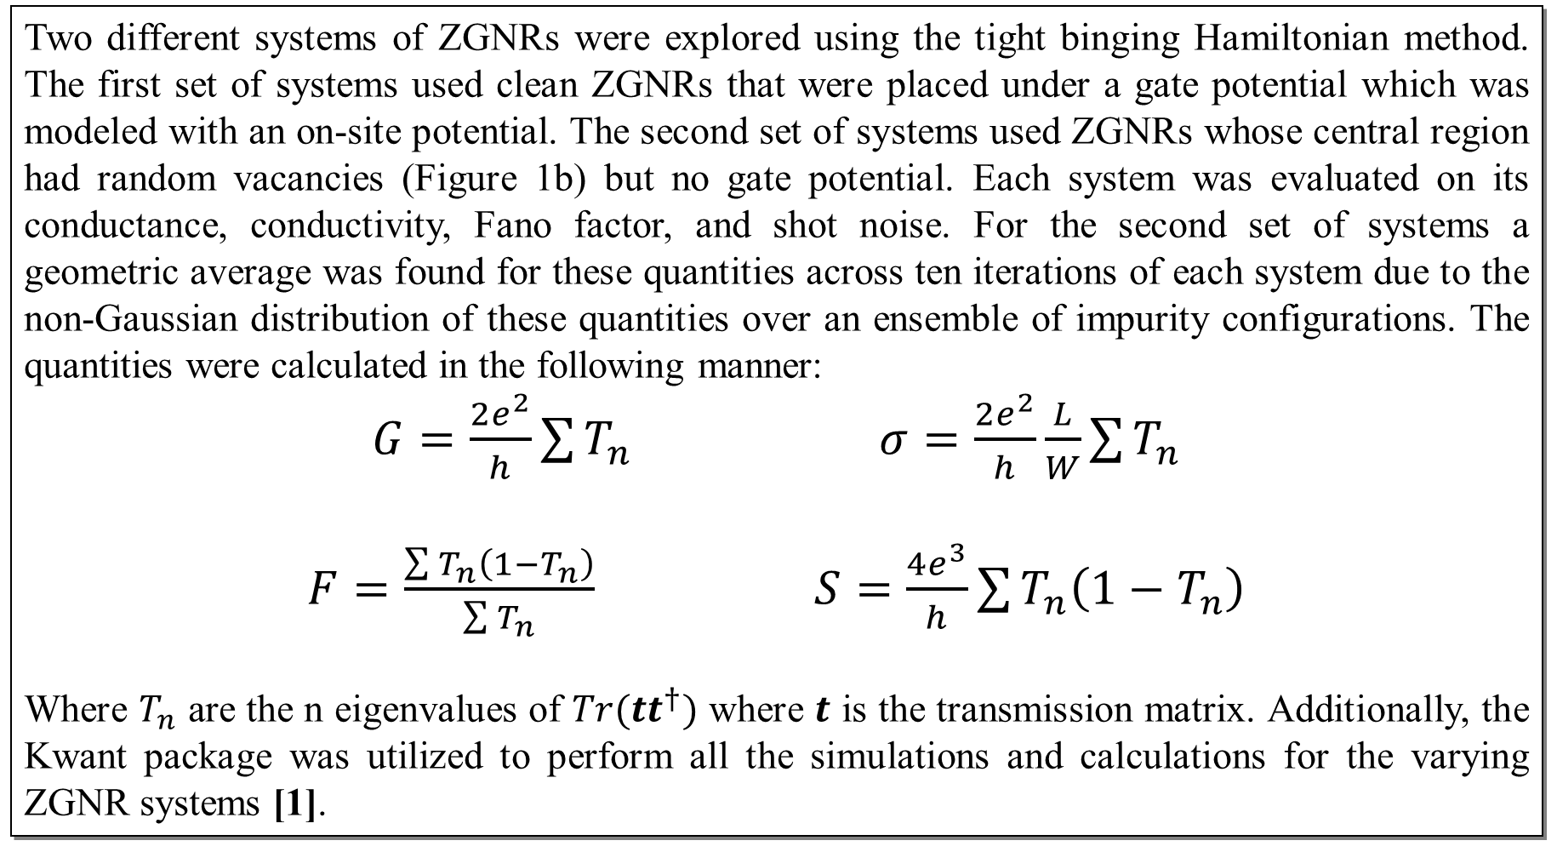
Pseudo Diffusive and Diffusive Electron Transport
through Zigzag Graphene Nanoribbons
Andrew Crossman
Department of Physics and Astronomy, University of Delaware, Newark, DE 19716
Abstract
Pseudo Diffusive Transport in Clean
ZGNRs
The electron transport of pseudo diffusive and diffusive zigzag graphene nano ribbons (ZGNRs) were computationally studied via the tight-binding Hamiltonian method. The conductances, conductivities, Fano factors, and current shot noises were evaluated numerically for several variations of both system types in order to determine their dependencies on the width, length, and cleanliness of the ribbons. It was shown that pseudo diffusive behavior is exhibited in clean ZGNRs when the $L/W$ ratio is $\sim .2$ and that the total region in which this behavior occurs increases as a function of the width of the ZGNR. It was further shown that ZGNRs at with fixed lengths and widths at $E_{F}=2eV$ undergo diffusive transport when $3\%<vacancy rate<10\%$and virtually no transport once the vacancy rate exceeds $30\%$.
Background and Motivation
A graphene ribbon (GNR) is a two-dimensional carbon material that is one atom thick and arranged in a honeycomb lattice. GNRs posses many unique and desirable electrical, optical, and mechanical properties. For example, GNRs possess low noise, and high thermal and electrical conductivities which makes them a potential alternative to copper in circuits. Some of these properties, like the electronic band structure, depend on the edge structure of the GNR – armchair or zigzag. Armchair GNRs exhibit semi-conductor behavior whereas Zigzag GNRs exhibit metallic behavior. The bandgaps of both can be tuned topologically and in range.
A property of special interest is the electron transport of Zigzag GNRs (Figure 1). Studies have shown that the length, width, and cleanliness (how perfect the system is) of ZGNRs cause its electron transport to fluctuate between the ballistic and diffusive regimes [2], [4]. Herein, the aim is to validate these findings and identify any additional information that can be used to contextualize the circumstances in which the type of transport changes.
Fig.4 ZGNRs whose ratio of vacancies in their central region are fixed at 5% are plotted at $E_{F}=2eV$. Plot (c) reveals that the Fano factors evolved marginally as the length increased over the measured interval and remained in the diffusive regime. Interestingly, the smaller the width of the ZGNR the greater increase of the Fano factor. This is probably because smaller widths correspond to fewer overall channels. Thus, breaking even one channel causes a larger difference. This conclusion is supported by (a) where one can directly read off the number of open channels. Furthermore, plots (a) and (c) show a nearly linear dependence with respect to the length unlike the exponential relationship with respect to the vacancy rate observed in Fig.3.
Fig.2 ZGNRs whose widths are measured in Å are plotted as a function of their Length/Width ratio with a gate potential $V=.5eV$ at $E_{F}=.501eV$. The region in which the ZGNRs undergo pseudo diffusive transport ($F≈1/3$) is shown to expand (c) about $L/W≈.2$ as the width of the ribbon increases. Prior to and after this region, the ZGNRs undergo ballistic transport which is reflected in the unit conductance equating to the number of open channels (a). Additionally, as $L/W→\sim .6$ the conductivities are shown to converge along the line $σ≈L/W$.
Conclusions
Diffusive Transport and Localization in ZGNRs with Vacancies
In summary, numerical simulations were performed to evaluate the conductance, conductivity, Fano factor, and shot noise dependencies on the length, width, and cleanliness of pseudo diffusive and diffusive ZGNRs via a nearest neighbor tight binding Hamiltonian. It was shown that pseudo diffusive behavior is exhibited in clean ZGNRs when the $L/W$ ratio is $\sim .2$ and that the total region in which this behavior occurs increases as a function of the width of the ZGNR. It was further found that outside of this region that ballistic transport occurred. Additionally, the conductances, conductivities, Fano factors, and shot noises all scaled similarly across various ZGNR widths as a function of their $L/W$ ratios.
The diffusive ZGNRs also scaled similarly to one another as a function of their vacancies and lengths. It was shown that the vacancy dependent ZGNRs underwent quasi-ballistic transport when the $vacancy rate<3\%$, diffusive transport when $3\%<vacancy rate<10\%$, and vanishing transport when $vacancy rate>30\%.$ When fixed to a $5\%$ vacancy rate it was found that the measured quantities were linearly dependent on the length. The Fano factor had a marginal increase over the measured interval but never left the diffusive transport regime.
Fig1. The structure of clean ZGNR (a) and unclean ZGNR (b) through vacancies are shown.
Computational Procedure
Two different systems of ZGNRs were explored using the tight binging Hamiltonian method. The first set of systems used clean ZGNRs that were placed under a gate potential which was modeled with an on-site potential. The second set of systems used ZGNRs whose central region had random vacancies (Figure 1b) but no gate potential. Each system was evaluated on its conductance, conductivity, Fano factor, and shot noise. For the second set of systems a geometric average was found for these quantities across ten iterations of each system due to the non-Gaussian distribution of these quantities over an ensemble of impurity configurations. The quantities were calculated in the following manner:
$G=\frac{2e^{2}}{h}\sum{T_{n}}$ $σ=\frac{2e^{2}}{h}\frac{L}{W}\sum{T_{n}}$
$F=\frac{\sum{T_{n}\left(1−T_{n}\right)}}{\sum{T_{n}}}$ $S=\frac{4e^{3}}{h}\sum{T_{n}\left(1−T_{n}\right)}$
Where $T_{n}$ are the n eigenvalues of $Tr(tt^{†})$ where $t$ is the transmission matrix. Additionally, the Kwant package was utilized to perform all the simulations and calculations for the varying ZGNR systems [1].
References
[1] Groth, C. W., Wimmer, M., Akhmerov, A. R., & Waintal, X. (2014b). Kwant: a software package for quantum transport. New Journal of Physics, 16(6), 063065.
[2] Cresti, A., Grosso, G., & Parravicini, G. P. (2007). Numerical study of electronic transport in gated graphene ribbons. Physical Review B, 76(20).
[3] Ferreira, A. (2015, August 31). Critical Delocalization of Chiral Zero Energy Modes in Graphene. Physical Review Letters., 115(10).
[4] Lewenkopf, C. H., Mucciolo, E. R., & Castro Neto, A. H. (2008). Numerical studies of conductivity and Fano factor in disordered graphene. Physical Review B, 77(8).
[5] Lagendijk, A., Tiggelen, B. V., & Wiersma, D. S. (2009). Fifty years of Anderson localization. Physics Today, 62(8), 24–29.
Fig.3 ZGNRs whose lengths are fixed at $50$Å are plotted as a function of the ratio of vacancies in their central region at $E_{F}=2eV$. Plots (a) and (c) show that when the $vacancy rate<3\%$ that the transport acts quasi-ballistically; when $3\%<vacancy rate<10\%$ the transport is pseudo diffusive ($F≈1/3$); and when $vacancy rate>10\%$ the transport quickly dissipates due to reflective scattering and Anderson Localization [5] caused by the disorder in the system. As a result, the total conductance is effectively zero by $vacancy rate>30\%.$

