Slide 1
V/Q Matching and O2 transport
Drew Marquis

Slide 2
Objective
We want to understand how blood and air flow affect oxygen flux into the blood stream
Develop and analyze a suite of progressively more complex models representing pulmonary oxygen transport
Model A – simplest compartmental model
Model B – Extending Model A but accounting for hemoglobin and the non-linear relationship between O2 partial pressure and concentration in the blood
Model C – Extending Model A but accounting for spatial transport of O2 along the pulmonary capillary
Model D – a hybrid of Model B and C

Slide 3
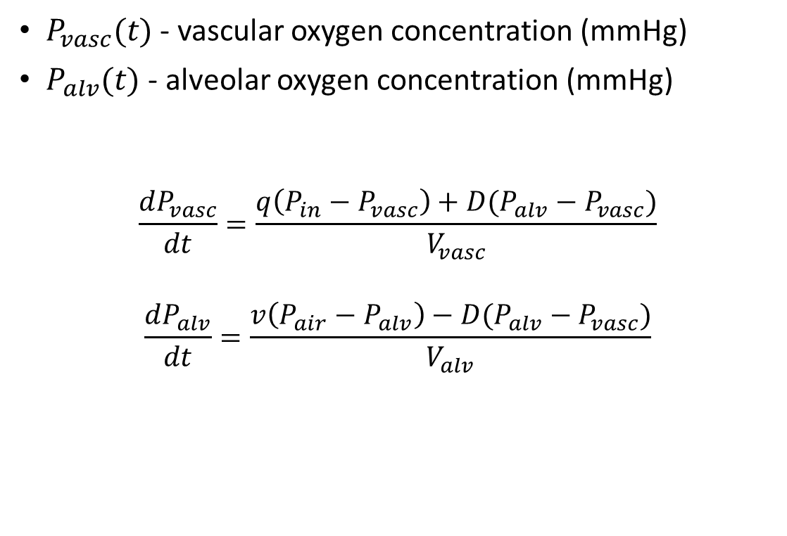
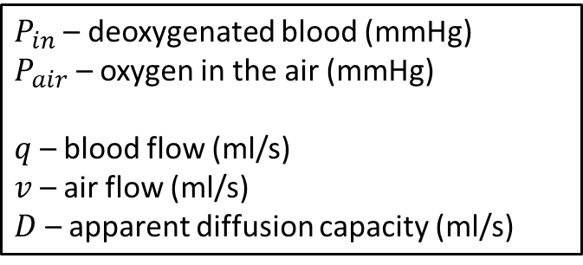
Model A
$P_{in}$ – deoxygenated blood (mmHg)
$P_{air}$ – oxygen in the air (mmHg)
$q$ – blood flow (ml/s)
$v$ – air flow (ml/s)
$D$ – apparent diffusion capacity (ml/s)
$P_{vasc}(t)$ - vascular oxygen concentration (mmHg)
$P_{alv}(t)$ - alveolar oxygen concentration (mmHg)
$$\frac{dP_{vasc}}{dt}=\frac{q\left(P_{in}−P_{vasc}\right)+D(P_{alv}−P_{vasc})}{V_{vasc}}$$
$$\frac{dP_{alv}}{dt}=\frac{v\left(P_{air}−P_{alv}\right)−D(P_{alv}−P_{vasc})}{V_{alv}}$$
Airway
⇋
Alveoli
Capillaries

Slide 4

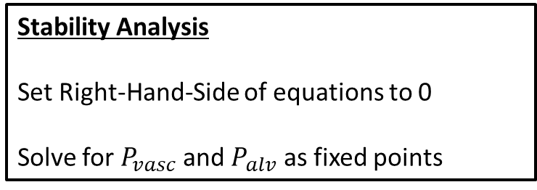
Fixed points of Model A
Oxygen transport equations
$\frac{dP_{vasc}}{dt}=\frac{q\left(P_{in}−P_{vasc}\right)+D(P_{alv}−P_{vasc})}{V_{vasc}}$
$\frac{dP_{alv}}{dt}=\frac{v\left(P_{air}−P_{alv}\right)−D(P_{alv}−P_{vasc})}{V_{alv}}$
Fixed points
$P_{vasc}^{∗}=\frac{P_{in}qv+P_{in}Dq+P_{air}Dv}{qv+Dq+Dv}$
$P_{alv}^{∗}=\frac{P_{air}Dv+P_{in}Dq+P_{air}qv}{qv+Dq+Dv}$
Stability Analysis
Set Right-Hand-Side of equations to 0
Solve for $P_{vasc}$ and $P_{alv}$ as fixed points
Plot $P_{vasc}^{∗}$ and $P_{alv}^{∗}$ as a function of $q$ and $v$

Slide 5
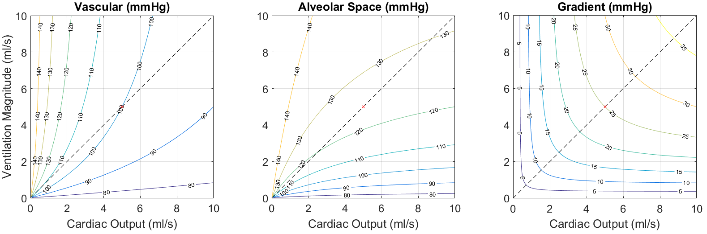
Fixed points of Model A
The magnitude of (air, blood) flow affect pulmonary oxygen uptake

Slide 6
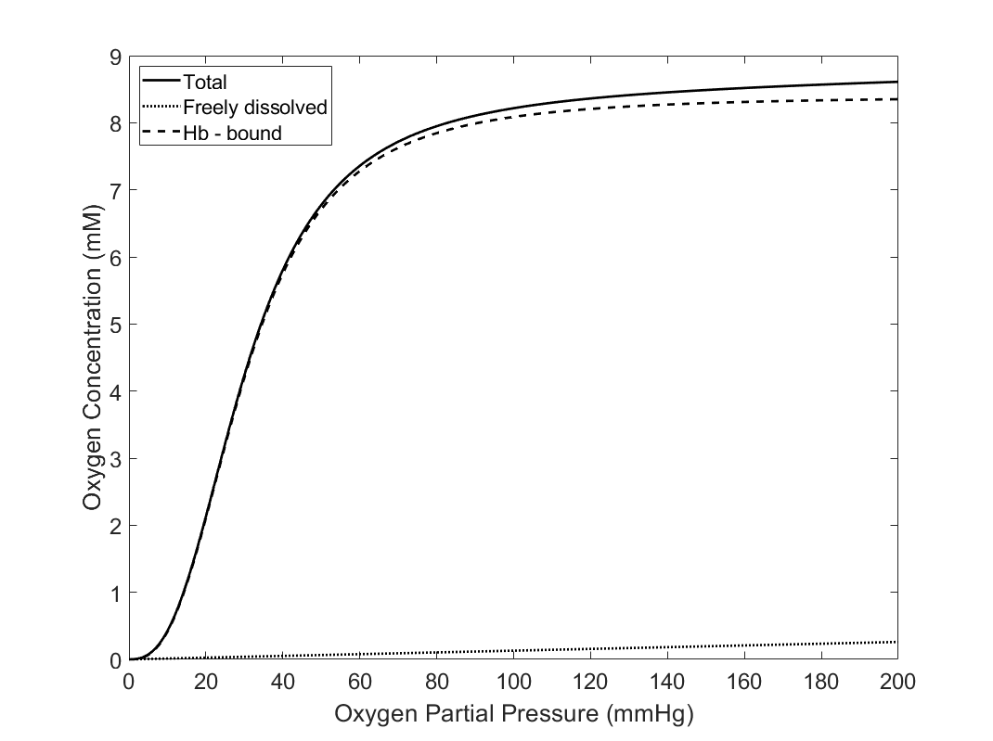

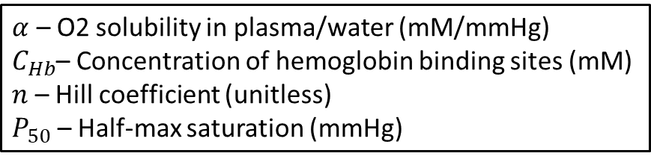
Model B
$C_{O2}=αP_{O2}+C_{Hb}\frac{P_{O2}^{n}}{P_{O2}^{n}+P_{50}^{n}}$
$α$ – O2 solubility in plasma/water (mM/mmHg)
$C_{Hb}$– Concentration of hemoglobin binding sites (mM)
$n$ – Hill coefficient (unitless)
$P_{50}$ – Half-max saturation (mmHg)

Slide 7
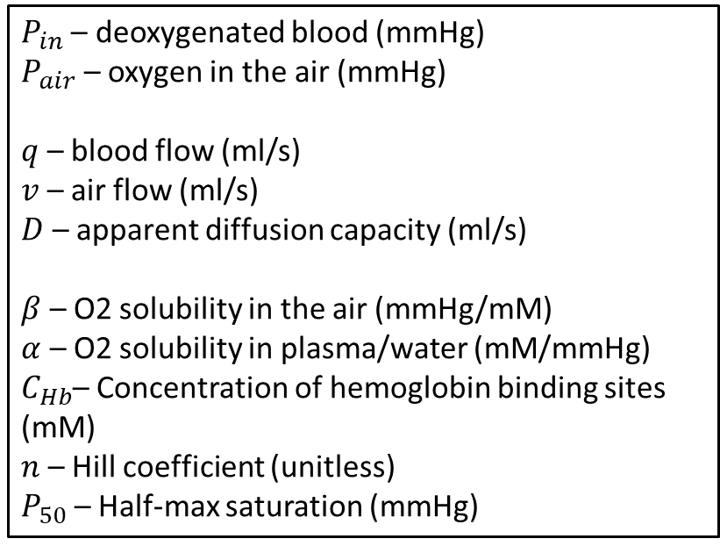
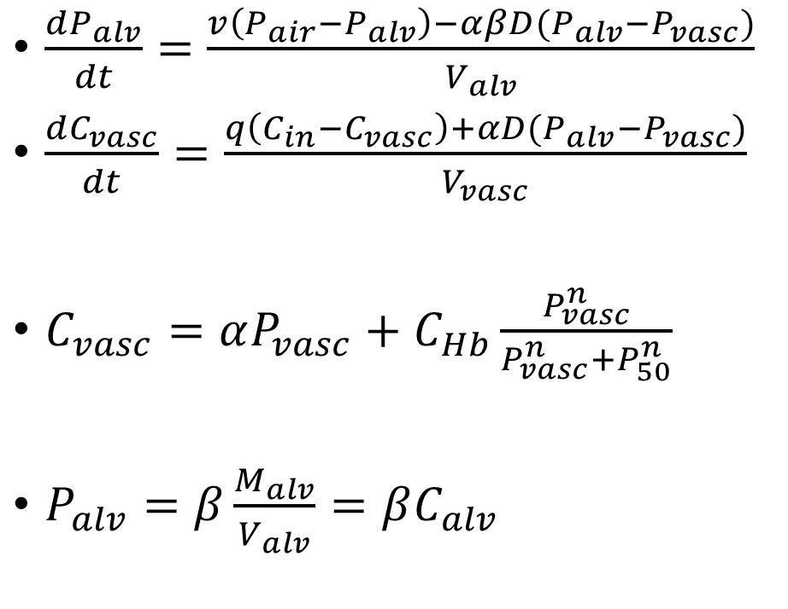
Model B
Airway
⇋
Alveoli
$\frac{dP_{alv}}{dt}=\frac{v\left(P_{air}−P_{alv}\right)−αβD(P_{alv}−P_{vasc})}{V_{alv}}$
$\frac{dC_{vasc}}{dt}=\frac{q\left(C_{in}−C_{vasc}\right)+αD(P_{alv}−P_{vasc})}{V_{vasc}}$
$C_{vasc}=αP_{vasc}+C_{Hb}\frac{P_{vasc}^{n}}{P_{vasc}^{n}+P_{50}^{n}}$
$P_{alv}=β\frac{M_{alv}}{V_{alv}}=βC_{alv}$
Capillaries
$P_{in}$ – deoxygenated blood (mmHg)
$P_{air}$ – oxygen in the air (mmHg)
$q$ – blood flow (ml/s)
$v$ – air flow (ml/s)
$D$ – apparent diffusion capacity (ml/s)
$β$ – O2 solubility in the air (mmHg/mM)
$α$ – O2 solubility in plasma/water (mM/mmHg)
$C_{Hb}$– Concentration of hemoglobin binding sites (mM)
$n$ – Hill coefficient (unitless)
$P_{50}$ – Half-max saturation (mmHg)

Slide 8
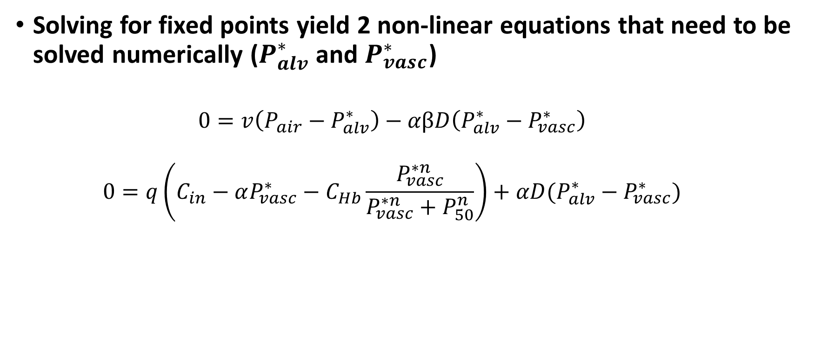
Fixed Points of Model B
Solving for fixed points yield 2 non-linear equations that need to be solved numerically ($P_{alv}^{∗}$ and $P_{vasc}^{∗}$)
$$0=v\left(P_{air}−P_{alv}^{∗}\right)−αβD\left(P_{alv}^{∗}−P_{vasc}^{∗}\right)$$
$$0=q\left(C_{in}−αP_{vasc}^{∗}−C_{Hb}\frac{P_{vasc}^{∗n}}{P_{vasc}^{∗n}+P_{50}^{n}}\right)+αD(P_{alv}^{∗}−P_{vasc}^{∗})$$

Slide 9
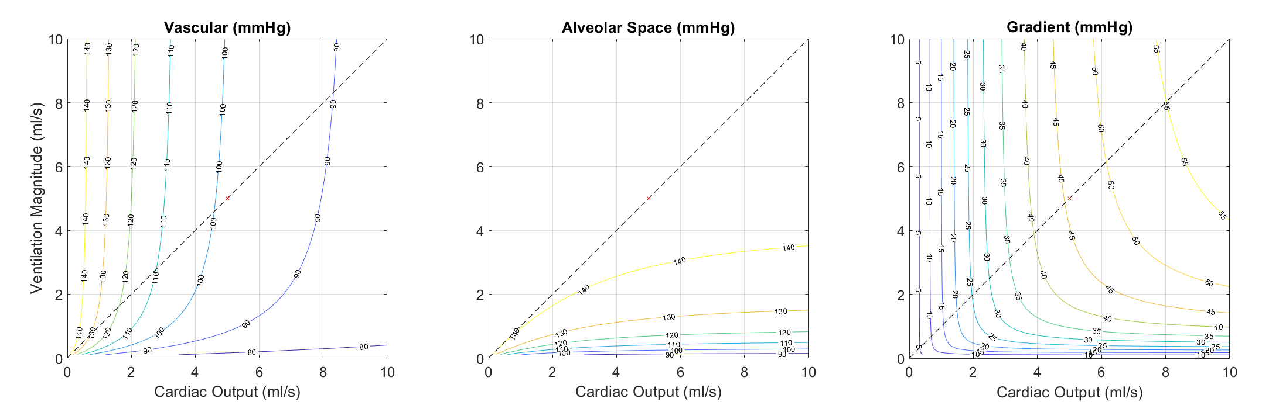
Fixed points of Model B
The magnitude of (air, blood) flow affect pulmonary oxygen uptake

Slide 10
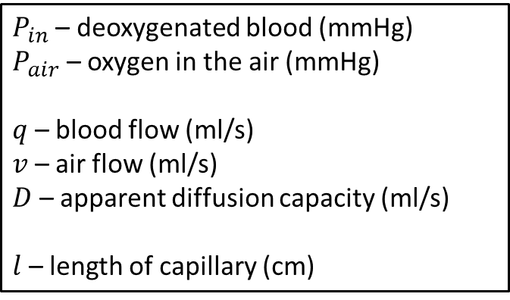

Model C
Airway
⇋
Alveoli
$\frac{dP_{alv}}{dt}=\frac{V\left(P_{air}−P_{alv}\right)−D(P_{alv}−〈P_{vasc}〉)}{V_{alv}}$
$\frac{∂P_{vasc}}{∂t}+\frac{ql}{V_{vasc}}\frac{∂P_{vasc}}{∂x}=\frac{D}{V_{vasc}}(P_{alv}−P_{vasc})$
$〈P_{vasc}〉(t)=\frac{1}{l}\int{P_{vasc}(t,x)dx}$
Capillaries
$P_{in}$ – deoxygenated blood (mmHg)
$P_{air}$ – oxygen in the air (mmHg)
$q$ – blood flow (ml/s)
$v$ – air flow (ml/s)
$D$ – apparent diffusion capacity (ml/s)
$l$ – length of capillary (cm)

Slide 11
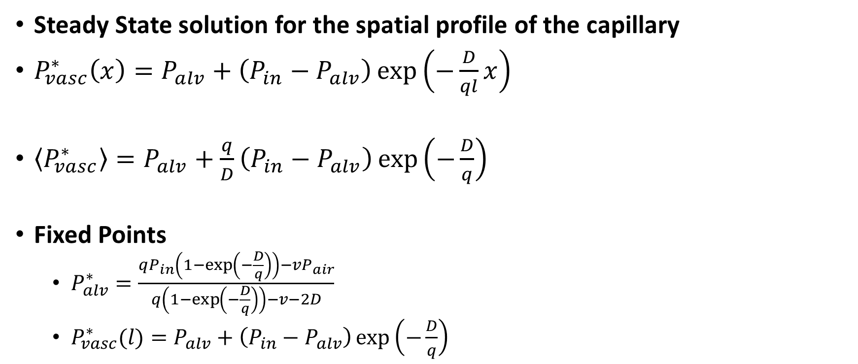
Fixed Points of Model C
Steady State solution for the spatial profile of the capillary
$P_{vasc}^{∗}\left(x\right)=P_{alv}+\left(P_{in}−P_{alv}\right)\exp\left(−\frac{D}{ql}x\right)$
$〈P_{vasc}^{∗}〉=P_{alv}+\frac{q}{D}\left(P_{in}−P_{alv}\right)\exp\left(−\frac{D}{q}\right)$
Fixed Points
$P_{alv}^{∗}=\frac{qP_{in}\left(1−\exp\left(−\frac{D}{q}\right)\right)−vP_{air}}{q\left(1−\exp\left(−\frac{D}{q}\right)\right)−v−2D}$
$P_{vasc}^{∗}(l)=P_{alv}+\left(P_{in}−P_{alv}\right)\exp\left(−\frac{D}{q}\right)$

