Slide 1
V/Q Matching and O2 transport
Drew Marquis

Slide 2
Objective
We want to understand how blood and air flow affect oxygen flux into the blood stream
Develop and analyze a suite of progressively more complex models representing pulmonary oxygen transport
Model A – simplest compartmental model
Model B – Extending Model A but accounting for hemoglobin and the non-linear relationship between O2 partial pressure and concentration in the blood
Model C – Extending Model A but accounting for spatial transport of O2 along the pulmonary capillary
Model D – a hybrid of Model B and C

Slide 3
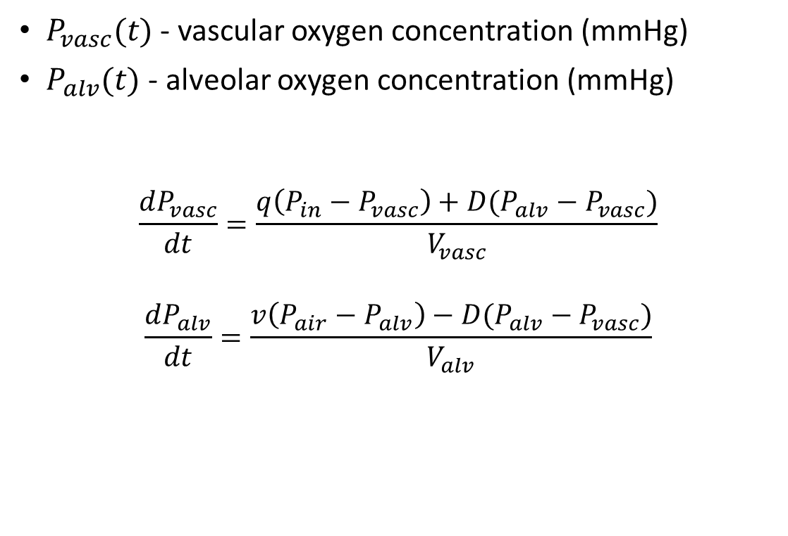
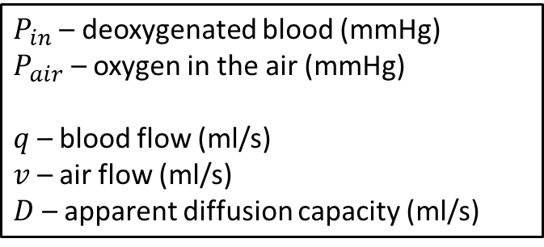
Model A
$P_{in}$ – deoxygenated blood (mmHg)
$P_{air}$ – oxygen in the air (mmHg)
$q$ – blood flow (ml/s)
$v$ – air flow (ml/s)
$D$ – apparent diffusion capacity (ml/s)
$P_{vasc}(t)$ - vascular oxygen concentration (mmHg)
$P_{alv}(t)$ - alveolar oxygen concentration (mmHg)
$$\frac{dP_{vasc}}{dt}=\frac{q\left(P_{in}−P_{vasc}\right)+D(P_{alv}−P_{vasc})}{V_{vasc}}$$
$$\frac{dP_{alv}}{dt}=\frac{v\left(P_{air}−P_{alv}\right)−D(P_{alv}−P_{vasc})}{V_{alv}}$$
Airway
⇋
Alveoli
Capillaries

Slide 4

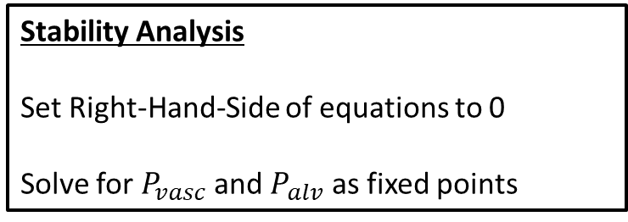
Fixed points of Model A
Oxygen transport equations
$\frac{dP_{vasc}}{dt}=\frac{q\left(P_{in}−P_{vasc}\right)+D(P_{alv}−P_{vasc})}{V_{vasc}}$
$\frac{dP_{alv}}{dt}=\frac{v\left(P_{air}−P_{alv}\right)−D(P_{alv}−P_{vasc})}{V_{alv}}$
Fixed points
$P_{vasc}^{∗}=\frac{P_{in}qv+P_{in}Dq+P_{air}Dv}{qv+Dq+Dv}$
$P_{alv}^{∗}=\frac{P_{air}Dv+P_{in}Dq+P_{air}qv}{qv+Dq+Dv}$
Stability Analysis
Set Right-Hand-Side of equations to 0
Solve for $P_{vasc}$ and $P_{alv}$ as fixed points
Plot $P_{vasc}^{∗}$ and $P_{alv}^{∗}$ as a function of $q$ and $v$

Slide 5
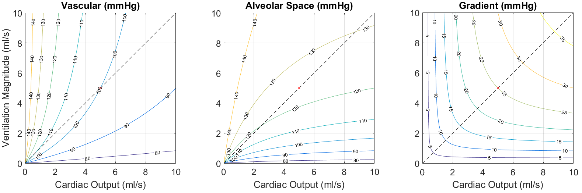
Fixed points of Model A
The magnitude of (air, blood) flow affect pulmonary oxygen uptake

Slide 6
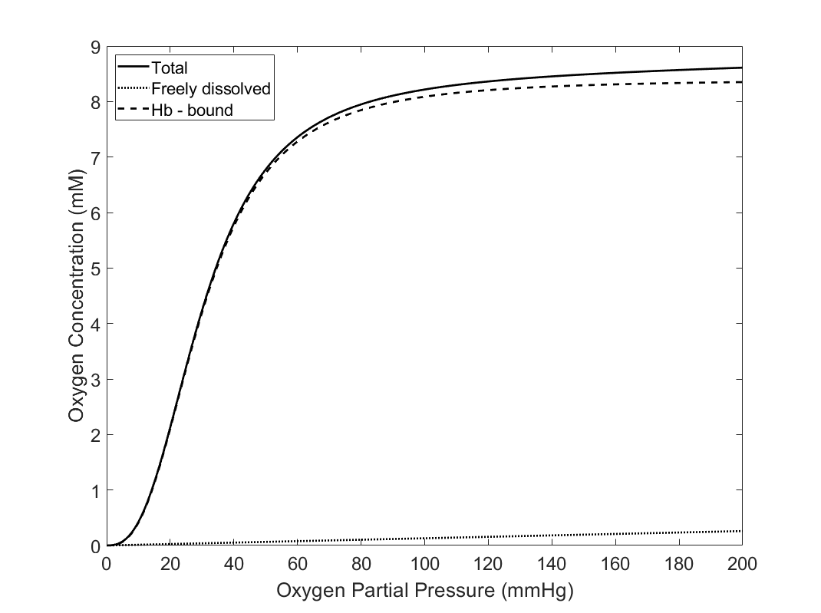

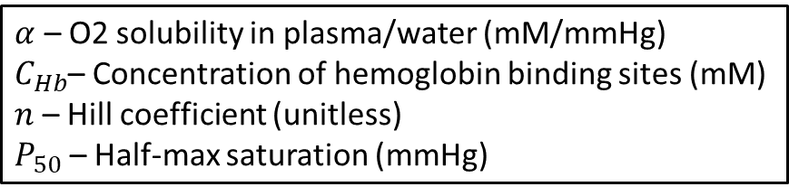
Model B
$C_{O2}=αP_{O2}+C_{Hb}\frac{P_{O2}^{n}}{P_{O2}^{n}+P_{50}^{n}}$
$α$ – O2 solubility in plasma/water (mM/mmHg)
$C_{Hb}$– Concentration of hemoglobin binding sites (mM)
$n$ – Hill coefficient (unitless)
$P_{50}$ – Half-max saturation (mmHg)

Slide 7
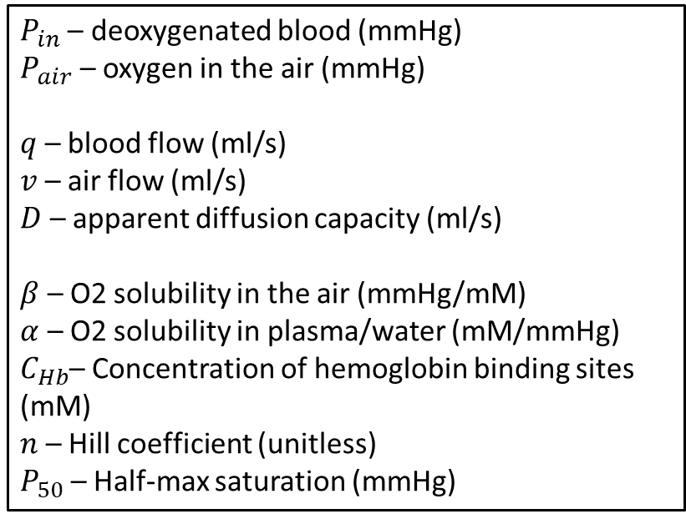
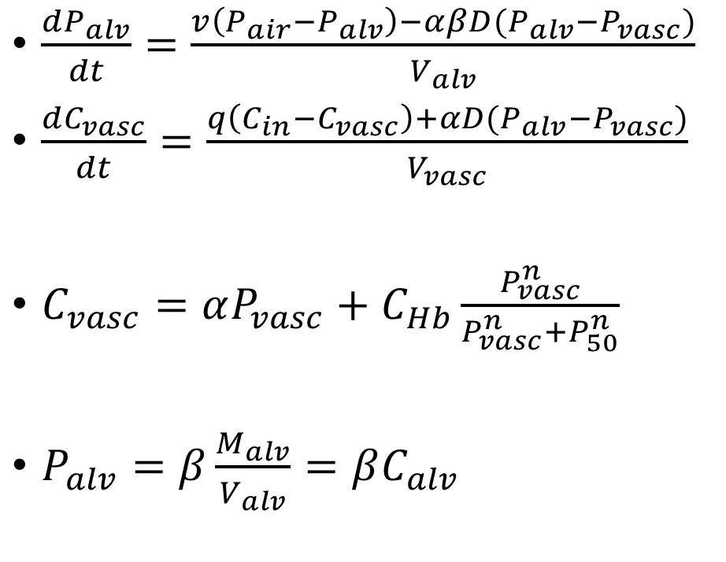
Model B
Airway
⇋
Alveoli
$\frac{dP_{alv}}{dt}=\frac{v\left(P_{air}−P_{alv}\right)−αβD(P_{alv}−P_{vasc})}{V_{alv}}$
$\frac{dC_{vasc}}{dt}=\frac{q\left(C_{in}−C_{vasc}\right)+αD(P_{alv}−P_{vasc})}{V_{vasc}}$
$C_{vasc}=αP_{vasc}+C_{Hb}\frac{P_{vasc}^{n}}{P_{vasc}^{n}+P_{50}^{n}}$
$P_{alv}=β\frac{M_{alv}}{V_{alv}}=βC_{alv}$
Capillaries
$P_{in}$ – deoxygenated blood (mmHg)
$P_{air}$ – oxygen in the air (mmHg)
$q$ – blood flow (ml/s)
$v$ – air flow (ml/s)
$D$ – apparent diffusion capacity (ml/s)
$β$ – O2 solubility in the air (mmHg/mM)
$α$ – O2 solubility in plasma/water (mM/mmHg)
$C_{Hb}$– Concentration of hemoglobin binding sites (mM)
$n$ – Hill coefficient (unitless)
$P_{50}$ – Half-max saturation (mmHg)

Slide 8
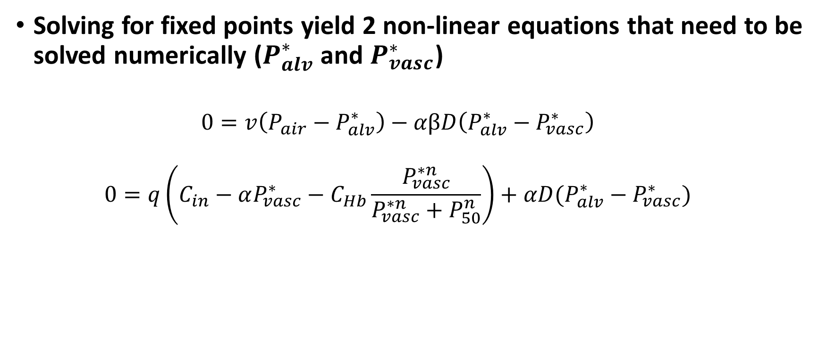
Fixed Points of Model B
Solving for fixed points yield 2 non-linear equations that need to be solved numerically ($P_{alv}^{∗}$ and $P_{vasc}^{∗}$)
$$0=v\left(P_{air}−P_{alv}^{∗}\right)−αβD\left(P_{alv}^{∗}−P_{vasc}^{∗}\right)$$
$$0=q\left(C_{in}−αP_{vasc}^{∗}−C_{Hb}\frac{P_{vasc}^{∗n}}{P_{vasc}^{∗n}+P_{50}^{n}}\right)+αD(P_{alv}^{∗}−P_{vasc}^{∗})$$

Slide 9
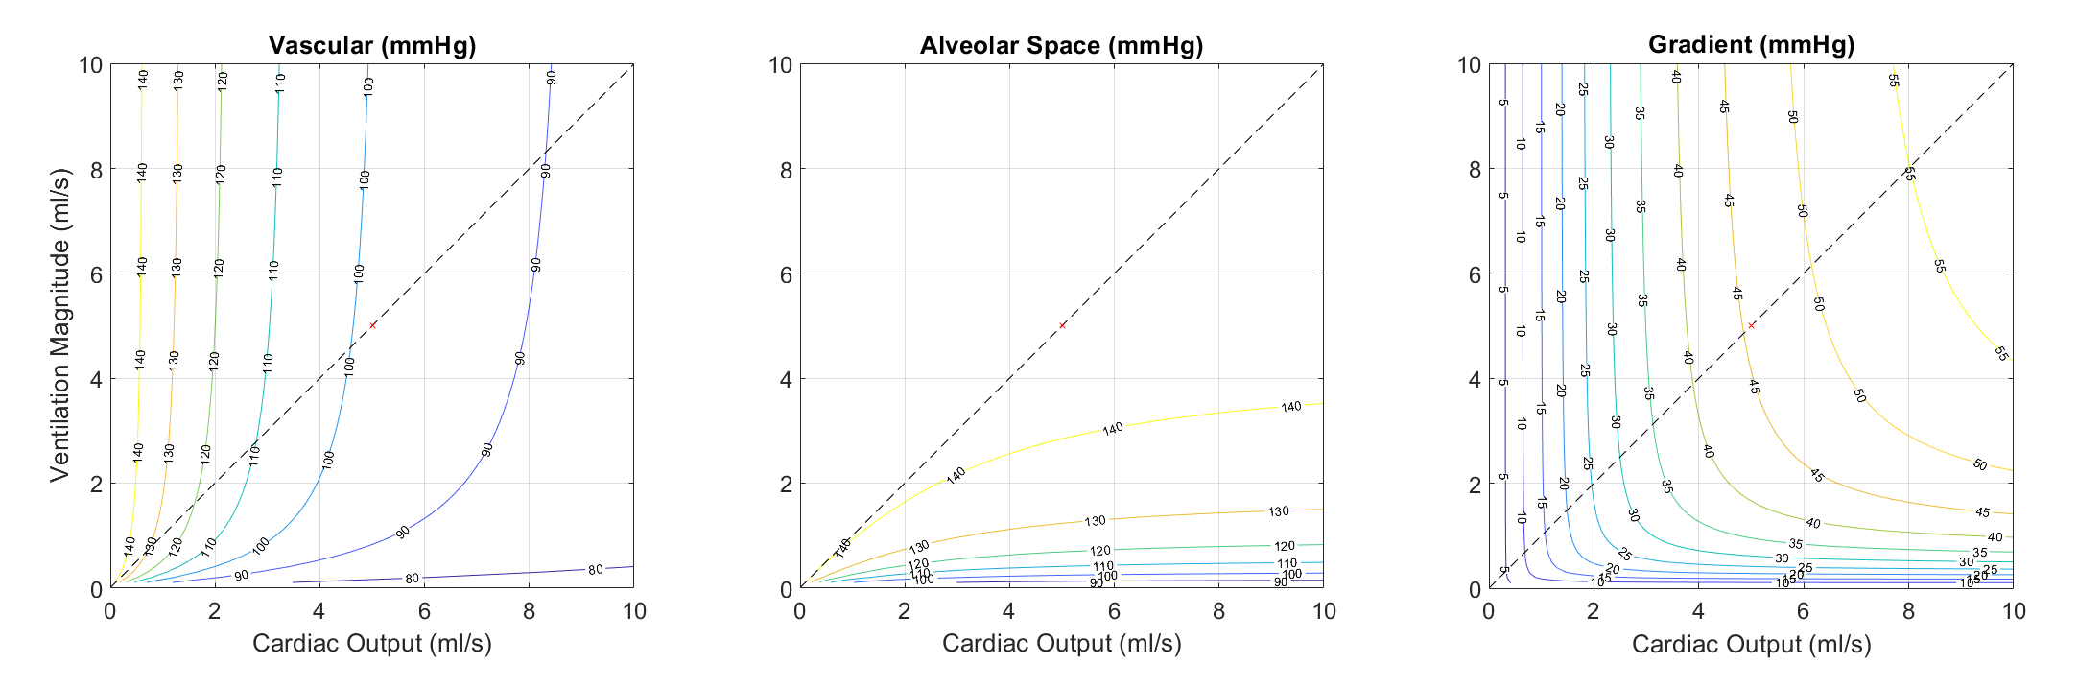
Fixed points of Model B
The magnitude of (air, blood) flow affect pulmonary oxygen uptake

Slide 10
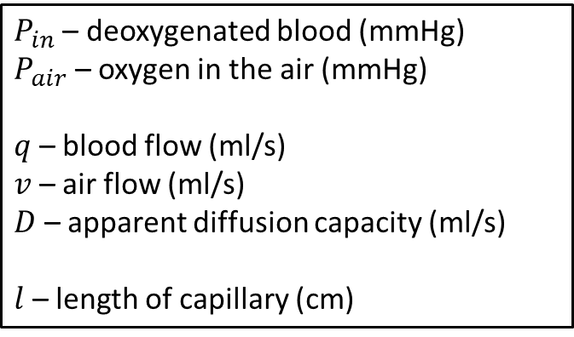

Model C
Airway
⇋
Alveoli
$\frac{dP_{alv}}{dt}=\frac{v\left(P_{air}−P_{alv}\right)−D(P_{alv}−〈P_{vasc}〉)}{V_{alv}}$
$\frac{∂P_{vasc}}{∂t}+\frac{ql}{V_{vasc}}\frac{∂P_{vasc}}{∂x}=\frac{D}{V_{vasc}}(P_{alv}−P_{vasc})$
$P_{vasc}\left(t,0\right)=P_{in}$
$〈P_{vasc}〉(t)=\frac{1}{l}\int{P_{vasc}(t,x)dx}$
Capillaries
$P_{in}$ – deoxygenated blood (mmHg)
$P_{air}$ – oxygen in the air (mmHg)
$q$ – blood flow (ml/s)
$v$ – air flow (ml/s)
$D$ – apparent diffusion capacity (ml/s)
$l$ – length of capillary (cm)

Slide 11
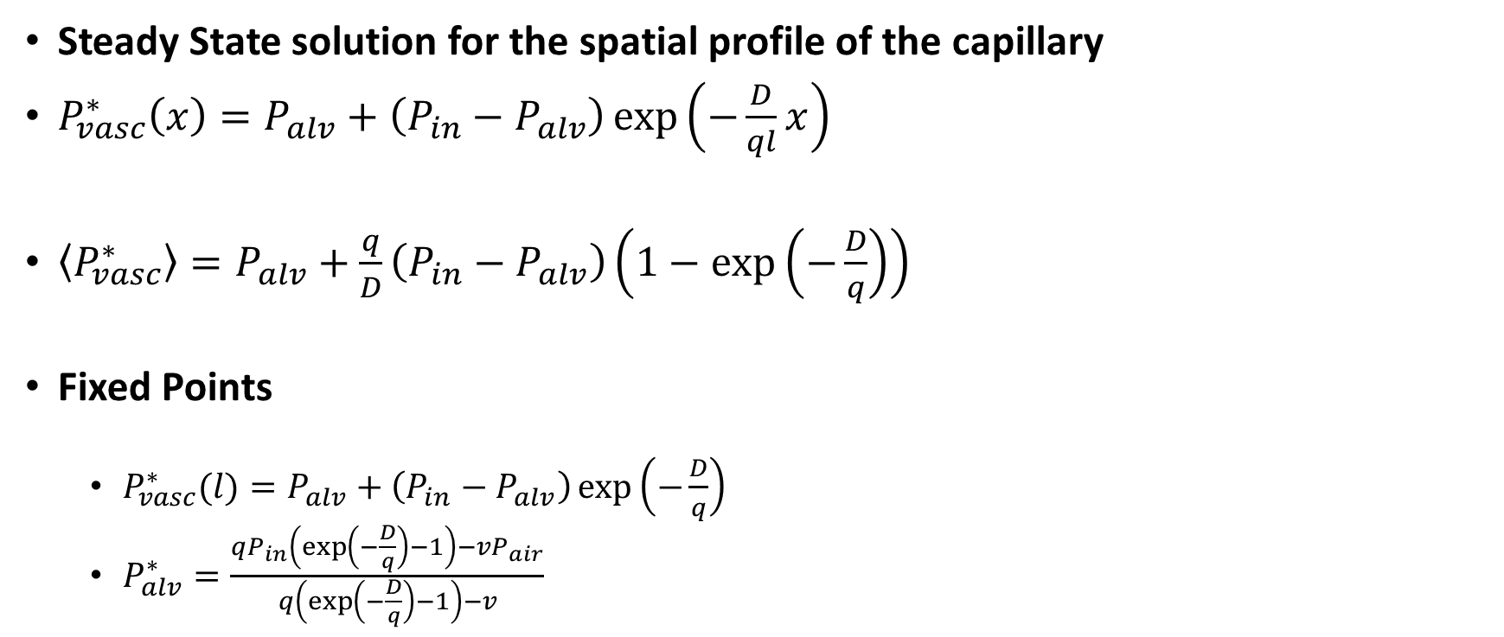
Fixed Points of Model C
Steady State solution for the spatial profile of the capillary
$P_{vasc}^{∗}\left(x\right)=P_{alv}+\left(P_{in}−P_{alv}\right)\exp\left(−\frac{D}{ql}x\right)$
$〈P_{vasc}^{∗}〉=P_{alv}+\frac{q}{D}\left(P_{in}−P_{alv}\right)\left(1−exp\left(−\frac{D}{q}\right)\right)$
Fixed Points
$P_{vasc}^{∗}(l)=P_{alv}+\left(P_{in}−P_{alv}\right)\exp\left(−\frac{D}{q}\right)$
$P_{alv}^{∗}=\frac{qP_{in}\left(\exp\left(−\frac{D}{q}\right)−1\right)−vP_{air}}{q\left(\exp\left(−\frac{D}{q}\right)−1\right)−v}$

Slide 12
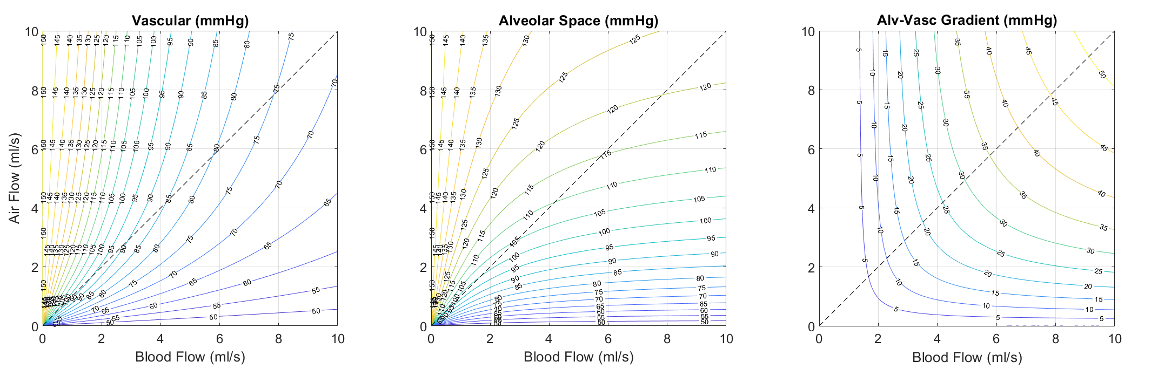
Fixed Points of Model C
The magnitude of (air, blood) flow affect pulmonary oxygen uptake

Slide 13


Model D
Airway
⇋
$\frac{dP_{alv}}{dt}=\frac{v\left(P_{air}−P_{alv}\right)−αβD(P_{alv}−〈P_{vasc}〉)}{V_{alv}}$
$\frac{∂C_{vasc}}{∂t}+\frac{ql}{V_{vasc}}\frac{∂C_{vasc}}{∂x}=\frac{αD}{V_{vasc}}(P_{alv}−P_{vasc})$
$C_{vasc}\left(t,0\right)=C_{in}$
$〈P_{vasc}〉(t)=\frac{1}{l}\int{P_{vasc}(t,x)dx}$
$C_{vasc}=αP_{vasc}+C_{Hb}\frac{P_{vasc}^{n}}{P_{vasc}^{n}+P_{50}^{n}}$
$P_{alv}=β\frac{M_{alv}}{V_{alv}}=βC_{alv}$
Alveoli
Capillaries
$C_{in}$ – deoxygenated blood (mM)
$P_{air}$ – oxygen in the air (mmHg)
$q$ – blood flow (ml/s)
$v$ – air flow (ml/s)
$D$ – apparent diffusion capacity (ml/s)
$l$ – length of capillary (cm)
$β$ – O2 solubility in the air (mmHg/mM)
$α$ – O2 solubility in plasma/water (mM/mmHg)
$C_{Hb}$– Concentration of hemoglobin binding sites (mM)
$n$ – Hill coefficient (unitless)
$P_{50}$ – Half-max saturation (mmHg)

Slide 14
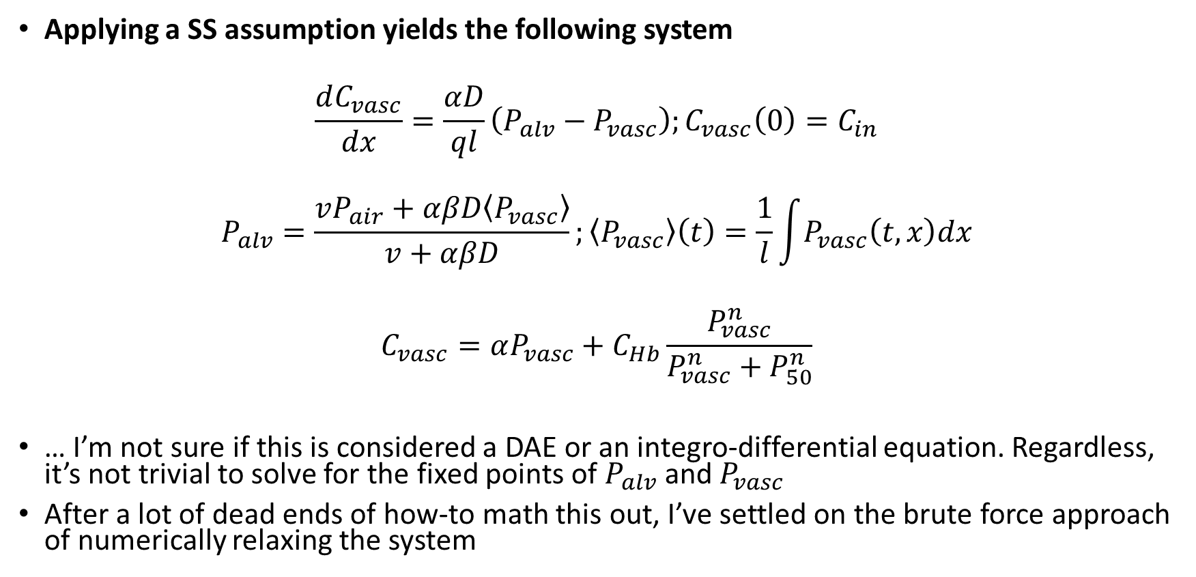
Solving for the Fixed Points of Model D
Applying a SS assumption yields the following system
$$\frac{dC_{vasc}}{dx}=\frac{αD}{ql}\left(P_{alv}−P_{vasc}\right);C_{vasc}\left(0\right)=C_{in}$$
$$P_{alv}=\frac{vP_{air}+αβD〈P_{vasc}〉}{v+αβD};〈P_{vasc}〉\left(t\right)=\frac{1}{l}\int{P_{vasc}\left(t,x\right)dx}$$
$$C_{vasc}=αP_{vasc}+C_{Hb}\frac{P_{vasc}^{n}}{P_{vasc}^{n}+P_{50}^{n}}$$
… I’m not sure if this is considered a DAE or an integro-differential equation. Regardless, it’s not trivial to solve for the fixed points of $P_{alv}$ and $P_{vasc}$
After a lot of dead ends of how-to math this out, I’ve settled on the brute force approach of numerically relaxing the system

Slide 15
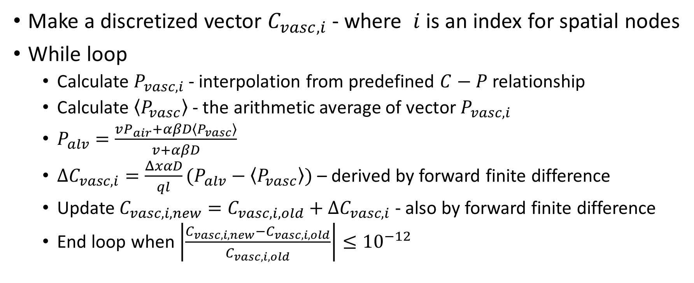
Approach to solve for Fixed Points of Model D
Make a discretized vector $C_{vasc,i}$ - where $i$ is an index for spatial nodes
While loop
Calculate $P_{vasc,i}$ - interpolation from predefined $C−P$ relationship
Calculate $〈P_{vasc}〉$ - the arithmetic average of vector $P_{vasc,i}$
$P_{alv}=\frac{vP_{air}+αβD〈P_{vasc}〉}{v+αβD}$
$ΔC_{vasc,i}=\frac{ΔxαD}{ql}(P_{alv}−〈P_{vasc}〉)$ – derived by forward finite difference
Update $C_{vasc,i,new}=C_{vasc,i,old}+ΔC_{vasc,i}$ - also by forward finite difference
End loop when $\left|\frac{C_{vasc,i,new}−C_{vasc,i,old}}{C_{vasc,i,old}}\right|≤{10}^{−12}$

Slide 16
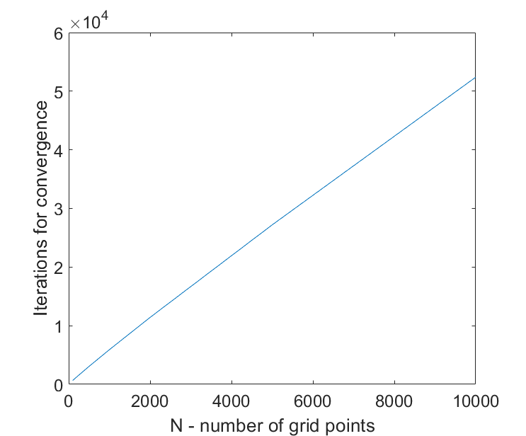
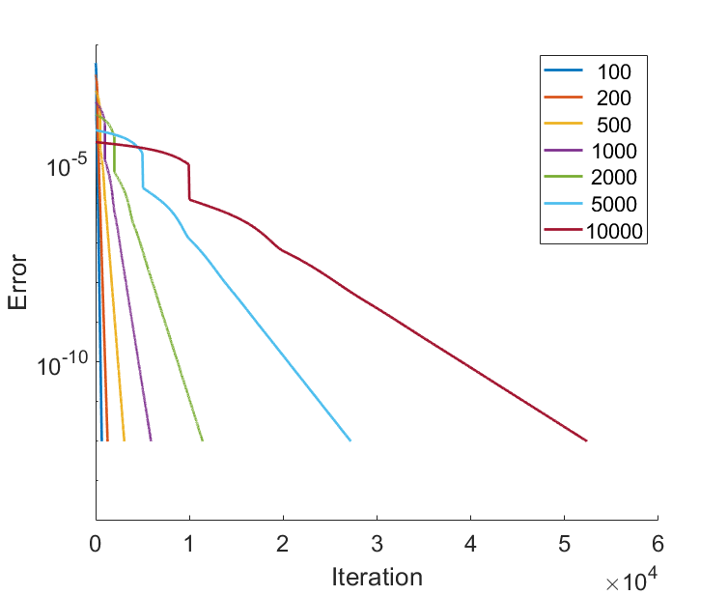
Numerical Stability
The more granular discretization we use, the more iterations are required to reach a given error threshold

Slide 17
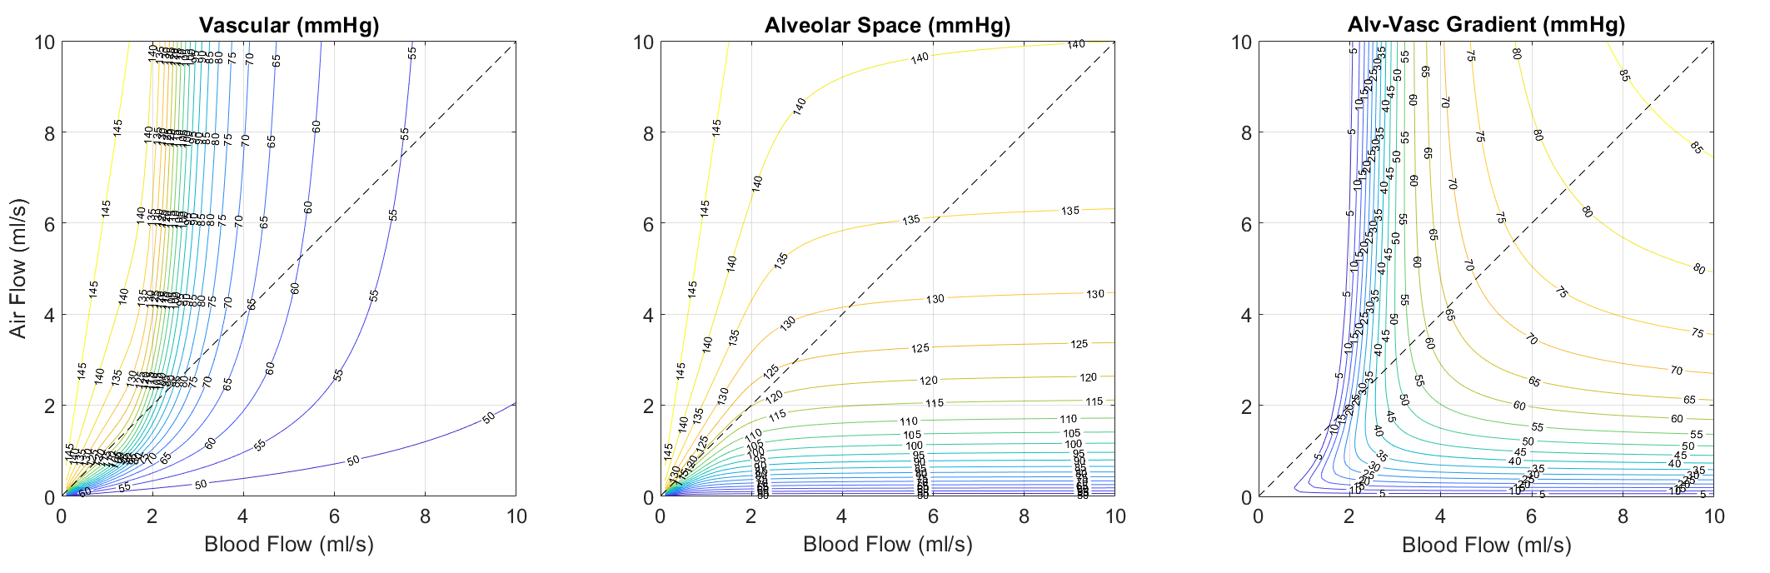
Fixed Points of Model D

Slide 18
Interpretations/Observations
Model A
Alv-vasc O2 gradient as a function of air and blood flow is symmetric
To follow a given O2 isocline in the vascular space, airflow needs to be increased more than a given increase in blood flow
Model B
Similar behavior to Model A, but the Alv-vasc O2 gradient surface is no longer perfectly symmetric – a likely result of the hemoglobin saturation function
Model C
Similar behavior to Model B, however the change in symmetry of the Alv-vasc O2 gradient is likely due to this formulation accounting for the spatial length of a capillary
Model D
We see a new nonlinearity emerge on the Alv-vasc O2 gradient surface when we account for both hemoglobin and the spatial profile
Vascular O2 appears to be a lot more sensitive to changes in blood flow compared to the other 3 models

Slide 19
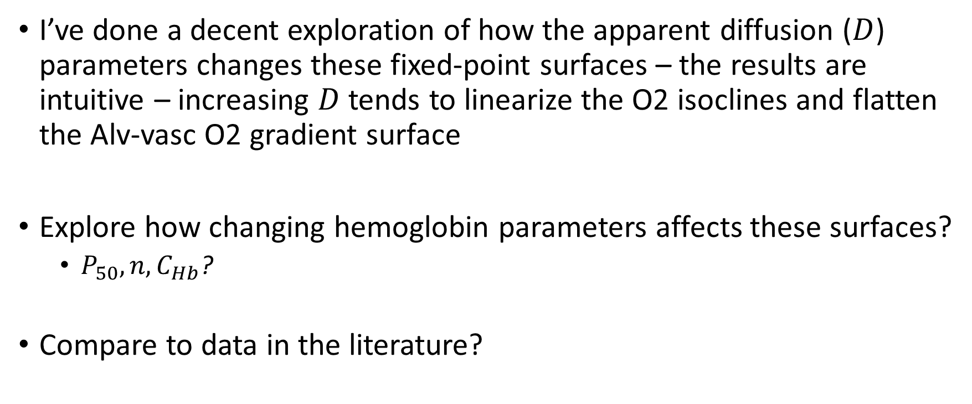
Next Steps?
I’ve done a decent exploration of how the apparent diffusion ($D$) parameters changes these fixed-point surfaces – the results are intuitive – increasing $D$ tends to linearize the O2 isoclines and flatten the Alv-vasc O2 gradient surface
Explore how changing hemoglobin parameters affects these surfaces?
$P_{50}, n, C_{Hb}$?
Compare to data in the literature?

