Slide 1
V/Q Matching and O2 transport
Drew Marquis

Slide 2
Objective
We want to understand how blood and air flow affect oxygen flux into the blood stream
Develop and analyze a suite of progressively more complex models representing pulmonary oxygen transport
Model A – simplest compartmental model
Model B – Extending Model A but accounting for hemoglobin and the non-linear relationship between O2 partial pressure and concentration in the blood
Model C – Extending Model A but accounting for spatial transport of O2 along the pulmonary capillary
Model D – a hybrid of Model B and C

Slide 3
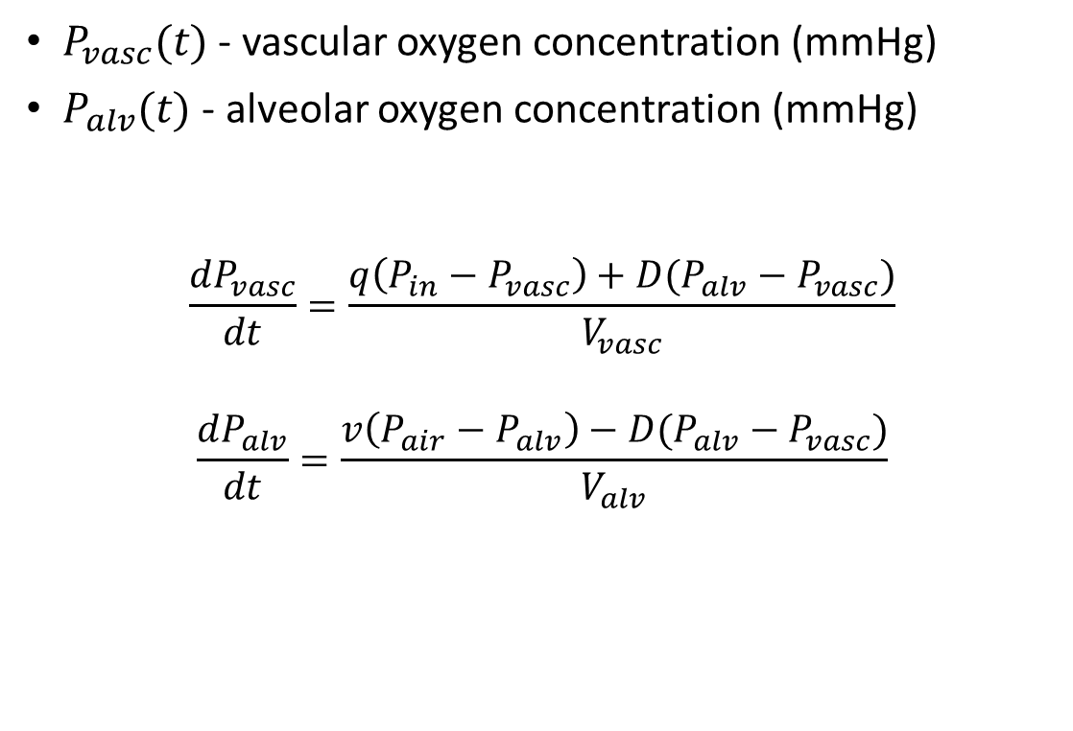
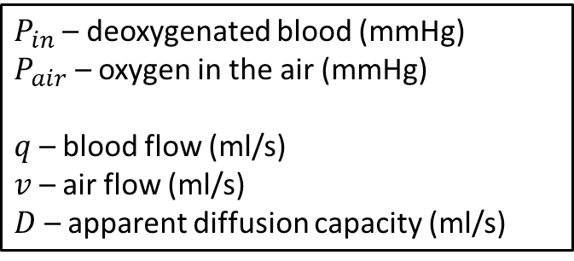
Model A
$P_{in}$ – deoxygenated blood (mmHg)
$P_{air}$ – oxygen in the air (mmHg)
$q$ – blood flow (ml/s)
$v$ – air flow (ml/s)
$D$ – apparent diffusion capacity (ml/s)
$P_{vasc}(t)$ - vascular oxygen concentration (mmHg)
$P_{alv}(t)$ - alveolar oxygen concentration (mmHg)
$$\frac{dP_{vasc}}{dt}=\frac{q\left(P_{in}−P_{vasc}\right)+D(P_{alv}−P_{vasc})}{V_{vasc}}$$
$$\frac{dP_{alv}}{dt}=\frac{v\left(P_{air}−P_{alv}\right)−D(P_{alv}−P_{vasc})}{V_{alv}}$$
Airway
⇋
Alveoli
Capillaries

Slide 4

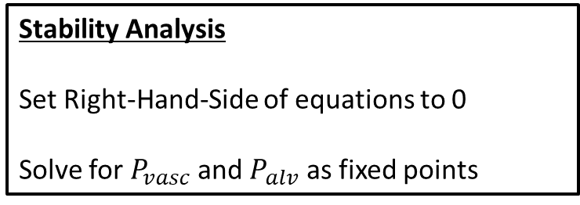
Fixed points of Model A
Oxygen transport equations
$\frac{dP_{vasc}}{dt}=\frac{q\left(P_{in}−P_{vasc}\right)+D(P_{alv}−P_{vasc})}{V_{vasc}}$
$\frac{dP_{alv}}{dt}=\frac{v\left(P_{air}−P_{alv}\right)−D(P_{alv}−P_{vasc})}{V_{alv}}$
Fixed points
$P_{vasc}^{∗}=\frac{P_{in}qv+P_{in}Dq+P_{air}Dv}{qv+Dq+Dv}$
$P_{alv}^{∗}=\frac{P_{air}Dv+P_{in}Dq+P_{air}qv}{qv+Dq+Dv}$
Stability Analysis
Set Right-Hand-Side of equations to 0
Solve for $P_{vasc}$ and $P_{alv}$ as fixed points
Plot $P_{vasc}^{∗}$ and $P_{alv}^{∗}$ as a function of $q$ and $v$

Slide 5
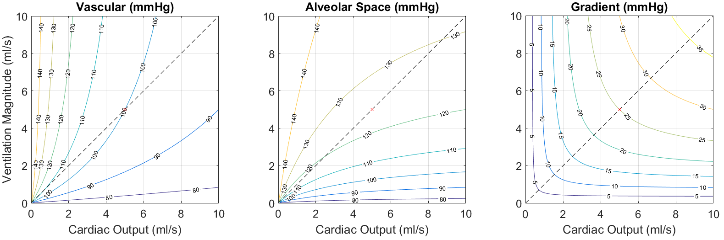
Fixed points of Model A
The magnitude of (air, blood) flow affect pulmonary oxygen uptake

Slide 6
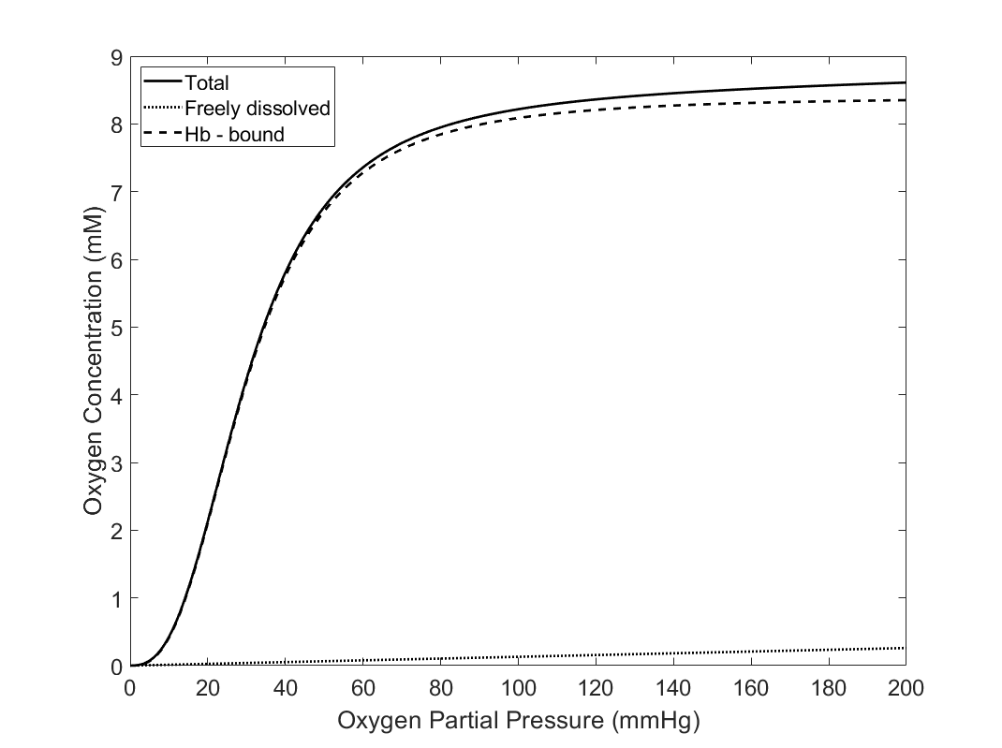

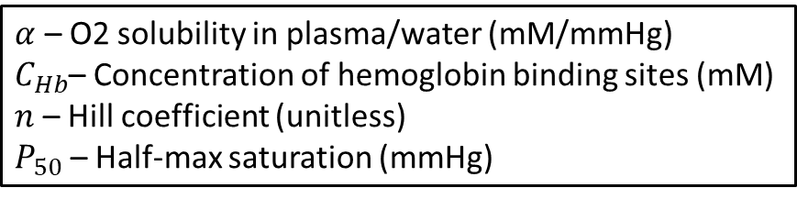
Model B
$C_{O2}=αP_{O2}+C_{Hb}\frac{P_{O2}^{n}}{P_{O2}^{n}+P_{50}^{n}}$
$α$ – O2 solubility in plasma/water (mM/mmHg)
$C_{Hb}$– Concentration of hemoglobin binding sites (mM)
$n$ – Hill coefficient (unitless)
$P_{50}$ – Half-max saturation (mmHg)

Slide 7
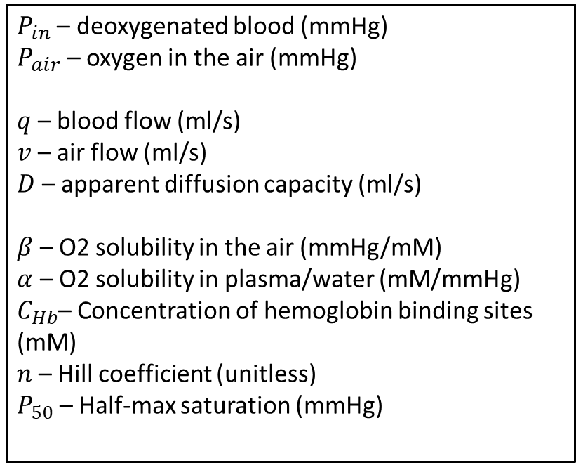
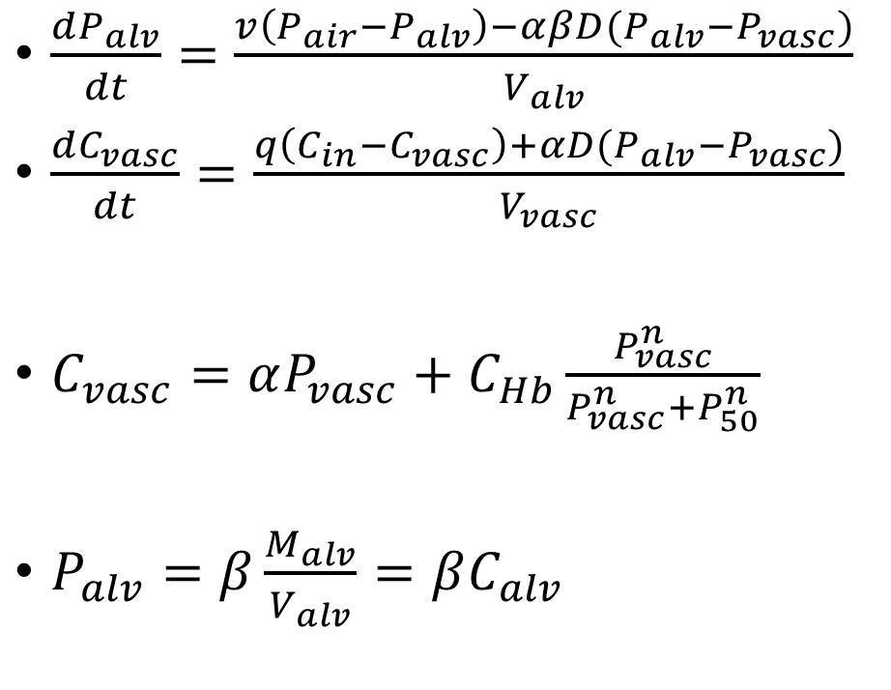
Model B
Airway
⇋
Alveoli
$\frac{dP_{alv}}{dt}=\frac{v\left(P_{air}−P_{alv}\right)−αβD(P_{alv}−P_{vasc})}{V_{alv}}$
$\frac{dC_{vasc}}{dt}=\frac{q\left(C_{in}−C_{vasc}\right)+αD(P_{alv}−P_{vasc})}{V_{vasc}}$
$C_{vasc}=αP_{vasc}+C_{Hb}\frac{P_{vasc}^{n}}{P_{vasc}^{n}+P_{50}^{n}}$
$P_{alv}=β\frac{M_{alv}}{V_{alv}}=βC_{alv}$
Capillaries
$P_{in}$ – deoxygenated blood (mmHg)
$P_{air}$ – oxygen in the air (mmHg)
$q$ – blood flow (ml/s)
$v$ – air flow (ml/s)
$D$ – apparent diffusion capacity (ml/s)
$β$ – O2 solubility in the air (mmHg/mM)
$α$ – O2 solubility in plasma/water (mM/mmHg)
$C_{Hb}$– Concentration of hemoglobin binding sites (mM)
$n$ – Hill coefficient (unitless)
$P_{50}$ – Half-max saturation (mmHg)

Slide 8
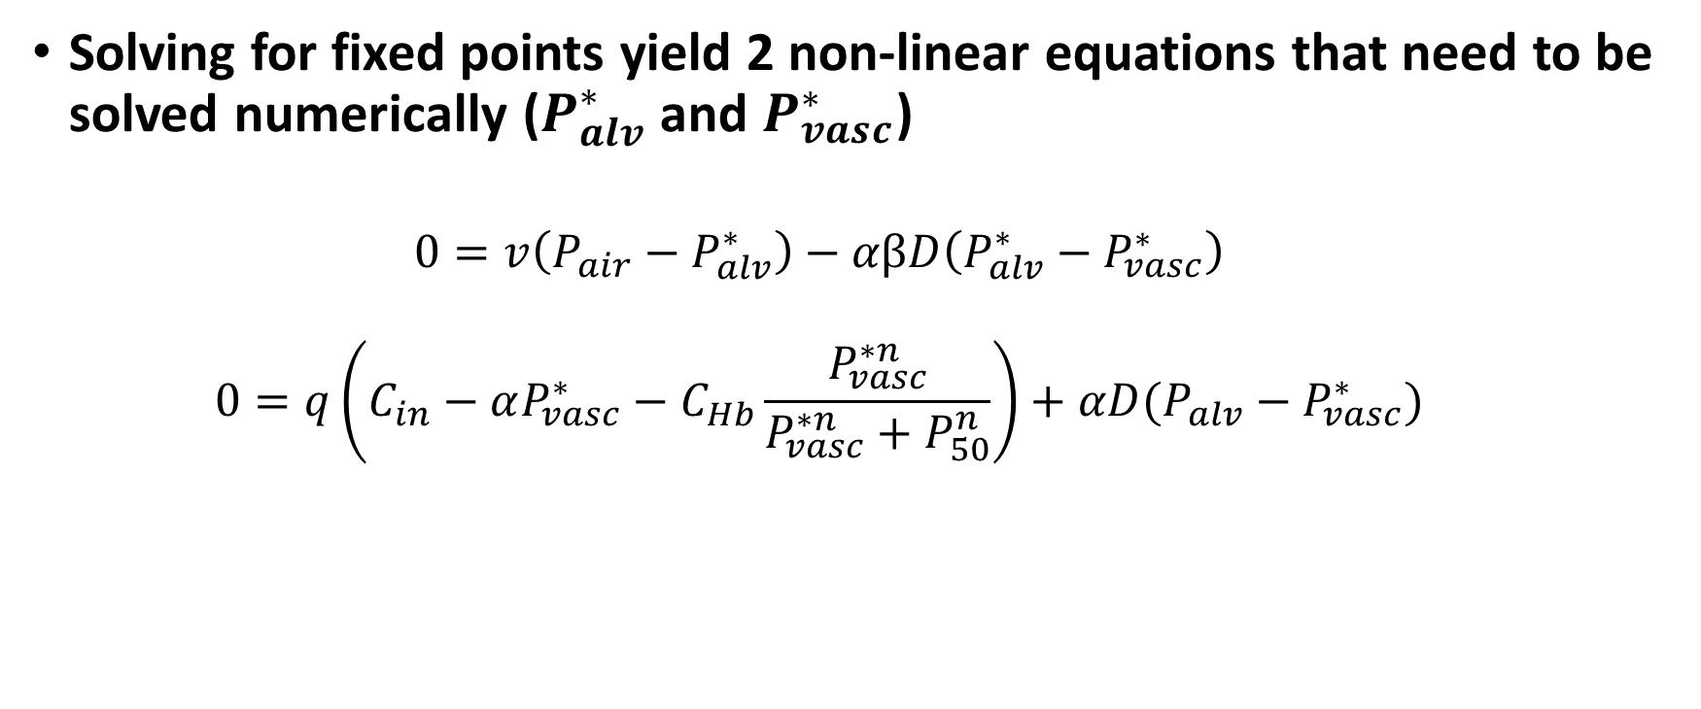
Fixed Points of Model B
Solving for fixed points yield 2 non-linear equations that need to be solved numerically ($P_{alv}^{∗}$ and $P_{vasc}^{∗}$)
$$0=v\left(P_{air}−P_{alv}^{∗}\right)−αβD\left(P_{alv}^{∗}−P_{vasc}^{∗}\right)$$
$$0=q\left(C_{in}−αP_{vasc}^{∗}−C_{Hb}\frac{P_{vasc}^{∗n}}{P_{vasc}^{∗n}+P_{50}^{n}}\right)+αD(P_{alv}−P_{vasc}^{∗})$$

Slide 9
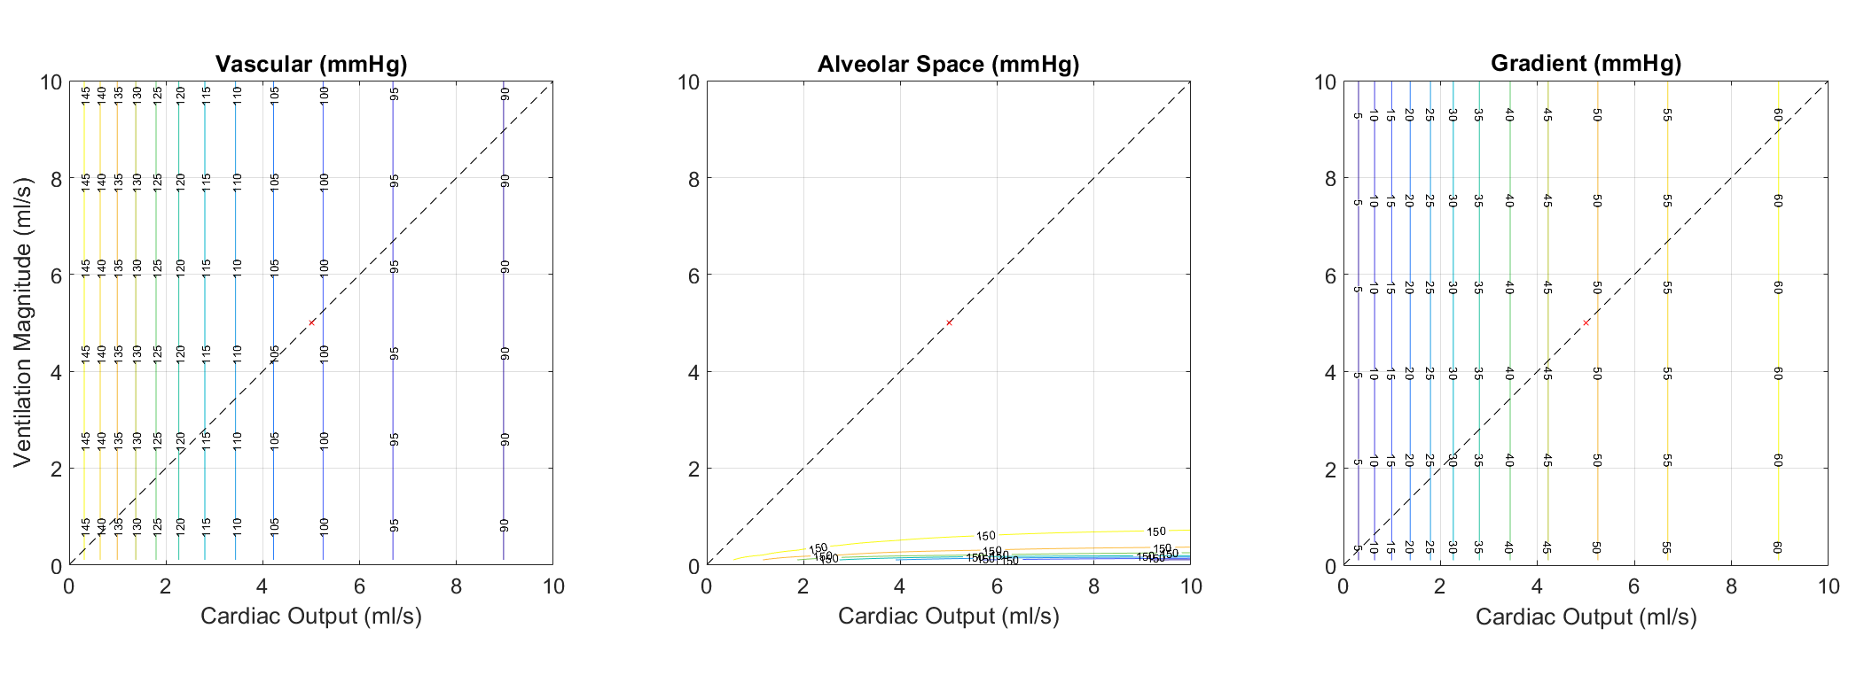
Fixed points of Model B
Hemoglobin removes dependence on airflow? Also, the alveolar fixed point is effectively atmospheric oxygen partial pressure (150 mmHg)?

Slide 10
Current thoughts on Model B
Something is likely wrong with the model formulation
But I’m not sure what
The complete removal of airflow dependence does not make sense
It appears that the fixed point for the alveolar oxygen is effectively the oxygen in the atmosphere for all air and blood flows
I’ve double checked this by solving the kinetics of the ODE system and the model does equilibrate so that alveolar oxygen is basically 150 mmHg for all conditions
I can conclude that I did my numerical solving of fixed points properly, so something about the model formulation must be wrong

