Slide 1
Cloud computing and big data
The Web Under a Microscope

Slide 2
overview
Course Work Overview
Cloud Environment Setup
Dataset Ingestion
Structured Data Manipulation and Query
Data Analytics using Databricks
Data Enrichment using Machine Learning
Data Visualization
Conclusion

Slide 3

Coursework overview

Slide 4
The goal of the project is to demonstrate mastery of both cloud and big data technologies applied to big data analytics
To achieve the goal, I only needed 1 fundamental component, the dataset
The main dataset I used is: The Extrovert-Introvert Behavior Analysis, from Kaggle, a well-known platform used by thousands of data professionals and novices to hone their skills or to contribute to the community with valuable insights or solutions to popular challenges
(I also used two additional LARGE datasets from online Open Dataset initiatives )

Slide 5
Cloud environment setup

Slide 6
The cloud provider used for the project work is Google Cloud, one of the many leaders in the tech industry in many fields, such as that of cloud computing
The main steps I performed, once I downloaded the dataset(s), to obtain the Cloud Storage Bucket are:
Create a Google Cloud account (I already had one)
Create a Project: ccbd-exam-2025-darnall-gc-bucket
Create a Cloud Storage Bucket (same name as the project)
Create a preferred directory structure in my bucket
Uploaded the downloaded dataset(s) via the web UI
(alternatively, the data upload to the storage bucket could have been performed via the Python-based SDK, gsutil from a terminal interface such as Bash or PowerShell)

Slide 7
The following are the steps performed specifically for the creation of the bucket
Log into the Google Cloud Platform
Choose the project
Go to the storage option
Click on the create bucket button
Enter a name
Proceed until completion by leaving the default settings
Here you can find a tutorial to manually create a Google Cloud Storage Bucket from command line (or the Google Cloud Shell), the steps remain the same (Auth, bucket setup, configuration and creation)

Slide 8
The default configuration for the bucket was kept on purpose since it fits the use case perfectly, under all aspects:
Availability
Region Location (us-east mainly and multi-region)
Security (Uniform access is fine if I am the sole user of the bucket)
Storage Class (standard which is great for frequently accessed data such as that used for analytics)
Retention Policy (soft delete since I technically am a novice and might accidentally delete data that I should not have deleted, as it often used to happen with junior developers with production databases or database tables)
Encryption (Since google has a good cryptosystems and the data I am uploading is not confidential nor does it require supervision from the Data Protection Officer, this option fits perfectly the use case)

Slide 9
Data ingestion

Slide 10
As the creation of the bucket could have been approached in two different ways, UI-based and command line-based the same applies to the uploading of the dataset(s)
Before uploading the dataset(s), I added a directory hierarchy to my bucket so that my data could be stored in a structured manner
📂 ccbd-exam-2025-darnall-gc-bucket
├── 📁 data-analytics-results
│ ├── (Folder contents...)
│ ├── 📁 datasets
│ ├── 📁 common_crawl_25
│ │ ├── 📄 common_crawl_data.csv
│ │
│ ├── 📁 gdelt_23
│ │ ├── 📄 gdelt_merged.csv
│ │
│ ├── 📁 introvert-vs-extrovert-behavior
│ │
├── 📄 personality_dataset.csv

Slide 11
After creating the directory structure in my bucket, I simply entered the subdirectory of interest and clicked on the upload file button, selected the file on my host machine and once it finished uploading, I could use it or manipulate it with the Cloud Shell or notebooks (next slides)
The gsutil code equivalent is:
gsutil cp ~/data/gdelt_merged.csv gs://ccbd-exam-2025-darnall-gc-bucket/datasets/gdelt_23/gdelt_merged.csv

Slide 12
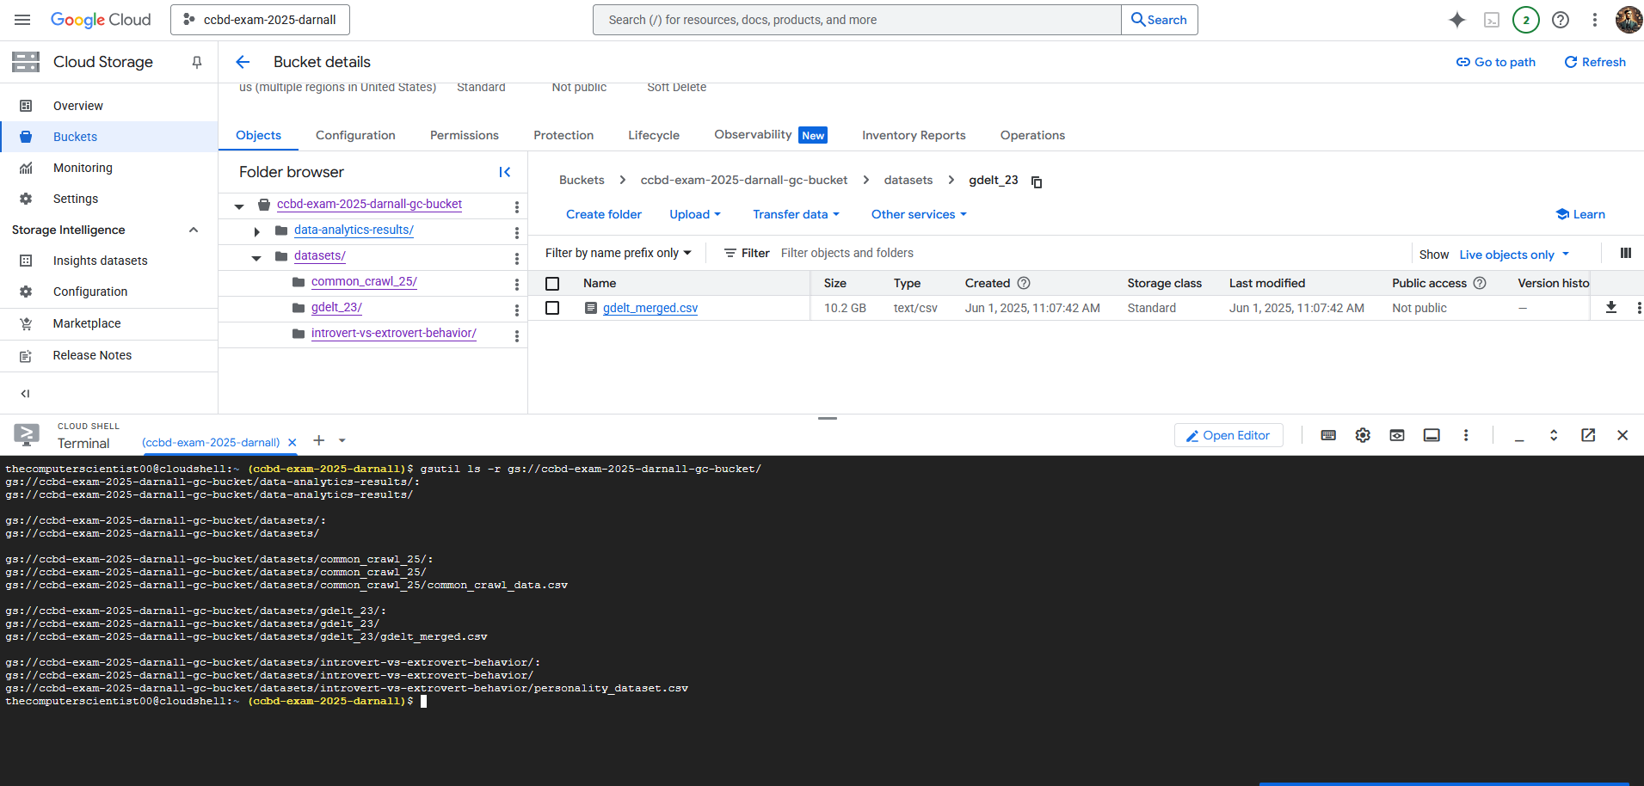
The following are the contents of my bucket after uploading the dataset

Slide 13
Data manipulation using SQL

Slide 14
The first target platform to query the dataset(s) is the Google Cloud Big Query service, specifically the SQL service
Big Query provides both Data Manipulation Language (DML) and Data Definition Language (DDL)
To investigate the data, I:
Created a dataset object
Created a table object within the dataset
Selected the Google Cloud Storage Bucket as the source of the data, by selecting the auto-inference on the schema (from the imported .csv file)
Created a query and started inquiring about the data

Slide 15
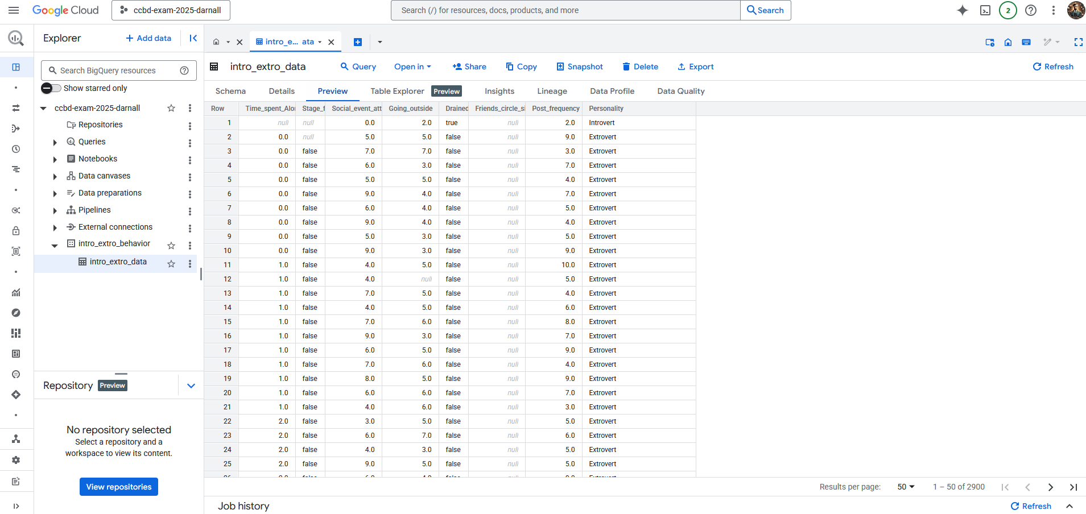

Slide 16
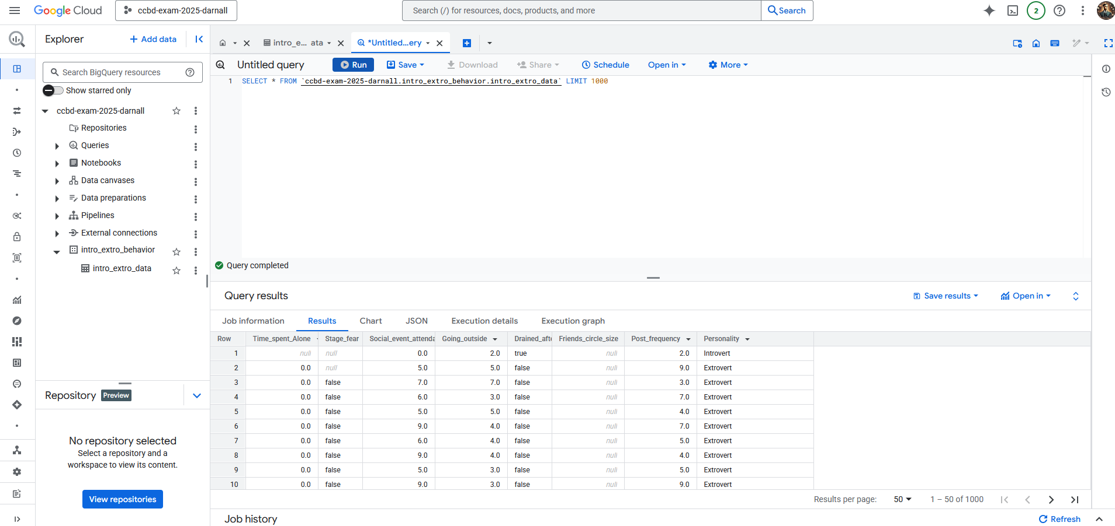

Slide 17
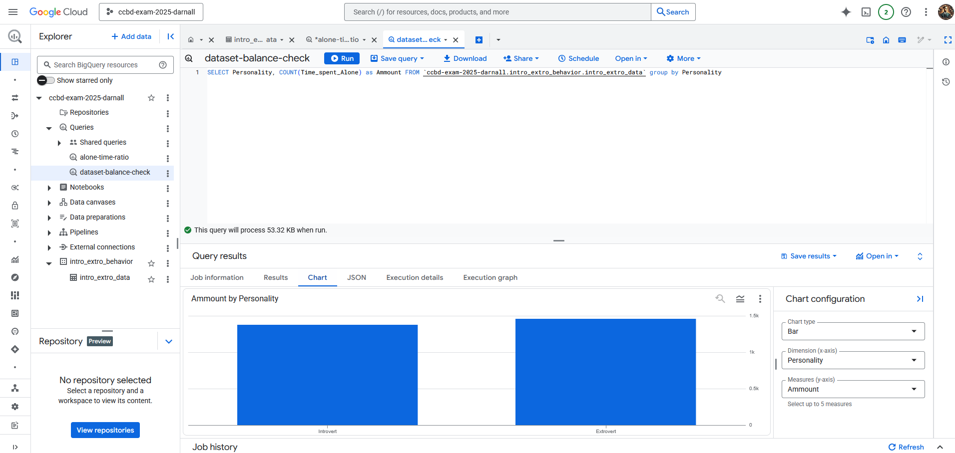
The very first query I executed, other than the exploratory one, is one of the upmost importance to assess weather the drawn conclusions from the analysis are sound or not, which is dataset balance (which it is, hence the high usability score on Kaggle)

Slide 18
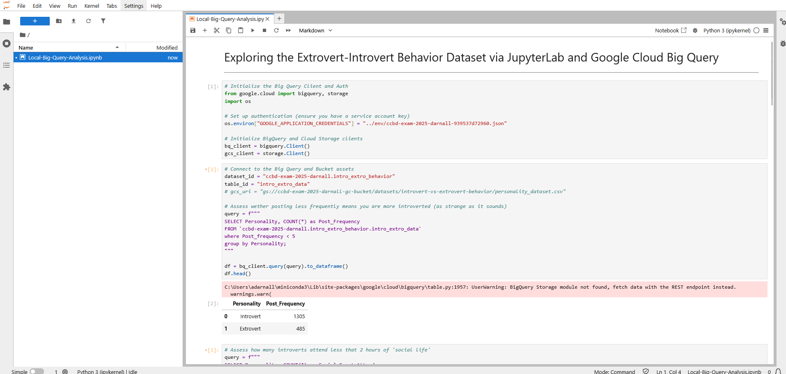
The following shows how leveraging the Google Cloud Big Query engine, one could perform more notebook-oriented SQL inquiries about the data using Jupyter Lab

Slide 19
Data analysis with databricks

Slide 20
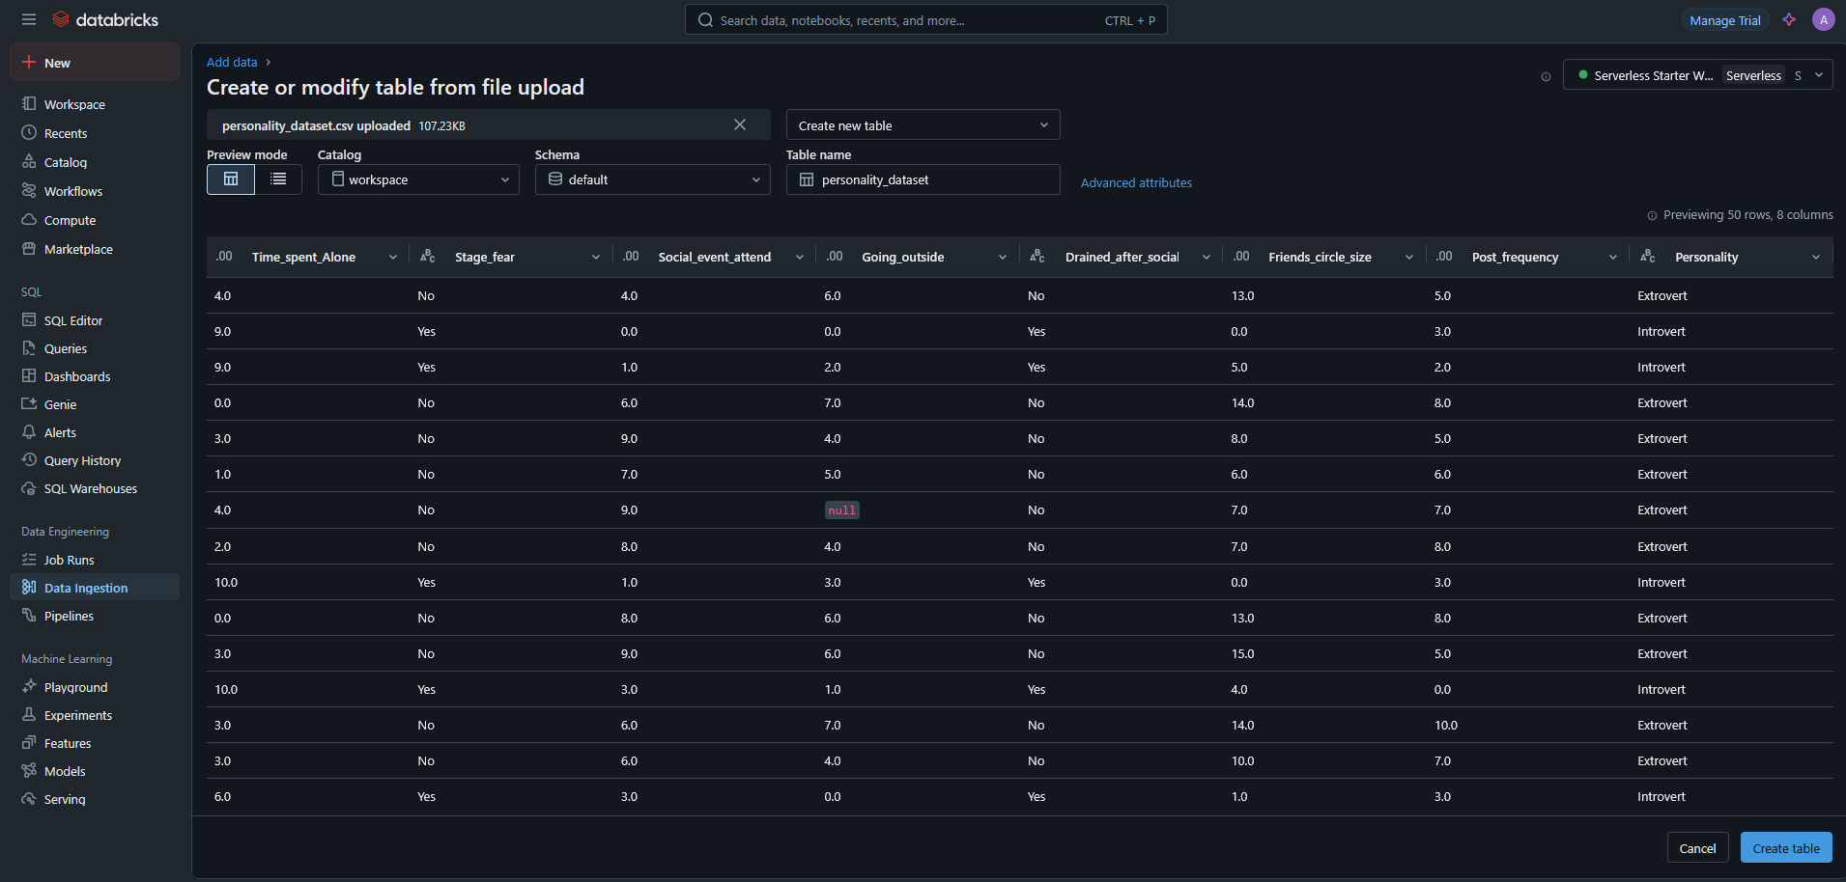
First, I created a table in Databricks, then I configured the permissions and finally I performed the queries

Slide 21
What does the data say?

Slide 22

The Personality Behavior Dataset

Slide 23








Dataset Features
Social Media Post Frequency
Personality Type
Friend Group Size
Social Battery Drainage
Social Event Attendance
Time Outdoors
Stage Fear
Alone Time

Slide 24

The Size of the Dataset
2900

Slide 25

Is the dataset balanced
SELECT Personality AS Personality, COUNT(*) AS Samples
FROM `ccbd-exam-2025-darnall.intro_extro_behavior.intro_extro_data`
GROUP BY Personality
%sql
SELECT Personality AS Personality, COUNT(*) AS Samples
FROM haky_workspace.default.personality_dataset
GROUP BY Personality
df.groupBy(col("Personality")) \
.agg(count("*").alias("Samples")) \
.select(col("Personality"), col("Samples")) \
.show()

Slide 26

What is the total (absolute) number of friends per personality type
SELECT Personality, COUNT(*) AS Total_Friend_Count
FROM `ccbd-exam-2025-darnall.intro_extro_behavior.intro_extro_data`
GROUP BY Personality
%sql
SELECT Personality, COUNT(*) AS Total_Friend_Count
FROM haky_workspace.default.personality_dataset
GROUP BY Personality
df.groupBy("Personality").agg(count("*").alias("Total_Friend_Count")).show()

Slide 27

What is the average friend group size per personality type
SELECT Personality, AVG(Friends_circle_size) AS Average_Friend_Group_Size
FROM `ccbd-exam-2025-darnall.intro_extro_behavior.intro_extro_data`
GROUP BY Personality
%sql
SELECT Personality, AVG(Friends_circle_size) AS Average_Friend_Group_Size
FROM haky_workspace.default.personality_dataset
GROUP BY Personality
df.groupBy("Personality").agg(
avg("Friends_circle_size").alias("Average_Friend_Group_Size")
).show()

Slide 28
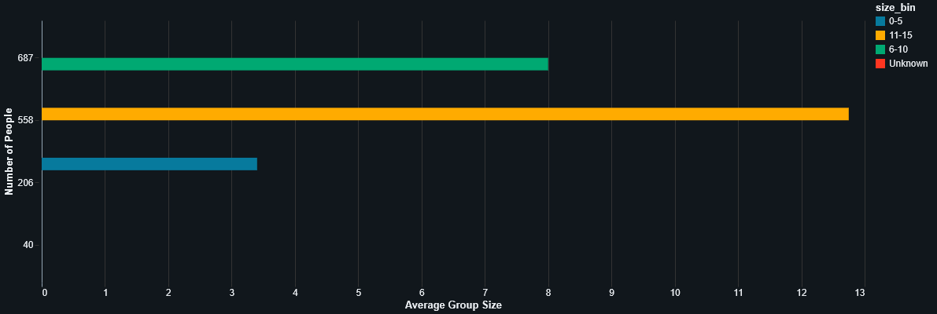
%sql
SELECT
CASE
WHEN Friends_circle_size BETWEEN 0 AND 5 THEN '0-5'
WHEN Friends_circle_size BETWEEN 6 AND 10 THEN '6-10'
WHEN Friends_circle_size BETWEEN 11 AND 15 THEN '11-15'
WHEN Friends_circle_size BETWEEN 16 AND 20 THEN '16-20'
ELSE 'Unknown'
END AS size_bin,
COUNT(*) AS group_count,
AVG(Friends_circle_size) AS Average_Group_Size
FROM
haky_workspace.default.personality_dataset
WHERE
Personality = 'Extrovert'
GROUP BY
size_bin
ORDER BY
CASE
WHEN size_bin = '0-5' THEN 1
WHEN size_bin = '6-10' THEN 2
WHEN size_bin = '11-15' THEN 3
WHEN size_bin = '16-20' THEN 4
ELSE 5
END
What are the most common friend group sizes by for extroverts

Slide 29
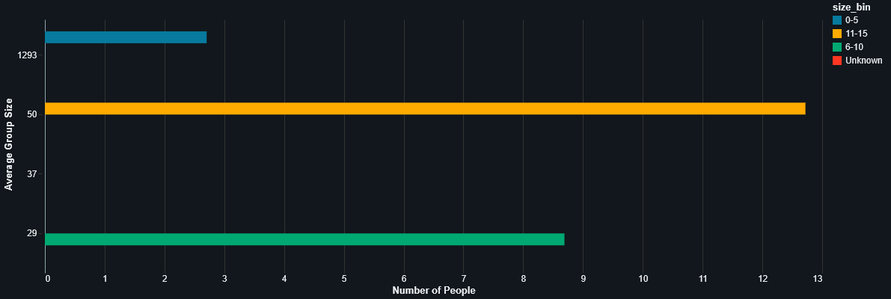
%sql
SELECT
CASE
WHEN Friends_circle_size BETWEEN 0 AND 5 THEN '0-5'
WHEN Friends_circle_size BETWEEN 6 AND 10 THEN '6-10'
WHEN Friends_circle_size BETWEEN 11 AND 15 THEN '11-15'
WHEN Friends_circle_size BETWEEN 16 AND 20 THEN '16-20'
ELSE 'Unknown'
END AS size_bin,
COUNT(*) AS group_count,
AVG(Friends_circle_size) AS Average_Group_Size
FROM
haky_workspace.default.personality_dataset
WHERE
Personality = 'Introvert'
GROUP BY
size_bin
ORDER BY
CASE
WHEN size_bin = '0-5' THEN 1
WHEN size_bin = '6-10' THEN 2
WHEN size_bin = '11-15' THEN 3
WHEN size_bin = '16-20' THEN 4
ELSE 5
END
What are the most common friend group sizes by for introverts

Slide 30
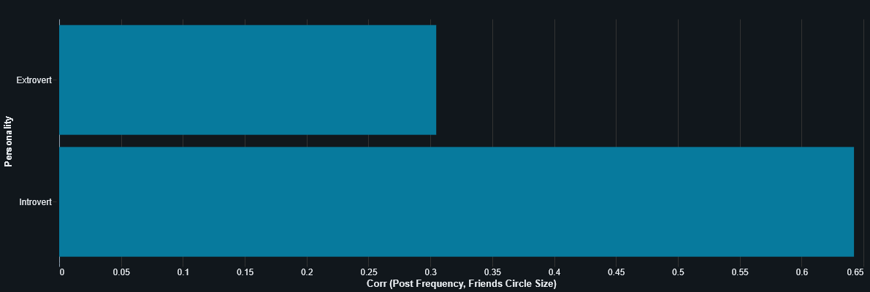
Is there a correlation between Post frequency and Friend Circle Size
SELECT Personality, CORR(Post_frequency, Friends_circle_size) AS Post_Freq_Friend_Circle_Size_Corr
FROM `ccbd-exam-2025-darnall.intro_extro_behavior.intro_extro_data`
GROUP BY Personality
%sql
SELECT Personality, CORR(Post_frequency, Friends_circle_size) AS Post_Freq_Friend_Circle_Size_Corr
FROM haky_workspace.default.personality_dataset
GROUP BY Personality
df.groupBy("Personality").agg(corr("Post_frequency", "Friends_circle_size")).show()

Slide 31
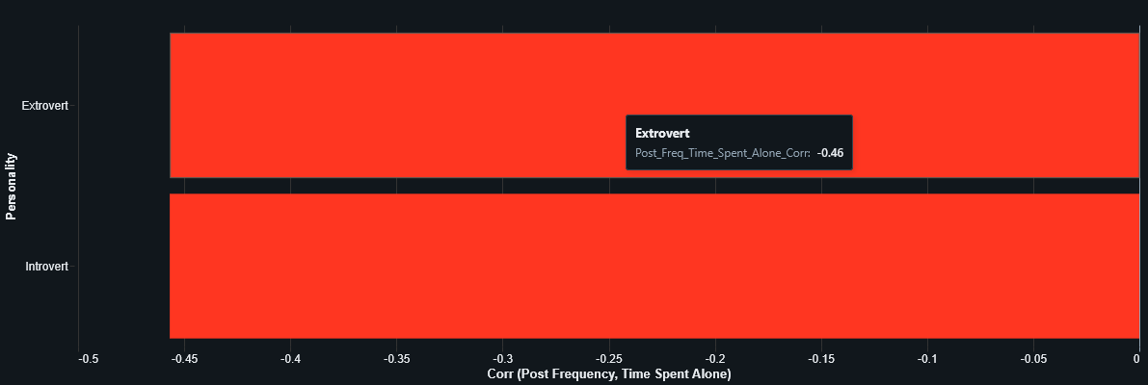
Is there a correlation between Post Frequency and Time Spent Alone
SELECT Personality, CORR(Post_frequency, Time_spent_Alone) AS Post_Freq_Time_Spent_Alone_Corr
FROM `ccbd-exam-2025-darnall.intro_extro_behavior.intro_extro_data`
GROUP BY Personality
%sql
SELECT Personality, CORR(Post_frequency, Time_spent_Alone) AS Post_Freq_Time_Spent_Alone_Corr
FROM haky_workspace.default.personality_dataset
GROUP BY Personality
df.groupBy("Personality").agg(corr("Post_frequency", "Time_spent_alone")).show()

Slide 32
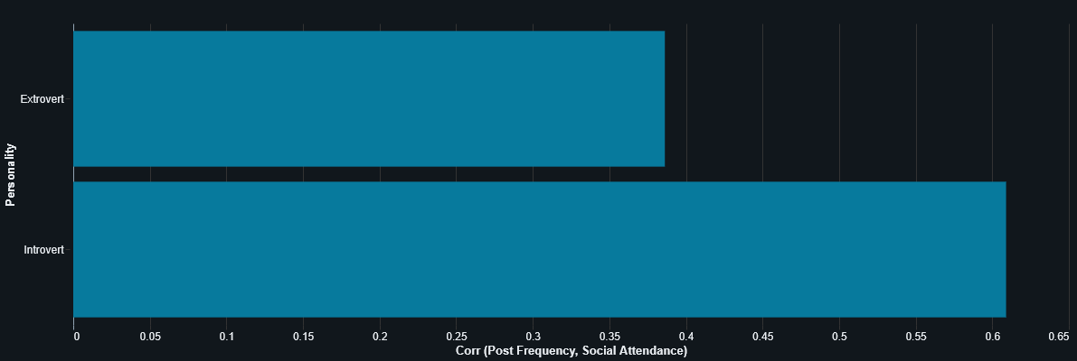
Is there a correlation between Post Frequency and Social Attendance
SELECT Personality, CORR(Post_frequency, Social_event_attendance) AS Post_Freq_Social_Attendance_Corr
FROM `ccbd-exam-2025-darnall.intro_extro_behavior.intro_extro_data`
GROUP BY Personality
%sql
SELECT Personality, CORR(Post_frequency, Social_event_attendance) AS Post_Freq_Social_Attendance_Corr
FROM haky_workspace.default.personality_dataset
GROUP BY Personality
df.groupBy("Personality").agg(corr("Post_frequency", "Social_event_attendance")).show()

Slide 33

What is the average Social Event Attendance per Personality Type
SELECT Personality, AVG(Social_event_attendance) AS Average_Social_Event_Attendance
FROM `ccbd-exam-2025-darnall.intro_extro_behavior.intro_extro_data`
GROUP BY Personality
%sql
SELECT Personality, AVG(Social_event_attendance) AS Average_Social_Event_Attendance
FROM haky_workspace.default.personality_dataset
GROUP BY Personality
df.groupBy("Personality") \
.agg(avg("Social_event_attendance").alias("Average_Social_Event_Attendance")) \
.show()

Slide 34

What is the average Post Frequency by Personality Type
SELECT Personality, AVG(Post_frequency) AS Average_Social_Post_Frequency
FROM `ccbd-exam-2025-darnall.intro_extro_behavior.intro_extro_data`
GROUP BY Personality
%sql
SELECT Personality, AVG(Post_frequency) AS Average_Social_Post_Frequency
FROM haky_workspace.default.personality_dataset
GROUP BY Personality
df.groupBy("Personality") \
.agg(avg("Post_frequency").alias("Average_Social_Post_Frequency")) \
.show()

Slide 35
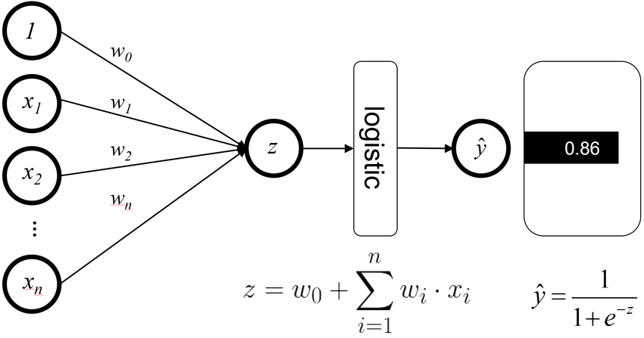
Data Enrichment via Logistic Regression

Slide 36
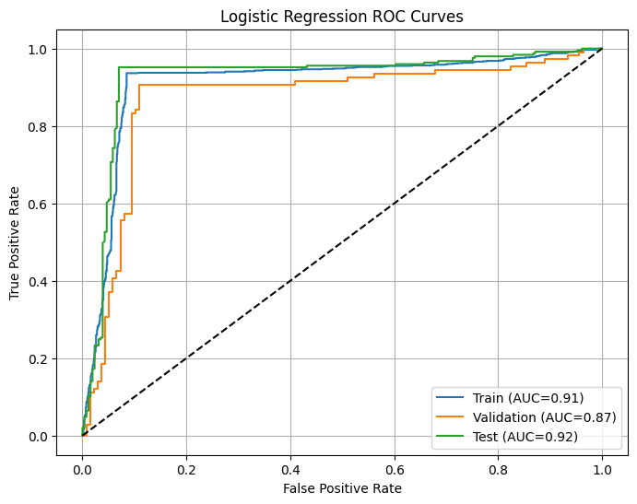
Logistic Regressor Performances – AUC Curve

Slide 37
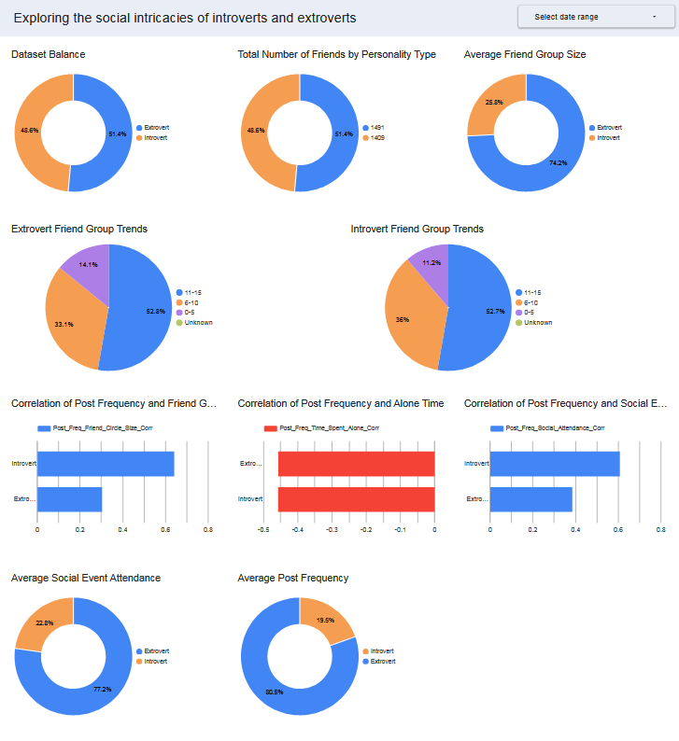
From this simple yet insightful analysis we gained insights pertaining to the intricacies behind two prominent personalities in our society
The following is a dashboard summarizing what we have seen thus far in the presentation

Slide 38
The end

