Slide 1
FINAL PRESENTATION
MobileViT for Real-Time
Traffic Monitoring
YOLOv8-nano
+
MobileViT-S
+
SORT
+
FastAPI
A Web-Based Classification, Detection, and Tracking System
5.6M PARAMETERS
96.44% TEST ACCURACY
~4 fps PIPELINE
Andreas Demosthenous & Marios Olympios
EPL 445 – Digital Video Processing | University of Cyprus | 25 May 2026
EPL 445 – Digital Video Processing | University of Cyprus | Final Presentation, 25 May 2026 | Slide 1/18
01

Slide 2
Agenda
From problem to deployable traffic dashboard
1
Problem and motivation
5
Tracking (SORT) and per-lane counting
2
Dataset and pre-processing
6
Web dashboard
3
MobileViT classifier and training
7
Quantitative results
4
Detection pipeline: sliding window vs YOLO hybrid
8
Live demo, discussion, and questions
EPL 445 – Digital Video Processing | University of Cyprus | Final Presentation, 25 May 2026 | Slide 2/18
02

Slide 3
Problem and Motivation
Live vehicle counts feed digital-twin traffic platforms
Scientific question Can a lightweight vision transformer classify traffic patches accurately enough to power a real-time, web-based per-lane counting dashboard on integrated graphics?
Why MobileViT 5.6 M parameters, ImageNet-pretrained, combines convolution with self-attention. Fits in 8 GB shared VRAM where ViT-base does not.
Why hybrid detection MobileViT outputs class probabilities, not boxes. YOLOv8-nano gives tight proposals, then MobileViT keeps the custom 4-class decision: car, bus, truck, background.
End-to-end deliverable FastAPI dashboard with video upload, per-lane polygon ROI, density timeline, cross-frame tracking, and live H.264 playback — runs from one uvicorn command.
Video Upload / webcam
Detect YOLO boxes
Classify MobileViT crop
Track SORT IDs
Count Lane dashboard
EPL 445 – Digital Video Processing | University of Cyprus | Final Presentation, 25 May 2026 | Slide 3/18
03

Slide 4
Dataset and Pre-processing
UA-DETRAC, 4 classes, sequence-disjoint splits
• Source: UA-DETRAC via Kaggle mirror (~140 K annotated frames, 100 surveillance sequences).
• Crops: every box larger than 32×32 px; capped at 5 000 per class; ~475 K total.
• Label map: car → car, bus → bus, van/others → truck. Negatives sampled from frame corners.
• Pre-processing: resize 256×256, ImageNet normalization, horizontal flip, ±10° rotation, colour jitter.
• Splits: 70/15/15 by SEQUENCE ID (MVI_xxxxx) to avoid frame leakage.
• Leakage fix: random splits gave ~99%; sequence-level split gives honest 96%+ generalisation.
Class distribution
(after balancing)
5 000 car
~3 200 bus
5 000 truck
~2 000 background
EPL 445 – Digital Video Processing | University of Cyprus | Final Presentation, 25 May 2026 | Slide 4/18
04

Slide 5
MobileViT-S Architecture
Mehta & Rastegari, ICLR 2022 — light-weight, mobile-friendly
Conv stem 3×3 conv
downsample 128×128
MV2 ×3 Inverted residuals
depthwise conv
MViT 1 Local conv →
patch attention
MViT 2 192 ch
4 transformer layers
MViT 3 240 ch
3 transformer layers
Head GAP → linear
4 classes
• 5.6 M parameters total — roughly 4× smaller than ResNet-50 with similar UA-DETRAC patch accuracy.
• Convolutional stages capture local texture such as wheels, windows, and vehicle edges.
• Transformer blocks model global context inside each crop.
• Pretrained on ImageNet via timm, then fine-tuned for 15 epochs on traffic patches.
• Fits in 8 GB shared VRAM on the AMD Radeon 780M iGPU; trains with batch size 4.
EPL 445 – Digital Video Processing | University of Cyprus | Final Presentation, 25 May 2026 | Slide 5/18
05

Slide 6
Training Procedure
Two-phase fine-tuning, AdamW, cosine schedule
Optimiser AdamW, lr 3e-4, weight decay 1e-4. Cosine annealing over 15 epochs.
Two phases Epochs 1–3: frozen backbone, head trains. Epochs 4–15: backbone unfrozen, lr reduced by 10×.
Loss Class-weighted cross-entropy to compensate for under-represented background and bus samples.
Hardware AMD Radeon 780M iGPU, ROCm 7.2, HSA_OVERRIDE_GFX_VERSION=11.0.0, batch size 4.
Selection Early stopping on macro F1, patience 5. Best validation macro F1 = 0.9807 at epoch 13.
EPL 445 – Digital Video Processing | University of Cyprus | Final Presentation, 25 May 2026 | Slide 6/18
06

Slide 7
Detection Pipeline
Sliding-window baseline → YOLOv8-nano + MobileViT hybrid
Multi-scale sliding window (Interim 2) • Three window sizes: 120, 180, 256 px, 50% stride
• Every tile classified by MobileViT
• Per-class greedy NMS, IoU = 0.3
• ~3 fps on 640×360 frames
• Many overlapping detections and background tiles
YOLOv8-nano + MobileViT (Final) • YOLO emits ~one tight box per vehicle (COCO 2/3/5/7)
• MobileViT classifies each crop in the 4-class taxonomy
• Background-labelled boxes are discarded
• ~4 fps steady-state on same hardware
• Single box per object; far fewer duplicates
• Same MobileViT backbone reused — no retraining
Frame 640×360
YOLO Proposal boxes
Crop Vehicle patch
MobileViT 4-class label
NMS/SORT Clean output
EPL 445 – Digital Video Processing | University of Cyprus | Final Presentation, 25 May 2026 | Slide 7/18
07

Slide 8
Cross-Frame Tracking (SORT)
Bewley et al., ICIP 2016 — IoU-association tracker
Association Per-frame detections match to trackers by IoU. Unmatched detections create new trackers; trackers retire after max_age = 5 frames.
Confirmation gating min_hits = 2 before a track is reported, suppressing one-frame false positives.
CSV instrumentation Each detection row receives a track_id. aggregate_counts emits unique_vehicles_by_class plus raw detection counts.
Demo impact Raw detections over-count because each vehicle appears in N frames. SORT reveals the unique vehicles needed by the digital twin.
Detection bbox + class
IoU match existing track
Track ID stable vehicle
Unique count per class / lane
EPL 445 – Digital Video Processing | University of Cyprus | Final Presentation, 25 May 2026 | Slide 8/18
08

Slide 9
Per-Lane Counting and Web Dashboard
Polygon ROIs + FastAPI + vanilla HTML/JS, no build step
Polygon ROIs Operator draws closed polygons on the first frame. Backend tests detection-centre membership with OpenCV pointPolygonTest. No re-inference required.
Endpoints POST /jobs, GET /jobs/{id}/counts | /timeline | /video | /frame, POST /jobs/{id}/lanes, POST /jobs/{id}/roi.
Frontend Single index.html + app.js + style.css. Chart.js via CDN for bar and line charts. HTML5 canvas for ROI and lane editing.
Robustness OpenCV writes mp4v; browsers need H.264. /video lazily re-encodes to libx264/yuv420p/+faststart and the worker pre-warms it after each job.
EPL 445 – Digital Video Processing | University of Cyprus | Final Presentation, 25 May 2026 | Slide 9/18
09

Slide 10
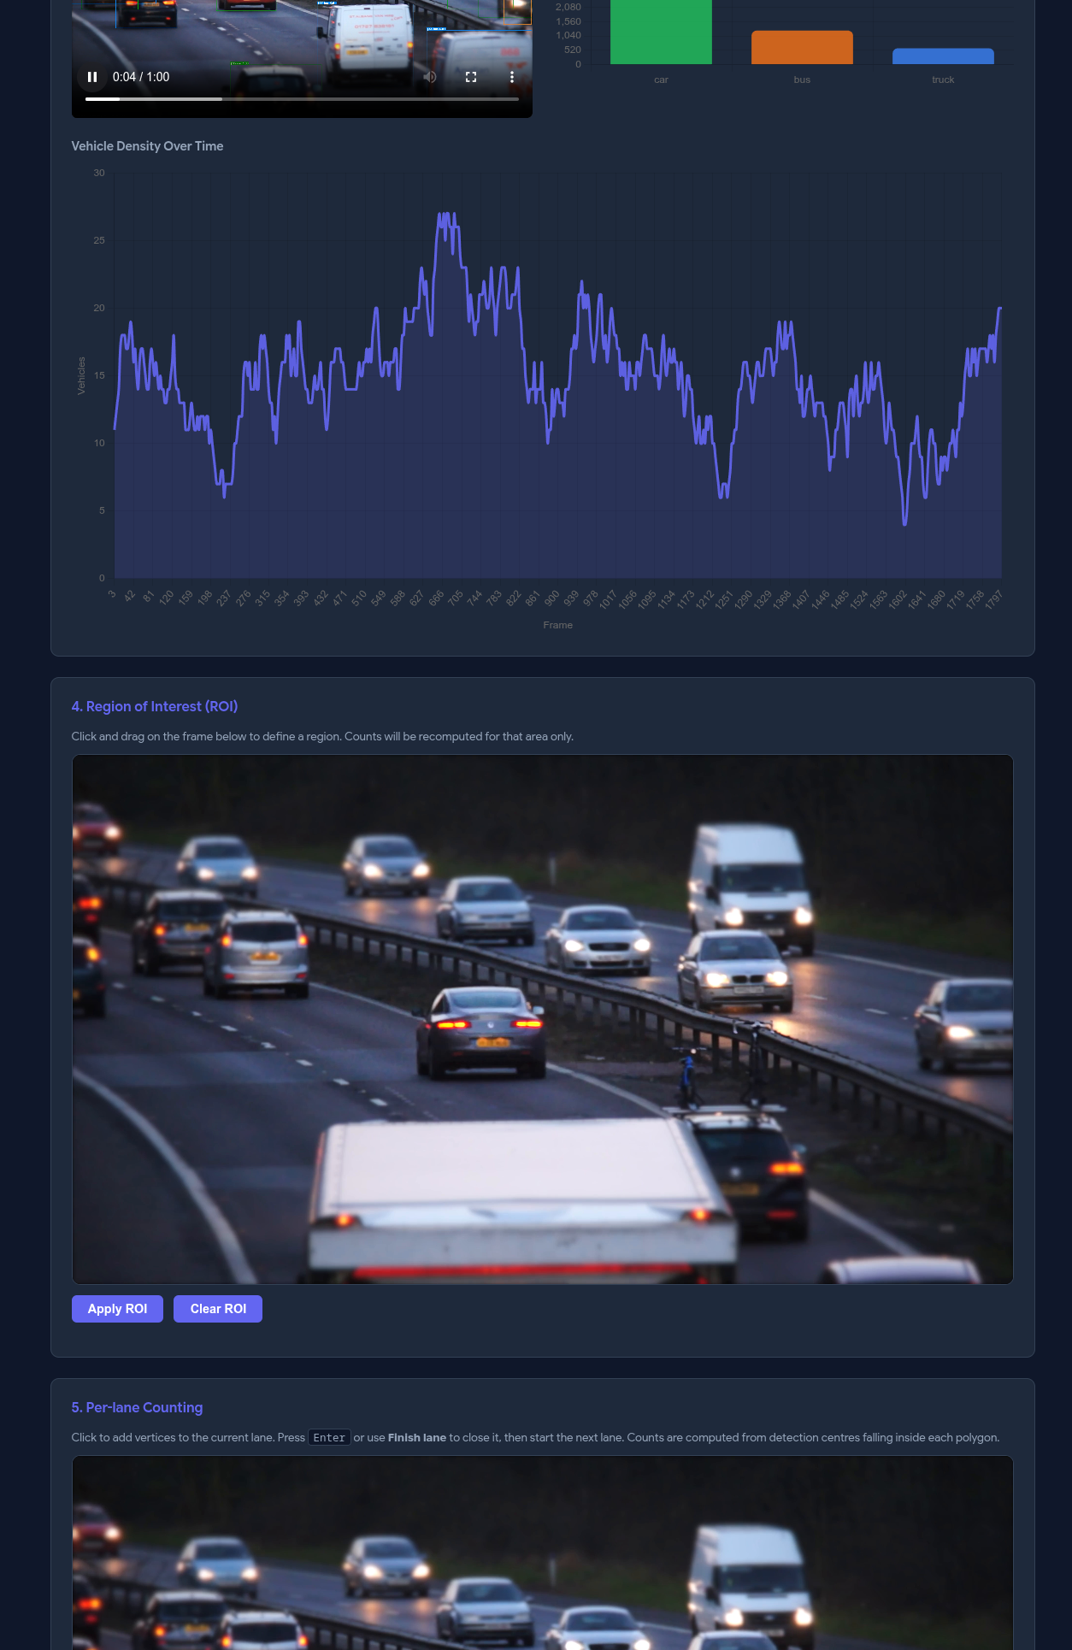
Live Dashboard
FastAPI + vanilla HTML/JS, no build step
Drag-and-drop upload MP4 in, inference starts, progress polls every 3 s
Annotated H.264 video Lazily re-encoded from OpenCV mp4v so it plays in-browser
Counts and timeline Bar chart + density line chart via Chart.js CDN
Rectangle and polygon ROIs Filter detections by region or split into per-lane polygons
Past jobs table Click to re-open any prior run
EPL 445 – Digital Video Processing | University of Cyprus | Final Presentation, 25 May 2026 | Slide 10/18
10

Slide 11
Results — Classification Metrics
Sequence-disjoint test set, 2 614 patches, 16 unseen sequences
96.44% ACCURACY
95.90% MACRO F1
99.59% MACRO AUC
0.9807 VAL F1 (best)
Class
Precision
Recall
Specificity
F1
car
0.960
0.929
0.992
0.944
bus
0.992
0.974
0.994
0.983
truck
0.937
0.963
0.977
0.950
background
0.939
0.980
0.990
0.959
Bus is easiest (large, distinctive). Car is hardest — confused with truck at distance.
EPL 445 – Digital Video Processing | University of Cyprus | Final Presentation, 25 May 2026 | Slide 11/18
11

Slide 12
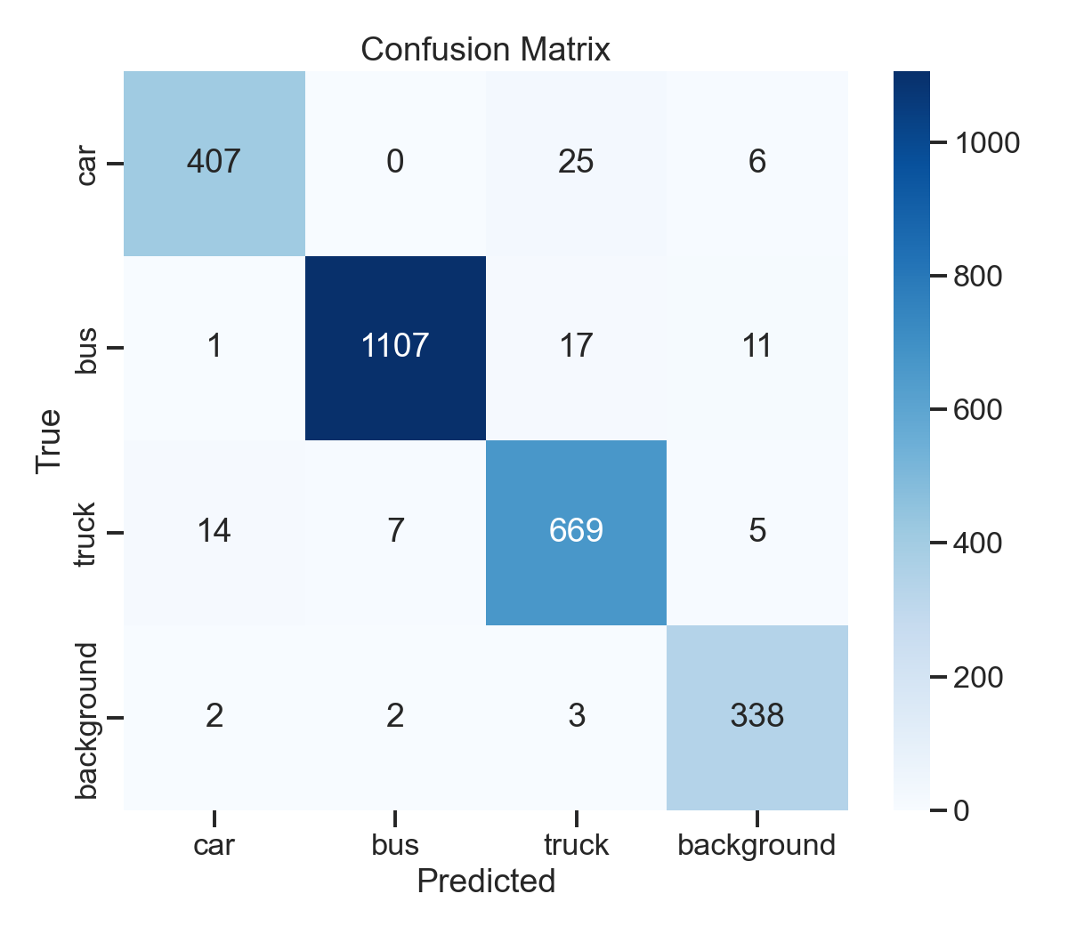
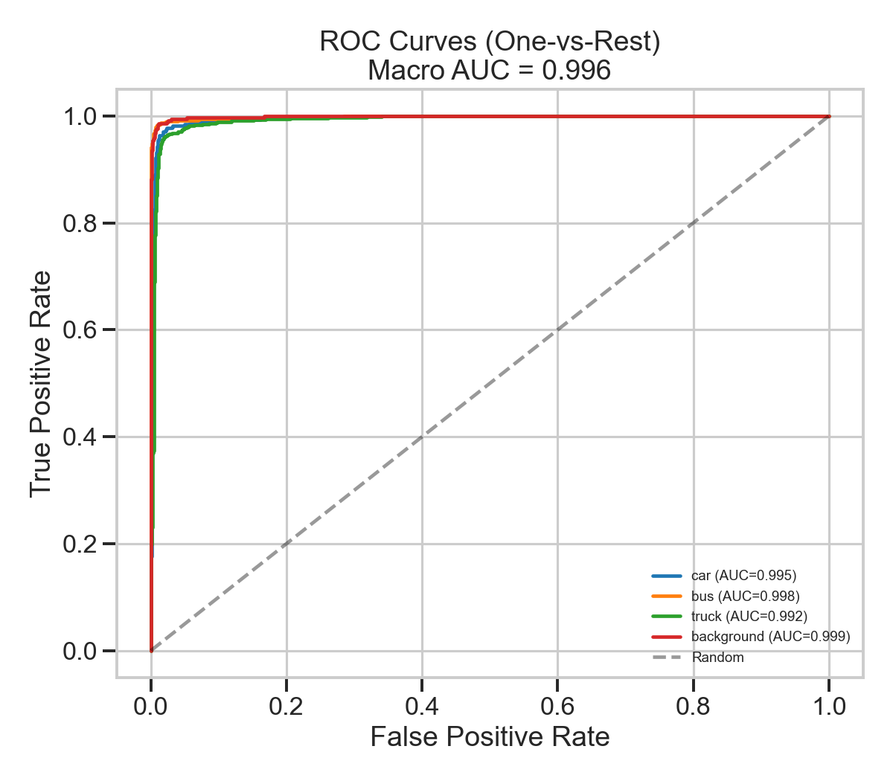
Results — Confusion Matrix and ROC
Mistakes concentrate on car ↔ truck; ROC curves crowd the top-left corner
EPL 445 – Digital Video Processing | University of Cyprus | Final Presentation, 25 May 2026 | Slide 12/18
12

Slide 13
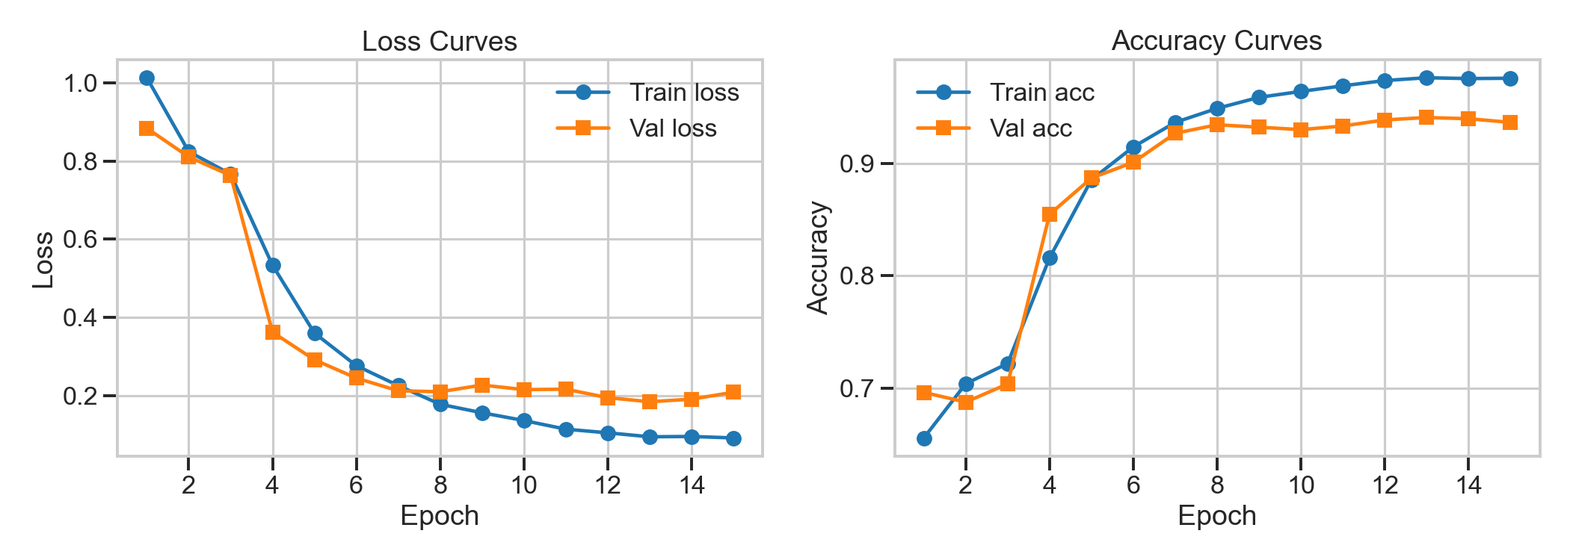
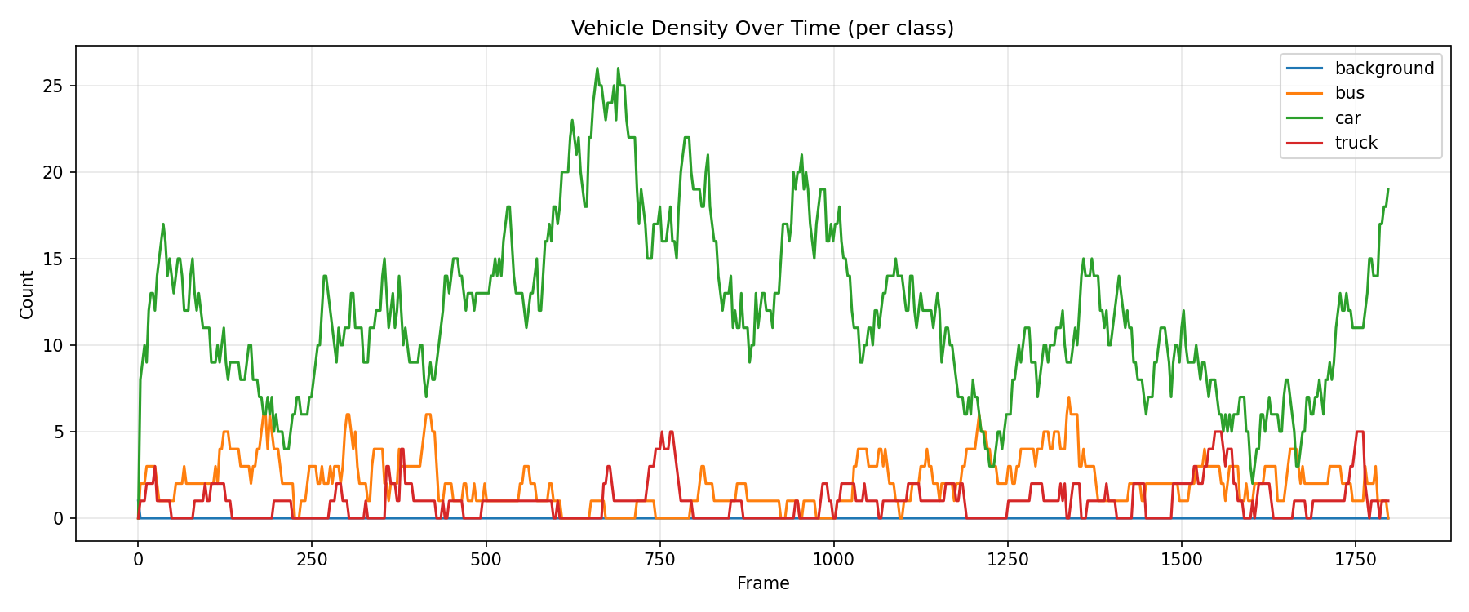
Results — Training Curves and Density Over Time
Backbone unfreezes at epoch 4; density peaks follow platoon arrivals
EPL 445 – Digital Video Processing | University of Cyprus | Final Presentation, 25 May 2026 | Slide 13/18
13

Slide 14
Speed / Accuracy Benchmark
MobileViT classifier on AMD Radeon 780M (iGPU)
Input size
Latency
Accuracy
Use case
128×128
~5 ms
94.5%
Edge / battery-constrained
192×192
~7 ms
95.8%
Real-time stream
256×256
~13 ms
96.44%
Production (default)
End-to-end pipeline YOLO + MobileViT + SORT + annotation: ~4 fps on 4K frames downscaled to 640×360 for inference, vs ~3 fps for sliding-window. First-frame YOLO compile adds a one-off ~15 s warmup.
EPL 445 – Digital Video Processing | University of Cyprus | Final Presentation, 25 May 2026 | Slide 14/18
14

Slide 15
Discussion and Limitations
What worked, and what still fails in dense scenes
What worked Decoupling detection from classification: YOLO emits high-quality boxes; MobileViT handles the bespoke 4-class decision with the background filter.
Why MobileViT, not ResNet-50 Roughly 4× smaller, comparable accuracy on UA-DETRAC, fits in 8 GB shared VRAM. Self-attention helps with partial occlusion.
Limitation: no temporal model SORT only does IoU association. Full mutual occlusion can collapse two tracks into one at dense intersections.
Limitation: motorcycles Our 4 classes do not include motorcycles. YOLO class-3 boxes are usually labelled as car or background by MobileViT.
Limitation: iGPU batch size AMD Radeon 780M with 8 GB shared VRAM forces batch size 4. A discrete GPU would speed training by roughly 3–4×.
EPL 445 – Digital Video Processing | University of Cyprus | Final Presentation, 25 May 2026 | Slide 15/18
15

Slide 16
Future Work
Next steps to improve tracking, deployment, and evaluation
ByteTrack Stronger association for longer occlusions, with re-identification embedding.
Motion-guided sliding Restrict fallback sliding window to motion masks from frame differencing.
End-to-end YOLO comparison Fine-tune YOLOv8 on UA-DETRAC for apples-to-apples speed/accuracy.
INT8 quantisation ONNX export + INT8 for Jetson Nano-class edge deployment.
Temporal voting Aggregate MobileViT predictions across short tracker windows for stable labels.
EPL 445 – Digital Video Processing | University of Cyprus | Final Presentation, 25 May 2026 | Slide 16/18
16

Slide 17
Live Demo
uvicorn src.app.main:app → http://localhost:8000
1 Upload sample_traffic.mp4
or stream from webcam
2 Watch progress and
annotated H.264 video
3 Inspect bar chart +
density timeline
4 Draw two polygon lanes
for per-lane counts
5 Toggle sliding-window
for speed comparison
uvicorn src.app.main:app → http://localhost:8000
EPL 445 – Digital Video Processing | University of Cyprus | Final Presentation, 25 May 2026 | Slide 17/18
17

Slide 18
Thank you — questions?
MobileViT-S MODEL
Andreas Demosthenous & Marios Olympios
FastAPI DEPLOYMENT
{ademos05, molymp01}@ucy.ac.cy
Repository: github.com/AndrewDemsDS/EPL445_MobileViT
SORT TRACKING
EPL 445 – Digital Video Processing | University of Cyprus | Final Presentation, 25 May 2026 | Slide 18/18
18

